Slide 1
LECTURE 2
CHROMOSOME ANOMALIES

Slide 2
Lecture Objectives:
By the end of this lecture, the students should be able to:
Describe and explain the events in mitosis & meiosis.
Define non-disjunction and describe its consequences for meiosis and mitosis.
Classify chromosomal abnormalities
Understand the common numerical autosomal disorders: trisomies 21, 13, 18.
Understand the common numerical sex chromosome disorders: Turner`s & Klinefelter`s syndromes
Recognize the main structural anomalies in chromosomes

Slide 3
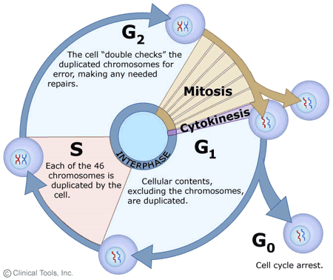

Slide 4
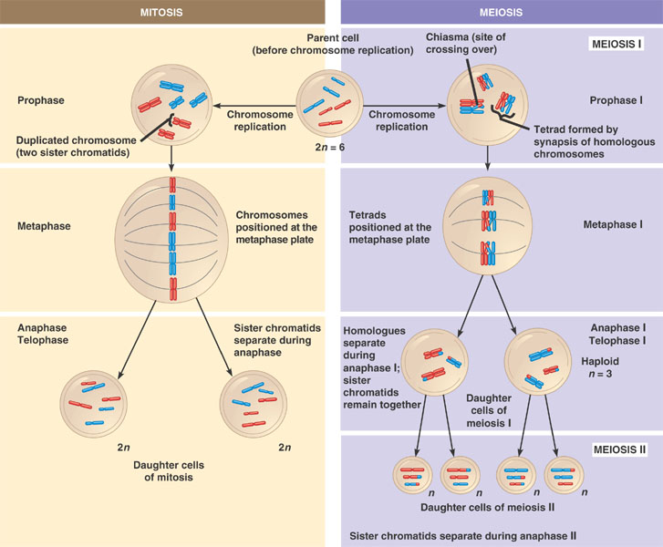

Slide 7
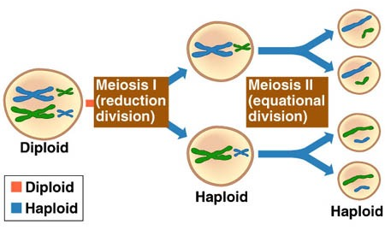
The phases of meiosis I & II

Slide 8
CHROMOSOME ANOMALIES
TYPES:
Numerical
Structural
MECHANISMS
NOMENCLATURE
Etiology

Slide 9
Non-disjunction in Meiosis
Nondisjunction ("not coming apart") is the failure of chromosome pairs to separate properly during meiosis stage 1 or stage 2.
As a result, one daughter cell has two chromosomes or two chromatids, and the other has none.
The result of this error is a cell with an imbalance of chromosomes (Aneuploidy)

Slide 10
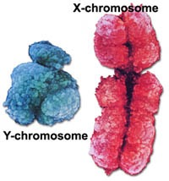
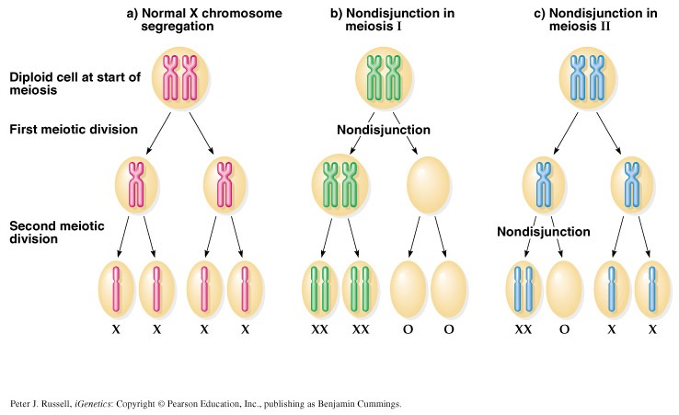

Slide 13
Meiotic non-disjunction
can affect each pair of chromosomes
is not a rare event
non disjunction in first meiotic division produces 4 unbalanced gametes.
non disjunction in second division produces 2 normal gametes & 2 unbalanced gametes:
Gamete with an extra autosome
Nullosomic gamete (missing one chromosome)

Slide 14
NUMERICAL CHROMOSOMAL ANOMALIES

Slide 15
Numerical anomalies in autosomes

Slide 16
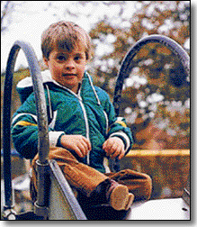
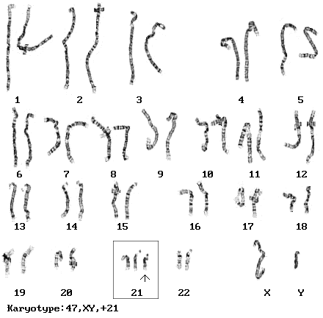
Down syndrome, trisomy 21 Karyotype: 47, XY, +21
The incidence of trisomy 21 rises sharply with increasing maternal age
Most cases arise from non disjunction in the first meiotic division
The father contributing the extra chromosome in 15% of cases (i.e. Down syndrome can also be the result of nondisjunction of the father's chromosome 21)
A small proportion of cases are mosaic and these probably arise from a non disjunction event in an early zygotic division.
The symptoms include characteristic facial dysmorphologies, and an IQ of less than 50.
Notes:
Down syndrome is around 50 (70 and below is defined as the cut-off for intellectual disability), whereas healthy young adult controls have an average IQ of 100.
Every 691 babies born in the United States each year is born with Down syndrome. It is typically associated with physical growth delays, a particular set of facial characteristics and a severe degree of intellectual disability. Pregnancies with this diagnosis are often terminated.
Down syndrome is characterized by decelerated maturation (neoteny), incomplete morphogenesis (vestigia) and atavisms.^{[13]} Individuals with Down syndrome may have some or all of the following physical characteristics: microgenia (abnormally small chin),^{[14]} oblique eye fissures on the inner corner of the eyes,^{[15][16]} muscle hypotonia (poor muscle tone), a flat nasal bridge, a single palmar fold, a protruding tongue (due to small oral cavity, and an enlarged tongue near the tonsils) or macroglossia,^{[15][16]} "face is flat and broad",^{[17]} a short neck, white spots on the iris known as Brushfield spots,^{[18]} excessive joint laxity including atlanto-axial instability, excessive space between large toe and second toe, a single flexion furrow of the fifth finger, a higher number of ulnar loop dermatoglyphs and short fingers.
Average height for men is 5 feet 1 inch (154 cm) and for women is 4 feet 9 inches. Life expectancy among persons with Down syndrome has increased from 12 years in 1912, to 60 years. In March 2012, the Guinness Book of Records website listed Joyce Greenman, now 87, of London.
Ultrasound imaging can be used to screen for Down syndrome. Increased fetal nuchal translucency (NT) is an indicator of increased risk of Down syndrome.

Slide 17
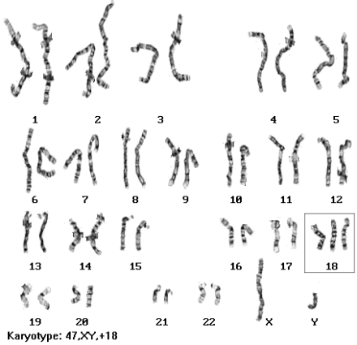
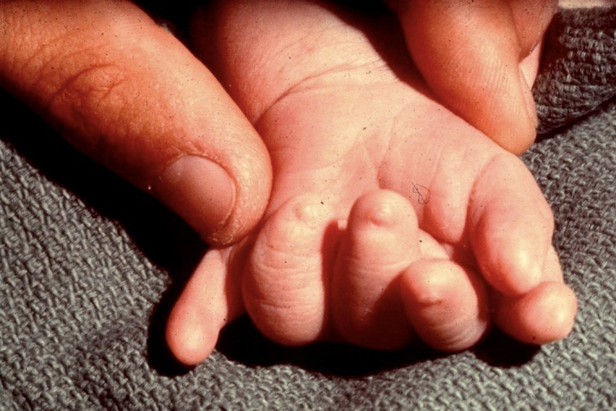
Edward's syndrome, Trisomy 18 Karyotype: 47, XY, +18
It is the second most common autosomal trisomy, after Down syndrome, that carries to term
It occurs in around one in 6,000 live births and around 80 percent of those affected are female
Most babies die in the first year and many within the first month & has a very low rate of survival
Common anomalies are heart abnormalities, kidney malformations, and other internal organ disorders

Slide 18
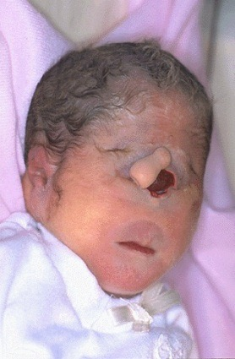
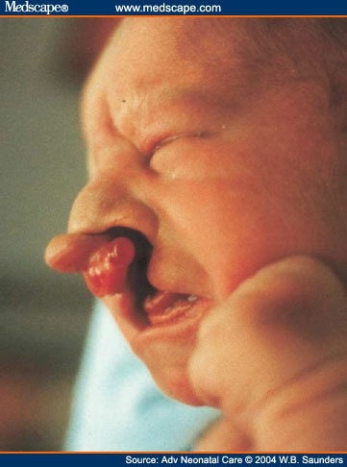
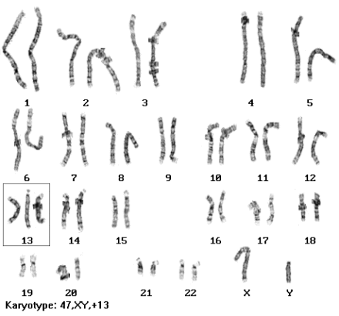
Patau Syndrome, Trisomy 13 Karyotype: 47, XY, +13
Fifty % of these babies die within the first month and very few survive beyond the first year.
There are multiple dysmorphic features.
Most cases, as in Down's syndrome, involve maternal non-disjunction.

Slide 19
Numerical anomalies in Sex chromosomes

Slide 20
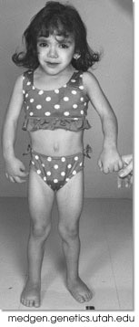
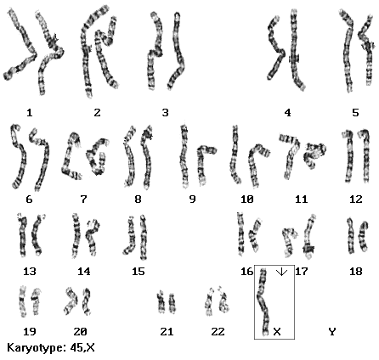
Monosomy X (Turner’s syndrome, 45, XO)
Occurring in 1 in 5000 phenotypic females
The only viable monosomy in humans
Characteristics: Webbed neck, Individuals are genetically female, not mature sexually, Sterile, Short stature, Broad chest, Low hairline, Streak ovaries, Normal intelligence, Normal life span
Notes:
The disorder occurs in 1 in 2,000 live births and is reportedly the cause of 15% of spontaneous abortions.
Females with TS are typically of short stature and prone to ovarian failure (both occur in approximately 95% of females with TS). Intelligence is typically average, but individuals with TS are more likely to demonstrate visuospatial deficits including poor handwriting and likely underdeveloped arithmetic skills

Slide 21
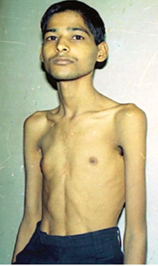
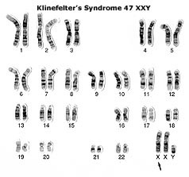
Klinefelter Syndrome: 47,XXY males
Male sex organs; unusually small testes which fail to produce normal levels of testosterone→ breast enlargement (gynaecomastia) and other feminine body characteristic
Patients are taller and thinner than average and may have a slight reduction in IQ but generally they have normal intelligence
No spermatogenesis → sterile
Very rarely more extreme forms of Klinefelter syndrome occur where the patient has 48, XXXY or even 49, XXXXY karyotype. These individuals are generally severely retarded.
Notes:
Most common chromosomal abnormality in humans. It occurs in 1 in 500 to 1 in 1000 live births.
Physically, males with KS are difficult to distinguish from XY males due to the variability in physical features present in the syndrome and the fact that there is no obvious facial dysmorphology. The most common physical abnormality that exists for males with KS is small testicular size due to a failure of the testes to grow. Individuals with KS can have gynecomastia (enlargement of the breast tissue) which ranges in frequency from 10% to 88% depending on the study. Decreased facial and body hair is also a common finding. Head circumference tends to remain around the 50th percentile while height approximates the 75th percentile. The increase in height is usually a function of increased leg length, but it should also be noted that the arms of males with KS tend to be longer, making the person appear to be lanky and often uncoordinated. The shoulders are narrower and hips wider than in the non-KS male.
In the cognitive domain language-based developmental delays have been some of the most common findings in individuals with KS. Individuals with KS are prone to a disproportionate level of Reading Disorders

Slide 22
Sex chromosome unbalance
Of much less deleterious effect
47, XYY
May be without any symptoms. Males are tall but normally proportioned. 10 - 15 points reduction in IQ compared to sibs.
XXX females
It seems to do little harm, individuals are fertile and do not transmit the extra chromosome. They do have a reduction in IQ comparable to that of Kleinfelter's males

Slide 23
Numerical anomalies affecting the number of complete haploid set (n) of chromosomes

Slide 24
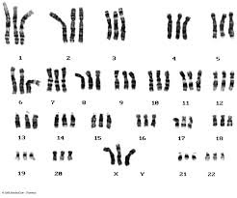
Polyploidy
Triploidies are the most frequent,
- 3N = 69 chromosomes: e.g. 69, XXX, or 69, XXY, or 69, XYY.
- Are found in 20 % of spontaneous miscarriages.
Tetraploidy,
4N = 92 chromosomes.

Slide 25
Can an individual have A combination of cells: - some cells with normal chromosomal numbers, & - some cells with numerical chromosomal anomalies?

Slide 26
MOSAICISM
A mosaic individual is made of 2 (or more) cell populations, coming from only 1 zygote
Is denoted by a slash between the various clones observed e.g.46, XY / 47, XY, +21).
Numerical mosaic anomaly is usually due to a mitotic non-disjunction
A mosaic must not be confused with a chimeras.
Chimerism is the presence in an individual of two or more genetically distinct cell lines derive from more than one zygote (e.g. 2 sperms fertilize 2 ova → 2 zygotes that fuse to form 1 embryo
Notes:
This condition is either inherited, or it is acquired through the infusion of allogeneic hematopoietic cells during transplantation or transfusion
Tetragametic chimerism is a form of congenital chimerism. This condition occurs through the fertilization of two separate ova by two sperm, followed by the fusion of the two at the blastocyst or zygote stages. This results in the development of an organism with intermingled cell lines.

Slide 27
STRUCTURAL CHROMOSOMAL ANOMALIES

Slide 28
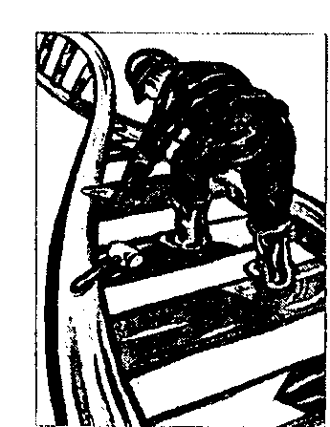
STRUCTURAL CHROMOSOMAL ANOMALIES
The most frequent Structural anomalies are:
Translocations
Inversions
Deletions (terminal or interstitial)
Isochromosome ( i )
Ring formation ( Ring chromosome)

Slide 29
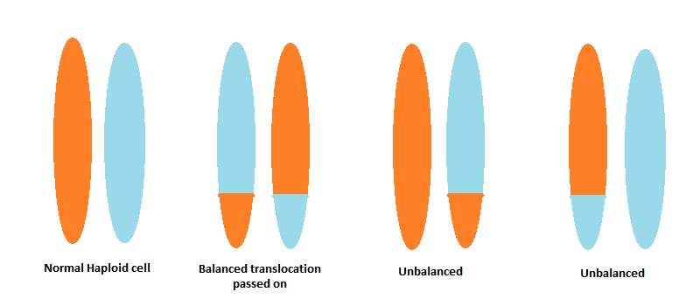
Reciprocal translocation:
A mutual exchange between terminal segments from the arms of 2 chromosomes.
Provided that there is no loss or alteration at the points of exchange, the new rearrangement is genetically balanced, and called a Balanced rearrangement.

Slide 30
Deletion
Loss of a segment from a chromosome, either terminal or interstitial
Invariably, but not always, results in the loss of important genetic material
Deletion is therefore an unbalanced rearrangement.
Recorded as del

Slide 31
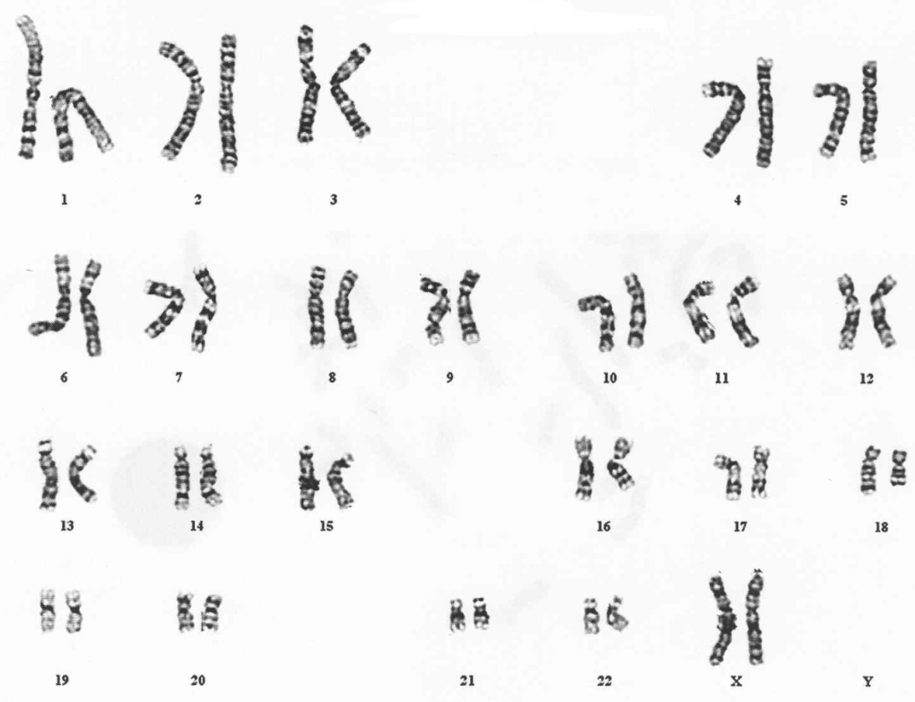
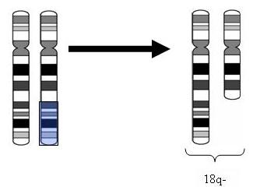
Terminal Deletion
46,XX,del(18)(q21.3).

Slide 32
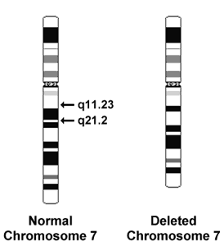
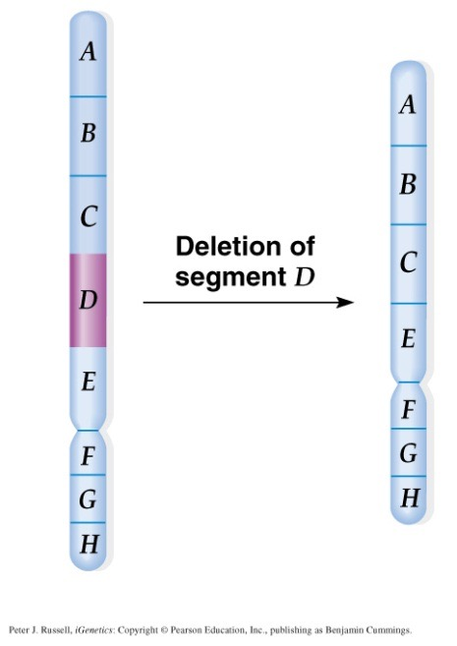
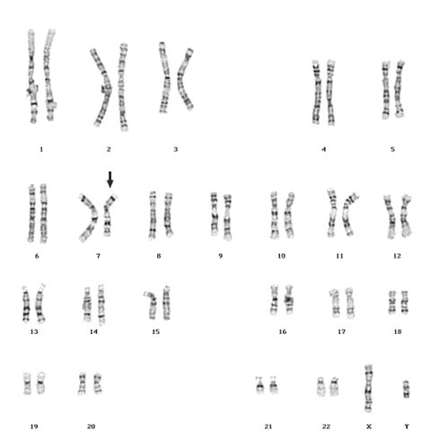
Interstitial deletion (7 Karyotype)
46,XY,del(7)(q11.23q21.2)
The key to the karyotype description is as follows:
- 46: the total number of chromosomes.
- XY: the sex chromosomes (male).
- del(7): deletion in chromosome 7.
- (q11.23q21.2): breakpoints of the deleted segment.

Slide 33
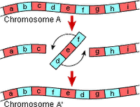
Inversion
Inversion occurs when a segment of chromosome breaks, and rejoining within the chromosome effectively inverts it.
Recorded as inv.
Only large inversions are normally detected.
They are balance rearrangements that rarely cause problems in carriers

Slide 34
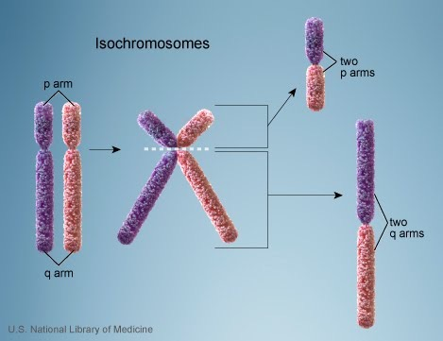
Isochromosome
The most probable explanation for isochromosome is that the centromere has divided transversely rather than longitudinally

Slide 35
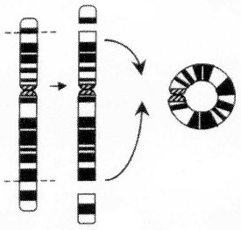
Ring formation (Ring chromosome)
A break on each arm of a chromosome → two sticky ends on the central portion → Reunion of the ends as a ring → loss of the 2 distal chromosomal fragments
Ring chromosomes are often unstable in mitosis

Slide 36
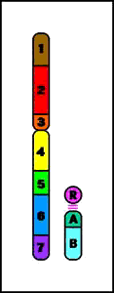
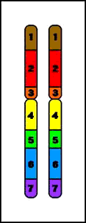
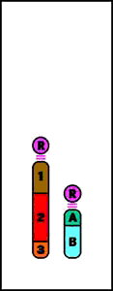
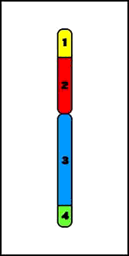
STRUCTURAL CHROMOSOMAL ANOMALIES
Deletion
Duplication
Reciprocal
translocation
Ring
Chromosome
Terminal
Deletion
Insertion
Inversion
Robertsonian
Translocation
Isochromosomes

Slide 37
Take home message
Chromosome abnormalities can be numerical or structural.
Numerical abnormalities include aneuploidy and polyploidy.
In trisomy, a single extra chromosome is present, usually as a result of non-disjunction in the 1st or 2nd meiotic division.
In polyploidy, ≥3 complete haploid sets are present instead of the usual diploid complement.
Structural abnormalities include translocations (balanced or unbalanced), inversions, deletions, isochromosome & rings.

Slide 38
THANK YOU ☺

