Slide 1
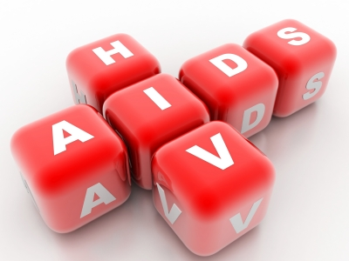
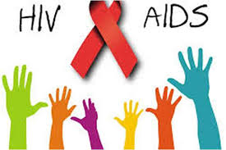
Human Immunodeficiency Virus (HIV) & Acquired Immune Deficiency Syndrome (AIDS)
Prepared by:
Dr.Amany Ballow
Consultant Immunology

Slide 2
Objectives
To understand :
The modes of transmission of HIV
HIV interactions with CD4 positive helper lymphocytes
Mechanisms involved in immunodeficiency associated with HIV
the course of immunological events from the time of infection
with HIV until the development of AIDS

Slide 3
What is AIDS
HIV is the virus that causes AIDS
Is the final Stage of HIV infection.
when the Immune system CD4 cells drop to a very low level, person’s ability to fight infection is lost

Slide 4
Human Immunodeficiency Virus (HIV)
HIV belongs to a group of retroviruses called lenti-viruses.
The genome of retroviruses is made of RNA (ribonucleic acid), and each virus has two single chains of RNA
for replication, the virus needs a host cell, and the RNA must first be transcribed into DNA (deoxyribonucleic acid), which is done with the enzyme reverse transcriptase.
HIV infects mainly the CD4+ lymphocytes, but also to a lesser degree monocytes, macrophages, and dendritic cells.
Once infected, the cell turns into an HIV-replicating cell and loses its function in the human immune system
HIV is a lentivirus that causes HIV infection and over time acquired immunodeficiency syndrome (AIDS)

Slide 5
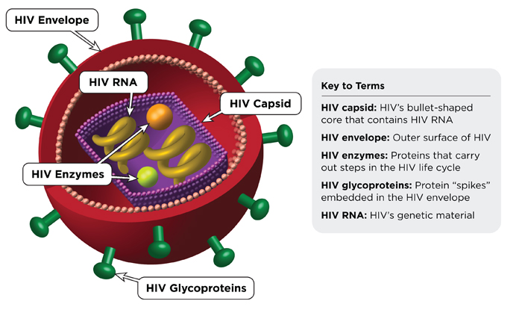
HIV

Slide 6
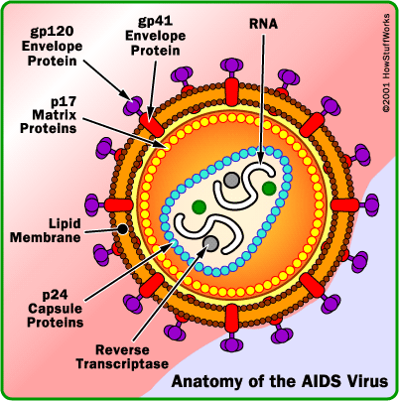

Slide 7
How HIV Enters Cells
gp120 env protein binds to CD4 molecule
CD4 found on T-cells macrophages, and microglial cells
Binding to CD4 is not sufficient for entry
gp120 env protein binds to co-receptor
Chemokine receptors:
CCR5 and CXCR4 receptors
Binding of virus to cell surface results in fusion of viral envelope with cell membrane
Viral core is released into cell cytoplasm.

Slide 8
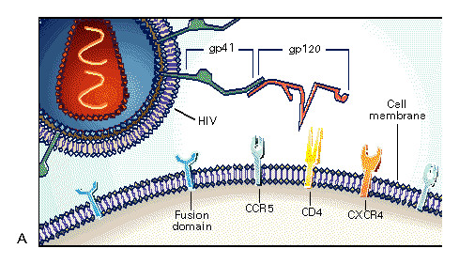
HIV and Cellular Receptors
This picture shows HIV’s attachment and entry into a host cell.
gp-120 protein attaches to a CD4 receptor.
gp-41 is exposed for attachment to the host cell, and fusion of the cell membrane with the viral envelope starts.

Slide 9
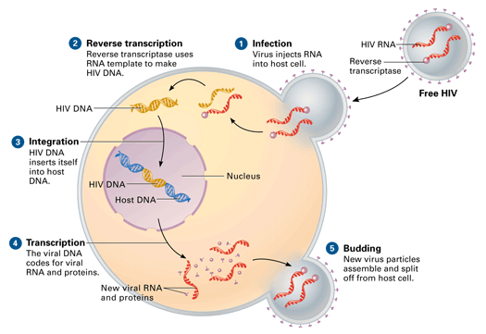
How HIV infect CD4 cells

Slide 11
Adaptive Immune response
The adaptive immune response is divided into two types:
1-Cell-mediated (cytotoxic t-cell) type
2-Humoral (antibody-mediated) type.
In general, the location of the infection (intracellular or extracellular) determines the type of adaptive immune response.
Intracellular infections stimulate a cell-mediated response that will ultimately kill the infected cell. This is mediated by T8 cells, and utilizes the MHC I system.
Extracellular infections stimulate a humoral response that will help contain these free antigens. Some extracellular antigens will be picked up by APC and be presented by way of MHC-II to the TH cell, which will further differentiate into either TH1 or TH2.
TH1 in turn will augment the cell-mediated response and Th2 augments the humoral.

Slide 12
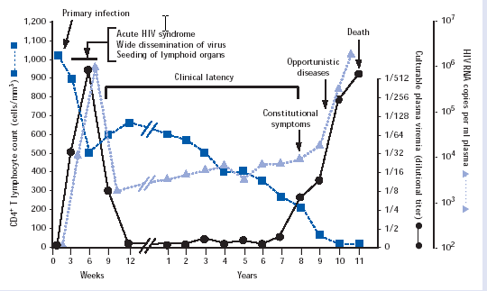
Natural history of infection

Slide 13
HIV infection stages
There are three stages of HIV infection:
Acute HIV Infection
Chronic HIV Infection
AIDS

Slide 14
1-Acute HIV Infection
Is the earliest stage of HIV.
Generally develops within 2 to 4 weeks after a person is infected with HIV.
During acute HIV infection, many people have flu-like symptoms, such as fever, headache, and rash, cervical lymphadenopathy, aseptic meningitis, encephalitis, myelitis, polyneuritis.
In this acute stage of infection:
HIV multiplies rapidly and spreads throughout the body.
The virus attacks and destroys the infection-fighting CD4cells of the immune system.
HIV can be transmitted during any stage of infection, but the risk is greatest during acute HIV infection.

Slide 15
1-Acute HIV Infection
(1 to 3 months): After infection, there is in general a first peak in HIV RNA copies and a steep decline in CD4 (300-400) cells in the blood.
These changes can be explained by the fact that during the early days, HIV can replicate without being controlled by the immune system (viral RNA copies to >1 million) .
70-80% symptomatic (3-12) weeks after exposure
When the body's anti-HIV immune response begins (antibody responses begin to develop 4 to 8 weeks after infection), symptoms of sero-conversion may develop and viral load falls.
Recovery in 7-14 days

Slide 16
1-Acute infection
The window period begins at the time of infection and can last 4 to 8 weeks.
During this period, a person is infected, infectious and viremic, with a high viral load and a negative HIV antibody test.
The point when the HIV antibody test becomes positive is called the point of sero-conversion

Slide 17
1-Acute HIV infection
Sero-cversion
Median 8 weeks after infection.
Level of viral load post sero-conversion correlates with risk of progression of disease
Asymptomatic Phase
Remain well with no evidence of HIV disease except for generalized lymphadenopathy Fall of CD4 count by about 50-150 cells per.

Slide 18
1-Acute HIV infection
The majority of all mucosal CD4 T lymphocytes are lost, especially in the gastrointestinal tract (GIT).
Infection is associated with increased permeability of the GIT leading to increased circulating lipopolysaccharide (LPS) levels, a component of the cell wall of Gram-negative bacteria in the GIT.
The circulating LPS cause chronic immune activation in a non-specific way.
The chronic immune activation causes higher susceptibility to HIV because HIV needs activated CD4 T cells for replication.

Slide 19
2-Chronic HIV Infection
The second stage of HIV infection is chronic HIV infection (also called asymptomatic HIV infection or clinical latency).
During this stage of the disease, HIV continues to multiply in the body but at very low levels.
People with chronic HIV infection may not have any HIV-related symptoms, but they can still spread HIV to others.
Without treatment with HIV medicines, chronic HIV infection usually advances to AIDS in 10 to12 years.

Slide 20
2-Chronic HIV Infection
On average 8-10 years, without antiretroviral treatment
After the acute infection phase, CD4 cell concentration in the peripheral blood increases again, although not as high as before infection.
HIV RNA copy number in the plasma declines again, and the stabilized plasma concentration after the peak of the primary infection is called the viral set-point.

Slide 21
3-AIDS
AIDS is the final stage of HIV infection.
Because HIV has destroyed the immune system, the body can’t fight off opportunistic infections and cancer.
AIDS is diagnosed when a person with HIV has a CD4 count of less than 200 cells/mm³ and/or one or more opportunistic infections.

Slide 22
3-AIDS
HIV gradually disrupts the immune system, kills the CD4 lymphocytes, and throws the immune system out of balance.
HIV also destroys the immune system's memory. CD4 cells, which have been programmed to recognize infections, become depleted.
For this reason opportunistic infections such as TB, candida, and others can develop when the CD4 count falls low.
On average 2-3 years, without antiretroviral treatment:
The third phase is characterized by a rapid increase in HIV RNA copies and a decline in CD4 cell counts in peripheral blood

Slide 23
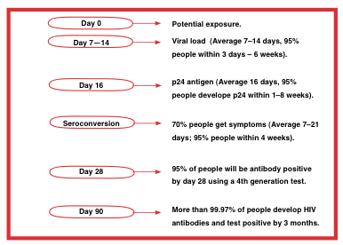

Slide 24
Mechanisms of CD4 Depletion and Dysfunction
Direct
Elimination of HIV-infected cells by virus-specific immune responses
Loss of plasma membrane integrity because of viral budding
Indirect
Syncytium formation
Apoptosis
Autoimmunity

Slide 25
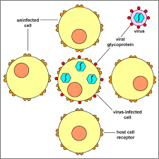
Syncytium Formation
Observed in HIV infection, most commonly in the brain
Uninfected cells may then bind to infected cells due to viral gp120
This results in fusion of the cell membranes and subsequent syncytium formation.
These syncytia are highly unstable and die quickly

Slide 26
Role of Cellular Activation in Pathogenesis of HIV
HIV induces immune activation
Which may seem paradoxical because HIV ultimately results in severe immunosuppression
Activated T-cells support HIV replication
Inter-current infections are associated with transient increases in viremia
Accounts for why TB worsens underlying HIV disease

Slide 27
Role of Cytokine Dys-regulation in Pathogenesis of HIV
HIV is associated with increased expression of pro-inflammatory cytokines
TNF-alpha, IL-1,IL-6, IL-10, IFN-gamma
HIV results in disruption and loss of immuno-regulatory cytokines
IL-2, IL-12
Necessary for modulating effective cell-mediated immune responses (CTLs and NK cells)

Slide 28
CD4 T-cell Count and Progression to AIDS
Gradual reduction in number of circulating CD4 cells is inversely correlated with the viral load
Any depletion in numbers of CD4 cells renders the body susceptible to opportunistic infections

Slide 29
Laboratory Markers of HIV Infection
Viral load
Marker of HIV replication rate
CD4 count
Marker of immunologic damage

Slide 30
Diagnosis
Antibody test, ELISA
Screening test
Western blot (protein immunoblot)
Confirmatory test.
Confirm the presence of Ab and help to diagnose the condition
Used to detect specific protein using gel electrophoresis
HIV RNA viral load (PCR)
Nucliec Acid Amplification Testing (NAAT)

Slide 31
Management
Treatment recommended when symptomatic or CD4 count below 200.
Earlier if high viral load, rapidly falling CD4 count, hepatitis C co-infection.
Ant-iviral therapy
Reverse transcriptase inhibitors
Protease inhibitors
Fusion inhibitors

Slide 32
Take Home Message
Infection with HIV usually occurs by sexual transmission, blood transfusion, mother to infant or accidental exposure
HIV targets the immune system and primarily infects CD4 positive lymphocytes
Immunodeficiency associated with HIV infections is mainly due to reduction in CD4 positive helper lymphocyte numbers
Increased viral load, significant reduction in CD4 lymphocytes and opportunistic infections are the hallmarks of progression to AIDS

Slide 33
Thanks

