Slide 1
Reproductive System, Ovarian Cysts and Tumors
Sufia Husain.
Pathology Department
KSU, Riyadh
March 2016
Reference: Robbins & Cotran Pathology and Rubin’s Pathology

Slide 2
Lecture outlines
The pathology of the major types of ovarian cysts (follicular and luteal).
The classification and pathology of common ovarian tumors including surface epithelial, germ cell, stromal and metastatic neoplasms.

Slide 3
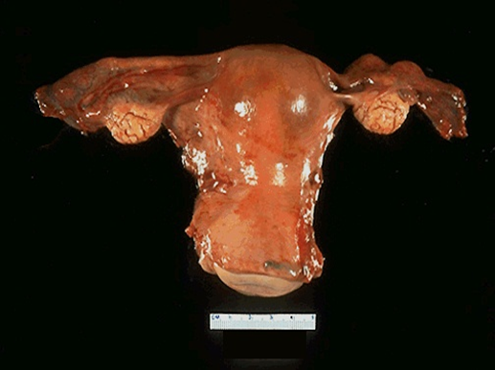
Ovarian Cysts and Tumors
Non neoplastic cysts are common but they are not serious problems.
Inflammation of ovaries is rare. It is ususally associated with salpingitis of fallopian tubes (salpingo-oophoritis)
Frequently, the ovaries are affected by endometriosis.
The most important medical problems in ovaries are the neoplasms
Death from ovarian cancers is more common than that of cervix and uterus together because ovarian tumors grow silently and are usually diagnosed late, which make them so dangerous.

Slide 4
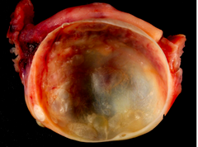
Non-Neoplastic Cysts of ovary
Non Neoplastic Cyst are more common than the neoplastic ones. They usually cause no problems. Rarely a non neoplastic cyst can rupture and cause acute pain and intrabdominal hemorrhage. Common
non-neoplastic cysts are as follows:
Follicullar cyst
Corpus luteum cyst
Theca lutein cyst/ hyperreactio luteinalis
Chocolate cyst /Endometriotic cyst
http://o.quizlet.com

Slide 5
Non-Neoplastic Cysts of ovary
Follicullar cyst
Arise from the ovarian follicles and are due to distension of un-ruptured Graafian follicle.
Corpus luteum cyst
Results from hemorrhage into a persistent mature corpus luteum.
Theca lutein cyst/ hyperreactio luteinalis
Are thin walled cysts lined by luteinized theca cells. They are associated with high levels of circulating gonadotropins (e.g. pregnancy, hydatidiform mole, etc).
Chocolate cyst /Endometriotic cyst
The ovary is the most frequent site of endometriosis. And chocolate cyst is a blood filled cyst of the ovary. It is due to endometriosis in the ovary with hemorrhage.
Endometriotic cyst
http://www.humpath.com/IMG/jpg_ovarian_endometriotic_cyst_07_2a.jpg

Slide 6
Ovarian Tumors
One of the leading cause of cancer death in women
Ovarian cancers grow silently and go undetected in the early stage when it is still curable. Most of the patients already have metastasis at the time of diagnosis.
The WHO Histological Classification for ovarian tumors divides ovarian neoplasms into primary and metastatic (secondary).

Slide 7
Ovarian Tumors classification
A. PRIMARY TUMORS: There are three main primary types of ovarian tumors based on the origin of the tumor cell. They are:
Surface epithelial ovarian tumors (65%): derived from the cells on the surface of the ovary. This is the most common form of primary ovarian cancer and occurs in adults.
Germ cell tumors (15%): derived from the egg producing cells of the ovary, i.e. from the ovarian follicles. This occurs mainly in children, teens and young women. They are less common as compared to epithelial ovarian tumors.
Sex cord stromal tumors (10%): derived from the ovarian stroma. Uncommon and this class of tumors often produces steroid hormones.
These 3 main types are further divided into many subtypes (see later).
B. METASTATIC/ SECONDARY TUMORS (5%): Cancers from other organs can also spread to the ovaries

Slide 8
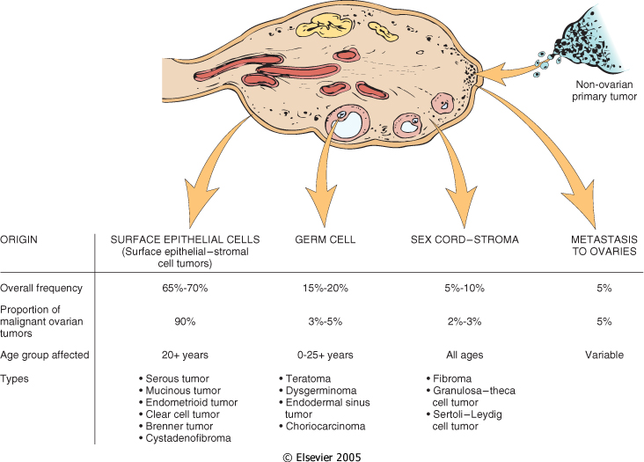
Various ovarian neoplasms and their frequency and age distribution.
Downloaded from: Robbins & Cotran Pathologic Basis of Disease

Slide 9
Simplified classification of primary ovarian tumors
SURFACE EPITHELIAL TUMORS
Serous tumors:
Benign (cystadenoma)
Borderline tumors (serous borderline tumor)
Malignant (serous adenocarcinoma)
Mucinous tumors:
Benign (cystadenoma)
Borderline tumors (mucinous borderline tumor)
Malignant (mucinous adenocarcinoma)
Endometrioid tumors:
Benign (cystadenoma)
Borderline tumors (endometrioid borderline tumor)
Malignant (endometrioid adenocarcinoma)
Clear cell tumors:
Benign
Borderline tumors
Malignant (clear cell adenocarcinoma)
Transitional cell tumors:
Brenner tumor
Brenner tumor of borderline malignancy
Malignant Brenner tumor
Transitional cell carcinoma (non-Brenner type)
Others
SEX CORD STROMAL TUMORS
Almost always Benign
Fibromas/ Fibrothecomas /Thecomas
With Malignant Potential
Granulosa cell tumors
Sertoli-Leydig cell tumors
Others
GERM CELL TUMORS
Teratoma:
Immature (malignant)
Mature (benign)
Solid
Cystic (dermoid cyst)
Monodermal (e.g., struma ovarii, carcinoid)
Dysgerminoma
Yolk sac tumor (endodermal sinus tumor)
Choriocarcinoma
Embryonal carcinoma
Mixed germ cell tumors
NOTE: all ovarian GCTs are considered as malignant except mature teratoma

Slide 10
Surface Epithelial Ovarian Tumors

Slide 11
Surface Epithelial Ovarian Tumors
Neoplasms of surface epithelium account for majority of all primary ovarian tumors.
Are 65 – 70 % of overall tumors
They account for 90 % of malignant tumors in the ovary
Age 20+

Slide 12
Surface Epithelial Ovarian Tumors
The subtypes of the surface epithelial tumors are:
Serous Tumors
Mucinous Tumors
Endometrioid Tumors
Clear cell Tumors
Transitional/Brenner cell Tumors
Others
All surface epithelial tumors are further divided into:
Benign: They do not spread and invade other tissues.
Malignant: are carcinomas and have potential to metastasize beyond the ovary.
Borderline/ intermediate/ tumors of low malignant potential: this is a gray zone. They are ‘semi-malignant’. These appear to be low grade cancers with limited invasive potential. They have better prognosis than malignant. These tumors may seed or implant into the peritoneum.

Slide 13
Simplified classification of primary ovarian tumors
SURFACE EPITHELIAL TUMORS
Serous tumors:
Benign (cystadenoma)
Borderline tumors (serous borderline tumor)
Malignant (serous adenocarcinoma)
Mucinous tumors, endocervical-like and intestinal type:
Benign (cystadenoma)
Borderline tumors (mucinous borderline tumor)
Malignant (mucinous adenocarcinoma
Endometrioid tumors:
Benign (cystadenoma)
Borderline tumors (endometrioid borderline tumor)
Malignant (endometrioid adenocarcinoma)
Clear cell tumors:
Benign
Borderline tumors
Malignant (clear cell adenocarcinoma)
Transitional cell tumors:
Brenner tumor
Brenner tumor of borderline malignancy
Malignant Brenner tumor
Transitional cell carcinoma (non-Brenner type)
Others

Slide 15
Serous Tumors
Serous ovarian tumors are the most common type ovarian tumors. They are also the most common group of epithelial tumors. The tumor cells are of serous nature.
Age is 30 -40
Usually cystic filled with clear serous fluid
Serous tumors are often bilateral.
Psammoma bodies are commonly seen
The tumors are subdivided into benign (60%), borderline (15%) and malignant (25%).
Benign serous tumors (serous cystadenomas), are commonly large, cystic and thin-walled, and unilocular. They are lined by serous cells and contain thin, clear yellow fluid.
Borderline serous tumors cystic with thin wall and smooth surface, but often have multiple papillary excresences (grape-like clusters), protruding into the lumen in places.
Malignant serous tumors (serous cystadenocarcinoma) is the commonest malignant ovarian tumor, forming about a third of all cancers of the ovary. The tumors are partly cystic and partly solid with prominent excrescences, often with necrosis and hemorrhage. These tumors usually present with ascites due to abdominal metastases. Treatment: surgery, chemotherapy and radiotherapy. Prognosis; poor.

Slide 16
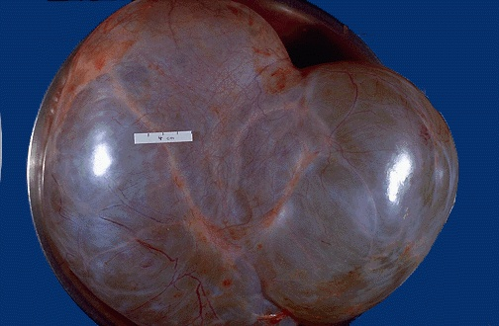
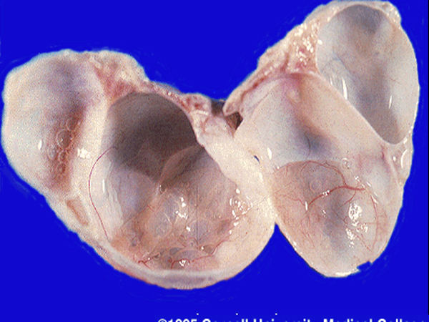
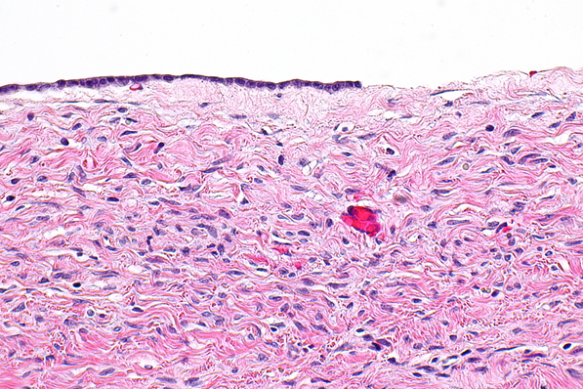
Serous cystadenoma
commons.wikimedia.org

Slide 17
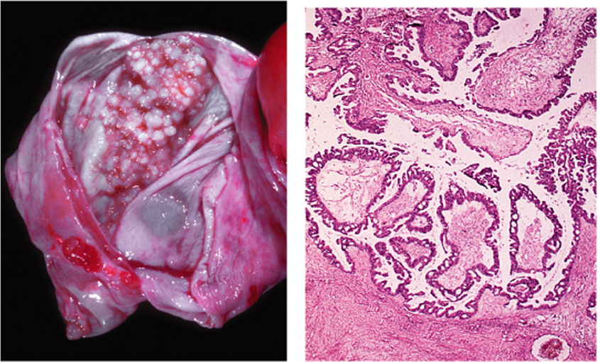
Borderline serous tumor
"Ovarian Cancer - A Clinical and Translational Update", book edited by Iván Díaz-Padilla, ISBN 978-953-51-1030-9, Published: February 27, 2013 under CC BY 3.0 license. © The Author(s). Borderline Epithelial Tumors of the Ovary By Gennaro Cormio, Vera Loizzi, Maddalena Falagario, Doriana Scardigno, Donatella Latorre and Luigi E. Selvaggi DOI:http://dx.doi.org/10.5772/54828

Slide 18
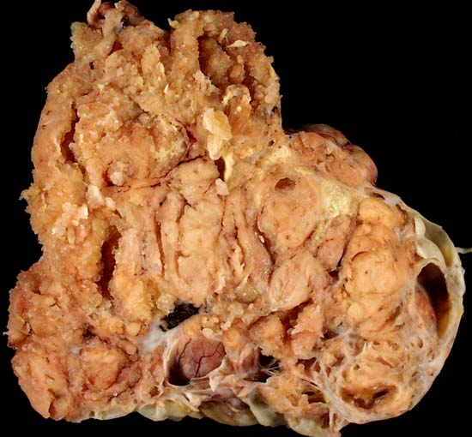
Serous cystadenocarcinoma, ovary
Ed Uthman, MD. http://web2.airmail.net/uthman/specimens/images/ovary_serous_ca.html
imgbuddy.com http://missinglink.ucsf.edu/lm/IDS_107_ovary_uterus_kidney/assets/Slide340OACAhp_small.jpg

Slide 19
Mucinous Tumors
Mucinous tumors form about 25% of all ovarian neoplasms. The tumor cells are mucin-producing cells (which are either endocervical type or intestinal type cells).
Less likely to be malignant
80% are benign
10% are borderline
10% malignant
Bilaterality is uncommon.
Mucinous tumors can be very large.
They are typically cystic and multilocular and filled with thick sticky, viscous mucoid fluid.
Mucinous cystadenoma with multicystic cut section and glistening mucoid material; in it. B. the cyst is lined by columnar epithelium (mucin producing)

Slide 20
Other surface epithelial tumors
ENDOMETRIOID TUMORS
TRANSITIONAL CELL/ BRENNER TUMOR
They have tubular gland that resemble the endometrium so the name endometrioid (endometrium-like) .
Endometrioid tumors form 10 to 20% of all ovarian tumors.
Most of the endometrioid tumors are malignant (carcinomas).
Some endometrioid tumors are accompanied by an endometrial carcinoma in the uterus and / or endometriosis in the ovaries
Tumor cell are transitional cell type
Most are benign

Slide 22
Sex Cord-Stromal tumors

Slide 23
Sex Cord-Stromal tumors:
Almost always Benign
Thecoma, Fibroma and Fibrothecoma
With Malignant Potential
Granulosa Cell tumor
Sertoli-Leydig cell tumor
Others

Slide 24
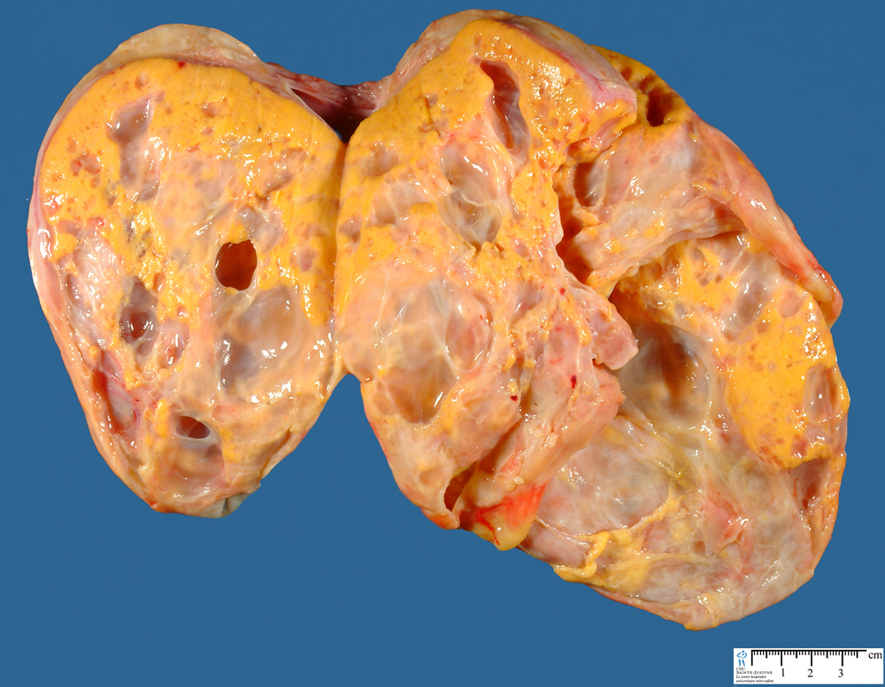
Sex Cord Tumors: Thecoma-Fibroma
Any age
Unilateral
Almost always benign. Very rarely malignant.
They can be either pure thecomas, pure fibromas or fibrothecomas (mixture of both).
Pure theca cell tumors produce estrogen
Fibromas do not produce estrogen except when mixed with thecomas.
They are solid tumors, vary in color from white to yellow. Fibromas are whiter, harder with whorled cut surface.
About 40% cases are associated with ascites and hydrothorax called as Meig’s Syndrome
FIBROMA http://www.med.cmu.ac.th/student/patho
http://www.humpath.com

Slide 25
Sex Cord Tumors:
Granulosa Cell Tumor
Sertoli – Leydig cell tumor
Unilateral, solid and cystic
Produce estrogen
2 forms: adult and juvenile.
Adult form is more common in postmenopausal women.
The juvenile form is seen the first three decades, can present with isosexual precocity
can present with abnormal vaginal bleeding
can be associated with endometrial hyperplasia and carcinoma
About 5 to 25% show malignant behavior
Rare tumors of low malignant potential
All ages
Unilateral yellowish solid tumor.
Produces androgens and present with virilization in 1/3 of cases (oligomenorrhea, amenorrhea, loss of female secondary sex characteristics with hirsutism, clitoromegaly, deepening of voice)

Slide 26
Germ Cell Tumors

Slide 27
Classification of Ovarian Germ Cell Tumors (GCT)
GERM CELL TUMORS
Teratoma:
Immature
Mature (benign)
Solid
Cystic (dermoid cyst)
Monodermal (e.g., struma ovarii, carcinoid)
Dysgerminoma
Yolk sac tumor (endodermal sinus tumor)
Choriocarcinoma
Embryonal carcinoma
Mixed germ cell tumors: mixture of germ cell tumors occurring together in one tumor mass
NOTE: all ovarian GCTs are considered malignant except mature teratoma.

Slide 28
Germ Cell Tumors: Teratoma
Are 15-20 % of ovarian tumors. Majority in the first 2 decades
The tumors are subdivided into mature, immature and monodermal.
Mature cystic teratoma are the most common. They are benign.
Immature teratomas are malignant and rare.
The younger the patient, the greater the likelihood of malignant behavior
Mature cystic teratoma
Is the most common ovarian germ cell tumor and the most common type of ovarian teratoma
benign neoplasm that typically occurs during reproductive years composed of mature elements of the ectoderm, endoderm and mesoderm
cystic tumor, filled with sebaceous material and hair and occasionally teeth.
Histology: skin, hair, sebaceous glands, and mature neural tissue predominate; cartilage, bone, respiratory and intestinal epithelium are common.
complications include torsion, rupture, infection etc.

Slide 29
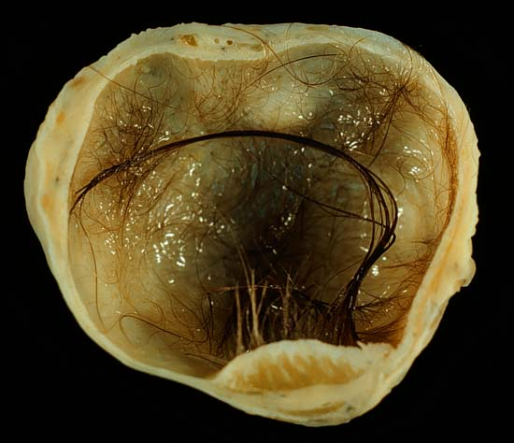
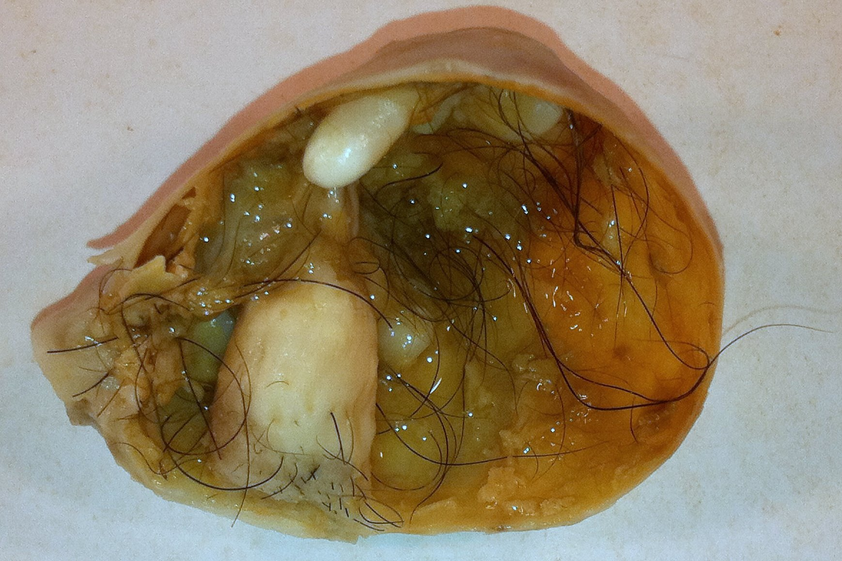
"Mature cystic teratoma of ovary" by Photograph by Ed Uthman, MD. - http://web2.airmail.net/uthman/specimens/index.html. Licensed under Public Domain via Wikimedia Commons - http://commons.wikimedia.org/wiki/File:Mature_cystic_teratoma_of_ovary.jpg#/media/File:Mature_cystic_teratoma_of_ovary.jpg
http://commons.wikimedia.org/wiki/File:Mature_Cystic_Teratoma_of_the_Ovary_%285560431170%29.jpg

Slide 30
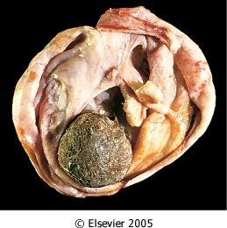
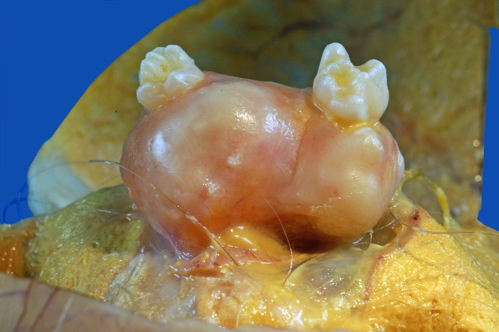
Opened mature cystic teratoma (dermoid cyst) of the ovary. Hair ball is present.
Robbins & Cotran Pathologic Basis of Disease

Slide 31
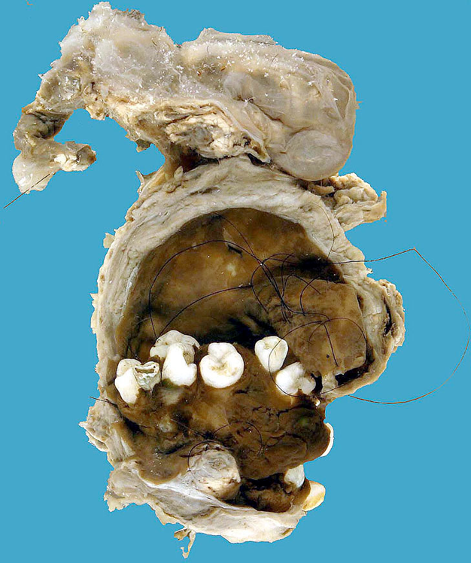
https://secure.health.utas.edu.au/intranet/cds/pathprac/Files/Cases/Female/Case60/Case60.htm

Slide 32
Germ Cell Tumors: Teratoma
Immature teratoma
Mailgnant neoplasms, occurs in children and young adults
Usually a unilateral, solid tumor
Similar to mature teratoma but in addition they contain immature or embryonal tissues especially immature neuroepithelium
They are graded based on the amount of immature tissue
"Immature teratoma high mag" by Nephron - Own work. Licensed under CC BY-SA 3.0 via Wikimedia Commons - http://commons.wikimedia.org/wiki/File:Immature_teratoma_high_mag.jpg#/media/File:Immature_teratoma_high_mag.jpg

Slide 33
Germ Cell Tumors: Teratoma
Monodermal teratoma
a teratoma composed predominantly of one tissue element
most common type is "struma ovarii", which is mature thyroid tissue.
The thyroid tissue can sometimes become malignant.
Sometimes a carcinoid tumor can arise from it.
A Case of Bilateral Struma Ovarii Combined with Subclinical Hyperthyroidism
Endocrinol Metab. 2012 Mar;27(1):72-76. Korean. http://dx.doi.org/10.3803/EnM.2012.27.1.72

Slide 34
Other Germ Cell Tumors:
DYSGERMINOMA
ENDODERMAL SINUS TUMOR
Uncommon
Between 10 to 30yrs of age
Unilateral and solid mass
Microscopically look exactly like its counterpart in testis (Seminoma) and brain (germinoma)
All malignant
PLAP positive
Highly sensitive to radiation therapy
Also known as yolk sac tumor
Under 30 years of age
can be pure or a component of a mixed germ cell tumor
is radioresistant but responds to combination chemotherapy
the tumor is associated with elevated serum αlpha-fetoprotein and αlpha-1-antitrypsin.
Its characteristic histologic feature : Schiller-Duval bodies
Positive for immunostain for αlpha-fetoprotein

Slide 35
Other Germ Cell Tumors:
CHORIOCARCINOMA
EMBRYONAL CARCINOMA
Rare, aggressive, highly malignant, radioresistant but responds to chemotherapy.
Similar to its that in testis, usually occurs in combination with other GCTs (mixed GCT)
2nd and 3rd decade (children and young adults)
Unilateral, solid tumor with hemorrhage and necrosis
CD 30 immunostain positive.
Rare aggressive, highly malignant, metastasizes widely through the bloodstream to the lungs, liver, bone etc
Radioresistant AND chemoresistant
Similar to its that in testis, usually occurs in combination with other GCTs (mixed GCT)
elevated serum hCG levels
unilateral, solid, hemorrhagic tumor, composed of malignant cytotrophoblast and syncytiotrophoblast
HCG immunostain positive

Slide 36
Metastatic carcinoma in ovary
Accounts for approximately 5% of ovarian tumors
Older ages, Mostly Bilateral and sometimes very large
Primary tumor can be from Gastro-intestinal tract (most common), Breast and lung.
One of the most classic forms of metastatic carcinoma involving the ovaries is the Krukenberg tumor. This tumor is a metastatic carcinoma composed of signet ring cells in a fibrous background. The most common sites of origin is the GIT (stomach, colon and appendix).

