Slide 1
Reproduction Block Pathology Practicals
Prof. Ammar Al Rikabi
Dr. Sayed Al Esawy
Dr. Marie Mukhashin
Dr. Shaesta Zaidi
Prepared by:
Head of Pathology Department: Dr. Hisham Al Khalidi

Slide 2
1st Practical Session
MALE
GENITAL SYSTEM
Pathology Dept, KSU
Reproduction block

Slide 3
TESTIS
Normal Anatomy and Histology
Pathology Dept, KSU
Reproduction block

Slide 4
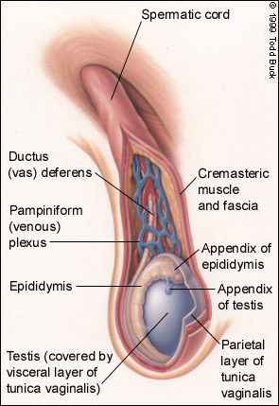
Diagram of Normal Testis
Pathology Dept, KSU
Reproduction block

Slide 5
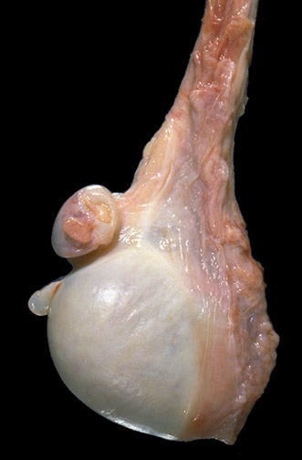
Anatomy of Normal Testis - Gross
Here is a normal testis and adjacent structures. Identify the body of the testis, epididymis, and spermatic cord. Note the presence of two vestigial structures, the appendix testis and the appendix epididymis.
Pathology Dept, KSU
Reproduction block

Slide 6
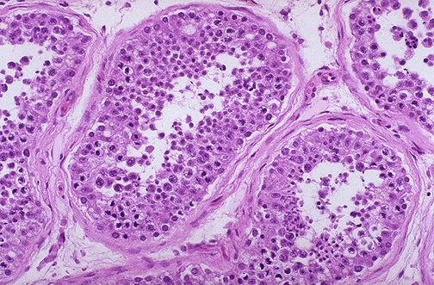
Histology of Normal Testis - LPF
The seminiferous tubules have numerous germ cells. Sertoli cells are inconspicuous. Small dark oblong spermatozoa are seen in the center of the tubules.
Pathology Dept, KSU
Reproduction block

Slide 7
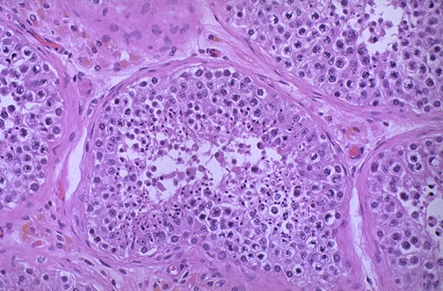
Histology of Normal Testis - LPF
Pink Leyding cells are seen here in the interstitium. Note the pale golden brown pigment as well. There is active spermatogenesis.
Pathology Dept, KSU
Reproduction block

Slide 8
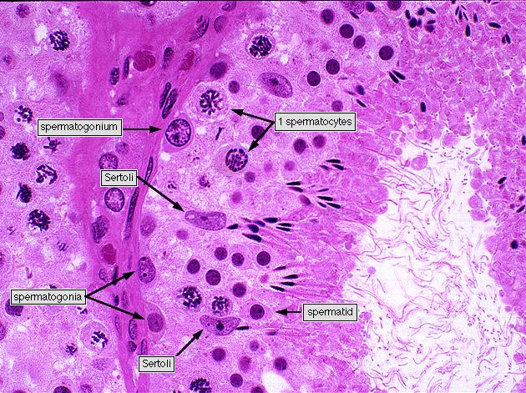
Histology of Normal Testis - HPF
Pathology Dept, KSU
Reproduction block

Slide 9
PROSTATE
Normal Anatomy and Histology
Pathology Dept, KSU
Reproduction block

Slide 10
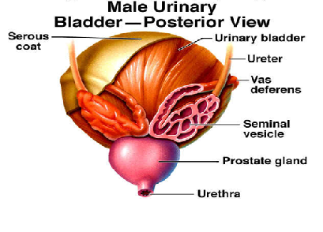
Diagram of Prostate and Seminal Vesicle
Pathology Dept, KSU
Reproduction block

Slide 11
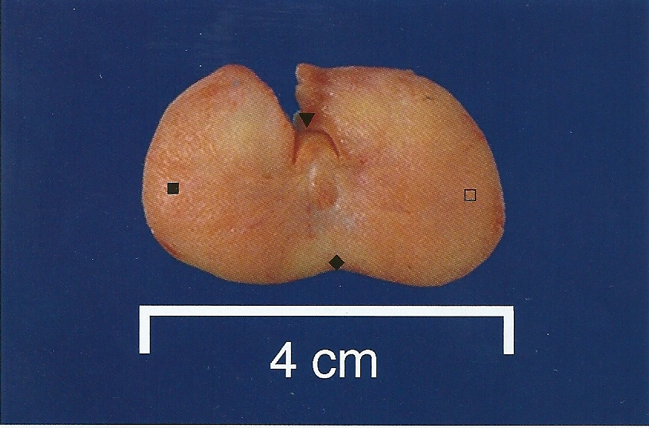
Normal Prostate - Gross
A normal prostate gland is about 3 to 4 cm in diameter.
This is an axial transverse section of a normal prostate. There is a central urethra(▼), at the depth of the cut made to open this prostate anteriorly at autopsy, with the left lateral lobe (), the right lateral lobe () , and the posterior lobe (). Consistency is uniform without nodularity.
Pathology Dept, KSU
Reproduction block

Slide 12
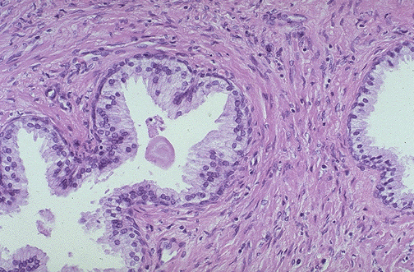
Normal Prostate Histology - LPF
A small pink concretion (typical of the corpora amylacea seen in benign prostatic glands) appears in the gland just to the left of center. Note the well-differentiated glands with tall columnar epithelial lining cells. These cells do not have prominent nucleoli.
Pathology Dept, KSU
Reproduction block

Slide 13
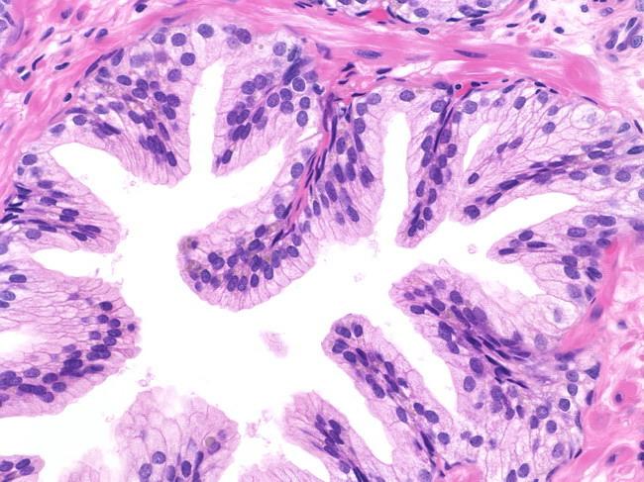
Normal Prostate Histology - HPF
In this benign gland, the luminal contour shows tufts and papillary infoldings. The tall secretory epithelial cells have pale clear cytoplasm and uniform round or oval nuclei. Prominent nucleoli are not seen. Many basal cells can be identified
Pathology Dept, KSU
Reproduction block

Slide 14
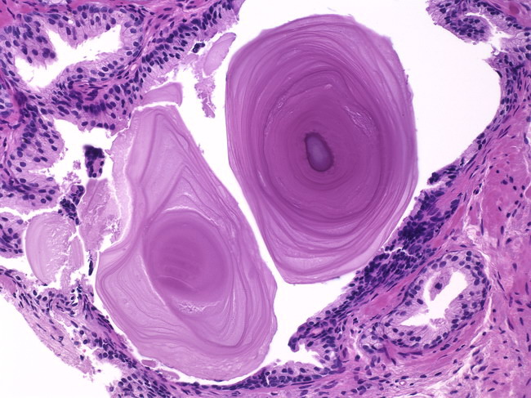
Corpora Amylacea in Prostate - HPF
Corpora amylacea are inspissated secretions that may have a lamellated appearance. Usually they are pink or purple in appearance. Sometimes they may be golden-brown
Pathology Dept, KSU
Reproduction block

Slide 15
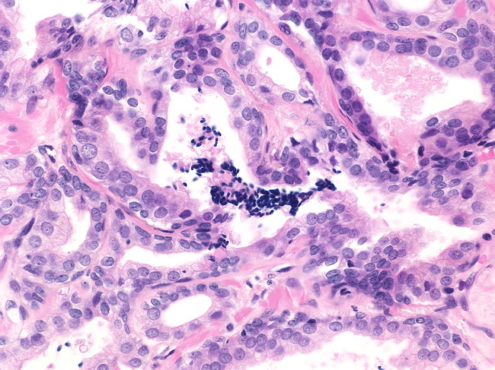
Sperms in Normal Prostate Biopsy – HPF
Spermatozoa are seen in approximately 1% of prostate needle biopsies (unpublished personal observation).
Pathology Dept, KSU
Reproduction block

Slide 16
SEMINAL VESICLE
Normal Anatomy and Histology
Pathology Dept, KSU
Reproduction block

Slide 17
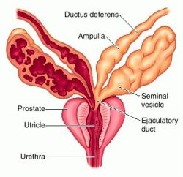
Diagram of Seminal Vesicle
Pathology Dept, KSU
Reproduction block

Slide 18
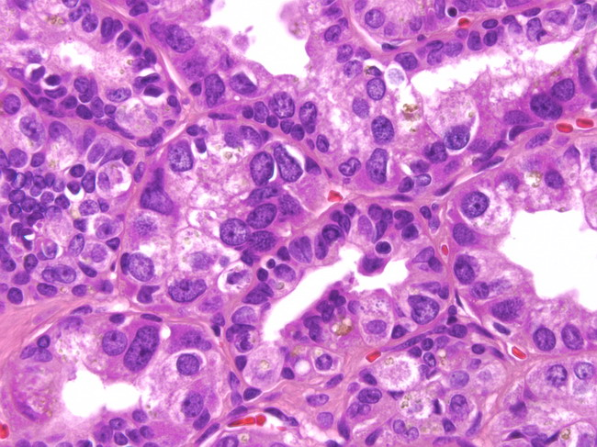
Normal Seminal Vesicle – HPF
Highly atypical cells are a normal finding in the seminal vesicles of about 80% of older men. The nuclei are large, irregular, hyperchromatic & show prominent nucleoli.
The atypia is degenerative and not observed in the
seminal vesicles of young men
Pathology Dept, KSU
Reproduction block

Slide 19
HISTOPATHOLOGY
OF THE TESTIS
Testicular Atrophy
Pathology Dept, KSU
Reproduction block

Slide 20
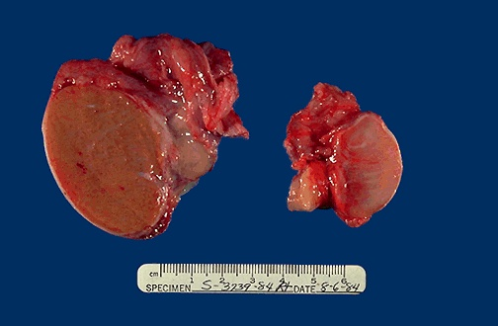
Normal vs Atrophied Testis - Gross
On the left is a normal testis. On the right is a testis that has undergone atrophy. Bilateral atrophy may occur with a variety of conditions including chronic alcoholism, hypopituitarism, atherosclerosis, chemotherapy or radiation, and severe prolonged illness.
Pathology Dept, KSU
Reproduction block

Slide 21
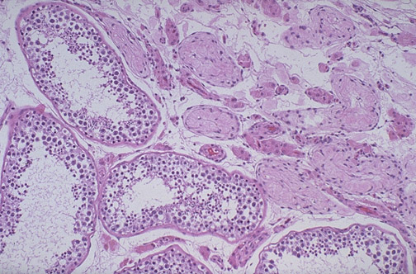
Normal vs Atrophied Testis - Microscopic
Lt
Rt
There is focal atrophy of tubules seen here to the upper right. The most common reason for this is probably childhood infection with the mumps virus, which produces a patchy orchitis
Pathology Dept, KSU
Reproduction block

Slide 22
Seminoma of the Testis
Pathology Dept, KSU
Reproduction block

Slide 23
Seminoma of the Testis - Gross
Here is a Seminoma that is larger yet. Normal testis appears to the left of the mass. Pale and lobulated testicular mass with bulging and potato like cut surface with attached and congested spermatic cord . Most important risk factor is cryptorchidism (undescended testicle) .
Pathology Dept, KSU
Reproduction block

Slide 24
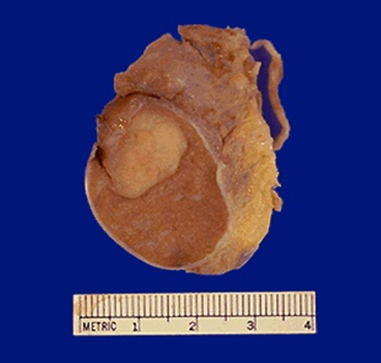
Seminoma of the Testis - Gross
Seminoma: Germ cell neoplasms are the most common types of testicular neoplasm. They are most common in the 15 to 34 age group. They often have several histologic components: seminoma, embryonal carcinoma, teratoma & choriocarcinoma.
Pathology Dept, KSU
Reproduction block

Slide 25
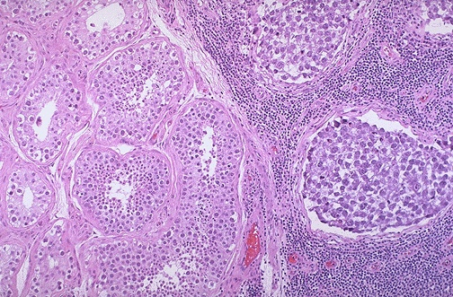
Seminoma vs Normal Testis - LPF
Lt
Rt
Normal testis appears at the left, and seminoma is present at the right. Note the difference in size and staining quality of the neoplastic nests of cells compared to normal germ cells.
Note the lymphoid stroma between the nests of seminoma.
Pathology Dept, KSU
Reproduction block

Slide 26
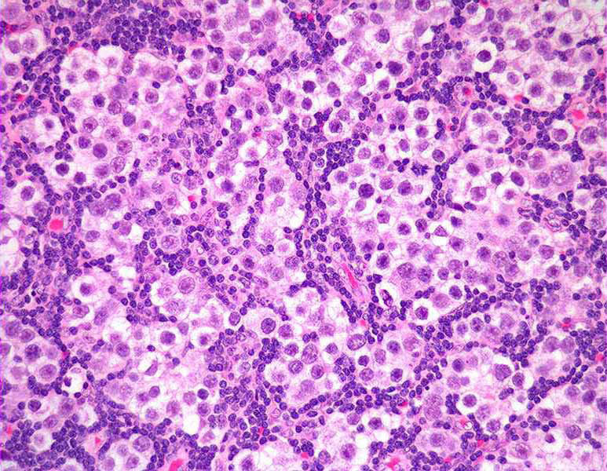
Seminoma of the Testis - HPF
Seminoma ; a malignant tumour consisting of sheets of uniform malignant germ cells showing large vesicular nuclei and prominent nucleoli.
Pathology Dept, KSU
Reproduction block

Slide 27
Embryonal Carcinoma & Teratoma of the Testis
Pathology Dept, KSU
Reproduction block

Slide 28
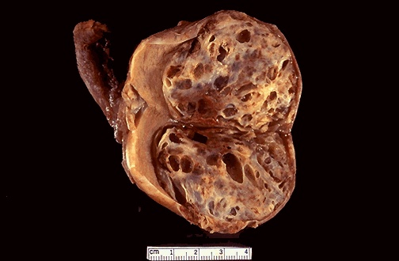
Embryonal Carcinoma & Teratoma - Gross
Here is an embryonal carcinoma mixed with teratoma in which islands of bluish white cartilage from the teratoma component are more prominent. A rim of normal brown testis appears at the left.
Pathology Dept, KSU
Reproduction block

Slide 29
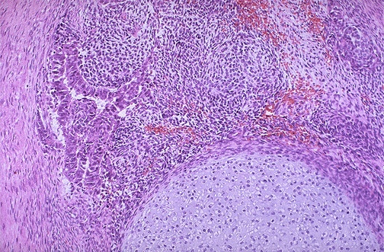
Embryonal Carcinoma & Teratoma - HPF
At the bottom is a focus of cartilage. Above this is a primitive mesenchymal stroma and to the left a focus of primitive cells most characteristic for embryonal carcinoma. This is embryonal carcinoma mixed with teratoma.
Pathology Dept, KSU
Reproduction block

Slide 30
PROSTATE
Pathology Dept, KSU
Reproduction block

Slide 31
Prostatic Hyperplasia
Pathology Dept, KSU
Reproduction block

Slide 32
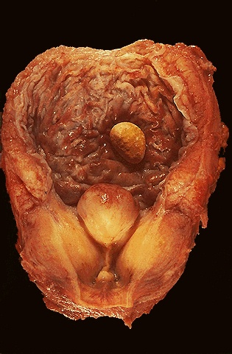
Prostatic Hyperplasia - Gross
Enlarged lateral lobes, and median lobe that obstructs the prostatic urethra that led to obstruction with bladder hypertrophy, as evidenced by the prominent trabeculation of the bladder mucosa. Obstruction with stasis also led to the formation of the yellow-brown calculus (stone).
Pathology Dept, KSU
Reproduction block

Slide 33
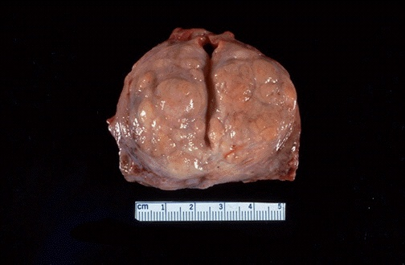
Prostatic Hyperplasia - Gross
Here is another example of benign prostatic hyperplasia. Nodules appear mainly in the lateral lobes. Such an enlarged prostate can obstruct urinary outflow from the bladder and lead to an obstructive uropathy
Pathology Dept, KSU
Reproduction block

Slide 34
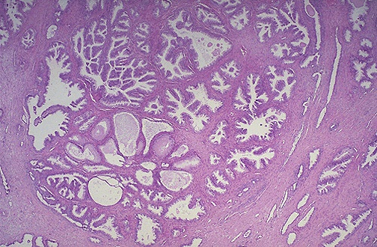
Prostatic Hyperplasia - LPF
Microscopically, benign prostatic hyperplasia can involve both glands and stroma, though the former is usually more prominent. Here, a large hyperplastic nodule of glands is seen
Pathology Dept, KSU
Reproduction block

Slide 35
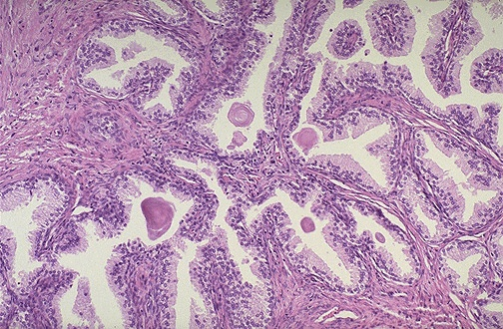
Prostatic Hyperplasia - HPF
The enlarged prostate has glandular hyperplasia. The glands are well-differentiated and still have some intervening stroma. The small laminated pink concretions within the glandular lumens are known as corpora amylacea
Pathology Dept, KSU
Reproduction block

Slide 36
Adenocarcinoma of Prostate
Pathology Dept, KSU
Reproduction block

Slide 37
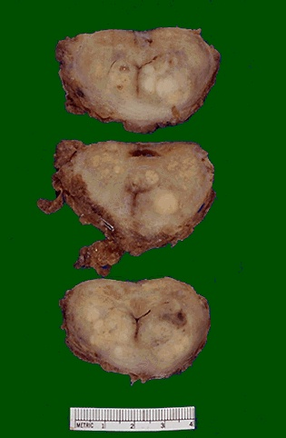
Adenocarcinoma of the Prostate - Gross
These sections through a prostate removed via radical prostatectomy reveal irregular yellowish nodules, mostly in the posterior portion (seen here superiorly). This proved to be prostatic adenocarcinoma
Pathology Dept, KSU
Reproduction block

Slide 38
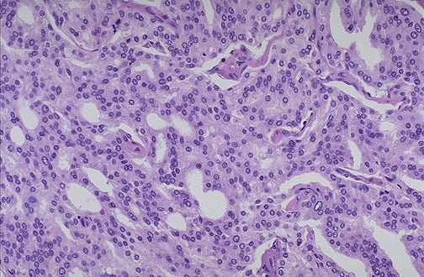
Adenocarcinoma of the Prostate - MPF
At high magnification, the neoplastic glands of prostatic adenocarcinoma are still recognizable as glands, but there is no intervening stroma and the nuclei are hyperchromatic.
Pathology Dept, KSU
Reproduction block

Slide 39
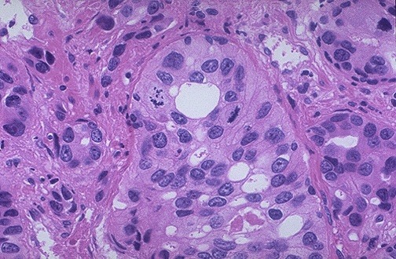
Adenocarcinoma of the Prostate - HPF
At high magnification, this poorly differentiated prostatic adenocarcinoma demonstrates cells with nucleoli and mitotic figures.
Pathology Dept, KSU
Reproduction block

Slide 40
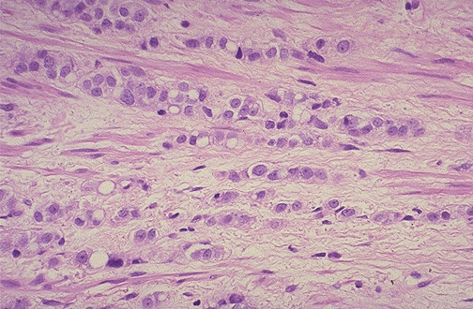
Adenocarcinoma of the Prostate - HPF
This adenocarcinoma of prostate is so poorly differentiated that no glandular structure is recognizable, only cells infiltrating in rows.
Pathology Dept, KSU
Reproduction block

