Slide 1
Lecture 2 Physiology of ovarian cycle
Dr. Laila Al Dokhi
Assistant Professor
Department of Physiology

Slide 2
Objectives
By the end of this lecture, you should be able to:
List the hormones of female reproductive organs and describe their physiological functions
Describe the changes that occur in the ovaries during the menstrual cycle
Describe the hormonal control of the development of ovarian follicles, mature oocytes and corpus luteum
Describe the pituitary ovarian axis and in correlation with the changes that occur in the ovaries leading up to and following ovulation during an ovarian cycle
Keywords: 17β-estradiol, progesterone, graafian follicle, ovulation, corpus luteum

Slide 3
Anatomy of the female sexual organs

Slide 4
Relation of the ovary to fallopian tube

Slide 5
Monthly ovarian cycle: Monthly rhythmical changes in the rates of secretion of female hormones & corresponding physical changes in the ovaries & other sexual organs.
Duration of the cycle average 28 days (20-45 days).
There are 2 results of the female sexual cycle:
Single ovum is released from the ovaries each month
Uterine endometrium is prepared for implantation for the fertilized ovum.

Slide 6
Gonadotropic hormones and their effects on the ovaries:
The ovarian changes during the reproductive cycle depend on FSH & LH secreted by AP.
In the absence of these hormones, the ovaries remain inactive throughout childhood,
At puberty the AP starts to secrete FSH & LH which lead to the beginning of monthly reproductive cycles.
First menstrual cycle is called menarche.
Both FSH and LH stimulate their ovarian target cells by combining with highly specific receptors to increase
Rates of secretion,
Growth & proliferation of the cells.

Slide 7
Ovarian follicle growth:-
“Follicular” phase of the ovarian cycle:
In female child each ovum is surrounded by single granulosa cell sheath called primordial follicle.
During childhood, the granulosa cells
Provide nourishment for the ovum
Secrete oocyte maturation inhibiting factor which keeps the ovum in its primordial state.
After puberty, AP secrete FSH and LH which
Stimulate the ovaries and result in growth of some follicles.
Growth of the follicle begins with increase in size of the ovum & growth of additional layers of granulosa cells of some follicles
At this stage it is known as primary follicles.

Slide 8
During the first few days of the monthly female reproductive cycle there is increase in secretion of FSH and LH,
Increase in FSH is slightly more & earlier than LH which causes the acceleration of growth of many primary follicles each month.
There is proliferation of the granulosa cells to many layers. The ovary interstitium collect in several layers outside the granulosa cells to form a second mass of cells called theca.
This theca is divided into 2 layers:
Theca interna, the cells have epitheloid characteristics and similar to the granulosa cells and secrete sex hormones (estrogen and progesterone)
Theca externa, the outer layer, develops into a highly vascular connective tissue capsule of the developing follicle.

Slide 9
Few days after proliferation & growth of the follicles, the granulosa cells secrete follicular fluids contain high concentration of estrogen.
This fluid accumulate to form antrum within the mass of the granulosa cells.
The early growth of the follicle up to the antral is under FSH stimulation.
Then there is accelerated growth of the follicle to larger follicle called vesicular follicle caused by:-
Estrogen secreted into the follicle causes the granulosa cells to form increasing number of FSH receptors which causes positive feedback effect;
Both estrogen & FSH combine to promote LH receptors on the granulosa cells, allowing more increase follicular secretion;
The increasing estrogen from the follicle plus increasing LH from the AP causes proliferation of the follicular theca cells & increase their secretion.

Slide 10
Stages of follicular development

Slide 11
Layers in the mature graafian follicle

Slide 12
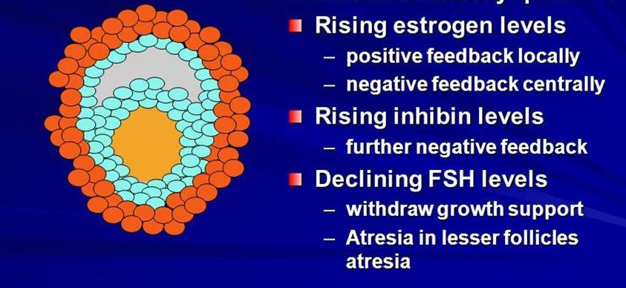
The antral follicles begin to grow.
The ovum enlarges & remain embedded at one pole of the granulosa cells of the follicle.
Only one follicle continue to grow & the remaining follicles (5 to 11) undergo atresia or involute the
Cause: Figure

Slide 13
Ovulation:
It occurs 14 days after the onset of menstruation in 28 days cycle. Before ovulation,
Small area in the center of the follicle called stigma protrude & fluids ooze from the follicle &
The stigma ruptures allowing more viscous fluid outward carrying with it the ovum surrounded by mass of granulosa cells called corona radiata.
LH surge is necessary for ovulation:
2 Days before ovulation, the rate of LH secretion from the AP increase markedly to 6-16 fold & peak about 16 hrs before ovulation.
FSH also increases to 2 to 3 fold & acts synergistically with LH to cause swelling of the follicle before ovulation.
LH has specific effect on the granulosa cells & theca cells converting them to progesterone secreting cells so the rate of estrogen secretion begins to fall about 1 day before ovulation while progesterone secretion begin to increase.

Slide 14
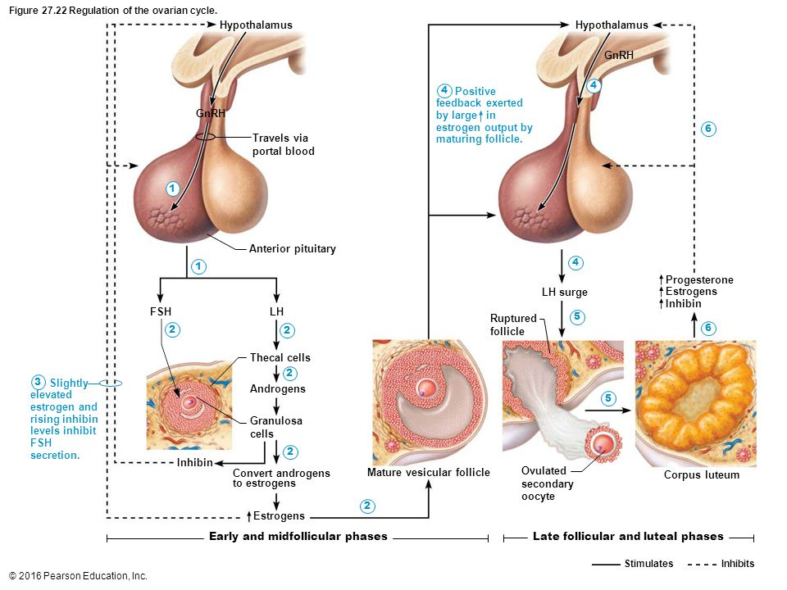

Slide 15
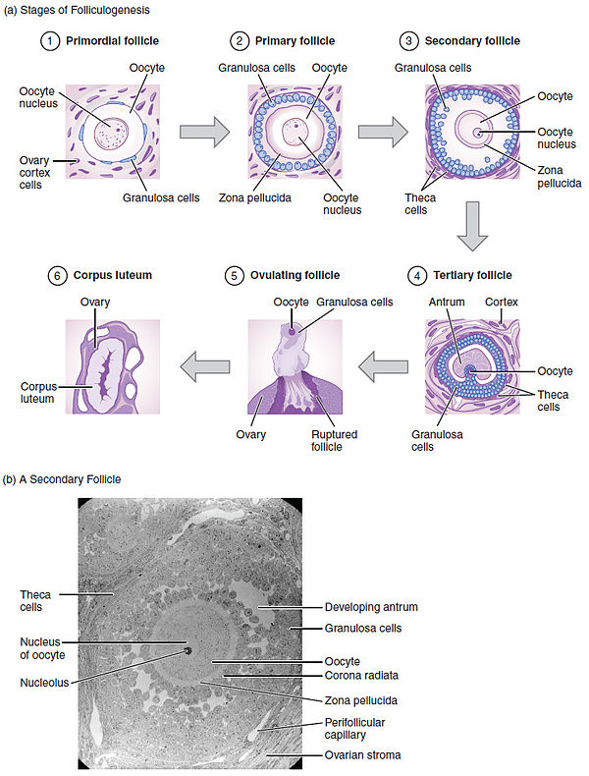
Summary of follicular growth

Slide 16
Initiation of ovulation:
Large quantity of LH secreted by the AP causes rapid secretion of progesterone from the follicle few hours
2 events occur which are necessary for ovulation:
1) The theca externa begins to secrete proteolytic enzymes & causes weakening of the wall result in swelling of the follicle & degeneration of the stigma;
2) Rapid growth of new blood vessels into the follicle wall & prostaglandins are secreted into the follicular tissue.
-Those two changes causes swelling of the follicle & plasma transudation into the follicle & degeneration of the stigma with discharge of the ovum.

Slide 18
Luteal phase of the ovarian cycle:
After expulsion of the ovum from the follicle, the remaining granulosa & theca interna cells change to lutein cells & become filled with lipid inclusions giving them yellowish appearance.
The granulosa cells with the theca cells called corpus luteum.
The granulosa cells in corpus luteum develop extensive intracellular endoplasmic reticula & form large amount of progesterone & estrogen.
The theca cells form mainly androgens which are converted by granulosa cells into female hormones.
The corpus luteum grow to about 1.5 cm in diameter, at about 7 to 8 days after ovulation .
Then begins to involute & losses its secretory function & its yellowish characteristic about 12 days after ovulation & becomes corpus albicans & replaced by connective tissue & absorbed.

Slide 19
Luteinizing function of LH:
A local hormone in the follicular fluid called luteinization – inhibiting factor hold the luteinization process until after ovulation.
After extrusion of the ovum from the follicle the following changes occur:
Conversion of granulosa and theca interna cells into lutein cells.
Secretion of progesterone & estrogen from the corpus luteum.
- If pregnancy occur, the chorionic gonadotropin from the placenta act on the corpus luteum to prolong its life for 2 to 4 months of pregnancy.

Slide 20
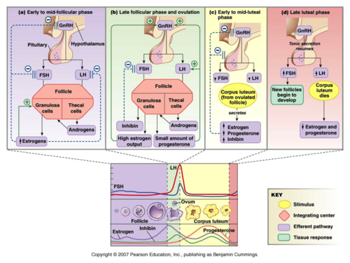
Summary of the ovarian cycle

Slide 21
Involution of the corpus luteum and onset of the next ovarian cycle:
Lutein cells of the corpus luteum secrete:
Progesterone & Estrogen which inhibit the secretion of FSH & LH.
Inhibin which inhibit secretion of FSH by AP.
Low levels of both FSH & LH & causes the corpus luteum to degenerate completely, called involution of the corpus luteum.
Around 26th days of normal reproductive cycle & after involution of corpus luteum, sudden cessation of secretion of estrogen, progesterone & inhibin removes the feedback inhibition of the AP & allowing increase secretion of FSH & LH again.
FSH & LH initiate the growth of new follicles, beginning a new ovarian cycle.

