Slide 1
Congenital Infection
Ali M Somily MD

Slide 2
Rout of Transmission
Transmission | Types
Intra-uterine | Transplacental
 | Ascending infection
Intra-partum | Contact with infected material during delivery, secretion , blood faeces
Post-partum | Breast feeding
 | Blood transfusion
 | Nosocomial

Slide 3
Important Information for any congenital infection
Background prevalence
Incidence of infection in pregnancy
Risk of mother to child transmission
Timing of mother to child transmission
Risk factors for maternal and perinatal infections
Consequences of both congenital/perinatal infection short and long term

Slide 4
Terminology
Congenital
Perinatal
Neonatal
What is TORCH
Toxoplasmosis,
Other (syphilis ,parvovirus &VZV),
Rubella,
CMV,
Herpes( Hepatitis &HIV),

Slide 5
Risk and features of congenital infection
Risk of congenital infection:
Organism (Teratogenicity)
Type of maternal infection(Primary ,recurrent)
Time during pregnancy (1st,2nd,3rd Trimester)
features of congenital infection :
Intrauterine growth retardation(IUGR)
Fever
Skin rash, joundice
Microcephaly
Hepatosplenomegaly(HSM)
Generalized lymphadenopathy
Thrombocytopenia
IgM, Persistent IgG
Notes:
Congenital toxoplasmosis — Toxoplasmosis is caused by the protozoan parasite Toxoplasma gondii. Primary infection during pregnancy can result in congenital disease. (See "Toxoplasmosis and pregnancy".)
Most infants with congenital toxoplasmosis are asymptomatic or without apparent abnormalities at birth. Although subclinical disease is the rule, signs present at birth may include fever, maculopapular rash, hepatosplenomegaly, microcephaly, seizures, jaundice, thrombocytopenia, and, rarely, generalized lymphadenopathy (picture 1). The so-called classic triad of congenital toxoplasmosis consists of chorioretinitis, hydrocephalus, and intracranial calcifications (image 1).
Infants with subclinical congenital toxoplasmosis who do not receive treatment have an increased risk of long-term sequelae. The most common late finding is chorioretinitis (picture 2), which can result in vision loss. Intellectual disability (mental retardation), deafness, seizures, and spasticity also can be seen in a minority of untreated children.
The diagnosis, management, and prevention of congenital toxoplasmosis are discussed separately. (See "Congenital toxoplasmosis: Clinical features and diagnosis" and "Congenital toxoplasmosis: Treatment, outcome, and prevention".)
Congenital syphilis — Congenital syphilis occurs when the spirochete Treponema pallidum is transmitted from a pregnant woman to her fetus. Infection can result in stillbirth, hydrops fetalis, or prematurity and associated long-term morbidity. Because of this morbidity, great emphasis has been placed on routine syphilis screening of all pregnant women. (See "Syphilis in pregnancy", section on 'Maternal screening'.)
The incidence of congenital syphilis reflects the rate of syphilis in women of childbearing age. Many congenital cases develop because the mother received no prenatal care, no penicillin treatment, or inadequate treatment before or during pregnancy.
Most neonates with congenital syphilis are asymptomatic at birth. Overt infection can manifest in the fetus, the newborn, or later in childhood. Clinical manifestations after birth are divided arbitrarily into early (≤2 years of age (table 2)) and late (>2 years of age (table 3)).
The diagnosis, management, and prevention of congenital syphilis are discussed separately. (See "Congenital syphilis: Clinical features and diagnosis" and "Congenital syphilis: Evaluation, management, and prevention".)
Congenital rubella — Rubella typically causes a mild, self-limited illness; its major impact occurs during pregnancy, when it can have devastating effects on the developing fetus.
Congenital rubella syndrome (CRS) is rare in developed countries with established rubella immunization programs. It is no longer endemic in the United States, although an average of 5 to 6 cases are reported to the National Congenital Rubella Registry each year, usually in infants whose mothers emigrated from countries without rubella immunization programs.
Clinical manifestations of CRS include sensorineural deafness, cataracts, cardiac malformations (eg, patent ductus arteriosus, pulmonary artery hypoplasia), and neurologic and endocrinologic sequelae. Neonatal manifestations may include growth retardation, radiolucent bone disease (not pathognomonic of congenital rubella), hepatosplenomegaly, thrombocytopenia, purpuric skin lesions (classically described as "blueberry muffin" lesions that represent extramedullary hematopoiesis), and hyperbilirubinemia.
The diagnosis, management, and prevention of CRS are discussed separately. (See "Congenital rubella syndrome: Clinical features and diagnosis" and "Congenital rubella syndrome: Management, outcome, and prevention".)
Congenital cytomegalovirus — Cytomegalovirus (CMV) is a ubiquitous virus worldwide. Despite its listing as the fourth infection in the TORCH designation, CMV has emerged as the most common congenital viral infection.
Epidemiology — Primary infection and reactivation of virus can occur during pregnancy, and both can result in congenital CMV, the most common congenital viral infection. Approximately 40,000 infants are born with congenital CMV infection annually in the United States [12]. Although the majority of congenital infections are asymptomatic, approximately 5 to 20 percent of infants born to mothers with primary CMV infection will be overtly symptomatic. These children have a mortality rate of almost 30 percent, and severe neurologic morbidity occurs in 80 percent of survivors.
The risk of seroconversion to CMV during pregnancy averages 2.0 to 2.5 percent [13]. Intrauterine infection occurs in 0.5 to 2 percent of all live births. Congenital infection from seropositive mothers ranges from 0.2 to 1.5 percent. In contrast, primary maternal infection during pregnancy leads to transmission in approximately 40 percent of fetuses [14]. (See "Cytomegalovirus infection in pregnancy".)
There generally appears to be little risk of CMV-related complications in the offspring of women infected with CMV at least six months before conception. For this group, which accounts for 50 to 80 percent of the women of childbearing age, the rate of newborn CMV infection is 1 percent. These infants appear to have little significant illness or sequelae, although severe fetal cytomegalic inclusion disease after maternal reactivation of CMV during the first trimester of pregnancy has been reported [15,16].
Factors that can influence CMV infection during pregnancy include maternal age, parity, and gestational age [17]. Although several studies have suggested that gestational age has no apparent influence on the risk of transmission of CMV in utero [18-21], an increased risk of transmission was observed in late gestation in one retrospective study (36, 45, and 78 percent, for the first, second, and third trimesters, respectively) [22]. However, sequelae appear to be more severe when infection is acquired earlier in pregnancy.
Transmission — Infection requires intimate contact with a person excreting the virus in saliva, urine, or bodily fluids. Congenital CMV infection generally is the result of transplacental transmission of the virus. The virus also can be transmitted sexually, via organ transplants, via breast milk, and, rarely, via blood transfusion. Transmission is higher in households with young children or in day care centers. Excretion rates in childcare centers can be as high as 70 percent in children one to three years of age [23].
Clinical manifestations — Congenital CMV has a wide constellation of clinical symptoms, ranging from none to fulminant end-organ dysfunction.
Approximately 90 percent of infants with congenital CMV infection are asymptomatic at birth. However, 0.5 to 15 percent of these children are at risk for development of psychomotor, hearing, neurologic, ocular, or dental abnormalities within the first few years of life [24,25]. Some otherwise asymptomatic infants with congenital CMV infection are identified through newborn hearing screening [26]. In particular, sensorineural hearing loss will appear in 5 to 10 percent of cases and may interfere with learning abilities (table 4) [27-33]. Hearing loss appears to be associated with increased concentrations of CMV in peripheral blood and urine [34]. (See "Hearing impairment in children: Etiology".)
Approximately 10 percent of infants with congenital CMV infection are symptomatic [35]. One study suggested that symptomatic congenital infection correlated with the amount of virus present in the amniotic fluid; infants born to mothers with ≥10³ genome equivalents in amniotic fluid by polymerase chain reaction (PCR) had a 100 percent probability of acquiring CMV, and for those with ≥10⁵ genome equivalents, this infection was symptomatic [36].
Fifty percent of symptomatic infants present with an attenuated form of congenital infection, usually consisting of isolated splenomegaly, jaundice, and/or petechiae [35,37]. The other 50 percent of symptomatic infants present with the syndrome of cytomegalic inclusion disease, consisting of [38]:
●Jaundice – 67 percent
●Hepatosplenomegaly – 60 percent
●Petechial rash – 76 percent
●Multiorgan involvement (eg, microcephaly, motor disability, chorioretinitis, cerebral calcifications (image 2), lethargy, respiratory distress, seizures)
Laboratory abnormalities include: abnormal blood counts (especially thrombocytopenia), hemolytic anemia, elevated transaminases, and elevated direct and indirect serum bilirubin.
In this fulminant presentation, mortality can be up to 30 percent and occurs within a few days or weeks [35,39]. In survivors, jaundice and hepatosplenomegaly may subside, but neurologic sequelae (eg, microcephaly, intellectual disability [mental retardation], hearing disorders) persist.
More than 80 percent of infants symptomatic at birth will develop late complications that may include hearing loss, vision impairment, and varying degrees of intellectual disability and delay in psychomotor development (table 4) [28]. Infections acquired in late pregnancy may have less prominent signs, although severe developmental problems associated with CNS calcification, microcephaly, and hearing loss have been reported [40].
A wide range of abnormalities of the brain may be detected on cranial imaging (eg, unenhanced computed tomographic [CT] scan) (image 2). These abnormalities include periventricular leukomalacia and cystic abnormalities, periventricular calcifications (linear or punctate), ventriculomegaly, vasculitis, neuronal migration abnormalities, and hydranencephaly [41,42].
Sensorineural hearing loss is detected in more than two-thirds of newborns with symptomatic congenital CMV infection [18,39]. Like that associated with asymptomatic infection, this hearing loss almost always is progressive, eventually producing severe to profound hearing loss in the affected ear [41,42]. Infants with hearing loss caused by congenital CMV infection or disease may be cognitively normal, or they may experience cognitive delays, depending upon the degree of brain involvement experienced in utero [43,44].
Ocular abnormalities, including chorioretinitis (a posterior uveitis), retinal scars, optic atrophy, and central vision loss, also may be seen [45]. In one prospective study of 125 infants with congenital CMV, 42 of them symptomatic, visual impairment was significantly more common in the symptomatic patients (22 versus 2.4 percent) [45]. Moderate to severe involvement frequently bilaterally included optic atrophy, macular scars, and cortical visual impairment. Strabismus also was more frequent in those with symptomatic compared with asymptomatic congenital CMV (29 versus 1.2 percent). (See "Evaluation and management of strabismus in children", section on 'Differential diagnosis'.)
The presence of microcephaly, intracranial calcifications, or other CT scan abnormalities plus chorioretinitis correlates with a poor neurodevelopmental outcome, although the absence of these factors predicts a normal or near-normal cognitive outcome. Infants with symptomatic congenital CMV should undergo regular screening of hearing, vision, and development, with follow-up testing and referral as indicated. (See"Hearing impairment in children: Evaluation" and "Visual development and vision assessment in infants and children".)
Diagnosis — The diagnosis of congenital CMV infection or disease is accomplished by isolation of the virus in urine or saliva samples collected within the first three weeks of life. These infants often have very high titers of virus, and the culture frequently will become positive within one to three days of incubation [18]. The use of culture enhancement centrifugation systems, such as the shell vial assay (staining for early antigen production), has been substituted for traditional cell monolayer culture in many laboratories. Detection of CMV DNA in the urine and serum of newborns also using polymerase chain reaction (PCR) techniques may be used to diagnose congenital CMV infection, but these methods are less available, more expensive, and often less reliable than is traditional cell culture or shell vial culture of the urine [46,47].
CMV IgM antibodies in cord serum or as part of a TORCH titer panel is highly suggestive of congenital infection but should be confirmed by viral culture. Serology for CMV IgG antibody determination is not helpful because most of the general population has CMV antibody, and a positive result may only reflect passive transfer of maternal antibody to the infant. Several serologic assays with differing sensitivity and specificity are available for IgM determinations. These tests are discussed separately. (See "Overview of diagnostic tests for cytomegalovirus infection", section on 'Serology'.)
Different approaches have been evaluated to identify women at risk of transmitting CMV during pregnancy. Amniocentesis for PCR or culture is the preferred method of diagnosis, but negative results do not exclude intrauterine infection [48]. Ultrasonographic markers, including microcephaly, hepatosplenomegaly, and intracranial calcification, may suggest fetal CMV infection, but normal ultrasonography does not exclude the diagnosis. Measurement of IgM, the IgG avidity determination, and combined application of the microneutralization and avidity assays are additional approaches to making a prenatal diagnosis. These approaches are discussed in detail separately. (See "Cytomegalovirus infection in pregnancy", section on 'Prenatal diagnosis'.)
Treatment — In a phase II randomized, controlled multicenter clinical trial evaluating the use of ganciclovir for the treatment of infants with symptomatic congenital CMV infection and evidence of CNS involvement, 47 infants received ganciclovir (8 to 12 mg/kg daily in 2 divided doses for up to 6 weeks) [49]. Ganciclovir was discontinued in eight patients because of side effects but was well tolerated in the other newborns. Decreased excretion of virus was noted during ganciclovir administration, although viruria returned promptly after cessation of therapy. Sixteen percent of the infants had stabilization or improvement in hearing at six months of follow-up. Similar results were observed in a smaller trial [50].
A phase III randomized clinical trial of ganciclovir (6 mg/kg per dose IV every 12 hours) for six weeks in neonates with virologically confirmed congenital CMV disease and neurologic involvement suggested that treatment with ganciclovir prevents hearing deterioration at six months and possibly beyond [51]. The conclusions are limited because only 42 of the 100 enrolled subjects were evaluated for the primary outcome (hearing assessment at six months) [52]. In addition, neutropenia (absolute neutrophil count ≤1250/microL) was more common among ganciclovir recipients than controls (63 versus 21 percent).
It remains unknown whether this early and intensive administration of ganciclovir will hasten resolution of disease, beneficially influence growth and development, decrease auditory and visual impairment, or improve intellectual outcome in these infants. Ganciclovir should not be used routinely for fear of unforeseen long-term effects, such as testicular atrophy and bone marrow suppression. However, it may be reasonable to consider in selected cases. However, anecdotal evidence does suggest that critically ill newborns, especially those who are premature and have CMV pneumonia, may benefit acutely from ganciclovir treatment. Compassionate use also may be appropriate for patients with life- or sight-threatening congenital CMV. Thus, we recommend its use only after careful consideration in selected cases.
The treatment of newborns with asymptomatic congenital infection is not indicated. Even though these infants are at some risk for hearing loss, the side effects of therapy with currently available antiviral agents and the lack of established benefit argue against routine administration.
The use of CMV hyperimmune globulin has not been evaluated extensively for the treatment of congenital CMV disease. However, anecdotal reports suggests some benefit [53,54]. Both CMV immune globulin and alpha interferon are being studied for the treatment of congenital CMV. The development of CMV vaccines also is underway [55].
Herpes simplex virus — Genital herpes simplex virus (HSV) infection during pregnancy poses a significant risk to the developing fetus and newborn.
HSV is transmitted to an infant during birth, primarily through an infected maternal genital tract. The risk of transmission is greater with primary HSV infection acquired during pregnancy, compared with reactivation of previous infection. Among mothers with primary infection, acquisition near the time of labor is the major risk factor for transmission to the neonate. (See "Genital herpes simplex virus infection and pregnancy".)
Most newborns with perinatally acquired HSV appear normal at birth, although many are born prematurely. HSV infection in newborns usually develops in one of three patterns, which occur with roughly equal frequency:
●Localized to the skin, eyes, and mouth (SEM)
●Localized CNS disease
●Disseminated disease involving multiple organs
The initial manifestations of CNS disease frequently are nonspecific and include temperature instability, respiratory distress, poor feeding, and lethargy; they may progress quite rapidly to hypotension, jaundice, disseminated intravascular coagulation (DIC), apnea, and shock. Vesicular skin lesions may or may not be present and develop late in some patients; the absence of skin lesions complicates recognition of the infection. (See "Neonatal herpes simplex virus infection: Clinical features and diagnosis".)
The diagnosis, management, and prevention of neonatal HSV infections are discussed separately. (See "Neonatal herpes simplex virus infection: Clinical features and diagnosis", section on 'Evaluation and diagnosis' and "Neonatal herpes simplex virus infection: Management and prevention".)
Congenital varicella syndrome — Most cases of congenital varicella syndrome occur in infants whose mothers were infected between 8 and 20 weeks gestation. Characteristic findings in neonates may include:
●Cutaneous scars, which may be depressed and pigmented in a dermatomal distribution
●Cataracts, chorioretinitis, microphthalmos, nystagmus
●Hypoplastic limbs
●Cortical atrophy and seizures
The clinical manifestations and diagnosis of congenital varicella syndrome are discussed separately. (See "Varicella-zoster virus infection in pregnancy", section on 'Fetal effects of VZV infection' and "Varicella-zoster virus infection in pregnancy", section on 'Congenital varicella syndrome'.)
APPROACH TO THE INFANT WITH SUSPECTED INTRAUTERINE INFECTION
Overview — Timely diagnosis of perinatally acquired infections is crucial to the initiation of appropriate therapy, the development of a care plan, prognosis, and family counseling. A high index of suspicion for congenital infection and awareness of the prominent features of the most common congenital infections can help to facilitate early diagnosis and tailor appropriate diagnostic evaluation (table 1).
Clinical suspicion — In some cases, intrauterine infection may be suspected on the basis of laboratory results obtained during pregnancy (eg, positive syphilis serology with increasing titers). In the absence of suggestive maternal laboratory results, intrauterine infection may be suspected in newborns with certain clinical manifestations, or combinations of clinical manifestations including (but not limited to):
●Hydrops fetalis
●Microcephaly
●Seizures
●Cataract
●Hearing loss
●Congenital heart disease
●Hepatosplenomegaly
●Jaundice
●Rash
●Thrombocytopenia
These findings are not restricted to TORCH infections and some of the features above may occur in other infections (eg, human parvovirus, Chagas disease) and in conditions other than intrauterine infection (eg, inborn errors of metabolism, Rh incompatibility, etc). Thus, the entire clinical constellation, including maternal history and exposures must be taken into account when deciding to evaluate an infant for congenital infection.
Initial evaluation — The evaluation of a newborn with clinical findings compatible with intrauterine infection may include [56,57]:
●Review of maternal history (evidence of rubella immunity, syphilis serology, history of herpes simplex virus (HSV), exposure to cats, etc)
●Assessment of physical stigmata consistent with various intrauterine infections
●Complete blood count and platelet count
●Liver function tests (particularly important in HSV infection)
●Radiographs of long bones
●Ophthalmologic evaluation
●Audiologic evaluation
●Neuroimaging [58]
●Lumbar puncture
Specific evaluation — The results of the initial evaluation may help to determine whether evaluation for a specific pathogen (or pathogens) is warranted. Findings that are more prominent in particular infections, and may prompt evaluation for a specific pathogen, are listed in the Table (table 1).
The diagnostic evaluation for specific infections is discussed separately:
●Congenital toxoplasmosis (see "Congenital toxoplasmosis: Clinical features and diagnosis", section on 'Evaluation and diagnosis')
●Congenital syphilis (see "Congenital syphilis: Clinical features and diagnosis", section on 'Approach to diagnosis')
●Congenital rubella (see "Congenital rubella syndrome: Clinical features and diagnosis", section on 'Evaluation and diagnosis')
●Congenital cytomegalovirus (see "Cytomegalovirus infection and disease in newborns, infants, children and adolescents", section on 'Laboratory diagnosis')
●Congenital herpes simplex virus (see "Neonatal herpes simplex virus infection: Clinical features and diagnosis", section on 'Evaluation and diagnosis')
●Congenital varicella (see "Varicella-zoster infection in the newborn", section on 'Diagnosis')
●Congenital enterovirus infection (see "Clinical manifestations and diagnosis of enterovirus and parechovirus infections", section on 'Laboratory diagnosis')
INFORMATION FOR PATIENTS — UpToDate offers two types of patient education materials, “The Basics” and “Beyond the Basics.” The Basics patient education pieces are written in plain language, at the 5thto 6th grade reading level, and they answer the four or five key questions a patient might have about a given condition. These articles are best for patients who want a general overview and who prefer short, easy-to-read materials. Beyond the Basics patient education pieces are longer, more sophisticated, and more detailed. These articles are written at the 10th to 12th grade reading level and are best for patients who want in-depth information and are comfortable with some medical jargon.
Here are the patient education articles that are relevant to this topic. We encourage you to print or e-mail these topics to your patients. (You can also locate patient education articles on a variety of subjects by searching on “patient info” and the keyword(s) of interest.)
●Basics topic (see "Patient information: Avoiding infections in pregnancy (The Basics)")
●Beyond the Basics topic (see "Patient information: Avoiding infections in pregnancy (Beyo

Slide 6
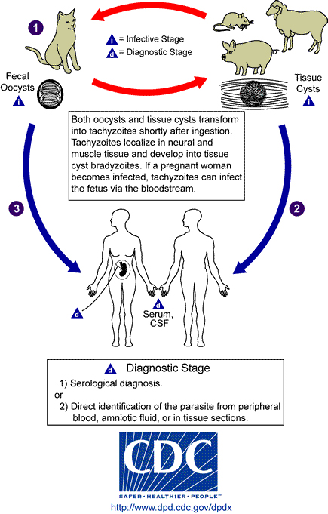
Toxoplasmosis
Toxoplasma gondii
Definitive host is the domestic cat
Contact with oocysts in feces
Ingestion of cysts (meats, garden products)
Can be transmitted from the mother to the baby

Slide 7
Epidemiolology
European countries (ie France, Greece)
Usually asymptomatic
Primary maternal infection in pregnancy
Infection (Transmission) rate higher with infection in 3rd trimester
Fetal death higher with infection in 1st trimester

Slide 8
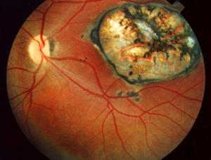
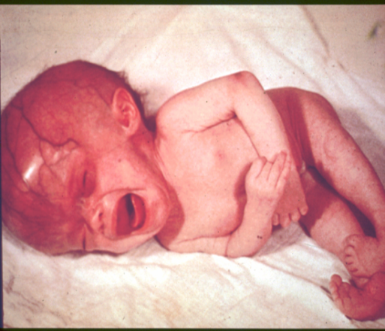
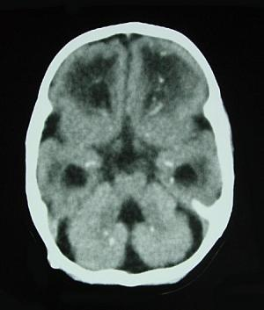
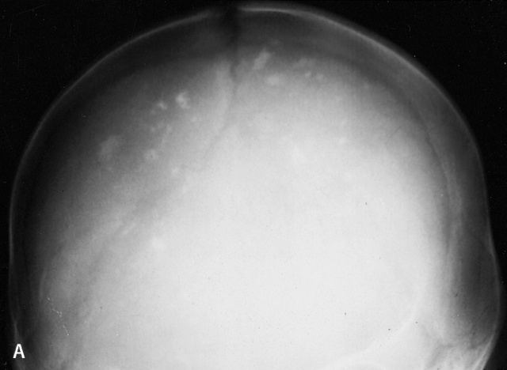
Clinical presentation
Mostly asymptomatic
Classic triad of symptoms:
Chorioretinitis
Hydrocephalus
Intracranial calcifications
Other symptoms include fever, rash, HSM, microcephaly, seizures, jaundice, thrombocytopenia, lymphadenopathy

Slide 9
Diagnosis , treatment and prevention
Diagnosis
Maternal serology IgM/IgA , IgG,
Fetal ultrasound/ tissue culture and PCR.
Newborn
Serology
Culture
PCR
Treatment
Spiramycin
Pyrimethamine and sulfadiazine
Prevention
Avoid exposure to contaminated food or water and undercooked meat
Hand washing

Slide 10
Syphilis
Treponema pallidum (spirochete)
Transmitted via sexual contact
Mother with primary or secondary syphilis
Typically occurs during second half of pregnancy

Slide 11
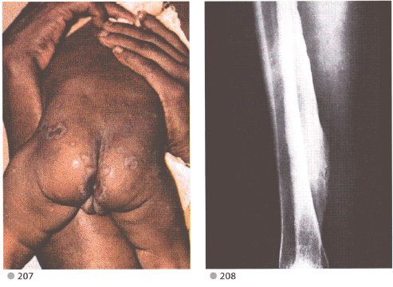
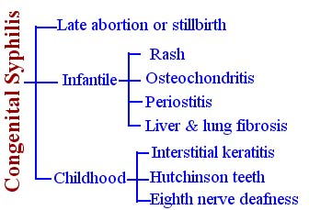
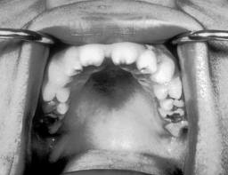
Clinical features
Intrauterine death in 25%
3 major classifications
and Funisitis (umbilical cord vasculitis)
Frontal bossing, Short maxilla, High palatal arch, Saddle nose , Perioral fissures
Notes:
Fetal: stillbirth, neonatal death, hydrops fetalis
Early congenital (typically 1st 5 weeks):Cutaneous lesions (palms/soles),HSM,Jaundice, Anemia, Snuffles, Periostitis and metaphysial dystrophy, Funisitis (umbilical cord vasculitis)
Late congenital: Frontal bossing, Short maxilla, High palatal arch, Hutchinson teeth, 8th nerve deafness, Saddle nose , Perioral fissures

Slide 12
Diagnosis and Treatment
Diagnosis
RPR/VDRL: non-treponemal test
MHA-TP/FTA-ABS: specific treponemal test
Confirmed if T. pallidum identified in skin lesions, placenta, umbilical cord, or at autopsy
Treatment
Penicillin G
Prevention
RPR/VDRL screen in ALL pregnant women early in pregnancy and at time of birth

Slide 13
Parvovirus P 19
Parvovirus P 19
Causative agent of Fifth disease (erythema infectiosum)
Spread by the respiratory route, blood and transplacental

Slide 14
Epidemiology
Most of the population is eventually infected.
Half of women of childbearing age are susceptible to infection.
Risk of fetal death highest when infection occurs during the second trimester of pregnancy (1st 20 wks of pregnancy (12%).
Minimal risk to the fetus if infection occurred during the third trimesters of pregnancy.

Slide 15
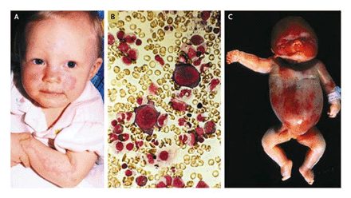
Clinical Faeture
Known to cause fetal loss through hydrops fetalis; severe anaemia, congestive heart failure, generalized oedema and fetal death
No evidence of teratogenecity

Slide 16
Diagnosis, and Treatment
Diagnosis
ultrasound
Serology IgM, persistant IgG
PCR
Traetment
intrauterine transfusions and administration of digoxin to the fetus.

Slide 17
Neonatal Varicella
90% of pregnant women already immune
Primary infection during pregnancy carries a greater risk of severe disease

Slide 18
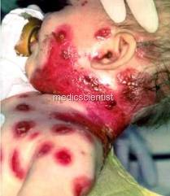
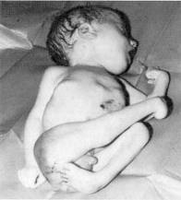
Clinical Features
First 20 weeks of Pregnancy
Up to 3% chance of transmission to the fetus, recognised congenital varicella syndrome;Scarring of skin, Hypoplasia of limbs, CNS and eye defects

Slide 19
Diagnosis
Test |  | Pregnant mother and Fetus | Neonate
Direct form the vesicles | Culture | + | +
 | DFA | + | +
 | PCR | + Fetal blood and amniotic fluid | +
Serology | IgM Rising IgG | + + | +
US and MRI |  | +

Slide 20
Treatment and Prevention
Acyclovir at first signs of varicella pneumonia
Pre-expoure;live-attenuated vaccines before or after pregnancy but not during pregnancy.
Postexposure Zoster immunoglobulin to susceptible pregnant women and infants whose mothers develop varicella during the last 5 days of pregnancy or the first 2 days after delivery and premature baby <28 wks of gestation

Slide 21
rubella
R=rubella
RNA enveloped virus, member of the togaviridae family
Spread by respiratory droplets and transplacentally

Slide 22
Epidemiology
Vaccine-preventable disease
No longer considered endemic.
Mild, self-limiting illness
Infection earlier in pregnancy has a higher probability of affected infant (first 12 wks 70% and 13-16 wks 20% and rare >16 wks of pregnancy)

Slide 23
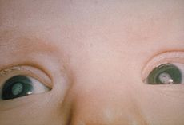
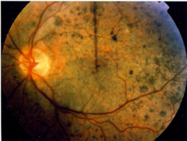
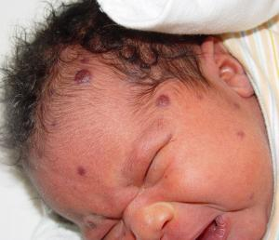
Clinical Features
Sensorineural hearing loss (most common)
Cataracts, glaucoma
“Salt and Pepper” retinopathy
Cardiac malformations
Neurologic (less common)
Others to include growth retardation, bone disease, HSM, thrombocytopenia, “blueberry muffin” lesions

Slide 24
Diagnosis
Maternal IgG is useless!
Viral isolation virus from nasal secretions, throat, blood, urine, CSF.
Serologic testing. IgM = recent postnatal or congenital infection.
Rising monthly IgG titers suggest congenital infection.

Slide 25
Treatment Prevention
Supportive care only with parent education
Prevention by immunization
Maternal screening
Vaccinate if not immune (avoid pregnancy for three months)

Slide 26
cytomegalovirus
C=cytomegalovirus
Most common congenital viral infection~40,000 infants per year.
Mild, self limiting illness

Slide 27
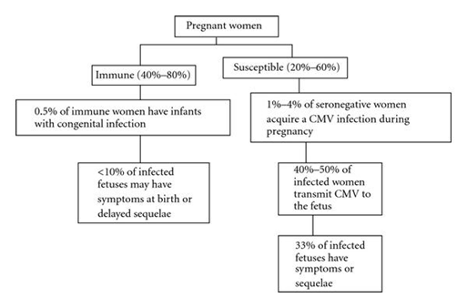
Epidemiology
Transmission can occur with primary infection or reactivation of virus but 40% risk of transmission in primary infection
Increased risk of transmission later in pregnancy but more severe sequalae associated with earlier acquisition

Slide 28
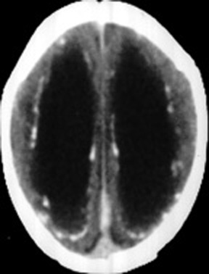
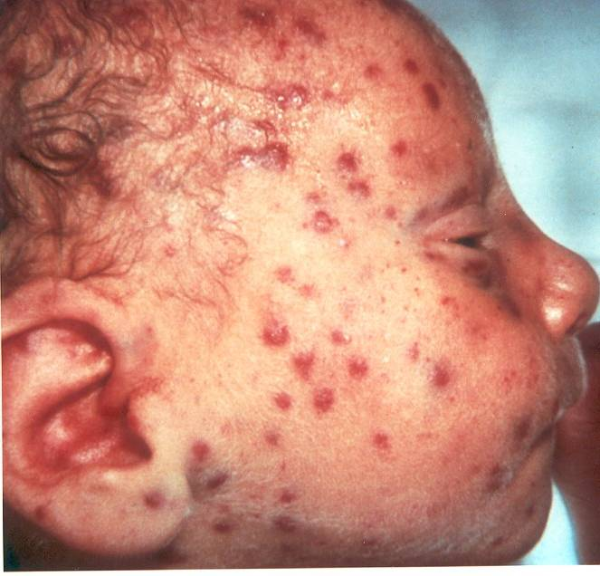
Clinical presentation
90% are asymptomatic at birth
Up to 15% develop symptoms later
Microcephaly, periventricular calcifications, neurological deficits, HSM, petechiae, jaundice, chorioretinitis
>80% develop long term complications: Hearing loss, vision impairment, developmental delay

Slide 29
Diagnosis
Maternal IgG shows only past infection
Viral isolation from urine or saliva in 1st 3 weeks of life
Viral load and DNA copies can be assessed by PCR
Detection of Cytomegalic Inclusion bodies in affected tissue
Serologies not helpful given high antibody in population

Slide 30
Treatment Prevention
Ganciclovir x6wks in symptomatic infants

Slide 31
herpes simplex
H=herpes simplex (HSV)
HSV1 or HSV2

Slide 32
Epidemiology
Primarily transmitted through infected maternal genital tract
Primary infection with greater transmission risk than reactivation
Rationale for C-section delivery prior to membrane rupture

Slide 33
Clinical presentation
Most are asymptomatic at birth
3 patterns of equal frequency with symptoms between birth and 4wks:Skin, eyes, mouth , CNS disease, Disseminated disease (present earliest)
Initial manifestations very nonspecific with skin lesions NOT necessarily present

Slide 34
Diagnosis and treatment
Diagnosis
Culture of maternal lesions if present at delivery
Cultures in infant
CSF PCR
Serologies is useless
Treatment
High dose of acyclovir

