Slide 1
Ethics of Medical Research
Professor Ahmed A. Adeel

Slide 2
Objectives
By the end of this lecture the student should be able to
Identify the main principles of medical research ethics.
Discuss the balance of research and clinical care.
Describe requirements of ethics review committees, including definition of informed consent.
Identify the key international and national references for the rules and regulations of medical research

Slide 3
Why do research in medicine ?
Monitoring and evaluation of drugs / treatments being used
The development of new treatments, especially drugs, medical devices and surgical interventions.
Understanding human physiology .
Understanding causes of diseases and the best ways to prevent or cure them.
Factors in human health, including patterns of disease (epidemiology),
The organization, funding and delivery of healthcare (health systems research),
Social and cultural aspects of health (medical sociology and anthropology),

Slide 4
Why do practicing physicians need a good understanding of medical research methods ?
All physicians make use of the results of medical research in their clinical practice.
To maintain their competence, physicians must keep up with the current research , they must know how to interpret the results of research and apply them to their patients.

Slide 5
Two potential problems for practicing physicians :
The physician’s primary responsibility is the health and well-being of the patient, whereas the researcher’s primary responsibility is the generation of knowledge, which may or may not contribute to the research subject’s health and wellbeing .
Conflict of interest when the physician is influenced by financial gains from research or results of the research.

Slide 6
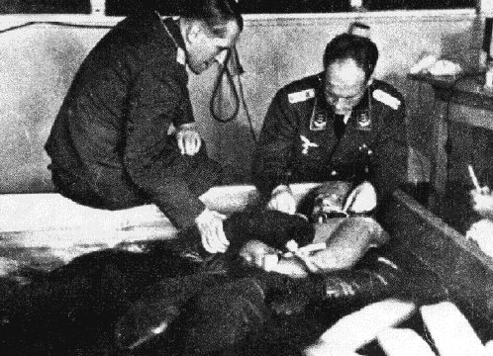
HISTORY : Development of codes of ethics for medical research , the Nuremberg Code
In During World War II , physicians in Nazi Germany and elsewhere performed research on subjects that clearly violated fundamental human rights.
The Nazis immersed their subjects into vats of ice water at sub-zero temperatures, or left them out to freeze in the winter cold. As the prisoners excreted mucus, fainted and slipped into unconsciousness, the Nazis meticulously recorded the changes in their body temperature, heart rate ,muscle response, and urine.

Slide 7
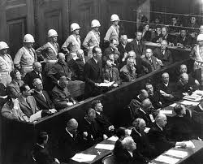
HISTORY : Development of codes of ethics for medical research , the Nuremberg Code
Following World War Two, some of these physicians were tried and convicted by a special tribunal at Nuremberg, Germany.
The basis of the judgment is known as the Nuremberg Code, which has served as one of the foundational documents of modern research ethics.
23 German doctors were charged with crimes against humanity for
experiments the defendants committed the murders, brutalities, cruelties, tortures,
atrocities, and other inhuman

Slide 8
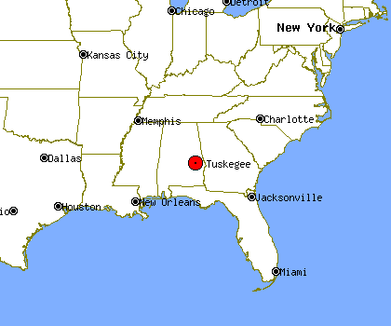
HISTORY : The Tuskegee Syphilis Study (1932-72)
“ the Tuskegee Study of Untreated Syphilis in the Negro Male ”
This clinical study that has become a symbol of unethical medical experimentation.

Slide 9
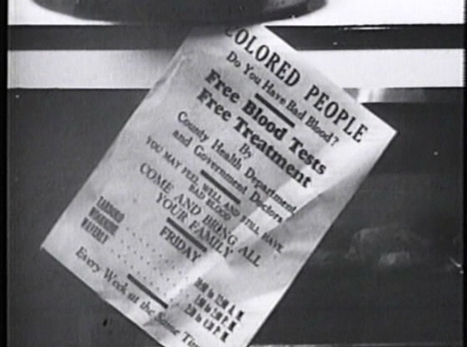
HISTORY : The Tuskegee Syphilis Study (1932-72)
Started in 1932 and involved nearly 400 poor and uneducated African-American men diagnosed with latent syphilis - meaning that they had the infection but showed no obvious symptoms at that stage.

Slide 10
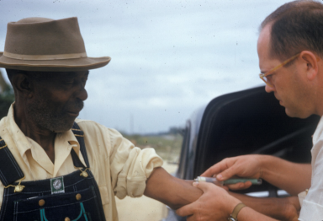
The Tuskegee Syphilis Study (1932-72)
For 40 years they were never told they had syphilis and were never treated for it, even when penicillin became a standard cure in 1947. They were simply told they had ‘bad blood’.
Among the aims of the study was to see whether syphilis affected black men differently from white men.

Slide 11
The Tuskegee Syphilis Study (1932-72)
For participating in the study, the men received free rides to and from the clinic at Tuskegee University, Alabama.
There they were given hot meals and free medical treatment for minor ailments. Any treatments they thought they were also getting for their ‘bad blood’ were actually placebos, aspirin or mineral supplements.
Medical staff allowed nothing to interfere with their work.
Even when 250 of the men were drafted for service in the Second World War, they remained part of the study.

Slide 12
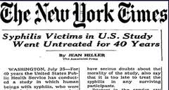
The Tuskegee Syphilis Study (1932-72)
When the study ended in 1972 following a public outcry, only 74 of the original participants were still alive.

Slide 13
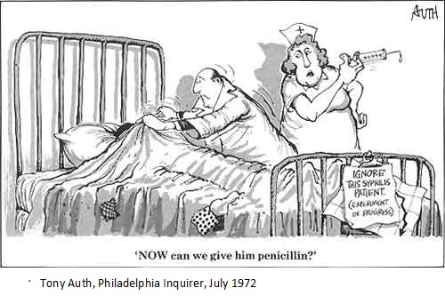
The Tuskegee Syphilis Study (1932-72)

Slide 14
The Tuskegee Syphilis Study
Only 74 men were still alive.
All rest had died of the disease or of related complications.
40 wives had been infected
19 children had been born with congenital syphilis.
Survivors eventually received financial compensation

Slide 15
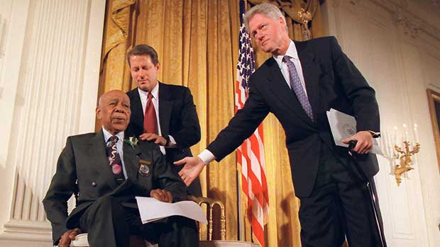
The Tuskegee Syphilis Study
1997 US President Bill Clinton was moved to declare that ‘on behalf of the American people, what the United States government did was shameful’

Slide 16
The Belmont Report 1979 Principles of research with human subjects
Principles of Research with Human Subjects:
• Respect for Persons
• Beneficence
• Justice
معاملة الإنسان كشخصية مستقلة له رأيه الحر دون إكراه
الإحسان و منع الإساءة كما يجب أن لآ يصيب الضرر الإنسان نتيجةللبحث
العدل في العبء و الفائدة المرجوة من البحث
http://ohrp.osophs.dhhs.gov/humansubjects/guidance/belmont.htm

Slide 17
The Belmont Report 1979 Principles of research with human subjects
Principles of Research with Human Subjects
• Respect for Persons
– individuals have autonomy and choice
– people can not be used as a means to an end
– provide protection to the vulnerable
– provide informed consent and privacy
• Beneficence
• Justice

Slide 18
The Belmont Report 1979 Principles of research with human subjects
Principles of Research with Human Subjects
• Respect for Persons
• Beneficence
–kindness beyond duty
– obligation to do no harm
– obligation to prevent harm
– obligation to do good
– minimize risks, maximize benefits
• Justice

Slide 19
The Belmont Report 1979 Principles of research with human subjects
Principles of Research with Human Subjects
• Respect for Persons
• Beneficence
• Justice
– treat all fairly
– share equitably burdens and benefits

Slide 20
Declaration of Helsinki (DoH)
Issued by World Medical Association (WMA) in 1964.
It was further revised in 1975, 1983, 1989, 1996, 2000 and 2008.
The DoH is a concise summary of research ethics. Other, much more detailed, documents have been produced in recent years on research ethics in general (e.g., Council for International Organizations of Medical Sciences, International Ethical Guidelines for Biomedical Research Involving Human Subjects, 1993, revised in 2002) and on specific topics in research ethics (e.g., Nuffield Council on Bioethics [UK],
The Ethics of Research Related to Healthcare in Developing Countries, 2002).

Slide 21
Declaration of Helsinki (DoH) Important points
(1) Ethics Review Committee Approval
Medical research on human subjects must be reviewed and approved by an independent ethics committee before it can proceed.
(2) Scientific Merit
Medical research involving human subjects must be justifiable on scientific grounds .
( 3) Qualified Researchers :
Medical research involving human subjects must be conducted by qualified researchers.
(4) Social Value
Medical research project should that it contribute to the wellbeing of society in general.
(5) Risks and Benefits
It is also necessary for the researcher to demonstrate that the risks to the research subjects are not unreasonable or disproportionate to the expected benefits of the research, which may not even go to the research subjects.
(6) Informed Consent
The first principle of the Nuremberg Code reads as follows: “The voluntary
consent of the human subject is absolutely essential.”

Slide 22
Declaration of Helsinki (DoH) Important points
(7) Confidentiality
Research subjects have a right to privacy with regard to their personal health information.
(8) Conflict of Roles
The physician’s role in the physician-patient relationship is over the researcher’s role ,even if the physician and the researcher are the same person.
(9) Honest Reporting of Results
Research results be reported accurately, but unfortunately there have been numerous recent accounts of dishonest practices in the publication of research results.
(10) Whistle-blowing
In order to prevent unethical research from occurring, or to expose it after the fact, anyone who has knowledge of such behaviour has an obligation to disclose this information to the appropriate authorities.

Slide 23
Declaration of Helsinki (DoH) Important points
(11) Justice
Equitable selection of participants, i.e., avoiding participant populations that may be unfairly coerced into participating, such as prisoners and institutionalized children. The principle of justice also requires equality in distribution of benefits and burdens among the population group(s) likely to benefit from the research.

Slide 24
Informed Consent الموافقة بعد التبصير
Definitions: Voluntary agreement given by a person or a patients' responsible proxy (e.g.a parent) for participation in a study, etc., after being informed of the purpose, methods, procedures, benefits, and risks. The essential criteria of informed consent are that the subject has both knowledge and comprehension, that consent is freely given without duress or undue influence, and that the right of withdrawal at any time is clearly communicated to the patient. Other aspects of informed consent in the context of epidemiologic and biomedical research, and criteria to be met in obtaining it, are specified in International Guidelines for Ethical Review of Epidemiologic Studies (Geneva: CIOMS/WHO 1991) and International Ethical Guidelines for Biomedical Research Involving Human Subjects (Geneva: CIOMS/WHO 1993).

Slide 25
What the research ethics committees look for in a research proposal
Scientific design and conduct of the study
Risks and potential benefits
Selection of study population and recruitment of
research participants
Inducements, financial benefits, and financial costs
Protection of research participants’ privacy and confidentiality
Informed consent process
Community considerations

Slide 26
Informed Consent الموافقة بعد التبصير

Slide 27
نظام أخلاقيات البحث على المخلوقات الحية Code of Ethics for Research on Living Creatures, KSA
The National Committee of Medical & Bioethics was approved by the Royal Decree on 18/5/1422H, to be headquartered at KACST in Riyadh. It consists of the following sub-committees:
The legal sub-committee.
The human research sub-committee.
The flora & animal sub-committee.
The education & media sub-committee.

Slide 28
نظام أخلاقبات البحث على المخلوقات الحية Code of Ethics for Research on Living Creatures, KSA

Slide 29
Case Studies in Medical Research Ethics Case 1
Mrs X , an 81-year-old Alzheimer's patient hospitalized under your care has been asked to participate in a clinical trial testing a new drug designed to help improve memory. You were present when the clinical investigator obtained a signed informed consent from Mrs X a few days ago. However, when you visit Mrs. X today and ask her if she is ready to begin the study tomorrow, she looks at you blankly and seems to have no idea what you are talking about.
What should you do?

Slide 30
Case Studies in Medical Research Ethics Case 1 Discussion
The competence of Mrs. X to give an ethically valid informed consent is in doubt. You should contact the primary investigator to discuss Mrs. X ‘s participation in the trial. There may be a surrogate who can give consent for her participation if it is deemed to be in her best interests. Although she may be considered a vulnerable research subject because of her mental status, Mrs. X does belong to the population the intervention is designed to assist, and her participation may benefit herself and other Alzheimer's patients. However, a careful balancing of risks and benefits should occur.

Slide 31
Case Studies in Medical Research Ethics Case 2 Question
After having completed a study that involved the collection of tissue from the subjects, an investigator wishes to perform additional analysis of the archived tissue samples. This nature of this analysis was not explicitly (صراحةً)stated in the original consent form. Should the investigator be required to obtain explicit consent for the new research?

Slide 32
Case Studies in Medical Research Ethics Case 2 Discussion
Institutional Review Boards (or research committees) have increasingly required that explicit consent be obtained, if practical, before archived tissue can used for research. Archiving samples for an unspecified “future use” without explicit consent undermines the autonomy of the participants. Even if participants may be willing in general to have surplus tissue used for research purposes, they should still be asked for their consent.

Slide 33
Case Studies in Medical Research Ethics Case 3 Question
University of British Columbia (UBC) medical genetics researcher Dr. Richard Ward
883 subjects provided blood samples for arthritis study on a Canadian ethic group
No conclusive results were obtained but the blood samples were used for other studies by the reseacher.
Samples were used without consent for genetic analysis
Results of genetic analysis suggested that the origin of the group was contrary to the group’s own understanding
What are the ethical issues in this case ?

Slide 34
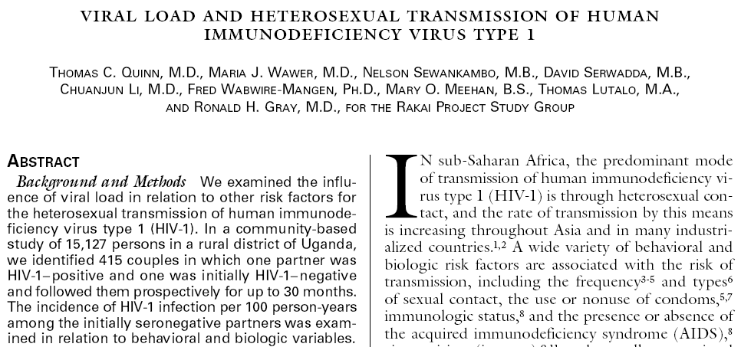
Case Studies in Medical Research Ethics Case 4 story

Slide 35
Case Studies in Medical Research Ethics Case 4 story
Goal of study to understand risk factors connected with heterosexual HIV transmission
Identified 415 couples in which one partner was HIV+ and other not
Followed up for 30 months
90 of HIV- partners seroconverted
No treatment offered for HIV+ participants
It was left up to HIV+ partner to determine whether their status was disclosed to their partner
What ethical issues do you see in this case?

Slide 36
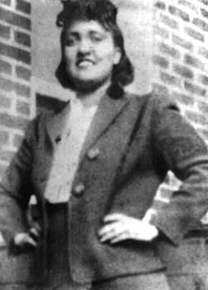
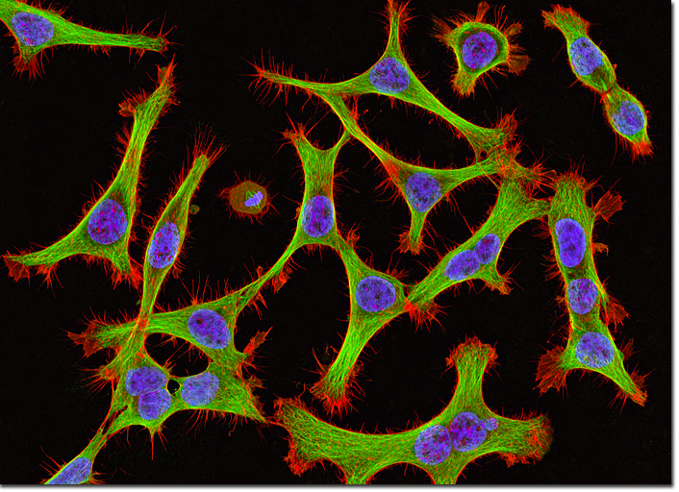
Case Studies in Medical Research Ethics Case 5 Story
Diagnostic test for of Henrietta Lacks reveals cervical cancer (1951)
Cancer cells are removed for research purposes without consent
Dr George Gey created the first immortal cell line “Hela Cells” , and they were widely shared
Creation of the cell line generated an increase in medical and biological research, including a vaccine for polio, cancer research, AIDS research, among others
The identity of Henrietta Lacks remained confidential until the 1970ies
After her identity was known, the family found out for the first time that Henrietta Lack’s cells were still “alive.”

Slide 37
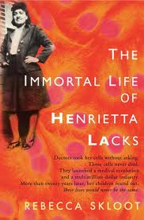
Case Studies in Medical Research Ethics Case 5 story
“The gist of the book, as I read it, is this: You have no legal property rights over your own cell tissue or anything it is used for after you visit a doctor's office. It is argued that this is necessary for the "good of mankind" - this generates research, vaccines, cures for diseases. However, after this free contribution is made, you do not have universal access to the scientific discoveries your tissues have afforded - you only have access to these discoveries if you can pay for them”

Slide 38
Selected references and guidelines
Guidelines
WHO Guidelines
Standards and operational guidance for ethics review of health-related research with human participants
Others:
Council for International Organizations of Medical Sciences
International ethical guidelines for biomedical research involving human subjects
Council for International Organizations of Medical Sciences
International ethical guidelines for epidemiological studies
World Medical Association
World Medical Association: Declaration of Helsinki

Slide 40
Group B
ABDULLAH ALSAHL
ABULAZIZ ALTUWAIL
FARIS BAKHISH
SUHAIL ALGHAMDI
ANAS ALZAHRANI
KHALID ANAZI
Group A
Omer REHBANI
HISHAM ALMOHEEZ
MOHAMED ALTOWAITA
ABDULRAHMAN ASKER

