Slide 1
Understanding and learning from errors and managing clinical risks

Slide 2
What is clinical risks ?
A clinical risk or healthcare risk is the chance of an adverse outcome resulting from clinical investigation, treatment or patient care.

Slide 3
Clinical risk management
Clinical risk management is a whole systems approach to identifying, assessing, evaluating, minimising and communicating risks associated with clinical activities in order to maximise safety for all parties

Slide 4
Why clinical risk is relevant to patient safety
clinical risk management specifically is concerned with improving the quality and safety of health-care services by identifying the circumstances and opportunities that put patients at risk of harm and acting to prevent or control those risks

Slide 5
4-step process to manage clinical risks
identify the risk
assess the frequency and severity of the risk
reduce or eliminate the risk
Reviewing the effectiveness of the assessment and action plan

Slide 6
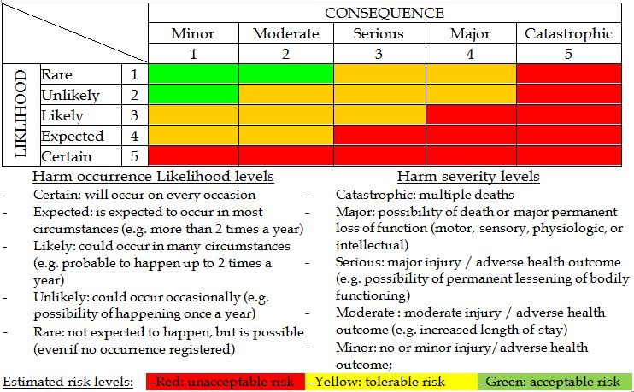
Clinical risk assessment tool

Slide 7
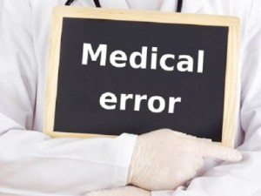
Medical error
Failure of planned action to be completed as intended
or
The use of wrong plan to achieve an aim

Slide 8
Types of errors
Sentinel events
Near miss
Adverse event
Medication errors

Slide 9
Near Miss:
incidence about to happen but by chance didn’t occur.
sentinel event:
A sentinel event is an unexpected occurrence involving death or serious physical or psychological injury
Medication Error:
is any preventable event that may cause or led to inappropriate medication use or patient harm.
Adverse event
defined as incidents in which harm resulted to a person receiving health care. They include infections, falls resulting in injuries,

Slide 10
How to capture error ?
Incident report
(OVR)
Patient complain

Slide 11
Incident report
is a form that is filled out in order to record details of an unusual event that occurs at the facility, such as an injury to a patient. the purpose of the incident report is to document the exact details of the occurrence while they are fresh in the minds of those who witnessed the event. this information may be useful in the future when dealing with liability issues stemming from the incident.

Slide 12
Patient complain
A complaint is defined as an expression of dissatisfaction by a patient, family member or carer
with the provided health care

Slide 13
KSUMC Reporting System
http://10.135.196.38/Datix/live/index.php

Slide 14
Analyzing incident
Root cause analysis(RCA)

Slide 15
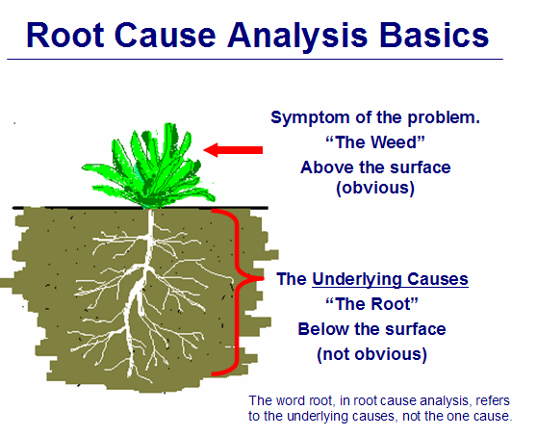
Root cause analysis (Fish bone analysis)
is an approach for identifying the underlying causes of why an incident occurred so that the most effective solutions can be identified and implemented

Slide 16
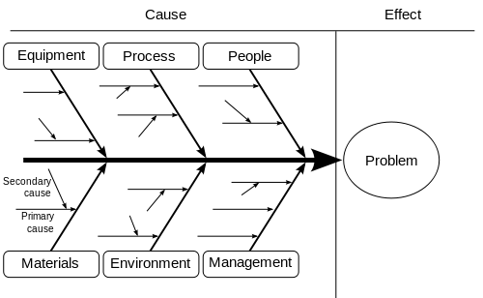
Fish bone analysis

Slide 17
Action plan and time frame
Objective (what) | Actions (how) | Responsible(who) | Timescale (when) | Progress (review regularly and sign off when completed)

Slide 18
Fitness to practice
When we say that someone is ‘fit to practice’ we mean that they have the skills, knowledge and character needed to practice their profession safely and effectively

Slide 19
Health-care services are required to check that a health-care professional has the right qualifications and experience to practise through different process:
credentialing
Accreditation
Registration

Slide 20
Credentialing
process of assessing and conferring approval on a person’s suitability to provide specific consumer/patient care and treatment services

Slide 21
Accreditation
is a formal process to ensure delivery of safe, high-quality health care based on standards and processes devised and developed by health-care professionals for health-care services

Slide 22
Registration (licensure)
Most countries require health-care practitioners to be registered with a government authority or under a government instrument
The principal purpose of a registration authority is to protect the health and safety of the public through mechanisms designed to ensure that health practitioners are fit to practise

Slide 23
Group exercise
Through incident reporting system quality management department t recognize tow major issues in the hospital
1- High volume of patient falls
2- medication error
Based on information you get from this lecture what is your plan to solve this problem ?

