Slide 2
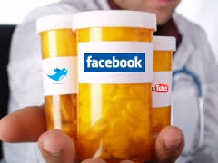
UNPROFESSIONAL BEHAVIOR
DR. KAMRAN SATTAR
MBBS. PGD MedEd UoD ( UK )
(MMed UoD ( UK )
Dept: of Medical Education,
College of Medicine
King Saud University

Slide 3
OBJECTIVES By the end of this lecture You should be able to;
Define unprofessional behavior
Identify various elements of human nature that contribute to unprofessionalism
Provide examples of such behaviors
Know how to avoid unprofessional behaviors.

Slide 4
Professionalism:
Attributes and behaviors that serve to maintain patient interests above physician self-interest.
It is the unconditional caring of the patient, putting others before self.
IT IS NOT WHAT WE DO BUT HOW WE DO IT THAT DEFINES MEDCIAL PROFESSIONALISM

Slide 5
Professional Attributes (A QUICK REVIEW)
Honesty/integrity
Openness
Reliability
Responsibility
Respect
Presence
Compassion/empathy
Competence
Commitment
Confidentiality
Autonomy
Self-improvement
Self-awareness / knowledge of limits
Communication /collaboration
Altruism/advocacy
Morality and ethical conduct
Self regulation
Teamwork

Slide 6
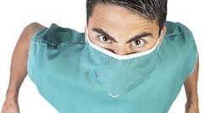
Can you recall a similar experience such as this ?

Slide 7
Scenario 1
A senior doctor, head of a high profile department, is known to bring in research dollars, to be very hard working and adept at specialized medical procedures. S/he is well known for shouting at nurses, throwing instruments back at them, and humiliating junior medical staff. S/he is often absent from department, Complaints are made to hospital administration from staff members; increased numbers of "critical incidents" and staff resignations are noted.

Slide 8
Scenario 2
A general practitioner is consistently late or absent for pre-scheduled sessions. S/he gives no explanation, leaving the partners to fill in and make excuses. When confronted, s/he becomes abusive in front of office staff and patients.

Slide 9
Scenario 3
A final-year medical student has caused disruptions throughout the course by monopolizing time in tutorials, behaving inappropriately with patients and being unwilling to heed advice. Many patients refuse to be interviewed by her/him and have complained to staff. S/he has not failed any exams, but several tutors and nurses have raised concerns about the student's "attitude" and ability to work as an intern.

Slide 10
Scenario 4
A 54 year old male patient is admitted for the fourth time in two months for complaints of severe ridiculer pain following several attempts at decompressive back surgery. His pain has been sub-optimally controlled with very high-dose narcotics and other adjuvant pain-management medications. The nursing staff take his vital signs at the start of every shift but otherwise only appear when his medications are due or he rings the call bell. The pain waxes and wanes but is so severe at times that he cries out. The medication orders for breakthrough pain is ineffective. When he tells one nurse this, she responds, sighing, :you have had your medication and you’ll just have to wait three hours for your next does. I’m going on break, so don’t bother me by ringing the bell”

Slide 11
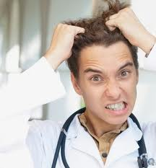
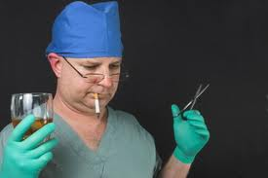
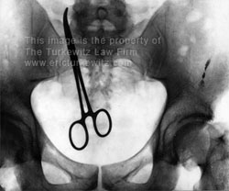

Slide 12
What is Unprofessionalism?
Not pertaining to the characteristic of a profession.

Slide 13
Medical Unprofessionalism:
Do not have to wait until patient dies to determine that medical care suffered.

Slide 14
Unprofessional behavior:
Increased workplace difficulties
Decreased morale in other staff
Decline in patient care

Slide 15
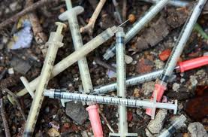
Unprofessional behavior: In general terms, acts that may be characterized as “unprofessional” fall into five categories:
1. Illegal or criminal acts
2. Immoral acts
3.Business related acts
4. Acts that violate acceptable medical practices
5. Plagiarism

Slide 16
1. Illegal or Criminal acts:
A physician may be disciplined and lose his medical license based solely on the fact that he was convicted for a crime or offense.

Slide 17
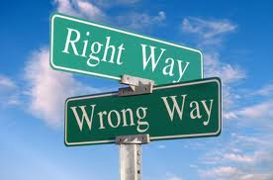
2. Immoral acts:
“Immoral” acts generally fall into the limited category of sexual activity with individuals that may be patients.

Slide 18
:3. Business related acts
These acts are related to the operation of the business, not the quality of the care
Obtain, maintain, or renew a license to practice medicine by bribery, fraud or misrepresentation

Slide 19
4. 2. Negligent practices
Failure to maintain records of a patient, relating to diagnosis, treatment and care
Altering medical records
Failure to make medical records available for inspection

Slide 20
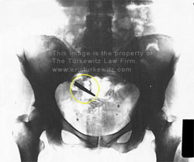
Negligent practices
Surgical mistakes/errors

Slide 21
5. Plagiarism
Is an unethical, dishonest act whereby an individual uses the work of another, commit literacy theft, or present work as an original idea without crediting the source or stating that it is derived from an existing source.

Slide 22
5. Plagiarism cont
Types of plagiarism:
Using data for example statistics, graphs, and drawings without acknowledging sources
Repeating another person’s apt phrase without acknowledgement
Using another person’s sentences or arguments as if they were your own.
Presenting another person’s idea, opinion, or theory in the development of an argument as though it is your own.

Slide 23
Unprofessional physician
Impaired
Disruptive behavior
Dishonest
Greedy
Abuses power
Lacks interpersonal skills
Conflict of interest
Self-serving

Slide 24
Impairment:
Impairment means more than making incorrect diagnosis.
1. Avoidance of patients and their psychological needs
2. Dehumanized care
3. Inappropriate treatment

Slide 25
Disruptive behavior
Include repeated episodes of:
Sexual harassment
Racial or ethnic slurs
Intimidation and abusive language
Persistent lateness in responding to calls at work

Slide 26
Early warning signs
Late or incomplete charting
Delayed or no responses to call or pagers
Abusive treatment of staff
Unkempt appearance and dress
Inability to accept criticism
Gender or Religious bias bias

Slide 27
Complaints as indicators of unprofessional behavior
20–25% apparently disappoint their patients
More than 2/3 of physicians never or very rarely generate patient complaints (Hickson et al. 2002, 2007a,2007b).
A total of 6% of doctors, however, received 25 or more complaints over a 6-year period
Nurse surveys suggest that 4–5% of physicians display such behavior
(Diaz & McMillin 1991; Rosenstein and O’Daniel 2005a)

Slide 28
The eyes and ears of patients, visitors and healthcare team members are considered to be the most effective surveillance tools for detecting unprofessional behavior.

Slide 29
How should we deal with such behavior?
Dealing with unprofessional behavior
Surveillance
Registration

Slide 30
Disruptive behavior pyramid
No change
Vast majority of doctors: no professionalism issues
Single ‘unprofessional’ incident
Apparent pattern
Pattern persists

Slide 31
What does formalizing a response need?
Cost
Time
Formalizing a response

Slide 32
عن أبي تميم بن أوس رضي الله عنه ، أن النبي صلى الله عليه وسلم قال : ( الدين النصيحة ، قلنا : لمن يا رسول الله ؟
قال : (الله ، ولكتابه ، ولرسوله ، ولأئمة المسلمين وعامتهم رواهالبخاري ومسلم
Abu Tameem ibn Aws may Allah be pleased with him, that the Prophet peace be upon him said: (Debt advice, we say: To whom, O Messenger of God? Said: (Allah and His Book, His Messenger, the leaders of the Muslims and their common folk Ruahalboukhara and Muslim
Notes:
IN THE FOURTH LINE “ ALLAH “

Slide 33
Summary
Not pertaining to the characteristic of a profession.
Unprofessional behavior fall into five categories:
Illegal or criminal acts
Immoral acts
Business related acts
Acts that violate acceptable medical practices
Plagiarism
Do not have to wait until patient dies to determine that medical care suffered.

Slide 34
FOR YOUR READING
Unprofessional Behavior among Medical Students
http://www.nejm.org/doi/full/10.1056/NEJMc060089
Unprofessional physicians http://www.ncbi.nlm.nih.gov/pmc/articles/PMC1237990/pdf/westjmed00257-0121.pdf
Unprofessional or Disruptive Conduct by Physicians
http://macmedlaw.hubpages.com/hub/Unprofessional-or-Disruptive-Conduct-by-Physicians
The Unprofessional Student Objectives Professionalism
web1.aapa.org/10ACSyllabi/1509UnprofessionalStudent.pdf

Slide 35
TOUGH TIMES DONT LAST TOUGH PEOPLE DO

Slide 36
THANK YOU VERY MUCH
& &

