Slide 1
Unprofessional Behavior
Hala Kfoury Kassouf MD, KSUF, FRCPA, EBP
Associate Professor of pathology
Consultant Pathologist
Laboratory Services
King Saud University
King Khaled University Hospital

Slide 2
World Health Organization
5-Star Doctor
  Care Provider
  Decision Maker
  Communicator
  Health Advisor and Community Leader
  Team Member

Slide 3
Unprofessional Behavior
7 Roles of the Physician
  Medical Expert (clinical decision-maker)
  Communicator (educator, humanist, healer)
  Resource Manager
  Health Advocate
  Learner
  Scientist/scholar
  A person

Slide 4
Unprofessional Behavior
Key Elements of a Good Physician
  Altruism
  Accountability
  Excellence
  Duty
  Honor/Integrity
  Respect for Others

Slide 5
Unprofessional Behavior
Professionalism is the basis of Medicine’s contract with society.
Allows for trust to be established.
3 General Principles
  Patient Welfare
  Patient Autonomy
  Social Justice

Slide 6
Unprofessional Behavior
11 Professional Responsibilities
  Professional Competence
  Honesty
  Patient Confidentiality
  Appropriate Relations with Patients
  Cooperation and Collegiality
  Open and Honest Relationships with Colleagues and 3rd parties

Slide 7
Unprofessional Behavior
11 Professional Responsibilities, cont’d
  Improving the health of the community
  Improving access to care
  Scientific Knowledge
  Maintaining trust by maintaining conflicts of interest
  Professional Responsibilities

Slide 8
“[Professionalism] demands placing the interests of patients above those of the physician”

Slide 9
Unprofessional Behavior
A Case of : Never on Wednesday

Slide 10
Unprofessional Behavior
Daughter reported: “The doctor my mom was to see entered the ED acting agitated… talked down to girl at desk: “Answer my questions immediately with a yes or no…don’t need any extra conversation…I’m here to see one of my patients.” Receptionist replied “no,” and said, “but there’s the consult we called about.” Dr. became even more upset…

Slide 11
Unprofessional Behavior
“Sensing that the doctor was in a hurry, I said that my mom was ready to be seen. Dr. whirled toward me, made a “T” sign with his hands and barked, ‘Time out! It’s not your turn to talk!’ Turning back to the receptionist, he demanded, ‘Who consulted me?...’”

Slide 12
Unprofessional Behavior
“Dr. yelled so the whole area could hear, ‘You didn’t do anything wrong. The staff did!...You need to go where they know what they are doing…I don’t do consults on Weds… months before I can book you an appt.’”
“Then he turned and left me standing there. I don’t think that was very professional.”
What might a member of your team do if they
witnessed this event?

Slide 13
Unprofessional Behavior
1- Abuse of power (abuse while interacting with patients and colleagues; bias and sexual harassment; and breach of confidentiality);
2- Arrogance (offensive display of superiority and self-importance);
3- Greed (when money becomes the driving force);

Slide 14
Unprofessional Behavior
4- Misrepresentation (lying, which is consciously failing to tell the truth; and fraud, which is conscious misrepresentation of material fact with the intent to mislead);
5- Impairment (any disability that may prevent the physician from discharging his/her duties);

Slide 15
Unprofessional Behavior
6- Lack of conscientiousness (failure to fulfill responsibilities);
7- Conflicts in interests (self-promotion/ advertising or unethical collaboration with industry; acceptance of gifts; and misuse of services – overcharging, inappropriate treatment or prolonging contact with patients).

Slide 16
Definition of Disruptive Behavior (DB)
Behavior that interferes with work or creates a hostile environment, e.g.:
verbal abuse, sexual harassment, yelling, profanity, vulgarity, threatening words/actions;
unwelcome physical contact; threats of harm; behavior reasonably interpreted as intimidating;
passive aggressive behaviors: e.g., sabotage and badmouthing colleagues or organization
behavior that creates stressful environments and
interferes with others’ effective functioning

Slide 17
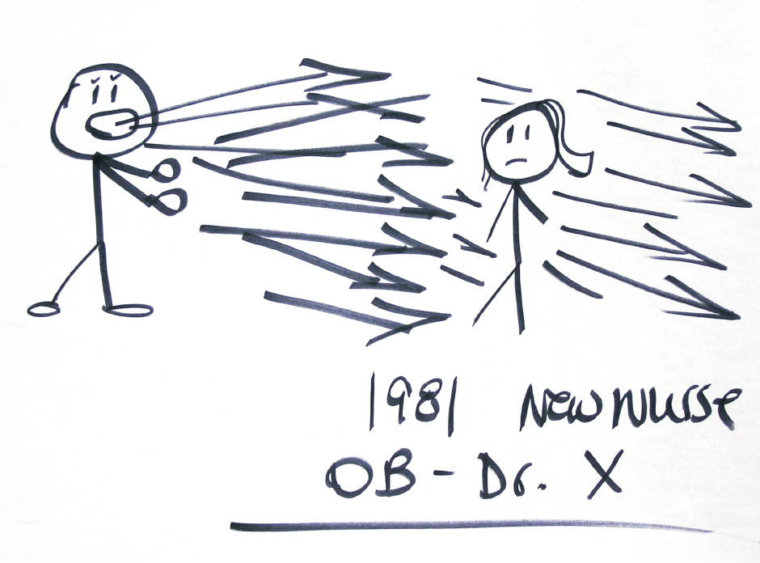
Unprofessional Behavior

Slide 18
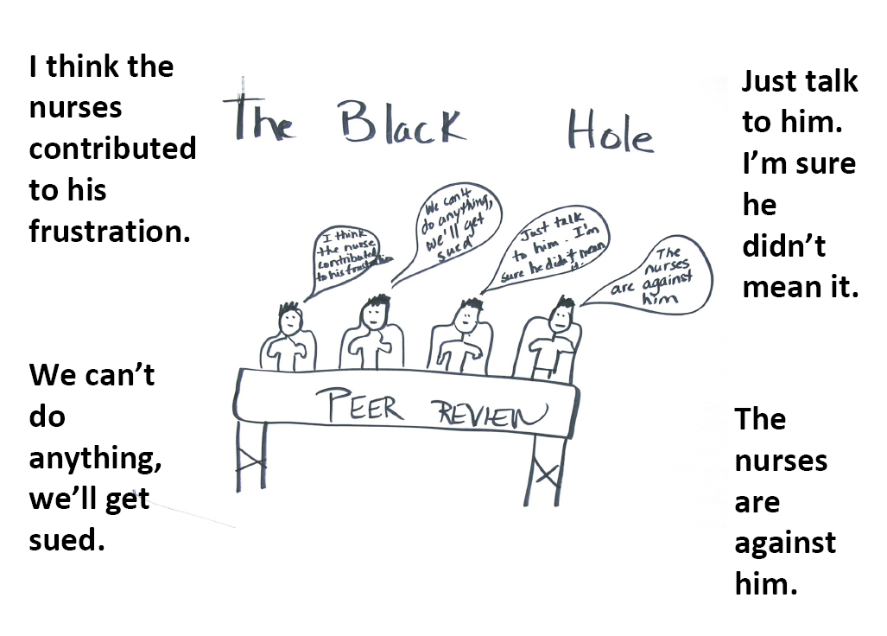
Unprofessional Behavior

Slide 19
Unprofessional Behavior
1. Leadership commitment
2. Supportive institutional policies
3. Surveillance tools to capture pt/staff allegations
4. Model to guide graduated interventions
5. Processes for reviewing allegations
6. Multi-level professional/leader training
7. Resources to help disruptive colleagues
8. Resources to help disrupted staff and patients

Slide 20
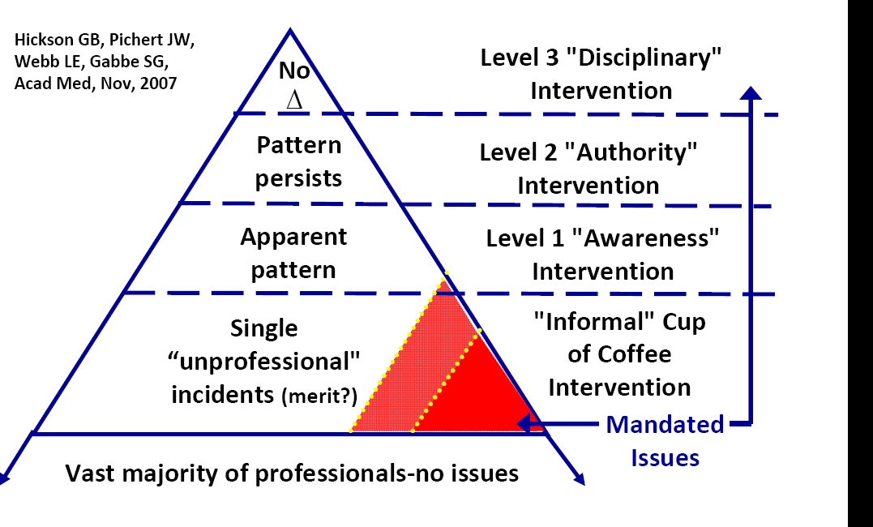
Disruptive Behavior Pyramid

Slide 21
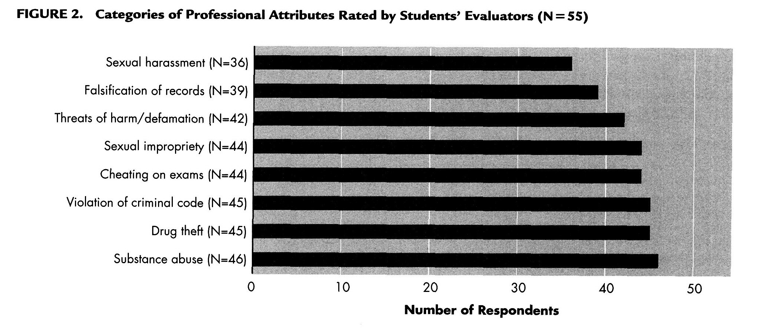
Unprofessional Behavior
Notes:
student

Slide 22
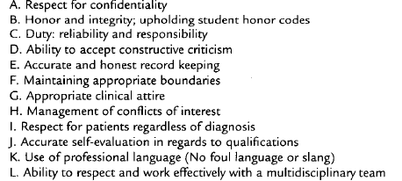
Unprofessional Behavior
Notes:
student

Slide 23
How can I make professionalism more concrete for learners?
§ Describe professionalism, or lapses of it, in terms of specific behaviors.
§ Categorize levels of professionalism and describe examples for each level.
§ Review professionalism scenarios

Slide 24
Unprofessional Behavior
Scenarios :
1- Lymph nodes Dissection: Colonic resection for adenocarcinoma
2- Review of cases signed by another pathologist.
3- Signing out cases
4- Orientation of specimens

Slide 25
Unprofessional Behavior
5- Pathology request
6- Autopsy
7- Payment form a physician
Notes:
Fracture site
Gallbladder

Slide 26
Unprofessional Behavior
8- FNA thyroid

Slide 27
Unprofessional Behavior
Conclusion

