Slide 1




Professionalism
All lectures in one file
Thanks to all team members:
Reema Alrasheed
Malak Alkhathlan
Elham alghamdi
Maha alrabiah
Meshael hussain
Nada alamri
Sarah alsalman
Sarah almubrik
Correction File

Slide 2
1
What does Professionalism mean?
-Different sources
Difinitions, key elements, attributes and general concepts
Profession is an occupation whose core elements is work, based on the mastery of a complex body of knowledge and skills. Oxford English Dictionar
Profession is the conduct, aims, or qualities that characterize a person in a work setting or profession

Professionalism “constituting those attitude and behaviors that serve to maintain patient interest above physician self-interest.” American Board of Internal Medicine
Professionalism is exhibited by one of the professional character, spirit , methods or the standing practice , or methods of a professional as distinguished from an amateur’’. American College Dictionary
Professionalism has three main discourses/characteristics
1) Individual 2) Interpersonal 4) Societal
MEDICINE:
is a vocation in which a doctor’s knowledge, clinical skills ,and judgment are put in the service of protecting and restoring human well-being.
This purpose is realized through a partnership between a patient and doctor, one based on mutual respect ,individual responsibility and appropriate accountability.
what is medical professionalism?
Medical professionalism is the ‘heart and soul of medicine’. More than adherence to a set of medical ethics; it is the daily expression of what originally attracted them to the field –a desire to help people and to help society as a whole by providing quality health care.
Professionalism in medicine
Professionalism embodies the relationship between medicine and society as it forms the basis of patient –physician trust. It attempts to make tangible certain attitudes, behaviors, and characteristics that are desirable among the medical profession.

Slide 3
Why professionalism is important?
Medical professionalism sets out three principles: ethical principles, knowledge and skills & selflessness
Being productive.
Effective management of relationships.
Handling conflicts.
Being an ambassador.
Being mission-minded.
Being able to know and avoid the unprofessional behavior.
Professionalism key elements
Professional Values (Six Columns of the building) | Key bases of professionalism (Four steps of the building)
Excellence. Humanism. Respect. Accountability. Altruism. Integrity and justice | Ethical and Legal Boundaries. Communication and Interpersonal Skills. Continuous Learning and Self Development. Clinical Competence (Knowledge and Skills)
Professional Attributes:
Confidentiality | Keeping conversations between doctor and patients unrevealed.
Trustworthiness | Deserving trust or confidence.
Honesty | Being truthful in representing facts.
Loyalty | Unfailing fulfillment to one’s duties and obligations.
Reliability | Keeping your word, honoring your commitments.
If You Have Any Questions Or Comments Please Inform Us:
professionalism434@gmail.com

Slide 4
Professionalism key elements:
Key elements | Example
Excellence ( a talent or quality that is unusually good and surpasses ordinary standards) | 1)Time management /Punctuality 2) Positive attitude ( enjoy work). 3) Commitment to lifelong learning, to exceed ordinary expectations. 4) Confidentiality. 5) Consider the language and culture of work. 6) Give the best of your talents and skills. 7) Recognition of professional limits 8) Protection of life 9) Prioritization 10) development in commitment, communication, interpersonal relationship, ethics and more .
Humanism is a way of being. It comprises a set of deep-seated personal convections about one’s obligations to others especially others in need | 1) Empathy & Compassion. 2) Encouragement. 3) Support. 4) Love and care. 5) Positive attitude. 6) Values and integrity.
Respect | 1) Respect patients, patients’ families, colleagues, and other healthcare professionals. 2) Treat patients with dignity and respect. 3) Demonstrated good attitude and effective communication. 4) Respect all patients in the same way regardless to their social status.
Accountability | 1) Accept responsibility. 2) Always consider confidentiality. 3) Work on resolving conflicts. 4) Avoid the business of blaming others, circumstances or how much you are busy 5)Addressing the health needs of the public 6) Adhering to medicine’s precepts.
If You Have Any Questions Or Comments Please Inform Us:
professionalism434@gmail.com

Slide 5
Altruism To go beyond the call duty to help meeting the needs of others. In other words, to put the duty and patient care ahead of your own needs. The sense of “giving” of oneself in patient care. | 1) Put the patient first. 2) Avoid any conflict between your needs and the patients’ rights. 3) Give full commitment to your patient. 4) Avoid any financial or relationship biases that could have any negative impact on the patient-doctor relationship
Integrity and Justice •Highest standards of behaviour.( Being fair, honest and truthful) -•Avoidance of relationships that allow personal gain to supersede the best interest of patients. | 1) Be a principle-based person. 2) Be honest, and stand by your words. 3) Be fair. 4) Do not abuse your position/authority. 5) Do what you say. 6) Behave in a good manner whether you are watched or not. 7) Adhere to good work-place ethic
Take Home Massege
Although there are common key elements in the definition of professionalism that must be fulfilled, the definition might varies depending on culture, law, and community needs.
Sources for defining professionalism might include: literature, published research papers, legal and ethical documents, as well as disciplinary action documents in the hospital, and workplace. These documents are confidential.
The definition components (key elements) should clearly define the unwritten contract between a doctor and patients.
The definition of professionalism is the benchmark that we could use to check our performance and could help us to direct our goals for continuous improvement
It is also the measure that could be used to assess our performance by our patients, colleagues, and the profession.
If You Have Any Questions Or Comments Please Inform Us:
professionalism434@gmail.com

Slide 6
Accountability
Definition:
Procedures and processes by which one party justifies and takes responsibility for its activities.
It comprises:
responsibilities to patients.
patient-physician relationship.
responsibilities to colleagues.
responsibilities to the profession.
responsibilities to the society and public.
2
Key components of accountability: (Meanings of accountability)
Responsibility | 1) That means to become responsible (accountable) to patients, their families, society & community. 2) To become accountable for quality of care, resolving conflict, and upholding principles.
Self-regulation in activities | This means that physicians’ actions and behavior should reflect legal, good ethical conduct, and no financial conflict in their performance.
Standard setting for current and future members of the profession | Accountability is about our willingness to maintain these professional standards in our day-to-day practices.
Ability to resolve conflict | Conflict might be financial, pharmaceutical. There is a need to disclose any conflict that could damage doctor’s accountability.
Free acceptance of duty to serve public | A doctor is accountable for improving the standards of the health care of their community, their country and worldwide.
Explain and give reasons for actions that could have caused harm to the patient, colleagues, and community | A doctor is accountable for actions that could cause harm to the patient, colleagues, and community.
If You Have Any Questions Or Comments Please Inform Us:
professionalism434@gmail.com

Slide 7
why do we need accountability?
Accountability is the key for providing optimal health care services.
Accountability enables continuing improvements in the health care system at its different levels.
Accountability helps in protecting the rights of patients.
Accountability is essential in resolving conflicts.
Accountability is essential for building trust, and ensuring that the workplace environment is safe and healthy.
Accountability reflects behaviour and attitude of responsible people.
Responsible style:
Promise only what can be delivered: Commitment ,delivered on time, accountability.
Support the basic tents of the profession: Develops a philosophy and sound rationale for professional practice.
Thinks before reacting: Foresees possible outcomes of professional actions.
Evaluates his/her professional practice: Confronts discrepancies between intentions and actions.
Why accountability is important to learn by medical students?
Social accountability for medical students is needed as behavior and as a practice and not needed as knowledge.
Social Accountability of Medical Students:
To enhance the health of people by educating physicians (e.g., prevention and early detection of diseases) & medical students; by conducting research in clinical and basic medical sciences and working with a research team conducting such studies.
By promoting the skills and attitudes of lifelong learning.
Preparation of future doctors to respond to population needs.
By committing your self to volunteer work that help in improving health care and awareness about diseases in the community.
If You Have Any Questions Or Comments Please Inform Us:
professionalism434@gmail.com

Slide 8
Initiative (Read only)
Definition:
The action of creating or starting.
To make a conscious effort to do things without being told to and to find alternatives if an option is not possible.
Characteristics of an Initiative:
People with initiative character are starters and self-motivators.
Have the ability to begin or to follow energetically with a plan or task.
Took the initiative in trying to solve the problem.
Have the power to or right to introduce a new legislative measure.
Altruism
What does altruism mean?
To go beyond the call duty to help meeting the needs of others. In other words, to put the duty and patient care ahead of your own needs. The sense of “giving” of oneself in patient care.
The roots of the word “altruism” is from the Latin word alter, meaning “other”, meaning to look after others and help them.
What are the key elements in altruism?
Donate time to humanitarian causes such as Medicine Sans Frontieres (Doctors with no borders).
Help or treat patients who are poor or cannot afford the costs of the service.
Going beyond the call of duty to help patients.
Show selfless behaviour and the willingness to serve others, particularly those in need.
Unselfish concern for the welfare of others.
Subordinate your own interest to the interest of others.
Trustworthiness (Read only)
The corner stone of the practice of medicine
Definition:Deserving of trust or confidence.Synonyms: true, accurate, honest, faithful
The demonstration of compassion, service and altruism that earns the medicine profession the trust of the public.
Trustworthy people keep their promise, are honest, reliable, principled and never inappropriately betray a confidence.
It embodies FOUR ethical principles:
A- Integrity B- Honesty C- Promise – Keeping D- Loyalty

Slide 9

A-Integrity
*Walk the Talk when it comes to Integrity*
The most important factor in trust.
Integrity carries the sense of wholeness: a person of integrity like a whole number, is a whole person, undivided, complete.
Integrity is doing the right thing when no one is watching. represented by a number of values such as honesty, trustworthy, fairness, and no favoritism.
Meaning in more details:
Highest standards of behaviour.
Refusal to violate one’s personal professional codes.
Being fair, honest and truthful.
Keeping one’s word.
Avoidance of relationships that allow personal gain to supersede the best interest of patients.
Not working in the darkness or involved in any behaviour that aims at harming others or taking their rights without their knowledge.
Person with integrity: (More info)
Listen to his consciences and live by his principles no matter what others say and no matter the personal cost.
Is honorable and upright in all actions.
Has the courage to do what is hard or costly or failure is probable.
Build and guard his reputations.
Don’t do anything he feels is wrong.
Don’t lose heart if he fails.
If You Have Any Questions Or Comments Please Inform Us:
professionalism434@gmail.com

Slide 10
B-Honesty (The whole page, Read only)
✔ | x
Being honest in our conduct means playing by the rules and being trustworthy of another’s property and belongs. | Dishonest conduct by ways of cheating can come in many forms, such as trickery, fraud , misleading ,deliberately violating the rules, and swindling.
Two types of honesty:
Communication Honesty: Being truthful in representing facts and intentions to the best of one’s knowledge. Sincerity and candor. | Conduct Honesty: o Cheating 1- Using unauthorized materials to achieve better grade. 2- Falsification or invention of any information. 3- Attempting to help another person in an act of cheating. o Plagiarism (Submitting an assignment as if it were one’s own work). 1- Submitting a work that is purchased or obtained from internet source. 2- Incorporating a word or ideas of an author into one’s paper without acknowledging the original source.
C-Promise Keeping
A vital moral aspect of reliability.
Promise is a vow, pledge, a declaration assuring that one will or will not do something.
o Two areas of promise keeping:
Good work habit: complete our job /task
Reliability: being dependable e.g. Return what you borrow, pay your debts, show up on time, and be prepared.
D-Loyalty
This could be loyalty to an oath, one’s family, and our country.
It implies the unfailing fulfillment to one’s duties and obligations and strict adherence to vow or promise.
Trustworthiness in medicine
Physicians are expected to make patients’ needs the first priority.
Physicians should consider their contributions to their individual patients, to their own practice, the community and the health care system.
If You Have Any Questions Or Comments Please Inform Us:
professionalism434@gmail.com

Slide 11
Physician should (Read only)
Demonstrate professional competence
Be aware of their deficiencies.
Obtain help when needed.
Be honest and communicate information in complete confidence.
In communications with the community, physicians must ensure that representations they make are to the best of their knowledge and truthful.
Take Home Message
Accountability = Responsibility.
To be accountable you need to have self-regulation in your day-to-day actions.
Accountability requires that we maintain standard setting.
Accountability requires that we resolve conflicts (financial, ethical, moral, pharmaceutical etc).
Altruism means putting the patient’s healthcare needs ahead of yours.
Integrity is not about talking or claiming great values that you know or have. Integrity is about demonstrating that the values you hold you are applying in your day-to-day practice.

Slide 12
patient saftey
Definition:
The IOM Institute of medicine defines patient safety as “the prevention of harm to patients".
The Canadian Patient Safety defines patient safety as “the reduction and mitigation of unsafe acts within the healthcare system, as well as through the use of best practices shown to lead to optimal patient outcomes
The World Health Organization’s (WHO) defines patient safety as , “the reduction of risk of unnecessary harm associated with healthcare to an acceptable minimum. (WHO, World Alliance for Patient Safety 2009)
Introduction
Significant numbers of patients are harmed due to their health care, either resulting in permanent injury, increased length of stay (LOS) in health-care facilities, or even death.
44 – 98,000 deaths annually caused by medical error.
There are more deaths annually as a result of health care than from road accidents, breast cancer and AIDS combined.
Recent financial estimates suggest that adverse events cost the Uk £2 billion in 2000 in extra hospital days alone. Other costs, such as suffering of patients, their families and the health care workers involved, are incalculable.
3+18
If You Have Any Questions Or Comments Please Inform Us:
professionalism434@gmail.com

Slide 13
Patient saftey dimensions of heathcare quality
The 6 key dimensions of healthcare quality
Safe | Avoiding injuries to patients from the care that is intended to help them.
Timely | Reducing waits and avoid harmful delays sometimes unfavorable delays for both those who receive and those who give care.
Effective | Providing services based on scientific knowledge to all who could benefit and refraining from providing services to those not likely to benefit (avoiding underuse and overuse). Doing the right thing for the right person at the right time.
Efficient | Avoiding waste, in particular waste of equipment, supplies, ideas and energy.
Equitable Equal | Dealing fairly and equally with all patients ,care should not in quality because patient personal characteristic such as gender. Providing care that does not vary in quality because of personal characteristics such as gender, ethnicity, geographic location and socio-economic status
Patient centered Family- centered | Should be respectful to patient need & values. Providing care that is respectful of and responsive to individual patient preferences, needs and values, and ensuring that patient values guide all clinical decisions.
If You Have Any Questions Or Comments Please Inform Us:
professionalism434@gmail.com

Slide 14
Harm VS Error
Harm | Error
Impairment of structure or function of the body and/or any deleterious effect arising from interaction with health care. Harm includes disease, injury, suffering, disability and death. | An error is a failure to carry out a planned action as intended. Errors may manifest by doing the wrong thing (commission) or by failing to do the right thing (omission).
Example : A patient with breast cancer undergoes chemotherapy. The treatment causes severe nausea and vomiting (a known complication) and she is admitted with clinical dehydration. | Example, a patient with shortness of breath is diagnosed with pneumonia and treated with an antibiotic. A few days later she is admitted as her condition worsens. Subsequent investigations reveal a pulmonary embolism as the true problem. This is treated with anticoagulation.
Sources of System Error:
All errors can be divided into two main groups:
Active errors or human error are committed by frontline staff and tend to have direct patient consequences. | Latent or system errors are those errors that occur due to a set of external forces and indirect failures involving management, protocols/ processes, organizational culture, transfer of knowledge, and external factors
Example, giving the wrong medication, treating the wrong patient or the wrong anatomical site, or not following the correct policies and procedures. | Example : understaffed wards or inadequate equipment.
Error in medicine
Errors in health care can be caused by ‘‘active failures’’ or ‘‘latent conditions.’’
Most errors are not a result of personal error or negligence, but arise from system flaws or organizational failures

Slide 15
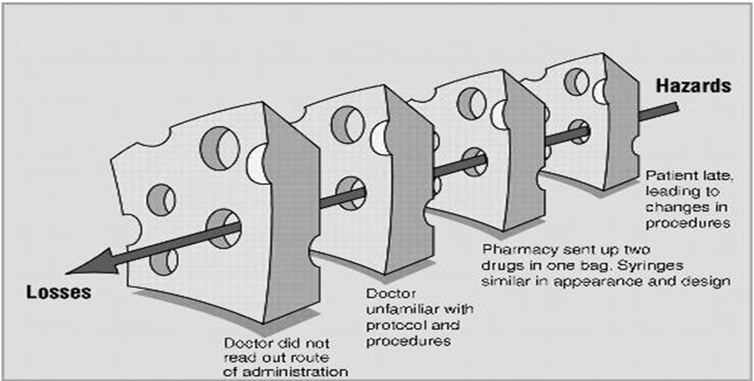
"Swiss cheese" model of accident causation
The systems have many holes: some from active failures and others from latent conditions.
These holes are continuously opening, shutting, and shifting their location. In any one slice, they do not normally cause harm, because the other intact slices prevent hazards from reaching the potential victim.
Only when the holes in many layers momentarily line up does the trajectory of accident opportunity reach the victim causing the damage.
Culture of patient safety (Definition from the Health and Safety Commission)
The safety culture of an organization is the product of individual and group values, attitudes, perceptions,, and patterns of behavior that determine the commitment to, and the style and proficiency of an organization’s health and safety management.
Definition of patient safety culture:
An integrated pattern of individual and organizational behavior, based on a system of shared beliefs and values, that continuously seeks to minimize patient harm that may result from the process of care delivery.
Safety culture divided into seven subcultures and defined as:
Leadership | Teamwork | Evidenced based | Communication | Learning | Just a culture and Patient centred

Slide 16
Patient safety culture
Previously, in many cases the traditional response to adverse incidents in health care has been to blame, shame and punish individuals.
The opposite of a ‘blame’ culture is a ‘blame-free’ culture, which is equally inappropriate. In some instances, the responsible individual should be held accountable.(in case of negligence or recklessness)
Recently , the a ‘just’ culture has been adapted which means : balancing the ‘blame’ and ‘no blame’ approaches
Example..
If a patient is found to have received the wrong medication and suffered a subsequent allergic reaction,
Blame culture: we look for the individual student, pharmacist, nurse or doctor who ordered, dispensed or administered the wrong drug and blame that person for the patient’s condition care at the time of the incident and hold them accountable
Just Culture: we look for the system defect such as communication , protocols and processes for medication management , in addition to investigate the negligence or recklessness of the worker.
The concept of Clinical incident:
Definition:
A clinical incident is an event or circumstance resulting from health care which could have, or did lead to unintended harm to a person, loss or damage, and/or a complaint. (deviation from standard of care and safety )
Examples:
Medication errors (e.G. Wrong medication, omission, overdose);
Patient falls;
Intended self harm or suicidal behaviour;
Therapeutic equipment failure;
Contaminated food;
Problems with blood products;
Documentation errors;
Delayed diagnosis;
Surgical operation complications;
Hospital acquired infection;

Slide 17
Types of Clinical incident: (important)
Adverse Event:
An adverse event is an unintended injury or complication which results in disability, death or prolonged hospital stay, and is caused by health- care management
Example : Medication errors
A-Sentinel events: (قدر الله وماشاء فعل)
A sentinel event is an unexpected occurrence involving death or serious physical or psychological injury, or the risk thereof. Serious injury specifically includes loss of limb or function.
Example:
Hemolytic transfusion reaction involving administration of blood or blood products having major blood group incompatibilities
B-Never Events:
Events should never happen while in a hospital, and can be prevented in most cases.
Example:
Infant discharged to the wrong person
Wrong surgical procedure performed on a Patient
Patient death or serious disability associated with a medication error
Clinical Incidence
Adverse Event
Near Miss
Sentinel Event/Never Event
Adverse drug reaction

Slide 18
Adverse drug reaction:
A response to a drug which is noxious and unintended, and which occurs at doses normally used in man for the prophylaxis, diagnosis, or therapy of disease, or for the modifications of physiological function'.( WHO,1972)
Seven (7) levels of safety
Patient factors: such as personality, language and psychological problems may also be important as they can influence communication with staff.
Task factors: The design of the task, the availability and utility of protocols ….
Individual factors: include the knowledge, skills and experience of each member of staff
Team factors: The way an individual practices, and their impact on the patient, is influenced by other members of the team and the way they communicate and support each other.
Working conditions: These include the physical environment, availability of equipment and supplies and the light, heat, interruptions and distractions that staff endure.
Organizational factors: The team is influenced in turn by management actions and by decisions made at a higher level in the organization. These include policies, continuing education, training and supervision and the availability of equipment and supplies.
External environment factors: The organization itself is affected by financial constraints, external regulatory bodies and the broader economic and political climate.
Near miss:
Is any situations that did not cause harm to patients (that did not reach the patient) , but could have done.

Slide 19
The physician’s role in patient safety
Standardization, such as the use of order sets, protocols, and reminders.
Designing safe systems and implementation of technology:
  use smart intravenous pumps that detect medication errors,
  barcoding to ensure the five rights of medication administration (right patient, right route, right dose, right time, right medication).
Teamwork
Communication:
  poor communication can delay diagnosis, create confusion regarding the plan of care, and increase the cost of care through repeated tests.
  Lack of effective communication creates frustration with patients and families and increases their anxiety
Involve yourself in measuring, monitoring, and improving quality.
Avoid blaming when an error occurs.
Practice evidence-based care.
Detect adverse events: report and Disclose errors to patients and their families.
Adhere and follow the National Patient Safety Goals/ ROP(Required Organization Practice )
Adhere and follow the national Patient Safety Goals/ROP (Required Organization Peactice):
Adverse reporting Client verification Medication reconciliation Dangerous abbreviations Transfer of client information at transition points Control of concentrated electrolytes Infusion pumps training High-alert medications | Hand hygiene Antibiotic prophylaxis during surgery Falls prevention strategy Pressure ulcer prevention Venous thromboembolism prophylaxis Safe injection practices Safe surgical practices Preventive maintenance program
If You Have Any Questions Or Comments Please Inform Us:
professionalism434@gmail.com

Slide 20
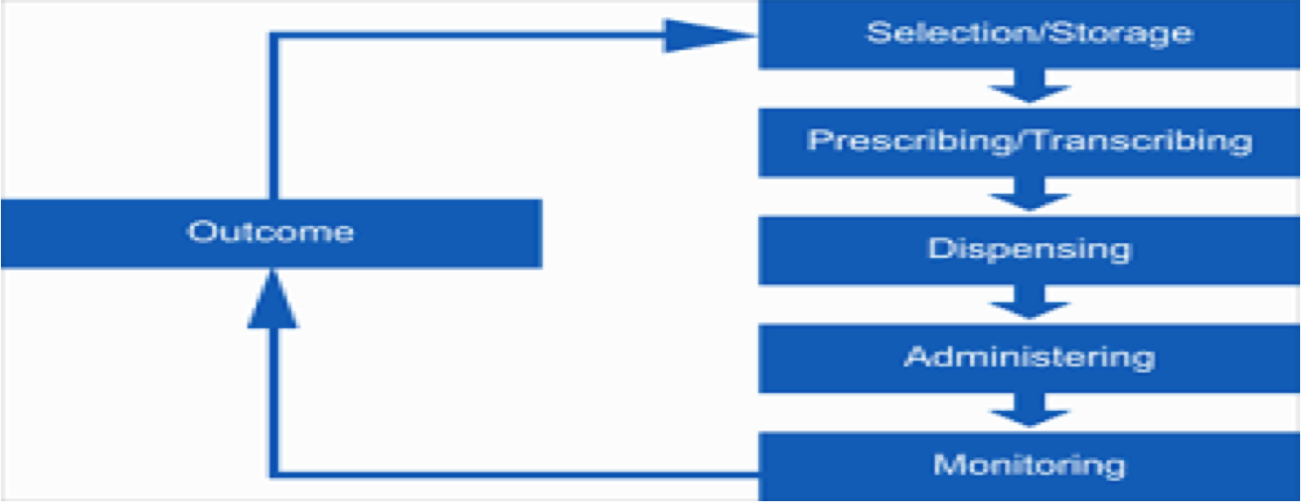
Medication Use Process in The Institutional Setting:
Sources of error in prescribing:
Documentation - illegible, incomplete, dangerous abbreviation
Inadequate knowledge about drug indications and contraindications
Not considering individual patient factors, such as allergies ,pregnancy, co-morbidities, other medications
Wrong patient, wrong dose, wrong time, wrong drug, wrong route
Inadequate communication (written, verbal)
Mathematical error when calculating dosage
A) Strategies to Reduce (Prescribing) errors
*Just understand the categories
•Avoid Illegible Handwriting: •Write/Print More Carefully •Use Computers | •Write Complete Information: •Patient’s Name •Patient-Specific Data •Generic and Brand Name •Drug Strength -Dosage Form •Amount -Directions for Use •Purpose -Refills
•Look at Patient-Specific Information •Age -Weight •Renal and Hepatic Function •Laboratory Test Results •Concurrent Medications -Allergies •Medical/Surgical/Family History •Pregnancy/Lactation Status | Do Not Use Abbreviations •Drug names •“QD” or “OD” for the word daily •Letter “U” for unit •“µg” for microgram (use mcg) •“QOD” for every other day

Slide 21
*Just understand the categories
Decimals: •Avoid whenever possible •Use 500 mg for 0.5 g •Use 125 mcg for 0.125 mg •Never leave a decimal point “naked” •Haldol .5 mg ® Haldol 0.5 mg •Never use a terminal zero •Colchicine 1 mg not 1.0 mg •Space between name and dose •Inderal40 mg ® Inderal 40 mg | Be alert to Drug Name: “Look-Alike” or “Sound-Alike” Drug Names •Celebrex (celecoxib, anti-inflammatory); Cerebryx (fosphenytoin, anticonvulsant); Celexa (Citalpram,antidepressant)
Write the Medication Reconciliation •Learn and practice thorough medication history taking: •Include name, dose, route, frequency and •duration of every drug the patient is taking; •Enquire about recently ceased medications; •Ask about over-the-counter medications, •dietary supplements and complimentary medicines; | More Attention to Dosage Calculations: •Use patient-specific information •height •weight •age •body system function
Verbal Orders: •Avoid when possible •State numbers like pilots (i.e., “one-five mg” for 15 mg) •Spell out difficult drug names •Specify concentrations | Know the High Alert Medications: •Need double check •Example : •Oral anticoagulants •Insulin •Chemotherapeutic agents •Neuromuscular blocking agents •Concentrated electrolytes •Emergency medications (potent and used in high pressure situations)

Slide 22
B) (Dispensing) Process Errors Prevention:
1.Standardized concentrations for all IV medication
2.Use commercially prepared solutions
C) (Administration) Process Errors Prevention:
1.Be familiar with the institution policy
2.Preprinted & standardized infusion rate charts
3.Use programmable infusion device
D) (Calculation errors)
Contributory Factors for Medication Errors
Patient Factors
Patients on multiple medications
Patients with another condition, e.g. renal impairment, pregnancy
Patients who cannot communicate well
Patients who have more than one doctor
Children and babies (dose calculations required?)
Contributory Factors for Medication Errors
Staff Factors
Inexperience
Rushing
Doing two things at the same time
Interruptions
Fatigue, or stress
Lack of checking and double checking habits
Poor teamwork and/or communication between colleagues

Slide 23
What are some of the ways to make
medication use safer?
Use generic names where appropriate
Tailor prescribing to individual patients
Know which medications are high-risk/high alert and take precautions
Be very familiar with the medication you prescribe and/or dispense
Remember the 5 Rs when prescribing and administering
Develop checking habits
Encourage patients to be actively involved in the process
Report and learn from medication errors
Remember the 5 Rs when prescribing and administering:
Right Patient (check the name in the order & the patient, use two identifier & ask the patient to identify himself/herself).
Right Medication (check the medication label & order).
Right Route (Confirm that the patient can take or receive the medication by the ordered route)
Right Time (Check the frequency of the ordered medication & Confirm when the last dose was given).
Right Dose (Confirm appropriateness of the dose using a current drug reference & correct calculation)
Recommended actions:
Pharmacists / Technician should READ / CHECK carefully the label of each medication they prepare.
DOUBLE CHECKING is essential tool to avoid such mistakes
Look Alike medications should be stored separately with proper labeling to avoid such mistakes
To change the brand the hospital purchases of either drugs if possible

Slide 24
Conclusion:
Patient safety is the avoidance, prevention and amelioration of harm from healthcare.
Two approaches to the problem of human fallibility exist:
  The person approach focuses on the errors of individuals, blaming them
  The system approach concentrates on the conditions under which individuals work
Some errors cause harm but many do not.
Blaming and then punishing individuals is not an effective approach for improving safety within the system
Adverse events often occur because of system breakdowns
Standardizing and simplifying clinical processes is a powerful way of improving patient safety
•Medications can greatly improve health when used wisely and correctly
•Yet, medication error is common and is causing preventable human suffering and financial cost
•Remember that using medications to help patients is not a risk-free activity
•Know your responsibilities and work hard to make medication use safe for your patients
Tips of improvement patient safety: (Not important)
Constitution of patient safety committee
Develop clear policies and protocol for patient safety
Discuss regularly patient safety initiative within hospital staff
Orientation hospital staff on patient safety
Encourage transparency in the regular death review
Non punitive reporting by staff
Review , monitor and evaluate safety procedures regularly

Slide 25
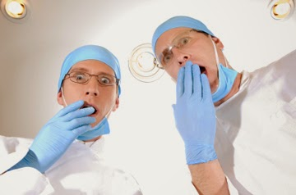
4
What are Human Factors:
Human factors refer to environmental, organizational and job factors, and human and individual characteristics which influence behavior at work in a way which can affect health and safety.
Human factors can be defined as anything that affects an individual’s performance.
human factors is to think about three aspects:
The job | The individual | The organization/environmental
This including: Nature of the task Workload Working environment *This includes matching the job to the physical and the mental strengths and limitations of people. | Including: Competency Skills (changeable) Personality,attitude(fixed) Risk perception Sleep deprivation * Individual characteristics influence behavior in complex ways. | Including: Work patterns The culture of the workplace, resources Communications Leadership and so on
The Benefit of Applying Human Factors in Healthcare
. To prevent Medical Errors.
Understand why healthcare staff make errors.
Identify ‘systems factors’ threaten patient safety.
To prevent occupational accidents and ill health.
Medical errors..
Failure of a planned action to be completed as intended or the use of a wrong plan to achieve an aim, such as :
Retained surgical instruments.
Restraint -related injuries.

Slide 26
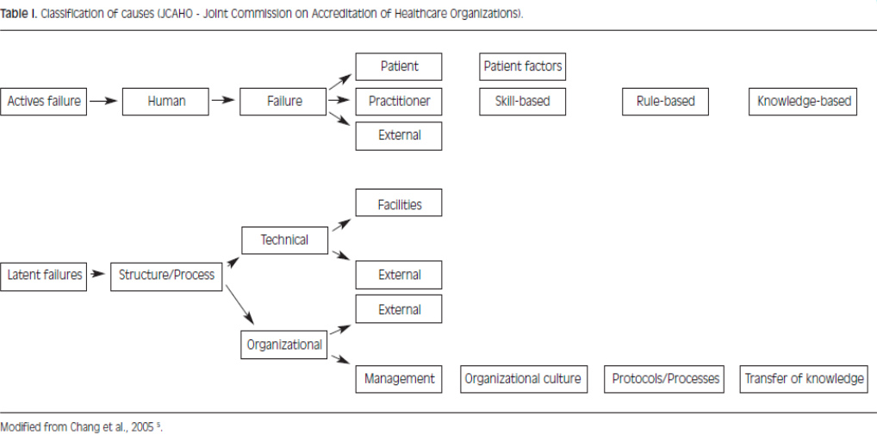
King Saud University Medical City (KSUMC)–Medical Errors:
Expired medication.
dispensed Un planned hysterectomy.
Wrong Sponge counting.
Self extubation.
Wrong patient ID , went to wrong procedure.
Wrong medication delivered.
Wrong dose administered.
Sources of Error: (Read only)
If You Have Any Questions Or Comments Please Inform Us:
professionalism434@gmail.com

Slide 27
Types of Medical Errora: (Important)
Diagnostic Error or delay in diagnosis(in the case of the diabetic patient may lead to blindness or glaucoma). Use of outmoded tests or therapy. | Preventive Failure to provide prophylactic treatment Inadequate monitoring or follow-up of treatment ( no order for anticoagulant post major orthopedic procedure may lead to PE).
Treatment Error in the performance of an operation, procedure, or test(inserting a breathing tube into a patient’s esophagus ). Error in the dose or method of using a drug . | Other Failure of communication. Equipment failure.
The Most Common Medical Errors:
Wrong site surgery (13.4%)
Patient suicide (11.9%) (not common on our hospitals)
Operative and post operative complication (10.8% )
Delay in treatment (8.6 %)
Medication error (8.1 %)
Patient fall (6.4 %)
If You Have Any Questions Or Comments Please Inform Us:
professionalism434@gmail.com

Slide 28
Causes of Medical Errors: (Important)
1- Healthcare Complexity | 2- System and Process Design | 3-Environmental factors | 4-Infrastructure failure | 5- Human Factors and Ergonomics
- Complicated technologies. - Drugs interaction. - Intensive care. -Prolonged hospital stay. -Multidisciplinary approach. | - Inadequate communication - Unclear lines of authority. | - Over crowded services. - Unsafe care provision areas. - Areas poorly designed for safe monitoring. | - Lack of documentation process. - Lack of continuous improvement process. | - HALT → Hungry, Angry/ Emotions , Late/ lazy , Tired/fatigue/sleep less. - Lack of skilled workers. - Lack of training
Actions to Reduce Medical Errors as Related to Humans Factors..
Part 1: (Organization level) Organizational Management and Human Factors (important)..
1) Developing a positive safety culture.
Just culture.
Reporting culture (e-OVR Reporting system).
Learning culture(Morbidity and mortality review process).
2) Human factors training in healthcare.
3) Develop Clinical Practice Guidelines , protocols , algorithms.. etc
If You Have Any Questions Or Comments Please Inform Us:
professionalism434@gmail.com

Slide 29
Part 2: Making your care and work safer (individual level ) (important) *Don't memorize the examples
Stress | Complex calculations | Storage | Physical demands
-Focus first on the tasks that are high risk or where it is particularly important. - In emergency situations : use algorithms and protocols. - Quickly allocate a clear leader. - Consider if there is a way of running a simulation with your team. | - Find out if there is a pre-calculated list available in your area. - Before you start the task, think about ways of managing or avoiding distractions. For example, ask a colleague to take your bleep for a minute. - Look at the dose strengths of ampoules in your drug cupboard. - Double check with your colleague. | - Look at the products you use and have stored. E.g Look-alike packaging. | - Physical tiredness :get enough sleeping before your duty. - Demands exceeding capability : Most people at some time overestimate their abilities or underestimate their limitations.
Teamwork | Reliance on vigilance and memory | Distractions | The physical environment
- Briefing and debriefing can help teams develop a shared mental model of a planned procedure or a patient’s clinical status. - SBAR (Situation, Background, Assessment, Recommendation). | - When you have a large number of tasks to remember making lists can be a helpful - Checklists or visible permanent reminders (The World Health Organization's (WHO) Surgical Safety Checklist). | - Think about the tasks you do that require your focus (examples could be giving a blood transfusion, drug prescribing ). | - Poor lighting: Look at the lighting in the areas where you need to perform detailed or complex tasks.

Slide 30
OVR(Occurrence Variance Reporting) or
IR(Incident Reporting):
Occurrence :An Occurrence is defined as any event or circumstance that deviates from established standards of care & safety.
OVR :an internal form/system used to document the details of the occurrence/event and the investigation of an occurrence and the corrective actions taken.

Slide 31
إسهام الحضارة الإسلامية في تطور الطب في العالم : * قراءه
Scientific Islamic medicine passed through three stages: 1- The first stage was the stage of translation of foreign sources into Arabic. It extended through the seventh and eighth centuries. 2- The second stage was the stage of excellence and genuine scientific contribution, in which the Islamic physicians were the leaders and the source of new chapters of medicine. This stage extended from the ninth to the thirteenth centuries. 3- The third stage was the stage of decline, where medicine, as well as other branches of science, became stagnant and deteriorated. This stage started mainly after the thirteenth century | ساهمت الحضارة الإسلامية في التطور العلمي للطب وقد مرت هذه المساهمات بثلاثة مراحل: 1: المرحلة الأولى مرحلة ترجمة المؤلفات (القرن السابع-القرن الثامن الميلادي): من الإغريقية و الهندية و الصينية و الفارسية للغة العربية. 2: المرحلة الثانية مرحلة الإزدهار و التأليف : ( القرن التاسع – القرن الثلث عشر الميلادي): قدم العرب مؤلفات مرجعية عرضوا فيها خلاصة المعرفة الطبية و أضافوا عليها إسهامات فريدة للطب العربي و الإسلامي. 3: المرحلة الثالثة مرحلة الركود و الإضمحلال: بعد القرن الثالث عشر الميلادي . حلت فترة من الركود في كل فروع العلوم التطبيقية بما في ذلك الطب.
5
إسهام الحضارة الإسلامية في تطور الطب في العالم
*مهم
ألف كتاب الحاوي في الطب . | أبي بكر محمد بن زكريا الرازي
أشهر كتبه القانون في الطب. | أبي علي الحسين بن سينا (Avicenna)
وقد كان أطباء كثيرون ألف ثلاثة ، يمارسون الجراحة إما جهرا وإما خفية .وأشهر من عرف بها هو.والف ثلاثه كتب .ومازال أحد هذه الكتب موجودا في باكستان كأحد المراجع النادرة وذلك في مكتبة "معهد ، الأبحاث الإسلامية "في إسلام أباد، واسم هذا المؤلف هو :التصريف لمن عجز عن التأليف. وكذلك وضع عددا من الكتب عن العمليات الجراحية التي قام بها. | أبو القاسم عباس بن خلف الزهراوي Abu-l-Qasim al-Zahrawi (Abulcasis)
-اول من اكتشف الدوره الدمويه الصغرى (palmonary circulation) -الف كتاب الشامل في الصناعيه الطبيه | ( علاء الدين أبو الحسن الدمشقي , ( ابن النفيس
طبيب عربي الف أول كتاب في الأخلاقيات و سماه أدب الطبيب | إسحاق بن علي الرهاوي
صاحبة أول مستشفى ميداني وكانت معروفة بمهارتها في الطب والعقاقير والأدوية وتصنيعها، والجروح وتضميدها والكسور وتجبيرها.أما النفقات والمصروفات فقد كانت من مالها الخاص وجهدها الذاتي، لا تأخذ على ذلك اجر او عوضا بل كانت تنفق وتبتغي الاجر من الله تعالى | الصحابية رفيدة الأسلمية
المسلمون هم أول من أسس المستشفيات في العالم فأول مستشفى إسلامي اسس في عهد الخليفة الأموي الوليد بن عبد الملك، وكان هذا المستشفى متخصص في الجذام ، وأنشئت بعد ذلك المستشفيات العديدة في العالم الإسلامي ، وبلغ بعضها شأو ا عظيما، وتغتبر من أوائل الكليات والجامعات في العالم .بينما انشئ أول مستشفى اوربي في باريس بعد ذلك بأكثر من تسعة قرون . وكانت المستشفيات تعرف بـ البيمارِسْتانات

Slide 32
مبادئ الأخلاقيات ألإسلامية في الطب:
¡As Western ethics are be based on human reason and experience as the arbiter between right and wrong action. ¡This shift from religious ethics to philosophical ethics does not apply in Islam . ¡While Islamic ethics incorporate various philosophical traditions it still is based mainly from religious texts. | فيِ الحضارة الغربية تُبنى المعايير الأخلاقية للطب على أُسس فلسفية و على تقدير البشر للأمور . أما الحضارة الإسلامية فنستمد هذه المعا يير من الشريعة و الفقه . و مع هذا الإختلاف في المصادر إلا أن الأخلاقيات الإسلامية تسع العناصر الإيجابية التي تتبناها الحضارات الأخرى.
:المبادئ الإسلامية في أخلاقيات المهن الطبية
مهم
¡The first principle is that Man is honored – ¡The second principle is that every human being has the right to live; his life is respected and protected. ¡The third principle is equity, which is regarded in religion as an essential value, being one of the purposes of messenger missions: ¡The fourth principle is doing well, : ¡The Arabic word ihsaan,translated here as doing well, has several denotations. ¡(1) First it denotes “quality,” as the root of the word that means “good.” A derivation of the same root is used in God’s promise to his servants “who listen to what is said and follow the best of it” (39:18). Such high quality is desired in everything, every single thing. The Prophet, blessing and peace be upon him, says, “God has ordained the doing well of everything.” This is the source of the concept of guaranteed quality in providing health care. ¡(2) The word ihsaan, however, also denotes charity and thus implies the gentle, compassionate touch which has been missing or almost missing in modern medical practice. It implies a giving nature, which makes a person wish for his brother what he wishes for himself and give priority to others over himself, even when he suffers a dire need. ¡The fifth principle is “no harm and no causing harm.” . The importance of this principle in the field of health is self-evident, particularly in prohibiting any physician or other health professional from exposing a patient to a diagnostic or therapeutic procedure that exposes him to harm or to any hazard. | المبدأ الأول : الإنسان مكرّم :بغضِّ النظر عن لونه و جنسه و معتقده. و يقتضي تكريمُه هذا المحافظة عليه في صحة تامة ومعافاة كاملة كما يقتضي تكريمُه إحترام شخصيته و إحترام خصوصياته و أسراره و إحترام حقه في الحصول على كل المعلومات التي تتعلق بأي إجراء طبي سوف يتعرض له و إحترام حقه في كونه هو صاحب القرار في ما يتعلق بشئونه الصحية ما دام ذلك في طار هذه القيم (۞ وَلَقَدۡ كَرَّمۡنَا بَنِىٓ ءَادَمَ وَحَمَلۡنَـٰهُمۡ فِى ٱلۡبَرِّ وَٱلۡبَحۡرِ وَرَزَقۡنَـٰهُم مِّنَ ٱلطَّيِّبَـٰتِ وَفَضَّلۡنَـٰهُمۡ عَلَىٰ ڪَثِيرٍ۬ مِّمَّنۡ خَلَقۡنَا تَفۡضِيلاً۬) المبدأ الثاني : الحياة حق لكل إنسان و هي مقدسة محترمة مدافع عنها. و قيمة النفس البشرية الواحدة تعدل قيمة البشر جميعا. يقول عز و جل (مَن قَتَلَ نَفۡسَۢا بِغَيۡرِ نَفۡسٍ أَوۡ فَسَادٍ۬ فِى ٱلۡأَرۡضِ فَڪَأَنَّمَا قَتَلَ ٱلنَّاسَ جَمِيعً۬ا وَمَنۡ أَحۡيَاهَا فَڪَأَنَّمَآ أَحۡيَا ٱلنَّاسَ جَمِيعً۬ا‌) و الإعتداء على حياة أى نفس بشرية , و لو كان جنينأ أو شيخا أو معوقا عدوان على البشر جميعا : من قتل نفسا بغير نفس أو فساد في الأرض فكأنما قتل الناس جميعا !!! علما بأن هذا الإحياء في مفهوم الإسلام ليس مقصورا على الإحياء البدني بل يتعداه إلى الإحياء النفسي و الروحي و الإجتماعي المبدأ الثالث :العدل وهو قيمة جوهرية وغاية أساسية من غايات إرسال الرسل : لَقَدۡ أَرۡسَلۡنَا رُسُلَنَا بِٱلۡبَيِّنَـٰتِ وَأَنزَلۡنَا مَعَهُمُ ٱلۡكِتَـٰبَ وَٱلۡمِيزَانَ لِيَقُومَ ٱلنَّاسُ بِٱلۡقِسۡطِ و قد أمر الله الناس بها أمرا عاما : ( إِنَّ ٱللَّهَ يَأۡمُرُ بِٱلۡعَدۡلِ وَٱلۡإِحۡسَـٰنِ وَإِيتَآىِٕ ذِى ٱلۡقُرۡبَىٰ وَيَنۡهَىٰ عَنِ ٱلۡفَحۡشَآءِ وَٱلۡمُنڪَرِ وَٱلۡبَغۡىِ‌ۚ يَعِظُكُمۡ لَعَلَّڪُمۡ تَذَكَّرُونَ ) (يَـٰٓأَيُّہَا ٱلَّذِينَ ءَامَنُواْ كُونُواْ قَوَّٲمِينَ لِلَّهِ شُہَدَآءَ بِٱلۡقِسۡطِ‌ۖ وَلَا يَجۡرِمَنَّڪُمۡ شَنَـَٔانُ قَوۡمٍ عَلَىٰٓ أَلَّا تَعۡدِلُواْ‌ۚ ٱعۡدِلُواْ هُوَ أَقۡرَبُ لِلتَّقۡوَىٰ‌ۖ وَٱتَّقُواْ ٱللَّهَ‌ۚ إِنَّ ٱللَّهَ خَبِيرُۢ بِمَا تَعۡمَلُونَ ) المبدأ الرابع : الإحسان 1: الإحسان بمعنى الجودة {quality} فالحسن هو الجيد : (ٱلَّذِينَ يَسۡتَمِعُونَ ٱلۡقَوۡلَ فَيَتَّبِعُونَ أَحۡسَنَهُ ۥۤ‌ۚ أُوْلَـٰٓٮِٕكَ ٱلَّذِينَ هَدَٮٰهُمُ ٱللَّهُ‌ۖ وَأُوْلَـٰٓٮِٕكَ هُمۡ أُوْلُواْ ٱلۡأَلۡبَـٰ) قال النبي «إن الله كتب الإحسان على كل شيء» وهنا ينبع مفهوم الجودة في الخدمات الصحية. 2: : الإحسان بمعنى العطاء و الرفق و كذلك صحوة الضمير و مراقبة الله عز وجل في كل تصرف و سلوك يقول النبي علي السلام: الإحسان أن تعبد الله كأنك تراه المبدأ الخامس:لا ضرَرَ و لا ضِرار . و لاتخفى أهمية هذا المبدأ في المجال الصحي , و لاسيما من حيث عدم جواز إقدام الطبيب أو غيره من أرباب المهن الصحية , على تعريض المريض إلى أيّ إجراء تشخيصي أو علاجي يكون من شأنه تعريضه للخطر أو الضرر.

Slide 33
الميثاق الإسلامي العالمي للأخلاقيات الطبية والصحية:ب
ظهرت الحاجة لكتابة ميثاق إسلامي للأخلاقيات الطبية و الصحي العدة أسباب منها
الشعور العام بتحول الممارسة الطبية لسلعة مادية تتجاهل الجانب الإنساني و الروحي-
- التطور التكنولوجي في الطب مما خلق أسئلة أخلاقية جديدة في الطب مثل زراعة االلأعضاء و التخصيب الصناعي .
-هناك مؤسسات أجنبية غير مسلمة لكنها تسعى لمعرفة المبادئ الأخلاقية الإسلامية كتبادل حضاري و لضرورة تعاملها مع مرضى من المسلمين.
قامت المنظمة الإسلامية للعلوم الطبية بالتنسيق مع منظمة الصحة العالمية و منظمات أخرى بإصدار الميثاق الإسلامي العالمي للأخلاقيات الطبية و الصحية .
الباب الأول: أخلاق الطبيب
الباب الثاني: واجبات الطبيب نحو المريض
الباب الثالث: السرّ الطبّي
الباب الرابع: واجبات الطبيب تجاه المجتمع
الباب الخامس: القضايا الاجتماعية
امثلة للقضايا الطبيه المعاصره التي تناولتها الاخلاقيات الاسلاميه بطريقه متميزه:
1/الاستنساخ البشري
2/المفطرات في مجال التداوي
3/مرض نقص المناعة المكتسبة
4/اجهزه الانعاش
5/اطفال الانابيب
6/بنوك الحليب
7/انتفاع الانسان بأعضاء جسم انسان اخر حيا كان او ميتا
8/مداواه الرجل للمرأه
If You Have Any Questions Or Comments Please Inform Us:
professionalism434@gmail.com

Slide 34
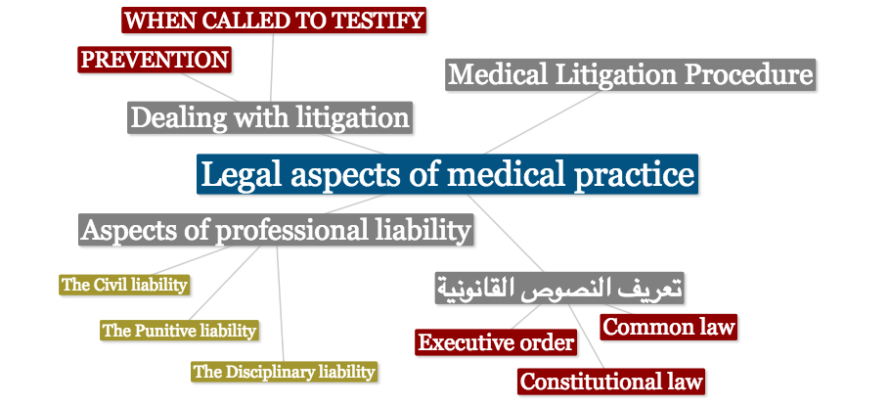
Mind Map
6
تعريف النصوص القانونية
القانون الدستوري (Constitutional law) هو أعلى قانون في الدولة (مثل النظام الأساسي للحكم، نظام مجلس الوزراء، نظام مجلس الشورى).
القانون العام (القانون الإداري) (Common law) هو القواعد القانونية التي تسنها السلطة التنظيمية (مجلس الوزراء) في الحدود التي سمح بها القانون الدستوري مثل (نظام الخدمة المدنية).
اللائحة التنفيذية (Executive order) وهي مجموعه القواعد القانونية التي تضعها السلطة التنفيذية لتفسير مواد النظام العادي، وتعتبر اللائحة معيبة بعدم النظامية إذا خالفت القانون العادي وبعدم الدستورية إذا خالفت القانون الدستوري (اللائحة تعتبر غير صالحة إذا خالفت قوانين الدستور).
شرح: القانون الدستوري هو القانون الأساسي الذي يسير عليه نظام البلد بشكل عام ويتم وضعه من قبل مجلس الشورى أو البرلمان مثلا، بعد ذلك يقوم كل وزير بإنشاء قوانين تختص بوزارته وتكون تابعة للقانون الدستوري، أخيرا تأتي اللائحة التنفيذية وهي تقوم بتفسير تفاصيل ما جاء في مواد قانون ما من عبارات عامة بوضوح (لعامة الشعب).
أنواع المخالفات الطبية
المخالفات العادية: و هي المخالفات النظامية و الشرعية التي لا صلة لها بالأصول الفنية لمهنة الطب و من ذلك الإجهاض المحرم و الإمتناع عن إسعاف مريض و إفشاء سر المريض و مزاولة المهنة بدون ترخيص .
المخالفات الفنية: و هي الأخطاء التي يخرج الطبيب فيها على الأصول و القواعد الفنية المتعارف عليها بين الأطباء .
If You Have Any Questions Or Comments Please Inform Us:
professionalism434@gmail.com

Slide 35
Aspects of professional liability
(جوانب المسؤولية المهنية)
The Civil liability (المسؤولية المدنية): This is the responsibility of a physician towards the patient when harm is inflicted as a result of direct action against medical rules from the physician or proven negligence.
شرح: هي عبارة عن حقوق المريض (المواطن) بالنسبة للطبيب، مثل لو نسي الطبيب مقص في بطن المريض بعد إجراء العملية بسبب إهماله يكون حق للمريض رفع شكوى على الطبيب، ويجب على المسؤول تعويض الضرر.
The Punitive liability (المسؤولية الجزائية - الجنائية): that deals with physicians who violate the rules and regulations of medical practice even with no subsequent harm resulted to the patient.
شرح: تتعلق بمسؤولية الطبيب تجاه قوانين الدولة حتى ولو لم يترتب على فعله خطر على المريض، وهذه حتى تتوفر يلزم وجود قصد جنائي من قبل الطبيب، مثال:
لو قام الطبيب بعملية الإجهاض الغير المشروع.
إذا قام طبيب بعملية لا تتعلق بتخصصه، مثل طبيب أنف وأذن وحنجرة يقوم بعملية عيون، حتى لو نجحت.
عند قيام الطبيب بإيذاء المريض عن قصد.
The Disciplinary liability (المسؤولية التأديبية): where a physician failed to meet with professional standards, requirements and ethics.
شرح: مثل عندما يعلن الطبيب عن نفسه على انه طبيب مسالك بولية وهو في الحقيقة طبيب جلدية بالتالي هو خالف القوانين التي أقسم عليها عند تخرجه أو عندما يكتب الطبيب أن يحمل الماجستير وهو في الحقيقة لا يحملها .
المادة الثامنة والعشرون: مع عدم الإخلال بأي عقوبة أشد منصوص عليها في أنظمة أخرى يعاقب بالسجن مدة لا تتجاوز ستة أشهر وبغرامة لا تزيد عن مائة ألف ريال, أو بإحدى هاتين العقوبتين كل من:
زاول المهن الصحية دون ترخيص.
قدم بيانات غير مطابقة للحقيقة أو استعمال طرقاً غير مشروعة كان من نتيجتها منحه ترخيصاً بمزاولة المهن الصحية. (مثل تزوير شهادة الطب)
استعمال وسيلة من وسائل الدعاية يكون من شأنها حمل الجمهور على الاعتقاد بأحقيته في مزاولة المهن الصحية خلافاً للحقيقة.
انتحل لنفسه لقباً من الألقاب التي تطلق عادة على مزاولي المهن الصحية. (الممرض لو ادعى انه طبيب)
وجدت لدية آلات أو معدات مما يستعمل عادة في مزاولة المهن الصحية دون أن يكون مرخصاً له بمزاولة تلك المهن أو دون أن يتوفر لديه سبب مشروع لحيازتها. (الصيدلي لو قام بفحص المريض)
امتنع عن علاج مريض دون سبب مقبول.
خالف أحكام المواد ٧ فقرة (ب) و ٩، ١١، ١٤ الفقرتين (أ , و) و١٩، ٢٠، ٢٢، ٢٣، ٢٤، ٢٧ فقرة (3) من هذا النظام.
تاجر بالأعضاء البشرية أو قام بزراعة عضو بشري مع علمه أنه تم الحصول عليه عن طريق المتاجرة.
If You Have Any Questions Or Comments Please Inform Us:
professionalism434@gmail.com

Slide 36
Medical Litigation Procedure
(اجراءات التقاضي) مُهم
A patient or a member of his/her relatives complains of a medical malpractice from their point of view that ends with a morbidity or mortality. The complaint is directed either to the Ministry of health (وزارة الصحة) or the City Government (الحكومة) according to the medical facility indulged منغمسةin the complaint.
A process of investigation and interrogation follows within the medical facility with the medical staff either sharing the responsibility or attending the event.
The Medical Legal Organization (MLO) (الهيئة الصحية الشرعية) then assigned to follow with a process of thorough review of all documents and medical filling together with interviewing both sides of the claim- the plaintiff and defendant(s), in order to reach a final decision .
Decisions of MLO could be appealed within 60 days to the Court of Appeals ديوان المظالم.
شرح: المريض أو أحد أقربائه يقوم بتقديم شكوى لوزارة الصحة ← وزارة الصحة تقوم بالتحقيق في القضية ثم يتم تحويلها إلى الهيئة الصحية الشرعية ← الهيئة الصحية الشرعية تقوم باستئناف التحقيق ← يتم تقديم نتائج التحقيق بعد ٦٠ يوم لديوان المظالم.
The committees of legal health organization -LHO (الهيئة الصحية الشرعية) are composed primarily of a judge with Islamic shariaah background to reach the verdict after completion of the medical investigation of the claim that is the responsibility of the other 3–4 members with the medical background referring to different sectors of health service mainly from ministry of health & university staff members.
كيفية الإثبات في قضايا المخالفات الطبية
يعتمد القاضي في إثبات موجب المسؤولية على أدلة الإثبات الشرعية التي منها:
الإقرار وهو أقوى الأدلة.
والشهادة مثل شهادة طبيب آخر أو ممرض أو مساعد لإثبات واقعة .
أما التقصير في الإجراء أو مخالفة الأصول العلميّة فهذا لا يقبل إلا من أهل خبرة و اختصاص.
المستندات الخطية والتقارير الموجودة في سجلات المستشفيات.
Evidence in medical litigation:
Medical records
Expert testimony
Testimony of other professionals
Affidavit
If You Have Any Questions Or Comments Please Inform Us:
professionalism434@gmail.com

Slide 37
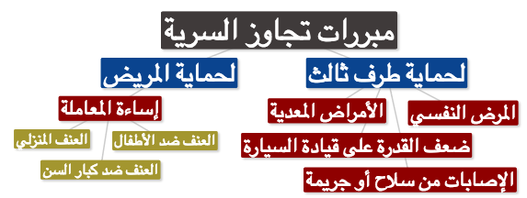
نظام مزاولة المهن الصحية في المملكة العربية السعودية - ١٤٢٦
* المادة الثانية (Legal requirements of competence):
  يحظر ممارسة أي مهنة صحية, إلا بعد الحصول على ترخيص بذلك من الوزارة.
  يشترط للترخيص بمزاولة المهن الصحية ما يأتي:
      الحصول على المؤهل المطلوب للمهنة من أي كلية طبية أو كلية صيدلية أو كلية علوم طبية تطبيقية أو كلية صحية أو معهد صحي, أو مؤهلات أخرى مطلوبة لمزاولة مهن صحية تعترف بها الهيئة, أو الحصول على شهادة من الخارج تعترف بها الهيئة.
      أن يكون قد أمضى مدة التدريب الإجبارية المقررة للمهنة, وأن تتوفر لدية اللياقة الصحية.
      التسجيل لدى الهيئة , وفقاً لمتطلبات التسجيل التي تحددها.
      إلا يكون قد سبق الحكم عليه في جريمة مخلة بالشرف أو الأمانة إلا إذا رد إليه اعتباره.
  يعد التعيين في الجهات الحكومية في وظائف المهن الصحية بمثابة الترخيص بمزاولة المهنة في هذه الجهات, على أن يسبق ذلك التسجيل لدى الهيئة.
* المادة التاسعة عشرة (CONSENT):
يجب ألا يجرى أي عمل طبي لمريض إلا برضاه أو موافقة من يمثله أو ولي أمره إذا لم يعتد بإرادته هو, واستثناء من ذلك يجب على الممارس الصحي في حالات الحوادث أو الطوارئ أو الحالات المرضية الحرجة التي تستدعي تدخلاً طبياً بصفه فورية أو ضرورية لإنقاذ حياة المصاب أو عضو من أعضائه , أو تلافي ضرر بالغ ينتج من تأخير التدخل وتعذر الحصول على موافقة المريض أو من يمثله او ولي أمره في الوقت المناسب - إجراء العمل الطبي دون انتظار الحصول على تلك الموافقة , ولا يجوز بأي حال من الأحوال إنهاء حياة أي مريض ميئوس من شفائه طبياً , ولو كان بناءاً على طلبه أو طلب ذويه.
* المادة الحادية والعشرون (CONFIDENTIALITY):
يجب على الممارس الصحي أن يحافظ على الأسرار التي علم بها عن طريق مهنته ولا يجوز له إفشاؤها إلا في الأحوال الآتية:
أ) إذا كان الإفشاء مقصوداً به:
الإبلاغ عن حالة وفاة ناجمة عن حادث جنائي أو الحيلولة دون ارتكاب جريمة , ولا يجوز الإفشاء في هذه الحالة إلا للجهة الرسمية المختصة.
الإبلاغ عن مرض سارٍ أو معدٍ.
دفع الممارس لاتهام وجهه إليه المريض أو ذووه يتعلق بكفايته أو بكيفية ممارسته المهنة.
ب) إذ وافق صاحب السر كتابة على إفشائه أو كان الإفشاء لذوي المريض مفيداً لعلاجه.
ج) إذا صدر له أمر بذلك من جهة قضائية.
If You Have Any Questions Or Comments Please Inform Us:
professionalism434@gmail.com

Slide 38
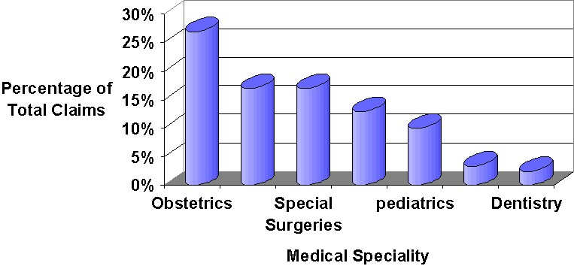
Dealing with litigation
(التعامل مع الدعاوى القضائية)
1. PREVENTION | 2. WHEN CALLED TO TESTIFY
Assess the patient as a whole. Good documentation in patient records. Don’t leave anything to memory specially in very sick patients. (write down everything you did) Consult with colleagues in other specialties. Be current in your knowledge. Emergency and intensive care: certification in basic & advanced cardiac life support (ACLS). Advanced trauma life support (ATLS) certification for those dealing with trauma. If your facility is lacking in equipment then refer the patient and document that. Before surgery communicate in clear language with patient/relative & make sure they understood. (Tell patient every possible complication could hapen) | Review the case records Make notes of the dates and details of your role Consult a lawyer Better to write an affidavit and show it to attorney (lawyer). If necessary bring copies of references mentioned in affidavit (الشهادة) .
Medical Liability Claims in Saudi Arabia
If You Have Any Questions Or Comments Please Inform Us:
professionalism434@gmail.com

Slide 39
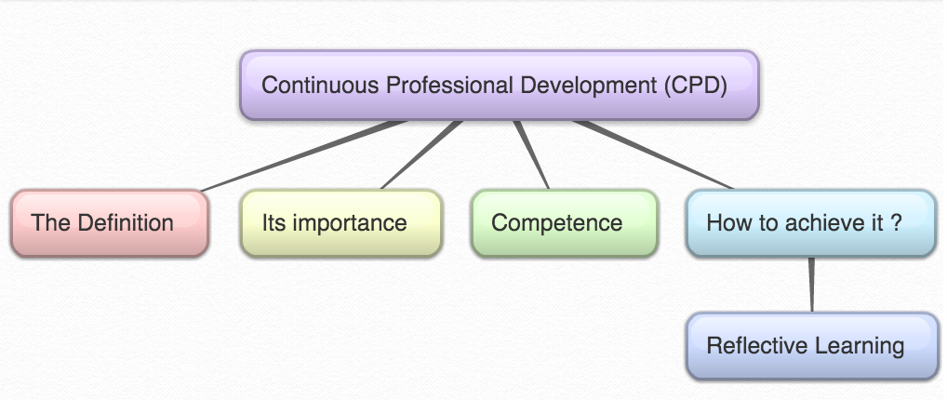
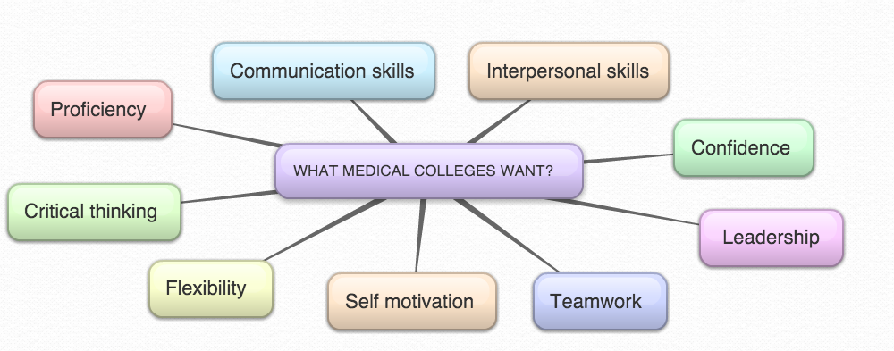
7
Mind Map
WHAT MEDICAL COLLEGES WANT?
Critical thinking & problem solving skills
If You Have Any Questions Or Comments Please Inform Us:
professionalism434@gmail.com

Slide 40
Competence
What is competence?
The ability to perform a specific task in a manner that yields desirable outcomes.
Different Aspects of Competence:
1. Knowledge
2. Skills "What you have learned to do"
3. Abilities "What you can actually do"
Competence develops over time and is nurtured by reflection on experience.
Skills | Abilities
- It's the capacity to perform specific actions. - A person’s skill is a function of both knowledge and the particular strategies used to apply knowledge. | - The power or capacity to do something or act physically, mentally, legally, morally, etc.
(Acquired ) - Can be taught and/or learned. - Is something that can be learned or acquired through training and can be cognitive, perceptual and motor. | (Innate) - Is performance, or what you are able to do. - Is the generic make up of an individual either perceptual or motor in nature that can be inherited from one's parents.
How is competence acquired?
It is gained in the healthcare professions through:
Pre-service education.
In-service training.
Work experience.
( CPD )
Levels of competence :
Novice
Advanced
Beginner
Competent
Proficient
Expert
Levels of competence in Medical Field:
Medical student
Intern
Resident
Registrar
Consultant

Slide 41
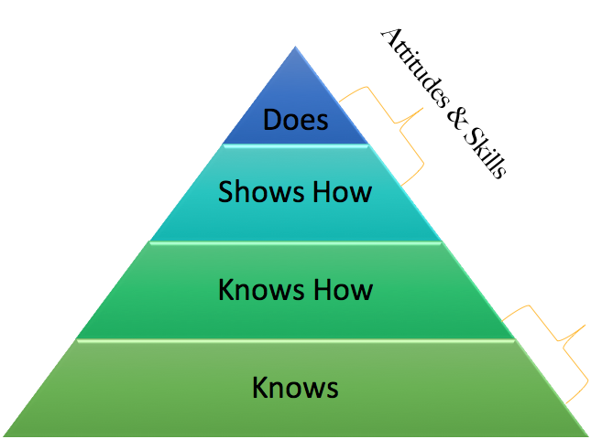

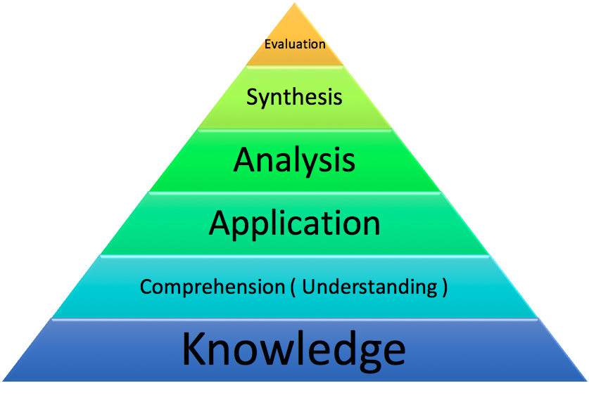
Miller's Pyramid of Clinical Competence :
Professionalism
Bloom’sTaxonomy :
Knowledge - What is the most common cause of…?
Understand - If you see this, what must you consider...?
Application - In this patient, what is causing...?
Analysis,synthesis,evaluation - critical thinking?
Continuous Professional Development (CPD)
What is (CPD)?
The conscious updating of professional knowledge and the improvement of professional competence throughout a person's working life.
It is a commitment to being professional, keeping up to date and continuously seeking to improve.
It is the key to optimizing a person's career opportunities, both today and for the future.
Why (CPD)?
Cardinal reasons:
Half-life of what we learn is very short.
If we do not update, we will practice obsolete medicine.
There is a high chance that patients will not get optimal care.
Requirement by the governing bodies of the profession. (This is only an ostensible reason).
Improtant

Slide 42
How is CPD different ?
CPD is for professionals but not in a formal educational setting .
There are no class rooms, prescribed curricula, prescribed learning events, etc.
Therefore, the learner needs to learn from whatever he/she does in the workplace.
Also, there are no formal examinations , Motivation to learning comes from the necessity to improve practice.
How can we achieve CPD?
Lecture programs
Conferences
Workshops
CME courses (Continuing Medical Education )
Others .
Many methods have been tried in the past .Currently, reflective practice/learning
is the most favoured .
What is Reflective learning ?
Systematic revisiting of a learning experience with a view to learning from it.
Reflection relates to a complex and deliberate process of thinking about and interpreting experience, in order to learn from it
Why Reflective learning ?
Key to become a lifelong learner – if not most learning opportunities are lost.
Reflection Stages:
Improtant
An awareness of uncomfortable feeling
Examination of situation
Exploration of alternative actions
Reflective thoughts
results in action
Reflective log : (a simplified version)
What is the learning event?
What did I learn?
What more do I have to learn?
How can I learn it?
Evidence for further learning / change of practice?
Reflective practice
Reflection-in action
Reflection-on action
Concrete experience
kolbs cycle
Active experimentation
Reflective observation
Abstract conceptualisation

Slide 43
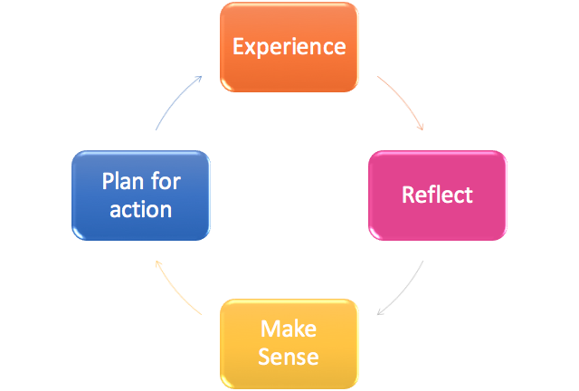

Scenario
A 55 year old man came to clinic with complaint of low back pain (LBP)
You have examined his back which was ok.His height was 160 cm, and weight is 100 kg.
You would like to manage this patient’s LBP contributed due to his excess body weight.
How to apply the reflective log ?
1- Learning experience – This obese person who needed to reduce weight.
2- What did I learn? Learned how the patient’s activities have been affected by obesity.
3- What do I have to learn more? Did not know the advice that should be given to the patient with a given BMI. Are there guidelines for interpreting BMI?
4- How do I learn it? (SDL) Refer a book/article. Talk to the dietician.
5- Evidence / change of practice – BMI was accurately interpreted. Patient was advised about the dietary/lifestyle changes and referred to an obesity clinic. References of books referred.
Improtant to be Undestood
Experiential Learning
Constraints on Development
(Development is a continuous process but sometimes it happens to be a broken continuity)
Time
Budgets
Life Cycle Issues
Motivation
Lack of Trust and Real Leadership
Notes:
1- Levels of competence are acquired through:
Continuous Professional Development.
Reflection & Reflective Practice.
2- Competence develops over time and is nurtured by reflection on experience.

Slide 44
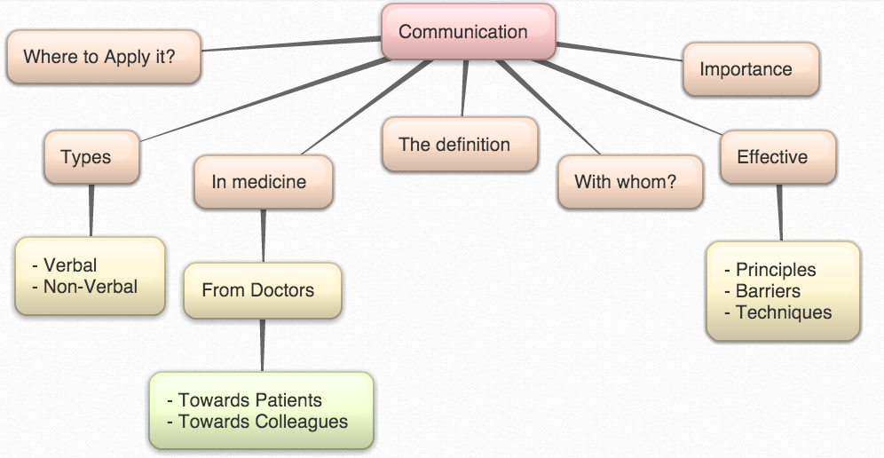
Mind Map
8
What is Communication?
Is the act by which information is shared between humans
It is the process by which we relate and interact with other people.
It includes listening & understanding with passion & respect as well as expressing views & ideas and passing information to others in a clear manner.
Communication theory:
Communication is a learned skill based on 3 pillars
Accuracy
Efficiency
Supportiveness
Effectiveness of communication
Importance of communication:
Effective communication is the basis of mutual understanding & trust.
Poor communication causes a lot of misunderstanding & hinders work & productivity.
If You Have Any Questions Or Comments Please Inform Us:
professionalism434@gmail.com

Slide 45
Types of communication
Verbal = 35% | Non-verbal = 65%
Speaking to the person - Look straight in the eye - make eye contact - Show respect | Facial expressions Tone of voice Movement Appearance Eye contact Gestures Posture
Clear message - Relevant - Use understandable language - Support by illustrations if needed
Good listener - Allow others to understand the message and reply - Listen carefully - Make a dialogue ant not one way instruction
Communication & medicine :
● Historically the emphasis was on the biomedical model in medical training which places more value on technical proficiency than on communication skills.
● Recently learning communication skills & evidence based practice become the corner stones of modern medicine.
What is required from Doctors?
Towards patients | Towards colleagues
Listen to patients and respond to their concerns and preferences. Give patients information in way they can understand Taking patient’s views into consideration when assessing their condition Respond to patients questions, keep them informed & share information . You must make sure, wherever practical, that arrangements are made to meet patient’s language and communication needs. You must be considerate to relatives, carers and partners in providing information and support. | Communicate effectively with colleagues within and outside the team Make sure your colleagues understand your role and responsibilities in the team and who is responsible for each aspect of patient care You must treat your colleagues fairly and with respect.
Doctors need to learn essentials of good communication more than other professionals, Why ?
● Because patients are humans with sensitive needs.
● Doctors cannot practice medicine without effective communication skills.
● Poor communication causes a lot of medico-legal and ethical problems.

Slide 46
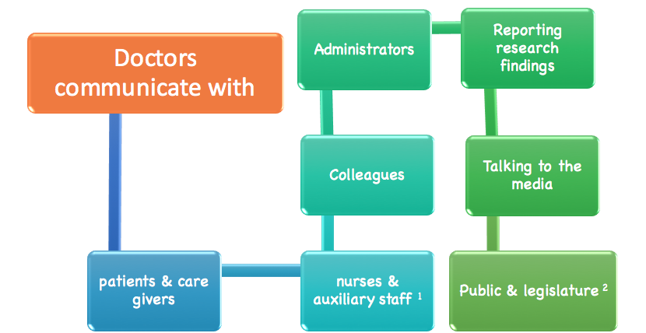
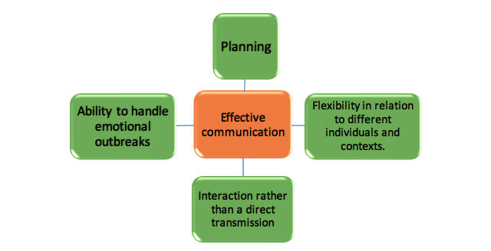
١: الموظفين المساعدين
٢: الهيئة التشريعية ( مثل البرلمان و الكونغرس )
Where to apply our Communication skills?
The medical interview is the usual communication encounter between the doctor and the patient.
It can be classified according to the purpose of the interview into 4 types:
1. History taking 2. Consultations
3. Obtaining informed consent 4. Breaking bad news
Principles of effective communication:
Communication with peers:
Mutual trust & respect
Exchange information
Ask your seniors

Slide 47
Effective communication: for (patients / you as a Doctor)
Ensures good working relationship
Increases patients satisfaction
Increases patients understanding of illness & management
Improves patients compliance with treatment
Reduces medico-legal problems
Reduces uncertainty
Communication Influences Your Thinking about Yourself and Others
Communication Influences How You Learn
Communication Represents You
Communication Skills Are Desired by all organizations / institutions
Communication & Medical care:
Good communication should be established between the patient, the family and the treating multidisciplinary team.
Patient & family should be encouraged to participate and verbalize in the ward round discussion about:
- Offered medical care & treatment
- Rehabilitation
- Follow- up/re-admission plans
- Doubts & worries.
Proper information to patient and family regarding services available and how they can utilize them.
Communication skills: Some techniques:
PRACTICE- fluent dialogue with patient
USE- silence effectively, allowing patient enough time to express thoughts or feelings
ENCOURAGE- patients with your supportive words
UTILIZE - non-verbal communication.
Listening vs Hearing
Hearing | Listening
A passive activity; no effort | -Attention - Active involvement. - Full understanding - Takes time and effort

Slide 48
Barriers to effective communication:
Personal attitudes
Ignorance
Human failings (tiredness, stress)
Language
Poor time management
Strenuous working environment
Conclusion
Effective communication is the key to success in professional career.
Good communication is essential for proper doctor-patient relationship and help avoids problems of misunderstanding.
If You Have Any Questions Or Comments Please Inform Us:
professionalism434@gmail.com

Slide 49


9
Why teamwork is an essential element of patient safety?
The importance of effective teams in health care is increasing due to factors such as:
The increased incidence of complexity and specialization of care.
  E. g. a pregnant woman with diabetes who develops a pulmonary embolus.
  The health-care team might include: Nurses, a midwife, an obstetrician, an endocrinologist and a respiratory physician, as well as the patient.
Increasing co-morbiditie. (so you need more than speciality to treat the patient)
Increasing incidence of chronic diseases.
Global workforce shortages.
Initiatives for safe working hours. (عند وجود فريق سيخفف ضغط ساعات العمل على الفرد)
What is a team? A team is a group of two or more individuals (have limited lifespan of membership) who:
Interact dynamically.
Have a common goal, objective, mission.
Have been assigned for specific tasks.
Possess (have) specialized and complementary skill.
The team might be:
  Multidisciplinary team (OR team), VS Intact team (same discipline e,g IV team)
  Single owner VS different owner
  Fixed team, (A constant set of members) VS Fluid team (the memberships may change frequently)
  Temporary teams VS Permanent teams (human resources team, operation team)
  Physical Team VS Virtual team
If You Have Any Questions Or Comments Please Inform Us:
professionalism434@gmail.com

Slide 50

Teams found in health care
Core teams الفريق الأساسي | Core teams consist of team leaders and members who are directly involved in caring for the patient. Include direct care providers such as: nurses, pharmacists, doctors, dentists, assistants and, of course, the patient.
Coordinating teams فريق التنسيق | Is the group responsible for day-to-day operational management, coordination functions and resource management for core teams. Nurses often fill such coordinating.
Contingency teams فريق الطوارئ | Contingency teams are formed for emergent or specific events (e.g. cardiac arrest teams disaster response teams, rapid response teams).
Ancillary services الخدمات المساعدة | Ancillary service teams consist of individuals who provide direct, task-specific, time-limited care to patients or support services that facilitate patient care. (e.g. cleaners staff).
Support services | Support services teams consist of individuals who provide indirect, task-specific services in a health-care facility. Such as Transportation team, security team.
Administration | Administration includes the executive leadership of a unit or facility and has 24-hour accountability for the overall function and management of the organization.
If You Have Any Questions Or Comments Please Inform Us:
professionalism434@gmail.com

Slide 51
Stages of team development
Initial stage when the team is formed and the members are coming together for the first time.
A best candidate should be selected to form a dynamic team , but a flexibility should be adopted in selection process.
The skills of the members should match the team task and goals.
Voluntary team membership seems to work best when given as a choice.
Forming stage
Each member tend to rely on his/her own experience.
Resistance to work together openly.
Hesitate to express new ideas and opinions.
Interpersonal disagreement and conflicts.
Personal goals rather than team goal.
Storming stage
مرحلة التعارف مرحلة المشاكل مرحلة الانسجام مرحلة التطوير
Start to know each other.
Start to accept each others ideas and opinions.
Understand the strengths and weaknesses of the team.
Members become friendly to each other.
Work together to overcome personal disagreement.
Share responsibilities and help each other.
Norming stage
Member are satisfied with the team progress.
Members are capable to deal with any task based on their strength and weaknesses.
Work together to achieve the team goals.
Performing stage
How to move from storming to norming stage?
Team members should be introduce to each other in more details.
Responsibilities must be assigned accordingly.
Clear communication.
Social activities. (e.g lunch break or coffee)
Role should be in rotation.
Everyone should be treated equally.
If You Have Any Questions Or Comments Please Inform Us:
professionalism434@gmail.com

Slide 52

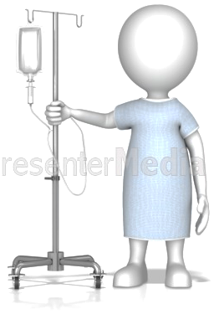

How the use of the team improves patient care ?!
Organizational benefits
Reduced hospitalization time and costs Reduced unanticipated admissions Better accessibility for patients
Patients benefits
Enhanced satisfaction with care Acceptance of treatment Improved health outcomes and quality of care Reduced medical errors
Team members benefits
Enhanced job satisfaction Greater role clarity Enhanced well-being
Team benefits
Improved coordination of care Efficient use of health-care Enhanced communication
If You Have Any Questions Or Comments Please Inform Us:
professionalism434@gmail.com

Slide 53
Characteristics of successful teams
Effective leadership
Teams require effective leadership that set and maintain structures, manage conflict, listen to members and trust and support members.
Effective leadership is a key characteristic of an effective team
Effective communication
The following strategies can assist team members in sharing information accurately
  SBAR
    Situation What is going on with the patient?
    Background What is the clinical background or context?
    Assessment What do I think the problem is?
    Recommendation What would I do to correct it?
Call-out: Call-out is a strategy to communicate important or critical information to inform all team members simultaneously during emergent situations. Such as CPR announcement
Check-back/read-back
Doctor: Give 25 mg Benadryl IV push.
Nurse: 25 mg Benadryl IV push?
Doctor: That’s correct.
Video, SBAR: https://www.youtube.com/watch?v=4SdyKnjPG78
Common purpose
Team members generate a common and clearly defined purpose that includes
collective interests and demonstrates shared ownership
Measurable goals
Teams set goals that are measurable and focused on the team’s task.
Good cohesion
Cohesive teams have a unique and identifiable team spirit and commitment and have greater longevity as team members want to continue working together
Mutual respect
Effective teams have members who respect each others talents and beliefs, in addition to their professional contributions
If You Have Any Questions Or Comments Please Inform Us:
professionalism434@gmail.com

Slide 54
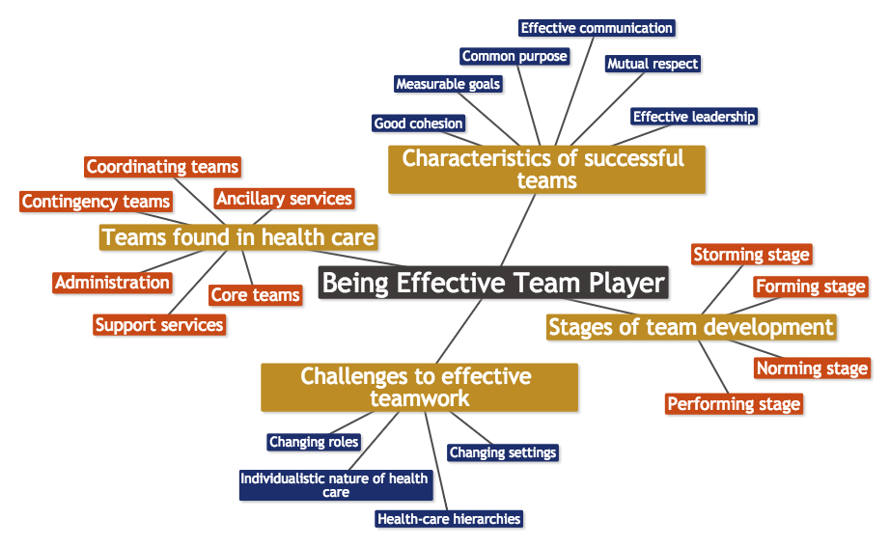
Challenges to effective teamwork
Changing roles | Changing settings | Health-care hierarchies رُتب موظفي الرعاية الطبية | Individualistic nature of health care
In many health-care environments there is considerable change and overlap in the roles played by different health-care professionals. | The nature of health care is changing in many ways, including increased delivery of care for chronic conditions in community care settings and the transfer of many surgical procedures to outpatient centres | Health care is strongly hierarchical in nature, which can be counterproductive to well functioning and effective teams where all members’ views should be considered | Many health-care professions, such as nursing, dentistry and medicine, are based on the autonomous one-to-one relationship between the provider and patient.
Mind map

Slide 55

10
Definition of Community service
- Community is a group of interacting people, living in the
same proximity (in space, time, or relationship).
- Community usually refers to a social unit larger than
a household that shares common values and has
social cohesion
In most cases, community service work is performed by volunteers who are not paid for their time.
Community service: is defined as donated service or activity that is performed by someone or a group of people for the benefit of the public or its institutions.
Some people associate community service with punishment -for offenders as an alternative to jail time..
However, community service can also be altruistic –unselfish-, and it is a vital part of many small communities.
Basically anything which benefits the society in any way can be considered as a community service project or activity.
Mention some examples of community service?
Visiting and spending time with lonely elderly.
Tutoring needy students in their studies for free.
Helping out at organizations such as libraries.
Why to carry out community service?
Benefits the community
The volunteers in the activities also gain a sense of accomplishment
Better social communication skills
Exposure to new peoples and cultures
Overall improved mental health
Health
depends not only on medical care but also on other factors including:
- Individual behavior
- Genetic makeup
- Social and economic conditions
If You Have Any Questions Or Comments Please Inform Us:
professionalism434@gmail.com

Slide 56
Physician and the community
Usually the focus is on the physician - patient relation but the broader sense of responsibility of physicians is towards their community.
Who are health stakeholders?
Health care providers
Public health agencies
Community organizations
Government agencies
Schools
Social services organizations
10 Essential services of stakeholders:
1. Monitor health status to identify community health problems.
2. Diagnose and investigate health problems and health hazards in the community.
3. Inform, educate, and empower people about health issues.
4. Mobilize community partnerships to identify and solve health problems.
5. Develop policies and plans that support individual and community health efforts.
6. Enforce laws and regulations that protect health and ensure safety.
7. Link people to needed personal health services and assure the provision of health care when otherwise unavailable.
8. Assure a competent public and personal health care workforce.
9. Evaluate effectiveness, accessibility and quality of personal and population-based health services.
10. Research for new insights and innovative solutions to health problems.
If You Have Any Questions Or Comments Please Inform Us:
professionalism434@gmail.com
If You Have Any Questions Or Comments Please Inform Us:
professionalism434@gmail.com

Slide 57
Physicians’ role in the community extends to:
A-Public Health | The science and practice of preventing diseases and promoting health in populations. • It depends largely on epidemiology. • Largely performed by governmental organizations. Traditional objective: • To control communicable diseases • Safety of water and food supply • Response to national disasters
B-Educational roles | Educating the public about: • Causes of illness • Preventive measures • Predisposing factors • Changes in lifestyle
C-Improving health care access | Improve the level and ease of access of individuals to health care services by reducing inequalities.
D-Fund raising | May not apply locally since health care services are provided by the governments. Funds may be raised to help those individuals who cannot afford to purchase medications or medical equipments.
E-International Aid | In some areas of the world, health care is very limited and almost non-existent ,most people suffer from diseases such as Malaria, Tuberculosis, Typhoid, and AIDS. Many of the illnesses can be improved or eliminated by basic medical care and other measures. *International community services done through:
Organizations providing humanitarian needs: (General Organizations) | Medical Organizations : | Governments
• Clean water supplies • Clothing • Education | • Medical care • Medications • Immunizations • Medical supplies • Teach communities about nutrition and preventive measures • Training of local health care providers | • Aid to other countries during time of need. May include sending: • Medical professionals • Medical equipments • Medications
If You Have Any Questions Or Comments Please Inform Us:
professionalism434@gmail.com
If You Have Any Questions Or Comments Please Inform Us:
professionalism434@gmail.com

Slide 58
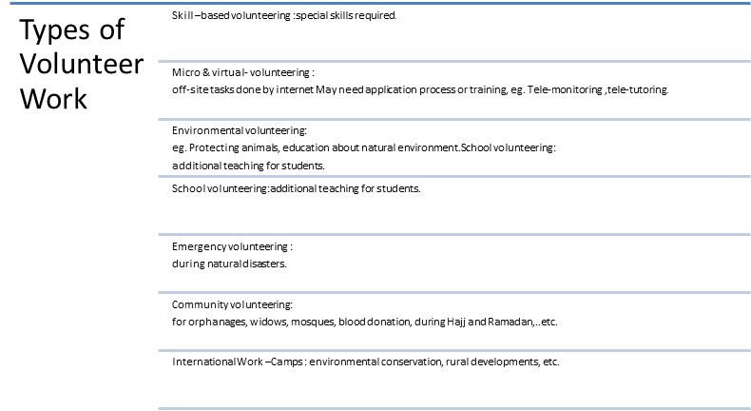
What is the Concept of Volunteering?
Volunteering is generally considered an altruistic activity, intended to improve human quality of life.
Why some people volunteer?
For their own skill development.
To solve problems when needed
To make contacts for possible employment.
To help others and earn respect and favor.
Get benefit of spare time.
Mention the types of volunteer work?
If You Have Any Questions Or Comments Please Inform Us:
professionalism434@gmail.com
If You Have Any Questions Or Comments Please Inform Us:
professionalism434@gmail.com

Slide 59

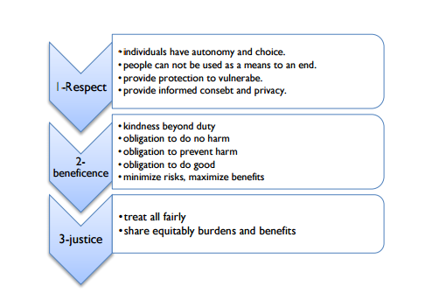
Main Functions of Medical Research:
Monitoring and evaluation of drugs / treatments being used.
Understanding human physiology .
Causes of diseases and the best ways to prevent or cure them.
The development of new treatments, especially drugs, medical devices and surgical interventions.
Factors in human health, including patterns of disease (epidemiology)
The organization, funding and delivery of healthcare (health systems research)
Social and cultural aspects of health (medical sociology and anthropology)
Why do practicing physicians need a good understanding of medical research methods?
All physicians make use of the results of medical research in their clinical practice.
To maintain their competence, physicians must keep up with the current research , they must know how to interpret the results of research and apply them to their patients.
(2) Potential problems for practicing physicians:
The physician’s primary responsibility is the health and well being of the patient, whereas the researcher’s primary responsibility is the generation of knowledge, which may or may not contribute to the research subject’s health and wellbeing.
Conflict of interest when the physician is influenced by financial gains from research or results of the research.Principles of Research with Human Subjects:
11
1. Respect for Persons | 1- معاملة الإنسان كشخصية مستقلة له رأيه الحر دون إكراه.
2. Beneficence | 2- الإحسان ومنع الإساءة كما يجب أن الا يصيب الإنسان الضرر نتيجة للبحث.
3. Justice | 3- العدل في العبء و الفائدة المرجوة من البحث.

Slide 60
Main ethical research requirements:
Elements Should Be Included In An Informed Consent:
Purpose of the research
Procedures involved in the research
Alternatives available should a subject decide not to participate in the research
All foreseeable risks and discomforts to the subject. *Note that these include not only physical injury but also possible psychological, social, or economic harm, discomfort, or inconvenience.
Benefits of the research to society and possibly to the individual human subject
Length of time the subject is expected to participate
Payment for participation (if applicable)
Person to contact for answers to questions or in the event of a researchrelated injury or emergency
Statement that participation is voluntary and that refusal to participate will not result in any consequences or any loss of benefits that the person is otherwise entitled to receive
Subjects' right to confidentiality and right to withdraw from the study at any time without any consequences.
Voluntary consent | For good of society
Animal experiments 1st; | Avoid unnecessary suffering
Do not conduct if death & debility likely human experiments 2nd | Risk commensurate with benefits
Protect subjects against harm | Conducted only by qualified persons
Subjects should be at liberty to discontinue | Terminate if becomes apparent that death or debility will occur.
If You Have Any Questions Or Comments Please Inform Us:
professionalism434@gmail.com

Slide 61
Declaration of Helsinki (DoH)
Important points of :
1. Ethics Review Committee Approval: Medical research on human subjects must be reviewed and approved by an independent ethics committee before it can proceed.
2. Scientific Merit: Medical research involving human subjects must be justifiable on scientific grounds
3. Qualified researchers : Medical research involving human subjects must be conducted by qualified researchers.
4. Social Value: Medical research project should that it contributes to the wellbeing of society in general.
5. Risks and Benefits: It is also necessary for the researcher to demonstrate that the risks to the research subjects are not unreasonable or disproportionate to the expected benefits of the research, which may not even go to the research subjects.
6. Informed Consent: The first principle of the Nuremberg Code reads as follows: “The voluntary consent of the human subject is absolutely essential.
7. Confidentiality Research subjects have a right to privacy with regard to their personal health information.
8. Conflict of Roles The physician’s role in the physician-patient relationship is over the researcher’s role, even if the physician and the researcher are the same person.
9. Honest Reporting of Results Research results be reported accurately, but unfortunately there have been numerous recent accounts of dishonest practices in the publication of research results.
10. Whistle-blowing:In order to prevent unethical research from occurring, or to expose it after the fact, anyone who has knowledge of such behavior has an obligation to disclose this information to the appropriate authorities.
11. Justice:
Equitable selection of participants, i.e., avoiding participant populations that may be unfairly coerced into participating, such as prisoners and institutionalized children. The principle of justice also requires equality in distribution of benefits and burdens among the population group(s) likely to benefit from the research.
Definition: a concise summary of research ethics. Other, much more detailed, documents have been produced in recent years on research ethics in general. Issued by: World Medical Association
If You Have Any Questions Or Comments Please Inform Us:
professionalism434@gmail.com

Slide 62

Informed consent
Definitions:
Voluntary agreement given by a person or a patients' responsible proxy (e.g.a parent) for participation in a study, etc., after being informed of the purpose, methods, procedures, benefits, and risks. The essential criteria of informed consent are that the subject has both knowledge and comprehension, that consent is freely given without duress or undue influence, and that the right of withdrawal at any time is clearly communicated to the patient. Other aspects of informed consent in the context of epidemiologic and biomedical research, and criteria to be met in obtaining it, are specified in International Guidelines for Ethical Review of Epidemiologic Studies and International Ethical Guidelines for Biomedical Research Involving Human Subjects.
The National Committee of Medical & Bioethics consists of the following sub-committees:
The legal sub-committee.
The human research sub-committee.
The flora & animal sub-committee.
The education & media sub-committee.
What the research ethics committees look for in a research proposal?
Scientific design and conduct of the study
Risks and potential benefits
Selection of study population and recruitment of
research participants
Inducements, financial benefits, and financial costs
Protection of research participants’ privacy and confidentiality
Informed consent process
Community considerations

Slide 63
12
what is mentoring | It is a relationship that involves interaction between two people ( mentor and mentee) normally working in a similar field or sharing similar experiences . “It is a professional relationship built within an organization that is intended to target and focus the training of individuals” Significant benefits are associated with mentorship. Effective mentorship is crucial to career success in academic medicine Mentoring is to support and encourage people to manage their own learning in order that they may maximise their potential, develop their skills, improve their performance and become the person they want to be.”
mentoring involves | . Interaction between two people • Mentor (Teacher, Adviser, Role model and friend) • Mentee (student, learner) 2. Normally working in a similar field or sharing similar experiences 3. Significant benefits are associated with mentorship 4. Effective mentorship is crucial to career success in academicmedicine
benifits of mentoring | A career development tool. Develop your skills and help others learn, grow, and improve their skills.
Variation of mentoring based on: | 1. Different human relationships. 2. Different learning needs. 3. Different styles of mentoring.
If You Have Any Questions Or Comments Please Inform Us:
professionalism434@gmail.com

Slide 64
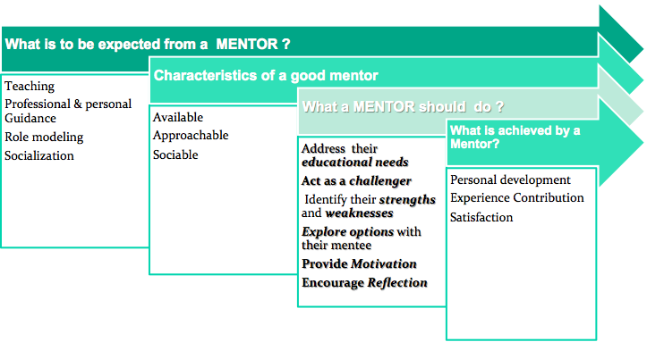
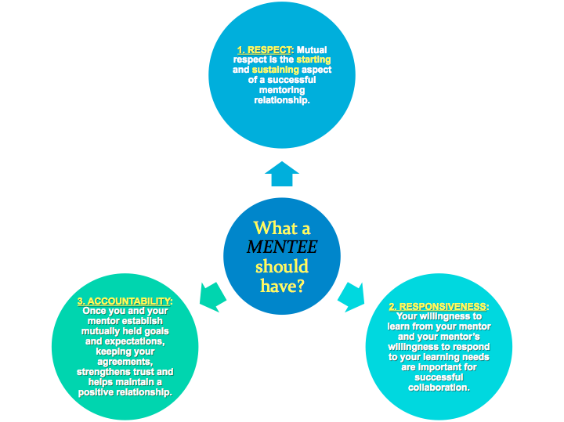
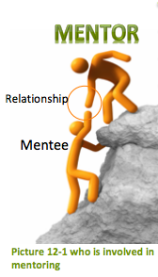
What a MENTEE should consider?
Students are obliged to recognize the multiple demands on a mentor's time.

Slide 65
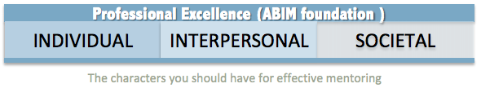
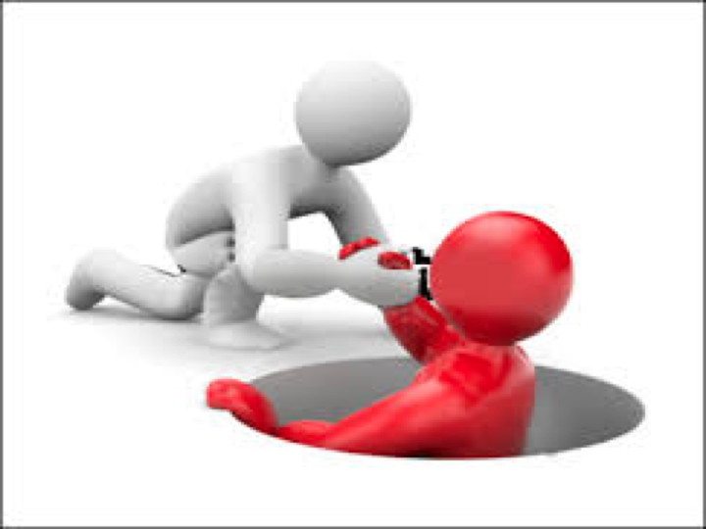
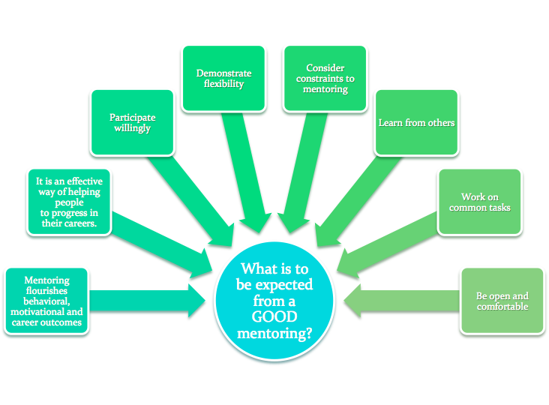
Characteristics of GOOD mentoring
Establish an open communicaton system with mutual feedback Set standards, goals, and expectations Establish trust Care for and enjoy each other Allow mistakes

Slide 66
Summary
AS A MENTOR YOU SHOUD HAVE
The desire to help – you should be willing to spend time helping someone else, and remain positive throughout.
The ability to challenge the mentee in a non-threatening way. Provide Feedback.
AS A MENTEE YOU SHOULD HAVE
Motivation to continue developing and growing and Listen actively
If You Have Any Questions Or Comments Please Inform Us:
professionalism434@gmail.com

Slide 67
13
Characteristics of Professionalism:
Competency.
Responsibilit..
Attitude.
Conduct on the job.
Attitudes Central To Medical Professionalism In Cultural Context
Humility تواضع
Empathy تعاطف
Respect
Sensitivity
Curiosity
Awareness of all outside influences including cultural on patients health
Cultural context
Knowlage | Skills
1.It is important for a medical student or post graduate trainee to learn about the surrounding community in which he/she practices or trains. e.g. Socio economic status, patterns of housing nutritional habits, healing practices and disease incidence and prevalence. 2.The knowledge taught has specific evidence based impact on health care delivery. e.g. How Ramadan fasting affects Muslims who are diabetic. | It is crucial to understand health beliefs of those who come from different cultures or have different health care experiences.
If You Have Any Questions Or Comments Please Inform Us:
professionalism434@gmail.com

Slide 68
Three fundamental principles:
Patient welfare | Patient autonomy | Social justice
1.Professional competence 2.Honesty with patients -- integrity 3.Patient confidentiality 4.Caring attitude 5.Scientific knowledge 6.Maintaining trust Setting and maintaining professional standards |  | 1.A just distribution of resources 2.Managing conflict of interest 3.Improving quality and access to care 4.Respect for colleagues
Cultural Influences,
While providing professional care physician must not impose his / her view on a patient’s:
Life style, culture, beliefs, race.
Sex, age / sexuality.
Social status / economic worth.
Physicians must be prepared to explain and justify
his / her actions and decisions.
CONFIDENTIALITY
Confidentiality concept may not be the same in the East as in the West.
 However its principles are applicable in most settings.

Slide 69
The Centrality Of Patient Physician Relationship To Medical Professionalism Four Possible Consultation Models
PATERNALISTIC MODEL Physician as a parent | Dependent on community’s social values and moral norms Physicians are in the best position to judge what is best for their patients. In a strong form of this, physicians authoritatively order patients to assent (with coercion if necessary). Culturally applicable in Chinese culture and partially in other Far East and South Asian cultures.
DELIBERATIVE MODEL Physician as a MENTOR | Physician objectively knows and prioritizes patient’s personal and medical values. The physician mentor’s grip on decision making is more relaxed than the physician / parent model but autonomy- conscious patients find it unsatisfactory. Culturally this is an option for some of the patients in Eastern countries
INFORMATIVE ENGINEERING MODEL Physicians as TECHNICIANS | Physicians only provide value neutral medical information and leaving patients to make decisions independently based on personal values (total patient autonomy) Physicians treat diseases rather than patients and sick persons are “Consumers”. Culturally applicable To certain sections of Western and relatively less eastern population.
INTERPRETIVE/ COLLEGIAL MODEL Physicians as FRIENDS OR COUNSELLORS | Physician’s medical facts and patients personal values contribute to balanced medical decision-making. Upholds patient autonomy without undermining the physician’s duty of beneficence. Shared decision making Culturally popular in the West Increasingly accepted in the East .

Slide 70

Special Cultural Issues In Professional Care In Different Parts Of The World:
Insistence on eye contact?

Uncovering of face in some females

Undressing of female patients?

Sharing of confidential information with spouses, relatives?

History taking of female adults from parents or husbands?
Giving information to patients in a way they can understand
Accepting gifts or other inducements
You should not ask for or accept any material rewards, except those of insignificant value from representatives of pharmaceutical companies.
Help with conferences and educational activities may be acceptable.
RESEARCH
Research should not be contrary to the patient’s interest e.g. exploitation of developing countries patients.
Research protocol should be approved by a research ethics committee.
This committee may be non existent in many settings.
Your conduct in the research must not be influenced by payments or gifts.
Record your research results truthfully.
Physicians must not exploit patient’s vulnerability or lack of medical knowledge.

Slide 71

Cultural Context In Under-graduate Medical Education
Curriculum:
The goal of the curriculum should be to prepare students to care for patients from diverse social and cultural backgrounds including racial, ethnic and gender biases.
CRASH Course
in Cultural Competency training program for medical professionals. CRASH is a mnemonic for the following essential components of culturally competent health care:
Cultural Competency
Respect
Assess
Sensitivity/ Self Awareness
Humility
The goal of the CRASH-Course in Cultural Competency is to build confidence and competence in the clinician’s ability to communicate effectively with diverse patient populations.
If You Have Any Questions Or Comments Please Inform Us:
professionalism434@gmail.com

Slide 72
Professionalism in Different Cultural Contexts
Partnership: Working with the patient to accomplish a shared outcome
 Empathy: Recognizing and comprehending another’s feelings or experience
Analogy: Being willing to acknowledge or express regret for contributing to a patient’s discomfort, distress, or ill feelings
 Respect: Non-judgmental acceptance of each patient as a unique individual; treating others as you would have them treat you.
 Legitimization: Accepting patient’s feelings or reactions regardless of whether or not you agree with those perceptions.
 Support: Expressing willingness to care and be helpful to the patient however you can.
Culture is directly related to health promotion, disease prevention, early detection, access to health care, trust and compliance
CONCLUSION
Patients are entitled to good standards of professional practice and care in all cultural settings.
The essential elements of this medical professionalism are:
1 - Professional competence.
2 - Good relationship with patients and colleagues.
3 - Observance of professional ethical obligations.
Medical teachers should be a role model’ in application of these essentials .

Slide 73
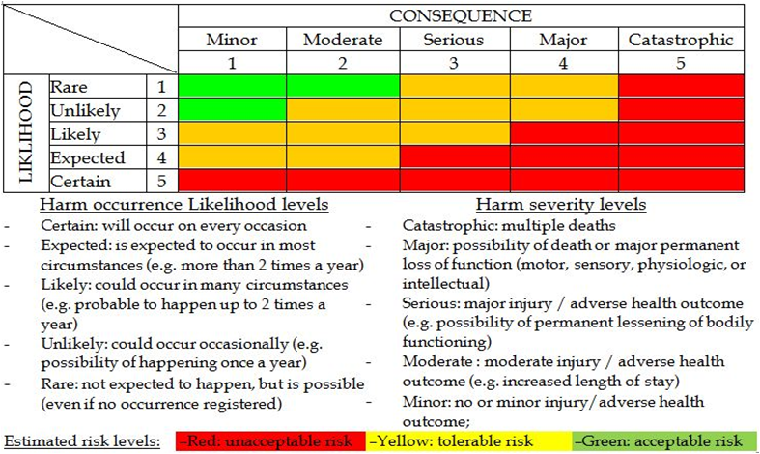
14
Hazard: is any activity, situation or, substance that potential to cause harm, including ill health, injury, loss of product and/or damage to plant and property.
Risk: is the probability that harm (illness or injury) will actually occur
What is clinical risks?
Is the chance of an adverse outcome resulting from: clinical investigation, treatment or patient care
Clinical risk management is a whole systems approach to identifying, assessing, evaluating, minimising and communicating risks associated with clinical activities in order to maximise safety for all parties
Purpose of Risk Management:
Improve organizational and client safety
Identify and minimize the risks and liability losses
Protect the organization resources
Support regulatory, accreditation compliance
Creating and maintaining safe systems of care, designed to reduce adverse events and improve human performance
4 step process to manage clinical risks:
Identify the risk
assess the frequency and severity of the risk
reduce or eliminate the risk
Reviewing the effectiveness of the assessment and action plan Assess the costs saved by reducing the risk or the costs of not managing the risk
Clinical risk assessment tool : (Not important)

Slide 74
Identify the risk | Assess the frequency and severity of the risk | Reduce or eliminate the risk
Use the following data as a sources for risk identification: •Adverse event reports. •Mortality and morbidities reports. •Patient complaints reports. •Assess the frequency and severity of the risk; | SAC (Severity Assessment Code) Score: it is a matrix scoring system/ numerical scores are given to the severity and likelihood of risks and these scores are multiplied to get a rating for the risk | extreme risk-immediate action required high risk-need to notify senior management medium risk-managment responsibility must be specified low risk-manage by routine procedures
Fitness-to-practice requirements: (important)
•Accountability
•Competency of healthcare professionals.
•Are they practicing beyond their level of experience and skill? Are they unwell, suffering from stress or illness
Credentialing | Registration (licensure) | Accreditation
The process of assessing and conferring approval on a person’s suitability to provide specific consumer/patient care and treatment services, within defined limits, based on an individual’s licence, education, training, experience, and competence. | •Registration of health-care practitioners with a government authority, to protect the health and safety of the public through mechanisms designed to ensure that health practitioners are fit to practise. •E.g Saudi Commission for Health Specialties •Proper registration is an important part of the credentialing and accreditation processes | •Is a formal process to ensure delivery of safe, high-quality health care based on standards and processes devised and developed by health-care professionals for health-care services. •National Accreditation Program: CBAHI •International Accreditation Program: Joint commission (US), Accreditation Canada(Canada)

Slide 75
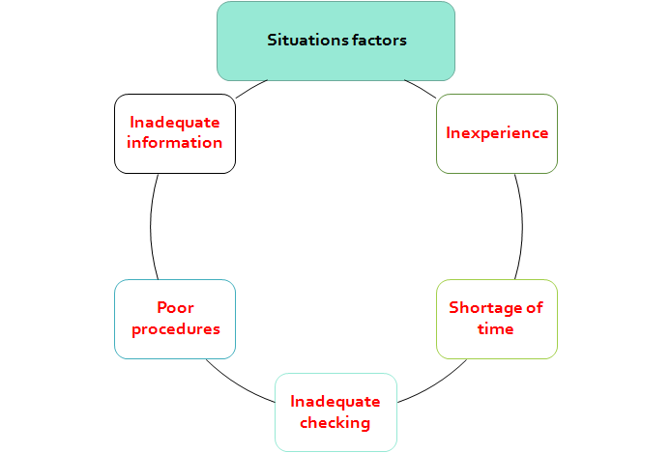
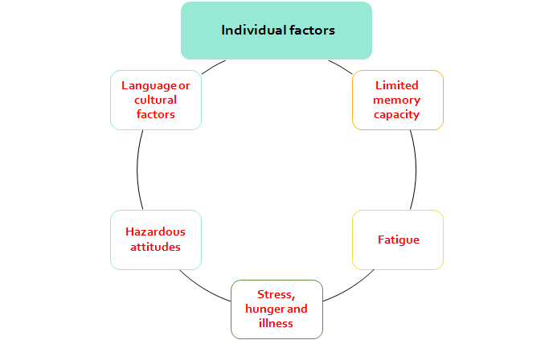
Principal Types of Human errors
A- Mistakes: Failure of planning
Rule-based: E,g: wrong diagnosis end with inappropriate treatment plan
Knowledge-based : E.g: when physicians are dealing with unfamiliar clinical situations
B- Skill-based errors:
Slips error : If the action is observable e.g pushing the wrong button on a piece of equipment
Lapse error : If the action is NOT observable e.g a memory failure, such as forgetting to administer a medication.
Factors Associated with an Increased Risk of Error :
Medical error:
Failure of planned action to be completed as intended or the use of wrong plan to achieve an aim
Violations: are errors caused by deliberate deviation by an individual from an accepted protocol or standard of care.
Types of errors :
Sentinel Event | Is an unexpected occurrence involving death or serious physical or psychological injury ex:opperating on the wrong side or wrong patient. e.g. surgery on the wrong patient or body site, incompatible blood transfusion. •Many health-care facilities have mandated the reporting of these types of events because of the significant risks associated with their repetition
Near Miss | Incidence about to happen but by chance didn’t occur
Adverse Event | Defined as incidents in which harm resulted to a person receiving Adverse Event health care. They include infections, falls resulting in injuries, (include sentinel event +medication error)
Medication Errors | Is any preventable event that may cause or led to inappropriate Medication Errors medication use or patient harm.

Slide 76
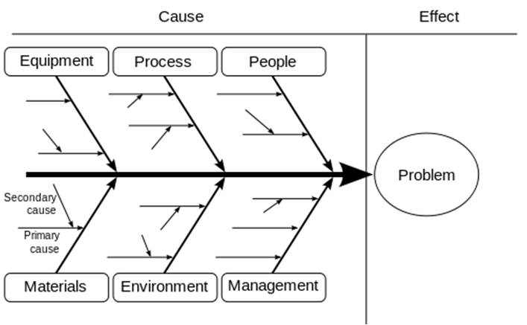
How to capture error? (Important, try to understand the difinitions)
1- Incident reporting :
Is a form that is filled out in order to record details of an unusual event that occurs at the facility, such as an injury to a patient.
the purpose of the incident report is to document the exact details of the occurrence while they are fresh in the minds of those who witnessed the event.
2- Patient complain:
A complaint : is defined as an expression of dissatisfaction by a patient, family member or carer with the provided health care.
•Complaints often highlight problems that need addressing, such as poor communication or suboptimal decision making.
•Communication problems are common causes of complaints, as are problems with treatment and diagnosis.
Benefits of complaints:
Assist the maintenance of high standards;
Reduce the frequency of litigation;
Help maintain trust in the profession;
Encourage self-assessment;
Protect the public.
Root cause analysis (Fish bone analysis)
is an approach for identifying the underlying causes of why an incident occurred so that the most effective solutions can be identified and implemented
*It’s not necessary to fill all of the six it depend on the problem

Slide 77
Action plan and time frame:
Objective (What) | Actions (How) | Responsible (Who) | Timescale (When) | Progress review regularly) and sign off when (completed
Patients fall | Handler | Engineering | 3months | متابعة القضية
Summary
Medical error is a complex issue, but error itself is an inevitable part of being human.
These tips are known to limit the potential errors caused by humans
Avoid reliance on memory
Simplify process
Standardize common processes and procedures
Routinely use checklists
Decrease reliance on vigilance
Learning from error can occur at both an individual level and an organizational level through incident reporting and analysis.
Root cause analysis (RCA) is a highly structured systemic approach to incident analysis that is generally reserved for the most serious patient harm episodes
Health-care professionals are responsible for the treatment, care and clinical outcomes of their patients.
Personal accountability is important, as any person in the chain might expose a patient to risk.
One way for professionals to help prevent adverse events is to identify areas prone to errors.
The proactive intervention of a systems approach for minimizing the opportunities for errors can prevent adverse events.
Individuals can also work to maintain a safe clinical working environment by looking after their own health and responding appropriately to concerns from patients and colleagues.

Slide 78
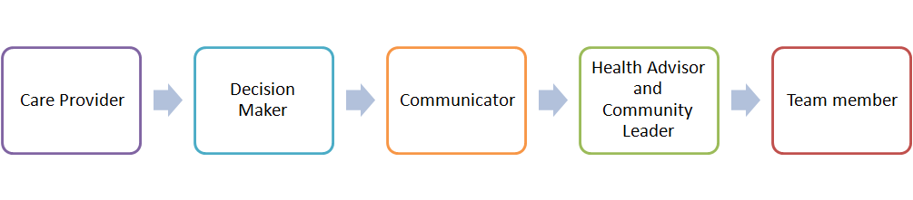
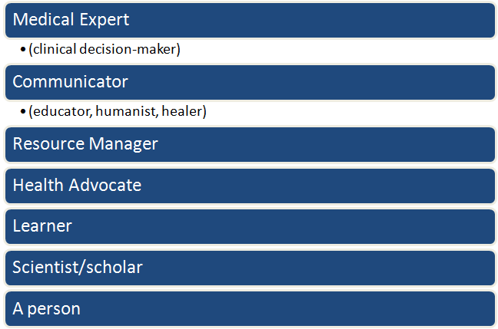
World Health Organization:
5-Star Doctor
15
7 Roles of the Physician :
Key Elements of a Good Physician:
Altruism
Accountability
Excellence
Duty
Honor/Integrity
Respect for Others
Professionalism is the basis of Medicine’s contract with society
Professionalism is Attributes and behaviors that serve to maintain patient interests above physician self-interest.
3 General Principles
Patient Welfare
Patient Autonomy
Social Justice
How can I make professionalism more concrete for learners?
Describe professionalism, or lapses of it, in terms of specific behaviors.
Categorize levels of professionalism and describe examples for each level.
Review professionalism scenarios

Slide 79
(11) Professional Responsibilities :
Examples of Unprofessional Behavior: (Read)
Professional Competence | Patient Confidentialiy | Cooperation and Collegiality | Improving access to care | Professional Responsibilities | Scientific Knowledge
Honesty | Appropriate Relations with Patients | Open and Honest Relationships with Colleagues and 3rdparties | Improving the health of the community | Maintaining trust by maintaining conflicts of interest
A final-year medical student has caused disruptions throughout the course by monopolizing time in tutorials, behaving inappropriately with patients and being unwilling to heed advice. Many patients refuse to be interviewed by her/him and have complained to staff. S/he has not failed any exams, but several tutors and nurses have raised concerns about the student's "attitude" and ability to work as an intern.
A senior doctor, head of a high profile department, is known to bring in research dollars, to be very hard working and adept at specialized medical procedures. S/he is well known for shouting at nurses, throwing instruments back at them, and humiliating junior medical staff. S/he is often absent from department, Complaints are made to hospital administration from staff members; increased numbers of "critical incidents" and staff resignations are noted.
A general practitioner is consistently late or absent for pre-scheduled sessions. S/he gives no explanation, leaving the partners to fill in and make excuses. When confronted, s/he becomes abusive in front of office staff and patients.

Slide 80

What is Unprofessionalism?
Not pertaining to the characteristic of a profession
Medical Unprofessionalism:
Do not have to wait until patient dies to determine that medical care suffered
Unprofessional Behavior:
Unprofessional behavior is a broad term which results in:
1- Abuse of power | Abuse while interacting with patients and colleagues; bias and sexual harassment; and breach of confidentiality
2- Arrogance | Offensive display of superiority and self-importance
3- Greed | When money becomes the driving force
4- Misrepresentation | lying, which is consciously failing to tell the truth; and fraud, which is conscious misrepresentation of material fact with the intent to mislead
5- Impairment | Any disability that may prevent the physician from discharging his/her duties
6- Lack of conscientiousness | failure to fulfill responsibilities
7- Conflicts in interests | Self-promotion/ advertising or unethical collaboration with industry; acceptance of gifts; and misuse of services – overcharging, inappropriate treatment or prolonging contact with patients
Increased workplace difficulties
Decreased morale in other staff
Decline in patient care

Slide 81
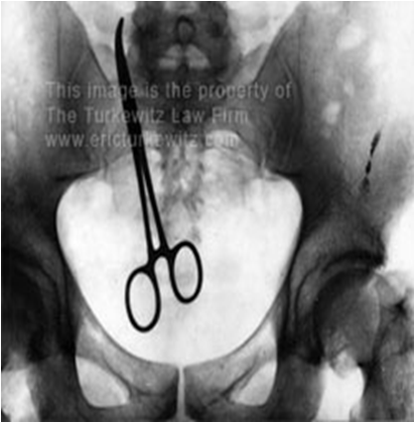
Categories of unprofessional behavior:
1. Illegal or criminal acts:
A physician may be disciplined and lose his medical license based solely on the fact that he was convicted for a crime or offense.
2. Immoral acts:
Fall into the limited category of sexual activity with individuals that may be patients.
3.Business related acts:
These acts are related to the operation of the business, not the quality of the care.
Obtain, maintain, or renew a license to practice medicine by bribery, fraud or misrepresentation
4. Acts that violate acceptable medical practices: 3 categories
Negligent practice
Is an act by a health care provider in which the treatment provided falls below the accepted standard of practice in the medical community and causes injury or death.
Failure to maintain records of a patient, relating to diagnosis, treatment and care
Altering medical records
Failure to make medical records available for inspection
5. Plagiarism:
Is an unethical, dishonest act whereby an individual uses the work of another, commit literacy theft, or present work as an original idea without crediting the source or stating that it is derived from an existing source.
Types of plagiarism:
Quality of care
Negligent practice
Administrative
Using data for example; statistics, graphs, and drawings without acknowledging sources
Repeating another person’s apt phrase without acknowledgement
Using another person’s sentences or arguments as if they were your own
*Presenting another person’s idea, opinion, or theory in the development of an argument as though it is your own

Slide 82
Unprofessional physician:
Impaired
Disruptive behavior
Dishonest
Greedy
Abuses power
Lacks interpersonal skills
Conflict of interest
Self-serving
Impairment:
Impairment means more than making incorrect diagnosis.
1. Avoidance of patients and their psychological needs
2. Dehumanized care
3. Inappropriate treatment
Disruptive behavior:
Behavior that interferes with work or creates a hostile environment
behavior that creates stressful environments and interferes with others’ effective functioning
Include repeated episodes of:
Sexual harassment
Racial or ethnic slurs
Intimidation and abusive language
Persistent lateness in responding to calls at work
Early warning signs:
Late or incomplete charting
Delayed or no responses to call or pagers
Abusive treatment of staff
Unkempt appearance and dress
Inability to accept criticism
Gender or Religious bias bias
Complaints as indicators of unprofessional behavior
20–25% apparently disappoint their patients
More than 2/3 of physicians never or very rarely generate patient complaints (Hickson et al. 2002, 2007a,2007b).
A total of 6% of doctors, however, received 25 or more complaints over a 6-year period
Nurse surveys suggest that 4–5% of physicians display such behavior
The eyes and ears of patients, visitors and healthcare team members are considered to be the most effective surveillance tools for detecting unprofessional behavior

Slide 83
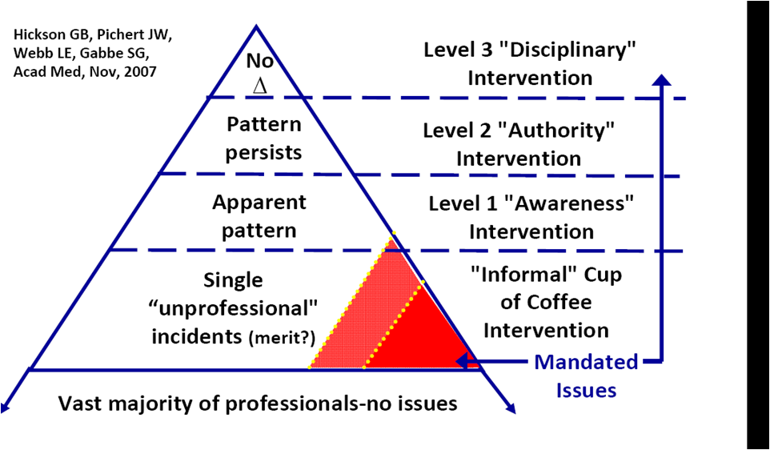
Disruptive behavior pyramid:
What does formalizing a response need?
It needs cost + time
Potential benefits of formalizing a response
cost-saving
Builds the trust of public/patient
Improves the healthcare services
Dealing with unprofessional behavior:
Surveillance | Registration

Slide 84
Summary
1) Not pertaining to the characteristic of a profession.
2) Unprofessional behavior fall into five categories:
Illegal or criminal acts
Immoral acts
Business related acts
Acts that violate acceptable medical practices
Plagiarism
3) Do not have to wait until patient dies to determine that medical care suffered.

Slide 85
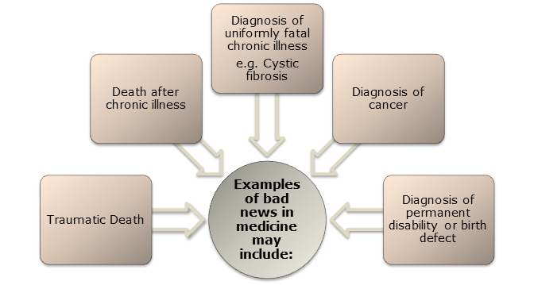
16
What is “Bad News” in Medicine?
Information that produces a negative alteration to a person’s expectation about their present and future could be deemed Bad News
Your Bad News may not be my Bad News.
Bad News doesn’t have to be fatal
Bad News doesn’t have to seem so bad to the medical practitioner.
To some patients or to their families“Bad News” may also include;
Unexpected admission to ICU
Long bone fracture
H1N1 influenza
Need for surgery e.g. Hernia or Appendicitis
“Bad News” Consensus:
Ensure Privacy and Adequate Time
Provide Information Simply and Honestly
Encourage Patients to Express Feelings
Arrange Review
Discuss all the available Treatment Options
Breaking Bad News “Options”
Nondisclosure | Full Disclosure | Individualized Disclosure
- | Give all information As soon as it is known | Tailors amount and timing of information Negotiation between doctor and patient As soon as it is known
Provide Information About Support Services
Document Information Given

Slide 86
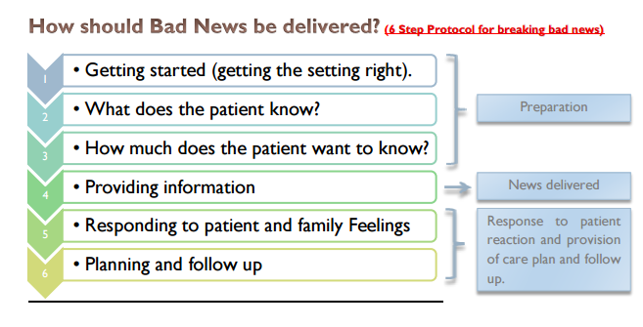
Basic Principles
When to be informed ? | -As soon as information is clearly known -Don’t pass on unsure information too soon
Where to be informed ? | -Private setting - In person, not on phone
Support persons present? | -Both parents -Other support people, family, friends, hospital support
Challenges. It’s a difficult task because; | It is frequent and stressful Most patients want to know the truth The truth is unpleasant and will upset the patients We are anxious and fear negative evaluation
If You Have Any Questions Or Comments Please Inform Us:
professionalism434@gmail.com

Slide 87
Steps 1,2,3 : Preparation
Prepare Yourself | B. Prepare Your Setting | C. Prepare Your Patient
1. Have your facts right first. 2. Familiarise yourself with the patient's background, medical history, test results and possible future management. 3. Mentally rehearse the interview including likely questions and potential responses. 4. Relatives can be in attendance, however you should be guided by the wishes of the patient | 1. Meet in a quiet room. 2. Arrange some privacy and ensure you are not going to be disturbed. 3. If you have recently examined the patient allow them to dress before the interview | 1. What do they know already? 2. What do they want to know? 3. Some patients do not want detail 4. Build up gradually
Step 4:
Use basic communication skills: use simple language, listen, follow up verbal and non-verbal cues.
Start at the level of comprehension and vocabulary of the patient.
Avoid excessive bluntness, as it is likely to leave the patient isolated and later angry.
Set the tone. "I am afraid I have some bad news".
Give the information in small chunks
Avoid using hopelessness terms
Be truthful, gentle and courteous.
Offer hope.
Emphasize the positive.
Allow questions.
If You Have Any Questions Or Comments Please Inform Us:
professionalism434@gmail.com

Slide 88
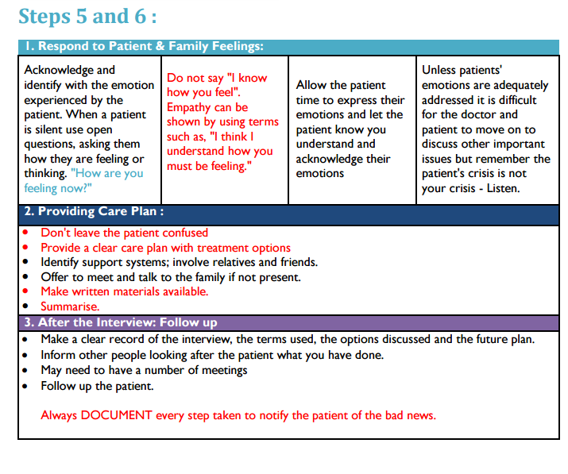
What Not to Do ?
Don’t Break bad news over the phone.
Don’t Avoid the patient.
Don’t Leave patient in suspense.
Don’t Lie to the patient.
Don’t Tell patient if he or she doesn't want to know.
Don’t Interrupt excessively.
Don’t Use jargon.
Don’t Give excessive information as this causes confusion.
Don’t Be judgmental.
Don’t Give a definite time span (just say "days to weeks" or "months to years" etc.
Don’t Pretend treatment is working if it isn't.
Don’t Say “Nothing can be done”.
Do not say "I know how you feel".
Instead
"I think I can understand how you must be feeling."

Slide 89
Breaking Bad News “in the Emergency Department”
It is a difficult task because | Families do not have time to prepare for the bad news. Practitioners do not have a prior relation with patient or family A stressful situation for practitioners.
Death notification | BE READY FOR Initial reaction of eruption of grief Reactions are varied and Culturally determined Very rarely yet chances of hostile reaction towards the staff | WHAT TO DO? Physician should stay in room with family: As a resource As a silent presence Remind family members (especially other children) that it was not their fault.
 | Follow the GRIEV_ING Protocol
The GRIEV_ING Protocol | G : Gather the family. R : Resources : call for support to assist the family. I : Identify yourself , identify the deceased patient by name and the knowledge to be disclosed to the family. E : Educate family about the event that occurred for their deceased in the emergency. V : Verify that their family member has died (dead). - : Space ; give the family personal space and time for emotional moment and absorb the information.

Slide 90
The purpose of Quality improvement methods
Identify a problem.
Measure the problem.
Develop a range of interventions designed to fix the problem
Test whether the interventions worked.
The science of improvement
The following four components of knowledge that underpin improvement:
17
A) Appreciation (Understand ) of A System: Most patient care outcomes or services result from a complex system of interaction between health-care professionals, (doctors, nurses, patients, treatments, equipment, procedures, theatres and so on). | B) Understanding of Variation: There is extensive variation in health care and patient outcomes can differ from one ward to another, from one hospital to another. Variation, though, is a feature of most systems. Shortages of personnel, drugs or beds can lead to variations of care.
C) Theory of knowledge When health professionals have experience and knowledge of the area they wish to change it is more likely that the change will result in an improvement. For example, health professionals who work in particular health-care settings such as a clinic may be better at predicting the results of a change in this environment. Because they have more knowledge about these clinics and the way they | D) Psychology Understanding the psychology of how people interact with each other and the system Example: A medical ward, includes a number of people who will vary in their reactions to a similar event such as introducing an incident monitoring system.
We do not need to understand these components in depth to apply the knowledge. we can drive a car without understanding how it works.
If You Have Any Questions Or Comments Please Inform Us:
professionalism434@gmail.com

Slide 91
The role of measurement in improvement
Measurement (collect and analyze data )is an essential component of quality Improvement.
There is strong evidence to show that when people use the appropriate measures to measure change, significant improvements can be made.
All quality improvement methods rely on measurement
.
Three main types of measures:
Change Concepts
A general idea, with proven merit and sound scientific or logical foundation, that can stimulate specific ideas for changes that lead to improvement.
Asking what changes can be made to improve a particular situation
Example :improved study habits, tension with a family member, a teacher or difficulties at work
Outcomes Measures نتيجة | Processes Measures عملية | Structure Measures
Represent the ultimate goal of healthcare Example: The 30-day mortality rate,morbidity ,readmission, infection. | Represent the delivery of specific clinical services to patients, are often based upon clinical guidelines. Example: The percentage of patients hospitalized for myocardial infarction who are treated with a beta blocker at the time of discharge ,complaince, daily use.. | Structure Measures (Number): Represent the characteristics of individual healthcare providers, organizations, and facilities. Example: Nursing to patient ratio in the ICU (Number)

Slide 92
Change Concepts
The following nine (9) general categories:
Eliminate waste | Look for ways of eliminating any activity or resource in the hospital or clinic that does not add value to patient care
Improve workflow | Improving the flow of work in processes is an important way to improve the quality of patient care delivered by those processes.
Optimize inventory | Inventory of all types is a possible source of waste in organizations; understanding where inventory is stored in a system is the first step in finding opportunities for improvement.
Change the work environment | Changing the work environment itself can be a high-leverage opportunity for making all other process changes more effective
Enhance the health provider/patient relationship | To benefit from improvements in quality and safety of health care, the health-care professionals and patients must recognize and appreciate the improvements
Manage time | An organization can get more achieved by reducing the time to deliver health care, develop new ways of delivering health care, reducing waiting times for services and cycle times for all services and functions in the organization.
Manage variation | Reducing variation improves the predictability of outcomes and helps reduce the frequency of adverse outcomes for patients.

Slide 93
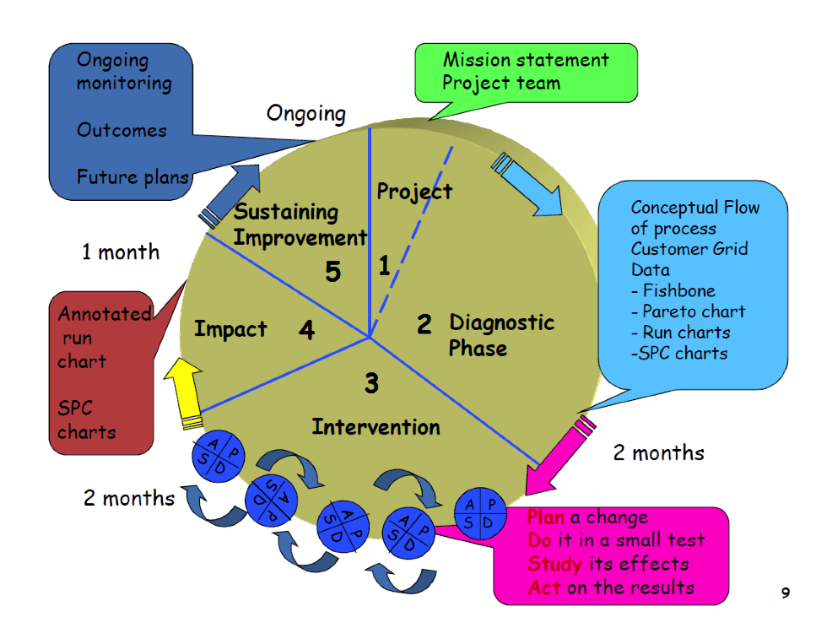
Design systems to avoid mistakes | Organizations can reduce errors by redesigning the system to ensure that there is redundancy i.e. multiple checks and balances to combat human error.
Focus on the product or service | Although many organizations focus on ways to improve processes, it is also important to address improvement of products and services
continuous improvement methods:
There are a number of examples of quality improvement methods in health care but the two most relevant to medical setting are:
Clinical practice improvement(CPI) methodology;
Root cause analysis(RCA).
PDSA (plan-do-study-act)
Not important

Slide 94
improvement model- (Plan-do-study-act cycle):
The IHI model has two parts:
Three fundamental questions, which can be addressed in any order
The PDSA cycle to test and implement changes in real work settings—the PDSA cycle guides the test of a change to determine if the change is an improvement.
The questions are: (Read only)
1. What are we trying to accomplish?
It is important that the team agrees that a problem exists and that it is worthwhile fixing.
2. How will we know whether a change is an improvement?
An improvement can only be confirmed when the measures show things were improved over time.
3. What changes can we make that will result in an improvement?
the team testing the different interventions used to make the improvements.
ACT PLAN
STUDY DO
If You Have Any Questions Or Comments Please Inform Us:
professionalism434@gmail.com

Slide 95
Root cause analysis (RCA): (Method)
Is a defined process that seeks to explore all of the possible factors associated with an incident by asking what happened, why it occurred and what can be done to prevent it from happening again.
Requires the following components.
Multidisciplinary team (More than one)
Root cause analysis effort is directed towards finding out what happened:
  Documentation and review (medical records, incident forms, hospitals guidelines, literature review;
  Site visit—to examine the equipment, the surroundings and observe the relationships of the relevant staff;
Event fishbone is a key part of the investigation as it:
Helps to form a common understanding of what happened;
Allows the team to develop problem statements
The team develops a problem statement
Establishing the contributing factors or root causes are accomplished through:
A brainstorming process of all possible factors:
Environmental factors: e.g. The work environment; medico-legal issues.
Organizational factors: e.g. Staffing levels; policies; workload and fatigue.
Team staff factors: e.g. Supervision of junior staff; availability of senior doctors.
Individual staff factors: e.g. Level of knowledge or experience.
Task factors: e.g. Existence of clear protocols and guidelines.
Patient factors: e.g. Distressed patients; communication and cultural barriers between patients and staff; multiple co-morbidities.

Slide 96
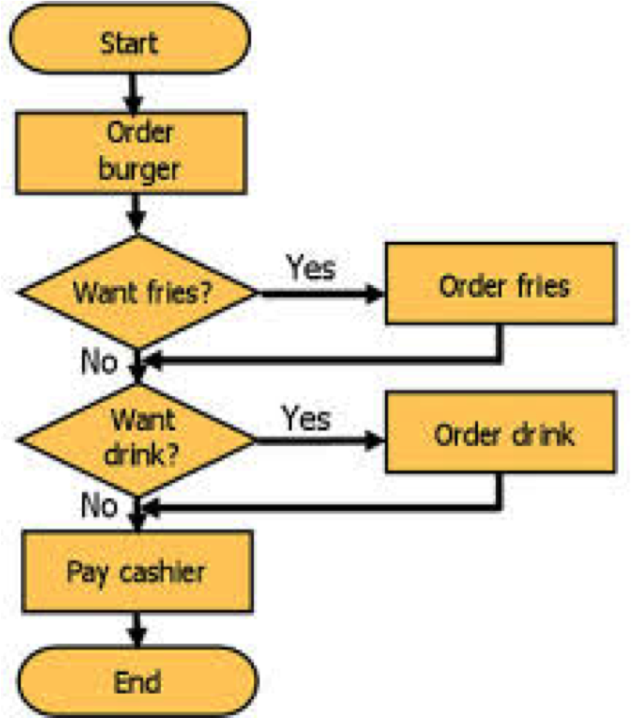
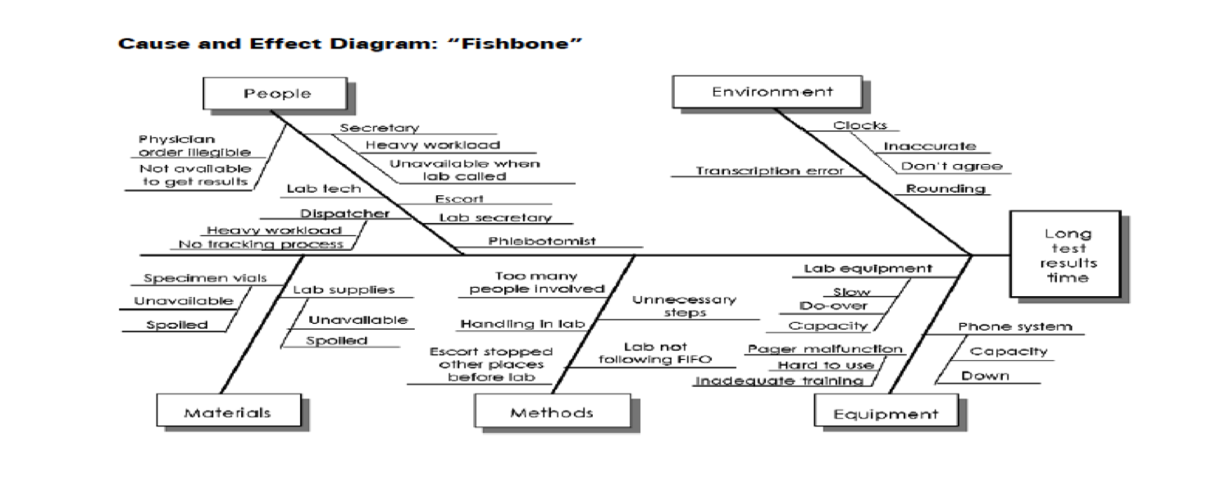
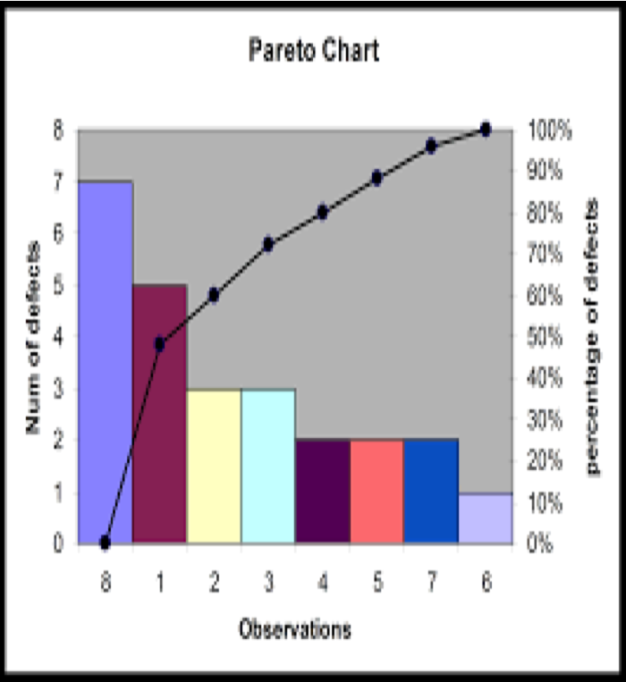
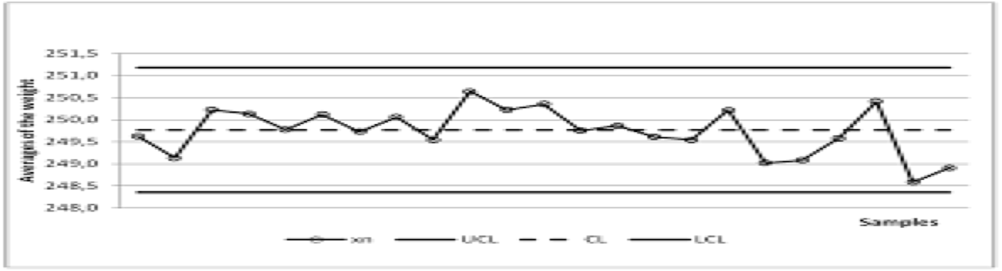
Quality improvement tools: (important)
Flowcharts (to facilitate A process..)
A flowchart is a pictorial method for showing all the
steps or parts of a process that makes up the system.
Cause and effect diagrams(ishikawa/fishbone) for RCA
A tool for solving problems. The diagram is used to explore and display the possible causes of a certain effect
Pareto charts
A bar chart in which the multiple factors that contribute to the overall effect are arranged in descending order according to the magnitude of their effect.
It helps the team concentrate its efforts on the factors that have the greatest impact
Run charts (TIME)
Run charts or time plots are graphs of data over time.
A run chart helps the team know if a change is an improvement over time or just a random fluctuation wrongly interpreted as significant improvement.

Slide 97
Summary
The patient care improves and errors are minimized when clinicians use quality improvement methods and tools.
You cannot manage what you cannot measure’.
Plan –Do – Check – Act’ cycle, plays a key role in quality and productivity improvement activities.
Flowcharts; fishbone; Pareto charts; and Run charts are effective tools for improvement
اللهم إني أستودعك ما قرأت و ما حفظت و ما
تعلمت، فرده عند حاجتي إليه، إنك على كل شيء قدير، حسبنا
الله و نعم الوكيل..

