Slide 1
Cerebrospinal Fluid (CSF) Analysis for total protein

Slide 2
CSF sample
The specimen should be delivered to the laboratory immediately after collection
Glucose and protein estimations should be performed as soon as possible after drawing the CSF specimen
If testing is to be delayed, the specimen should be frozen at – 20⁰ C.

Slide 3
Physical Examination
Turbidity
Clear- normal
Cloudy/ turbid- may indicate the presence of white, or red blood cells, microorganisms, or an increase in protein level

Slide 4
Physical Examination
Color
Colorless- normal
Yellow, orange-brown, or red- may indicate the presence blood

Slide 5
Physical Examination
Viscosity
Normal CSF should have the same consistency as water
Thicker CSF may be seen in patients with certain types of cancers or meningitis.

Slide 6
Chemical Analysis
Routinely performed biochemical tests in CSF are:
glucose
protein (total and specific)
lactate
lactate dehydrogenase
glutamine and acid-base parameters

Slide 7
Remember !!
Before any analysis, the fluid should be centrifuged to avoid contamination by cellular elements
CSF is the most precious biological material. Often, only small volumes of CSF are available for analysis due to difficulty in collection; hence handle this with care
The specimen may contain virulent organisms, so strict safety precautions should be followed.

Slide 8
CSF Protein Assay
Protein present in the CSF is detected by a kit based on Biuret method.
Biuret reagent when interacts with the peptide bonds in the protein give a blue coloured product
The intensity of the colour is proportional the amount of protein in CSF

Slide 9
CSF Protein Assay
Color intensity is determined by measuring the absorbance by the colored solution at a wavelength of 546nm
Absorbance is measured by an instrument, spectrophotometer

Slide 10
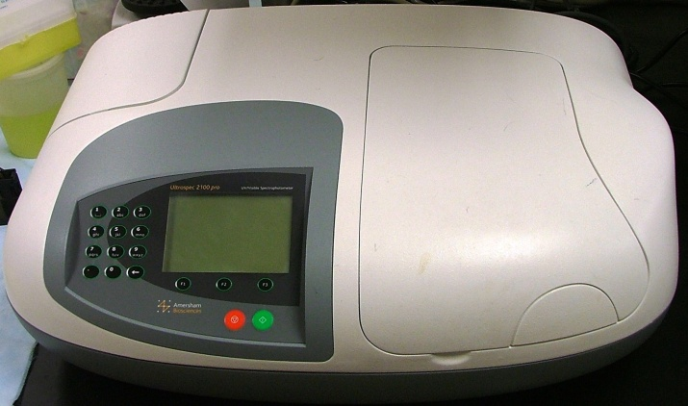
Spectrophotometer
Most of visible spectrophotometers are composed of:
Light source which works with visible wavelengths (400-700 nm)
Monochromator filter for choosing desired wavelength
Sample holder (cuvette)
Detector
Meter or recorder

Slide 11
Procedure
 | Test | Standard | Blank
Reagent | 2 ml | 2 ml | 2 ml
CSF sample | 40 μl | - | -
Standard | - | 40 μl | -
H₂O | - | - | 40 μl
Mix and incubate for 15 minutes at room temperature
Measure absorbance at 546 nm

Slide 12
Calculation
Protein conc (g/L) =
Abs of sample
X
Conc of standard (60g/L)
Abs of standard

Slide 13
Normal Range
Normal reference values for CSF protein:
15-45 mg/dL (0.1 -0.4 g/L)

Slide 14
CSF Examination Report
Physical examination
Volume
Color
Appearance
Viscosity
Chemical examination
CSF protein concentration (g/L)
Group number&Student names

Slide 15
Abnormal findings of CSF in some pathological conditions
Condition |  |  |  | Parameter
Brain Tumor | Viral Meningitis | Tuberculous Meningitis | Bacterial Meningitis
↑ | Normal | ↑ ↑ | ↑ ↑ | Protein
↓ | Normal or slightly ↓ | ↓ ↓ | ↓ ↓ | Glucose
Normal or ↓ | Normal or ↓ | ↓ ↓ | ↓ ↓ | Chlorides

