Slide 1
Microbiology of Middle Ear Infections prof. hanan habib & dr.ali somily pathology & laboratory medicine college of medicine, KSU

Slide 2
Objectives
Upon completion of the lecture , students should be able to:
Define middle ear infection
Know the classification of otitis media (OM).
Know the epidemiology of OM
Know the pathogenesis & risk factors of OM.
List the clinical features of OM.
Know the diagnostic approaches of OM.
Know the management of OM.
Recall common complications of OM.

Slide 3
Definitions
Middle ear is the area between the tympanic membrane and the inner ear including the Eustachian tube.
Otitis media (OM) is inflammation of the middle ear.

Slide 4
Anatomy of the Middle Ear

Slide 5
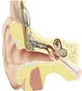
OM-Classification
Acute OM
Secretory ( Serous) OM
Chronic OM

Slide 6
OM- Epidemiology
Most common in infants 6 to 18 months of age (2/3 of cases). Improves with age, why ?
The Eustachian Tube which vents the middle ear to the nasopharynx is horizontal in infants, difficult to drain naturally, its surface is cartilage ,and the lymphatic tissue lining is an extension of adenoidal tissue from the back of the nose.
Accompanied by viral upper respiratory infection (URTI).

Slide 7
OM-Pathogenesis and Risk Factors
URTI or allergic condition cause edema or inflammation of the tube.
Functions of the tube ( ventilation, protection and clearance ) disturbed.
Oxygen lost leading to negative pressure
Pathogens enter from nasopharynx into the middle ear.
Colonization and infection result.

Slide 8
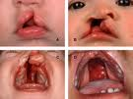
OM- Other risk factors
Anatomic abnormalities
Medical conditions such as Cleft palate ,obstruction due to adenoid or nasogastric tube tube or malignancy, immune dysfunction.
Exposure to pathogens from day care.
Exposure to smoking.

Slide 9
OM-Microbiology-Bacterial Causes
Acute OM
< 3months of age
> 3 months of age
S.pneumoniae,(40%) group B Streptococcus, H.influenzae (non typable) ,Gram negative bacteria including P.aeruginosa
S.pneumoniae, H.influenzae ,others eg. S.pyogenes, Moraxella catarrhalis, S.aureus

Slide 10
OM-Microbiology-cont.
Chronic OM
Serous OM
Mixed flora in 40% of cases
P.aeruginosa, H.influenzae, S.aureus, Proteus species, K.pneumoniae, Moraxella catarrhalis, anaerobic bacteria.
Same as chronic OM, but
most of the effusions are sterile
Few acute inflammatory cells

Slide 11
OM-Viral causes
RSV( Respiratory Synsechial Virus) -74%
Rhinovirus
Parainfluenza virus
Influenza virus

Slide 12
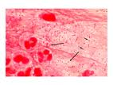
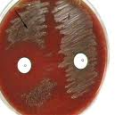
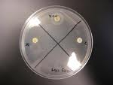
Microbiology of OM

Slide 13
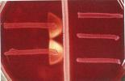
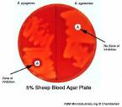
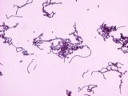
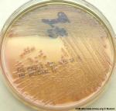
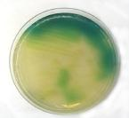
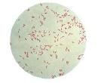
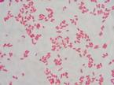
Microbiology of OM-continue

Slide 14
Clinical presentation
Acute OM
Mostly Bacterial ,often a complication of viral URTI. Pain often severe and continuous in bacteria causes.
First 1-2 days:
Fever (39 C), irritability, earache , muffled nose.
Bulging tympanic membrane ,poor mobility and obstruction by fluid or inflammatory cells on otoscopic examination.

Slide 15
3-8 days:
Pus and ear exudative discharge released spontaneously then pain and fever begin to decrease.
2-4 weeks :
Healing phase, discharge dies up and hearing becomes normal.

Slide 16
Images of acute OM

Slide 17
Serous OM (OM with effusion)
Collection of fluid within the middle ear as a result of negative pressure produced by altered Eustachian tube function.
Represent a form of chronic OM or allergy-related inflammation.
Over weeks to months, middle ear fluid become very thick and glue like( glue ear)
Tends to be chronic , with non –purulent secretions.
Cause conductive hearing impairment.

Slide 18
Images of serous OM

Slide 19
Chronic OM
Usually result from unresolved acute infection due to inadequate treatment or host factors that perpetuate the inflammatory process.
Involves perforation of tympanic membrane and active bacterial infection for long period.
Pus may drain to the outside (otorrhea).
Result in destruction of middle ear structures and significant risk of permanent hearing loss.

Slide 20
Images of chronic OM

Slide 21
Diagnostic approaches of OM
Clinical examination
Tympanometry ( detect the presence of fluid)
Gram stain and culture of aspirated fluid to determine the etiologic agents.

Slide 22
Management of OM
Acute OM requires antimicrobial therapy & careful follow up.
Antimicrobial usually empirical depending on the most likely bacterial pathogens, usually to cover S.pneumonia and H.influenzae.
Drainage of exudate may be required.
Chronic or serous OM need complex management, possibly surgical.

Slide 23
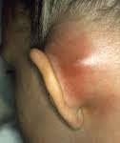
Complications
Intracranial
Extracranial
Hearing loss
Tympanic membrane perforation
Mastoiditis
Cholestatoma
Labyrinthitis
others
Meningitis
Extradural abscess
Subdural empyema
Brain abscess
others

