Slide 1
Viral infections of CNS
(CNS Block , Microbiology : 2016)
By: Dr.Malak M. El-Hazmi

Slide 2
Virus neurological diseases:
Acute viral infections of the CNS.
Chronic virus neurological diseases.
Neurological diseases precipitated by viral infections.

Slide 3
OBJECTIVES;
Acute viral infections of the CNS.
Aseptic meningitis , Paralysis &Encephalitis
;
Enteroviruses & polioviruses.
Herpes simplex virus 1.
Rabies virus.
Arboviruses (West Nile virus).
structure
Epidemiology
Pathogenesis
clinical presentations
Lab diagnosis
Treatment & prevention

Slide 4
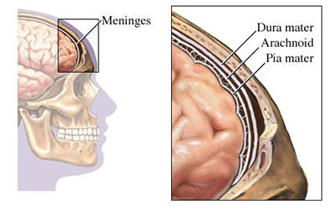
Meningitis
Caused by:
Infectious agents ;
bacteria
viruses
fungi
protozoa
Non-infectious agents.

Slide 5
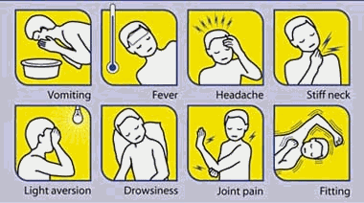
Viral Meningitis
Bacterial Meningitis
Caused by bacteria
Quite severe and may result in
a) brain damage
b) hearing loss
c) learning disability
It would also causes death!
Aseptic meningitis
Caused by virus.
Less severe
Resolves without specific
treatment within a week or two

Slide 6
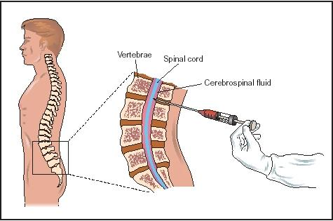
Cerebrospinal fluid (CSF) analysis ;
 | Normal | Aseptic meningitis | Septic meningitis
Colour | Clear | Clear | Cloudy
Cells/mm³ | < 5 | increase 100-1000 Lymphocytes | High/v. high 200-20,000 Neutrophils
Glucose mg/dl | 45-85 | Normal* | Low<45
Protein mg/dl | 15-45 | Normal/high 50-100 | High>100
Causes |  | Viruses* , others | Bacteria

Slide 7
Viral Meningitis (Aseptic meningitis)
Etiological Agents:
Enteroviruses .**
Other :
Mumps virus .
Arboviruses.
Herpes viruses.
Human Immunodeficiency Virus.
…..

Slide 8
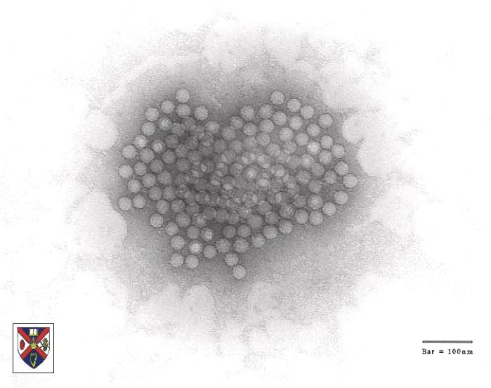
Enteroviruses
- Picornaviridae
Include ;
Poliovirus(1, 2&3 types)
Coxsackieviruses (A&B)
Echoviruses
Enteroviruses (68-71)
Nonenveloped , icosahedral , ss (+) RNA

Slide 9
Epidemiology
Reservoir : Human
Spread :
Fecal - oral route (mainly)
Inhalation of Infectious aerosols
(Crowded, Poor hygiene & Sanitation)
Age : children > adults
Seasonal distribution:
summer & fall

Slide 10
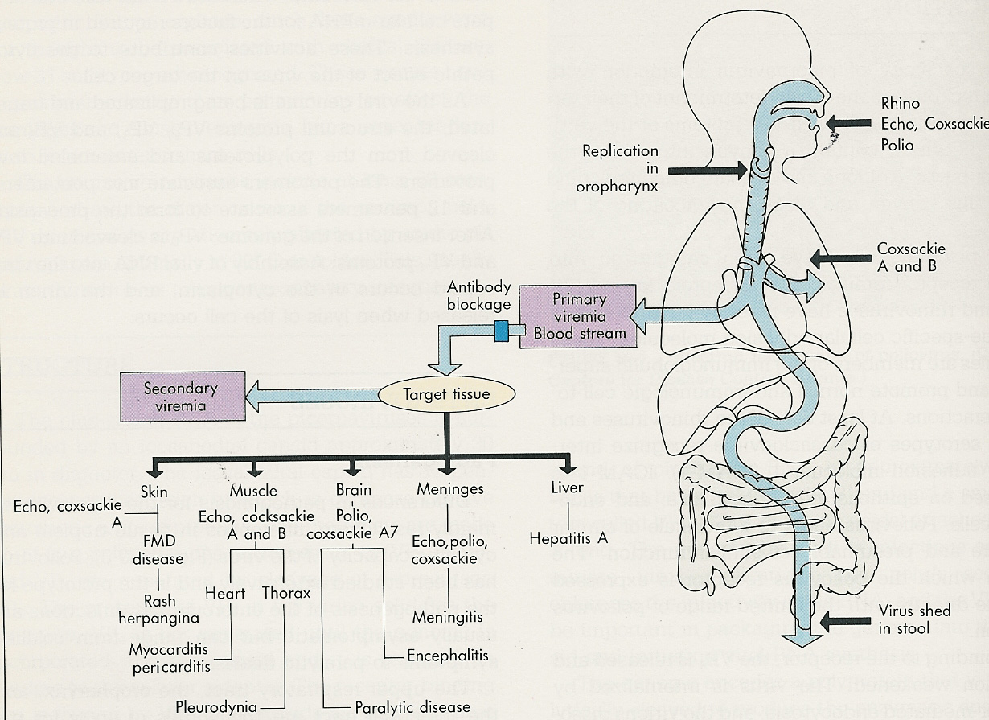
Pathogenesis
HFM
Echo,cox

Slide 11
Enteroviral infections
Asymptomatic Infections*
Diseases;
Neurologic Diseases | Poliovirus Types 1-3 | GP A COX. Types 1-24 | GP B COX. Types 1-6 | Echovirus Types 1-34 | Enterovirus Types 68-71
Aseptic meningitis Paralysis Encephalitis | 1-3 1-3 | Many 7,9 2,5-7,9 | 1-6 2-5 1-5 | Many 2,4,6,9,11,30 2,6,9,19 | 71 70,71 70,71
NON-Neurologic Diseases ;
Respiratory tract infections.
Skin and mucosa infections;
Cardiac infections
Acute hemorrhagic conjunctivitis
Others

Slide 12
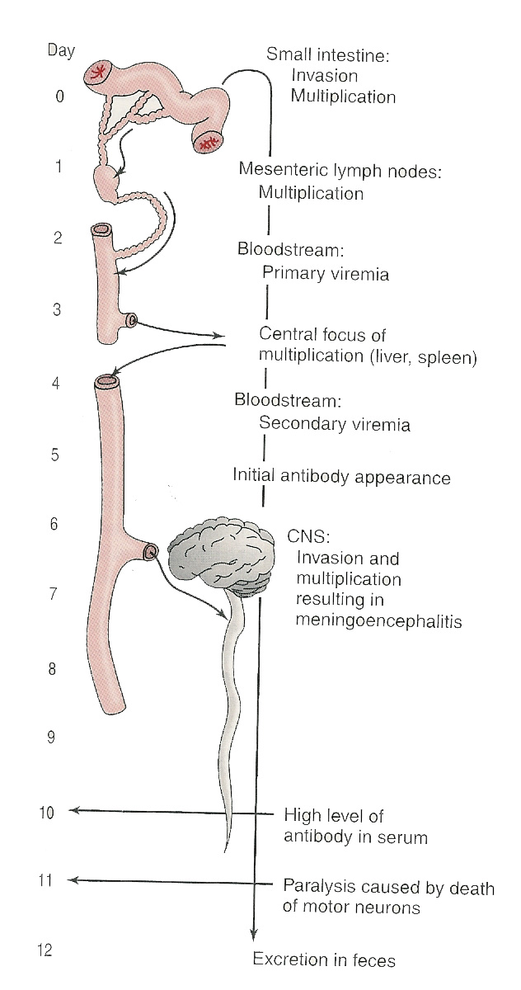
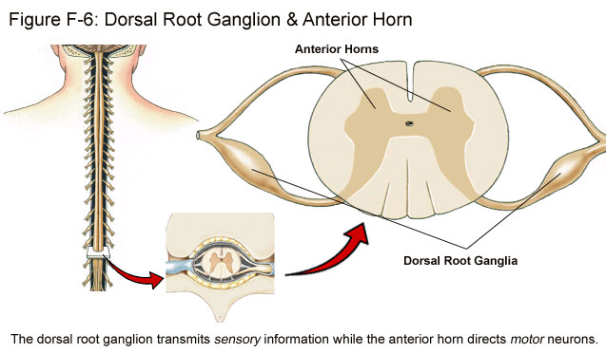
Pathogenesis of polio:
Pathway to CNS by:
Blood
Peripheral nerves
Causing destruction of
motor neurons of AHCs
Rarely affects brain stem
(bulber poliomyelitis)

Slide 13
Pathogenesis of Polio :
Immunity: IgA & IgG = Lifelong type-specific immunity

Slide 14
Poliovirus Infections
90-95%
No illness
Asymptomatic
4-8%
Minor Illness
1-2%
Abortive poliomyelitis (No CNS involvement)
Major Illness
1- Nonparalytic poliomyelitis (Aseptic meningitis)
2- Paralytic poliomyelitis: (Flaccid paralysis)

Slide 15
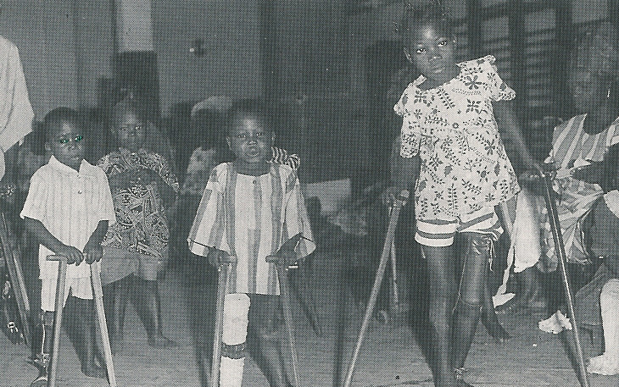

Slide 16
Lab Diagnosis of Enteroviruses
Virus isolation*:
Samples: Stool (best) .Rectal, throat swabs & CSF
Inoculate in cell cultures
All EVs grown except some strains of Cox A viruses
Observe for CPE
Identify the type
CSF in aseptic meningitis; lymphocytosis
Glucose level N to slightly , Protein level N or slightly
Isolation rate is variable
EV RNA detected in CSF by RT-PCR*
Serology (limited value)

Slide 17
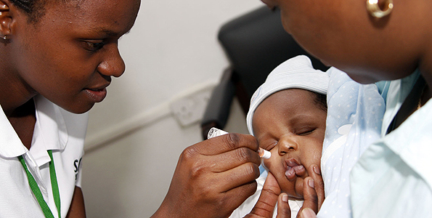
Management
Rx:
No antiviral Rx
Prevention:
Sanitation & Hygienic measures
Poliovirus vaccines
a- Inactivated polio vaccine
(IPV)
(Salk, Killed) (S/C or IM)
b- Live-attenuated polio vaccine
(OPV)
(Sabin, oral)

Slide 18
Important Features of Polio Vaccines
Attribute Killed (IPV) Live (OPV)
3 types (trivalent) Yes Yes
Prevents disease Yes Yes
Induces humoral IgG Yes Yes
Route of administration Injection Oral
Induces intestinal IgA No Yes
Interrupts transmission No Yes
Affords 2º protection by No Yes spread to others
Reverts to virulance No Yes (rarely)
Causes disease in the immun ed No Yes
Co-infection with other EVs No Yes may impair immunization
Requires refrigeration No Yes
Duration of immunity Shorter Longer

Slide 19
Poliovirus Vaccine
Adverse reactions ;
local reactions (IPV)
Vaccine -Associated Paralytic Poliomyelitis (OPV)
adult , immuno ed
4 doses of PV; 2, 4 , 6-18 ms
& 4 - 6 yrs
Combination vaccine ; IPV, DTaP ,Hib & HB vaccines
Polio Vaccination of Adults
Indications:
Travelers to polio-endemic countries
HCW
IPV

Slide 20
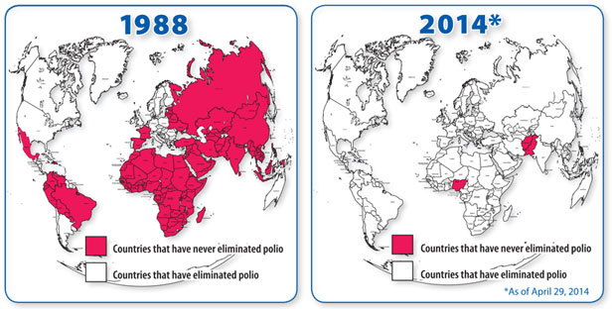

Slide 21
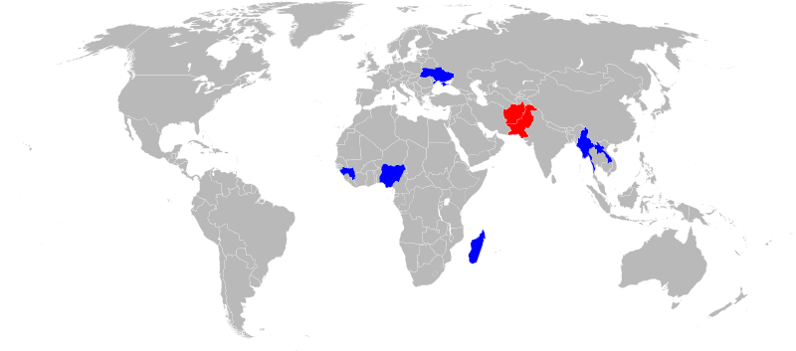
Reported polio cases in 2015
Country | Wild cases | Circulating vaccine- derived cases | Transmission status
Pakistan | 54 | 2 | endemic
Afghanistan | 20 | 0 | endemic
Madagascar | 0 | 10 | circulating vaccine-derived only
Laos | 0 | 6 | circulating vaccine-derived only
Guinea | 0 | 4 | circulating vaccine-derived only
Myanmar | 0 | 2 | circulating vaccine-derived only
Ukraine | 0 | 2 | circulating vaccine-derived only
Nigeria | 0 | 1 | circulating vaccine-derived only
Total | 71 | 27

Slide 22
Viral Encephalitis
Enteroviruses
Herpes viruses.
Rabies virus
Arboviruses.
Others

Slide 23
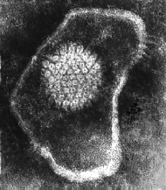
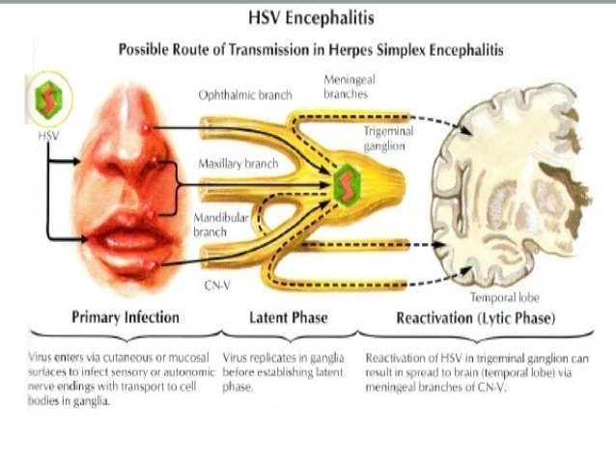
Herpes Simplex Encephalitis
Caused by;
Herpes simplex virus -1(HSV-1)
dsDNA , Enveloped , Icosahedral Virus

Slide 24
Herpes Simplex Encephalitis
Caused by;
Herpes simplex virus -1(HSV-1)
dsDNA , Enveloped , Icosahedral Virus
C/F;
F,H,V ,Seizures & altered mental status.
High mortality rate
Dx;
MRI
CSF---Lymph, glucose-N & Protain-
---detection of HSV-1 DNA by PCR.
Rx;
Acyclovir.

Slide 25
Rabies encephalitis
Rabies virus ;
Rhabdoviridae.
s.s (-)RNA genome,
Helical nucleocapsid,
Enveloped virus.
Bullet shaped virus

Slide 26
Pathogenesis;
Epidemiology;
Reservoir;
Major;
Raccoons , Foxes,
Wolves & bats.
Imp ; cats & dogs
Transmission;
Common route
Bite of a rabid animal
Uncommon route
Inhalation
while in a bat infested cave
Corneal transplant

Slide 27
Rabies; A fatal acute encephalitis
zoonotic disease .
1-The incubation period: 1-3 m > longer
2-The prodromal phase:
F, H , M , A, N &V.
Abnormal sensation around the wound.
3-Neurological phase ;
1- encephalitis
Nervous , Lacrimation , salivation,
Hydrophobia ,
Convulsion ,coma & death .
2-Paralytic illness ; Ascending , Death , Bat.
4- Recovery; Extremely rare

Slide 28
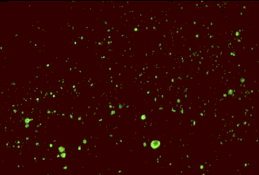
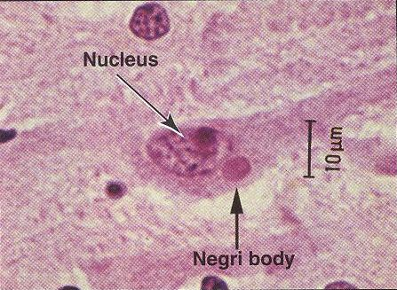
Laboratory Diagnosis
PCR; R. RNA in saliva
Rapid virus antigen detection ( IF )
Neck skin biopsy
Corneal impressions
Brain tissue
Histopathology
Virus cultivation
serology
Rabid brain stained with
Fluorescent anti-rabies antibody
neuronal brain cells
intracytoplasmic inclusions
(Negri bodies)
Negri bodies are diagnostic of rabies.

Slide 29
Prevention
Control measures against canine rabies include;
Stray animals control.
Vaccination of domestic animals.
Pre-exposure prophylaxis (Vaccine)
Persons at increased risk of rabies
e.g. vets, animal handlers etc.
Post-exposure prophylaxis
Wound treatment
Passive immunization;
human anti-rabies immunoglobulin
around the wound & I M.
Active immunization;
Human Diploid Cell Vaccine (HDCV)**
5 - 6 doses

Slide 30
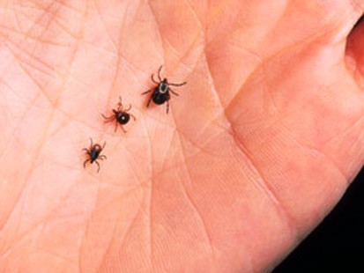
Arthropod –borne Viruses Arboviruses > 500 Vs
Epidemiology:
Reservoir: Wild birds & Mammals
Vector: Mosquito, ticks& Sandfly
Transmission: bite of infected vector
Infections
Asymptomatic Infections*
Diseases
Fever, Rash & arthralgia
Hemorrhagic fever ± hepatitis
CNS disease
(meningitis & encephalitis)

Slide 31
ArboVs associated with CNS disease:
Virus | Vector | Reservoir | Distribution
Eastern equine encephalitis EEEV | Mosquito | Birds | America
Western equine encephalitis WEEV | Mosquito | Birds | America
Venezuelan equine encephalitis VEEV | Mosquito | Rodent | America
Japanese encephalitis V | Mosquito | Birds Pigs | Orient
Murray Valley encephalitis V | Mosquito | Birds | Australia
West Nile V | Mosquito | Birds | Europe, Africa Middle East Asia, America

Slide 33
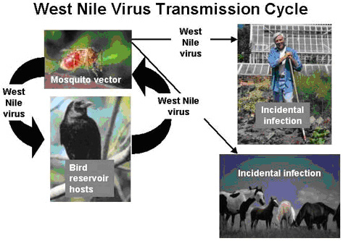
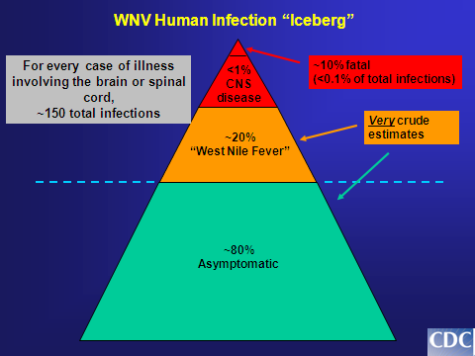
West Nile virus
Flaviviridae
Febrile illness meningitis , encephalitis

Slide 34
Laboratory Diagnosis
Isolation (Gold standard )
(Reference Lab)
B - IgM -AB* - ELISA, IF:
(most used)
C - Arbovirus RNA by RT-PCR

Slide 35
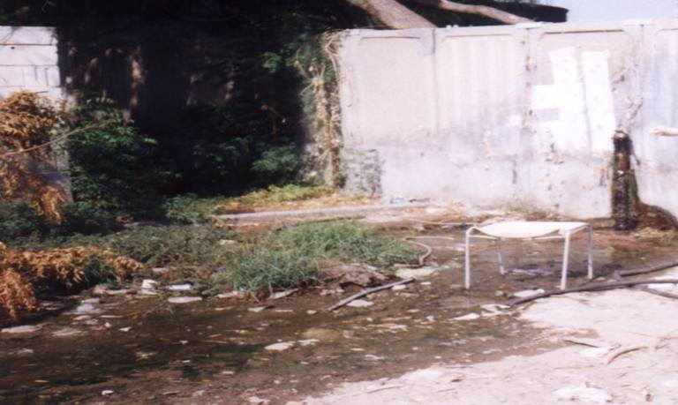
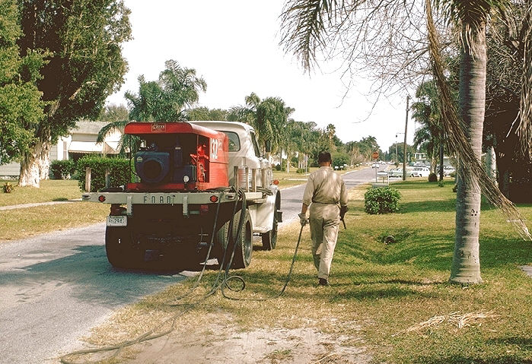
Prevention
Vector Control:
Elimination of
vector breading sites
using insecticides
Avoidance contact
with vectors
( repellants , net )
Vaccines:
Tick-borne encephalitis vaccine
Japanese encephalitis vaccine

Slide 37
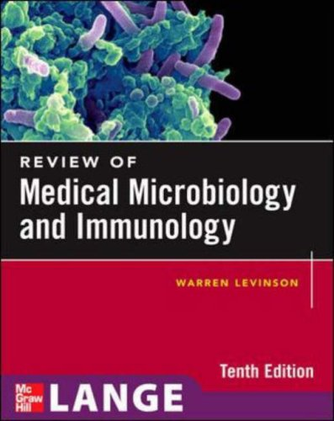
Reference books &the relevant page numbers
Notes on Medical Microbiology
By ; Morag C. Timbury, A. Christine McCartney, Bishan Thakker and Katherine N. Ward
(2002)
Pages; 345 - 351, 392-399, 406-410, 414-419
Review of Medical Microbiology and Immunology.
By: Warren Levinson.
10th Edition, 2008.
Pages; 280-281, 284-288, 302-305

