Slide 1
Integrated CNS Practical
Biochemical &Microbiological
Examination of CSF
CNS
Infection
CENTRAL NERVOUS SYSTEM BLOCK

Slide 2
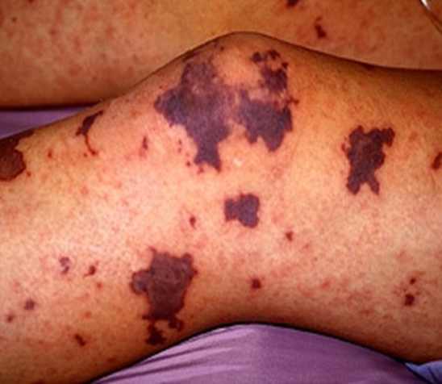
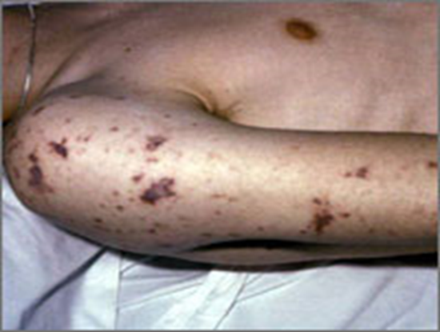
CASE 1
A 15-year-old healthy male visited emergency room presenting with fever, headache, vomiting and drowsiness. Physical examination showed decreased level of consciousness, neck stiffness, skin rash and high temperature (38°c). Cerebrospinal fluid (CSF) examination revealed opening pressure of 210cmH2O. Microscopy of the cerebrospinal fluid showed gram –ve cocci. The patient showed complete recovery after administration of ceftriaxone for 10 days.
The doctor in the emergency department takes a detailed history and conducts a clinical examination. Because of clinical findings, he decides to do a lumber puncture. The results of the lumber puncture are shown below:

Slide 3
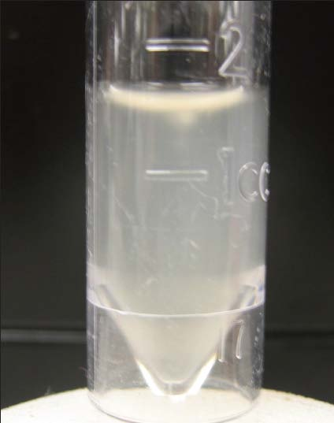
CASE 1: LUMBER PUNCTURE RESULTS
CSF | Patient’s results | Normal range
Appearance | Turbid | Clear
WBCs and differential | 8.320 per mm³ Mainly polymorphonuclear leucocytes (84%) | Few (<5 cells/mm³)
Protein | 5.0 | 01-0.4 g/L
Glucose | 1.3 | 3.0-4.5 mmol/L
Chloride | 110 | 115-130 mmol/L

Slide 4
QUESTION 1:
What is your diagnosis?
……………………………………………………………………………………………………………………
QUESTION 2:
What is the most likely infection responsible?(Select only one)
Mycobacterium Avium
Fungal infection
Parasitic infection
Viral infection
Bacterial infection
Trepanoma pallidum (Neurosyphilis)
Mycobacterium tuberculosis

Slide 5
QUESTION 3:
What is your justification for your answer to question two?
……………………………………………………………………………………………………………………
QUESTION 4:
What further investigation would you like to do at this stage?
……………………………………………………………………………………………………………………
QUESTION 5:
Mention two of the recommended antibiotics that can be used as empiric treatment in such a case?…………………………………………………………………………………………………………

Slide 6
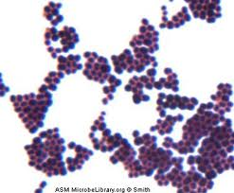
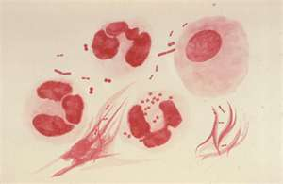
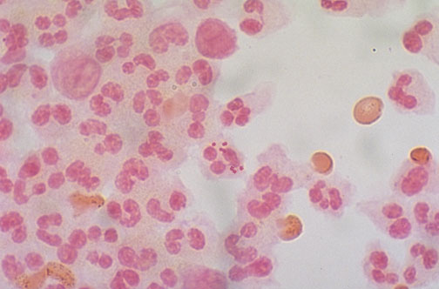
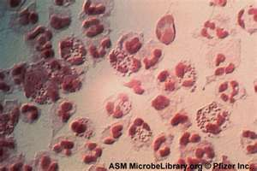
Bacterial meningitis: 1-Neisseria meningitidis Microscopic Appearance Gram stained smear from CSF deposit showing : gram negative intracellular diplococci + many pus cells

Slide 7
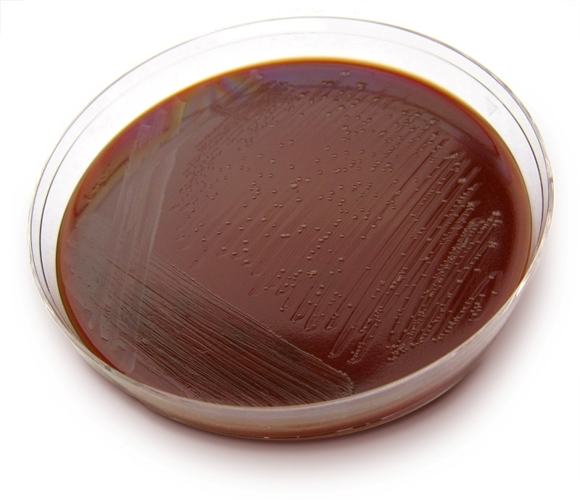
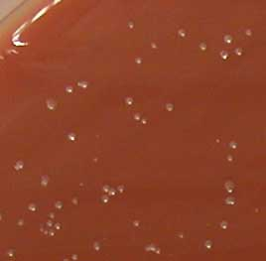
Bacterial meningitis: Neisseria meningitidis Culture on Thayer-Martin agar

Slide 8
CASE 2
A 10-year old boy is brought to the emergency department (A&E) at King Khalid Hospital accompanied by his mother. He has fever, headache, and vomiting for the last 2 days. Clinical examination confirmed that he has meningeal irritation. The doctor decided to do a lumber puncture.
The results of the lumber puncture are shown below:

Slide 9
CASE 2: LUMBER PUNCTURE RESULTS
CSF | Patient’s results | Normal range
Appearance | Clear | Clear
WBCs and differential | Few (<5 cells/mm3) | 1200 per mm3 Mainly lymphocytes (80%)
Protein | 0.1-0.4 g/L | 0.5
Glucose | 3.0-4.5 mmol/L | 2.7
Chloride | 115-130 mmol/L | 100

Slide 10
QUESTION 1:
What is your most likely diagnosis?
……………………………………………………………………………………………………………………
QUESTION 2:
What is the most likely infection responsible?(Select only one)
Mycobacterium Avium
Fungal infection
Parasitic infection
Viral infection
Bacterial infection
Trepanoma pallidum (Neurosyphilis)
Mycobacterium tuberculosis

Slide 11
Question 3:
Justify your answer to question two?
……………………………………………………………………………………………………………………
QUESTION 4:
What further investigation would you like to do at this stage?
……………………………………………………………………………………………………………………

Slide 12
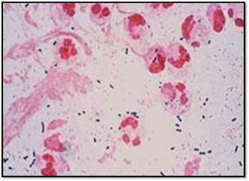
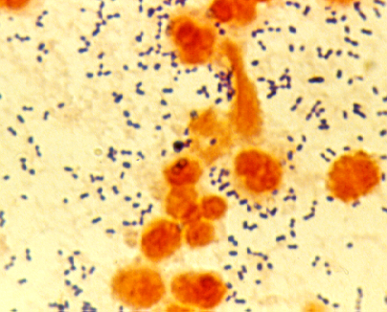
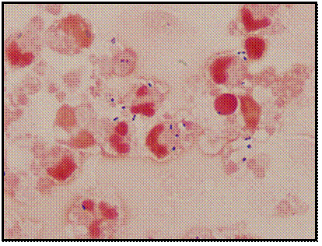
Bacterial meningitis: 2-Pneumococcal Meningitis Microscopic Appearance Direct gram stain of a CSF deposit shows gram-positive diplococcic with lanceolate shape and polymorphneoclear leucocytes

Slide 13
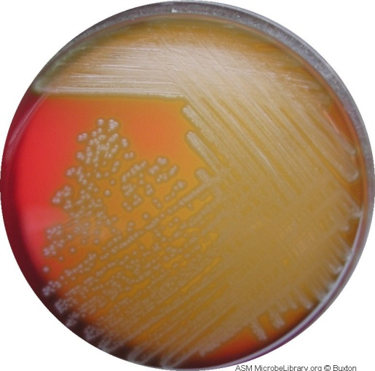
Bacterial meningitis: 2- Pneumococcal Meningitis Culture on blood agar Shwing alpha-hemolytic colonies

Slide 14
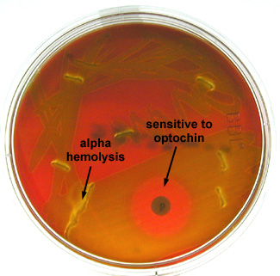
Bacterial meningitis: 2- Pneumococcal Meningitis
OPTOCHIN SENSITIVE ALPHA-HAEMOLYTIC STREPOCOCCI

Slide 15
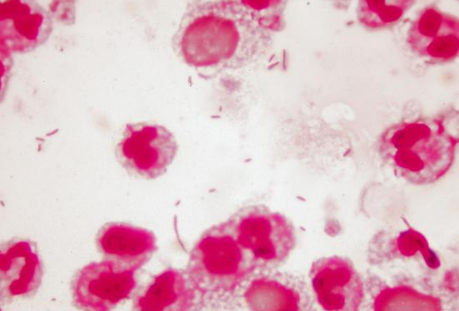
Bacterial meningitis: 3- H. influenzae Microscopic Apearance Direct gram stain of a CSF deposit shows Gram-Negative pleomorphic coccobacilli with many polymorphneuclear leucocyte

Slide 16
Bacterial meningitis: 3- H. influenzae
Culture on chocolate agar

Slide 17
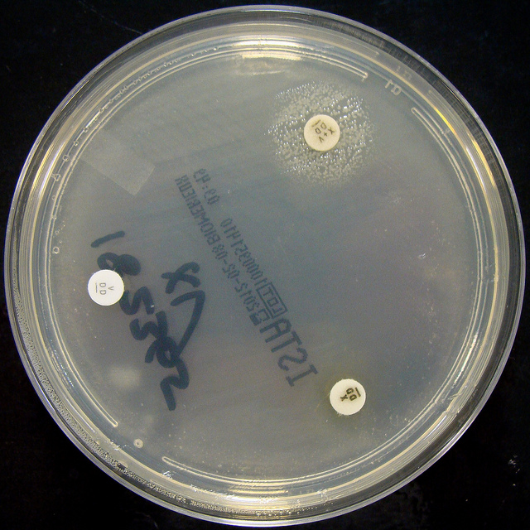
Bacterial meningitis: 3- H. influenzae
Culture on Nutrient agar
H. influenzae :Growth arround XV factors( requires both factors XV)
no growth arround X or V alone

Slide 18
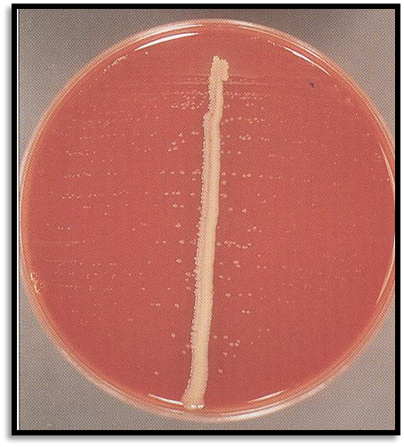
Bacterial meningitis: 3- H. influenzae
Culture on Blood agar
Growth on blood agar showing satellitisim adjacent to a streak of S.aureus. S.ureus producing surplus factor increasing growth of adjacent H.influenzae

Slide 19
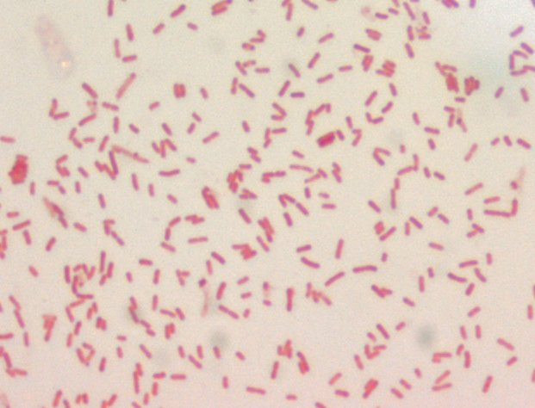
Bacterial meningitis: 4- E. coli Microscopic Appearance Gram negative bacilli

Slide 20
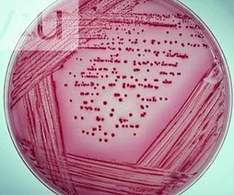
Bacterial meningitis: 4- E. coli Culture on MacConkey agar E. coli appear pink as they ferment lactose

Slide 21
Question 5:
Mention two of the recommended antibiotics that can be used as empiric treatment in such a case?
……………………………………………………………………………………………………………………

Slide 22
What is the most probable Pathogen isolated?
…………………………………………………………………………………………………………………………………………………………………………………………………………………………………………………..
What is your most likely diagnosis?
…………………………………………………………………………………………………………………………………………………………………………………………………………………………………………………....

Slide 23
CASE 3
A 65-year-old is referred from a general practitioner because of headache, fever, excessive sweating at night, and weight loss over the last 4-5 months. He has lost his appetite for food. On examination, there is neck rigidity. Laboratory tests including blood count, serum and electrolytes, blood urea, creatinine and blood culture are all normal. The doctors decides to do a lumber puncture.
The results of the lumber puncture are shown in the next slide:

Slide 24
CASE 3: LUMBER PUNCTURE RESULTS
CSF | Patient’s results | Normal range
Appearance | Clear | Turbid
WBCs and differential | Few (<5 cells/mm3) | 300 per mm3 Mainly lymphocytes
Protein | 0.1-0.4 g/L | 0.8
Glucose | 3.0-4.5 mmol/L | 2.0
Chloride | 115-130 mmol/L | 115

Slide 25
QUESTION 1:
What is your most likely diagnosis?
……………………………………………………………………………………………………………………
QUESTION 2:
What is the most likely infection responsible?(Select only one)
Fungal infection
Parasitic infection
Viral infection
Bacterial infection
Trepanoma pallidum (Neurosyphilis)
Mycobacterium tuberculosis

Slide 26
QUESTION 3:
What is your justification for your answer to question two?
……………………………………………………………………………………………………………………
QUESTION 4:
What further investigation would you like to do at this stage? (State 3)
……………………………………………………………………………………………………………………

Slide 27
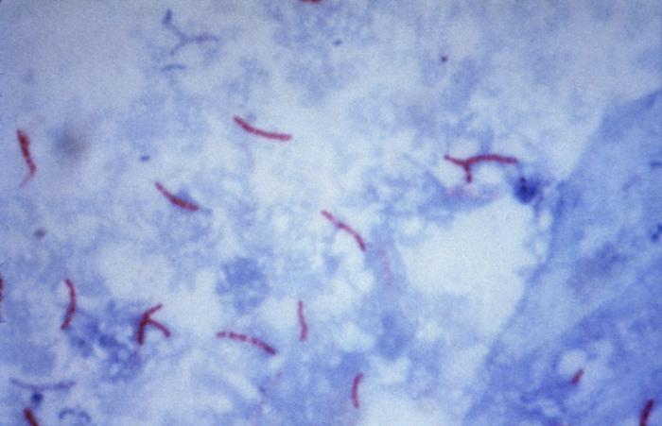
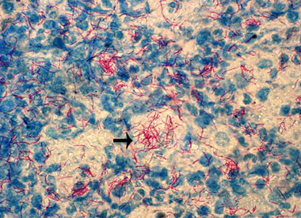
Bacterial meningitis: 5- Mycobacterium tubercuolosis Microscopic Appearance Direct Ziel – Neelsen Stained Smear of a CSF deposit shows Acid – Fast Bacilli AFB

Slide 28
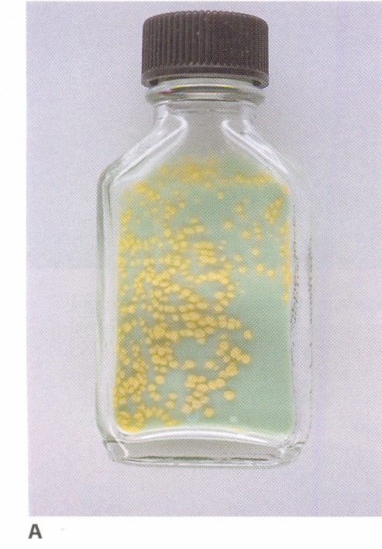
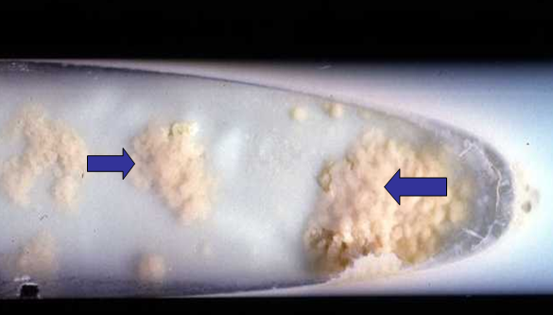
Bacterial meningitis: 5- Mycobacterium tuberculosis Culture on Lowenstein – Jensen medium Colonies or growth is Rough, Tough and Buff

