Slide 2
Central Nervous System
Pathology Practicals
Prof. Ammar Al Rikabi
Dr. Sayed Al Esawy
Dr. Marie Mukhashin
Dr. Shaesta Zaidi
Prepared by:
Head of Pathology Department Dr. Hisham Al Khalidi

Slide 3
First Practical Session
Pathology Dept, KSU
CNS Block

Slide 4
Brief review of normal anatomy and histology of nervous tissues
Pathology Dept, KSU
CNS Block

Slide 5
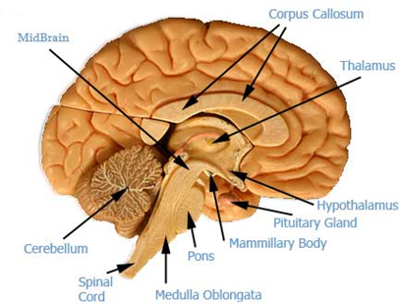
Brain Anatomy – Sagittal Section
Pathology Dept, KSU
CNS Block

Slide 6
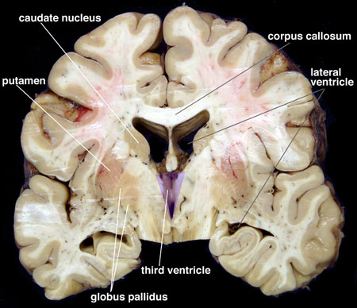
Brain Anatomy – Cut Section
Pathology Dept, KSU
CNS Block

Slide 7
Meningees
Pathology Dept, KSU
CNS Block

Slide 8
CNS Cells
Two cell types:
Neuron:
Conducts nerve impulses
Cannot be replaced if destroyed
Neuroglial cells:
Support, nourish, and protect the neurons
Include astrocytes, oligodendrocytes, ependymal cells and microcytes
Pathology Dept, KSU
CNS Block

Slide 9
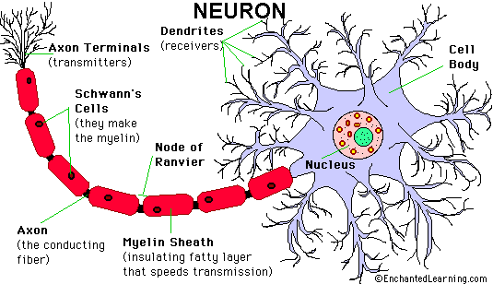
Pathology Dept, KSU
CNS Block

Slide 10
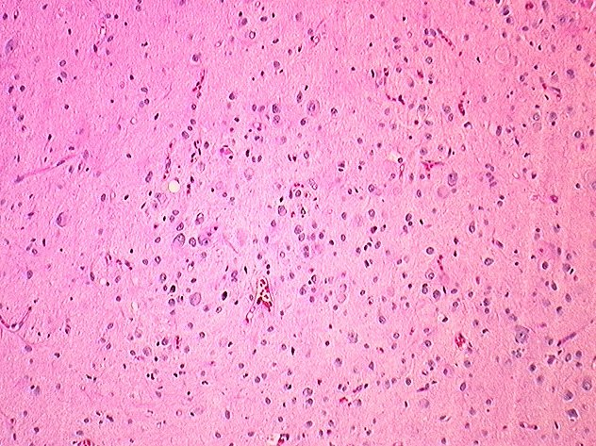
Histology of Brain tissue - LPF
H&E stained sections reveal that at low power (40x) there is no obvious increase in cellularity and that the tissue resembles normal brain parenchyma
Pathology Dept, KSU
CNS Block

Slide 11
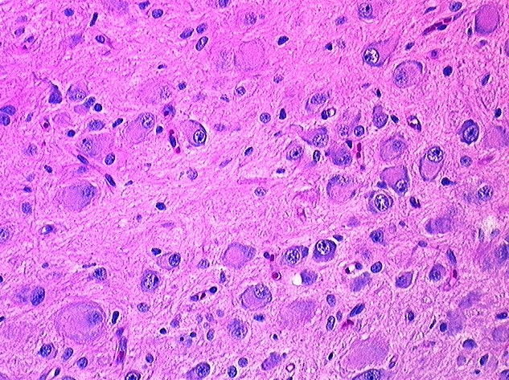
Histology of Brain tissue - HPF
The great variety in the size and shape of the neurons is better appreciated at higher magnification (200x)
Pathology Dept, KSU
CNS Block

Slide 12
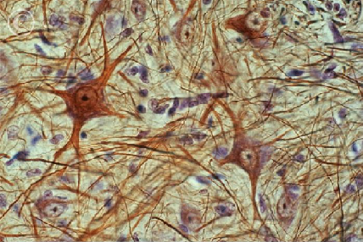
Histology of Brain tissue - HPF
Light micrograph of a section cut through human nervous tissue showing nerve cells in gray matter of the brain. Nerve cells are seen as cell bodies (brown) with round central nucleus.
Pathology Dept, KSU
CNS Block

Slide 13
Gross and microscopic findings of selected CNS diseases
Pathology Dept, KSU
CNS Block

Slide 14
Meningioma
Pathology Dept, KSU
CNS Block

Slide 15
CASE 1:
A 43- year old female complained of headache and two attacks of seizures in the past 4 months . Brain MRI revealed a 3 cm extra-axial mass in the parietal region. It was dural- based with mild edema in the surrounding brain tissue.
What is your provisional diagnosis?
Pathology Dept, KSU
CNS Block

Slide 16
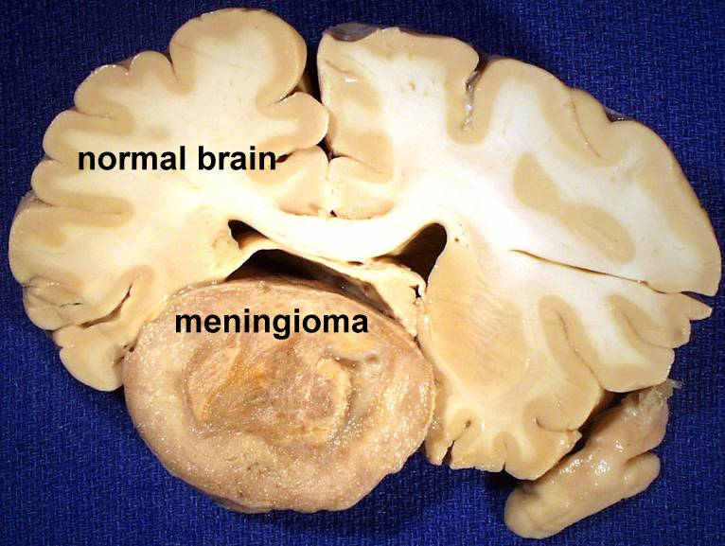
Meningioma vs Normal Brain
Pathology Dept, KSU
CNS Block

Slide 17
Meningioma – Gross
Note how this meningioma beneath the dura has compressed the underlying cerebral hemisphere. Rarely, meningiomas can be more aggressive and invade
Pathology Dept, KSU
CNS Block

Slide 18
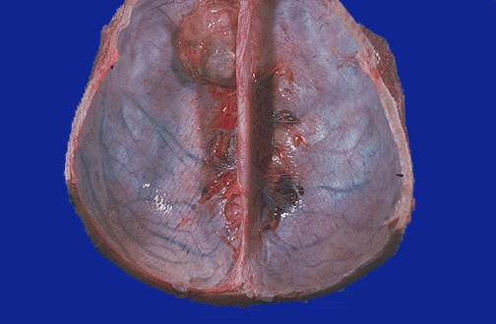
Meningioma – Gross
Here is another benign meningioma beneath the dura. These neoplasms are slow growing, but may reach a large size before symptoms lead to detection.
Pathology Dept, KSU
CNS Block

Slide 19
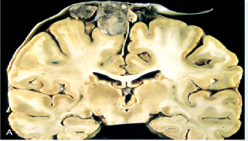
Parasagittal Meningioma - Gross
Parasagittal multilobular meningioma attached to the dura with compression of underlying brain.
Pathology Dept, KSU
CNS Block

Slide 20
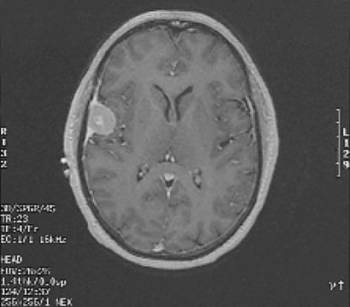
Meningioma – MRI view
This is an MRI scan demonstrating a discreet mass along the lateral convexity and extending from a dural base impinging upon the cerebral hemisphere. This is consistent with a meningioma
Pathology Dept, KSU
CNS Block

Slide 21
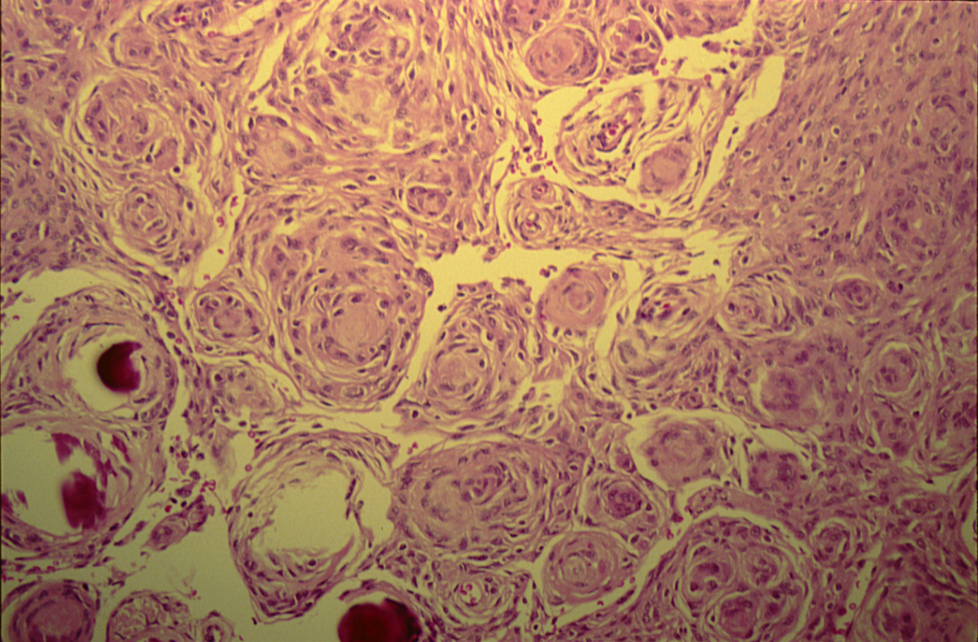
Meningioma - Microscopic view - LPF
Whorls of fibrocellular tissue. Cells are oval, spindle shape or elongated and lack mitosis.
Psammoma bodies (spherical calcified particles) are also seen within the tumour
Pathology Dept, KSU
CNS Block

Slide 22
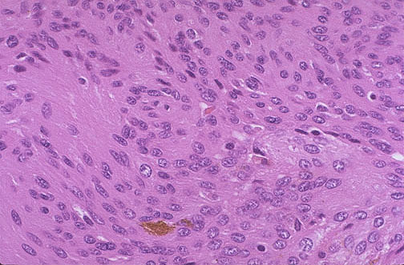
Meningioma – Microscopic view - HPF
At high magnification, this meningioma has plump pink cells. A small amount of brown granular hemosiderin is present. Meningiomas may also have psammoma bodies.
Pathology Dept, KSU
CNS Block

Slide 23
Glioblastoma Multiforme
Pathology Dept, KSU
CNS Block

Slide 24
CASE 2 :
A 55 years old man complained of headache for the last 2 months . Brain MRI reveals a
3 cm frontal intra - parenchymal space occupying lesion with rim enhancement on contrast studies.
What is your provisional diagnosis ?
Pathology Dept, KSU
CNS Block

Slide 25
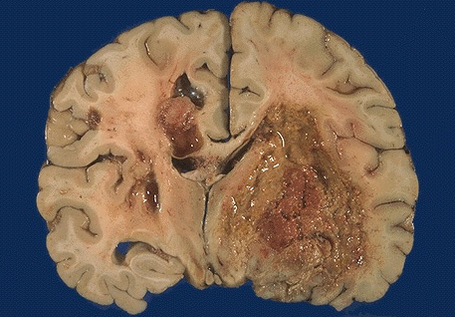
Glioblastoma Multiforme - Gross
This is the worst possible form of Glioma—
a Glioblastoma multiforme (GBM). These neoplasms are quite vascular with prominent areas of necrosis and hemorrhage. Note how this one has crossed the midline to the opposite hemisphere
Pathology Dept, KSU
CNS Block

Slide 26
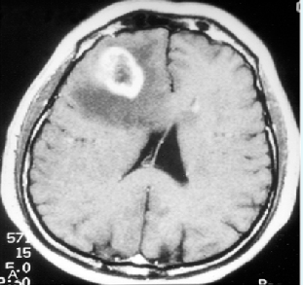
Glioblastoma Multiforme – CT scan
Computed tomographic (CT) scan of a large tumor in the cerebral hemisphere showing signal enhancement with contrast material and pronounced peritumoral edema.
Pathology Dept, KSU
CNS Block

Slide 27
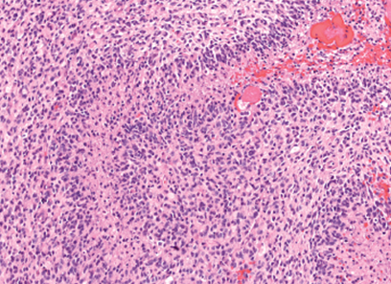
Glioblastoma Multiforme – LPF Microscopy
Glioblastoma. Foci of necrosis with pseudopalisading of malignant nuclei and endothelial cell proliferation.
Pathology Dept, KSU
CNS Block

Slide 28
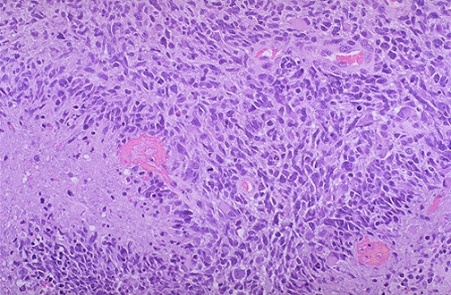
Glioblastoma Multiforme – HPF Microscopy
This glioblastoma multiforme (GBM) demonstrates marked cellularity with marked hyperchromatism and pleomorphism. Note the prominent vascularity as well as the area of necrosis at the left with neoplastic cells palisading around it.
Pathology Dept, KSU
CNS Block

Slide 29
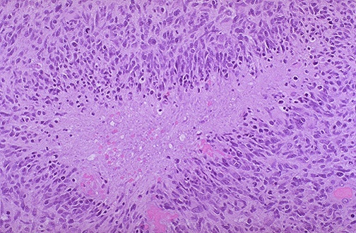
Glioblastoma Multiforme – HPF Microscopy
Here is another example of pseudopalisading necrosis of neoplastic cells in a glioblastoma multiforme (GBM). The cells of a GBM can infiltrate widely, particularly along white matter tracts, and even through the CSF.
Pathology Dept, KSU
CNS Block

Slide 30
Multiple Sclerosis
Pathology Dept, KSU
CNS Block

Slide 31
CASE 3 :
A 27 years old woman presents with a sudden onset of right sided blindness and weakness in her left leg. There is no history of trauma. However, she experienced a similar episode 8 months ago and was diagnosed as aseptic meningitis.
What is your provisional diagnosis?
Pathology Dept, KSU
CNS Block

Slide 32
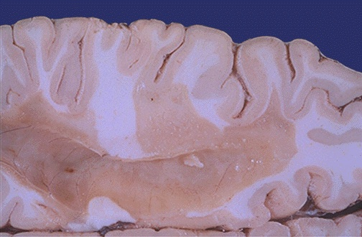
Multiple Sclerosis – Gross
A large "plaque" of demyelination in the white matter.
The plaque has a grey-tan appearance. Such plaques are typical for multiple sclerosis (MS). These plaques lead to the clinical appearance of transient or progressive loss of neurological function. The disease is multifocal and the lesions appear over time.
Pathology Dept, KSU
CNS Block

Slide 33
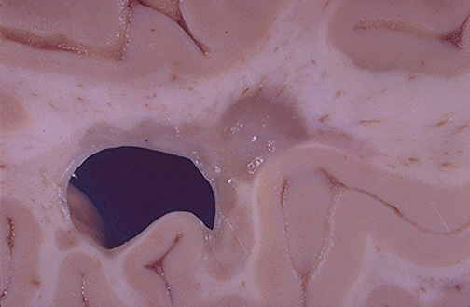
Multiple Sclerosis – Gross
Here is a demyelinated plaque in a patient with multiple sclerosis (MS). The lesions can be seen with MRI scans, but the appearance in the CSF of increased protein from IgG that demonstrates oligoclonal bands on electrophoresis is very consistent with this diagnosis.
Pathology Dept, KSU
CNS Block

Slide 34
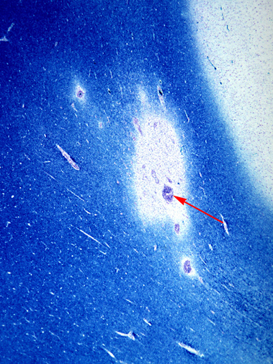
Multiple Sclerosis – Microscopic view
This is a myelin stain (luxol fast blue/PAS) of an early lesion. The lesion is centered around a small vein (arrow) which is surrounded by inflammatory cells.
Pathology Dept, KSU
CNS Block

Slide 35
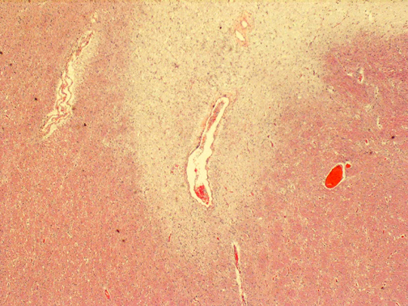
Multiple Sclerosis – Microscopic view
This is an H&E stained sections from a patient with long-standing MS. This lesion is centered on a vein. In this older lesion, however, there is very little inflammation around the vein. You can see the loss of myelin even without a special stain: it is lighter pink than the normal white matter surrounding it.
Pathology Dept, KSU
CNS Block

Slide 36
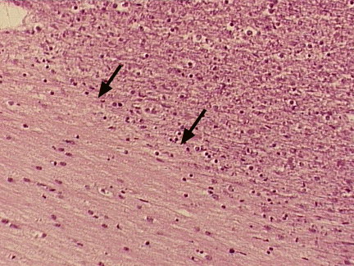
Multiple Sclerosis – Microscopic view
A high power photomicrograph of the MS plaque showing the pallor of the plaque almost devoid of myelin. There is a decrease in oligodendroglial nuclei and an increase of astrocyte nuclei characteristic of an older MS plaque.
Pathology Dept, KSU
CNS Block

Slide 37
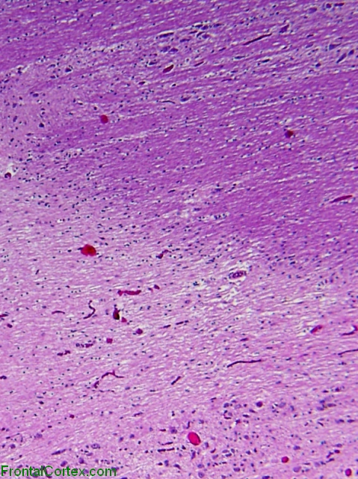
Multiple Sclerosis – Microscopic view
Inactive demyelinated plaque from a brain with MS. There is no active demyelination going on in this plaque. In this image, we see the border between the plaque – pale (red arrow) and normal neuropil – darker (green arrow). Pale plaque indicates
a lack of myelin.
Pathology Dept, KSU
CNS Block

Slide 38
The key microscopic features of Multiple Sclerosis are:
Perivenous mononuclear inflammation
(lymphocytes, plasma cells and macrophages).
Loss of myelin and variable loss of
oligodendrocytes.
Relative preservation of axons.
Reactive astrogliosis (sclerosis).
Pathology Dept, KSU
CNS Block

Slide 39
Early (acute) lesions are characterized by:
Perivascular and parenchymal infiltration by
inflammatory mononuclear cells, and myelin
breakdown and phagocytosis by macrophages.
Astrogliosis is not yet profound and axons are relatively preserved.
As the lesion progresses, there are fewer inflammatory cells and more astrogliosis.
Chronic lesions have few mononuclear cells, almost complete demyelination, and severe astrogliosis. There can be oligodendrocyte loss and some secondary axonal loss in advanced cases.
Pathology Dept, KSU
CNS Block

Slide 40
Schwannoma
Pathology Dept, KSU
CNS Block

Slide 41
CASE 4:
A 39 years old man complains that he had noticed a progressive hearing loss over a 2 years period. Except for occasional headache, he has no other complaints . Evaluation discloses severe sensorineural hearing loss of the left side . MRI shows 1.5 cm. mass at the left cerebellopontine angle .
What is your provisional diagnosis ?
Pathology Dept, KSU
CNS Block

Slide 42
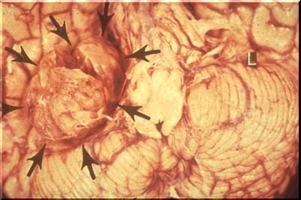
Schwannoma – Gross
Schwannoma : A nerve sheath tumor that seen most frequently on the eighth nerve (acoustic neuromas), in which case, they occupy the cerebello- pontine angle ( arrows).
Acoustic tumors can be removed, but usually not without damaging the eighth nerve and sometimes the facial nerve and brain stem.
Pathology Dept, KSU
CNS Block
Notes:
Mass at the cerebello-pontine angle .

Slide 43
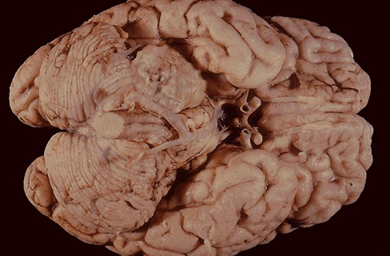
Schwannoma – Gross
Acoustic Schwannoma: The mass lesion here is arising in the acoustic (eighth cranial) nerve at the cerebellopontine angle. Patients may present with hearing loss. These benign neoplasms can be removed.
Pathology Dept, KSU
CNS Block

Slide 44
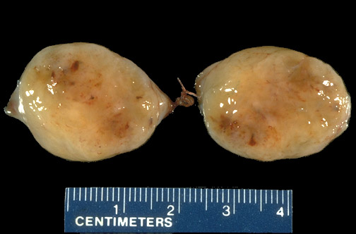
Schwannoma – Cut Section
The cut surface of a schwannoma is similar to that of many mesenchymal neoplasms, with a "fish flesh" soft tan appearance.
Pathology Dept, KSU
CNS Block

Slide 45
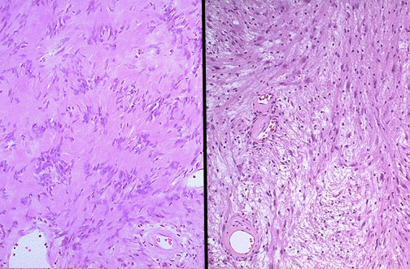
Schwannoma – LPF Microscopy
These are the classic microscopic appearances of
a schwannoma, which is benign. Note the more cellular "Antoni A" pattern on the left with palisading nuclei surrounding pink areas (Verocay bodies). On the right is the "Antoni B" pattern with a looser stroma, fewer cells, and myxoid change.
Pathology Dept, KSU
CNS Block

Slide 46
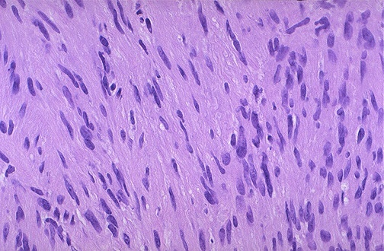
Schwannoma – HPF Microscopy
The schwannoma is seen here at higher magnification.
Pathology Dept, KSU
CNS Block

