Slide 2
PHYSIOLOHY OF BRAIN STEM
Dr. Hayam Gad
Associate Professor of Physiology, College of Medicine, KSU

Slide 3
Learning Objectives
Components of Brain stem
Important structures in brain stem
Functions of the Brain Stem
Signs & Symptoms of brain stem lesion
Brain stem function tests

Slide 4
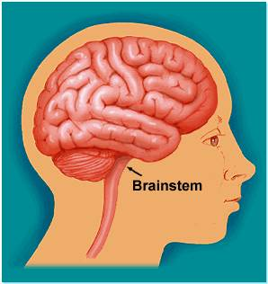
THE BRAIN STEM
The brain stem is the lower part of the brain, adjoining and structurally continuous with the spinal cord.

Slide 5
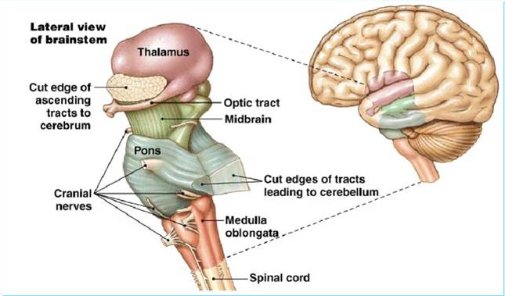
Components of Brain stem
Mid Brain
Pons
Medulla Oblongata

Slide 6
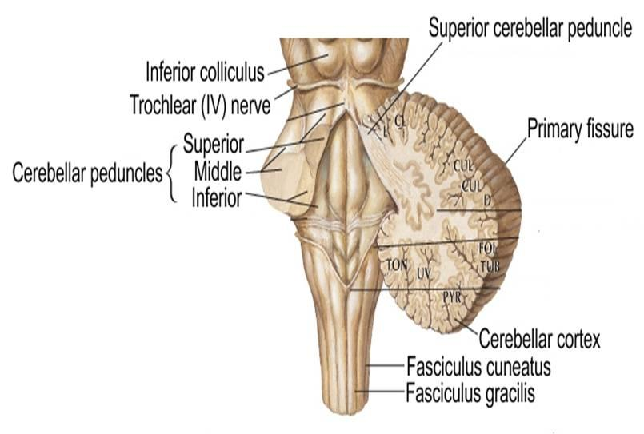
The midbrain, pons and medulla connect to the cerebellum via the superior, middle and inferior peduncles respectively.

Slide 7
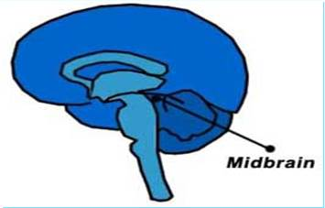
Midbrain
The midbrain is divided into three parts:
1- The Tectum
2- The Tegmentum
3- Cerebral Peduncles

Slide 9
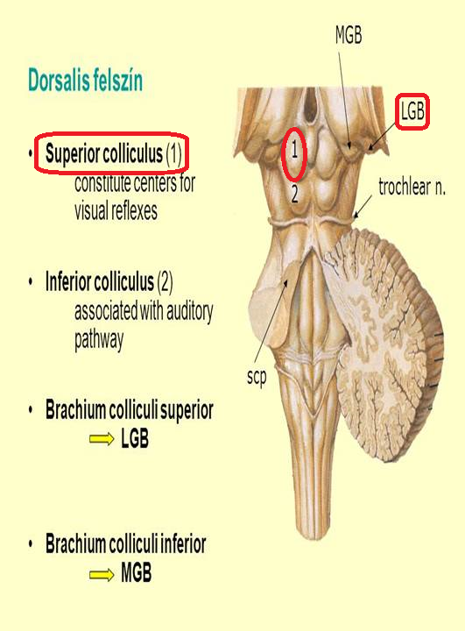
Midbrain
1- The Tectum ("roof" in latin) includes:
a) The superior colliculus
It constitutes center for visual reflexes
It sends its superior brachium to the lateral geniculate body of the thalamus.

Slide 10
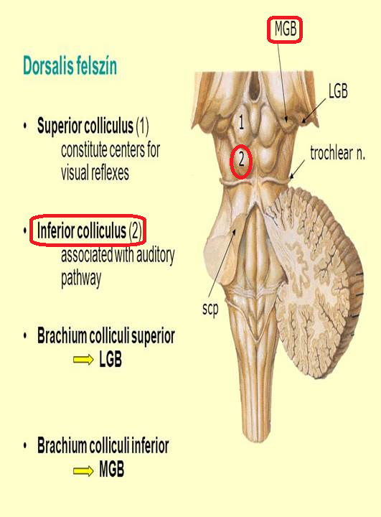
Midbrain
b) The inferior colliculus
It is associated with auditory pathway
It sends its inferior brachium to the medial geniculate body of the thalamus.
The cerebral aqueduct runs through the midbrain, beneath the colloculi.

Slide 11
Midbrain
2- The Tegmentum
Ventral to the cerebral aqueduct. Several nuclei, tracts and the reticular formation is contained here.
3- The ventral side is comprised of paired Cerebral Peduncles. These transmit axons of UMN.

Slide 12
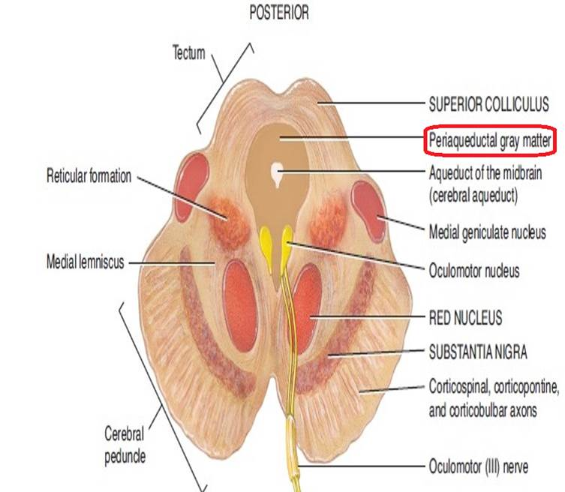
Midbrain internal structures
Midbrain
Periaqueductal Gray: Around the cerebral aqueduct, contains neurons involved in the pain desensitization pathway.

Slide 13
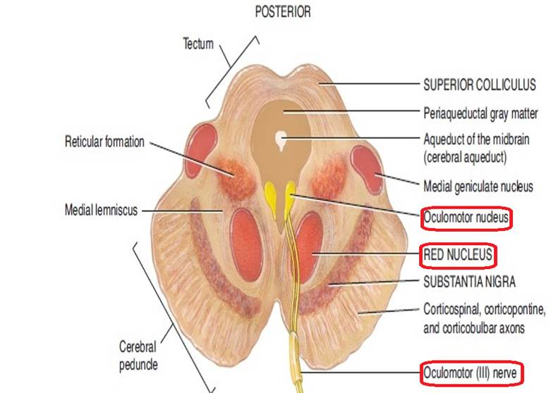
Midbrain
Occulomotor Nerve (CN III) nucleus.
Trochlear Nerve (CN IV) nucleus.
Red Nucleus: This is a motor nucleus that sends a descending tract to the lower motor neurons.

Slide 14
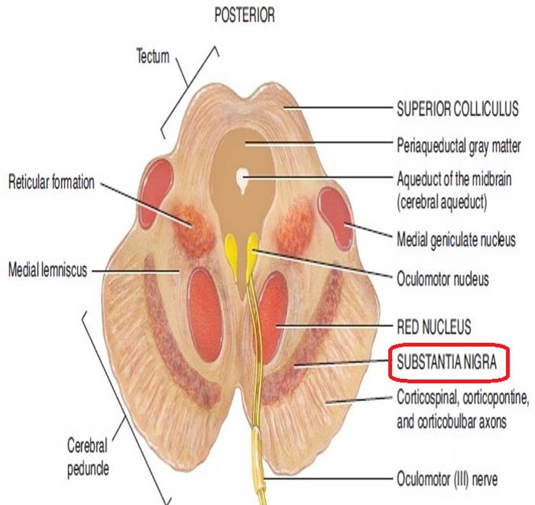
Midbrain
Substantia Nigra: a concentration of neurons in the ventral portion of midbrain that is involved in motor function.

Slide 15
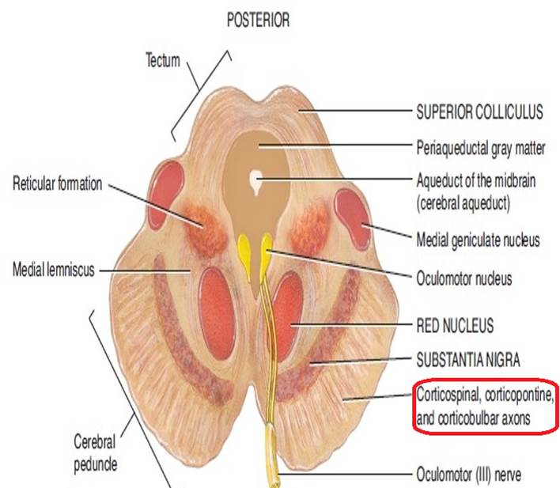
Midbrain
Central Tegmental Tract: Directly anterior to the floor of the 4th ventricle, this is a pathway by which many tracts project up to the cortex and down to the spinal cord.

Slide 16
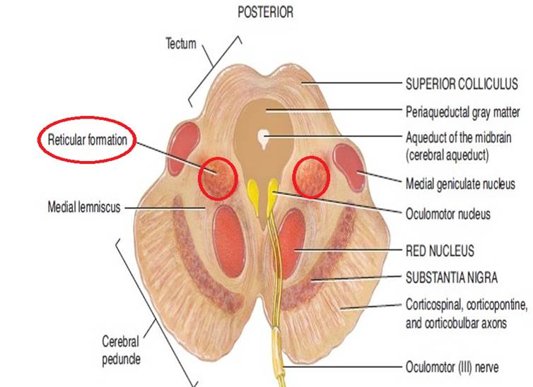
Midbrain
Reticular Formation: A large area that is involved in various important functions of the midbrain:
It contains LMN
It is involved in the pain desensitization pathway
It is involved in the arousal and consciousness systems
It contains the locus ceruleus, which is involved in intensive alertness modulation and in autonomic reflexes.

Slide 17
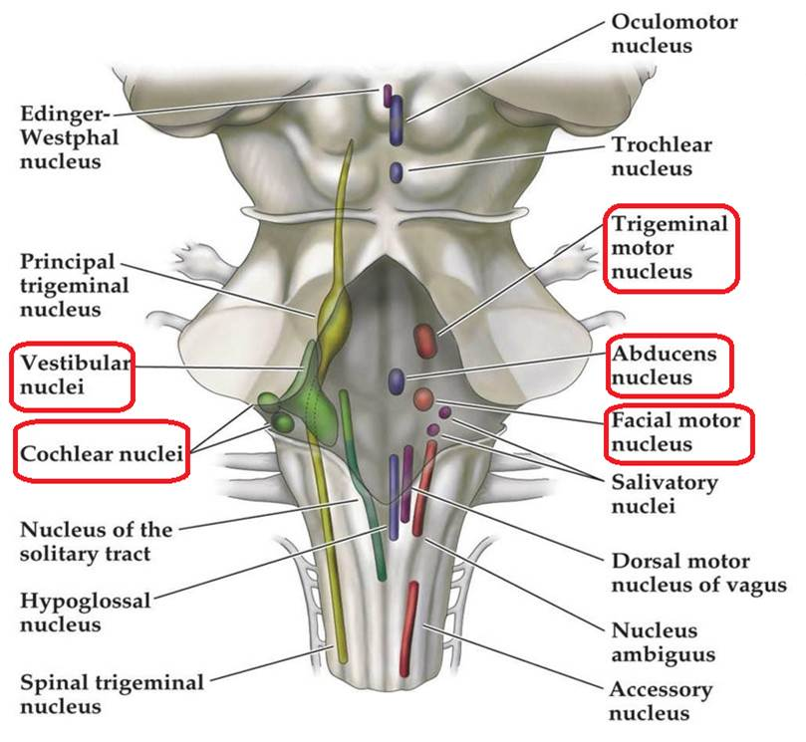
Pons
At the level of the midpons, trigeminal nerve (CN V) emerges.
Between the basal pons, cranial nerve 6 (abducens), 7 (facial) & 8 (vestibulo-cochlear) emerge (medial to lateral).

Slide 18
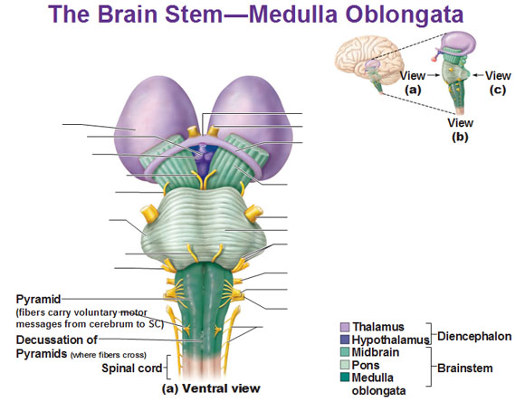
Medulla
Ventral view
The most medial part of the medulla is the anterior median fissure.
Moving laterally on each side are the pyramids. They contain the fibers of the corticospinal (pyramidal) tract as they head inferiorly to synapse on lower motor neuronal cell bodies within the ventral horn of the spinal cord.

Slide 19
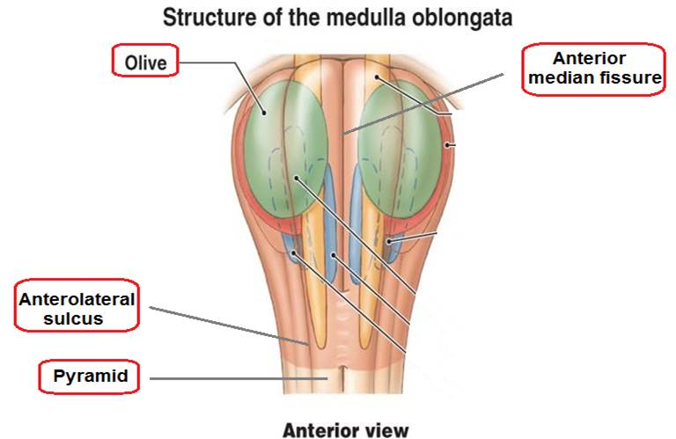
Medulla
The anterolateral sulcus is lateral to the pyramids.
Emerging from the anterolateral sulci are the hypoglossal nerve (CN XII) rootlets.
Lateral to the anterolateral sulci are the olives containing underlying inferior olivary nuclei and afferent fibers).
Lateral (and dorsal) to the olives are the rootlets for glossopharyngeal (IX) & vagus (X) cranial nerves.

Slide 20
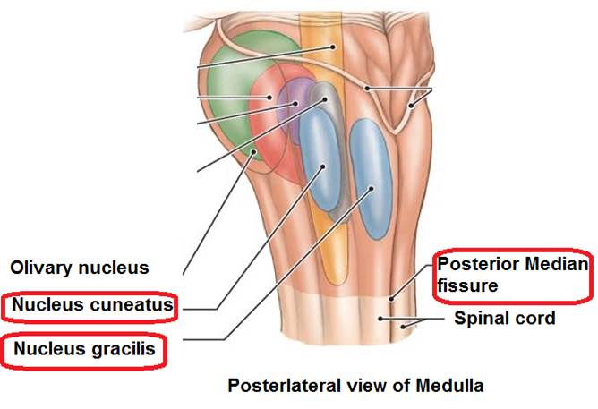
Medulla
Dorsal view
The most medial part of the medulla is the posterior median fissure.
Moving laterally on each side is the fasciculus gracilis.
Lateral to that is the fasciculus cuneatus.
Superior to each of these, are the gracile and cuneate tubercles, respectively. Underlying these are their respective nuclei.

Slide 21
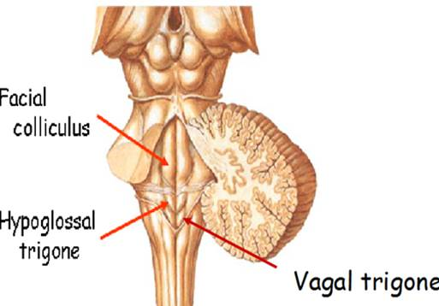
Medulla
In the midline is the vagal trigone and superior to that is the hypoglossal trigone. Underlying each of these are motor nuclei for the respective cranial nerves.

Slide 22
Functions of the Brain Stem
Though small, brain stem is an extremely important part of the brain:
Conduct functions.
Provides the origin of the cranial nerves (CN III-XII).
Conjugate eye movement.
Integrative functions.

Slide 23
Functions of the brain stem
1. Conduct functions
All information related from the body to the cerebrum and cerebellum and vice versa, must traverse the brain stem.

Slide 24
Functions of the brain stem
a) The ascending sensory pathways coming from the body to the brain includes:
The spinothalamin tract for pain and temperature sensation.
The dorsal column, fasciculus gracilis, and cuneatus for touch, proprioceptive and pressure sensation.

Slide 25
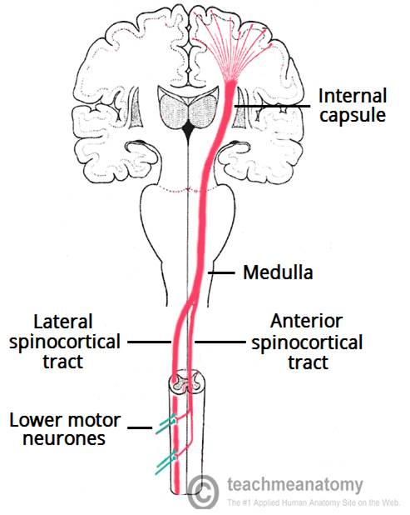
b) Descending tracts
Corticospinal tract (UMN): runs through crus cerebri, basal part of pons and medullary pyramids; 70-90 % of fibers cross in pyramidal decussation to form the lateral corticospinal tract, synapse on LMN in ventral horn of spinal cord.
Functions of the brain stem
Upper motor neurons that originate in brain stem's vestibular, red, and reticular nuclei, which also descend and synapse in the spinal cord.

Slide 26
Functions of the brain stem
2. The brain stem provides the main motor and sensory innervation to the face and neck via the cranial nerves (CN III-XII).
The fibers of cranial nerve nuclei except for olfactory & optic nerve either originating from, or terminating in, the cranial nerve nuclei in brain stem.

Slide 27
Functions of the brain stem
Origin & functions of the cranial nerves
From midbrain
CN III (oculomotor)
CN IV (trochlear)
Both moves eyes; CN III constricts the pupils, accommodates.

Slide 28
Functions of the brain stem
From pons
CN V (trigeminal): Chews and feels front of the head.
CN VI (abducens): Moves eyes.
CN VII (facial): Moves the face, tastes, salivates, cries.
CN VIII (acoustic): Hears, regulates balance.

Slide 29
Functions of the brain stem
From medulla
CN IX (glossopharyngeal): Tastes, salivates, swallows, monitors carotid body and sinus.
CN X (vagus): Tastes, swallows, lifts palate, talks, communication to and from thoraco-abdominal viscera.
CN XI (accessory): Turns head, lifts shoulder.
CN XII (hypoglossal): Moves tongue.

Slide 30
Functions of the brain stem
Classification of the cranial nerves according to functions
Sensory
CN I, CN II, CN VIII
Motor
CN III, CN IV, CN VI, CN XI, CN XII
Mixed
CN V, CN VII, CN IX, CN X

Slide 31
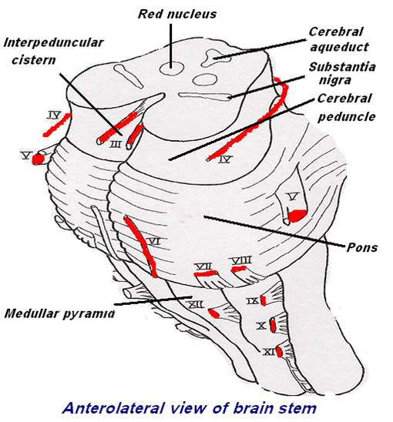

Slide 32
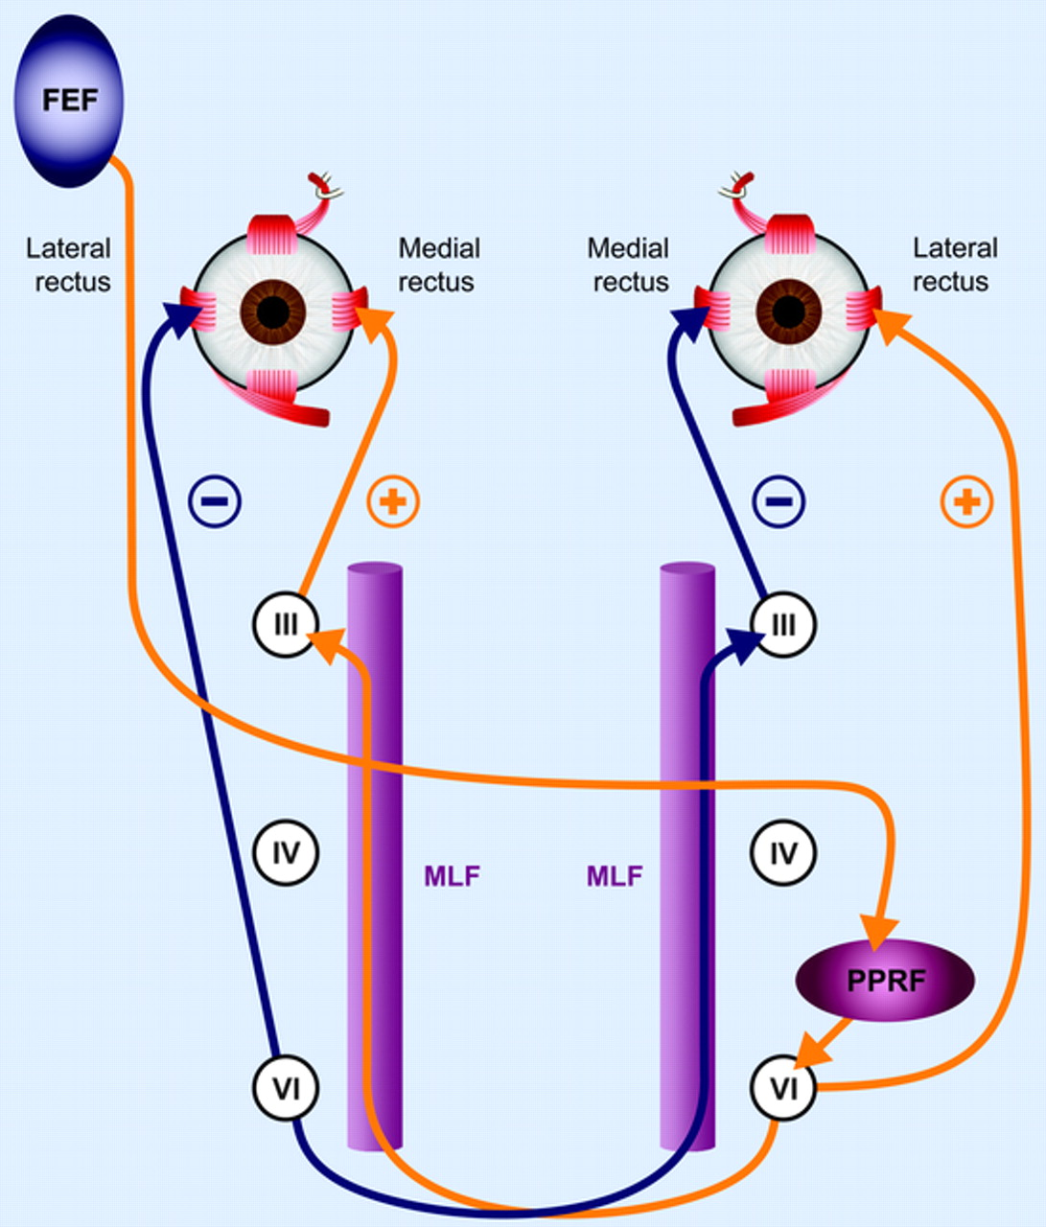
3. Conjugate eye movement.
It refers to motor coordination of the eyes that allows for bilateral fixation on a single object
The frontal eye field (FEF) projects to the opposite side at the midbrain-pontine junction, and then innervates the paramedian pontine reticular formation (PPRF).
From there, projections directly innervate the lateral rectus (contralateral to FEF) and the medial rectus muscle (ipsilateral to FEF).
The left FEF command to trigger conjugate eye movements to the right.

Slide 33
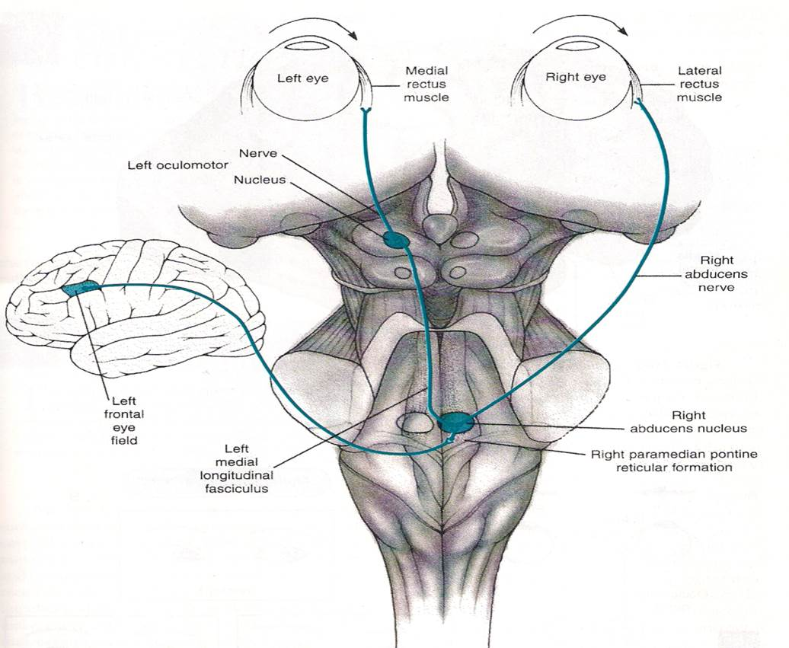
The frontal eye field (FEF) projects to the opposite side at the midbrain-pontine junction, and then innervates the paramedian pontine reticular formation (PPRF).
From there, projections directly innervate the lateral rectus (contralateral to FEF) and the medial rectus muscle (ipsilateral to FEF).
The left FEF command to trigger a saccade culminates in conjugate eye movements to the right.

Slide 34
Functions of the brain stem
4. Integrative functions
It controls consciousness & sleep cycle (alertness and arousal) through reticular formation.
It has got center for cardiovascular, respiratory & autonomic nervous system.
It has centers for cough, gag, swallow, and vomit.
Sense of body balance (Vestibular functions)

Slide 35
Functions of the brain stem
Substantia which is a part of the basal ganglia is present in midbrain and is involved in control of movement.
Midbrain also contain red nucleus which regulate the motor activity through cerebellum.

Slide 36
Functions of the brain stem
Inferior and superior colliculi are situated on the dorsal surface of the midbrain and is involved in auditory & visual processing required for head movements.
Pain sensitivity control: Periaqueductal grey matter of mesencephalon is an area which is rich in endogenous opioid and is important in modulation of painful stimuli.

Slide 37
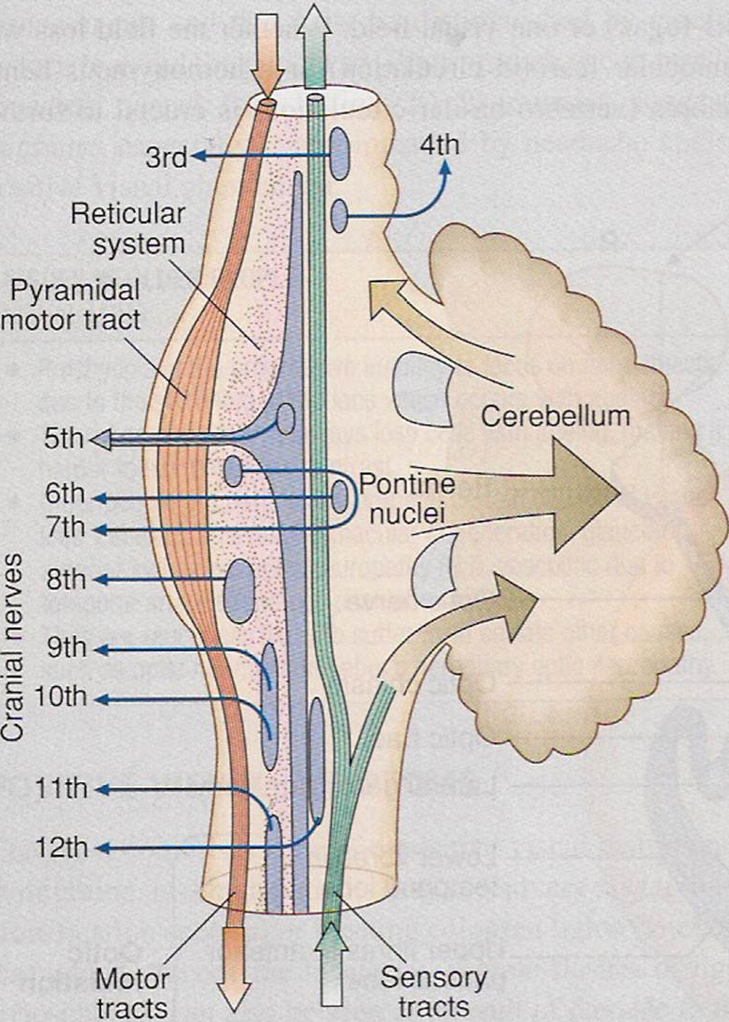
Functions of the brain stem
Functional organization of the Brain Stem
Ventral layer of brainstem is motor in function.
Middle layer is sensory in function & contains medial lemniscus which conveys sensory information from dorsal column.

Slide 38
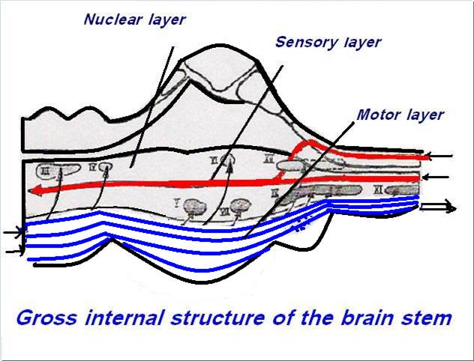

Slide 39
Function of Midbrain
Nerve pathway to cerebral hemispheres.
Auditory and Visual reflex centers.
Cranial Nerves:
CN III - Oculomotor [motor]. (Related to eye movement).
CN IV - Trochlear [motor]. (Superior oblique muscle of the eye which rotates the eye down and out).

Slide 40
Signs & Symptoms of midbrain lesion
Cranial Nerve (CN) deficits: Ipsilateral CN III, CN IV palsy and ptosis (drooping).
Pupils:
Size: Midposition to dilated.
Reactivity: Sluggish to fixed.
Movement: Abnormal extensor.
Respiratory: Hyperventilating.
Loss of consciousness (LOC): Varies

Slide 41
Functions of pons
Respiratory Center.
Cranial Nerves:
CN V - Trigeminal [motor and sensory]. (Skin of face, tongue, teeth; muscle of mastication).
CN VI - Abducens [motor]. (Lateral rectus muscle of eye which rotates eye outward).
CN VII - Facial [motor and sensory]. (Muscles of facial expression).
CN VIII - Acoustic [sensory]. (Hearing)

Slide 42
Symptoms and signs of lesion in pons
Pupils size: Pinpoint
LOC: Semi-coma
Movement: Abnormal extensor.
Respiratory:
-Apneustic (Abnormal respiration marked by sustained inhalation).
-Hyperventilation.
CN Deficits: CN V, CN VI, CN VII, CN VIII.

Slide 43
Functions of medulla oblongata
Crossing of motor tracts.
Cardiac Center.
Respiratory Center.
Vasomotor Center (nerves having muscular control of the blood vessel walls)
Centers for cough, gag, swallow, and vomit.
Cranial Nerves:

Slide 44
CN IX - Glossopharyneal [mixed]. (Muscles & mucous membranes of pharynx, the constricted openings from the mouth & the oral pharynx and the posterior third of tongue).
CN X - Vagus [mixed]. (Pharynx, larynx, heart, lungs, stomach).
CN XI - Accessory [motor]. (Rotation of the head and shoulder).
CN XII - Hypoglossal [motor]. (Intrinsic muscles of the tongue).

Slide 45
Signs and symptoms of lesion in medulla
Movement: Ipsilateral paralysis.
Pupils:
Size: Dilated.
Reactivity: Fixed.
Respiratory: Abnormal breathing patterns
CN Palsies: Inability to control movement. Absent cough, gag.
LOC: Comatose.

Slide 46
Brain Stem Function Tests
To test reticular formation
Alertness, Consciousness & Sleep.
Corticospinal tract
Motor power, reflexes
Pain response
Facial grimacing on firm pressure over the supra orbital ridge.
To test respiratory center
look for the normal pattern of respiration

Slide 47
To test cardiovascular center
Look for normal circulatory function
To test brainstem reflexes:
Pupilary and corneal reflexes.
Vestibulo-ocular reflex: Injection of iced water into the ear will produce eyes movement.
Oculo-cephalic reflex: Eyes will be fixed when head is moved in one or another directions.
Gag reflex.
Cough reflex

