Slide 1
THE CEREBELLUM & ITS RELEVANT CONNECTIONS
Prof. Ahmed Fathalla Ibrahim
Professor of Anatomy
College of Medicine
King Saud University
E-mail: ahmedfathala@gmail.com

Slide 2
OBJECTIVES
At the end of the lecture, students should:
Describe the external features of the cerebellum (lobes, fissures).
Describe briefly the internal structure of the cerebellum.
List the name of cerebellar nuclei.
Relate the anatomical to the functional subdivisions of the cerebellum.
Describe the important connections of each subdivision.
Describe briefly the main effects in case of lesion of the cerebellum.

Slide 3
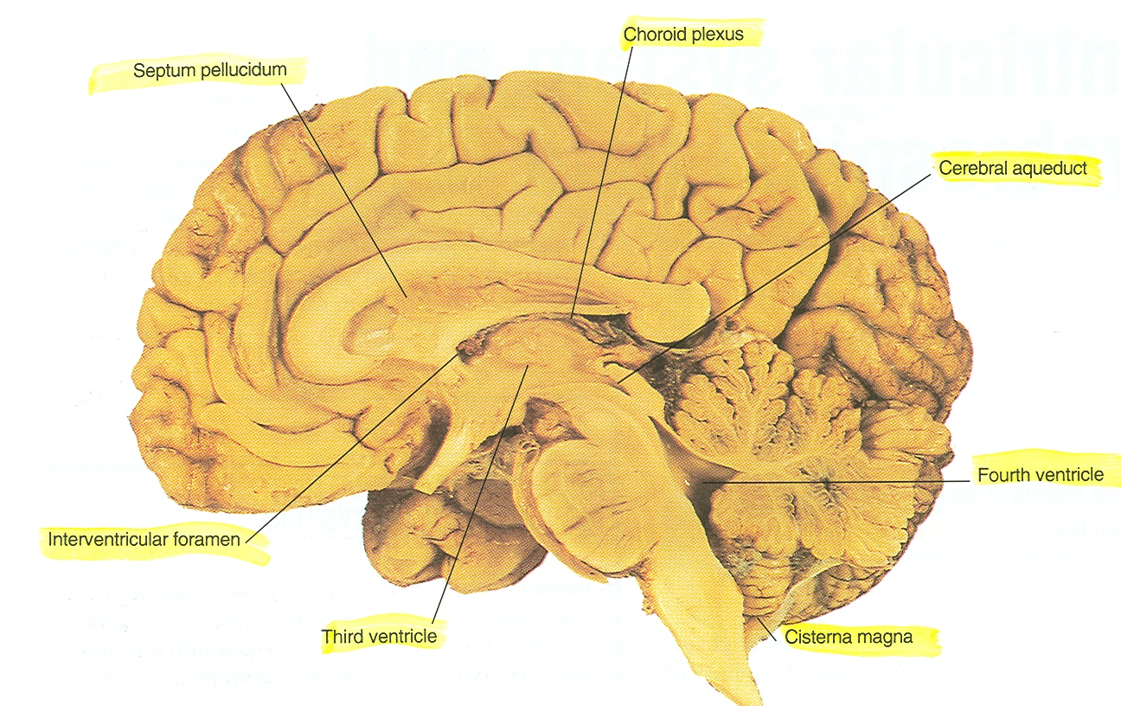
THE CEREBELLUM
ORIGIN: from hindbrain, separated from pons & medulla by fourth ventricle.
CONNECTION TO BRAIN STEM: by inferior, middle & superior cerebellar peduncles.

Slide 4
EXTERNAL FEATURES
It consists of two cerebellar hemispheres joined in midline by the vermis.
Its surface is highly convoluted forming folia separated by fissures.

Slide 5
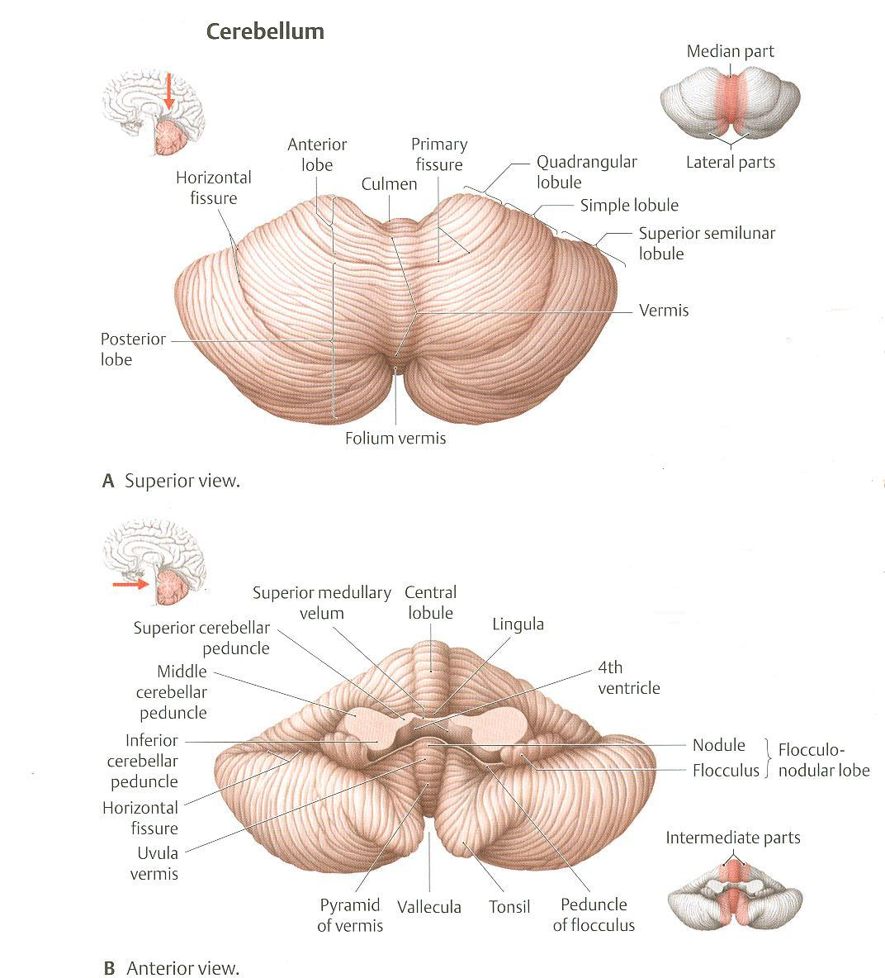
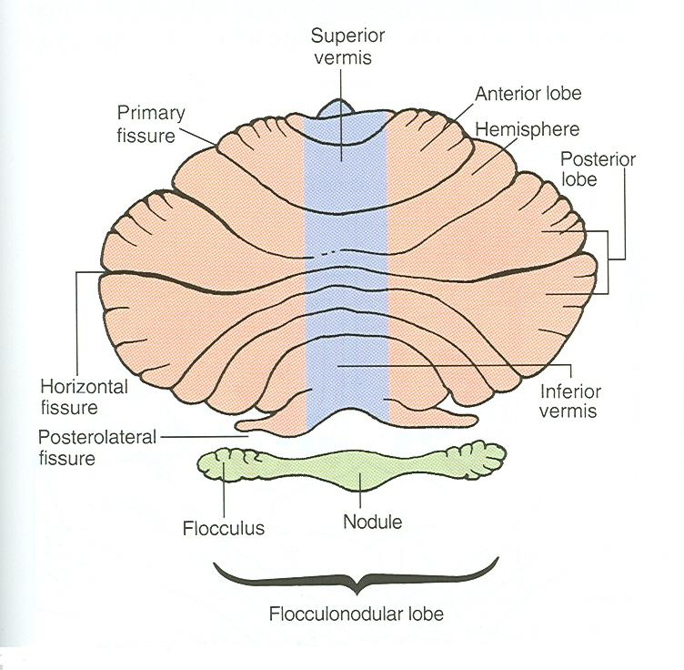
ANATOMICAL SUBDIVISION
1
2
2
Anterior lobe: in front of primary fissure
Posterior (middle) lobe: behind primary fissure
Flocculonodular lobe.

Slide 6
CONSTITUENTS
Outer grey matter: cerebellar cortex.
Inner white matter: cerebellar medulla.
Deeply seated nuclei in white matter: from medial to lateral:
Fastigeal nucleus: smallest one.
Globose nucleus.
Emboliform nucleus.
Dentate nucleus: largest one.

Slide 7
CEREBELLAR CORTEX
Divided into 3 layers:
Outer molecular layer
Intermediate Purkinje cell layer
Inner granular layer

Slide 8
CEREBELLAR MEDULLA
AFFERENT FIBRES:
Climbing fibres: from inferior olivary nucleus, relay to purkinge cells
Mossy fibres: rest of fibres:
From vestibular nuclei
From spinal cord
From pons
They relay to granule cells which in turn relay to purkinge cells

Slide 9
CEREBELLAR MEDULLA
Axons of purkinge cells are the only axons to leave the cortex to medulla:
The great majority of axons do not leave cerebellum & end in deep cerebellar nuclei.
Some of axons leave cerebellum as efferent fibres.

Slide 10
CEREBELLAR MEDULLA
EFFERENT FIBRES:
Most of efferent fibres are axons of deep cerebellar nuclei.
Main efferents go to:
Vestibular nuclei
Red nucleus
Ventral lateral nucleus of thalamus

Slide 11
FUNCTIONAL SUBDIVISIONS
OF
THE CEREBELLUM

Slide 12
ARCHICEREBELLUM
Purkinge cells of flocculonodular lobe
BALANCE
Fastigeal nucleus
ICP
ICP
Vestibular nuclei

Slide 13
ARCHICEREBELLUM
Part of cerebellum: flocculonodular lobe
Nuclei: fastigeal
Afferents: from vestibular nuclei (through ICP)
Efferents: to vestibular nuclei (through ICP)
Function: controls balance

Slide 14
PALEOCEREBELLUM
Purkinge cells of vermis & paravermis
ICP
POSTURE
& MUSCLE TONE
Globose & emboliform
nuclei
SCP
SCP
Spinal cord
Red nucleus

Slide 15
PALEOCEREBELLUM
Part of cerebellum: vermis & paravermis
Nuclei: globose & emboliform
Afferents: from spinal cord (dorsal & ventral spinocerebellar tracts through ICP & SCP, respectively)
Efferents: to red nucleus (through SCP)
Function: influences posture & muscle tone

Slide 16
NEOCEREBELLUM
Purkinge cells of rest of cerebellum
Dentate nucleus
MCP
Red nucleus
&
Ventral lateral nucleus
of thalamus
COORDINATION
OF VOLUNTARY MOVEMENTS
Pons
Motor cortex

Slide 17
NEOCEREBELLUM
Part of cerebellum: rest of cerebellum
Nuclei: dentate
Afferents: from pons (through MCP)
Efferents: to red nucleus but mostly to ventral lateral nucleus of thalamus (through SCP) then to motor cortex
Function: coordination of voluntary movements

Slide 18
CEREBELLAR LESIONS
MIDLINE LESION: Loss of postural control
UNILATERAL LESION: “Cerebellar ataxia” causes ipsilateral:
Incoordination of arm: intention tremor (on performing voluntary movements)
Incoordination of leg: unsteady gait
Incoordination of eye movements: nystagmus
Slowness of speech: dysarthria

Slide 19
SUMMARY
Anatomically, the cerebellum is divided into: anterior, posterior & flocculonodular lobes.
Developmentally & functionally, it is divided into: archi- paleo- & neocerebellum.
Archicerebellum (flocculonodular lobe) is the oldest part of cerebellum, related to fastigeal nucleus, connected to vestibular nuclei & concerning for control of body balance.

Slide 20
SUMMARY
Paleocerebellum (vermis & paravermis) is related to globose & emboliform nucleus, connected to spinal cord & red nucleus & concerning for regulation of posture & muscle tone.
Neocerebellum (most of human cerebellum) is related to dentate nucleus, connected to pons, thalamus. Its final destination is to motor cortex. It is concerned with coordination of voluntary movements.
Cerebellar lesions lead to ipsilateral incoordination (ataxia).

Slide 21
QUESTION 1
Which one of the following nucleus is related to archicerebellum?
Fastigeal nucleus
Dentate nucleus
Globose nucleus
Emboliform nucleus

Slide 22
QUESTION 2
To which part of the CNS the flocculonodular lobe send its efferent fibers?
Red nucleus
Pons
Vestibular nuclei
Motor cortex

Slide 23
THANK YOU

