Slide 1
Brachial Plexus & Lumbosacral Plexus
Dr. Saeed Vohra
&
Dr.Sanaa Alshaarawy

Slide 2
Objectives
At the end of this lecture, the students should be able to :
Describe the formation of brachial plexus (site, roots)
List the main branches of brachial plexus
Describe the formation of lumbosacral plexus (site, roots)
List the main branches of lumbosacral plexus
Describe the important Applied Anatomy related to the brachial & lumbosacral plexuses

Slide 3
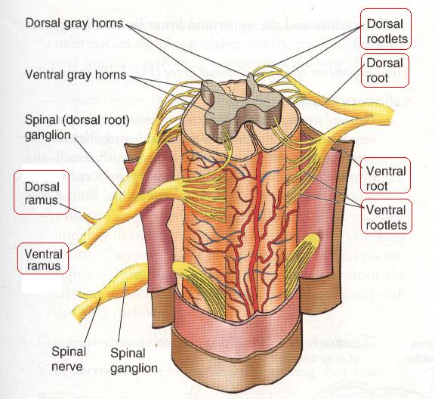
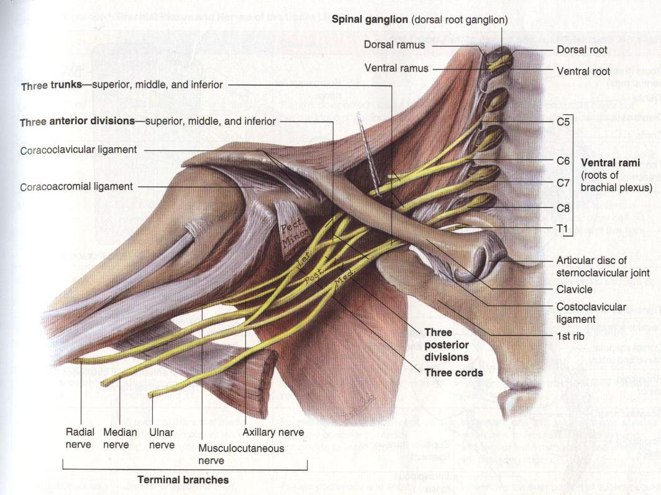
Formation of Brachial Plexuses
It is formed in the posterior triangle of the neck.
It is the union of the anterior rami of the 5th ,6th ,7th ,8th cervical and the 1st thoracic spinal nerves

Slide 4
Divisions
The plexus is divided into
Roots
Trunks
Divisions
Cords
Terminal branches

Slide 5
Trunks
Upper trunk
Union of the roots of C5 & 6
Middle trunk
Continuation of the root of C7
Lower trunk
Union of the roots of C8 & T1

Slide 6
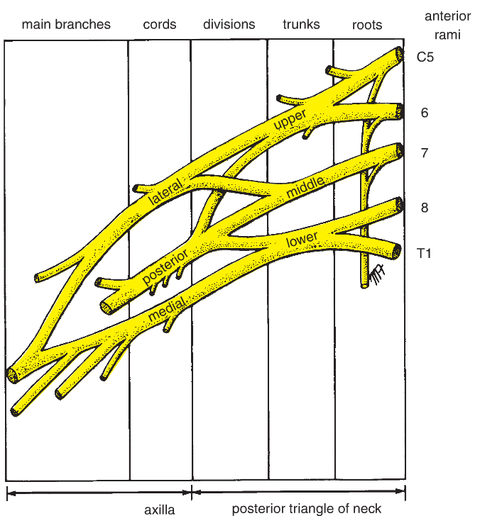
Divisions & Cords
Each trunk divides into anterior and posterior division
Posterior cord:
From the three posterior divisions
Lateral cord:
From the anterior divisions of the upper and middle cords

Slide 7
CORDS & BRANCHES
Medial cord
It is the continuation of the anterior division of the lower trunk
Branches
All three cords will give branches, those will supply their respective regions

Slide 8
The Brachial Plexus
Long Thoracic (C5,6,7)
Dorsal Scapular(C5)
Nerve to Subclavius(C5,6)
upper
trunk
Suprascapular(C5,6)
roots
lateral Cord
(2LM)
C5
C6
middle
trunk
C7
lower
trunk
C8
posterior Cord
(ULTRA)
T1
medial Cord
(4MU)
Anterior divisions
Posterior divisions

Slide 9
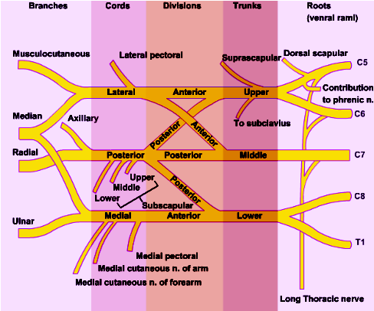
The Plexus can be divided into 5 stages:
Roots: in the posterior∆ of the neck
Trunks: in the posterior∆ of the neck
Divisions: behind the clavicle
Cords: in the axilla
Branches: in the axilla
The first 2 stages lie in the posterior triangle, while the last 2 sages lie in the axilla.

Slide 10
A. Branches from Roots
1. Nerve to rhomboids (dorsal scapular nerve) C5
2. Long thoracic nerve C5, 6 & 7
B. Branches from Trunk
Nerve to subclavius
Suprascapular nerve (supplies supraspinatus & infraspinatus)

Slide 11
(C)Branches from Cords
Lateral Cord
(2LM)
.Lateral pectoral n
.Lateral root to median n
.Musculocutaneous n
C5
C6
C7
C8
T1
Medial cord
(4MU)
.Medial pectoral n.
.Medial root to median n.
.Medial cutaneous n of arm.
.Medial cutaneous n of forearm.
.Ulnar n.
Posterior Cord
(ULTRA)
.Upper subscapular n
.Lower subscapular n
.Thoracodorsal n
.Radial n
.Axillary n

Slide 12
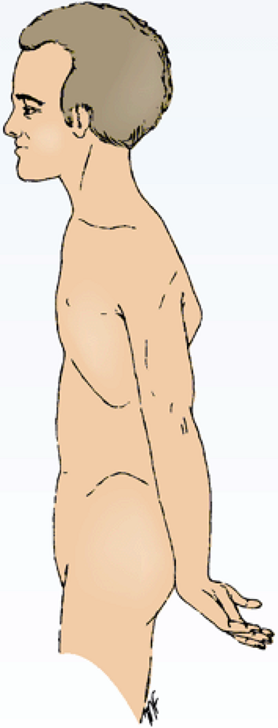
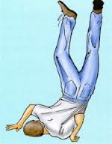
Brachial Plexus Injuries
Upper Lesions of the Brachial Plexus Upper Trunk C5,6 (Erb-Duchenne Palsy ”waiter's tip position”.
Resulting from excessive displacement of the head to the opposite side and depression of the shoulder on the same side (a blow or fall on shoulder).
The position of the upper limb in this condition has been likened to that of a porter or waiter hinting for a tip or policeman’s tip hand.
The arm hangs by the side and is rotated medially. The forearm is extended and pronated
Erb-Duchenne’s paralysis due to injury of Upper Trunk of Brachial Plexus.

Slide 13
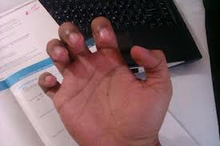
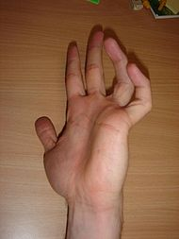
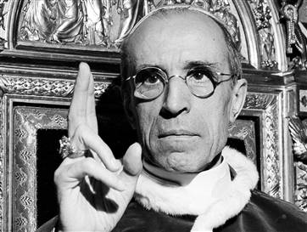
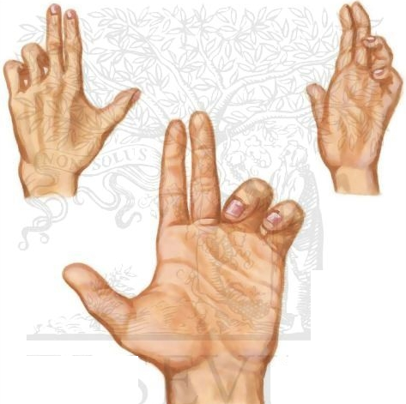
Brachial Plexus Injuries
Lower Lesions of the Brachial Plexus, (Klumpke Palsy)/LowerTrunk (C8,T1)Lesion
Lower lesions of the brachial plexus are usually traction injuries caused by a person falling from a height clutching at an object to save himself. The first thoracic nerve is usually torn.
The nerve fibers from this segment run in the ulnar and median nerves to supply all the small muscles of the hand. The hand has a clawed appearance due to ulnar nerve injury
Claw Hand
Claw Hand
Hand of Benediction or Pop’s Blessings (APE HAND) will result from median nerve injury.

Slide 14
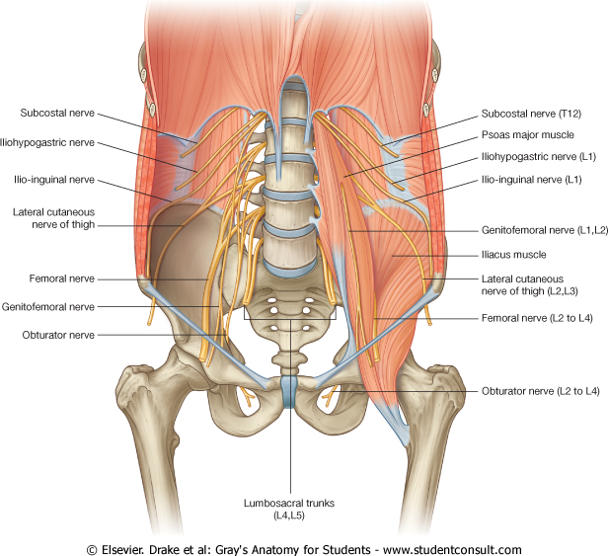
LUMBAR PLEXUS
Formation:
By ventral rami of L1, 2, 3 and most of L4
Site:
In the substance of psoas major muscle
Main branches:
Iliohypogastric & ilioinguinal (L1)
to anterior abdominal wall
Obturator (L2-L4)
to medial compartment of thigh
Femoral (L2-L4)
to anterior compartment of thigh

Slide 15
FEMORAL NERVE
Origin:
A branch from lumbar plexus (L2,3,4)
Course:
Descends lateral to psoas major & enters the thigh behind the inguinal ligament
Passes lateral to femoral artery & divides into anterior & posterior divisions.

Slide 16
FEMORAL NERVE INJURY
Motor effect:
Wasting of quadriceps femoris
Loss of extension of knee
Weak flexion of hip (psoas major is intact)
Sensory effect:
loss of sensation over areas supplied antero-medial aspect of thigh & medial side of leg & foot

Slide 17
SACRAL PLEXUS
Formation:
By ventral rami of a part of L4 & whole L5 (lumbosacral trunk) + S1, 2, 3 and most of the S4
Site:
In front of piriformis msucle

Slide 18
SACRAL PLEXUS
Main branches:
Pelvic splanchnic nerve preganglionic parasympathetic to pelvic viscera & hindgut
Pudendal nerve
to perineum
Sciatic nerve
to lower limb

Slide 19
LUMBOSACRAL PLEXUS

Slide 20
SCIATIC NERVE The largest nerve of the body
Origin:
from sacral plexus (L4, 5, S1, 2, & 3)
Course:
Leaves the pelvis through greater sciatic foramen, below piriformis & passes in the gluteal region (between ischial tuberosity & greater trochanter) then to posterior compartment of thigh
Divides into tibial & common peroneal (fibular) nerves
Ischial tuberosity

Slide 21
TIBIAL NERVE
Course:
Descends through popliteal fossa to posterior compartment of leg, accompanied with posterior tibial vessels
Passes deep to flexor retinaculum to reach the sole of foot where it divides into 2 terminal branches

Slide 22
COMMON PERONEAL (FIBULAR) NERVE
Course:
Leaves popliteal fossa & turns around the lateral aspect of neck of fibula Then divides into:
Superficial peroneal: descends into lateral compartment of leg
Deep peroneal: descends into anterior compartment of leg

Slide 23
SUMMARY
The lumbar plexus is formed by ventral rami of L1,2,3 and most of L4, in substance of psoas major muscle
The sacral plexus is formed by ventral rami of a part of L4 & whole L5 (lumbosacral trunk) plus the S1,2,3 and most of S4, in front of piriformis msucle.
The femoral nerve, a branch of lumbar plexus (L2,3,4).
Its injury will affect the flexion of hip & extension of knee as well as loss of sensation of skin of anteromedial aspects of the thigh, medial side of knee, leg and foot
The sciatic nerve is a branch of sacral plexus (L4,5, S1,2,3)
Its injury will affect the flexion of knee, extension of hip, all movements of leg & foot, as well as loss of sensation of skin of leg & foot (except areas supplied by saphenous branch of femoral nerve)

Slide 24
Thank you

Slide 25
1. Lesion of the upper trunk of the brachial plexus leads to :
Klumpke palsy.
Erb-Duchenne palsy
Drop wrist & hand.
Ape hand.
2. Which one of the following nerves is a branch of posterior cord of brachial plexus?
Ulnar
Radial
Median
Musclocutanous

Slide 26
QUESTION 1
The femoral nerve supplies:
Extensors of hip.
Skin of dorsum of foot.
Hamstrings.
Extensors of knee

Slide 27
QUESTION 2
Injury of common peroneal nerve leads to:
Loss of dorsiflexion of ankle
Loss of inversion of foot
Loss of extension of knee
Loss of flexion of toes

