Slide 1
Pathogenesis of Cerebral Infarction at Cellular & Molecular Levels

Slide 2
Objectives:
By the end of this lecture, the students should be able to:
Identify the possible cell death mechanisms implicated in the pathogenesis of ischemic brain injury
Acquire the knowledge of the important role played by oxidative stress and free radicals in the pathogenesis of cerebral infarction
Understand the various factors involved in ischemia-induced metabolic stress
Identify the Neurochemical changes involved in cerebral ischemia

Slide 3
Cerebral Ischemia (Strokes) subtypes
Stroke
Hemorrhagic
Intracerebral
Subarachnoid
Ischemic
Thrombotic
Embolic
Global incidence: 32%
Global incidence: 68%
http://www.uptodate.com/contents/overview-of-the-evaluation-of-stroke

Slide 4
Risk factors of strokes
There are a number of risk factors for stroke:
Some increase the risk of one type of stroke (hemorrhagic or ischemic).
Some increase the risk of both types.
Occasionally, strokes occur in people who have no risk factors.
Continued …...

Slide 5
Risk factors of strokes
Ischemic stroke risk factors
Age older than 40 years
Heart disease
High blood pressure
Smoking
Diabetes
High blood cholesterol levels
Illegal drug use
Recent childbirth
Previous history of transient ischemic attack
Inactive lifestyle and lack of exercise
Obesity
Current or past history of blood clots
Family history of cardiac disease and/or stroke
Hemorrhagic stroke risk factors
High blood pressure
Smoking
Illegal drug use (especially cocaine and "crystal meth")
Use of warfarin or other blood thinning medicines

Slide 6
The cell death mechanisms implicated in the pathogenesis of ischemic brain injury

Slide 7
Cell death mechanisms in cerebral ischemia: Necrosis and Apoptosis
Necrosis is commonly observed early after severe ischemic insults
Apoptosis occurs with more mild insults and with longer survival periods
The mechanism of cell death involves calcium-induced calpain-mediated proteolysis of brain tissue
Substrates for calpain include:
Cytoskeletal proteins, Membrane proteins and Regulatory and signaling proteins

Slide 8
Biochemical Responses to Ischemic Brain Injury
Oxidative stress
Metabolic stress
Neurochemical response

Slide 9
Oxidative stress

Slide 10
The Role of Reactive Oxygen Species (ROS) & Reactive Nitrative Species (RNS) in Normal Brain Physiology
They are mainly generated by microglia & astrocytes
They modulate synaptic transmission & non-synaptic communication between neurons & glia
During periods of increased neuronal activity, ROS & RNS diffuse to the myelin sheath of oligodendrocytes activating Protein kinase C (PKC) → posttranslational modification of myelin basic protein (MBP) by phosphorylation
They regulate neuronal signaling in both central & peripheral nervous systems
They are required for essential processes as learning & memory formation

Slide 11
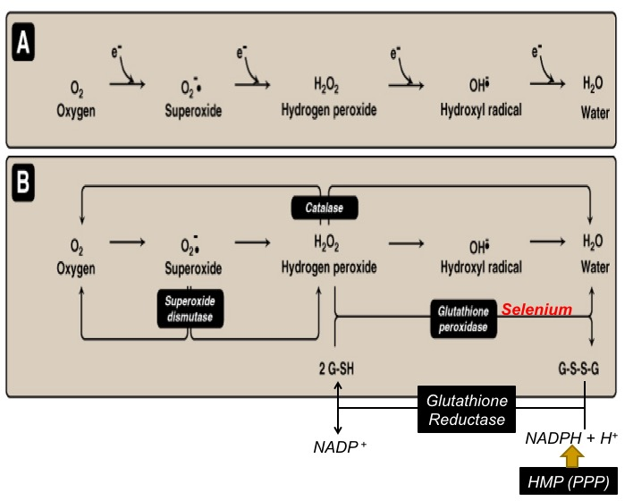

Slide 12
Oxidative stress
A condition in which cells are subjected to excessive levels of Reactive oxidizing species (ROS or RNS) & they are unable to counterbalance their deleterious effects with antioxidants.
It has been implicated in the ageing process & in many diseases (e.g., atherosclerosis, cancer, neurodegenerative diseases, stroke)

Slide 13
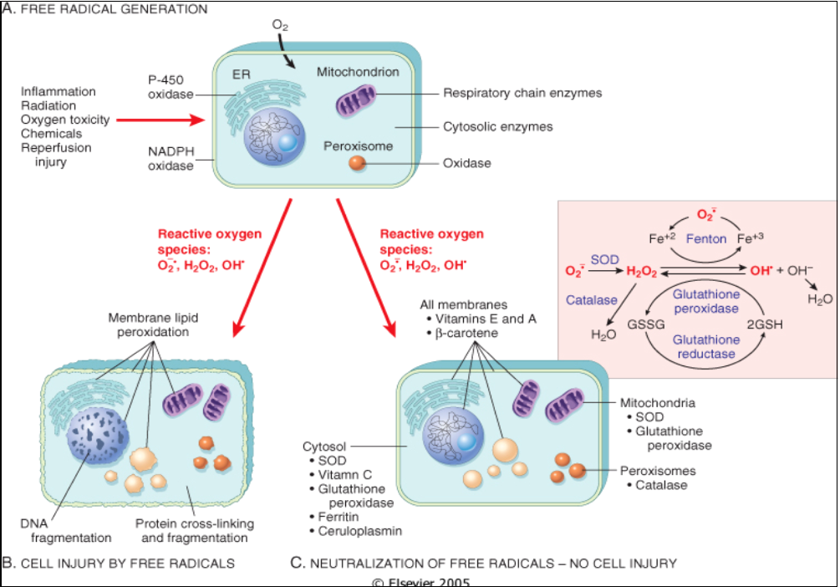

Slide 14
The brain and Oxidative stress
The brain is highly susceptible to ROS-induced damage because of:
High concentrations of peroxidisable lipids
Low levels of protective antioxidants
High oxygen consumption
High levels of iron (acts as pro-oxidants under pathological conditions)
The occurrence of reactions involving dopamine & Glutamate oxidase in the brain

Slide 15
Molecular & Vascular effects of ROS in ischemic stroke
Molecular effects:
DNA damage
Lipid peroxidation of unsaturated fatty acids
Protein denaturation
Inactivation of enzymes
Cell signaling effects (e.g., release of Ca²⁺ from intracellular stores)
Cytoskeletal damage
Chemotaxis
Vascular effects:
Altered vascular tone and cerebral blood flow
Increased platelet aggregability
Increased endothelial cell permeability

Slide 16
The role of NO in the pathophysiology of cerebral ischemia
Ischemia→ abnormal NO production
This may be both beneficial and detrimental, depending upon when and where NO is released
NO produced by endothelial NOS (eNOS) → improving vascular dilation and perfusion (i.e. beneficial).
In contrast, NO production by neuronal NOS (nNOS) or by the inducible form of NOS (iNOS) has detrimental (harmful) effects.
Increased iNOS activity generally occurs in a delayed fashion after brain ischemia and trauma and is associated with inflammatory processes

Slide 17
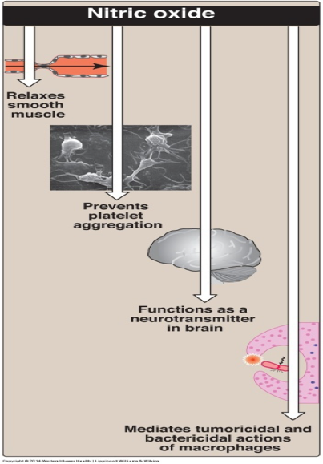
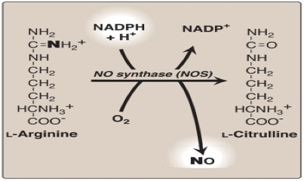

Slide 18
Metabolic stress

Slide 19
Biochemical changes in The brain during ischemia
Ischemia → interruption or severe reduction of blood flow, O₂ & nutrients in cerebral arteries → energy depletion (depletion of ATP & creatine phosphate)
↑ Lactic acid in neurons → acidosis → promotes the pro-oxidant effect → ↑ the rate of conversion of O₂^{.-} to H₂O₂ or to hydroxyperoxyl radical
Inhibition of ATP-dependent ion pumps
Membranes depolarization
Perturbance of transmembrane ion gradients
Ca²⁺ Influx (translocation from extracellular to intracellular spaces) → activation of cellular proteases (Calpains) & lipases → breakdown of cerebral tissue
Na⁺ influx
K⁺ efflux
K⁺-induced release of excitatory amino acids

Slide 20
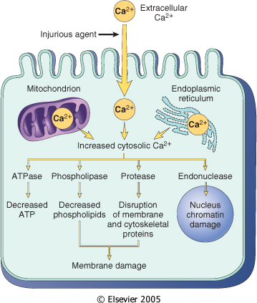
Sources & consequences of increased cytosolic Calcium in cell injury

Slide 21
Neurochemical response

Slide 22
The neurochemical response to cerebral ischemia
Following cerebral ischemia, extracellular levels of various neurotransmitters are increased e.g.,
Glutamate
Glycine
GABA
Dopamine

Slide 23
The Blood tests in patients with brain ischemia or hemorrhage
Complete blood count, including hemoglobin, hematocrit, white blood cell count, and platelet count
Prothrombin time, international normalized ratio (INR), and activated partial thromboplastin time
Thrombin time and/or ecarin clotting time if patient is known or suspected to be taking a direct thrombin inhibitor or a direct factor Xa inhibitor
Blood lipids, including total, high-density lipoprotein (HDL), and low-density lipoprotein (LDL) cholesterol, and triglycerides.
Cardiac enzymes and troponin
http://www.uptodate.com/contents/overview-of-the-evaluation-of-stroke

Slide 24
Biochemical basis of pharmacological intervention

Slide 25
Examples of Potential Biochemical Intervention in Cerebral Ischemia
Inhibitors of glutamate release
Ca²⁺ channel blockers
Nitric oxide synthase inhibitors & free radical inhibition
Calpain inhibitors
Notes:
SNX-111 is a presynaptic Ca²⁺ channel blocker that can reduce the influx of Ca²⁺ and the subsequent release of neurotransmitters and has been shown in a rabbit model to be neuroprotective (Perez-Pinzon et al. 1997)
Lamotrigine (3,5-diamino-6-(dichlorophenol)-1,2,4-triazine) is a phenyltriazine derivative that blocks voltage-gated Na⁺ channels and inhibits the ischaemia-induced release of glutamate. It is a commercially available, orally administered anticonvulsant with few side effects, although rashes and cases of Stevens-Johnson syndrome have been reported (Bourgeois 1998, Dunn et al. 1999)
Riluzole (2-amino-6-trigluoromethoxy benzothiazole) is a voltage-gated Na⁺ channel blocker that is also used clinically in cases of neurodegenerative diseases. It prevented ischaemic spinal cord injury in a rabbit model (Lang-Lazdunski et al. 1999), in another experiment animals treated with it had a better histopathological outcome after cardiac arrest (Kanthasamy et al. 1999).
Lubeluzole, a Na⁺ channel blocker that can inhibit the release of glutamate from ischaemic neurons, reducing postsynaptic excitotoxicity, may also inhibit postsynaptic nitric oxide synthetase activity. It has been shown in a rat model to improve the structural outcome for brain cells after global cerebral ischaemia (Haseldonckx et al. 1997).
Lifarizine is a similar substance that was found to be a promising neuroprotectant in an experimental setting (Brown et al. 1995), but clinical trials were discontinued on account of cardiac side effects such as hypotension and arrhythmia (Squire et al. 1995).
The voltage-dependent Na⁺ channel antagonist BW619C87 [4-amino-2-(4-methyl-1-piperazinyl)-5-(2,3,5-trichlorophenyl) pyrimidine]; has proved to a potent neuroprotectant, reducing the volume of hemispheric ischaemic damage by 51% at a dose of 50 mg/kg in a rat model (Kawaguchi et al. 1999).
Non-competitive NMDA receptor antagonists. In order to reach its binding site, a non-competitive NMDA receptor antagonist requires an ion channel to be opened up and the voltage-dependent Mg²⁺ block to be released by postsynaptic membrane depolarization.
NPS-1506 is a non-competitive NMDA receptor antagonist with a moderate affinity to its receptor. It was found to be neuroprotective in a rodent model for ischaemic stroke, haemorrhagic stroke and head trauma, being less neurotoxic than MK-801 (Mueller et al. 1999).
Dextromethorphan and its analogue AHN649 are relatively selective, low-affinity NMDA antagonists, and have been shown to have neuroprotective efficacy in a rat model utilizing temporal intraluminal filament occlusion of the middle cerebral artery (Britton et al. 1997, Tortella et al. 1999).
Aptiganel (CNS 1102) is a selective, non-competitive antagonist that acts on the ion channel associated with the NMDA receptor and has been shown to be neuroprotective in neonatal lambs after HCA (Bokesch et al. 1997).
Remacemide hydrochloride and its principal active desglycinyl metabolite are low-affinity non-competitive NMDA receptor antagonists. Remacemide hydrochloride was shown to be neuroprotective in an animal model of hypoxia and ischaemic stroke, and overall postoperative neurological recovery in a clinical prospective study of 171 patients undergoing aortocoronary bypass grafting (CABG) with CPB was more favourable in the remacemide group than in the controls (Arrowsmith et al. 1998).
Glycine site antagonists. Glycine, a major inhibitory neurotransmitter in the spinal cord and brainstem of vertebrates, is collected in the synaptic vesicles via a proton-coupled transport system and is released into the synaptic cleft after depolarization of the presynaptic terminal. It can participate in excitatory neurotransmission by modulating the activity of the NMDA subtype of the glutamate receptor.
7-Chlorokynuretic acid and its derivatives ACEA-1021 (Licostinel), ACEA-1031 and ACEA-1416 have also been found to reduce infarct volume in focal ischaemia models (Warner et al. 1995). Licostinel may be a safer and better tolerated neuroprotective agent than many of the previously evaluated NMDA antagonists (Albers et al. 1999).
Felbamate, a novel anticonvulsant that binds to the glycine site of the NMDA receptor, has been shown to have neuroprotective properties in vitro and in vivo. In a gerbil model of global ischaemia, felbamate given after carotid occlusion prevented delayed apoptosis, but the doses required to reach this effect were higher than those used for anticonvulsant treatment (Wasterlain et al. 1996).
Monosialogangliosides play important roles in the physiological pathways of the nervous system, particularly in the brain.
GM1 has also been shown to reduce cerebral injury following 2 hours of HCA at 18°C. In an experiment with adult dogs, a better behavioural outcome and less neuronal injury was seen in dogs pretreated with GM1 than in the controls (Redmond et al. 1993).
Calcium channel blockers may reduce Ca²⁺ influx into cells after the activation of EAA receptors, and they also inhibit vasoconstriction after ischaemic insult (Lipton and Rosenberg 1994). Calcium antagonists have been shown to improve the neurological outcome after aneurysmal subarchnoidal haemorrhage.
NO has been shown to mediate glutamate excitotoxicity, and the therapeutic potential of NOS inhibitors have been emphasized
(Barth et al. 1997). ARL17477, a selective NOS inhibitor, also provided some neuroprotection in a gerbil model, but the combination of MK-801 with ARL17477 provided 21% or 44% higher protection than either alone, indicating that several pathways contribute to ischaemic cell death and several agents targeting different points in the biochemical cascade may be of benefit (Hicks et al. 1999).
One possibility for pharmacologically targeting a "downstream" event in the cascade is to inhibit activated calpain. The CNS-penetrating calpain inhibitor MDL 28,170 can reduce infarct volume in rodents (Markgraf et al. 1998), as also can another inhibitor Cbz-Val-Phe-H (Hong et al. 1994).
Gelsolin expression at normal levels protects the brain from acute ischaemic injury with its ability to stabilize CA²⁺ influx. Cytochalacin D is a partial gelsolin analogue and can reduce ischaemic injury, although this can lead to apoptosis (Endres et al. 1999).
The pan-caspase inhibitor boc-aspartyl(OMe)-fluoromethylketone significantly improved neuroprotection when injected into brain ventriceles 3 h after cerebral hypoxic-ischaemia, and systemic injections of this molecule given in a delayed fashion resulted in significant neuroprotection. (Cheng et al. 1998).

Slide 26
To Summarize:

Slide 27
Ischemic cascade
Lack of oxygen supply to ischemic neurones
ATP depletion
Malfunctioning of membrane ion system
Depolarisation of neurones
Influx of calcium
Release of neurotransmitters, activation of proteases
Further depolarisation of cells
Further calcium influx

Slide 28
Cosequences of brain ischemia
Energy failure / depolarisation / Oxidative stress
Neurotransmitter release
and receptor activation
Ca²⁺
Lipolysis (DAG ↑→PKC↑)
Protein
phosphorylation
Proteolysis
(FFAs↑)
Breakdown of
cytoskeleton
Dysfunction of receptors and ion channels
Membrane damage
Inhibition of axonal
transport, blebbing

Slide 29
Take Home Message
Severe cerebral ischemic insults lead to a complex cascade of biochemical and molecular events, including:
Cell death
Oxidative stress
Metabolic stress and neurochemical changes

Slide 30
References
Lippincott’s Illustrated reviews: Biochemistry 6th edition, Unit 2, Chapter 13, Pages 145-156.
‪Role of Oxidative Stress in Chronic Diseases (Book).‏‬ (Link)
The Role of Neurotransmitters in Brain Injury (Book, Page 36). (Link)
http://www.uptodate.com/contents/stroke-symptoms-and-diagnosis-beyond-the-basics
Bramlett and Dietrich, Pathophysiology of Cerebral Ischemia and Brain Trauma: Similarities and Differences, Journal of Cerebral Blood Flow and Metabolism, 2004, 24: 133-150
Allen and Bayraktutan, Oxidative Stress and its Role in the Pathogenesis of Ischemic Stroke, World Stroke Organization International Journal of Stroke, 2009, 4:461–470

