Slide 1
Cerebral TB and other chronic Cerebral bacterial infection
Dr. Fawzia Al-Otaibi

Slide 2
Symptoms and signs of chronic cerebral and meningetic infection: over long period or can be recurrent
SYMPTOM
Chronic headache
Neck or back pain
Change in personality
Facial weakness
Double vision ,visual loss
Arm and leg weakness
clumsiness
SIGN
+/-Papilloedema
Brudzinski or Kerning 'positive sign of meningeal irritation
Altered mental status, memory loss, etc
Seventh nerve palsy
3,4,6 th,Nerve palsy
Ataxia
Hydrocephalus

Slide 3
Microbiological Causes Of Chronic Cerebral Infection And Meningitis
A –Bacterial ( Most important)
a)Tuberculosis in Saudi Arabia
b)Brucellosis
c) Partially treated acute meningitis
d) Syphilis-caused by Treponema Pallidium
E) Liptosporosis- caused by L.Icter haemorraghia
F) Lyme disease-caused by Borrelia burgdorferi not common in Saudi Arabia
g)Nocardiosis-caused by Nocardia speciese.g N.Asteroids
h) Cerebral abscesses can also same -----preferred as chronic infection

Slide 4
B- Fungal Causes
a- Cryptococcus neoformans
b-Candida species in Saudi Arabia species mainly Candida albicans in immunocompromised patients
c- Aspergillus species
d- Histoplasma capsulatum

Slide 5
C- Parasitic
a- Toxoplasma gonodii(most common)
b- Trypanosoiasis:caused by
T.gambiense
c- Rare causes Acanthamoeba spp

Slide 6
D- Virus
Some virus can some present as chronic meningitis these include:
a- Mumps
b-Herpes simplex
c- HIV

Slide 7
The most important causes of chronic bacterial cerebral and menigetic infection in saudi arabia are
1- Tuberculosis
2- Brucellosis
They should differentiated on the basis of:
a- Clinical History
b- Occupations
c- Clinical symptoms
d- Clinical signs in other organism
e- Cerebrospinal fluid findings

Slide 8
Brucellosis
Is common disease in Saudi Arabia
It affect people who are in contact with domestic animals or those who consume raw milk and milk products
It usually presents with Pyrexia( fever) of unknown organism of intermittent nature
The fever is accompanied by night sweating, in between the attacks of fever the patient is not very ill.
Same reasons it can caused chronic cerebral infection and meningitis
The commonest causes in Saudi Arabia is Br.melitensis

Slide 9
Tuberculosis
Is caused by Mycobacterium tuberculosis
Which infect one third of human race
The patient usually presents with fever of long duration
Symptoms of cough and coughing of blood (Haemoptoysis) when the chest is affected
It some cases present as meningitis and cerebral infection presenting chronic neurological symptoms and signs
Parenchymal CNS involvement can occur in the form of tuberculoma or, more rarely, abscess
spinal meningitis, radiculomyelitis, spondylitis, or spinal cord infarction
Pott’s spine and Pott’s paraplegia.

Slide 10
Classification of CNS tuberculosis
Intracranial
tuberculous meningitis (TBM)
TBM with miliary tuberculosis
tuberculous encephalopathy
tuberculous vasculopathy
space-occupying lesions: tuberculoma
(single or multiple); multiple small
tuberculoma with miliary tuberculosis;
tuberculous abscess
Spinal
Pott’s spine and Pott’s paraplegia
tuberculous arachnoiditis
(myeloradiculopathy)
non-osseous spinal tuberculoma
spinal meningitis

Slide 11
Diagnostic features of tuberculous meningitis
Clinical
fever and headache (for more than 14 days)
vomiting
altered sensorium or focal neurological deficit
CSF
pleocytosis (more than 20 cells, more than 60% lymphocytes)
increased proteins (more than 100 mg/dl)
low sugar (less than 60% of corresponding blood sugar)
India ink studies and microscopy for malignant cells should be negative
Imaging
exudates in basal cisterns or in sylvian fissure hydrocephalus
infarcts (basal ganglionic)
gyral enhancement
tuberculoma formation

Slide 12
Chronic cerebral and meningeal infection can produce:-
a) Neurological disability and, may be
b) Fatal if not treated
They usually have:-
a) Slow insidious onset
b) with progression of signs and symptoms over a period of weeks
They differ from those of acute infection which have
a) Rapid on set of symptoms and signs
They are usually diagnosed ,if the neurological syndrome exists for > 4 weeks

Slide 13
Diagnosis of chronic cerebral and meningeal infections
a- History
b-Clinical examination
c- Imaging by x- ray or MRI or ultrasound
d- Laboratory findings

Slide 14
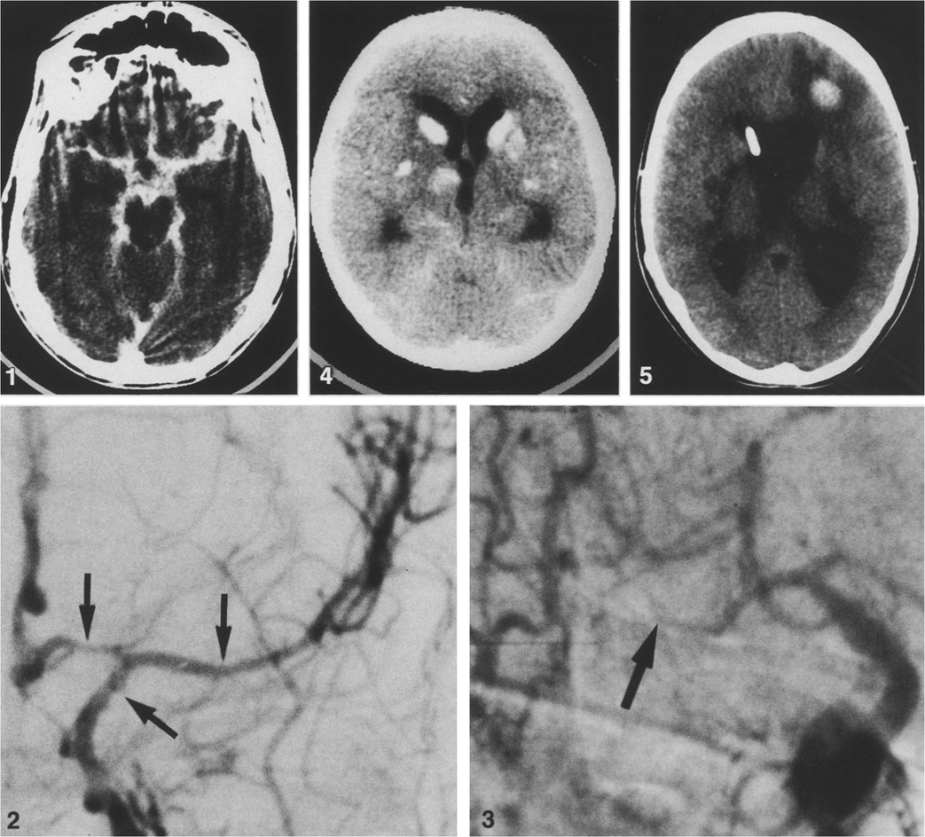
intense enhancement of the basal subarachnoid
cisterns in acute/subacute TB meningitis

Slide 15
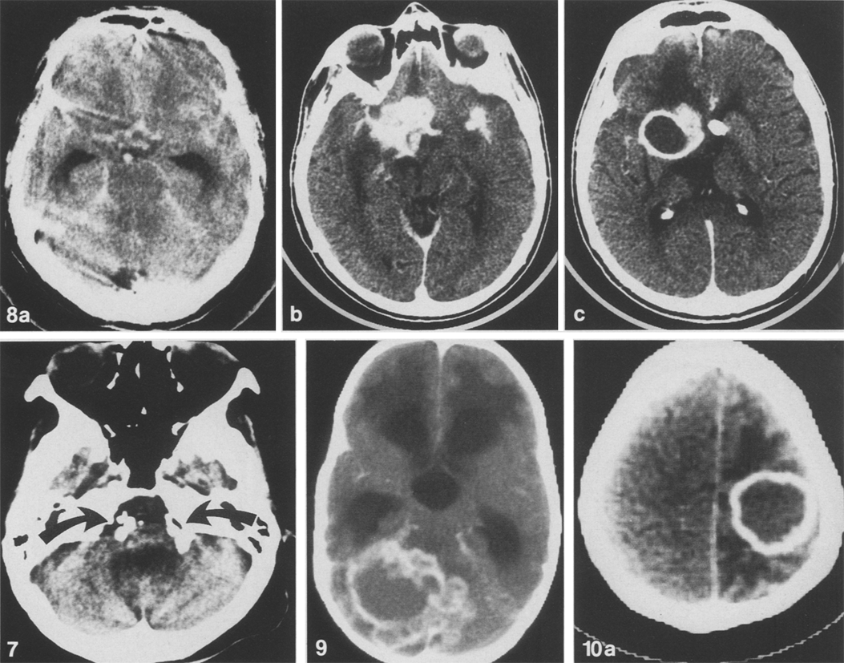

Slide 16
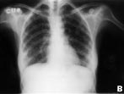
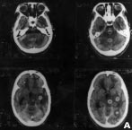
Case report: disseminated tuberculosis
A 30-year-old woman presented with
headache, vomiting and fever (104°F)
disoriented and inattentive for
6 days duration. She was conscious, had
lateral rectus palsy along with bilateral
papilloedema. Left plantar was extensor.
Neck rigidity and Kernig’s sign were
present. Other systemic and general
examinations were normal. All
haematological and serum biochemical
parameters, including liver function tests,
were normal. Chest X-ray showed
miliary shadows in both lungs (figure)
CSF revealed elevated opening
pressure, proteins 248 mg/dl, sugar 34
mg/dl (corresponding blood sugar was
98 mg/dl); 204 cells/ml, 15% polymorphs
rest lymphocytes. CT head showed
multiple small enhancing lesions in brain
parenchyma (figure ). The patient was
given antituberculous treatment and
corticosteroids. She showed significant
improvement in all her symptoms after
15 days.

Slide 17
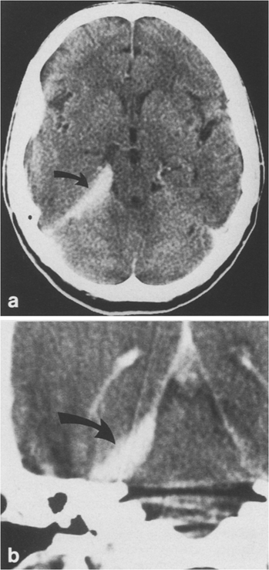
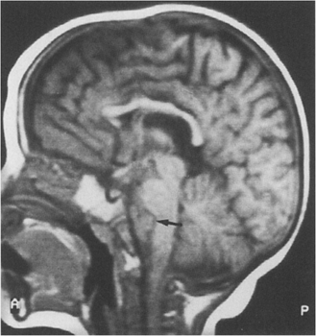
CT demonstrating tuberculoma

Slide 18
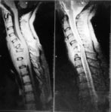
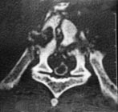
A lumbar myelogram showing spinal block at the level of T9 vertebra, aparaspinal abscess producing spinal block paraspinal abscess compressing the spinal cord

Slide 19
Laboratory Findings
Mainly related to the laboratory examination of cerebrospinal fluid including:-
a-Collect of 2-5 ml of CSF and checking for the pressure
b- Bio chemical investigation for :
1- Total protein
2- Glucose level in comparison to the
serum glucose level
c- Microscopy:
1- Presence of organism
2- Total white cell count
3- Differential count mainly for:-
a- Polymorphic
b- Lymphocytes

Slide 20
As in acute pyogenic infections, in chronic cerebral and meningeal infections the following CSF finding will be as follows
a- Increased CSF pressure indicating increased intra cranial pressure
b- Increased protein level due to presence of inflammatory substance, dead organism, protein and WBC
c- Reduced glucose level ( Normally is 2/3 of serum glucose level)
d- Increased local white cell count but in chronic infection the differential shows lymphocytosis while in acute infections there is increased % of polymorph
e- Gram stain can same time rarely shows causative organism
f- Z-N Stain can show AFB of T.B while modified Z-N can show Nocardia

Slide 21
Diagnosis continued
g- VDRL and other serological causes for syphilis
h- Wet preparation of CSF for fungal and parasite
i- India ink for Cryptococcus neoforman
j- Culture for CSF for Brucella,T.B Mycobacterium tuberculosis, Leplospira other Bacteria

Slide 22
Laboratory diagnosis of cerebral and meningetic Tuberculosis and Brucellosis
a) Mantoux test, Tuberculin skin test(TST)
b)Chest x-ray for primary focus
c) CSF microscopy for AFB
d) CSF culture an solid medium L.J or fluid medium
e) PCR or other molecular biopsy test for presence of bacterial element
f) Culture of CSF for Brucella
g) Serology for Brucella
Combination of these finding with clinical history and examination finding

Slide 23
Treatment for cerebral and meningeal Tuberculosis and Brucellosis
Tuberculosis
4 Drugs are used there are:-
1- Rifampicin
2- Isonized(INH) for 2 month
3- Ethambutol
4-Pyrazinamide
Then,
Rifampicin for 4-6 month
INH

Slide 24
Brucellosis Treatment
Two of the following 3 drugs
a- Tetracycline
b- Rifampicin
c- Cotrimoxazole
Usually Rifampicin and Cotrimoxazole are preferred as they have good penetration power in the blood brain- barrier

