Slide 1
Central nervous system block Neuropathology practical

Slide 2
First practical session

Slide 3
Brief review of Normal anatomy and histology

Slide 4
Cerebrum, Cerebellum and Brain Stem
C71.0
C71.3
C71.1
C71.4
C71.6
C71.2
C71.7

Slide 5
Meninges

Slide 6
CNS Cells
Two cell types
Neuron
Conducts nerve impulses
Cannot be replaced if destroyed
Neuroglial cells
Support, nourish, and protect the neurons
Include astrocytes, oligodendrocytes, ependymal cells and microglia
Notes:
The organs of the CNS contain two types of cells. The neurons are cells that conduct nerve impulses. Mitosis or cell division cannot take place in neurons so neurons cannot be replaced if they are destroyed.
The neuroglia or glia is the supporting structure of nervous tissue. The neuroglial cells support, nourish, and protect the neurons. Mitosis does take place in neuroglia. The types of neuroglial cells include astrocytes, oligodendrocytes, and microcytes. A large percentage of brain tumors originate in neuroglial cells.

Slide 7
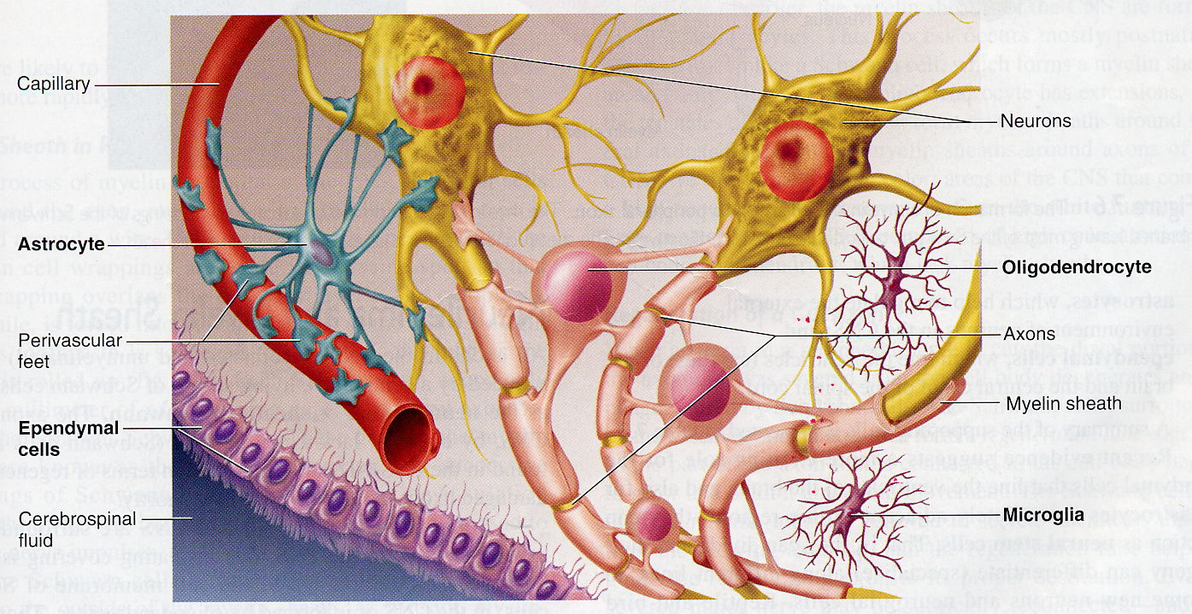

Slide 9
Gross and microscopic findings of selected CNS diseases

Slide 10
Case No. 1

Slide 11
43 years old female complained of headache and two attacks of seizures in the past 4 months . Brain MRI revealed a 3 cm. extra-axial mass in the parietal region. It was dural based with mild edema in surrounding brain tissue. What is your provisional diagnosis?

Slide 12
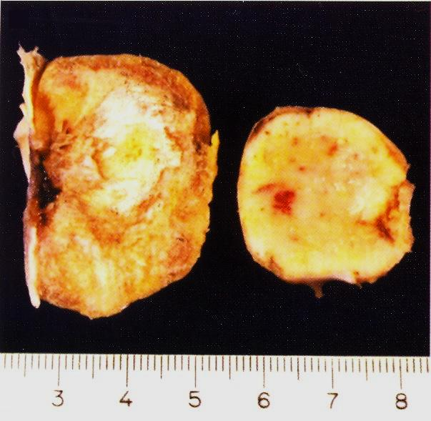

Slide 13
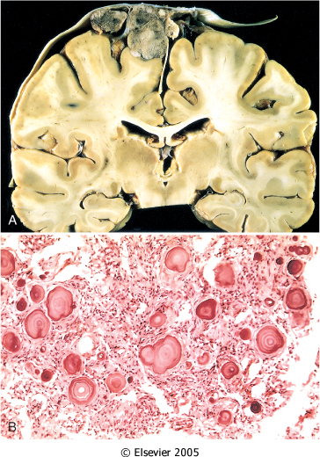
A, parasagittal multilobular meningioma attached to the dura with compression of underlying brain.
B, Meningioma with a whorled pattern of cell growth and psammoma bodies.

Slide 14
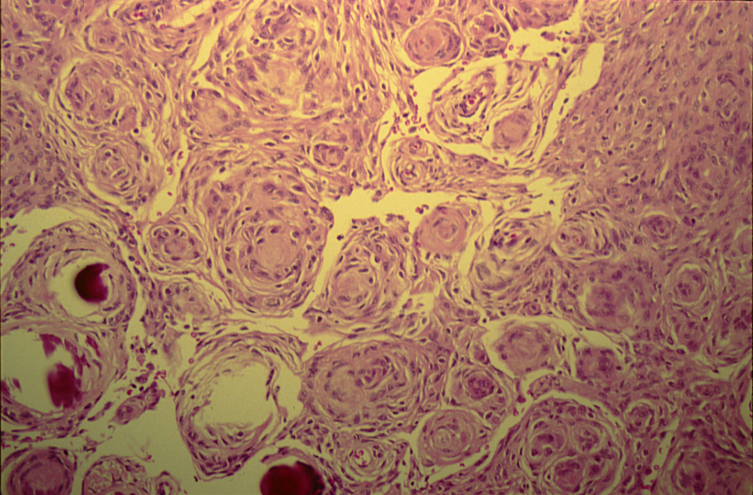
MENINGIOMA(DURA-BRAIN)

Slide 15
Meningioma: Section of tumour shows:
Whorls of fibrocellular tissue.
Cells are oval, spindle shape or elongated and lack mitosis.
Psammoma bodies (spherical calcified particles) are also seen within the tumour.

Slide 16
Meningioma

Slide 18
Case No. 2

Slide 19
55 years old man complained for the last 2 months of headache. Brain MRI reveals a 3 cm. frontal intra-parenchymal space occupying lesion with rim enhancement on contrast studies. What is your provisional diagnosis ?

Slide 20
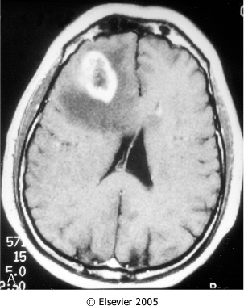
Computed tomographic (CT) scan of a large tumor in the cerebral hemisphere showing signal enhancement with contrast material and pronounced peritumoral edema.

Slide 21
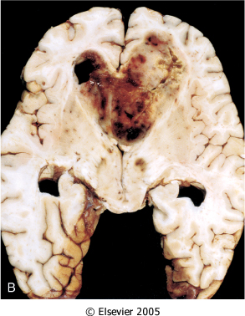
Glioblastoma multiforme appearing as a necrotic, hemorrhagic, infiltrating mass.

Slide 22
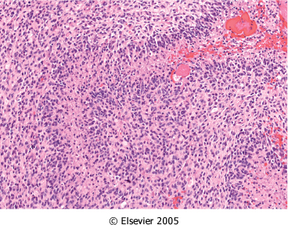
Glioblastoma. Foci of necrosis with pseudopalisading of malignant nuclei.

Slide 23
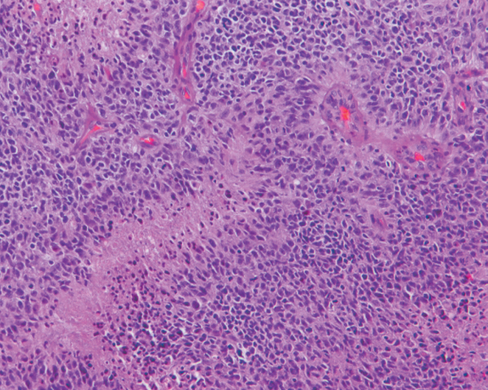
Glioblastoma. Foci of necrosis with pseudopalisading of malignant nuclei and endothelial cell proliferation

Slide 24
Glioblastoma

Slide 26
Case No. 3

Slide 27
27 years old woman presents with a sudden onset of right sided blindness and weakness in her left leg. There is no history of trauma. However, she experienced a similar episode 8 months ago and was diagnosed as aseptic meningitis.

Slide 28
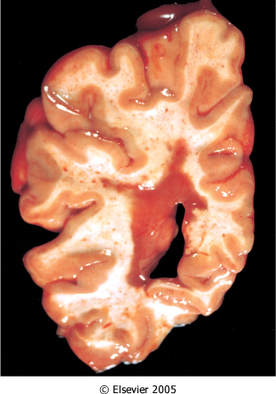
What is your provisional diagnosis?
Multiple sclerosis. Section of fresh brain showing brown plaque around occipital horn of the lateral ventricle.

Slide 29
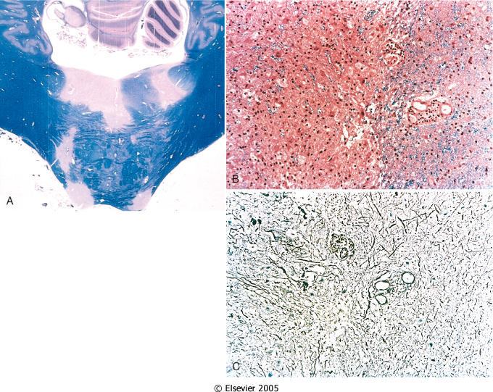
Multiple sclerosis. A, Unstained regions of demyelination (MS plaques) around the fourth ventricle (Luxol fast blue PAS stain for myelin).
B, Myelin-stained section shows the sharp edge of a demyelinated plaque and perivascular lymphocytic cuffs.
C, The same lesion stained for axons shows relative preservation.

Slide 30
Multiple sclerosis

Slide 32
Case No.4

Slide 33
39 years old man complains that he had noticed a progressive hearing loss over a
2 years period. Except for occasional headache, he has no other complaints . Evaluation discloses severe sensorineural hearing loss of the left side . MRI shows 1.5 cm. mass at the left cerebellopontine angle . What is your provisional diagnosis ?

Slide 34
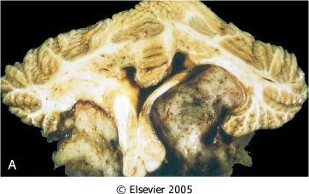
Schwannoma. A, Bilateral eighth nerve schwannomas.
What syndrome is suggested by such finding?

Slide 35
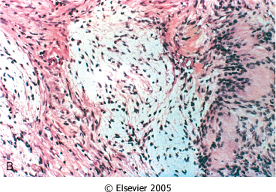
Schwannoma. B, Tumor showing cellular areas, including Verocay bodies (far right), as well as looser, myxoid regions.

Slide 36
Schwannoma

Slide 38
Second practical session

Slide 39
Case No. 5

Slide 40
9 months infant was suffering from enlarged head size and admitted to hospital with convulsions, went into coma and died. Autopsy was done and the brain was large with dilated ventricles . What is your provisional diagnosis?

Slide 41
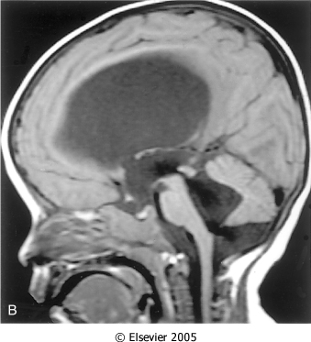
Midsagittal magnetic resonance image of a child with communicating hydrocephalus, involving all ventricles.

Slide 42
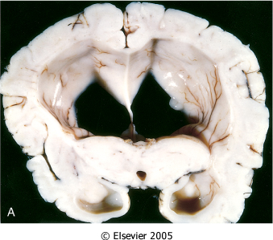
Hydrocephalus. Dilated lateral ventricles seen in a coronal section through the midthalamus.

Slide 43
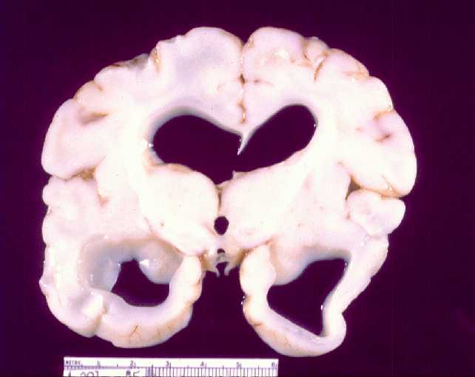

Slide 44
Hydrocephalus

Slide 46
Case No. 6

Slide 47
4 years old child who was treated from otitis media and suddenly complained from headache, vomiting, fever and stiff neck. CSF was found to be clouded with abnormal increase of neutrophils, increased protein and absence of sugar. Gram stain of the CSF fluid showed meningiococci . What is your diagnosis ?

Slide 48
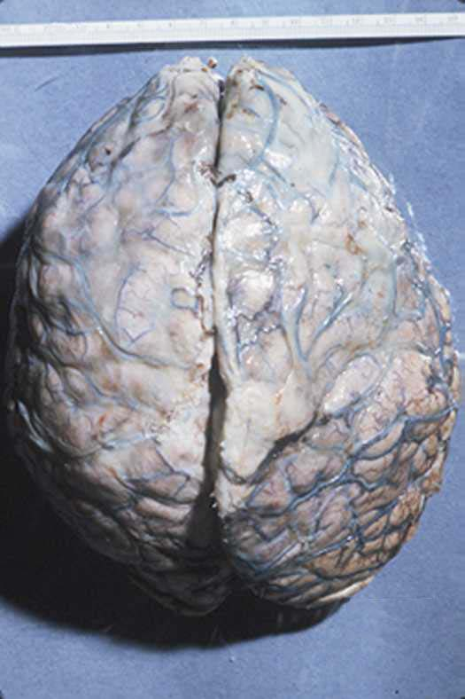

Slide 49
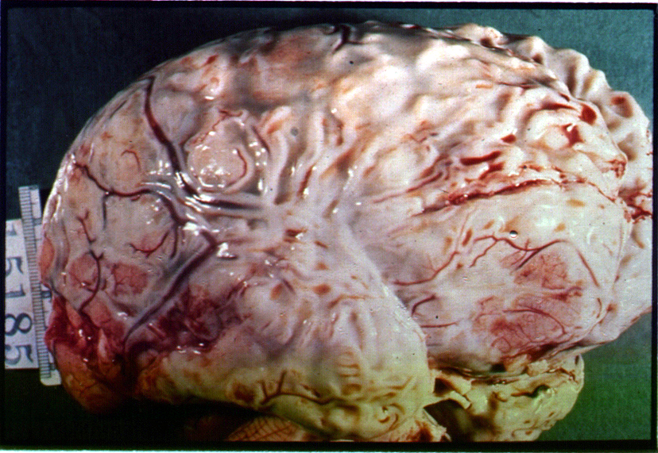

Slide 50
Meningitis

Slide 52
Case No. 7

Slide 53
35 years old lady complains from otitis media . Suddenly she suffers from headache and convulsions. Brain MRI reveals 5 cm. fluid filled cavity in the temporal lobe. Examination of the CSF shows increased pressure with lymphocytes and increased protein but there is no change of sugar content. What is your diagnosis ?

Slide 54
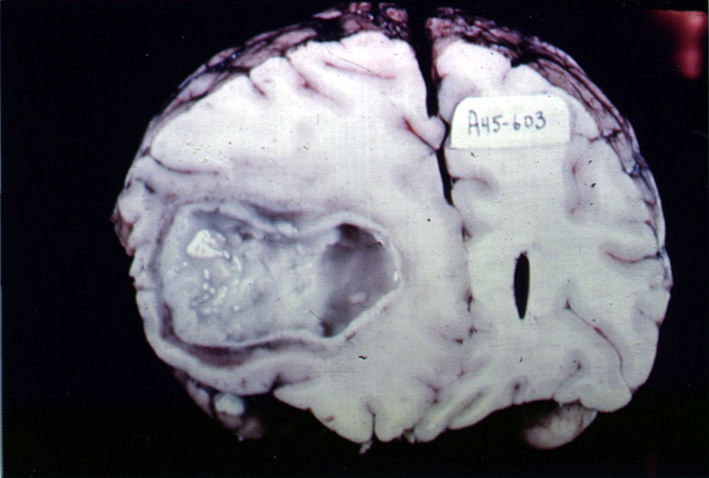

Slide 55
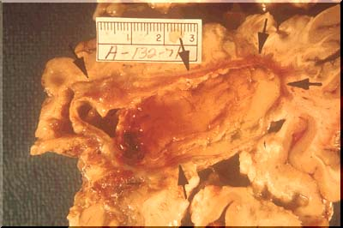

Slide 56
Brain abscess

Slide 58
Case No. 8

Slide 59
A previously healthy 31-year-old woman experiences a severe headache and loses consciousness within an hour. An emergent head CT scan reveals extensive subarachnoid hemorrhage at the base of the brain. She is afebrile. A lumbar puncture yields cerebrospinal fluid with many red blood cells, but no white blood cells. The CSF protein is slightly increased, but the glucose is normal. What is your provisional diagnosis ?

Slide 60
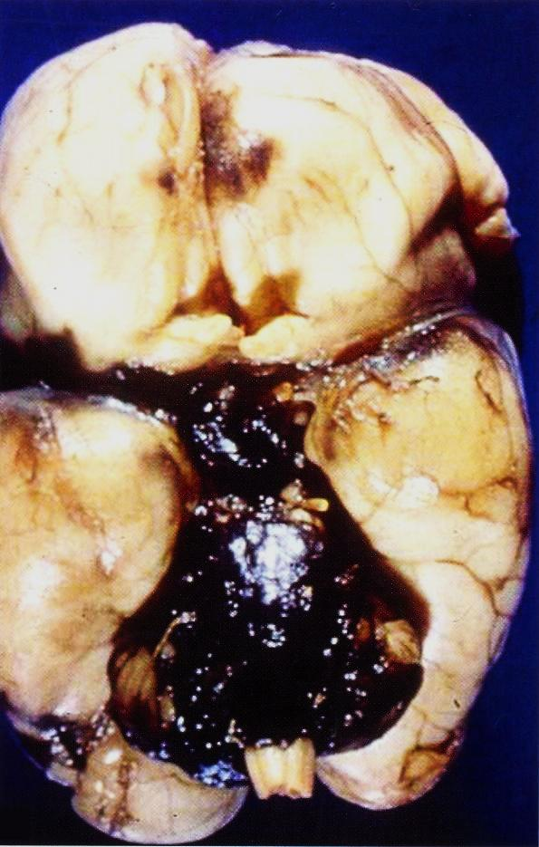

Slide 61
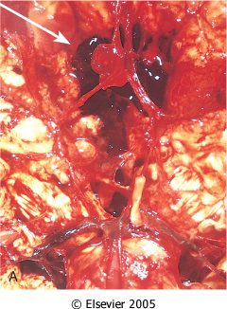
View of the base of the brain, dissected to show the circle of Willis with an aneurysm of the anterior cerebral artery (arrow).

Slide 62
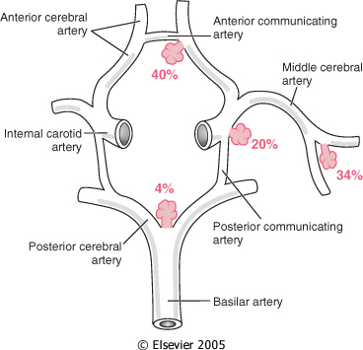
Common sites of saccular (berry) aneurysms in the circle of Willis

Slide 63
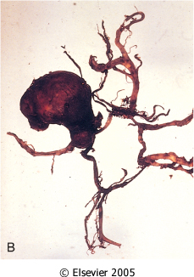
B, Dissected circle of Willis to show large aneurysm.

Slide 64
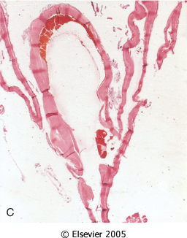
C, Section through a saccular aneurysm showing the hyalinized fibrous vessel wall.

Slide 65
Ruptured berry aneurysm causing subarachnoid hemorrhage

Slide 67
Case No.9

Slide 68
An 85 years old man complains of progressive loss of memory, disorientation and alterations in mood and behavior since 20 years. He was admitted to hospital because he was disabled and immobile and he died in hospital after one week of admission. Autopsy was done and the brain cortex was found to be atrophied. What is your diagnosis ?

Slide 69
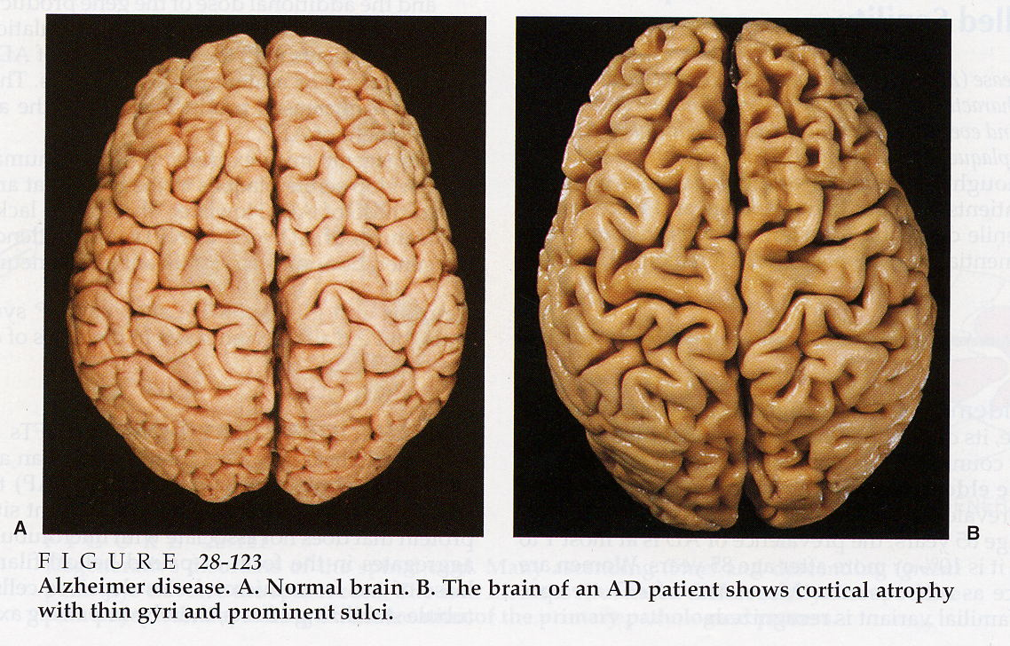

Slide 70
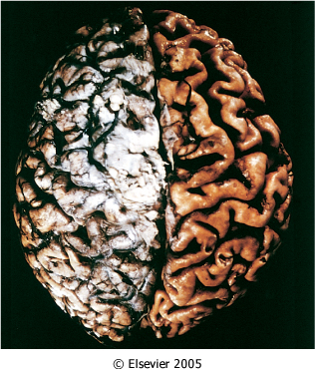
Alzheimer disease with cortical atrophy most evident on the right, where meninges have been removed.

Slide 71
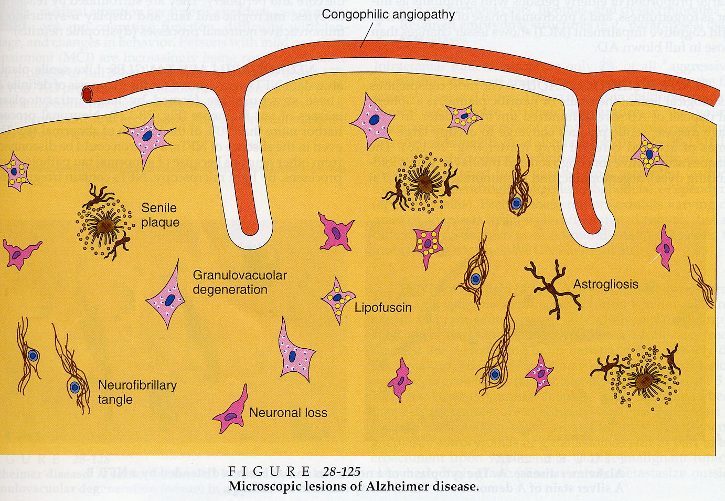

Slide 72
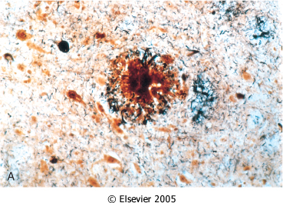
Alzheimer disease. A, Neuritic plaque with a rim of dystrophic neurites surrounding an amyloid core.

Slide 73
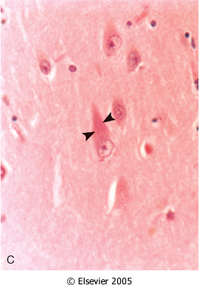
Alzheimer Disease. C, Neurofibrillary tangles (arrowheads) are present within the neurons.

Slide 74
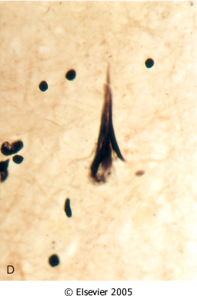
Alzheimer Disease. D, Silver stain showing a neurofibrillary tangle within the neuronal cytoplasm.

Slide 75
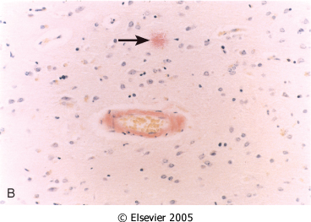
Alzheimer Disease. B, Congo red stain of the cerebral cortex showing amyloid deposition in the blood vessels and the amyloid core of the neuritic plaque (arrow)

Slide 76
Alzheimer disease

Slide 77
Alzheimer Disease
Macroscopic examination of the brain shows a variable degree of cortical atrophy with widening of the cerebral sulci that is most pronounced in the frontal, temporal, and parietal lobes
Microscopic: neuritic (senile) plaques, neurofibrillary tangles, and amyloid angiopathy

