Slide 1
PHYSIOLOGY OF CONCIOUSNESS

Slide 2
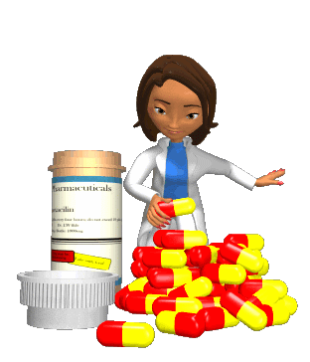
What is Consciousness?
Consciousness has been defined by psychologists as our awareness of ourselves and our environment.
Two awake states: relaxed awareness and awareness with concentrated attention For example : driving (Ganong 24th Ed)
Notes:
Discrete patterns of brain electrical activity correlate with
each of these states. Feedback oscillations within the cerebral
cortex and between the thalamus and the cortex serve as
producers of this activity and possible determinants of
the behavioral state. Arousal can be produced by sensory
stimulation and by impulses ascending in the reticular core
of the midbrain. Many of these activities have rhythmic
fl uctuations that are approximately 24 h in length; that is,
they are circadian.

Slide 3
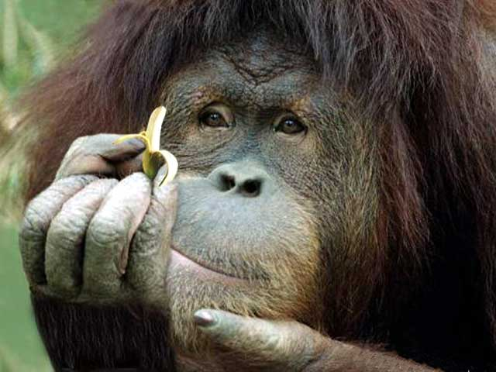
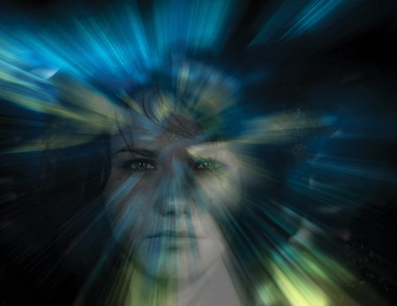
4 Levels of consciousness
(1) Normal Consciousness:
state of normal arousal , being
fully awake and aware of the self
and surroundings
(2) Clouded consciousness:
person conscious but mentally
confused e.g., in cases of drug or
alcohol intoxication, High fever
associated (malaria or septicemia ,
dementia , etc ) .

Slide 4
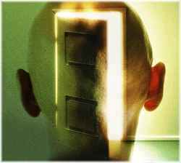
4 Levels of consciousness
(3) Sleep: person unconscious in relation to the external world & surroundings but is arousable ( can be aroused ) .
(4) Coma: person unconscious and not arousable

Slide 5
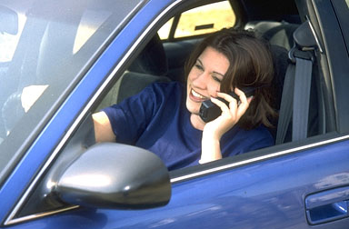
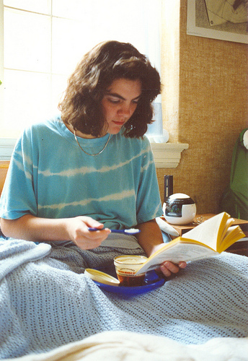
Levels of awareness in Consciousness
TOP: Controlled processes require attention (and interfere with other functions)
MIDDLE: Automatic processes require minimal attention (such as riding your bike)
LOWEST: Minimal or no awareness of the environment
Continuum of Consciousness refers to a broad range of experiences , from being sharply alert to being completely unaware and unresponsive.

Slide 6
Brain Structures Involved in the Conscious State
Brain stem Reticular formation
Thalamus
Hypothalamus
Ascending projection pathways
Wide spread area in the cerebral cortex

Slide 7
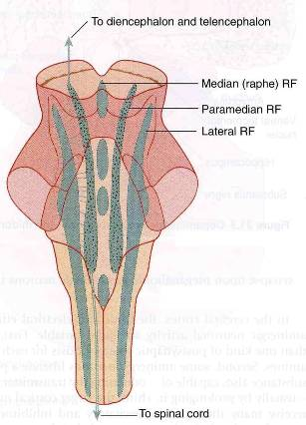
RETICULAR FORMATION
Set of interconnected nuclei that are located throughout the brainstem (Pons, Midbrain, Upper medulla) and the thalamus
Role in behavioral arousal
Role in consciousness (sleep/awake cycle)
Consists of 3 parts:
Lateral Reticular Formation
Paramedian Reticular Formation
Raphe nuclei (Median RF)

Slide 8
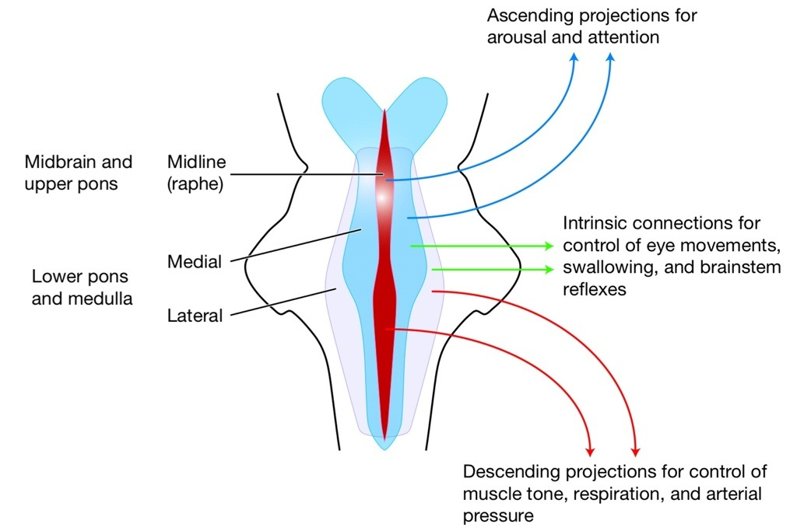

Slide 9
Lateral Reticular Formation
Has small neurones
Receives information from ascending tracts for touch and pain.
Receives vestibular information from median vestibular nerve.
Receives auditory information from superior olivary nucleus.
Visual information from superior colliculus.
Olfactory information via medial forebrain bundle

Slide 10
Paramedian Reticular Formation
Has large cells.
Receives signals from lateral reticular formation
Contains noradrenergic neurones & projects onto cerebral hemispheres.
Ventral tegmental nucleus contains dopaminergic neurones that project directly onto the cortex.
Cholinergic neurones project onto the thalamus

Slide 11
Raphe nuclei (Median RF)
In the midline of the reticular formation
Contain serotonergic projections to the brain and spinal cord.

Slide 12
Functions of reticular formation
1. Somatic motor control (Reticulospinal tracts)
2. Cardiovascular control
Thruogh cardiac and vasomotor centers of the medulla oblongata.
3. Pain modulation
Pain signals from the lower body >> >> RF >> >> cerebral cortex
RF is origin of the descending analgesic pathways
(act in the spinal cord to block the transmission of some pain signals to the brain)

Slide 13
Thalamus
Located n the mid-part of the diencephalon
Cholinergic projections from the thalamus are responsible for:
Activation of the cerebral cortex.
Regulation of flow of information through other thalamic nuclei to the cortex via projections into reticular nuclei.
Tuberomammillary nucleus in the hypothalamus projects to the cortex and is involved in maintaining the awake state.

Slide 14
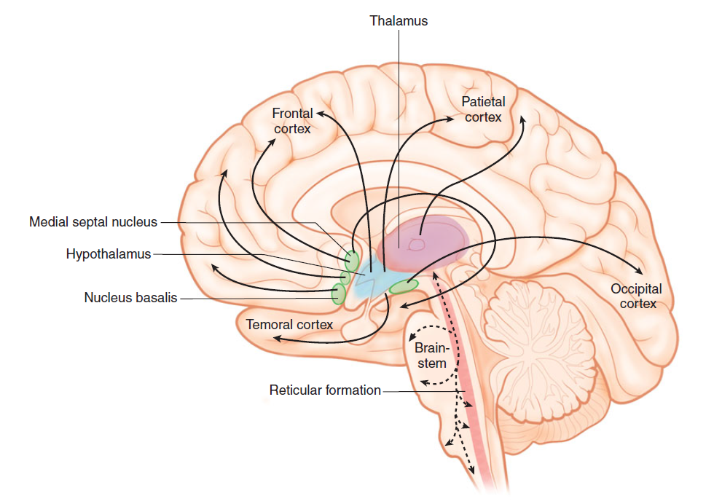
The system is nonspecific, whereas the classic ascending sensory pathways are specific for different modalities
Ascending reticular activating system
Notes:
FIGURE 143 Cross-section through the midline of the human brain showing the ascending reticular activating
system in the brainstem with projections to the intralaminar nuclei of the thalamus and the output from the intralaminar
nuclei to many parts of the cerebral cortex. Activation of these areas can be shown by positive emission tomography scans
when subjects shift from a relaxed awake state to an attention demanding task.

Slide 15
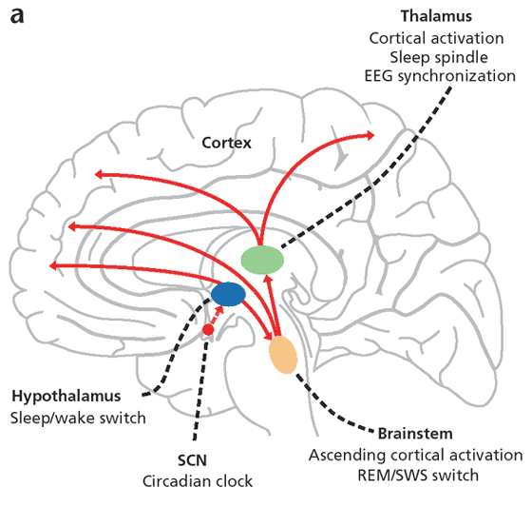
Anatomical components of RAS
The RAS is composed of several neuronal circuits connecting the brainstem to the cortex . These pathways originate in the upper brainstem reticular core and project through synaptic relays in the thalamic nuclei to the cerebral cortex
As a result, individuals with bilateral lesions of thalamic intralaminar nuclei are lethargic or drowsy

Slide 16
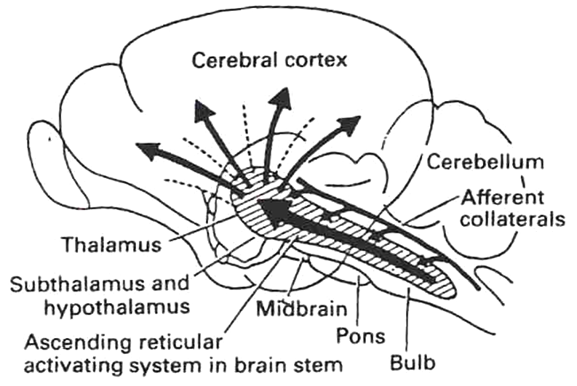
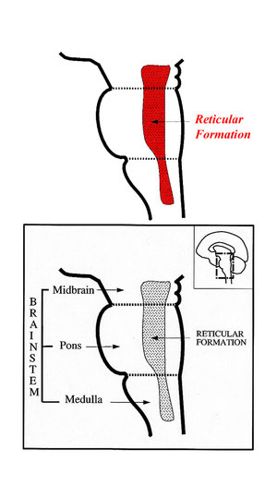
RAS
-Lesion in the mid-pons >>>>>>>unconsciousness
-Pons (uppers & middle) and midbrain are essential for wakefulness .
Bulboreticular Facilitory ( Excitatory ) = the reticular formation .

Slide 17
Sensory inputs to RAS

Slide 18
Functions of RAS: 1- Regulating sleep-wake transitions
Low voltage fast burst brain waves (EEG desynchronization) are associated wit wakefulness and REM sleep ,
RAS modify and potentiate thalamic and cortical functions resulting in (EEG) desynchronization.
Change from a state of deep sleep to wakefulness is reversible and mediated by the RAS.
Stimulation of the RAS produces EEG desynchronization by suppressing slow cortical waves.
RAS suppress ascending afferent activity to the CC >>>>> sleep

Slide 19
2-Attention
RAS mediate transitions from relaxed wakefulness to of high attention.

Slide 20
3-RAS and learning
The RAS is the center of balance for the other systems involved in learning, self-control or inhibition, and motivation.
Provides the neural connections for processing and learning of information,
Selective attention (to the correct task)

Slide 21
RAS dysfucntion
If RAS is depressed:
An under-aroused cortex
Difficulty in learning
Poor memory
Little self-control
lack of consciousness or even coma.
If the RAS is too excited,
Over aroused cortex
Hyper-vigilance (sensory sensitivity )
Touching everything
Talking too much
Restless
Hyperactive.

Slide 22
Indices of Level of Consciousness
Appearance & Behavior :
Posture ( sitting , standing ? )
Open eyes ?
Facial expression ?
Responds to stimuli ( including the examiner’s questions about name , orientation in time & place ? & other general Qs like who is the president ? )
Vital signs :
Pulse , BP, respiration , pupils , reflexes , particularly brainstem reflexes , etc )
EEG → Each of these states ( wakefulness , sleep , coma and death ) has specific EEG patterns .
Evoked potentials: in cases of Brain Death ).

Slide 23
Brain Death Confirmatory Testing with EEG
Normal EEG ( at normal magnification )
Brain Death ( Flat EEG ,at very high magnification )

Slide 24
Brain Death Confirmatory Testing with Somatosensory Evoked Potentials
Stimulation of a sense organ can evoke a cortical response that can be recorded by scalp electrode over the primary receiving cortical area for that particular sense .
Notes:
EVOKED CORTICAL POTENTIALSprimary evoked potential; the second is the
diff use secondary response

Slide 25
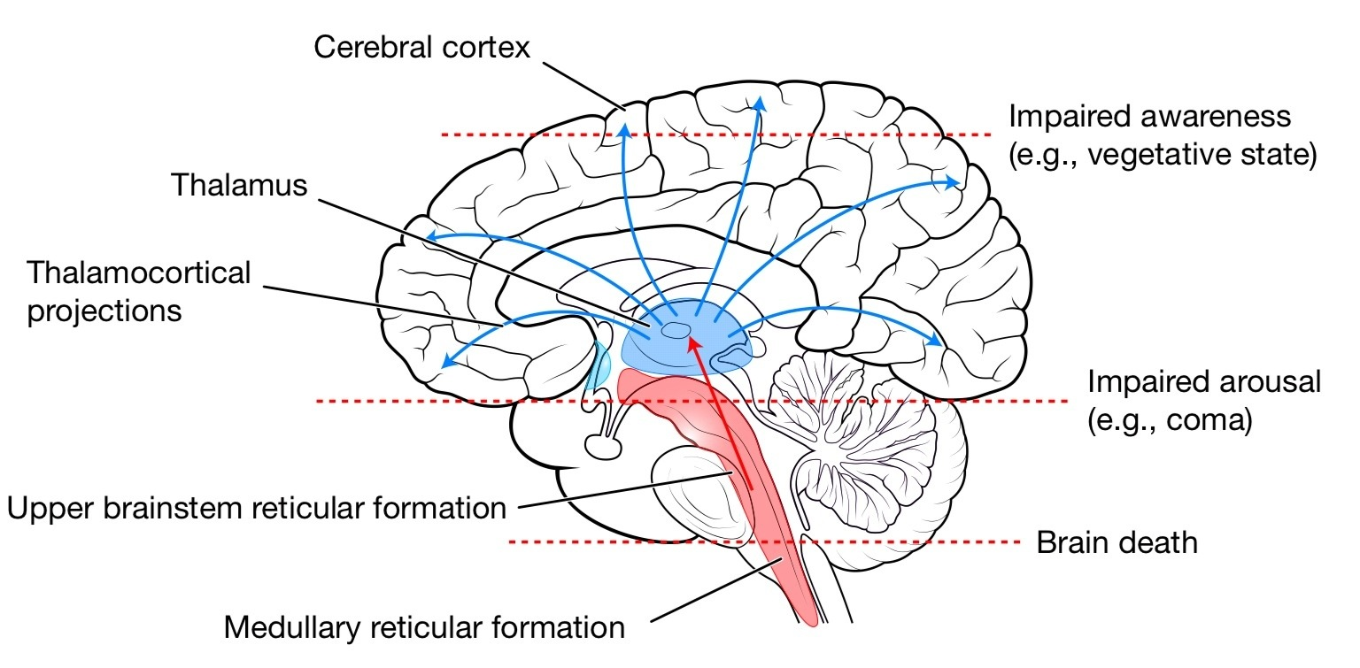

Slide 26
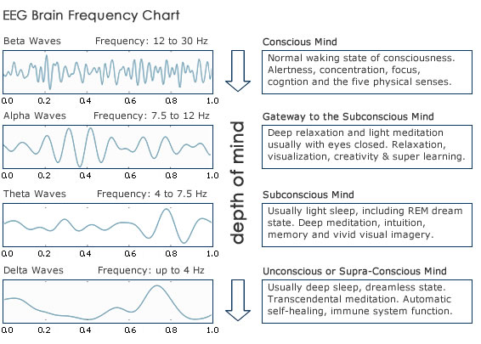

Slide 27
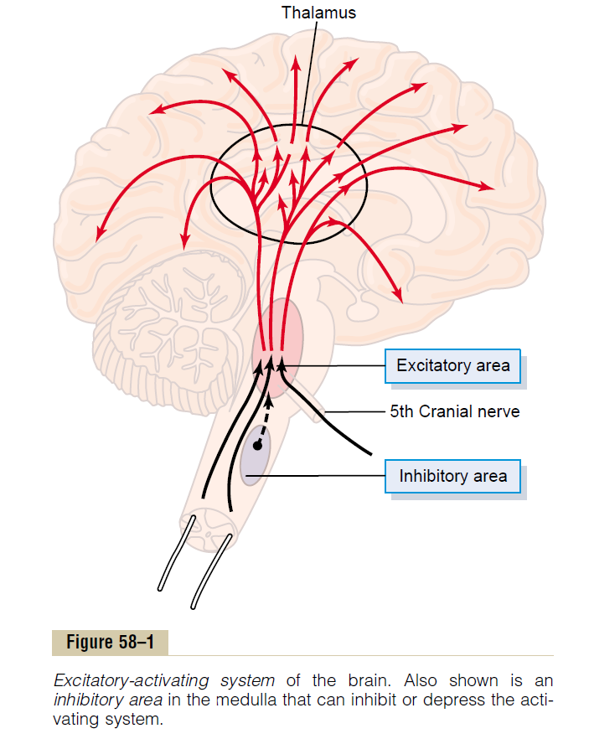
Excitation of the Excitatory Area by Peripheral Sensory Signals.
Cutting the brain stem above the point where the 5th CN enters the pons ➔coma
Cutting the brain stem above the point of 5th CN entry in pons ➔averts coma
A Reticular Inhibitory Area Located in the Lower Brain Stem
Notes:
But when the brain stem is transected
below the fifth nerves, which leaves much input of
sensory signals from the facial and oral regions, the
coma is averted.

Slide 28
positive feedback activity Between Sleep and Wakefulness
When the sleep centers are not activated, the mesencephalic and upper pontile reticular activating nuclei are released from inhibition, which allows the reticular activating nuclei to become spontaneously active.
This in turn excites both the cerebral cortex and the peripheral nervous system, both of which send numerous positive feedback signals back to the same reticular activating nuclei to activate them still further.
Therefore, once wakefulness begins, it has a natural tendency to sustain itself because of all this positive feedback activity.

Slide 29
Why do people alter consciousness?
Sacred rituals
Social interactions
Individual rewards

Slide 30
Unconscious Cognitive Processes
Information-processing view can be extended to analyses of unconscious processes
Notion is that many brain mechanisms operate in parallel
Some of these mechanisms operate outside of the level of consciousness
Functional significance of unconscious mechanisms:
Are efficient and rapid
Can operate simultaneously
Operate in the absence of consciousness?
© 2002 John Wiley & Sons, Inc.

Slide 31
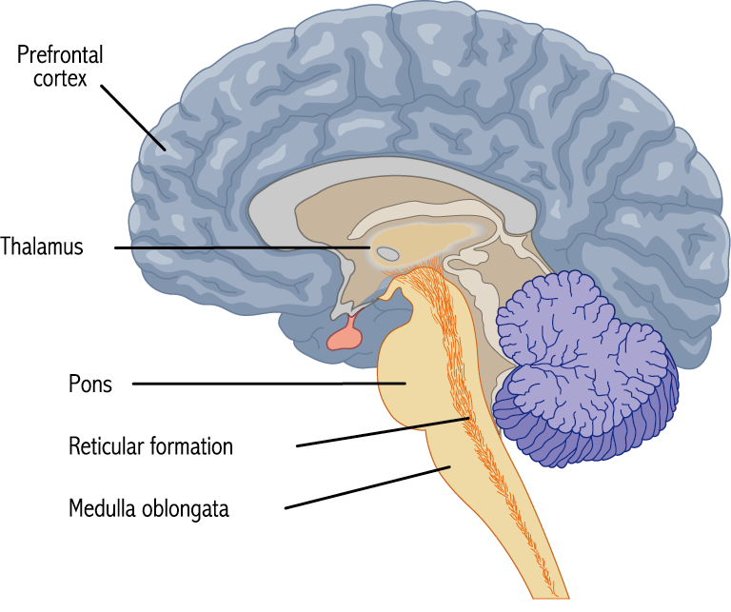
Neurology of Consciousness
Consciousness is distributed throughout the brain
Hindbrain and midbrain are important for arousal and for sleep
Damage to the reticular formation can lead to coma
Prefrontal cortex is key for conscious control of information processing
© 2002 John Wiley & Sons, Inc.

Slide 32
Altered States
Altered states of consciousness are achieved when using psychoactive drugs, meditation, hypnosis or lack of sleep. These all create a state that is different from the usual consciousness.

Slide 33
Higher consciousness
Higher Consciousness can be achieved by Meditation

Slide 34
Hypnosis
Hypnosis is an altered state of heightened suggestibility.
The hypnotic state is characterized by:
Narrow and focused attention
Imagination
Passive receptive attitude
Reduced reaction to pain
Heightened suggestibility

Slide 35
Altered States
Meditation refers to a set of techniques that promote a heightened sense of awareness.
can involve body movements and posture, focusing of attention on a focal point, or control of breathing
can induce relaxation, lower blood pressure, and can be associated with a sense of euphoria

