Slide 1
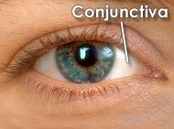
Vision
By
Dr/SALAH ELMALIK
College of Medicine
King Saud University

Slide 2
Objectives
At the end of this lecture, the student should be able -:
To Describe different components of the eye and function of each .
Describe the refraction of light as it passes through the eye to the retina
Identifying the refractive media of the eye
Know fluid system of eye & glaucoma
binocular vision .
Know layers of retina, blind spot, and fovea
Know principles of optics and errors of refraction

Slide 3
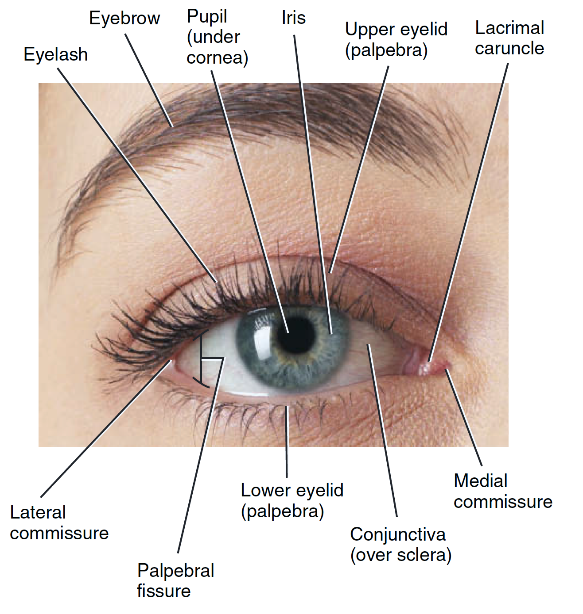
The Eye
Human vision is one of the most complex visual systems among animals.
The eye is a complex sensory organ, which capable of transduction physical stimuli of light rays into electrical and chemical signals that can be interpreted by the brain to construct physical images.

Slide 4
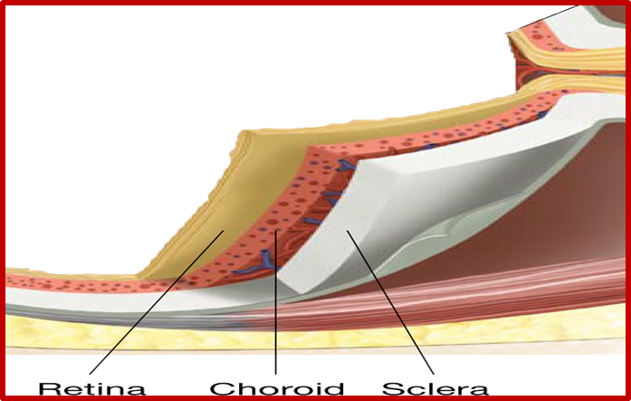
The eye consists of 3 layers :
  1/ Outer fibrous layer : consists of →
  (a) Sclera
  (b) Cornea
Cornea is transparent anterior portion
Conjunctiva lines the eyelids and covers the sclera. It is a transparent epithelium .

Slide 5
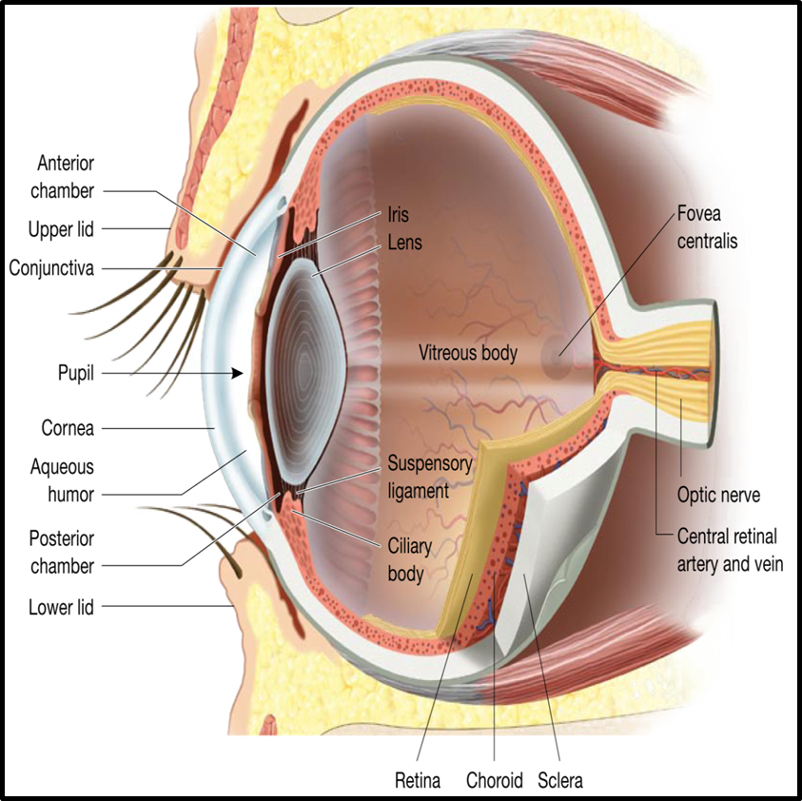
    2. Middle Vascular Layer:
    consists of →
  Iris:
  Is the colored part of the eye
  Has aperture (pupil) control & allow light to enter the eye
  (b) Ciliary body:
  Ciliary body consists of:
  Ciliary muscles
  Ciliary glands
  Suspensory ligaments which attached to the lens
  (c) Choroid

Slide 6
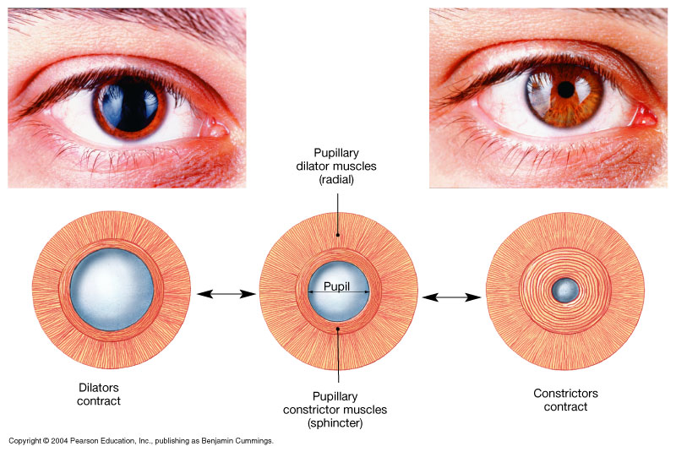
The Pupillary Muscles: consists of → Radial and Circular parts
Figure 17.5

Slide 7
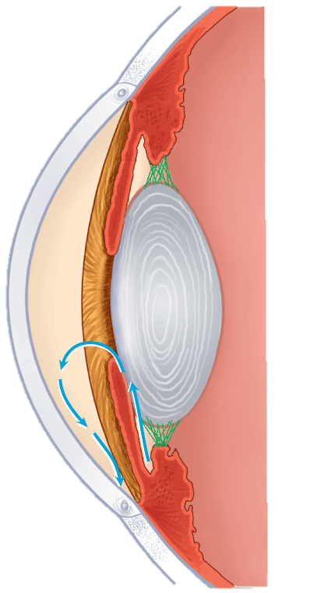
The Anterior & Posterior Cavities
The Ciliary Body (& its suspensary ligament ) and lens divide the eye into :
(1) Anterior cavity which contains a fluid called Aqueous Humor
(2) Posterior cavity
( which contains fluid called Vitreous Humor) .
POSTERIOR
CHAMBER
CILIARY BODY
ANTERIOR
CAVITY
SUSPENSORY
LIGAMENT
ANTERIOR
CHAMBER
IRIS
POSTERIOR CAVITY
CONTAIN VITREOUS
HUMOR
FLOW OF AQUEOUS HUMOUR
CILIARY BODY INSIDE
CILIARY MUSCLE
CANAL OF SCHLEMM

Slide 8
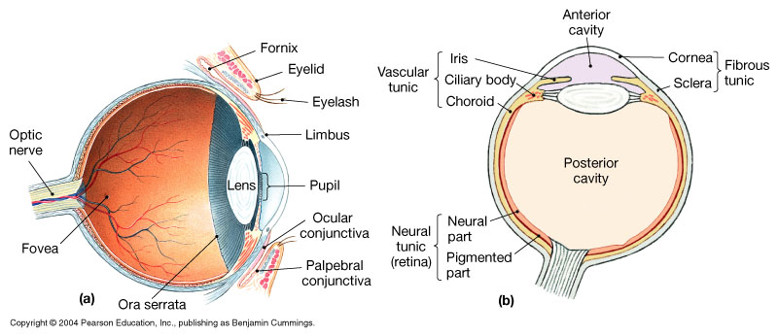
The Anterior and Posterior Chambers
Posterior Chamber
Anterior Chamber
Furthermore , the Iris further divides the anterior cavity into :
Anterior Chamber ( in front of the iris ) , and
Posterior Chamber ( behind the iris ; between the iris and lens ) .

Slide 9
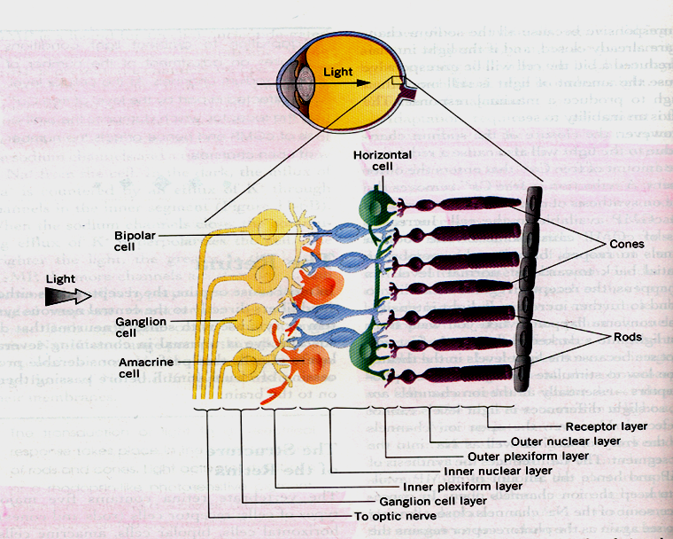
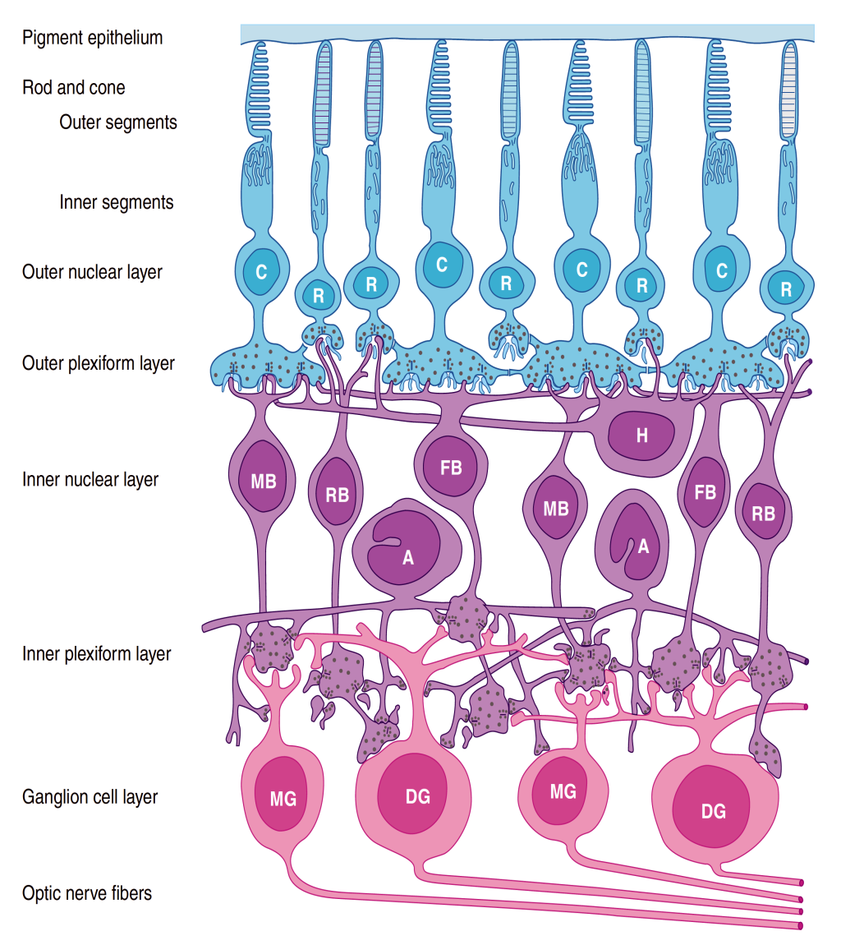
3. The Retina:
consists of →
Outer pigmented portion ( part )
Inner neural part , containing Photoreceptors called Rods and Cones .

Slide 10
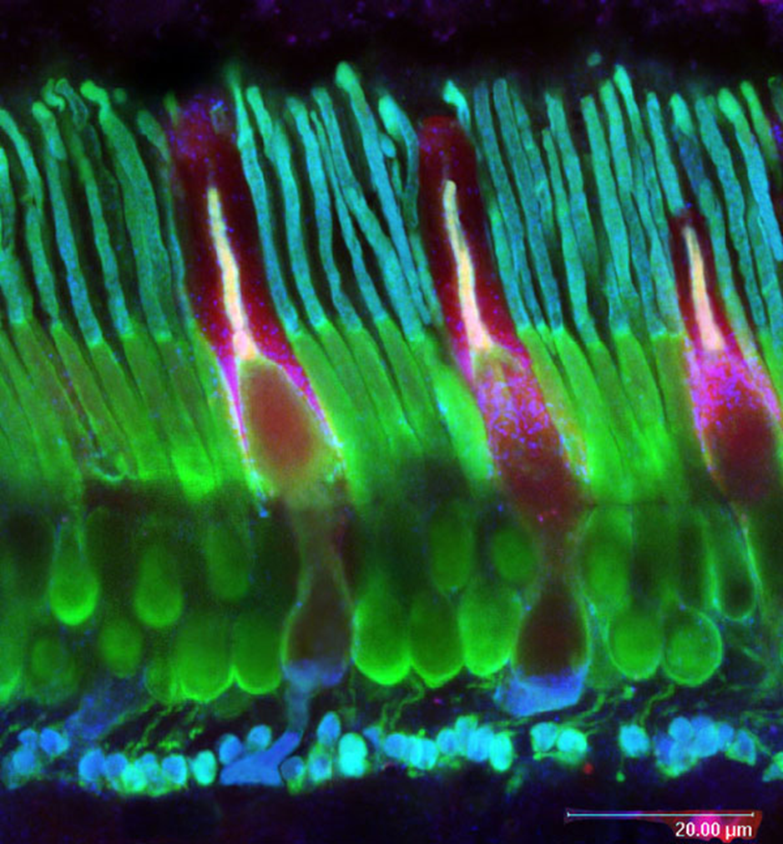
Rods & Cones
Rods
  (1) are best for vision in dim light (scotopic vision)
  (2) are better than cones for detection of flicker ( sudden movements of objects ).
Cones
are best for
  (1) vision in daylight or bright light ( photopic vision)
  (2) Color Vision ( color perception )
  (3) Perception of detail ( acuity of vision )

Slide 11
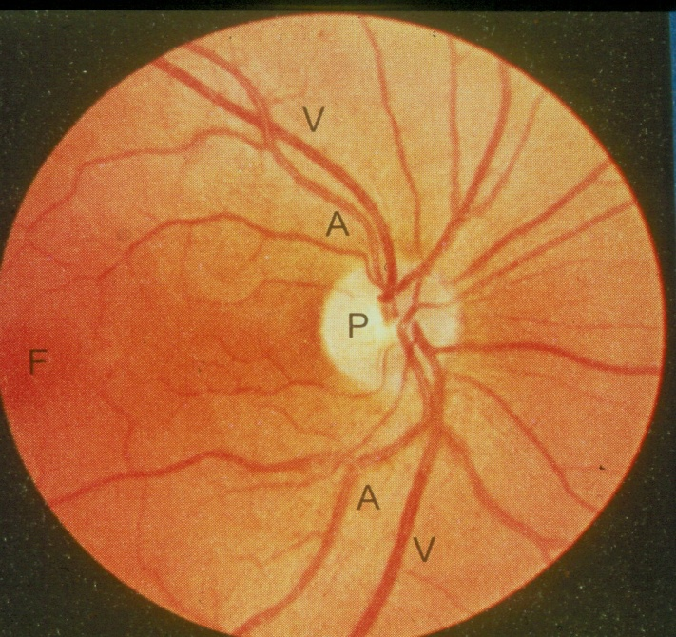
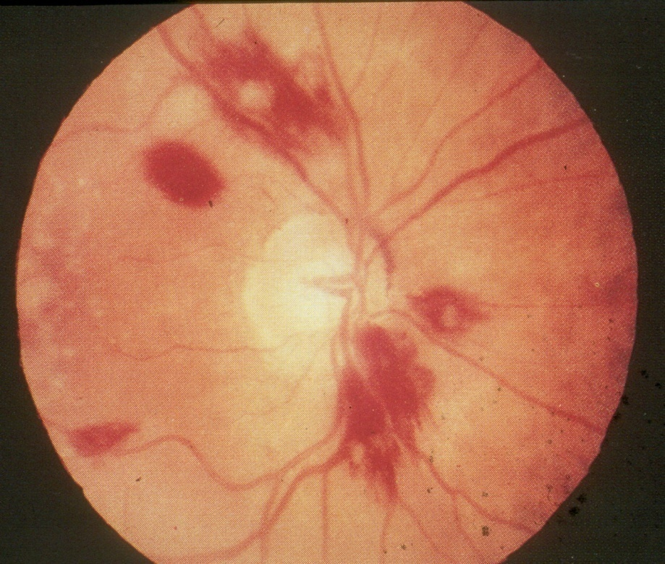
Macula & Fovea Centralis
Optic Disc
( Blind Spot )
An important part of the retina is the Macula Lutea .
At the center of the Macula we find the Fovea Centralis .
In the Fovea we find the maximum concentration of cones →consequently → the Fovea is the point of maximal visual activity in the retina .
Cones are densely packed at the Fovea .
Optic Disc (Blind Spot ) : point of exit of optic nerve fibers , contains no photoreceptors
Fovea ( point ofconcentration of Cones )

Slide 12
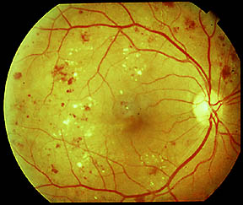
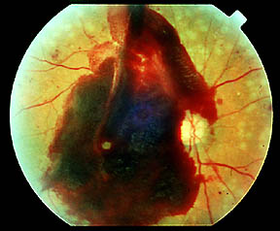
Disorders of the Eye and Vision: Retinopathy
Retinopathy in diabetes
  Vessels have weak walls – causes hemorrhaging and blindness

Slide 13
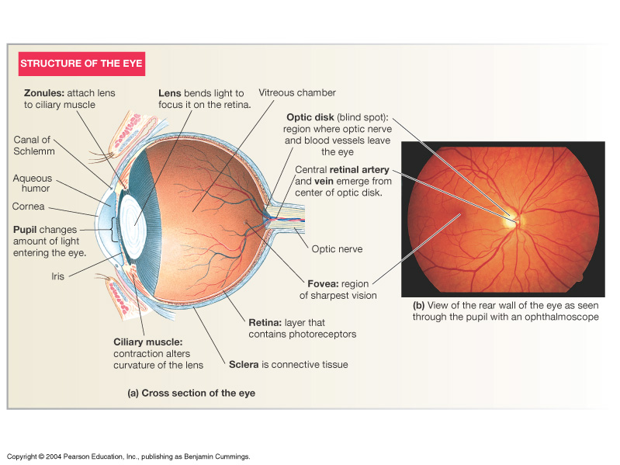

Slide 14
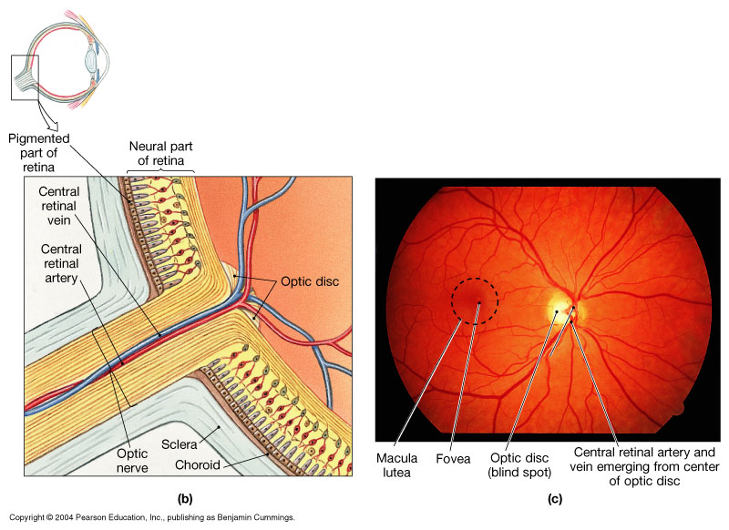
Organization of the Retina
Figure 17.6b, c

Slide 15
External protection of the eye
1. Bony orbit
2-Eye lids with their lashes
3 Conjunctiva
4-Tears from lacrimal gland has antibacterial, lubricating effect ,keep cornea moist & clear & provide nutrition to the cornea.

Slide 17
The image-forming mechanism - Optics of the eye –
Lenses
Principles of Optics

Slide 18
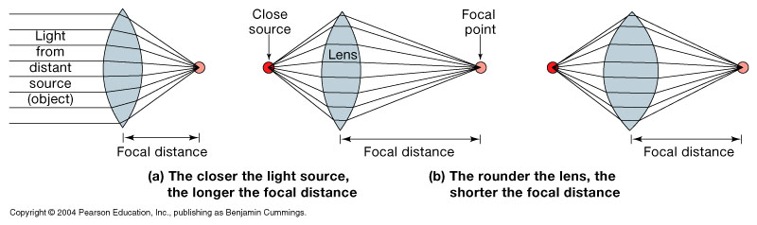
Image Formation
Figure 17.9

Slide 19
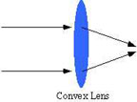
Principles of Optics
principle focus:-
parallel rays strike biconvex lens refracted in a point is PF.
principle axis:-
PF lies on line pass through centers of lens curvatures
Principal focal distance:-
distance between lens & PF.
Biconvex lens(converge) & biconcave lens(diverge)

Slide 20
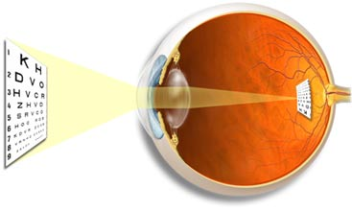
Emmetropic: objects focused on retina (normal)
Diopter:
Measurement of refractive power
Diopter = 1 / Principal focal distance in meters
Exp/ if Principal focal distance of a lens is 25cm,so its R.P=1/ 0.25 meter = 4D
Emmetropic eye;-
Normal eye has image on retina , has diopteric power of 59D
Lens-retina distance =17mm
The greater the curvature of the lens, the greater the refractive power of the eye.

Slide 21
Refractive media of the eye
(1)The interface between air and the anterior surface of the cornea,
(2) The interface between the posterior surface of the cornea and the aqueous humor,
(3) The interface between the aqueous humor and the anterior surface of the lens of the eye,
(4) The interface between the posterior surface of the lens and the vitreous humor.
- a total refractive power of 59 diopters when the lens is accommodated for distant

Slide 22
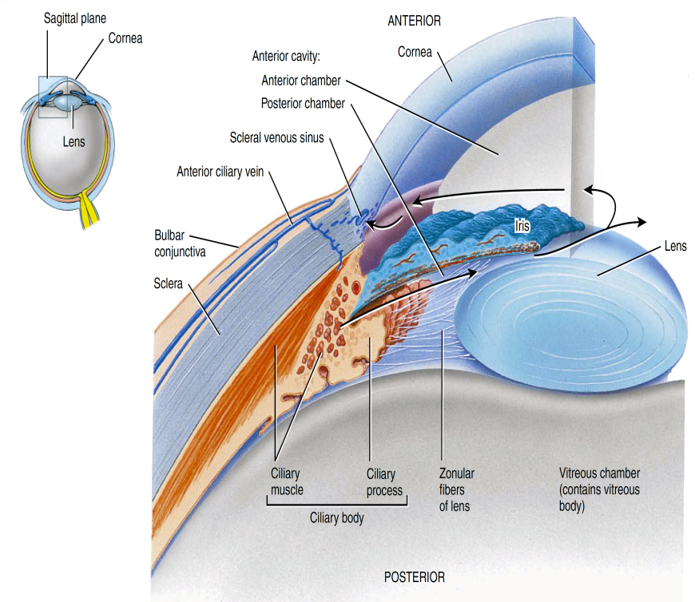
Refractive media of the eye
The Cornea
Its diopteric power is 40-45 diopter at its anterior surface.
About two thirds of the 59 diopters of refractive power of the eye is provided by the anterior surface of the cornea
-N.B/ The internal index of air is 1
  the cornea, 1.38
  the aqueous humor, 1.33
  the crystalline lens 1.40
  the vitreous humor 1.34.

Slide 23
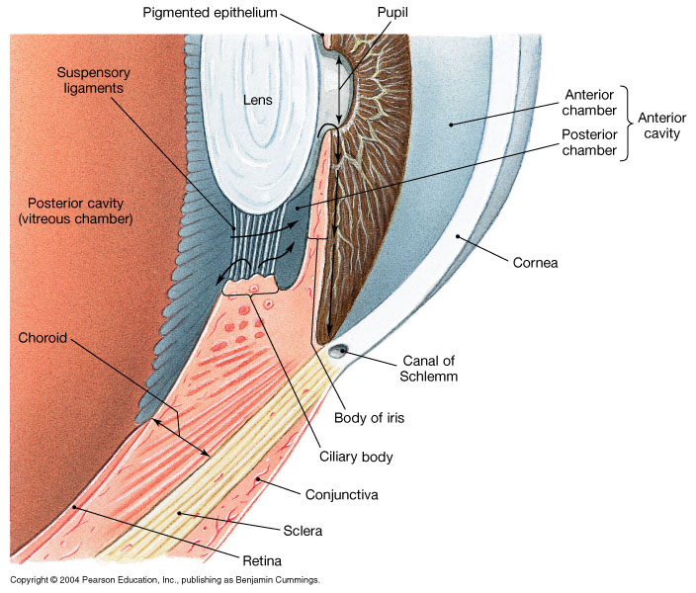
2. Aquous humour
Fluid produced by cilliary body ---to post chamber-----to pupil---to ant chamber----to canal of schlemm at angle of ant chamber---to veins
Function:
nourishing cornea
causes intraocular pressure 10-20mm Hg

Slide 24
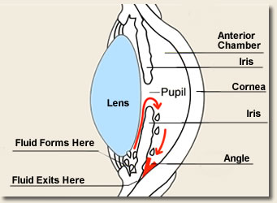
Glucoma
Build up of Aqueous Humor
Volume
Increases pressure in eye
Damages nerve
Meds/surgery

Slide 25
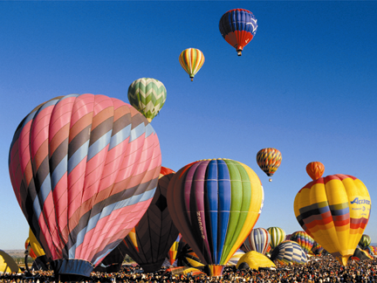

Normal Vision
Glaucoma
Glaucoma is an eye condition that develops when too much fluid pressure builds up inside of the eye. The increased internal pressure can damage the optic nerve, which transmits images to the brain. Without treatment, glaucoma can cause blindness within a few years. Glaucoma is most often inherited, meaning it is passed from parents to children. Less common causes of glaucoma include a blunt or chemical injury to the eye, severe eye infection, blockage of blood vessels in the eye and inflammatory conditions of the eye. Glaucoma usually occurs in both eyes, but it may involve each eye to a different extent.

Slide 26
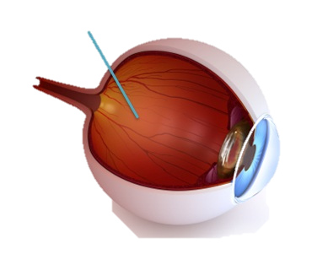
3. THE VITREOUS HUMOUR
is the transparent, colorless, gelatinous mass
It fills the vitreous chamber between the lens of the eye and the retina
The vitreous humour is clear and allows light to pass through
For nourishing retina & keep spheroid shape of the eye)
Both water and dissolved substances can diffuse slowly in the vitreous humors
VITREOUS HUMOUR REMAINS FROM BIRTH

Slide 27
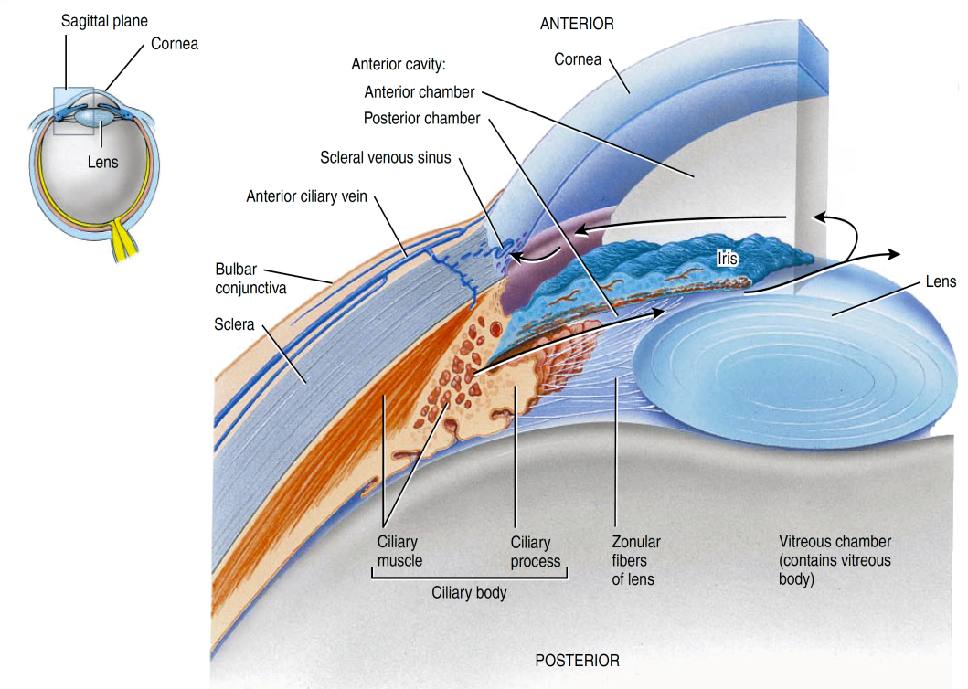
4. The Lens
Has diopteric power 15-20 D
(1/3 refractive power of eye) , more important than cornea.
why?
Importance of the internal lens is that, in response to nervous signals from the brain, its curvature can be increased markedly to provide “accommodation”

Slide 28
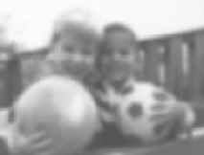
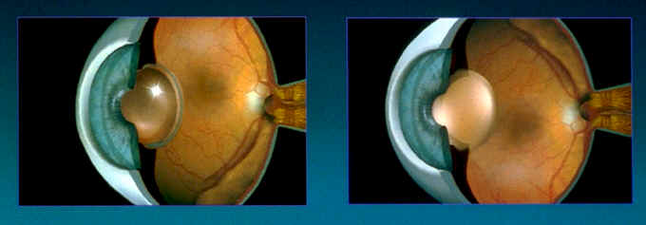
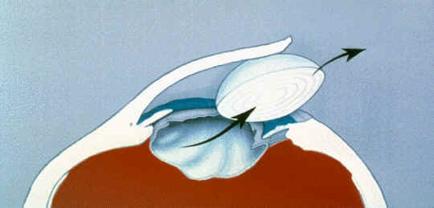
Cataracts
Lens clouds up
Must be removed
Typical to replace lens with implant
Can get clouding repeated
Laser removal

Slide 29
BINOCULAR VISION
are the areas in the centre of visual field of the two eyes in which any object in this area will be seen by both eyes.
BINOCULAR VISION for:
1- Large visual field
2- cancel the effect of blind spot
3- stereoscopic vision
4- one eye lesion does not affect vision
Monocular and binocular visual fields. -The dashed line encloses the visual field of the left eye;
-the solid line, that of the right eye. -The common area (heart-shaped in the center) is viewed with binocular vision.
-- The colored areas are viewed with monocular vision.

Slide 30
Errors of refraction
Hypermetropia (long sight)
Myopia (Short sight)
Astigmatism

Slide 31
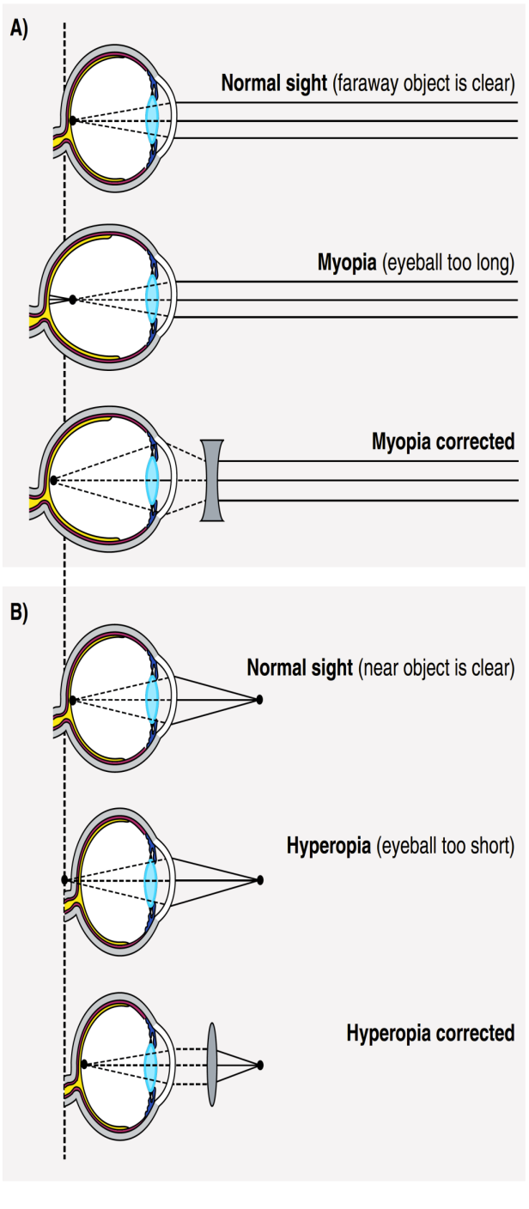
Errors Of Refraction
1-Hypermetropia (hyperopia = far-sightedness)
Short eyeball, focus behind retina,
An affected individual has to use accommodation even for distant objects.
Headache & hypertrophy of ciliary muscle
correction by biconvex lens.

Slide 32

Errors Of Refraction
2-Myopia(nearsightedness):
Genetic, large eye ball, long anteroposterior diameter, cause image to focus in front of retina
Correction by biconcave lens to diverge rays before strike lens)

Slide 33
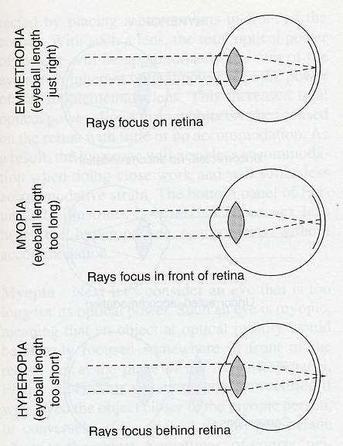
Image Focusing
Emmetropia
(normal vision)
Fully relaxed
unaccommodated
lens
Myopia
(Short sight)
Hyperopia
(long sight)

Slide 34
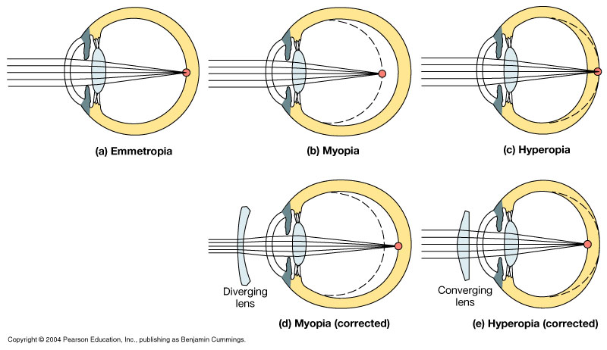
Figure 17.11 Visual Abnormalities
Long-shghted
Short-sighted
Normal
Biconcave lens
Biconvex lens
Figure 17.11

Slide 35
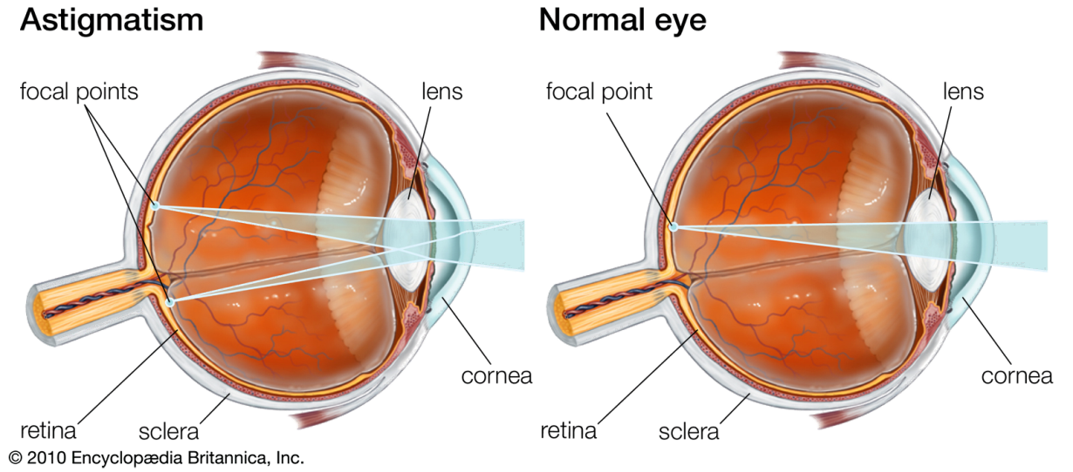
Astigmatism
3-Astigmatism :
Uneven & ununiformed corneal curvature, very rare ununiformed lens curvature
Rays refracted to diff focus---------blurred vision
Correction by cylindrical lens

Slide 36
ASTIGMATISM
RETINA
DISTORTED CORNEA

Slide 37
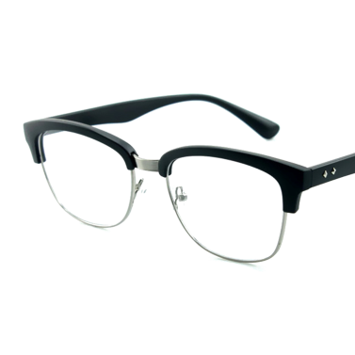
CORRECTED
ASTIGMATISM
RETINA
DISTORTED CORNEA
Cylindrical Lens

Slide 38

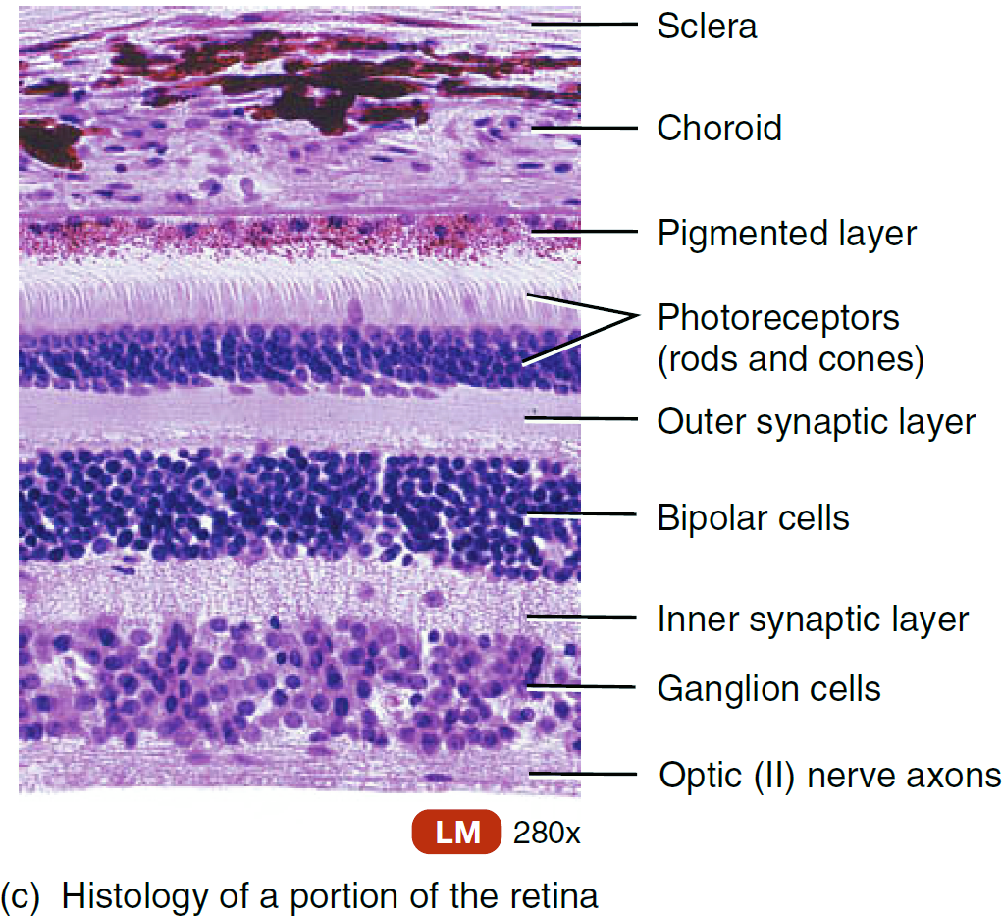
Retinal Layers

Slide 39
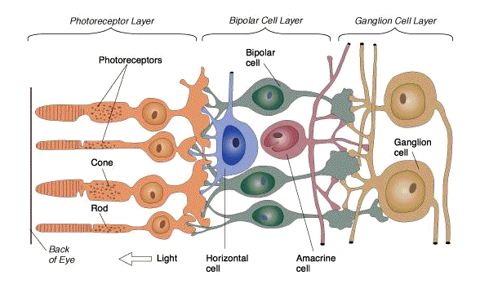
Light Pathway

Slide 40
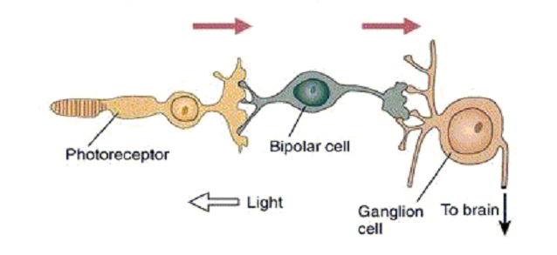
Retina: Neural Circuitry
Light hits photoreceptors, sends signal to the bipolar cells
Bipolar cells send signal to ganglion cells
Ganglion cells send signal to the brain

