Slide 1
Radiology of cerebral hemispheres
Department of Radiology

Slide 2
Radiology of cerebral hemispheres
Magnetic Resonance Imaging (MRI) | Computed Tomography (CT)
No ionizing radiation | Ionizing Radiation
Lengthy (15-20min) | Quick (2-3min) – actually 2-3 seconds
High resolution | Low resolution
T1, T2, FLAIR, Diffusion, contrast enhanced, perfusion, spectroscopy | Without contrast With contrast

Slide 3
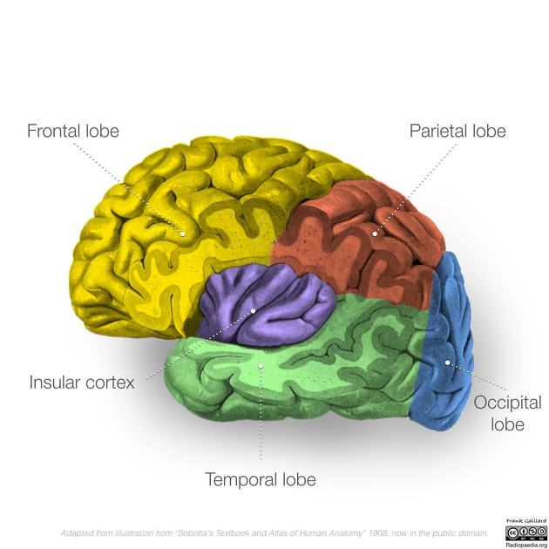

Slide 4
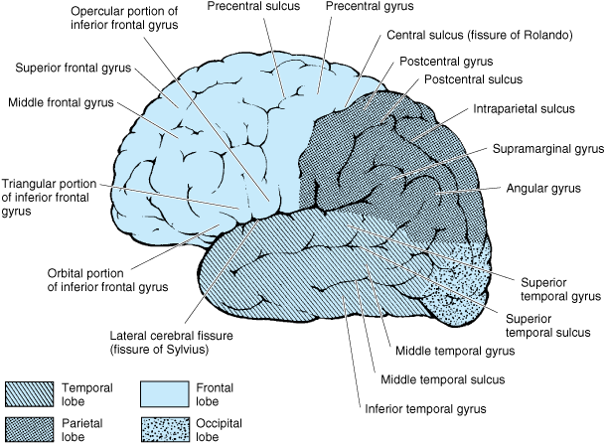

Slide 5
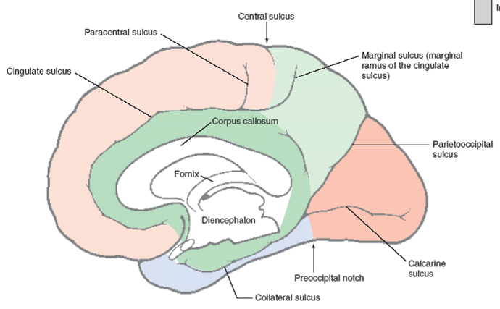
Notes:
Corpus callosum is a thick band of white matter that connect the 2 hemisphere

Slide 6
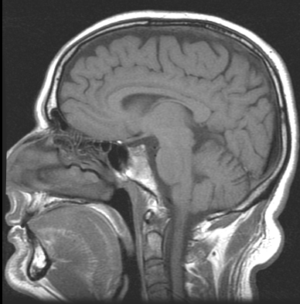
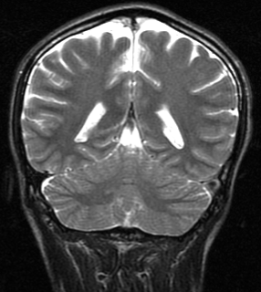
Cingulate Sulcus

Slide 7
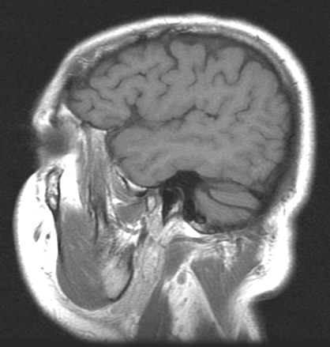
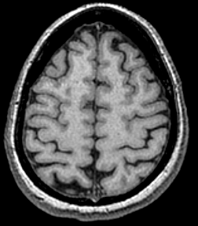
Central (Rolandic) fissure

Slide 8
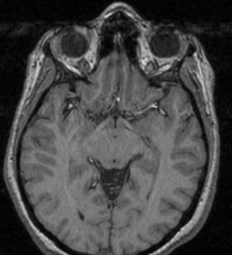
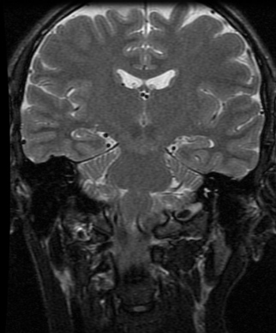
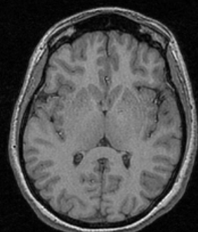
Sylvian fissure

Slide 9
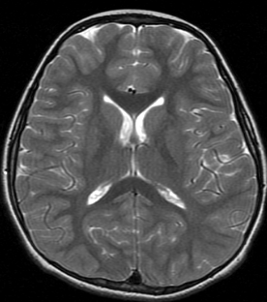
Parieto-occipital fissure

Slide 10
SuFrG
PrCG
SuFrG
PrCG

Slide 11
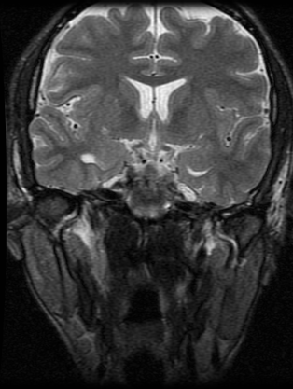
SuFrG
MFrG
InFrG

Slide 12
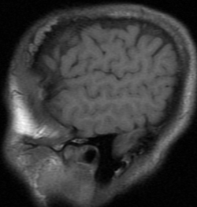
SuTG
SuTG
MTG
MTG
InTG
InTG
SuTG → Superior temporal gyrus
MTG → Middle temporal gyrus
InTG → Inferior temporal gyrus

Slide 13
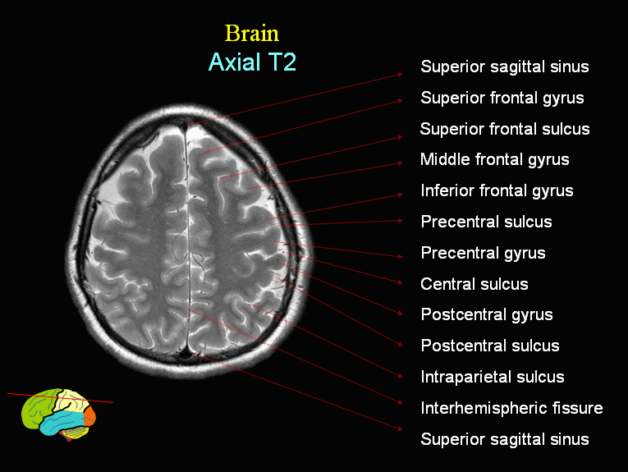

Slide 14
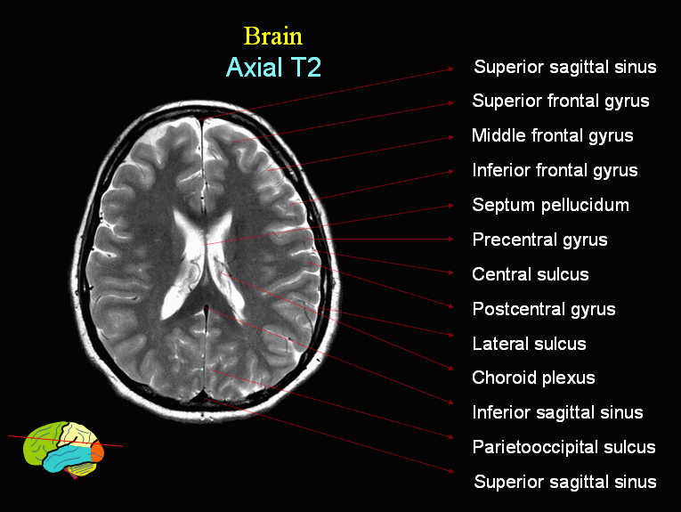

Slide 15
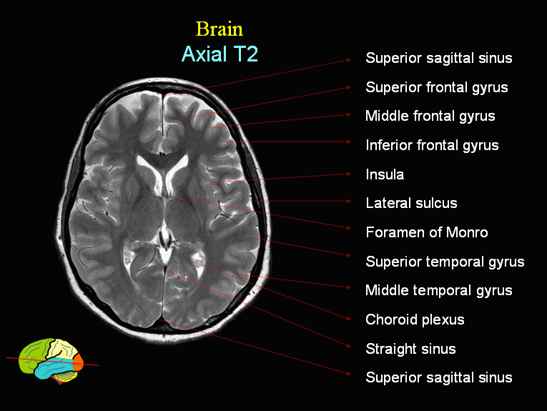

Slide 16
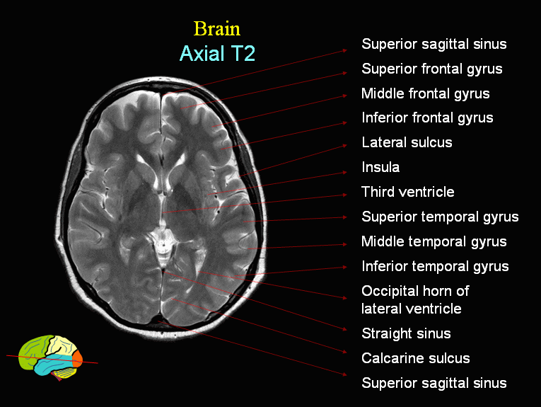

Slide 17
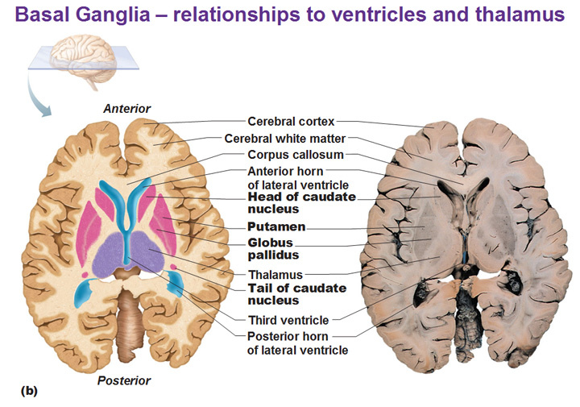

Slide 18
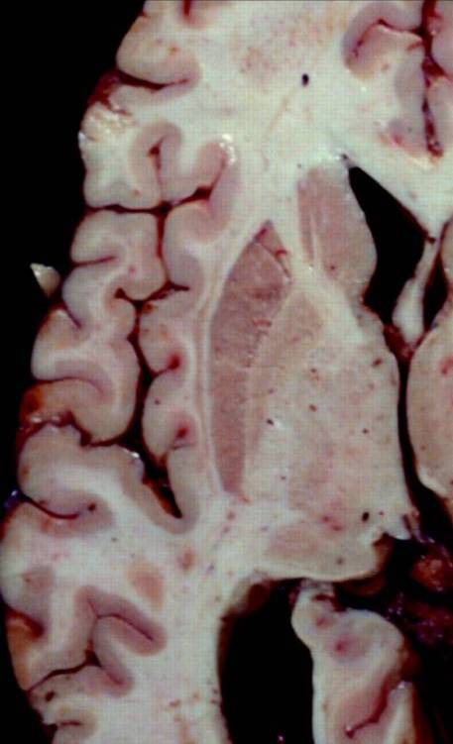
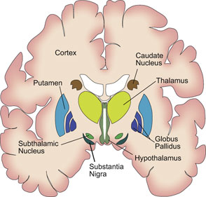

Slide 19
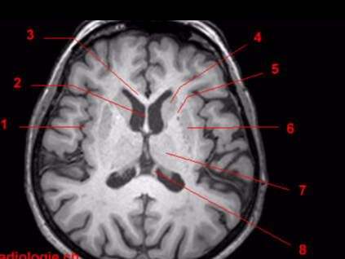
1, Insula.
2, Septum pellucidum.
3, Genu of corpus callosum.
4, Caudate nucleus.
5, Anterior arm of internal capsule.
6, Putamen.
7, Thalamus.
8, pillars of the fornix

Slide 20
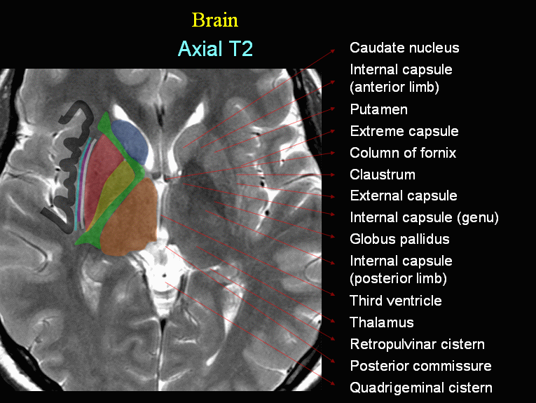

Slide 21
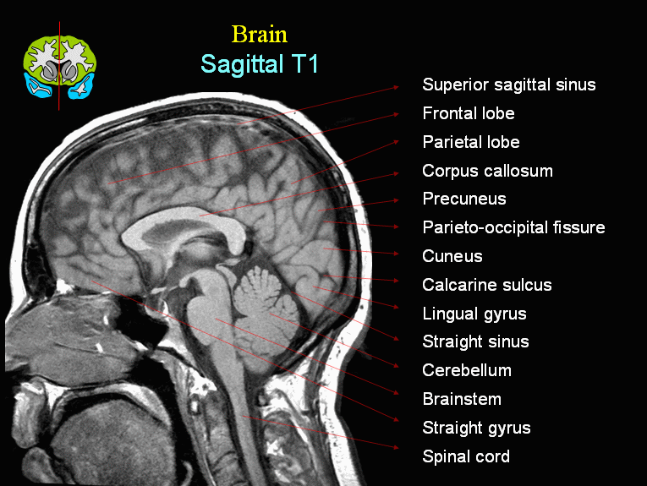

Slide 22
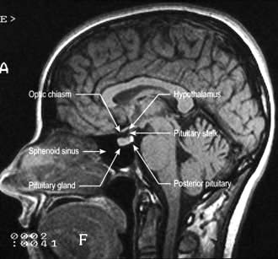

Slide 23
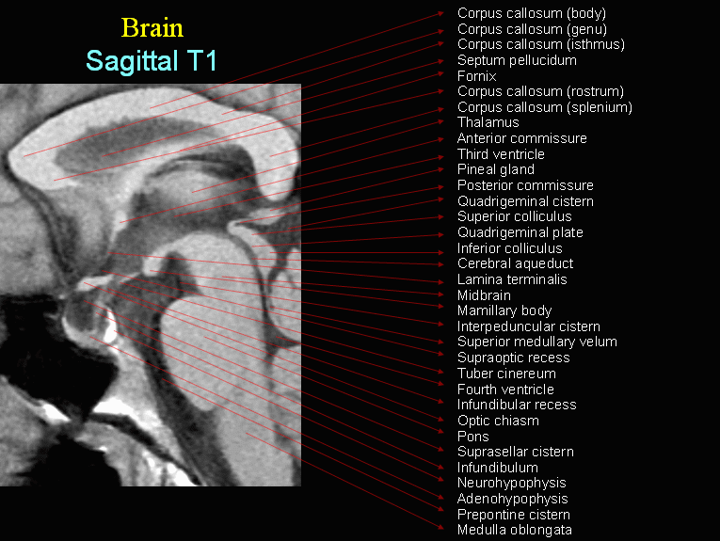

Slide 24
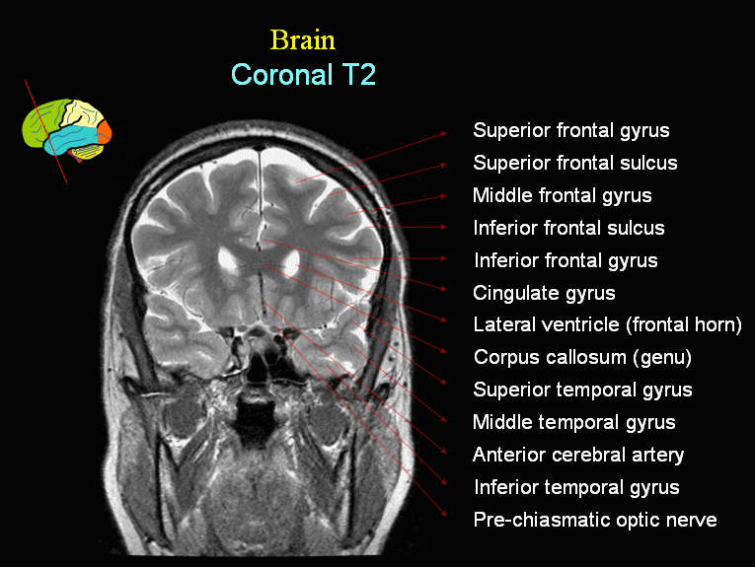

Slide 25
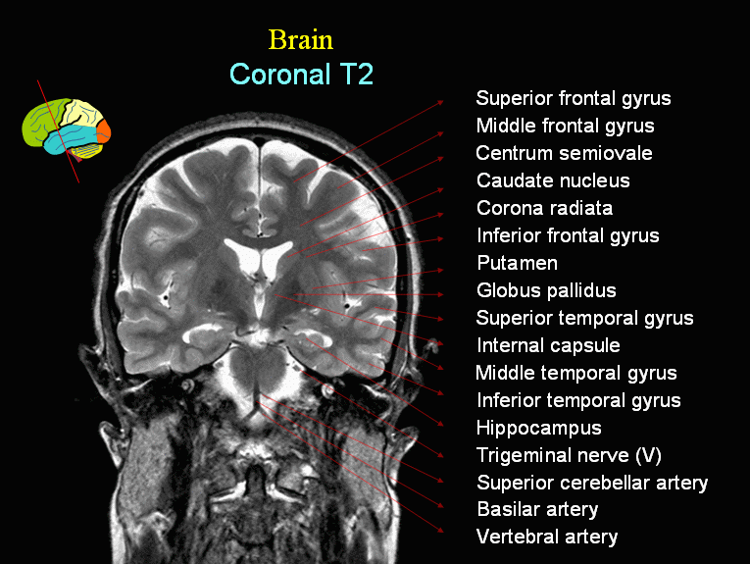

Slide 26
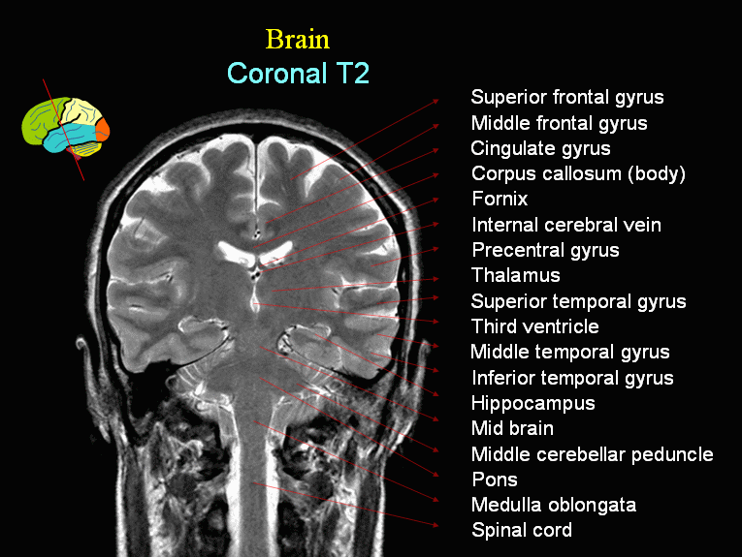

Slide 27
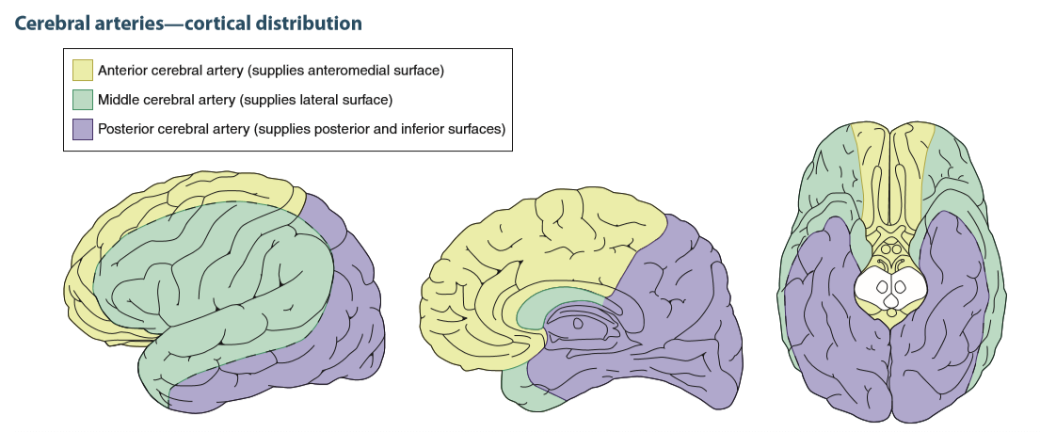

Slide 28
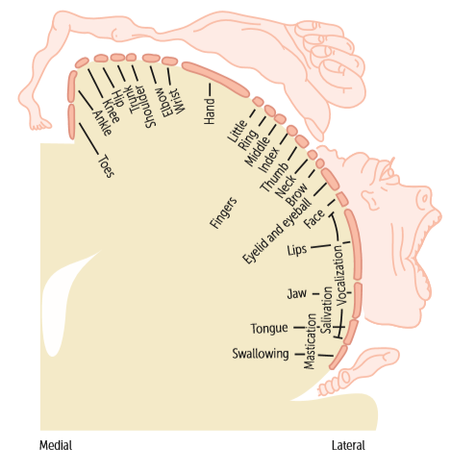

Slide 29
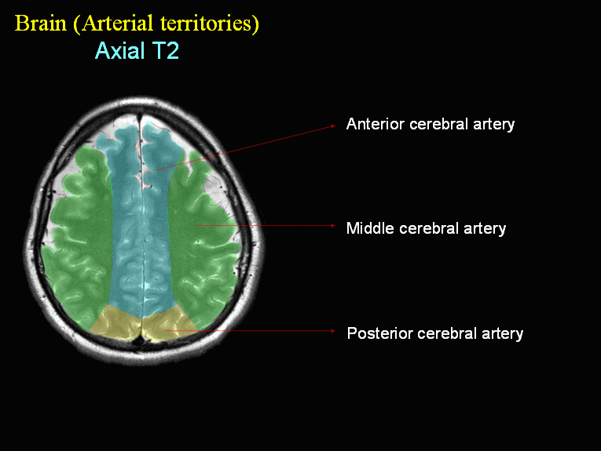

Slide 30
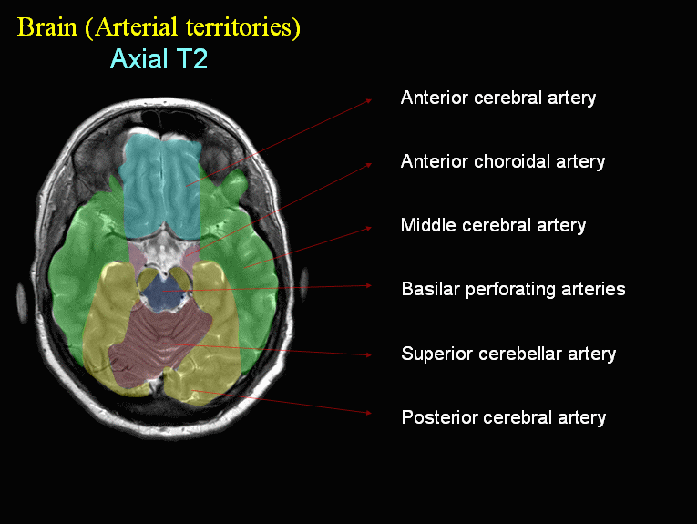

Slide 31
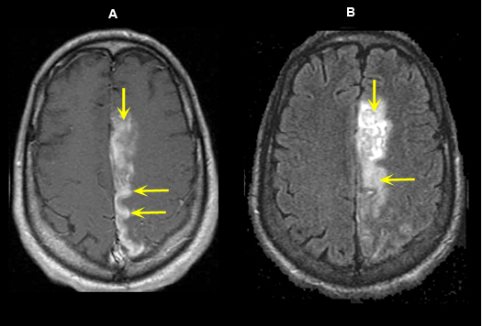

Slide 32
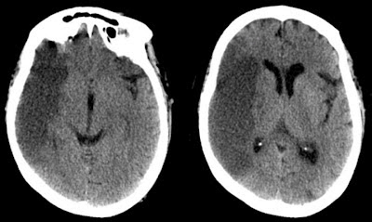

Slide 33
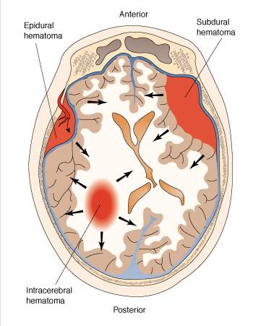
Intracranial Bleeding
Epidural
Subdural
Subarachnoid
Intraventricular
Intraparenchymal

Slide 34
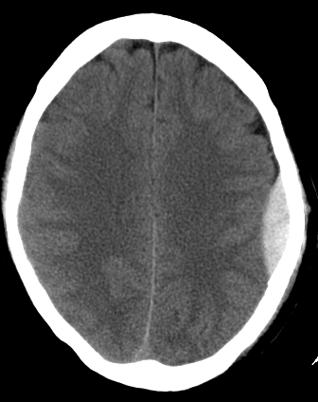
EDH
Blood collection between inner table and dura.
Biconvex (lentiform)
Arterial 90% middle meningeal artery (branch of maxillary artery)
Occur at site of impact
Does not cross sutures
Can cross falx and tentorium
Skull fracture in 90%
Lucid interval-50%
C/F: headache, nausia, vomiting, convulsions, herniation.

Slide 35
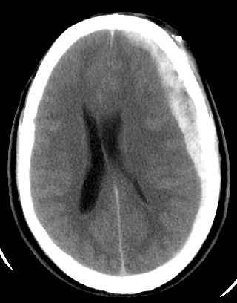
SDH
Blood collection between dura and arachnoid.
Rupture of bridging veins.
Crescent shape
Cross sutures, but not dural attachments
Can cause midline shift
May extend along falx and tentorium

Slide 36
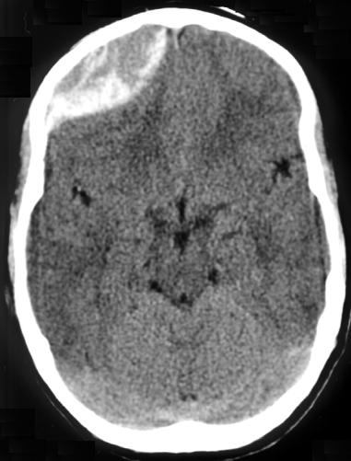

Slide 37
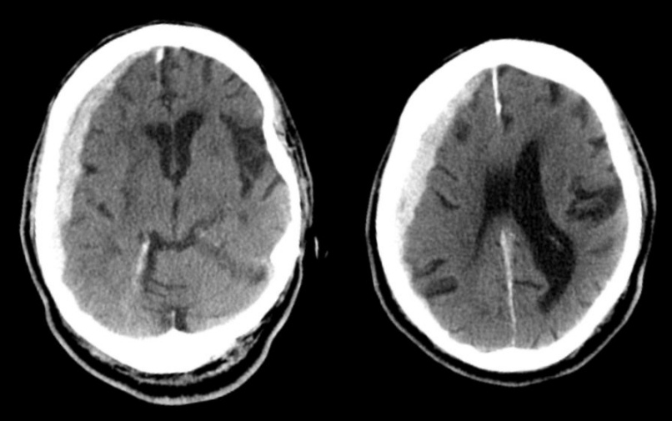

Slide 38
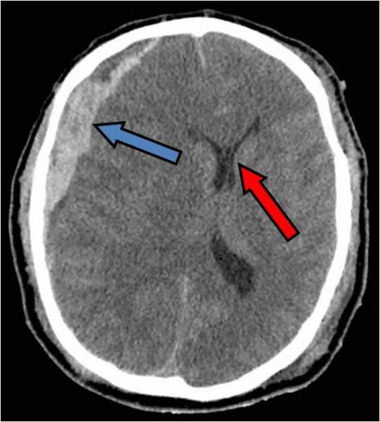

Slide 39
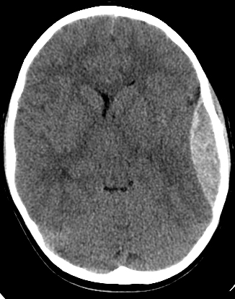

Slide 40
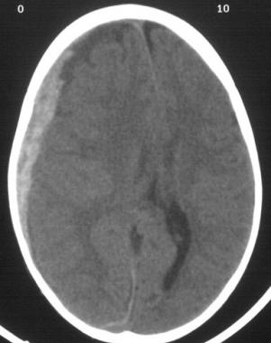

Slide 41
Thank you

Slide 42
Which of the following diagnostic modalities that provides a very detailed diagnostic pictures without the use of ionizing radiation:
a- CT with contrast
b- X-ray
c- MRI
d- CT without contrast

Slide 43
Which of the following is the first diagnostic imaging in local minor trauma cases:
a- MRI
b- CT scan
c- X-ray
d- Ultrasound

Slide 44
A 65-year-old gentleman with chronic renal disease, and heart failure, Presents with back pain. He had a pacemaker inserted 10 years ago. The patient asks if he could undergo an MRI study. Which of the following is a contraindication of using an MRI in this case:
a- Renal disease
b- Heart failure
c- Cardiac pacemaker
d- Age >60 years

Slide 45
Thank you

