Slide 1
APPROACH TO HAEMOLYSIS AND HAEMOGLOBINOPATHIES
By:
DR. SHIHAB AL-MASHHADANI
Consultant Haematologist Head of Haematology Division Associate Professor Department of Pathology College of Medicine
King Saud University

Slide 2
LEARNING OBJECTIVES
➢To be able to define haemolysis and haemolytic
anaemia
➢To be able to classify haemolytic anaemias into congenital and acquired types, and to know the aetiological factors in each division
➢To understand the difference between intravascular and extra-vascular haemolysis, and to recognise the laboratory features of each

Slide 3
cont’d…
➢To appreciate that disorders of globin function such as sickle cell disease are subtypes of haemolytic anaemia
➢To understand the role of autoantibodies in the production of haemolytic anaemias and to know the types of disease with which they are associated
➢To understand some causes of non-immune acquired haemolytic anaemias

Slide 4
HAEMOLYSIS
Premature destruction of RBCs.
Hemolysis could be due to:
  Defect in the RBCs (intra-corpuscular) as in congenital hemolytic Anaemia.
  Defect in the surrounding environment (extracorpuscular) as in acquired
Anaemia.

Slide 5
HAEMOLYTIC ANAEMIAS
Haemolysis
describes the shortening of the lifespan of a mature red
blood cell.
increased red cell output from the marrow
stimulated by erythropoietin
will be sufficient to compensate for the increased red cell
destruction
more marked reductions in red cell lifespan - say to 5-10
days from the usual 120 days
will result in haemolytic anaemia
this compensatory increase in erythroid output requires an adequately functioning bone marrow and effective erythropoiesis
a suboptimal marrow response is seen
haemolysis will result in anaemia more readily

Slide 6
Clinical Features of Hemolysis
Pallor, lethargy
Jaundice
Splenomegaly
Gall stones (Pigment – bilirubin)
Dark urine (urobilinogen)
Bone deformity (In some types of
haemolytic anaemia)
Leg ulcers (in some types of haemolytic anaemia).

Slide 7
Laboratory Features of Hemolysis
1.) Features of increased red cell breakdown.
↑ serum bilirubin is raised
(unconjugated and bound to albumin).
↑ urine urobilinogen.
↑ faecal stercobilinogen.
Absent serum haptoglobins.
↑ lactate dehydrogenase (LDH)

Slide 8


Laboratory Features of Hemolysis
) Features of increased red cells production.
  Reticulocytosis
  Bone marrow erythroid hyperplasia.
3.) Damaged red cells.
Morphology (e.g. microspherocytes, elliptocytes, red cells fragmentation).
Increased osmotic fragility, autohaemolysis etc).
Shortened red cell survival (This can be shown by ⁵¹Cr labeling with study of the sites of destruction.

Slide 9
Intravascular and extravascular haemolysis
a. Intravascular haemolysis, the process of
breakdown of
circulation.
b. Extravascular
red cells directly in the
haemolysis excessive
removal of red cells by cells of RE system
in the spleen and liver.

Slide 10

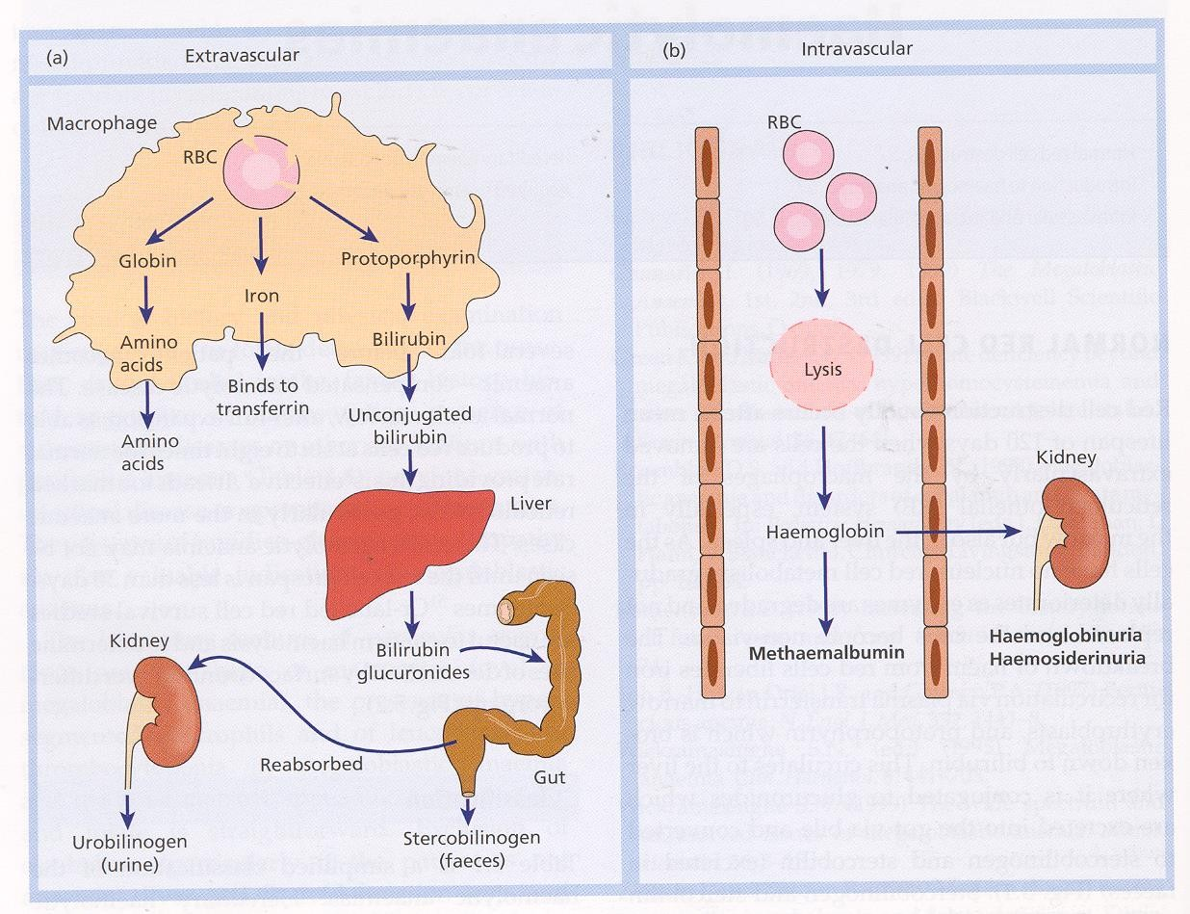

Slide 11
The main laboratory features of intravascular haemolysis are as follows:
Haemoglobinaemia and haemoglobinuria.
Haemosiderinuria (Iron storage protein in the spun deposit of urine).

Slide 12

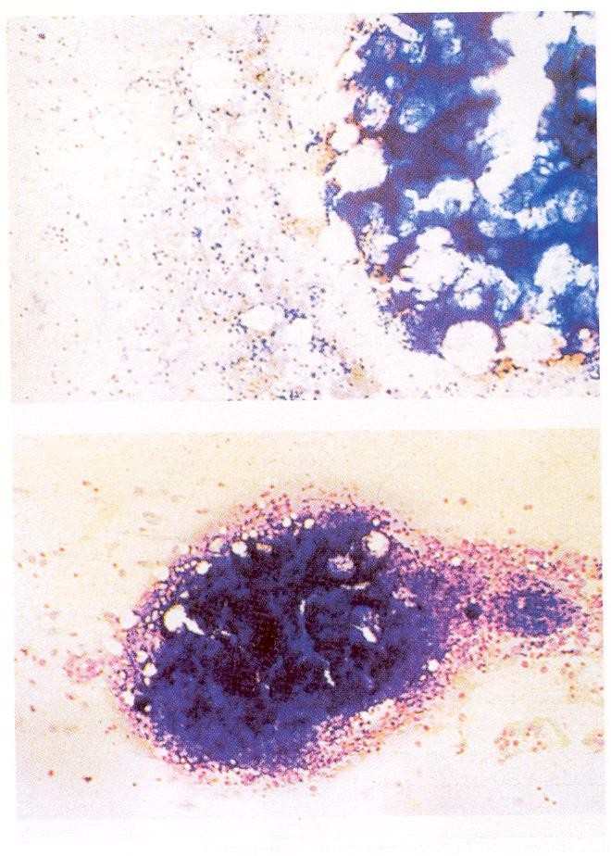

Slide 13
Causes of intravascular haemolysis
Mismatched blood transfusion (usually ABO)
G6PD deficiency with oxidant stress
Red cell fragmentation syndromes
Some autoimmune haemolytic anaemias
•
Some drug-and infection-induced anaemias
Paroxysmal nocturnal haemoglobinuria
March haemoglobinuria
Unstable haemoglobin
haemolytic

Slide 14
HAEMOLYTIC ANAEMIA
A . CONGENITAL
SICKLE CELL DISEASE & OTHER HAEMOGLOBIN DISORDERS THALASSAEMIAS
ENZYMOPATHIES MEMBRANOPATHIES
B. AQUIRED

Slide 15
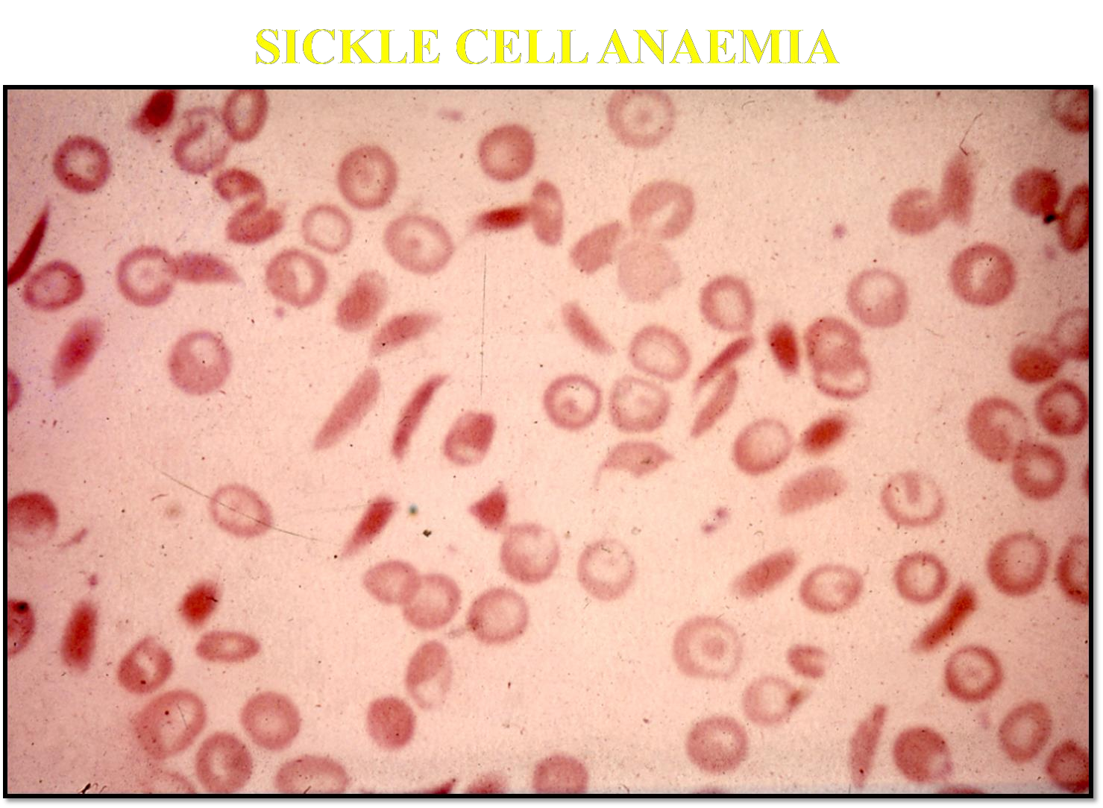

Slide 16
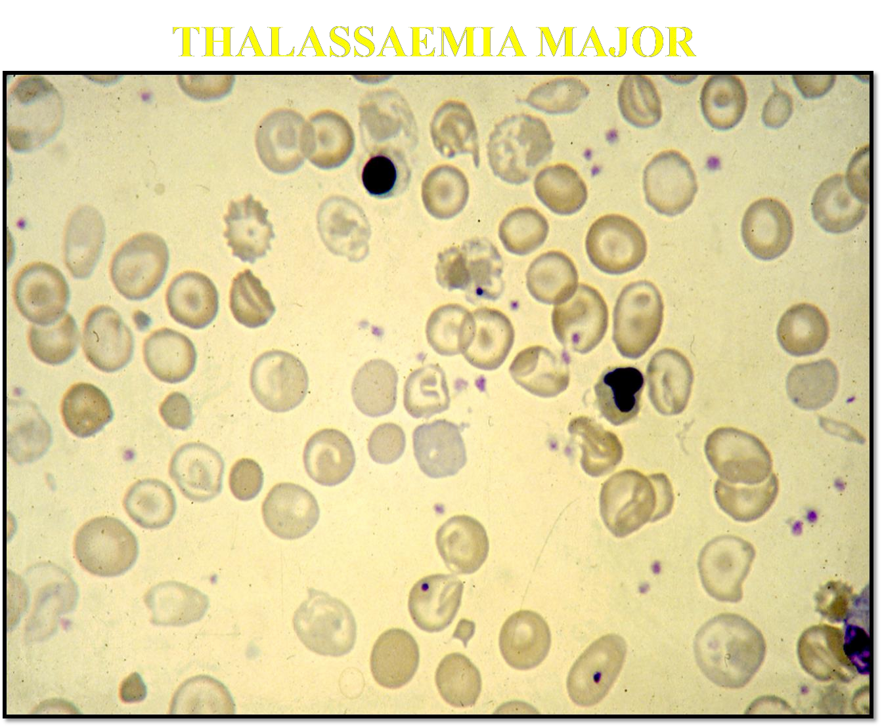

Slide 17
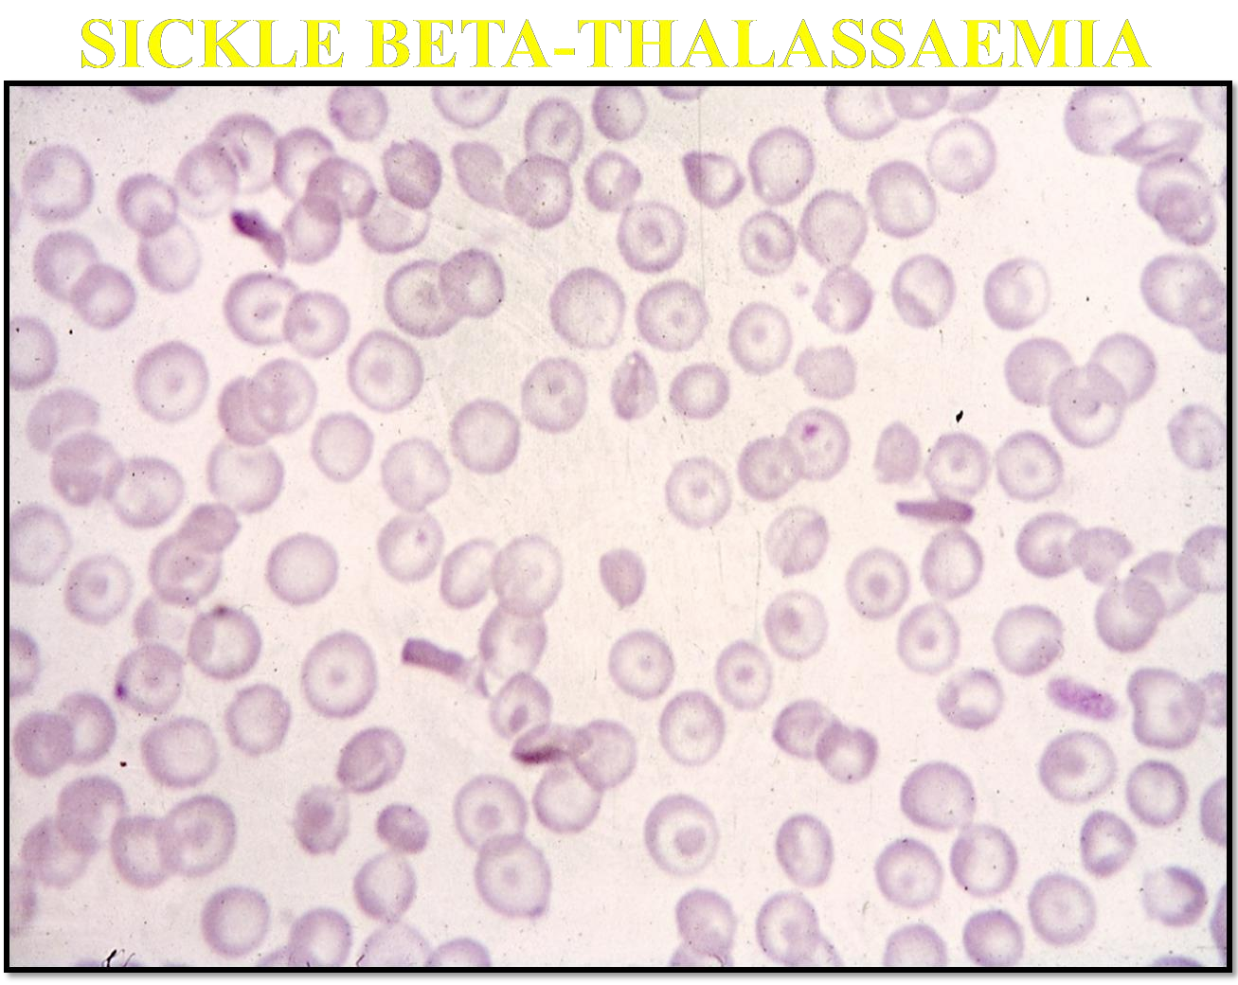

Slide 18
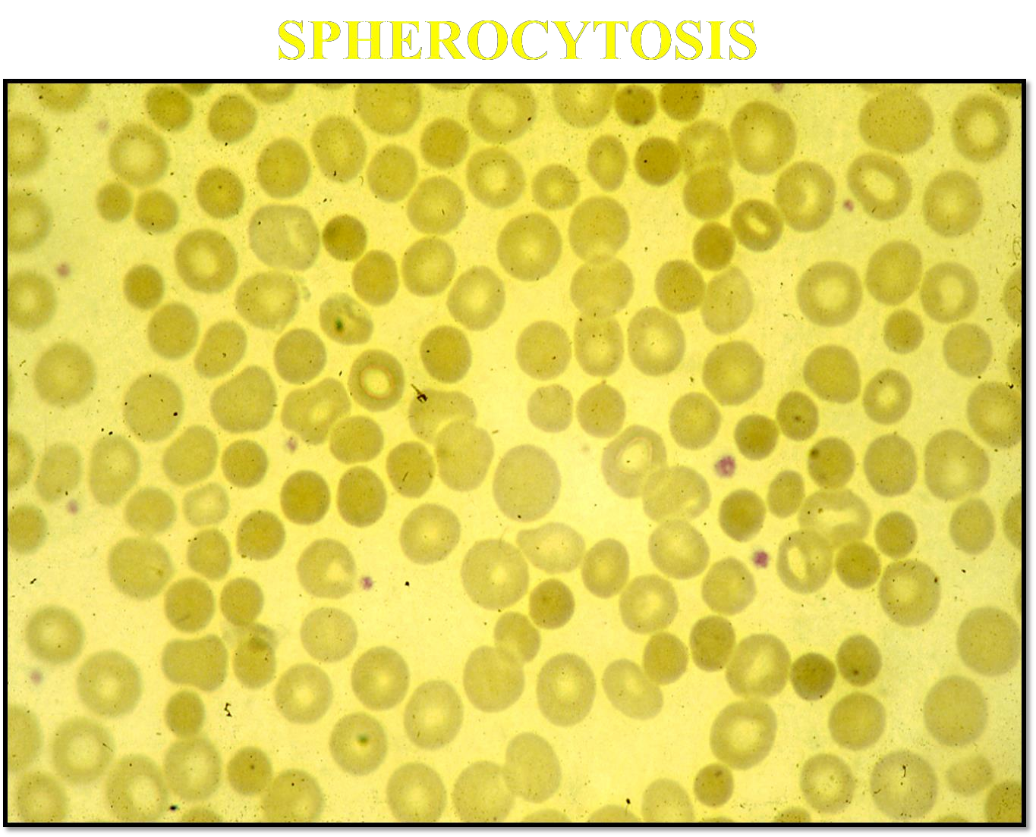

Slide 19
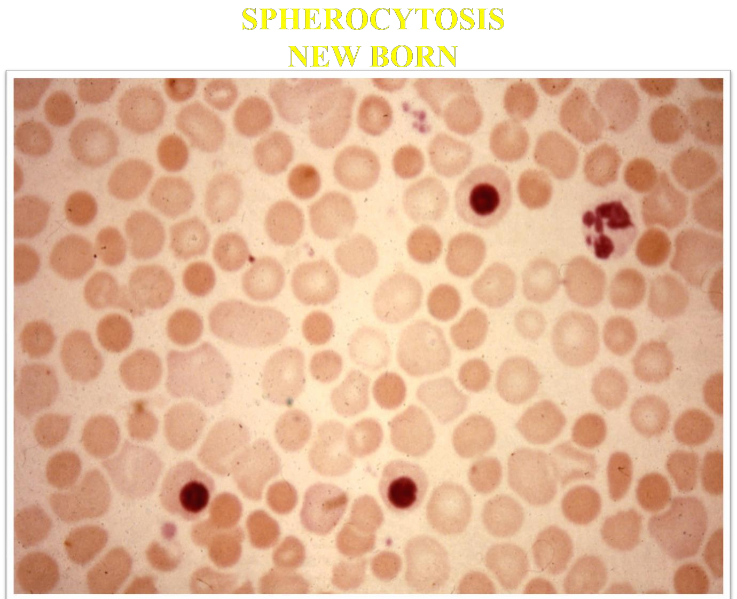

Slide 20
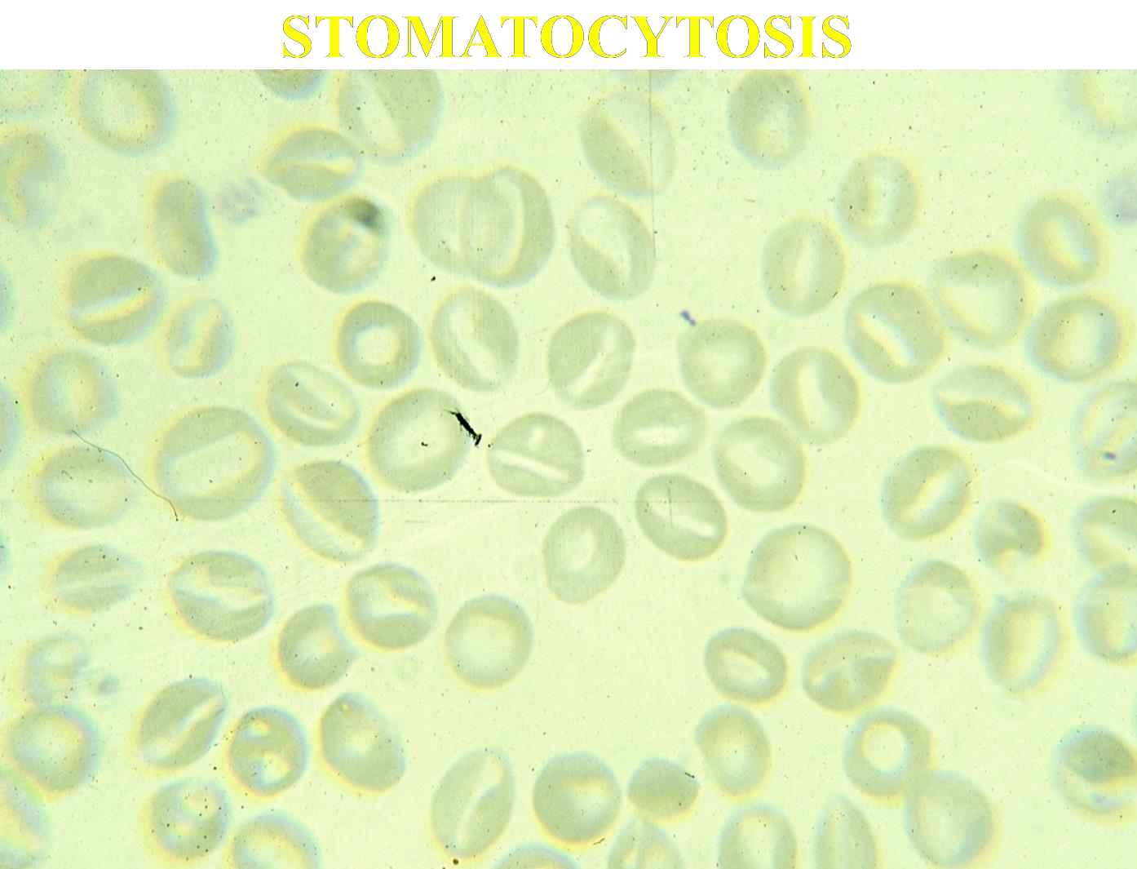

Slide 21
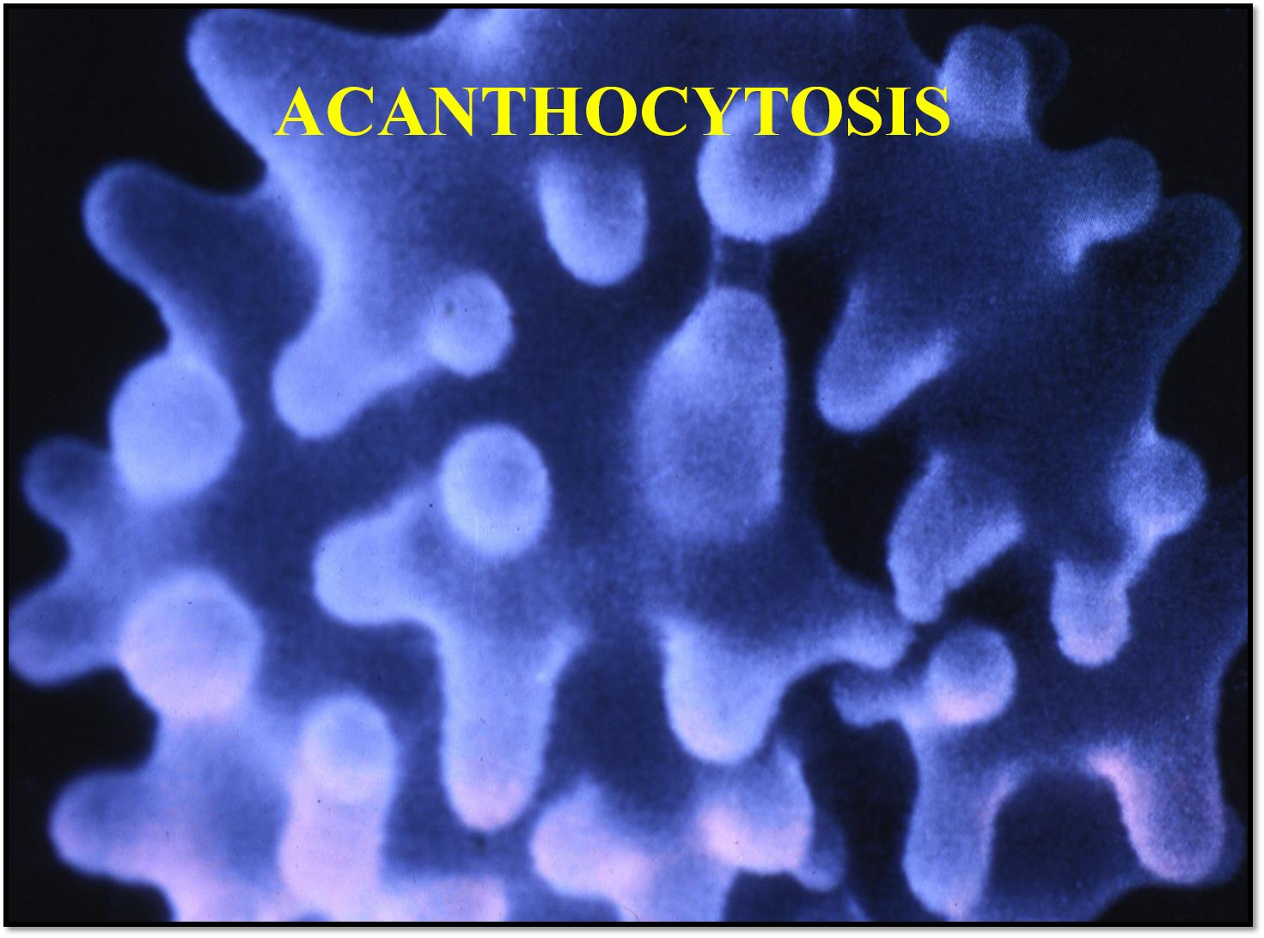

Slide 22

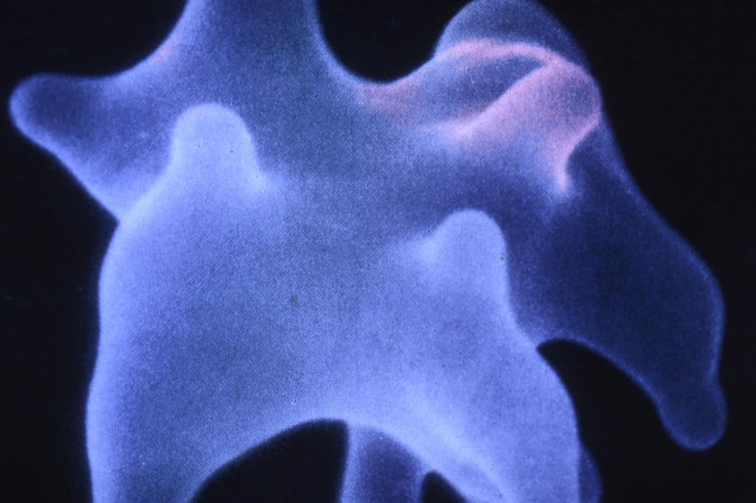

Slide 23
Classification Of Haemolytic Anaemias
------------------------------------------------------------------------------------------------------------------------------------------------------------------------------ ---------------------------------------------------------------------------------
Hereditary Acquired
------------------------------------------------------------------------------------------------------------------------------------------------------------------------------ ---------------------------------------------------------------------------------
Haemoglobin
Abnormal (Hb S, Hb C, unstable)
Thalassaemia Membranopathy Enzymopathy
Allografts, especially marrow transplantation
drug associated
Red cell fragmentation syndrome Arterial grafts, cardiac valves Microangiopathic
Thrombotic thrombocytopenic purpura Haemolytic uraemic syndrome Meningococcal sepsis
Pre-eclampsia
Disseminated intravascular coagulation
March haemoglobinuria Infections
Malaria, clostridia
Chemical and physical agents
Especially drugs, inductrial/domestic substances,
burns
Secondary
Liver and renal disease
Paroxysmal nocturnal haemoglobinuria

Slide 24
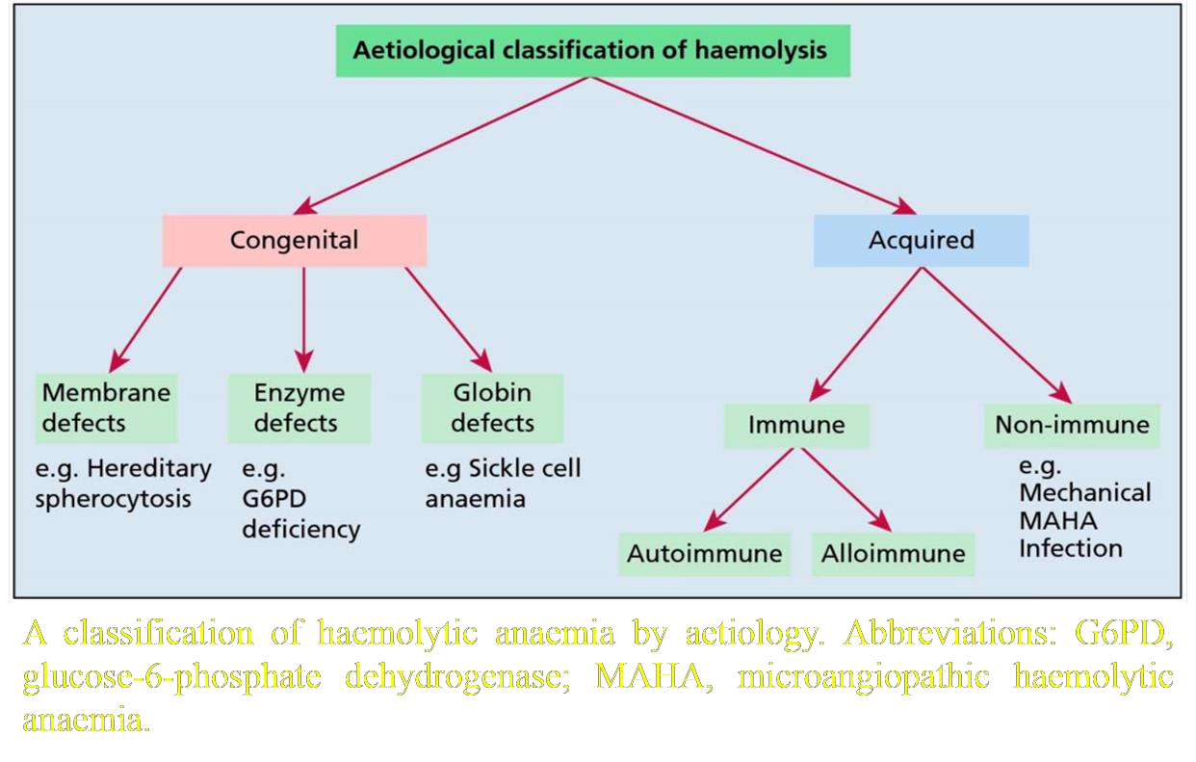

Slide 25
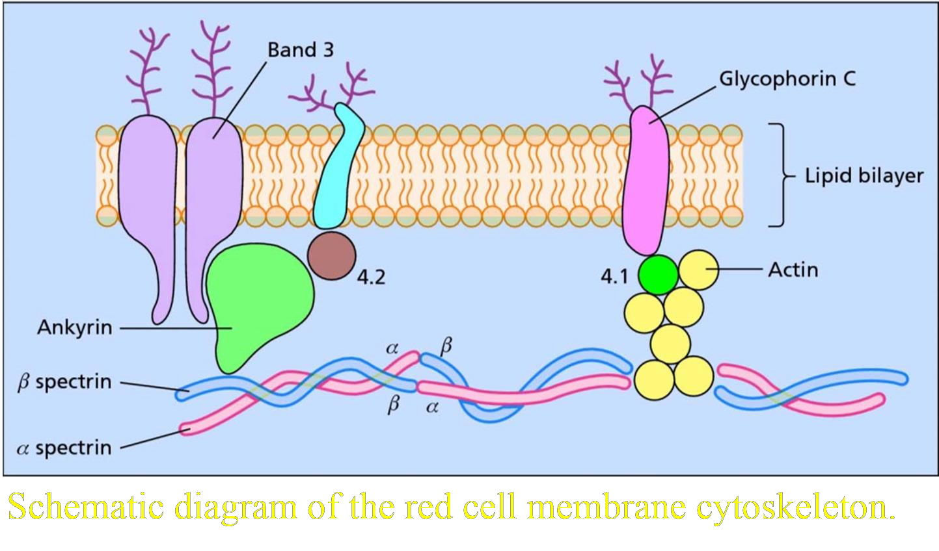

Slide 26
CONGENITAL HAEMOLYTIC ANAEMIAS
Haemolysis due to defects of the red cell membrane
Since the diameter of a normal red cell is similar to that of the smallest capillary lumen, it is essential for the red cell to be able to undergo significant deformations while traversing the circulation.
A flexible red cell cytoskeleton, which interacts with red
cell phospholipid membrane.
Key components of the cytoskeleton include α and β spectrin, actin and protein 4.1, while connections linking the cytoskeleton to the overlying red cell phospholipid bilayer include band 3, Rh-associated glycoprotein and glycophorin C.
Defects in any of these proteins can jeopardize the integrity
of the red cell and shorten its lifespan.

Slide 27
Hereditary spherocytosis (HS)
The most | common | haemolytic anaemia due to | a
membrane | defect is | hereditary spherocytosis (HS) | in
Caucasian
About 60% of patients have mutations affecting the Ankyrin gene
Loss of Ankyrin then leads to secondary reductions in
spectrin and protein 4.1
This leads to a loss of membrane surface area, with cells
adopting a spheroid rather than biconcave shape
Less deformable than normal red cells
Destroyed by splenic macrophages, leading to a reduction in red cell survival by extravascular haemolysis

Slide 28
cont’d…
Around 20% of all HS patients have mild disease with
well-compensated haemolysis
The majority of patients have moderate disease characterized by a Hb concentration of 8-11g/dl, while a small percentage have severe disease requiring intermittent or even regular transfusions
Complications of the chronic haemolysis in HS include
the development of pigment gallstones
Aplastic crises may occur secondary to parvovirus B19
infection
Megaloblastic anaemia due to folate deficiency is also
occasionally found

Slide 29
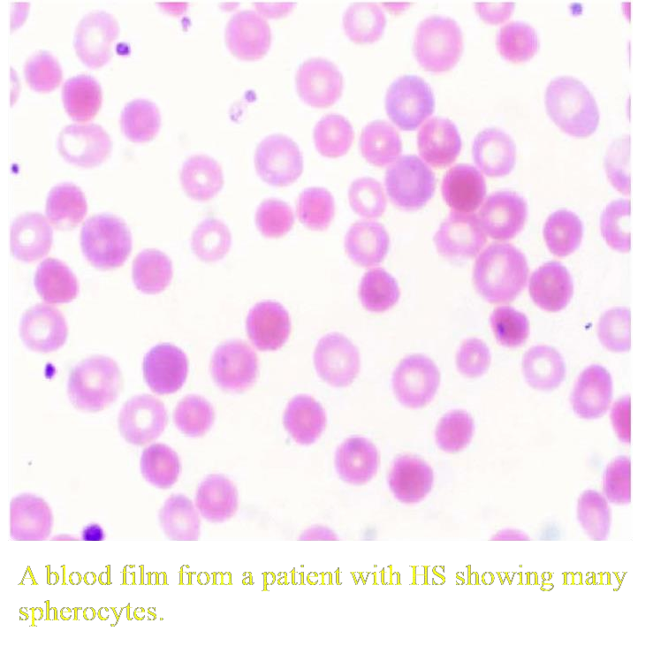

Slide 30
Diagnosis and management
Family history
Mild jaundice
Pallor and splenomegaly
Laboratory findings (anaemia,
reticulocytosis and
elevated plasma bilirubin
Presence of spherocytes on the peripheral blood film
The eosin-5-maleamide (EMA) binding test (may be used if more definitive evidence for the diagnosis is needed)
The red cell membrane proteins study
Electrophoresis on a denaturing polyacrylamide gel

Slide 31
cont’d…
The treatment of HS:
Folic acid supplementation
•
Splenectomy (children with severe disease). Splenectomy will, however, increase the risk of significant infection, particularly from encapsulated organisms. This risk is especially marked in children under the age of 5, delayed until age 5-10 years.
Administration of pneumococcal and meningococcal vaccine and Haemophilus influenzae type b vaccine (splenectomy preoperative preparation)
Prophylactic penicillin V is advised lifelong (post
splenectomy)

Slide 32
Hereditary elliptocytosis
Hereditary elliptocytosis (HE) is also a relatively common
condition
Defects in α spectrin
Most patients are clinically asymptomatic, some will have a chronic symptomatic haemolytic anaemia.
All show the very characteristic red cell shape on peripheral
blood films.
Hereditary pyropoikilocytosis
Severe disturbance of the multimerization of spectrin
Severe haemolytic anaemia from infancy
Bizarre peripheral blood morphology, including microspherocytes and poikilocytes. Such patients are described as having hereditary pyropoikilocytosis.

Slide 33
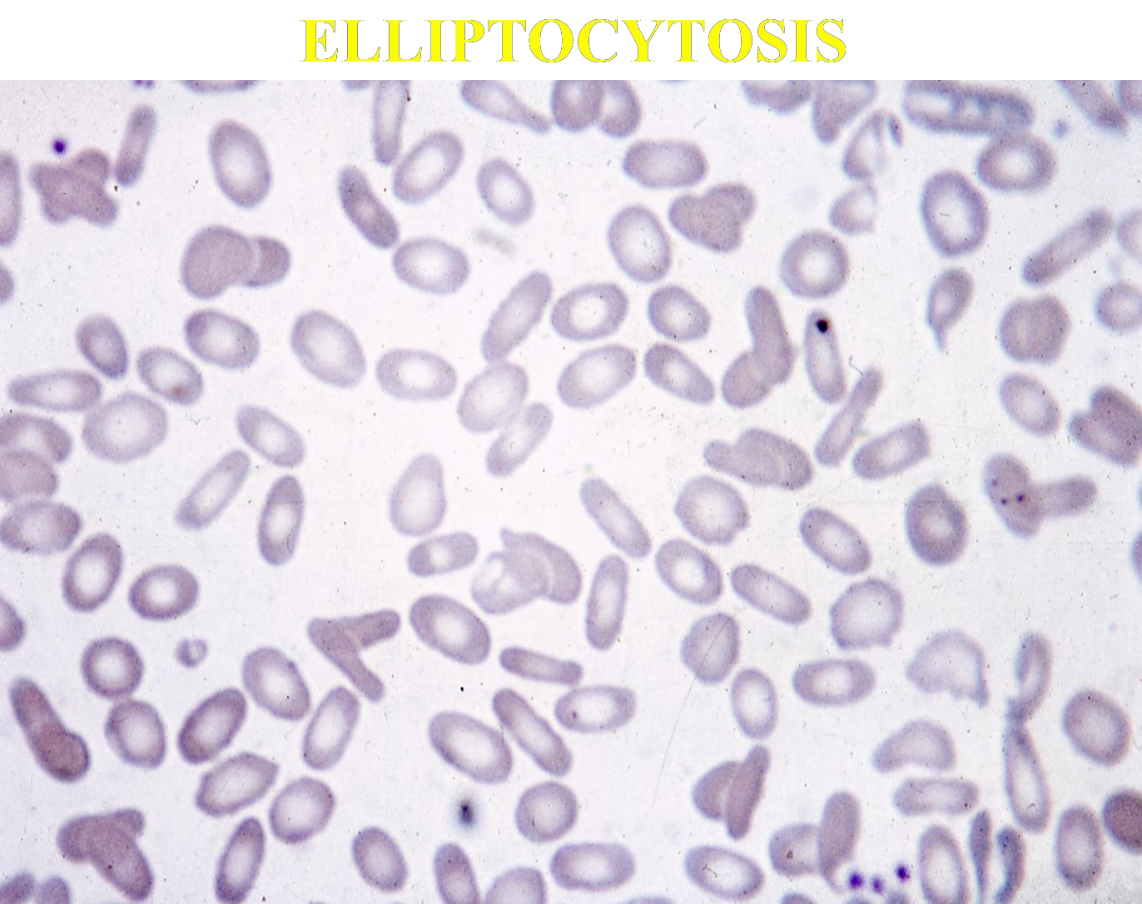

Slide 34
Haemolysis due to abnormalities of red cell enzymes
Haemolytic anaemias may also result from congenital abnormalities of the enzymes required for energy transfer in glucose metabolism. The red cell needs a continuous supply of energy for the maintenance of membrane flexibility and cell shape, the regulation of sodium and potassium pumps, and the maintenance of Hb in the reduced ferrous form.

Slide 35
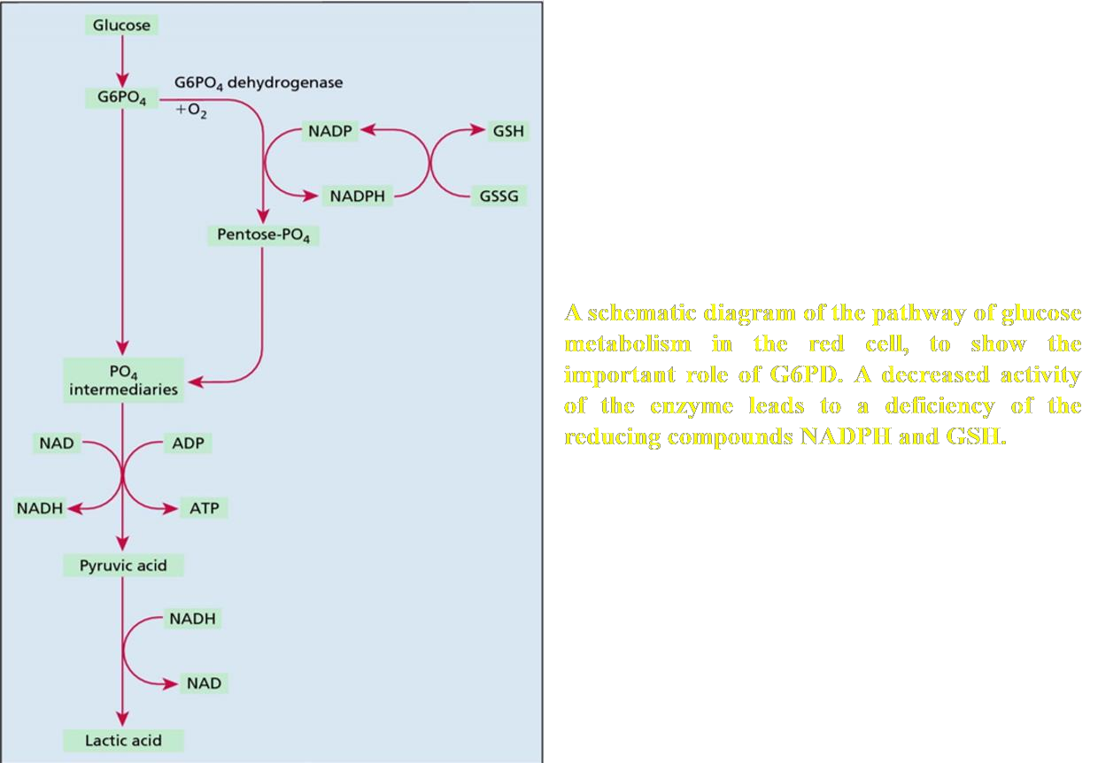

Slide 36
Glucose-6-phosphate dehydrogenase deficiency
Deficiency of glucose-6-phosphate dehydrogenase (G6PD), the first enzyme of the pentose-phosphate shunt, will prevent the normal generation of NADPH, with subsequent erythrocyte sensitivity to oxidative stress.
Various point mutations in the G6PD gene on the X chromosome resulting in enzymes with altered activity.
The normal G6PD enzyme is designated type B and is the prevalent form worldwide; G6PD type A is a normal variant found in approximately 20% of healthy individuals of African ancestry.
Defective forms of G6PD include the A- African variant and
the Mediterranean variant.
Since the gene for G6PD is found on the X chromosome,
affected individuals are male.

Slide 37
cont’d…
Patients with low levels of the enzyme are poorly protected against oxidative challenge - with some medications and even foods resulting in marked oxidative damage to the red cell.
When the red cell is exposed to oxidants, haemoglobin is converted to methaemoglobin and denatured.
Denatured haemoglobin then precipitates forming inclusions in the red cell (termed Heinz bodies and detected by supravital staining, as in Figure 3.7).
Heinz bodies, and the portion of the red cell membrane to which they become attached, are removed by splenic macrophages as the red cells pass through the spleen; the resulting inclusion-free cells display unstained areas at their periphery (‘bite’ cells, seen in Figure 3.8).

Slide 38
cont’d…
Screening
tests
and assays
for detecting
G6PD
deficiency are available.
Haemolysis typically begins 1-3 days following exposure to the oxidative stressor, with anaemia being maximal about 7-10 days after exposure.
Patient may report dark urine due to haemoglobinuria.
Favism - a syndrome in which an acute haemolytic anaemia occurs after the ingestion of the broad bean (Vicia fava) in individuals with a deficiency of G6PD (commonly of the Mediterranean type). Favism usually affects children; severe anaemia develops rapidly and is often accompanied by haemoglobinuria.

Slide 39
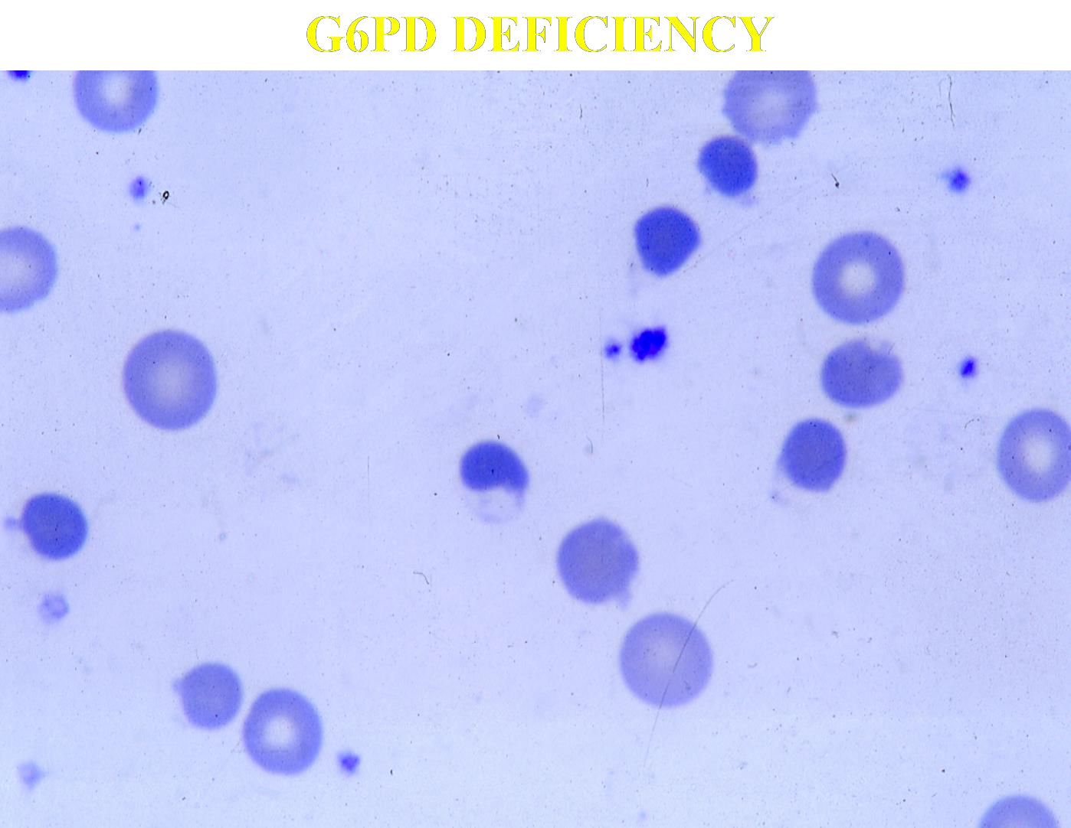

Slide 40
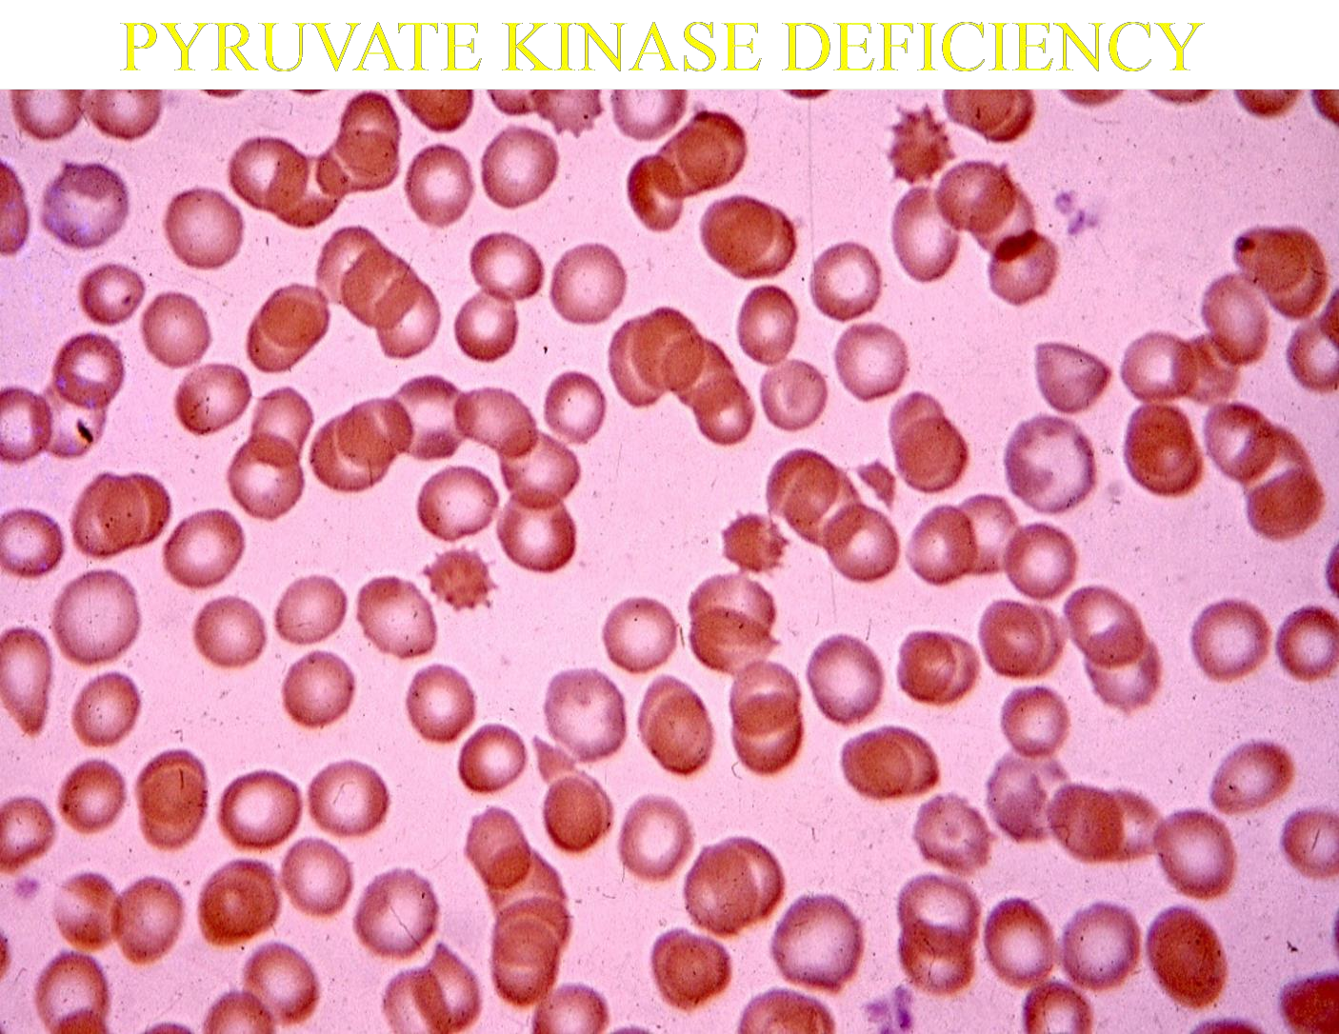

Slide 41
Treatment of G6PD deficiency
Treatment generally focuses on the avoidance of oxidative precipitants to haemolysis. In many cases, haemolysis is self limiting.
Packed red cell transfusion may be required in cases of severe haemolysis.
Other red cell enzyme deficiencies causing haemolysis
Pyruvate kinase deficiency is another relatively
common example.
There is usually a chronic haemolytic anaemia and
some patients may benefit from splenectomy.

Slide 42
Haemolysis due to haemoglobin defects
Defects in the structure of haemoglobin.
Structural variants of the globin chains may affect the lifespan of the red cell, with sickle cell anaemia being the best-described example.
A tendency of the HbS variant to polymerize under conditions of low oxygen tension leads to distortion of the erythrocyte in the well-recognized sickle shape.

Slide 43
Acquired haemolytic anaemias
In the acquired haemolytic anaemias, red cells may be destroyed either by immunological or by non-immunological mechanisms.

Slide 44
Immune haemolytic anaemias
In these conditions, antigens on the surface of red cells react with antibodies sometimes with complement activation. IgG-coated red cells interact with the Fc receptors on macrophages in the spleen, and are then either completely or partially phagocytosed. When the phagocytosis is partial, the damaged cell will return to the circulation as a spherocyte. Red cells that are also coated with the activated complement component C3 may interact with C3 receptors on macrophages and are usually completely phagocytosed. In most instances where complement is activated, the cascade sequence only proceeds further and permits deposition of the membrane attack complex (C5-C9) with resultant intravascular haemolysis.

Slide 45
cont’d…
The immune haemolytic anaemias may be due to autoantibodies; that is, antibodies formed against one or more antigenic constituents of the individual’s own tissues. These include autoimmune haemolytic anaemia (AIHA) and some drug-related haemolytic anaemias. It is also possible to develop alloimmune haemolytic anaemia, consequent on the production of antibodies against red cells from another individual, as in haemolytic transfusion reactions and haemolytic disease of the newborn.

Slide 46
Autoimmune haemolytic anaemias
‘Warm’ autoantibodies react best with the red cell
antigen at 37ºC and are usually of IgG subtype.
‘Cold’ antibodies react best at temperatures below 32ºC (usually below 15ºC) and, since they are usually of IgM subtype, are capable of agglutinating red cells.

Slide 47
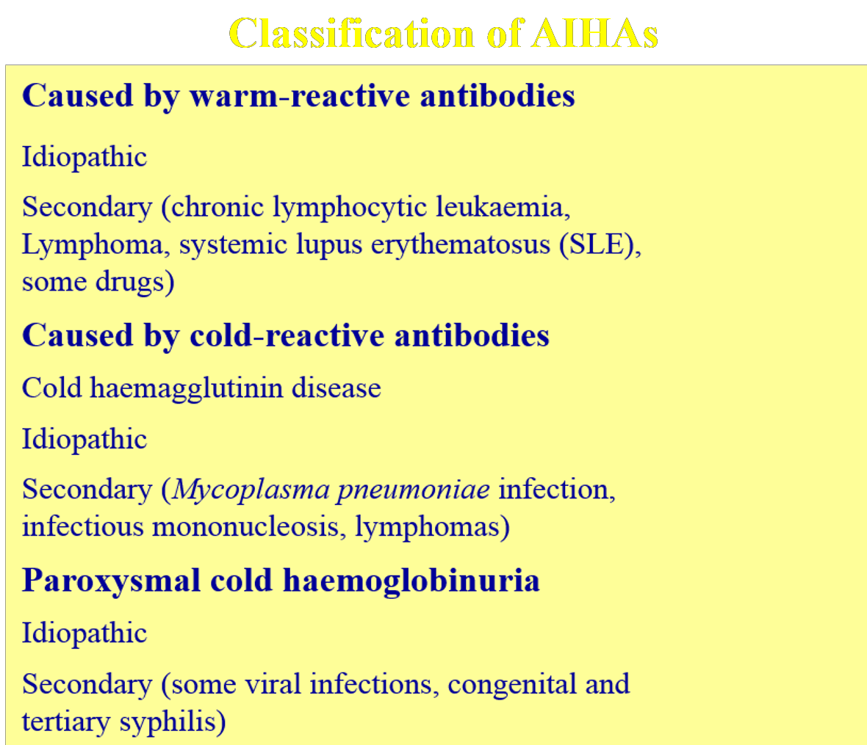

Slide 48
Warm AIHA
In idiopathic warm AIHA, haemolysis dominates the clinical picture and no evidence can be found of any other disease.
In secondary AIHA, the haemolysis is associated with a primary disease such as chronic lymphocytic leukaemia or systemic lupus erythematosus (SLE).
The antibody-coated red cells undergo partial or complete phagocytosis in the spleen and by the Kupffer cells of the liver. There may be partial activation of the complement cascade.

Slide 49
cont’d…
Haematological findings include anaemia, spherocytosis, reticulocytosis and occasional nucleated red cells in the peripheral blood. The critical diagnostic investigation is the direct antiglobulin test.
Haemolysis can be limited by treatment with
prednisolone.
If reduction in haemolysis is not maintained when the dose of steroids is lowered, splenectomy or alternative immunosuppressive therapy should be considered.
The anti-CD20 monoclonal antibody rituximab, as well as immunosuppressants such as azathioprine or cyclophosphamide, may be beneficial in reducing autoantibody production.

Slide 50
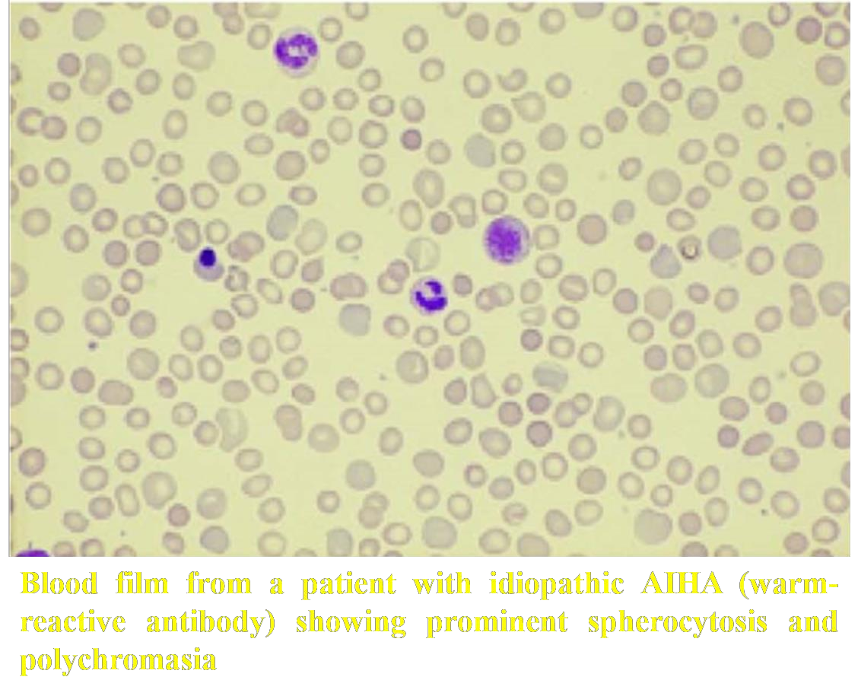

Slide 51
Cold haemagglutinin disease (CHAD)
Since cold antibodies react with red cells only at temperatures below about 32ºC, they typically bind to the red cell surface in the cooler superficial blood vessels of the peripheries.
Since the cold antibodies are typically of the IgM subtype, their pentameric structure permits direct agglutination of red cells coated with antibody; they are therefore sometimes termed cold agglutinins.
Symptoms due to cold AIHA are worse during cold weather. Exposure to cold provokes acrocyanosis, due to the formation of agglutinates of red cells in the vessels of the skin.

Slide 52
cont’d…
The direct activation of the complement system leads to red cells lysis and, consequently, to haemoglobinaemia and haemoglobinuria.
Chronic idiopathic CHAD is managed initially simply by keeping the patient warm.
Treatment with rituximab may be effective.
Other causes of haemolytic anaemia with an immune element include: 1) paroxysmal nocturnal haemoglobinuria; 2) paroxysmal cold haemoglobinuria;
3) drug-related haemolytic anaemias.

Slide 53
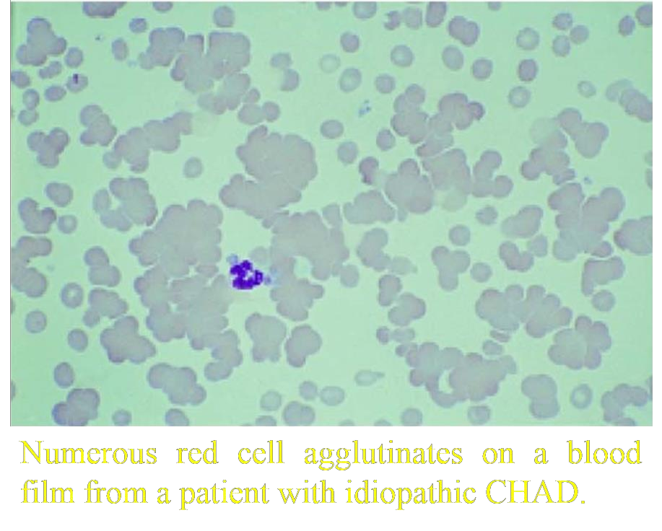

Slide 54
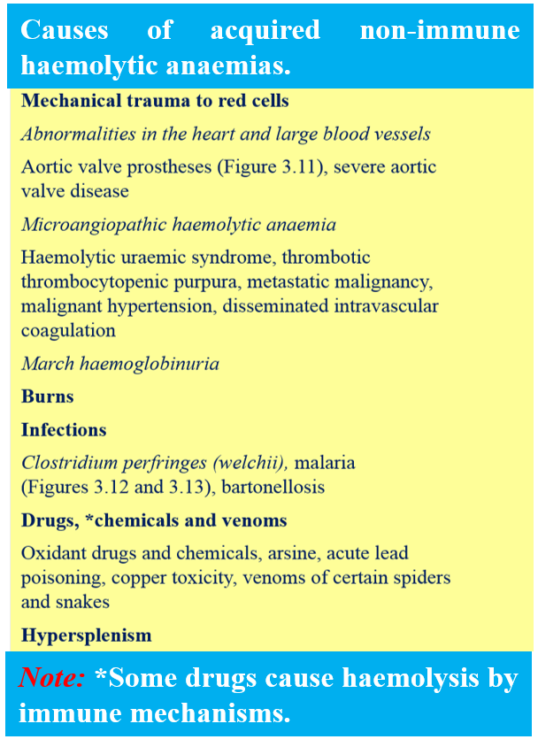

Slide 55
Non-immune haemolytic anaemias
Mechanical damage to red cells
Several of the mechanical causes of acquired non- immune haemolytic anaemia are summarized in Table
3.3. Red cells are mechanically damaged when they impact upon abnormal surfaces. In disseminated intravascular coagulation inappropriate activation of the coagulation cascade produces fibrin strands which are thought to cause mechanical destruction of red cells. Such damage usually results in the presence of red cell fragments in the blood film.

Slide 56
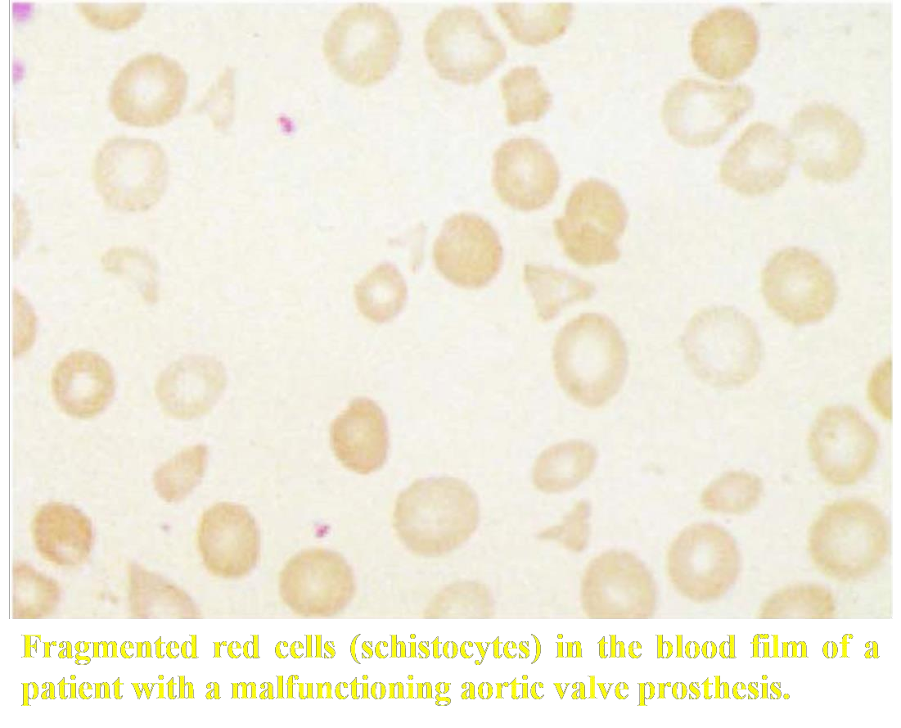

Slide 57
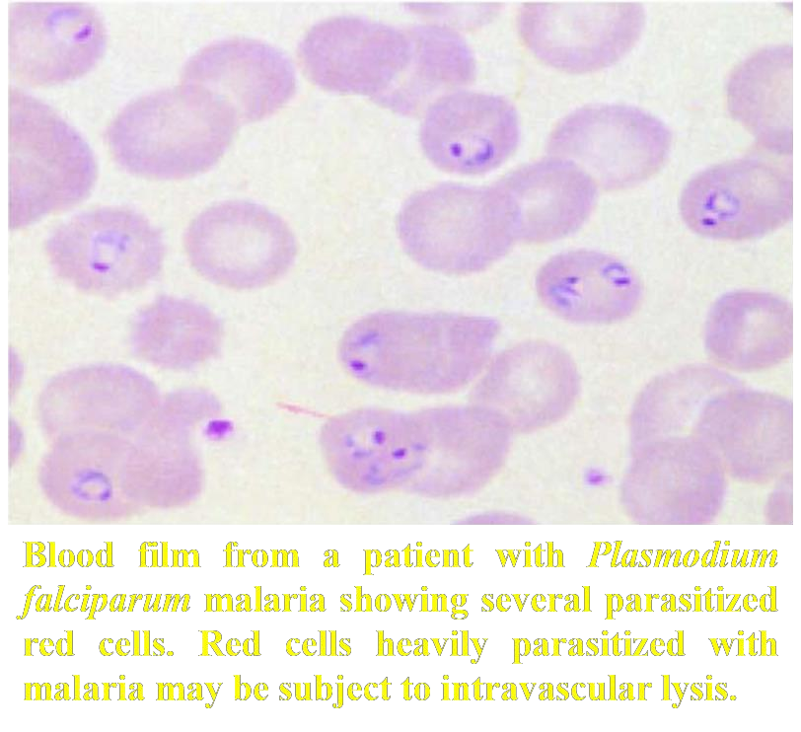

Slide 58
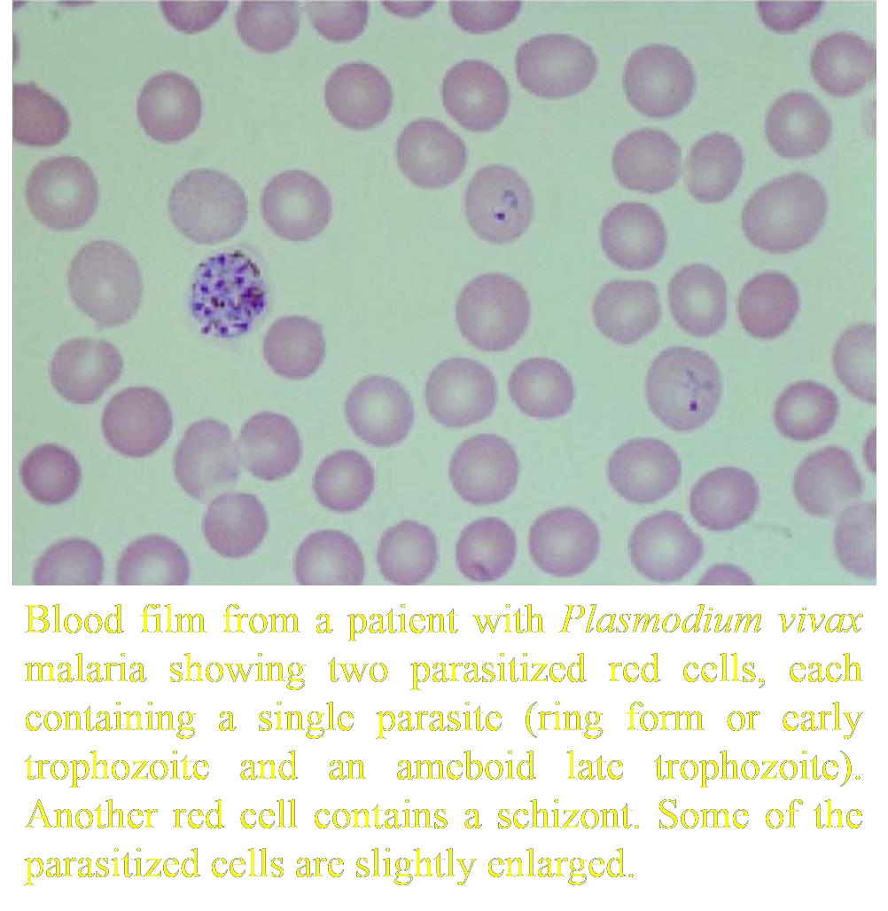

Slide 59
Hypersplenism
Hypersplenism describes the reduction in the lifespan of red cells, granulocytes and platelets
that may be found splenomegaly due to
in patients with any cause. The
cytopenias found in patients with enlarged spleens are also partly caused by increased pooling of blood cells within the spleen.

Slide 60

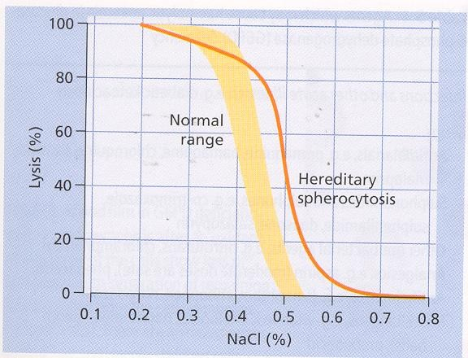

Slide 61

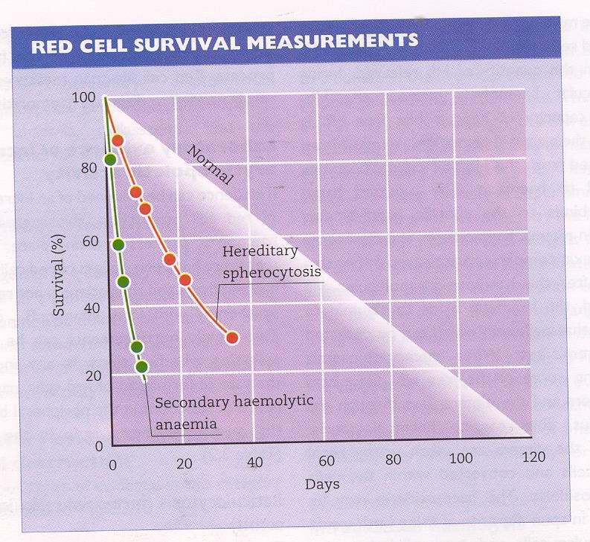

Slide 62

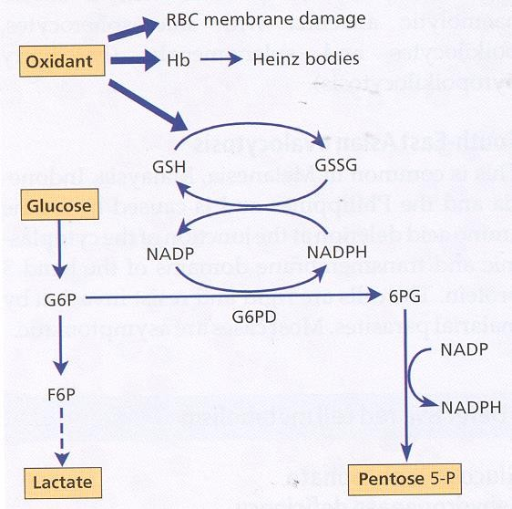

Slide 63
Abnormal Haemoglobins (Haemoglobinopathies)

Slide 64


Slide 65


Slide 66
Some Known Haemoglobin Mutants
NAME | SUBSTITUTION
Hb. S | α2 β2 6 GLU → VAL
Hb. C | α2 β2 6 GLU → LYS
Hb. E | α2 β2 26 GLU → LYS
Hb. O ARAB | α2 β2 121 GLU → LYS
Hb. D PUNJAB | α2 β2 121 GLU →GLN
Hb RIYADH | α2 β2 120 LYS → ASN
Hb. HAMMERSMITH | α2 β2 42 PHE → SER
Hb. N. BALTIMORE | α2 β2 95 LYS → GLU
Hb. KORLE-BU | α2 β2 73 ASP → ASN
Hb. K. WOOLWICH | α2 β2 132 LYS → GLN
Hb. K. IBADAN | α2 β2 46 GLY → GLU
Hb. KÖ LN | α2 β2 98 VAL → MET
Hb. J. BALTIMORE | α2 β2 16 GLY → ASP

Slide 67
Some Known Haemoglobin Mutants
NAME | SUBSTITUTION
Hb. G. PHILADELPHIA | α2 68 ASN → LYS β2
Hb. ZAMBIA | α2 60 LYS → ASN β2
Hb. G. CHINESE | α2 30 GLU → GLN β2
Hb. HASHARON | α2 47 ASP → HIS β2
Hb. J. TONGARIKI | α2 115 ALA → ASP β2
Hb. J. OXFORD | α2 15 GLY → ASP β2
Hb. NORFOLK | α2 57 GLY → ASP β2

Slide 68
DNA Coding for the Amino-Acid in the sixth position in the β-chain
Normal
Amino Acid
DNA Base Composition
5
pro
6
glu
7
glu
CCT G A G
G A G
Sickle
DNA Base composition
Amino Acid
CCT G T G
G A G
pro
5
val
6
glu
7

Slide 69
+ + - - +-
HbA…Val – His – Leu – Thr – Pro – Glu – Glu – Lys …
+ + - +-
HbS … Val – His – Leu – Thr – Pro – Val – Glu – Lys …
+ + +- +- +-
HbC … Val – His – Leu – Thr – Pro – Lys Glu – Lys …
Amino acid sequences of the peptides 4 in haemoglobins A,
S and C.

Slide 70
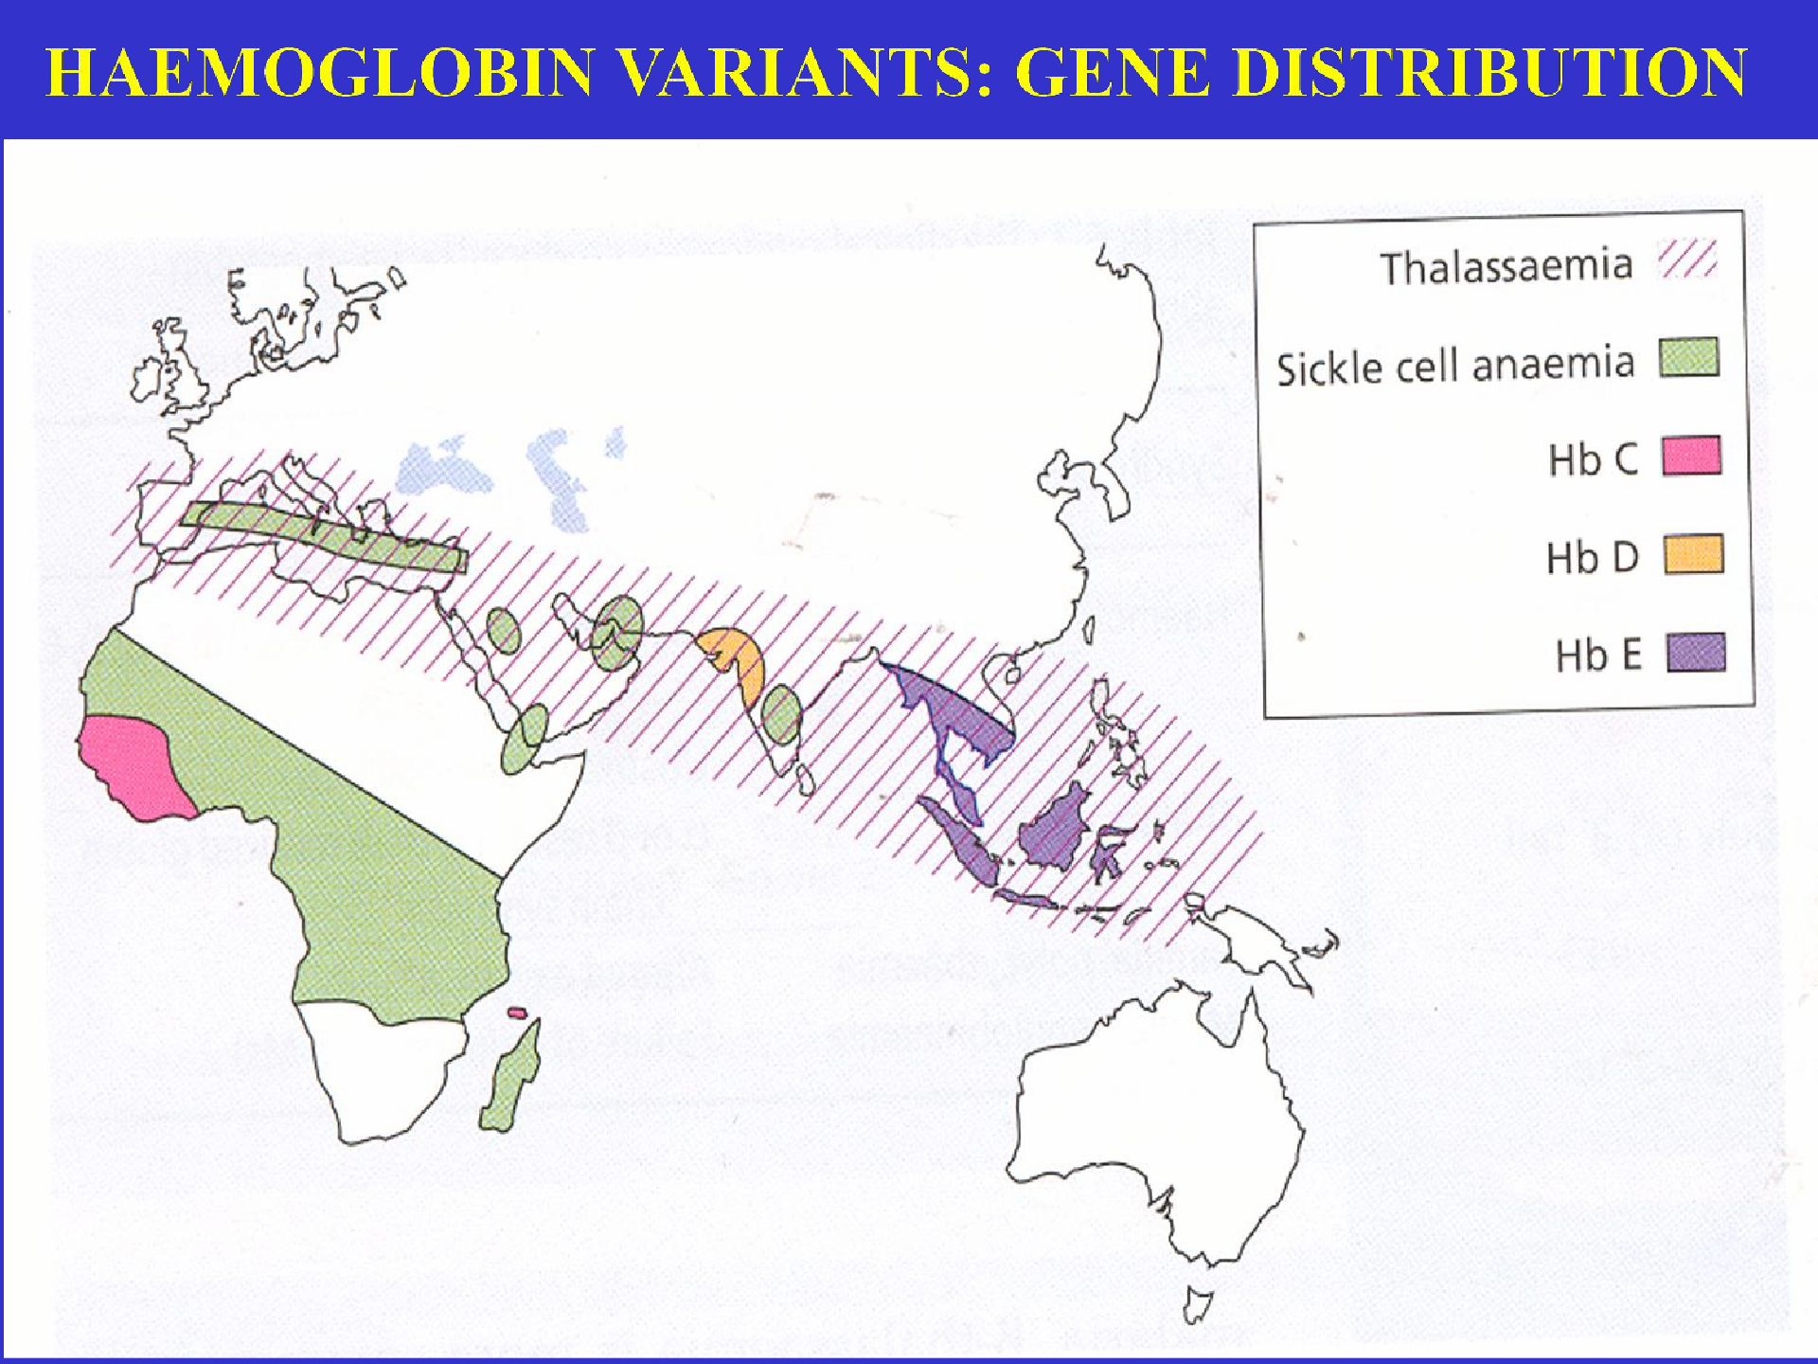

Slide 71







SICKLE CELL DISEASE
By:
DR. SHIHAB AL-MASHHADANI
Consultant Haematologist Head of Haematology Division Associate Professor Department of Pathology College of Medicine
King Saud University

Slide 73


Slide 74
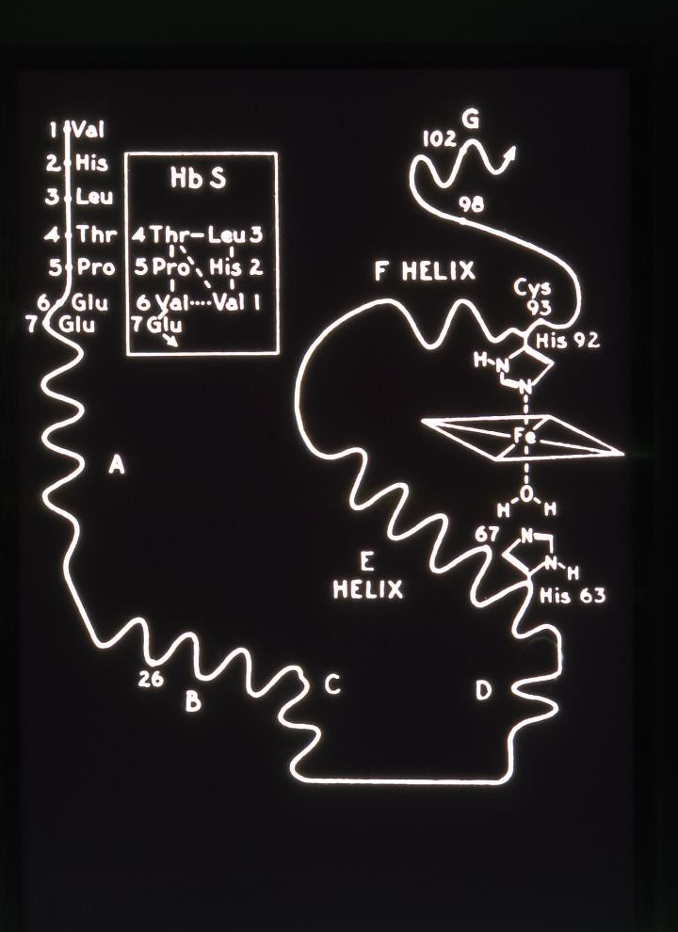

Slide 75
DNA Coding for the Amino-Acid in the sixth position in the β-chain
Normal
Amino Acid
DNA Base Composition
5
pro
6
glu
7
glu
CCT G A G
G A G
Sickle
DNA Base composition
Amino Acid
CCT
pro
G _{T} G G A G
glu
val
5
6
7

Slide 76
1910
₁st
published report of sickle cell
anaemia (Herrick)
1949
Pauling et al : chemical difference between HbA and HbS
1956
Ingram: Fingerprinting
βglu val

Slide 77

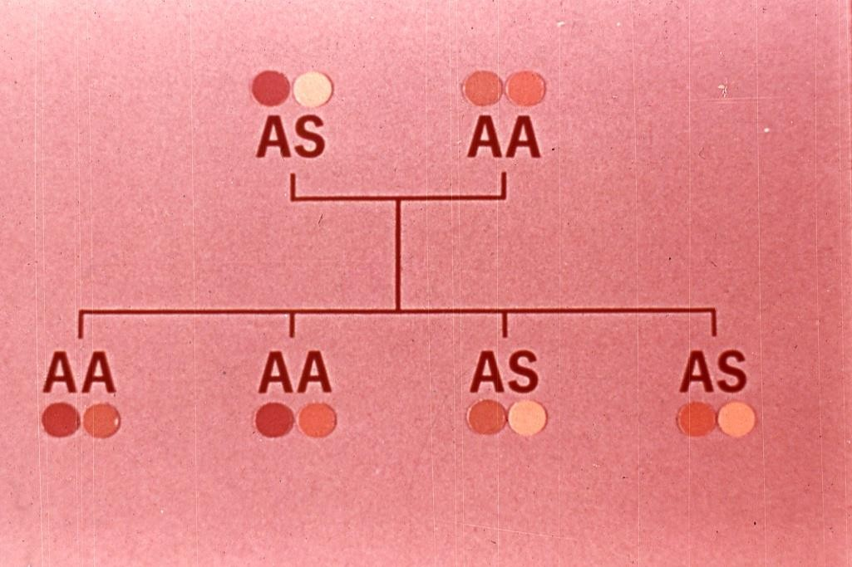

Slide 78

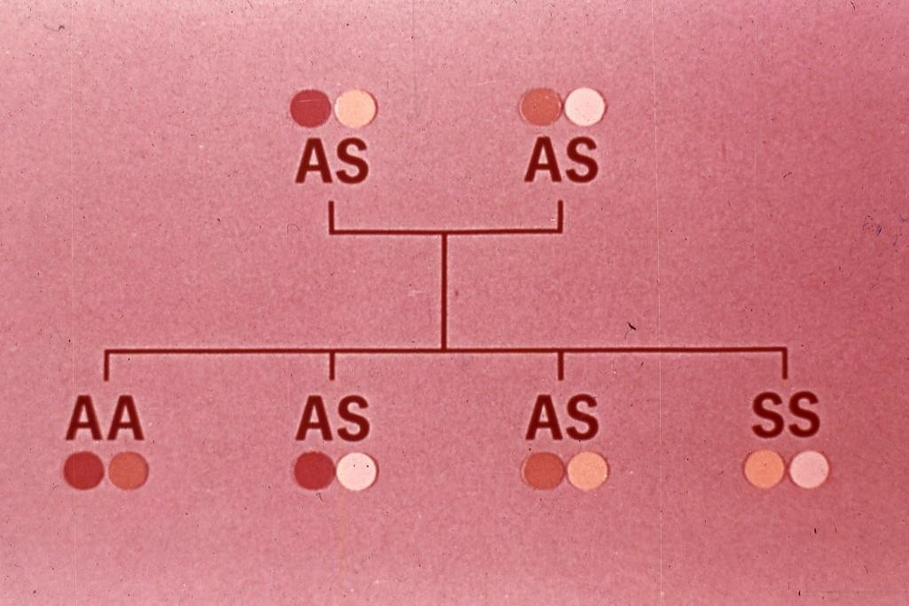

Slide 79

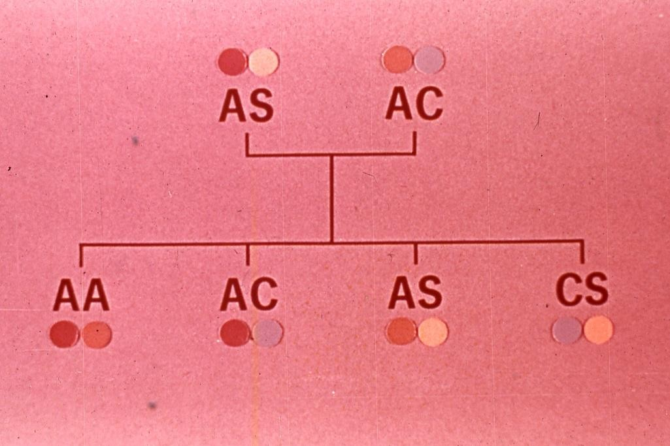

Slide 80

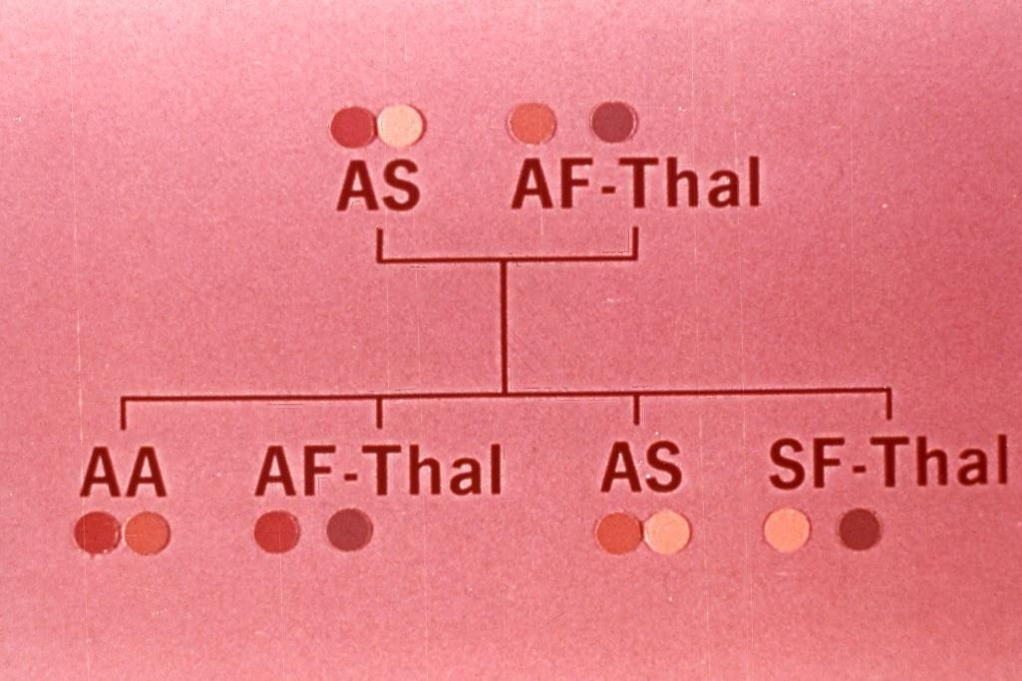

Slide 81

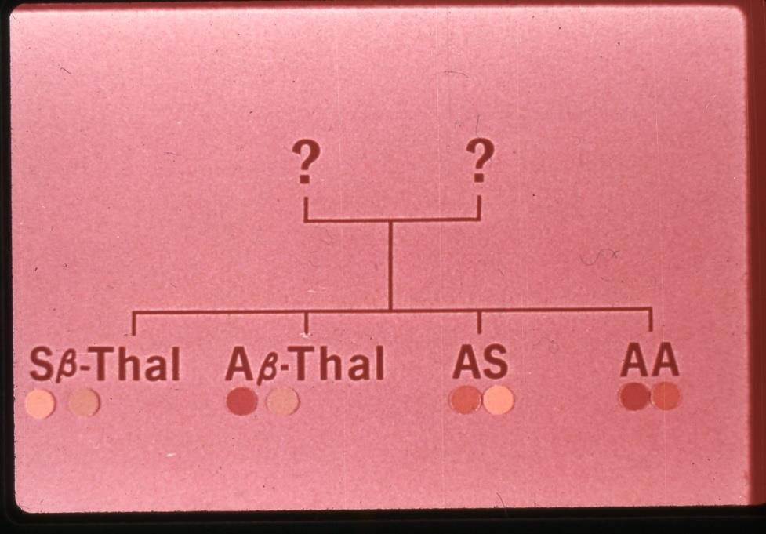

Slide 82
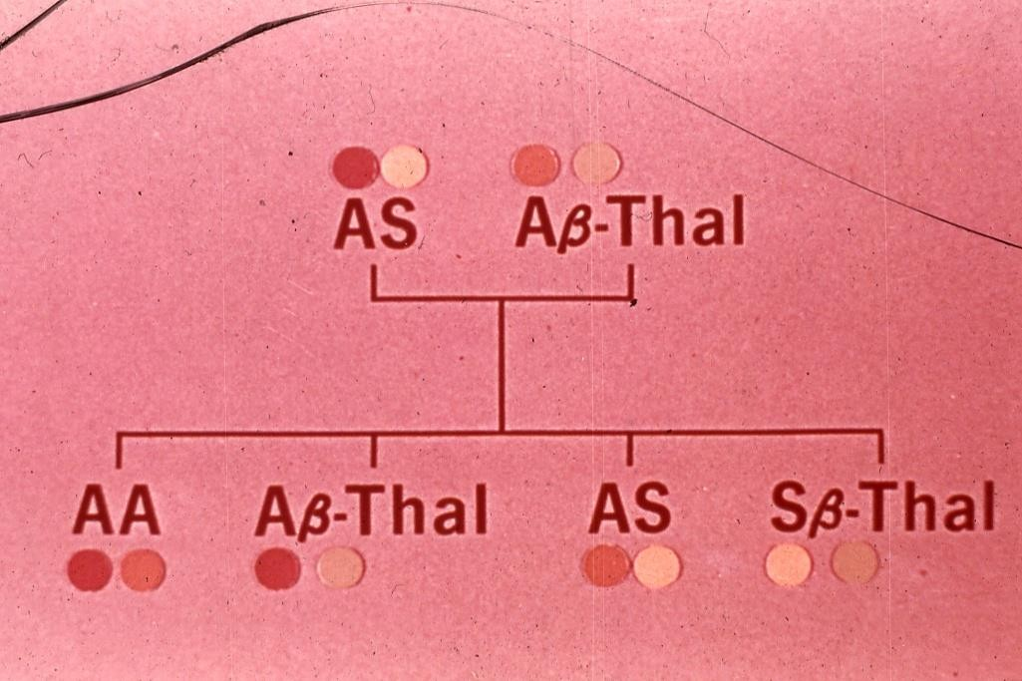

Slide 83
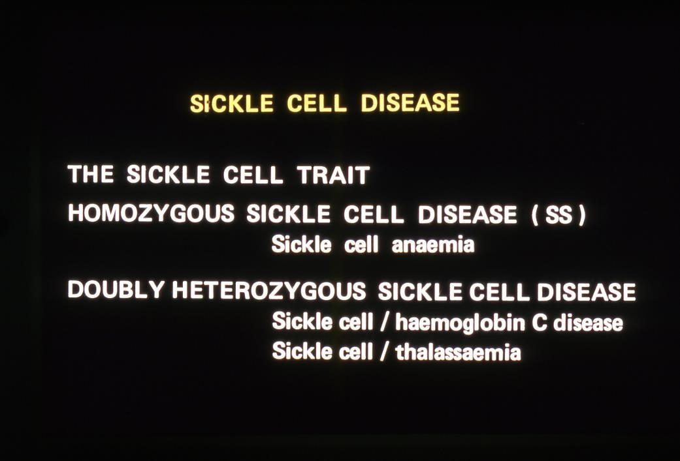

Slide 84
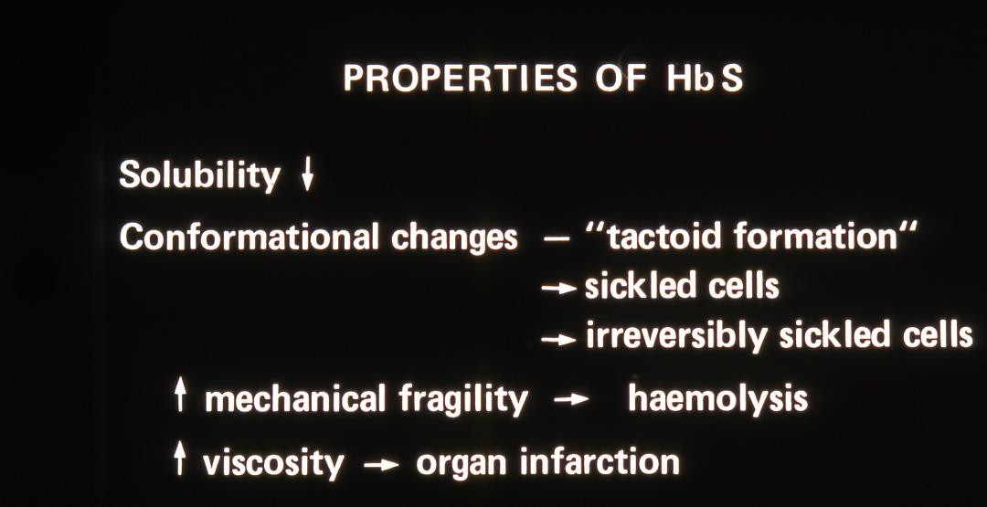

Slide 85
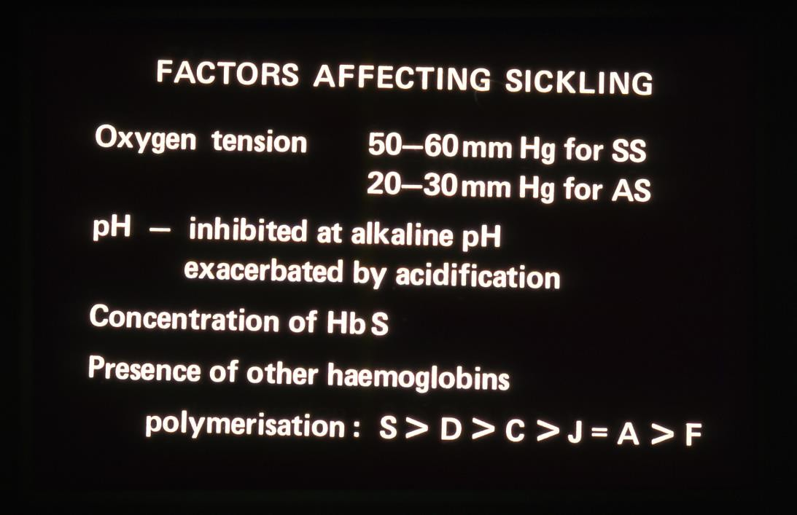

Slide 86
Sickling at low O₂ tension
Increased
Viscosity
PH
Low O₂ tension
Slow
blood flow

Slide 87
FACTORS PRECIPITATING CRISES
IN SICKLE CELL DISEASE
INFECTIONS (especially malaria)
PYREXIA
EXPOSURE TO COLD
DEHYDRATION
PREGNANCY

Slide 88

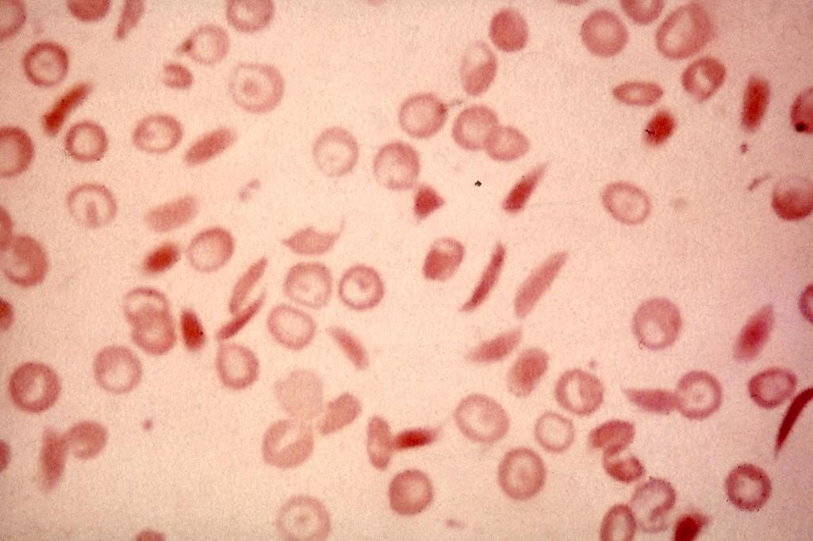

Slide 89

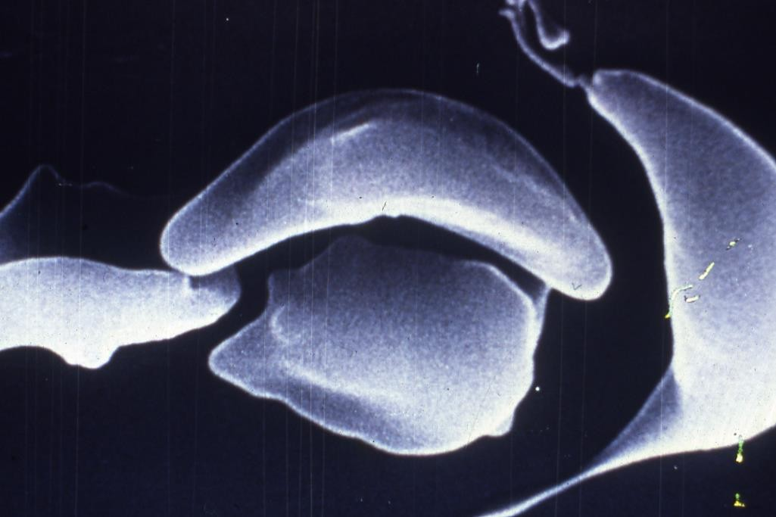

Slide 90

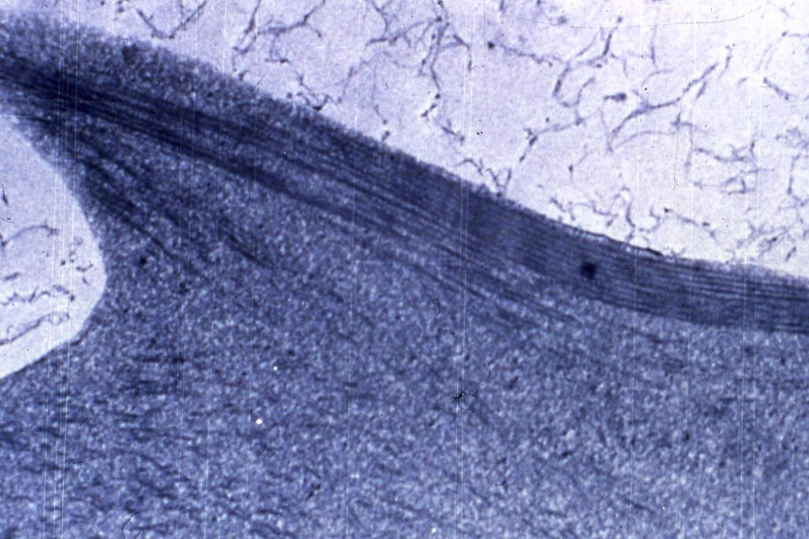

Slide 91
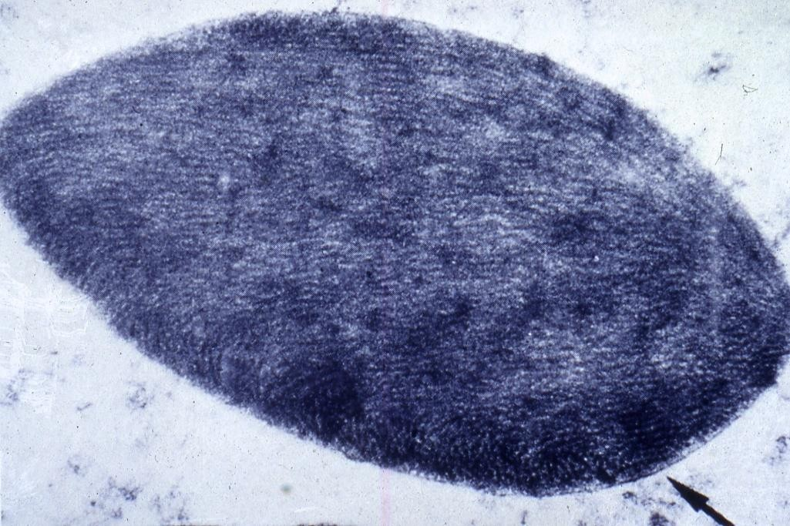

Slide 92

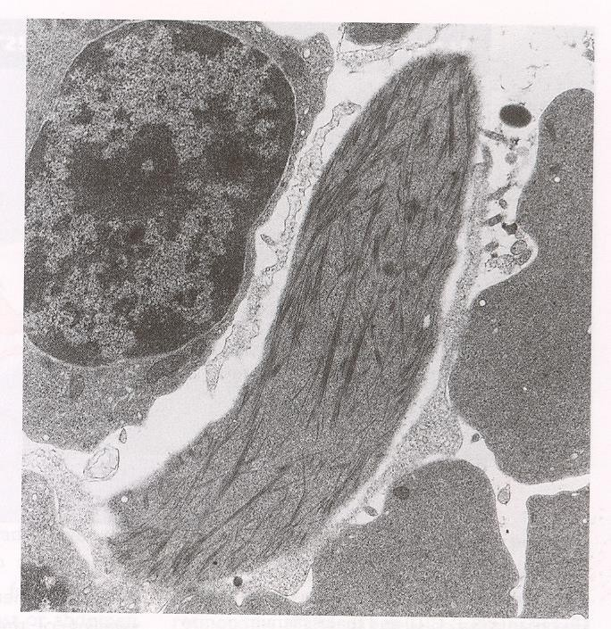

Slide 94

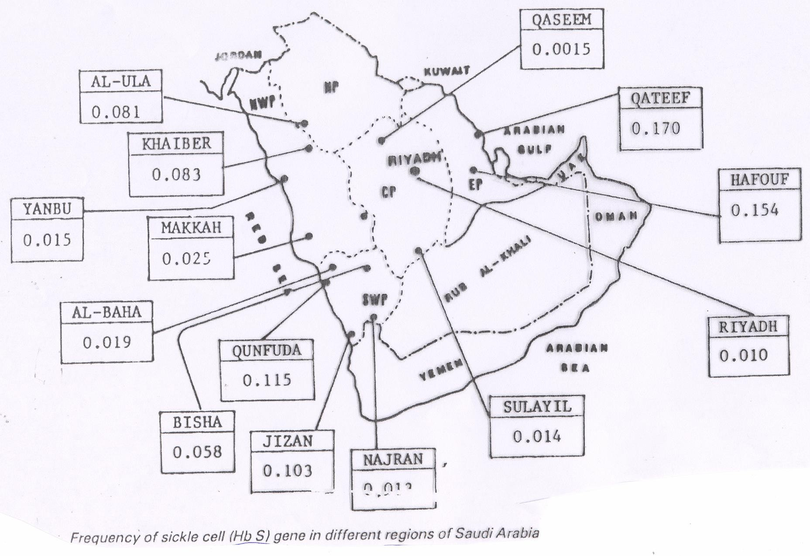

Slide 95
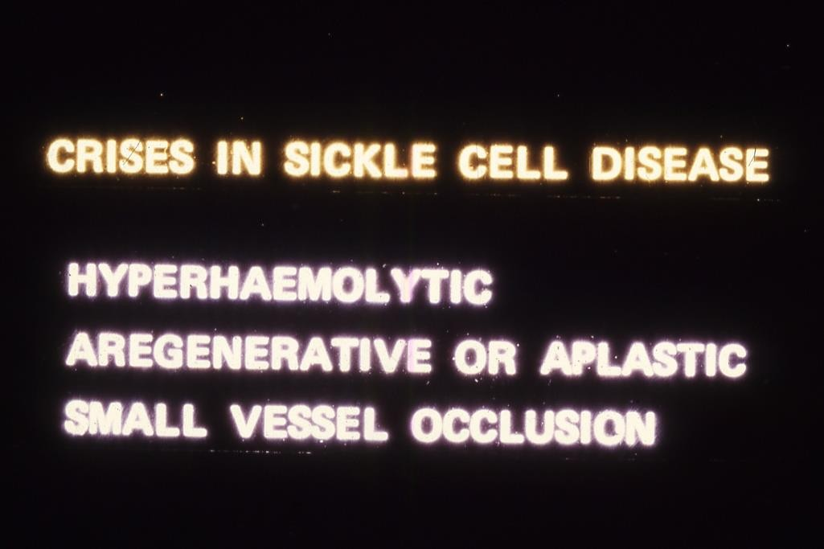

Slide 96
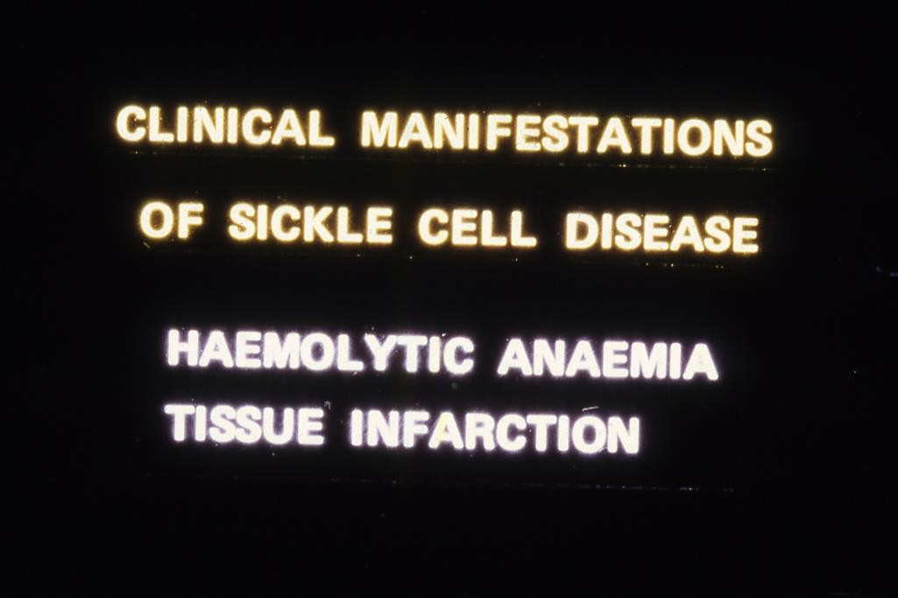

Slide 97
Clinical Manifestations in Sickle Anaemia
Pallor (Anaemia)
Jaundice & Dark Urine
Apathy & Anorexia
Hand-Foot Syndrome (Young Children)
Splenic sequestration (Young children) Hepatic
Sequestration
Bones and Joints Pain
Abdominal Pain

Slide 98
Clinical Manifestations in Sickle Anaemia
Recurrent Infections & Chest Symptoms (Acute Chest
Syndrome)
Hepato-Splenomegaly
(Early Childhood)
(Association with Thalassaemias)
CNS Presentations
Leg Ulceration
Skeletal Deformity

Slide 99

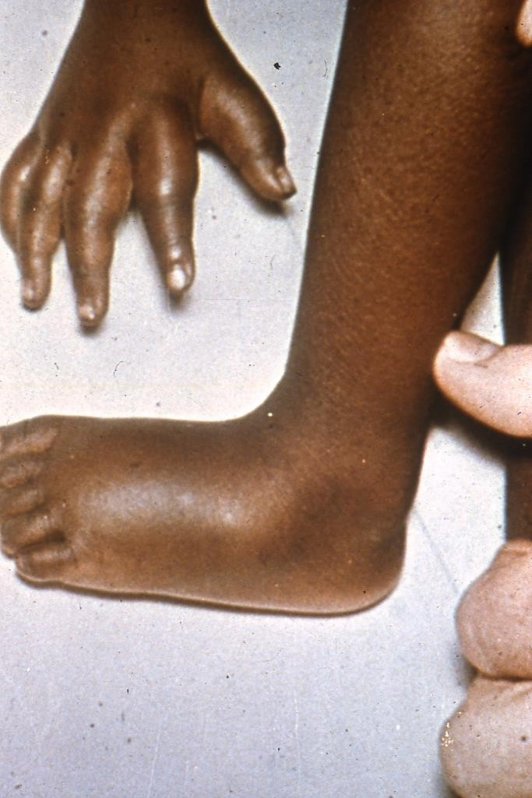
.

Slide 100

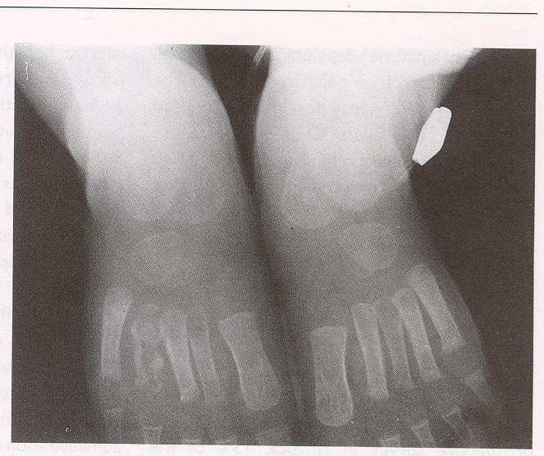

Slide 101

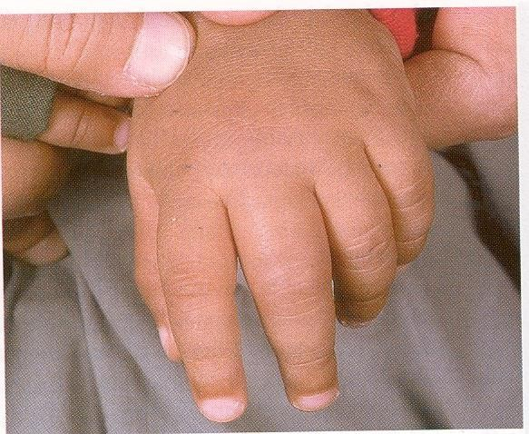

Slide 102

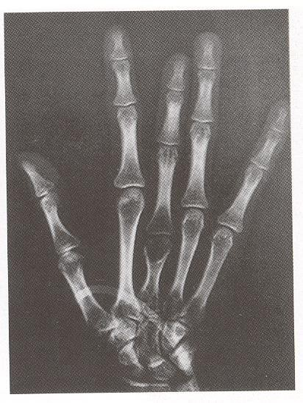

Slide 103


.

Slide 104


.

Slide 105



Slide 106


.

Slide 107


.

Slide 108



Slide 109


.

Slide 110



Slide 111


.

Slide 112


.

Slide 113


.

Slide 114



Slide 115


.

Slide 116
Laboratory Diagnosis of Sickle Cell Disease
CBC
Blood Film
Sickle Solubility Test
Hb Electrophoresis
Genetic Study

Slide 117


.

Slide 118



Slide 119
Indications for Blood Transfusion in Sickle Cell Anaemia
Splenic sequestration
Hepatic sequestration
Aplastic crisis
Overwhelming infections
Elective or emergency surgical operation
Severe painful crisis associated with severe
haemolysis
Pregnancy

Slide 120
Indications for exchange transfusion
Strokes
Pulmonary infarcts with infection
Pregnancy crisis)
Priapism
(Severe persistent
painful
Preparation for major surgery

Slide 121



