Slide 1
APPROACH TO BLEEDING
DISORDERS
BY:
DR. FATMA AL-QAHTANI ASSISTANT PROFESSOR AND CONSULTANT HAEMATOPATHOLOGIST
HEAD OF HAEMATOPATHOLOGY DIVISION DEPARTMENT OF PATHOLOGY
COLLEGE OF MEDICINE KING SAUD UNIVERSITY

Slide 2


LEARNING OBJECTIVES
To know the function of platelets and the relationship between the platelet count in peripheral blood and the extent of abnormal bleeding.
To know about the diseases associated with
  a failure of platelet production
  a shortened platelet lifespan, especially immune
thrombocytopenic purpura (ITP).
To know the principles of investigation of patient
suspected of having a haemostatic defect.

Slide 3
cont’d…
To understand the role of platelets, blood vessel wall
and coagulation factors in normal haemostasis.
To know the classification of haemostatic defects.
To know the platelet morphology and life span.
To know the platelet function and diseases due to
platelet function disorders.
To know the causes of thrombocytopenic purpura
and non-thrombocytopenic purpura.

Slide 4
Investigations of Bleeding
Disorders
Clinical Features:
Complaints
Full Clinical Examinations
History of Bleeding
Family History of Bleeding
If bleeding present, what is the pattern of bleeding episodes

Slide 5
Clinical distinction can frequently be made between bleeding due to platelet defects and (in number or function) and clotting defects (coagulation defects) .
a. Patient
with
platelets
defects or
blood vessel
wall
defects usually present with
superficial bleeding into
the skin (purpura) and from epithelial surfaces of
organs. This is called (mucocutaneous bleeding).
b. Patients
with
clotting
defects
(coagulation factors
deficiencies) usually
present with bleeding into deep
tissue and muscles (haematomas) and joints (haemarthrosis) this is called musculoskeletal bleeding.

Slide 6
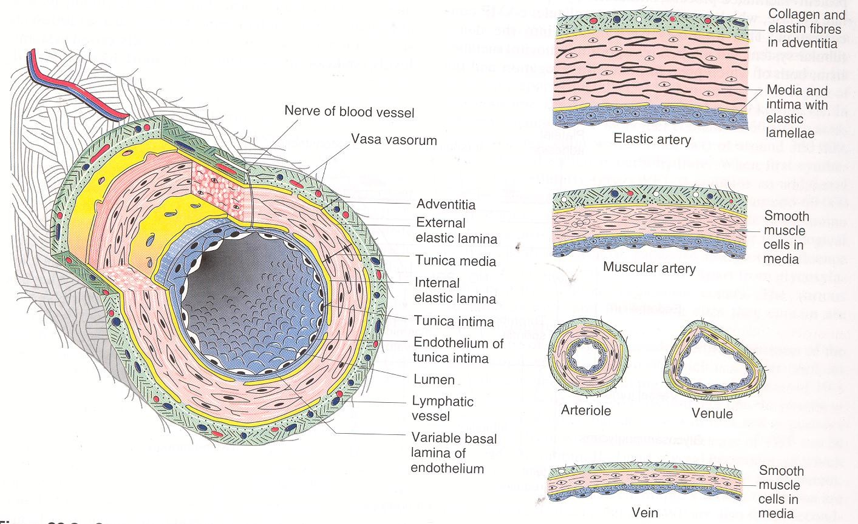

Slide 7
NORMAL HAEMOSTASIS:
The cessation of bleeding following trauma
to blood vessel is result from three processes:
1.) The contractions of vessel walls.
2.) The formation of the platelets plug at the site of the break in the vessel wall.
3.) The formation of a fibrin clot within and
around the platelet aggregates.

Slide 8
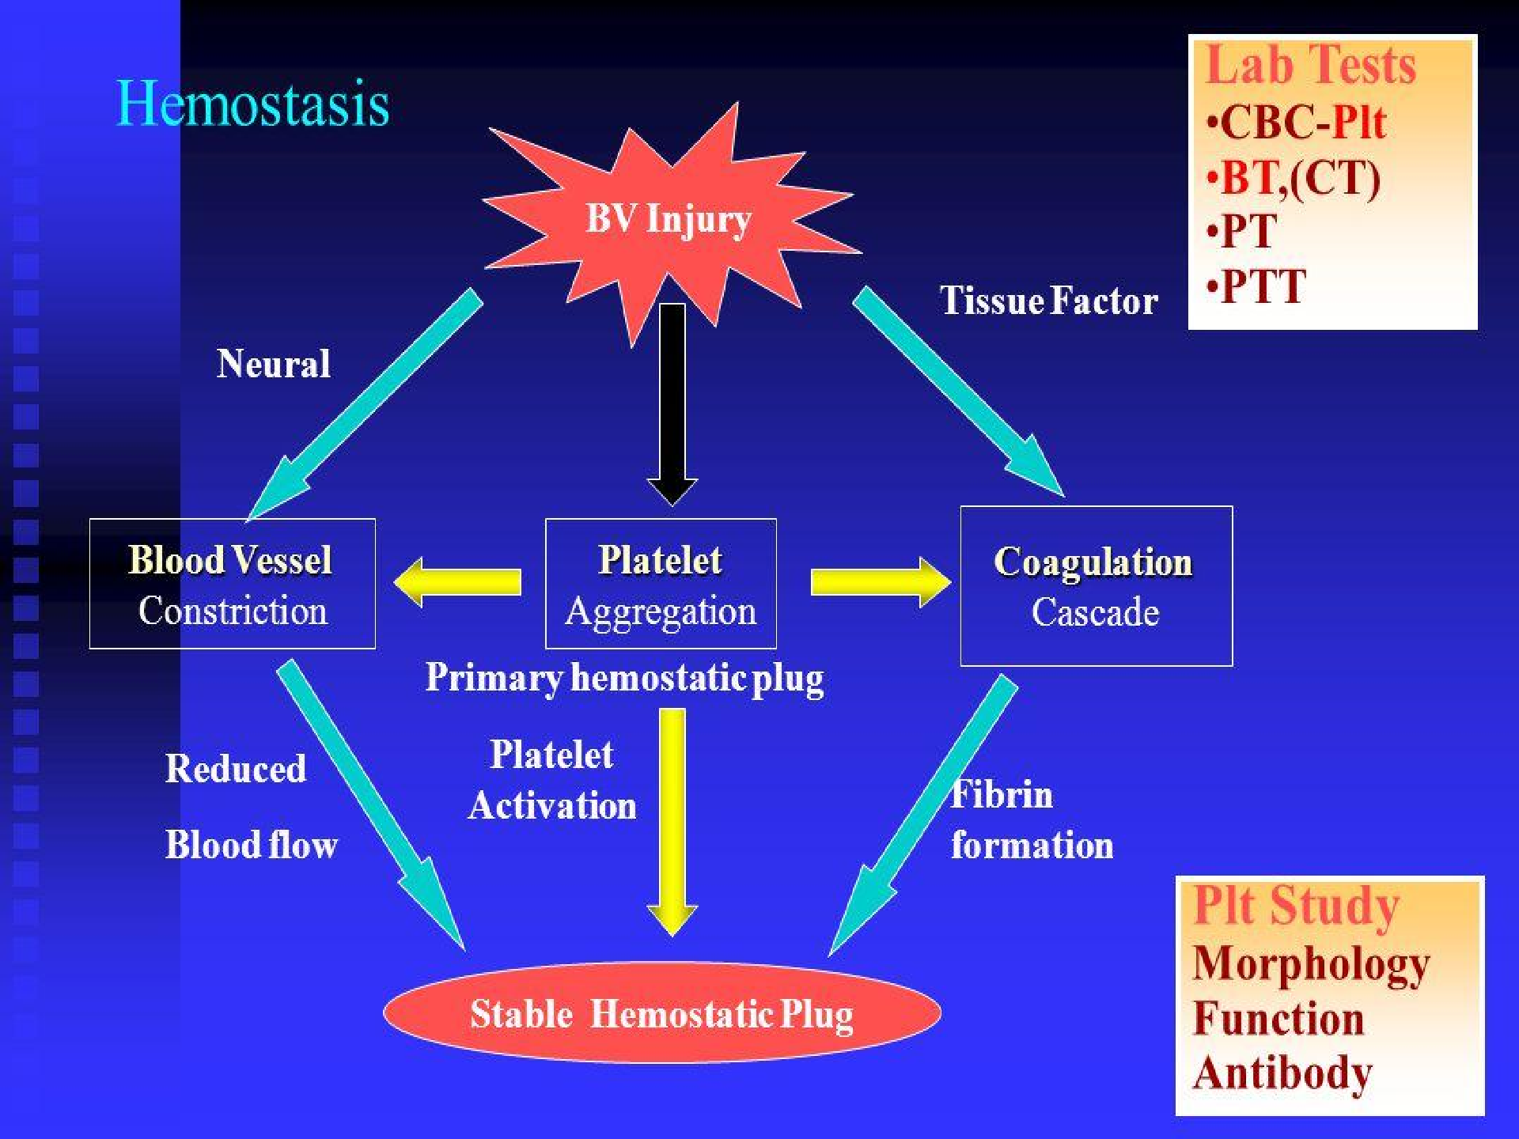

Slide 9
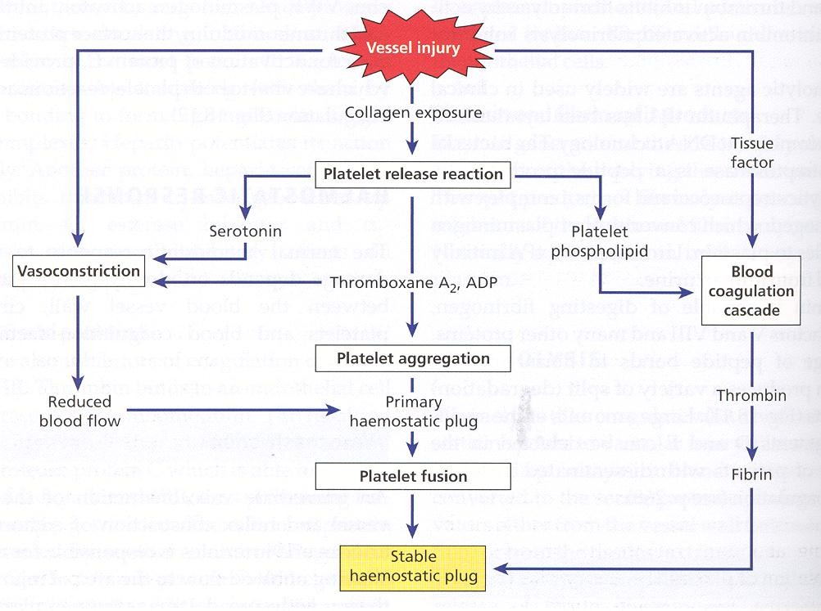

Slide 10
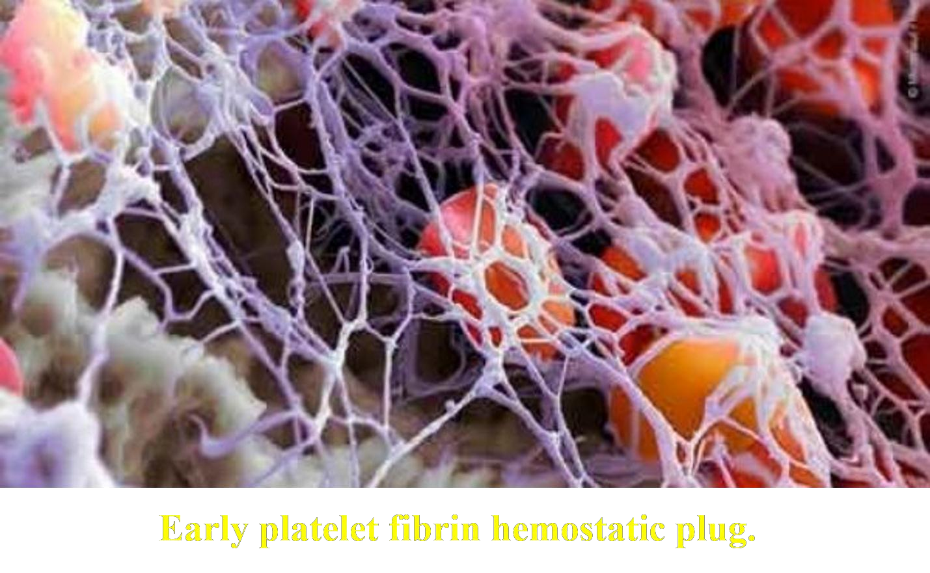

Slide 11
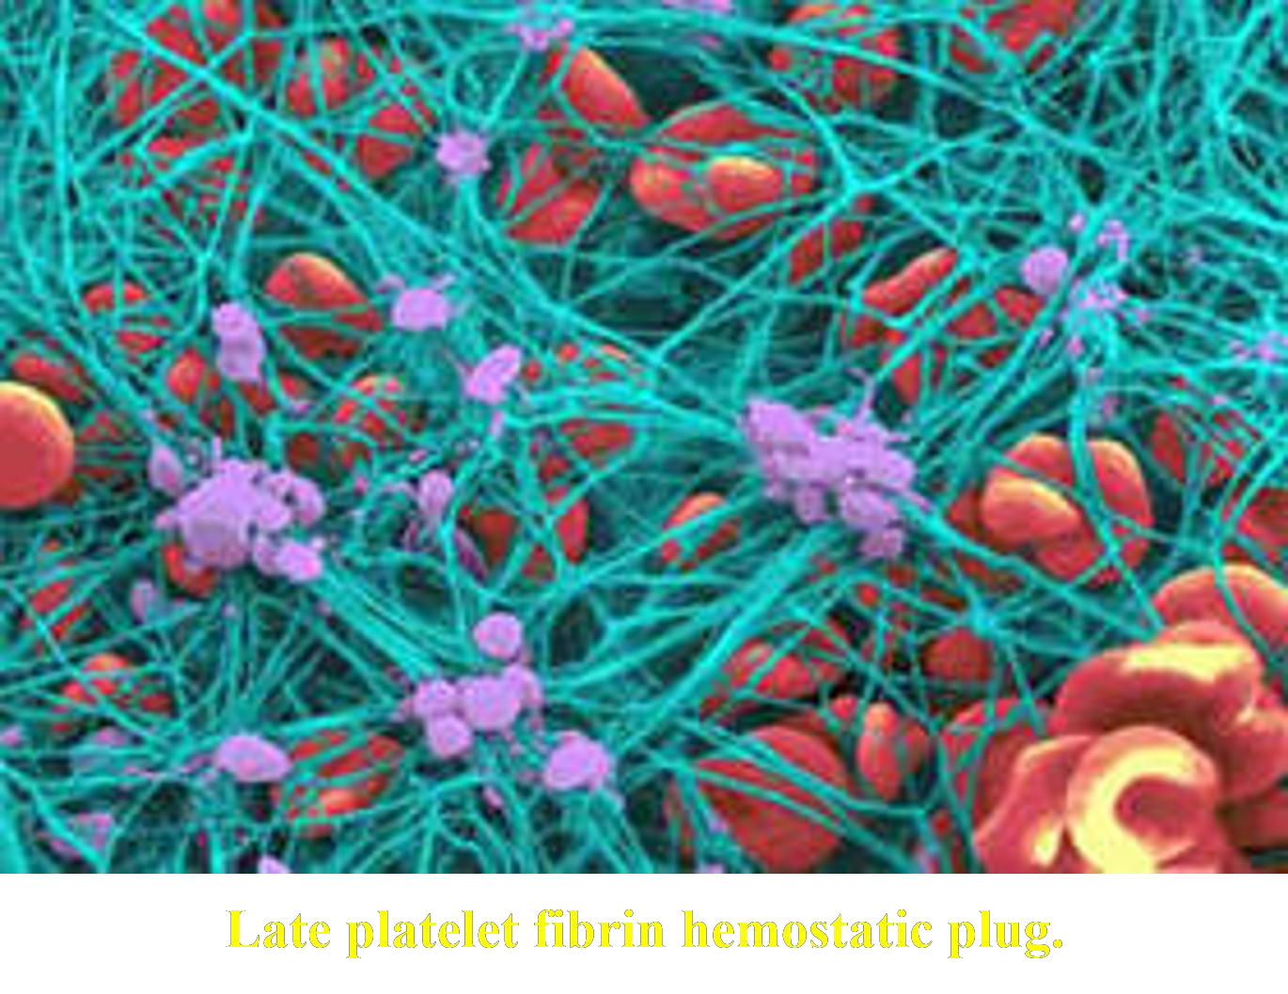

Slide 12
Physiology
The main
function of platelets is
the formation of a
haemostatic plug at sites of damage to vascular endothelium.
The platelets are also
prostaglandin, thromboxane
stimulated
to produce the
arachidonic acid
A₂ from
derived from the cell membrane. The release of ADP and thromboxane A₂ causes an interaction of other platelets with the adherent platelets and with each other (secondary platelet aggregation), thus leading to the formation of a platelet plug (primary haemostasis).
At the site of injury, tissue factor (TF) is expressed and the TF-VIIa complex initiates the formation of a fibrin clot within and around the platelet plug (secondary haemostasis)
Platelets are also responsible for the contraction of the fibrin
clot once it has been formed.

Slide 13
Classification of haemostatic defects
The action of platelets and the clotting mechanism are closely intertwined in the prevention of bleeding. However, bleeding arise from defects in one of the three processes:
Thrombocytopenia (a low platelet count) (the commonest cause).
Abnormal platelet function.
A defect in the clotting mechanism (the second commonest cause).
Patients with clotting defects usually present with bleeding into deep tissues; that is, muscles or joints. Patients with a deficiency of platelets usually present with mucocutaneous bleeding; that is, bleeding into the skin and from the epithelial surfaces of the nose, uterus and other organs.

Slide 14
cont’d…
Petechial haemorrhages and ecchymoses and bleeding from other sites may occur when the number of platelets falls below 50 X 10⁹/L. At levels between 20 and 50 X 10⁹/L, petechiae, ecchymoses and nose bleeds are the commonest symptoms, but below 20 X 10⁹/L, gross haemorrhage (melaena, haematemesis, haematuria) becomes increasingly common.

Slide 15
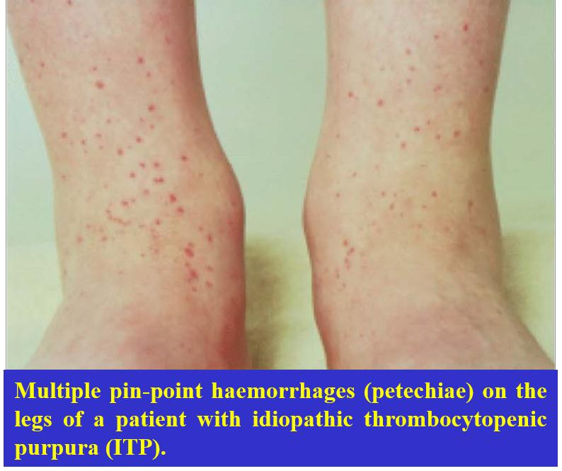

Slide 16
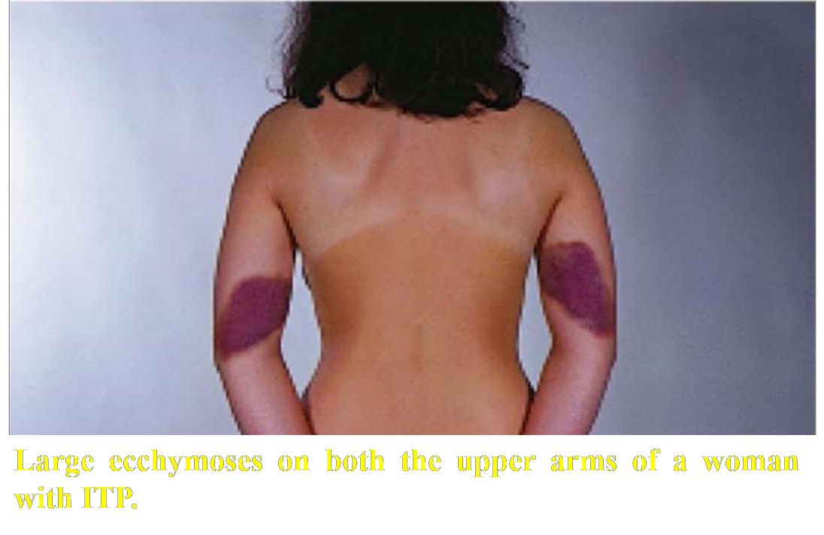

Slide 17
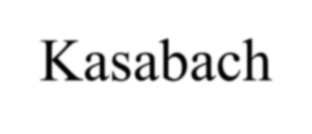
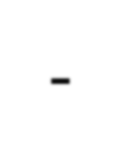
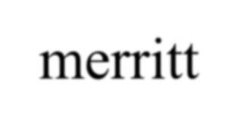

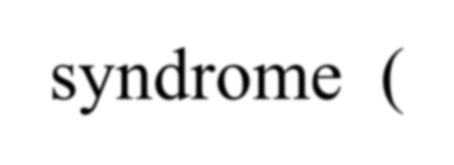
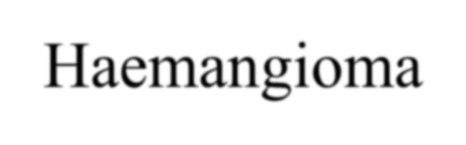

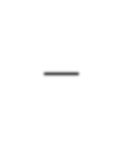

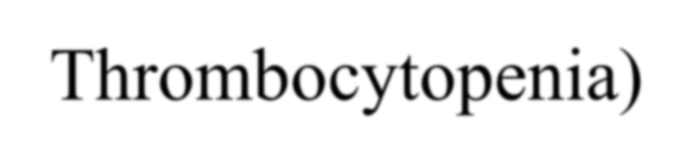
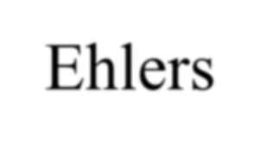
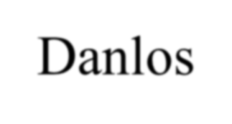
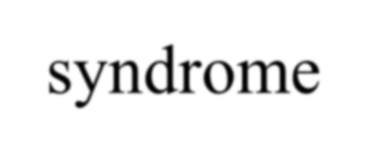
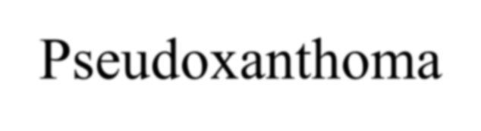
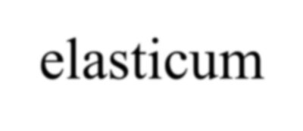
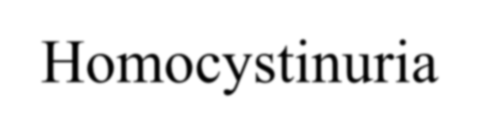
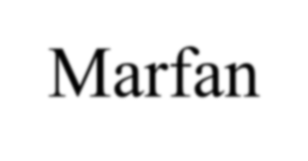
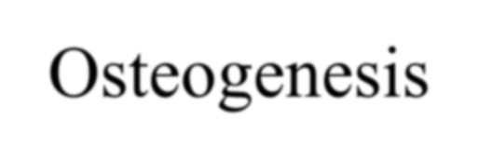
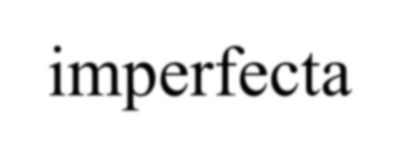

Hereditary Vascular Disorders
Hereditary Haemorrhagic Telangiectasia (Rendu-weber-
osler syndrome)
Kasabach-merritt syndrome (Haemangioma – Thrombocytopenia)
Ehlers-Danlos syndrome
Pseudoxanthoma elasticum
Homocystinuria
Marfan syndrome
Osteogenesis imperfecta

Slide 18
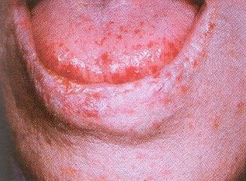
Hereditary Haemorrhagic Telangiectasia

Slide 19
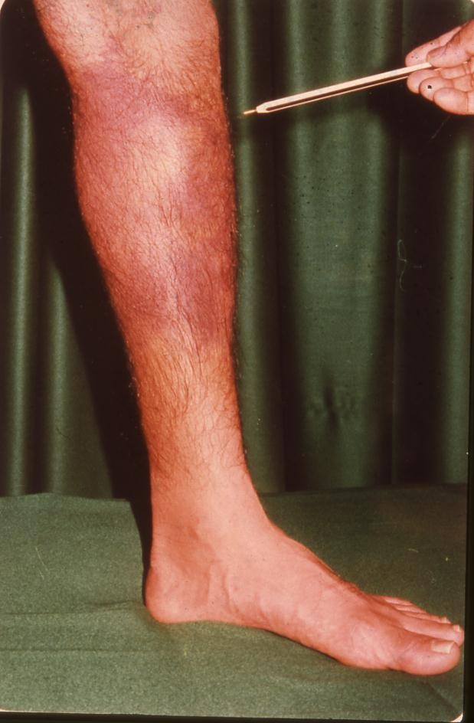
Ehlers-Danlos syndrome

Slide 20
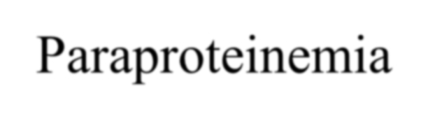
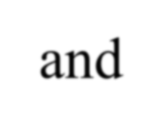
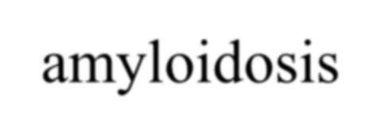

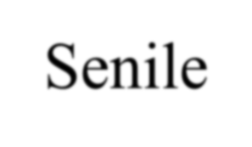
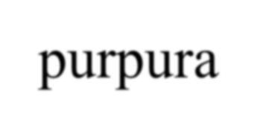
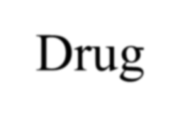
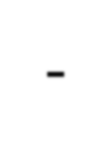
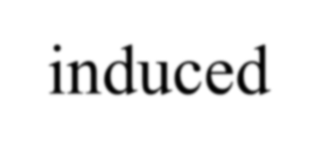

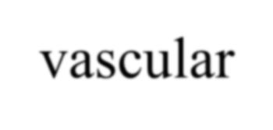
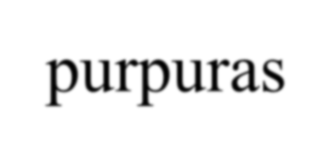

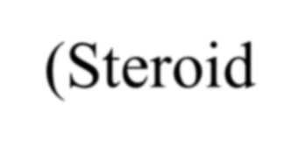
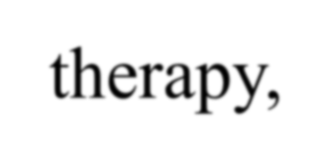

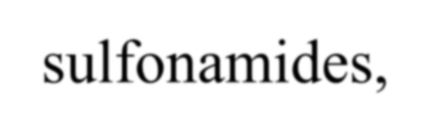

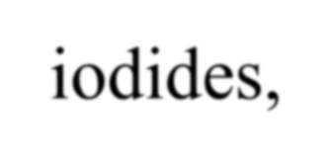
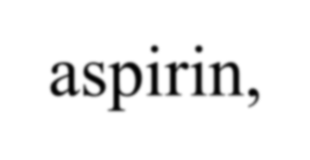
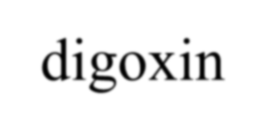

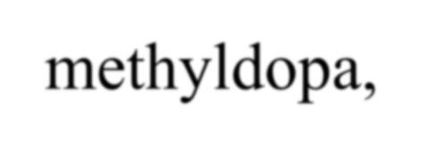
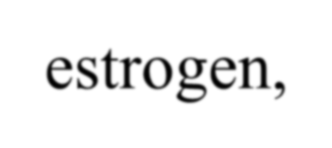

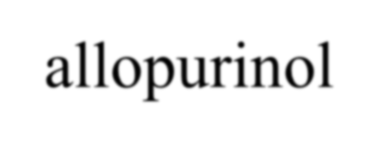

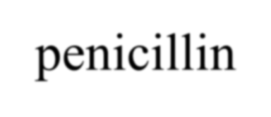
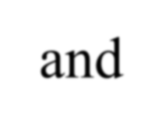
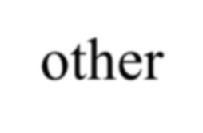
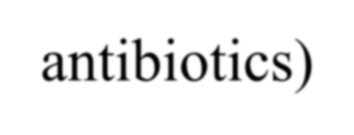

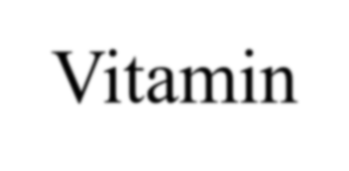
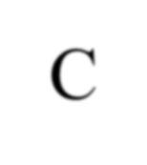














Acquired Vascular Disorders
Allergic purpura (Henoch-Schonlein purpura)
Paraproteinemia and amyloidosis.
Senile purpura
* Drug-induced sulfonamides,
vascular iodides,
purpuras (Steroid therapy, aspirin, digoxin, methyldopa,
estrogen, allopurinol, penicillin and other antibiotics).
Vitamin C Deficiency (Scurvy)
Purpura simplex (Easy brusability)
Psychogenic purpura
Purpura associated with infections.

Slide 21

Allergic purpura (Henoch-Schonlein purpura)

Slide 22




Paraproteinemia and amyloidosis

Slide 23

Senile purpura

Slide 24

Vitamin C deficiency (Scurvy)

Slide 25
THE PLATELETS
NORMAL PLATELET COUNT = 150-450x10⁹/L
NORMAL PLATELET SIZE MPV 7.2-11.1 fl
NORMAL PLATELET DIAMETER 1-3 µ
NORMAL PLATELET LIFE SPAN 7-10 days
PLATELET FORMATION IS BY SEGMENTATION OF THE CYTOPLASM OF THE MEGAKARYOCYTE IN THE BONE MARROW.

Slide 26


Slide 27


Slide 28


Slide 29


Slide 30


Slide 31


Slide 32


Slide 33


Slide 34


Slide 35



Slide 36


Slide 37
Platelet Activation
Stickiness
Shape Change
Internal Contraction
Secretion

Slide 38


Slide 39


Slide 42


Slide 43
Measurements of
Platelet Function

Slide 44
Tests of platelet function
Bleeding time
The bleeding time is estimated by making small wounds in the skin of the forearm after applying a blood pressure cuff to the upper arm and inflating it to 40mmHg; the average time that elapses until bleeding ceases is then measured.
PFA - 100 / PFA - 200
The bleeding time has largely been replaced by an in vitro estimation of primary haemostasis using a machine called a PFA-100.

Slide 45

BLEEDING TIME

Slide 46


Slide 47

PFA - 200

Slide 48
Platelet Aggregation

Slide 49
Platelet aggregation studies
The most
common
whereby
is light
transmission
aggregometry,
the aggregation of
of
platelets is
studied following the addition such as ADP, epinephrine,
substances
arachidonate, collagen and ristocetin to platelet- rich plasma. Aggregation causes an increase in the light transmitted through the sample and the test is performed using special equipment capable of continuously recording light transmission.

Slide 50


Slide 51


Slide 52


Slide 53

MULTIPLATE
Multiple Electrode Aggregometer

Slide 54


Slide 55
HEREDITARY
PLATELET DISORDERS

Slide 56
Inherited disorders of platelet function
Membrane abnormalities
  Bernard – Soluier syndrome
  Thrombasthenia (Glanzmann’s Disease)
  Platelet factor – 3 deficiency
Intracellular abnormalities
Storage-pool (dense body) deficiency
  Hermansky – Pudlak syndrome
  Wiskott – Aldrich syndrome
  Chediak – Higashi syndrome
  Thrombocytopenia with absent radii
  Idiopathic storage – pool disease
Storage-pool (α- granule) deficiency
  Gray platelet syndrome
  Combined deficiency of dense bodies and α granules
Defects of thromboxane synthesis
  Cyclo-oxygenase deficiency
  Thromboxane synthetase Deficiency
  Defective response to thromboxane
Miscellaneous
  Epstein’s syndrome
  May-Hegglin anomaly

Slide 59


Inherited
Glanzmann’s disease
This is a rare but severe platelet disorder caused by a lack of glycoprotein IIb/IIIa receptors. Inheritance is autosomal recessive and platelets are normal in morphology and number.

Slide 60


Slide 61


Slide 62


Slide 63


Slide 64


Slide 65


Slide 66
Bernard-Soulier disease
This is a platelet disorder caused by a lack of glycoprotein Ib receptors. Inheritance is autosomal recessive. Platelets are larger than normal and usually the platelet count is reduced.

Slide 67


Slide 68


Slide 69
Test | Patient | Reference Range
PT | 12.8s | 11.5 -13.2s
APTT | 27s | 26-32s
Fibrinogen (Clauss) | 2.9g/L | 2-4 g/L
Platelets | 45 x 10⁹/L | 150-450 x 10⁹/L
Haemostatic
syndrome.
profile
from
a patient
with
Bernard-Soulier

Slide 70

Blood film picture from a patient with Bernard-Soulier syndrome showing very large platelets (giant platelets).

Slide 71

The results of platelet aggregation tests in a patient with Bernard-Soulier syndrome.

Slide 72
Storage pool diseases
These are inherited conditions resulting in defective platelet granules (α granules or dense body granules or both).

Slide 73


Slide 74
Causes of Acquired Platelet Dysfunction
Uraemia
Myeloproliferative Disorders
Acute Leukaemias and Myelodysplastic Syndrome
Paraproteinaemias
Chronic Hypoglycemia
Liver Disease
Valvular and Congenital Heart Disease
Severe Burns
Scurvy
Drugs (aspirin etc.)

Slide 75
Acquired Abnormalities of platelet function
An acquired defect of platelet function is found after ingestion of aspirin and other antiplatelet drugs.
Other causes of an acquired abnormality of platelet
function include chronic
disorders, myelodysplastic
myeloproliferative
syndromes,
paraproteinaemias (e.g. myeloma or Waldenström’s macroglobulinaemia) and uraemia.

Slide 76


Slide 77
THROMBOCYTOPENIA

Slide 78
Causes of thrombocytopenia Bone Marrow Failure
Bone Marrow failure of platelet production
  Selective megakaryocyte depression in the bone marrow rare congenital defects (amegakaryocytic aplasia)
  drugs, chemicals, viral infections
  Part of general bone marrow failure
  cytotoxic drugs
  radiotherapy
  aplastic anaemia
  leukaemia
  myelodysplastic syndromes
  myelofibrosis
  marrow infiltration e.g. carcinoma, lymphoma
  multiple myeloma
  megaloblastic anaemia
  HIV infection

Slide 79
Causes of thrombocytopenia (continued)
Increased consumption of platelets in the peripheral blood
Immune
  autoimmune (idiopathic)
  associated with systemic luups erythematosus, chroniclymphocytic leukaemia or lymphoma
  feto-maternal alloimmune thrombocytopenia
  post-transfusional purpura
infections: HIV, other viruses, malaria
drug-induced (e.g. heparin induced thrombocytopenia)
Disseminated intravascular coagulation
Thrombotic thrombocytopenic purpura
Abnormal distribution of platelets
  Splenomegaly
Dilutional loss
  Massive transfusion of stored blood to bleeding

Slide 80
Increased splenic pooling
A normal
spleen
contains within 30% of all the
its blood
microcirculation platelets.
about
The splenic platelet
pool increases
with
increasing splenic size, so that in patients with moderate to massive splenomegaly it may account for 50-90% of all blood platelets, thus causing thrombocytopenia.

Slide 81
Clinical features of immune thrombocytopenia
--------------------------------------------------------------------------------------------------
Degree of Symptoms Physical findings Thrombocytopenia
--------------------------------------------------------------------------------------------------
Mild (>50 000/mm³)
Moderate
(30-50 000/mm³)
None
Bruising with minor trauma
None
Scattered ecchymoses at trauma site
Severe (10-30 000/mm³)
Spontaneous bruising. menorrhagia
Petechiae and purpura, more prominent on extremities
Marked (<10 000mm³)
spontaneous brusing, mucosal bleeding, risk for CNS bleeding
Generalized purpura, epistaxis, GU bleeding CNS symptoms
----------------------------------------------------------------------------------------------------

Slide 82

A newborn baby with allo-immune thrombocytopenia showing widespread purpura all over the body.

Slide 83

.

Slide 84

Intra-uterine platelet transfusion in allo-immune thrombocytopenia.

Slide 85
Immune thrombocytopenic purpura (ITP)
ITP is characterized by petechiae, bruising, spontaneous bleeding from mucous membranes and a reduction in the platelet count. The disease presents in both an acute and a chronic form.

Slide 86
Clinical features
Acute ITP
This is seen at all ages but is most common before the age of 10 years. Two-thirds of patients give a history of a common childhood viral infection (e.g. upper respiratory tract infection, chicken pox, measles) 2-3 weeks preceding the purpura. Platelet counts are often less than 20 X 10⁹/L. In most patients the disease runs a self-limiting course of 2-4 weeks, but in approximately 20% it becomes chronic; that is, it lasts more than 6 months. The mortality is low, the main danger being intracranial bleeding.

Slide 87
cont’d…
Chronic ITP
This occurs mainly in the age period 15-50 years; higher incidence in women than in men. Platelet counts are usually between 20 and 80 X 10⁹/L. Spontaneous cures are rare and the disease is characterized by relapses and remissions.

Slide 88
Diagnosis
Children with the appropriate clinical features, acute thrombocytopenia and an otherwise normal blood count (i.e. no evidence of acute leukaemia).
In ITP, bone marrow megakaryocytes are normal or increased in number (up to four-or eightfold) and increased in size.

Slide 89
Treatment
Acute ITP
Over 80% of patients recover without any treatment.
Corticosteroids are widely used
High doses of intravenous immunoglobulin (Ig)
cause a rapid increase in the platelet count
Chronic ITP
Treatment is usually not needed in patients with platelet counts above 30-50 X 10⁹/L who have no significant spontaneous bleeding.
High-dose corticosteroid therapy increases the
platelet count to more than 50 X 10⁹/L
Prednisolone 60 mg/day

Slide 90
cont’d…
Splenectomy
Second-line treatment
Azathioprine, cyclophosphamide,
danazol,
dapsone, cyclosporine A, mycophenolate mofetil and rituximab have all been used, particularly in patients who fail to respond to splenectomy.
High dose of intravenous Ig (e.g. 1 g/kg/day for
2 days) has also been found to increase the platelet count to greater than 50 X 10⁹/L in 80% of patients with chronic ITP.

Slide 91


Slide 92


Slide 93


Slide 94


Slide 95


Slide 96


Slide 97


Slide 98


Slide 99


Slide 100
Laboratory features of immune thrombocytopenia
--------------------------------------------------------------------------------------------------
--------------------------------------------------------------------------------------------------
Thrombocytpenia with increased numbers of large
platelets (>3μ)
Increased numbers and size of megakaryocytes.
Reduced intravascular platelet survival.
Elevated levels of platelet-associated IgG or IgM.

Slide 101


Slide 102


Slide 103
Thrombocytopenia as a result of drugs or toxins
-----------------------------------------------------------------------------------------------------------------------------------------------------------------------------------------------------
Bone marrow supression
Predictable (dose-related)
ionizing radiation, cytotoxic drugs, ethanol
Occasional
chloramphenicol, co-trimoxazole, idoxuridine, penicillamine, organic arsenicals, benzene, etc.
Immune mechanisms (proven or probable)
Analgesics, anti-inflammatory drugs, gold salts
Antimicrobials
penicillins, sulphonamides, trimethoprim, rifampicin

Slide 104
Thrombocytopenia as a result of drugs or toxins
(Continued…)
---------------------------------------------------------------------------------------------------------------------------------------------------------------------------------------------------------------------------------------------------------
sedatives, anticonvulsants
dizepam, sodium valproate, carbamazepine
Diuretics
acetazolamide, chlorathiazides, frusemide
Antidiabetics
chlorpropamide, tolbutamide
Others
digitoxin, heparin, methyldopa, oxyprenolol, quinine, quinidine
Platelet aggregation
Ristocetin, heparin

Slide 105
Thrombotic thrombocytopenic purpura (TTP)
In healthy individuals a VWF-cleaving
protease
(ADAMTS 13) cleaves the Tyr 842-Met 843 peptide bond in VWF to produce the characteristic multimer profile. In the absence of the protease, ultra-large VWF multimers are released that lead to platelet aggregation and the disease known as ‘thrombotic thrombocytopenic purpura’ (TTP).
This is a serious illness characterized by widespread arteriolar platelet thrombi leading to fragmentation of red cells, thrombocytopenia, neurological symptoms and renal impairment.

Slide 106


Slide 107


Slide 108


Slide 109


Slide 110


Slide 111


Slide 112
Platelet transfusions
It is often possible
to raise the
platelet
count
temporarily by platelet transfusions.
The main indication
for platelet
transfusion is
severe haemorrhage caused by:
Thrombocytopenia due to production or DIC; or
Abnormal platelet function.
diminished
platelet

Slide 113
cont’d…
Transfusion may also be indicated in a patient with thrombocytopenia or defective platelet function prior to surgery.
Another indication for platelet transfusion is thrombocytopenia (platelets <50 X 10⁹/L) in patients receiving massive blood transfusions.
Platelet counts need only be maintained above 10-20 X 10⁹/L, since severe bleeding is rare above this level.

Slide 114

Thank you !!!

