Slide 1
Chronic Leukaemias
Heterogeneous group of hematopoietic neoplasms
Uncontrolled proliferation and decreased apoptotic activity with variable degrees of differentiation
Composed of relatively mature cells
Indolent. (If untreated, the course is in months or years)
Occurs mainly in adults

Slide 2
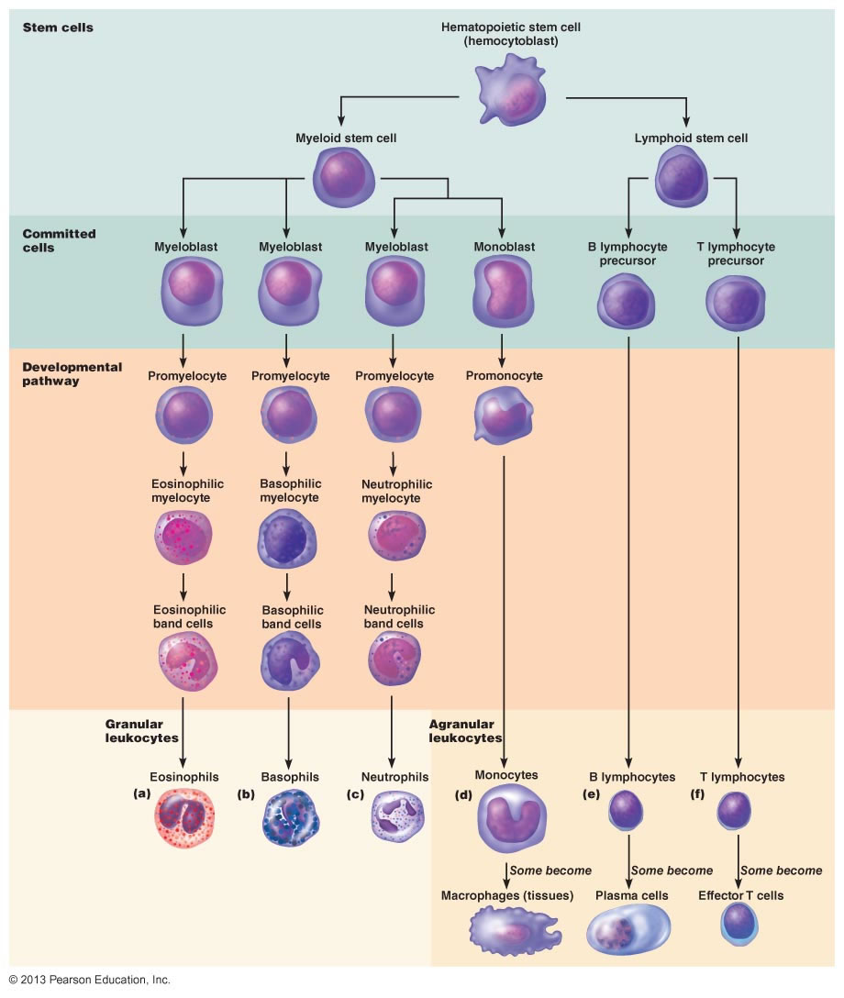
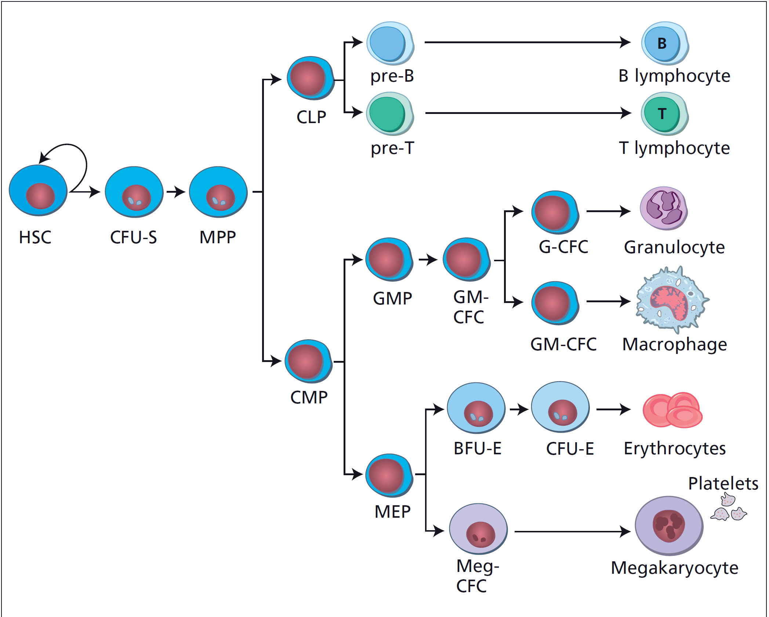
HSC
Megakaryoblast
Erythroblast

Slide 3
Main Types of Leukemia
Chronic | Acute
LPN(CLL) | ALL | Lymphoid
MPN/MDS (CML) | AML | Myeloid
 | Acute Biphenotypic | Mixed
 | Acute Undifferentiated | Non

Slide 4
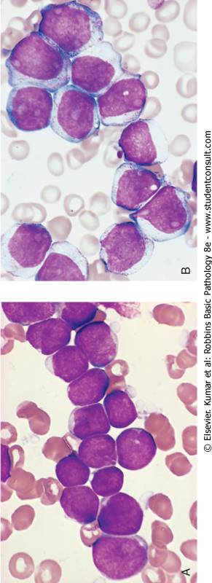
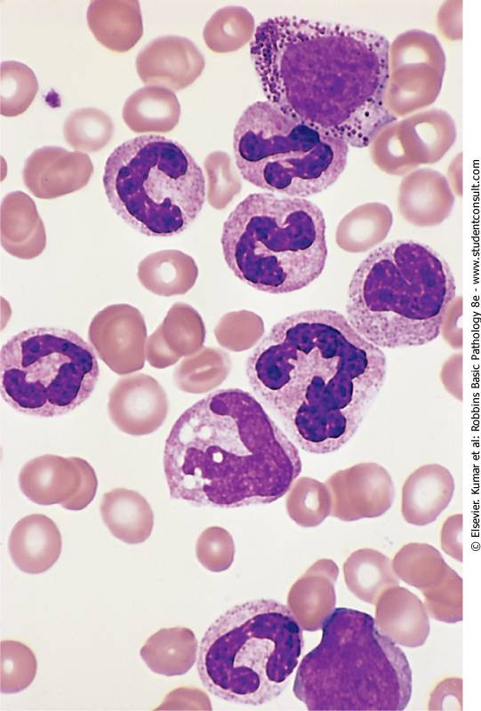
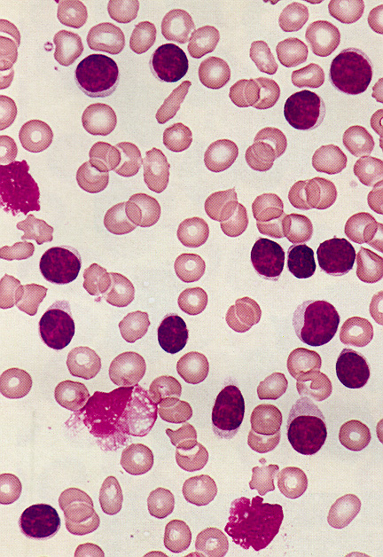
AML
ALL
CML
CLL
4

Slide 5
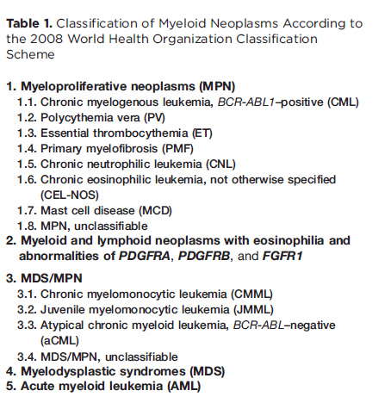

Slide 6
Myeloproliferative Neoplasms
Malignant proliferation of myeloid cells (maturing cells) in blood and bone marrow.
Occur mainly in adults
Slow onset and long course

Slide 7
MPN features
Cytoses
Organomegaly (mainly splenomgaly)
High uric acid
Hypercellular bone marrow
Progression to acute leukaemia (mainly AML)

Slide 8
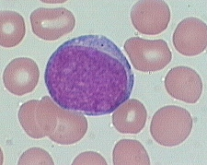
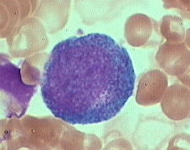
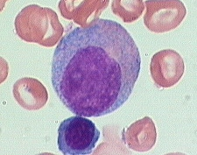
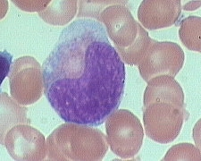
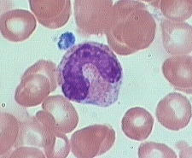
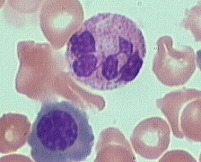
Chronic Myeloid Leukemia (CML)
Stem cell MPN.
Predominant proliferation of granulocytic cells.
Consistently associated with the BCR-ABL1 fusion gene located in the Philadelphia (Ph) chromosome which results from t(9;22) .
myeloblast
promyelocyte
myelocyte
metamyelocyte
band
neutrophil
MATURATION

Slide 9
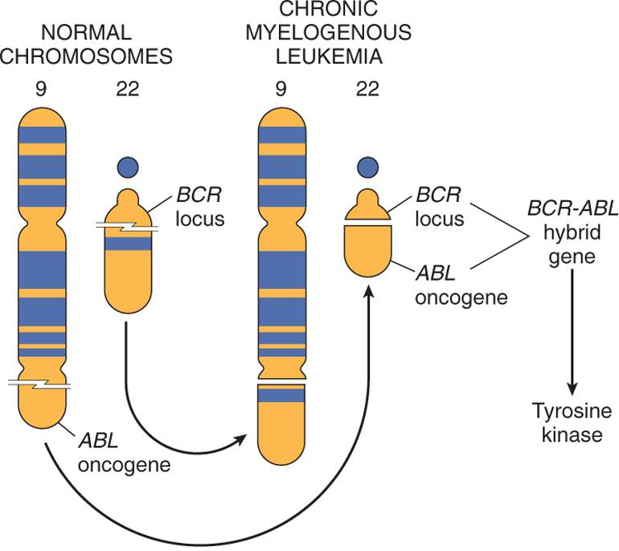
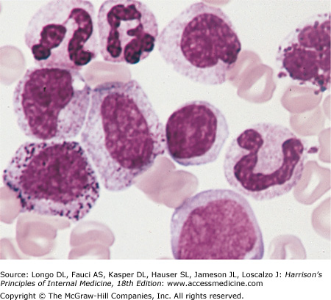
Pathogenesis of CML
Tyrosine Kinase
Activation of signal transduction pathways
Uncontrolled proliferation

Slide 10
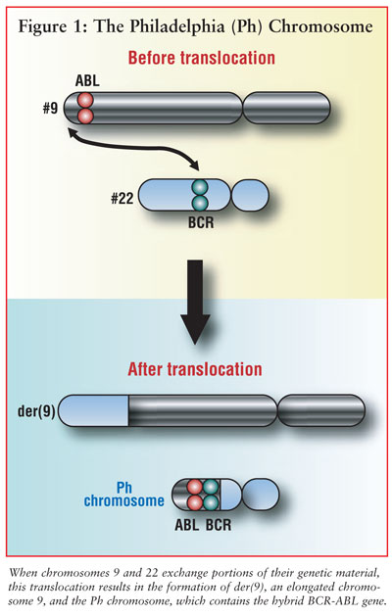
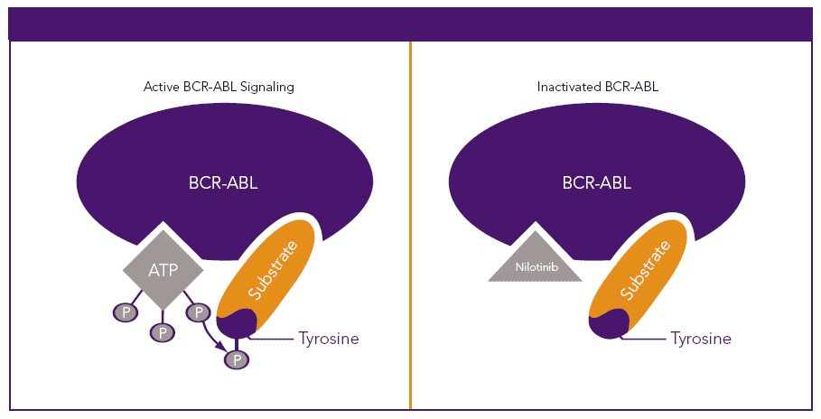
Pathogenesis of CML
p210 kD
BCR
ABL

Slide 11
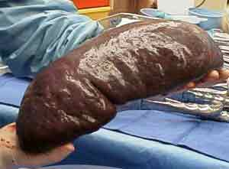
Clinical Presentation
Asymptomatic presentation(20-40%):
Routine CBC : marked leukocytosis
Common symptoms : Fatigue ,weight loss or night sweating
Abdominal discomfort due to splenomegaly
Splenomegaly (Massive )

Slide 12
Main Differential Diagnosis
1- Chronic myelomonocytic leukemia (monocytosis ,BCR-ABL –ve) .
2-Leukemoid reaction: Leukocytosis due to physiological response to stress or infection
Leukaemoid | CML
Any age | Adult | Age
High but <100,000 | High | WBC count
Mainly Bands | Mainly myelocytes and segmented | Differential
Toxic | Hypogranular | Morphology
-/+ | + | Splenomegaly
High | Low | NAP score
-ve | +ve | BCR/ABL
Acute | Chronic | Onset

Slide 13
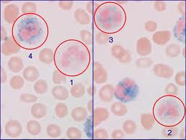

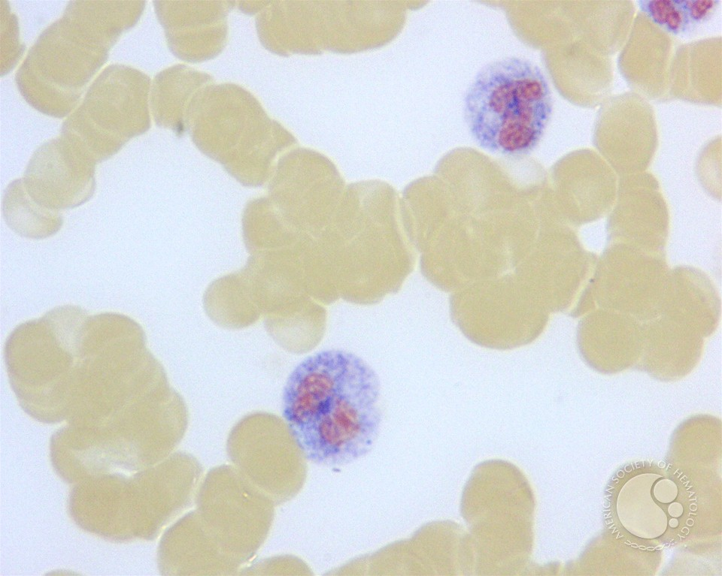
Neutrophil Alkaline Phosphatase (NAP)score :
Cytochemical stain that estimate the amount of alkaline phosphatase enzyme in neutrophilis .
Low : CML
High: Leukemoid

Slide 14
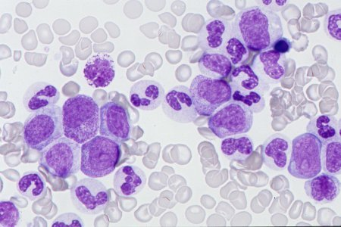
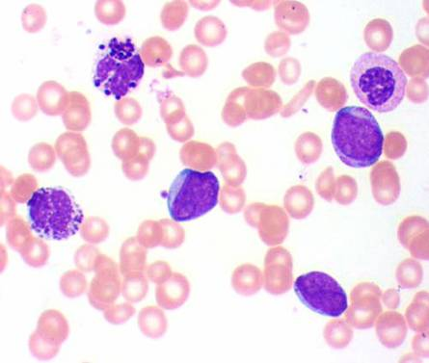
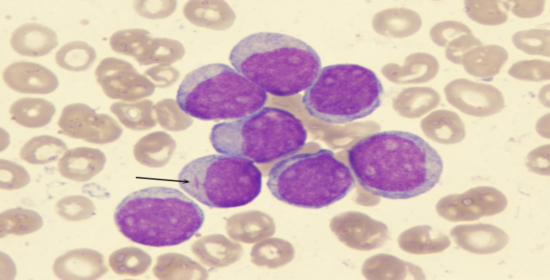
CML Phases
Chronic phase
Leukocytosis (12-1000×10⁹/L)
Mainly neutrophils & myelocytes
Blasts ≤10% ,Basophils≤ 20%
Stable course (years)
Accelerated phase
Increasing counts
10-19% blasts (basophils ≥20%)
Unstable course (months)
Blastic phase
≥20% blasts = Acute Leukemia
80% AML & 20% ALL
(coarse: Weeks)

Slide 15
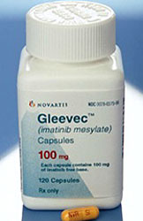
CML Treatment
  Targeted therapy (tyrosine kinase inhibitors like Imatinib)
  Excellent response (5y overall survival≥ 90%)
  If no response ; stem cell transplantation

Slide 16
Myelodysplastic Syndromes MDS
Group of myeloid neoplasms characterized by:
1-Peripheral cytopenia ( Low HB ± Low WBC & Low PLT )
2- Dysplasia (abnormal morphology)
3- Ineffective hematopoiesis (hypercellular marrow)
4-Progression to AML (preleukaemic disease)
5-Enhanced apoptosis

Slide 17
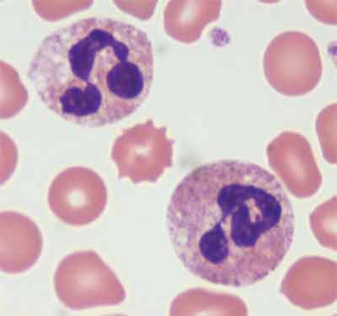
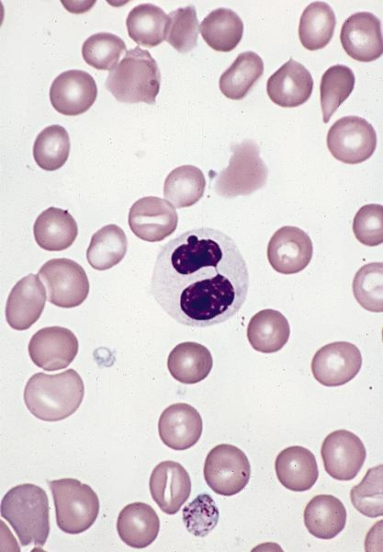
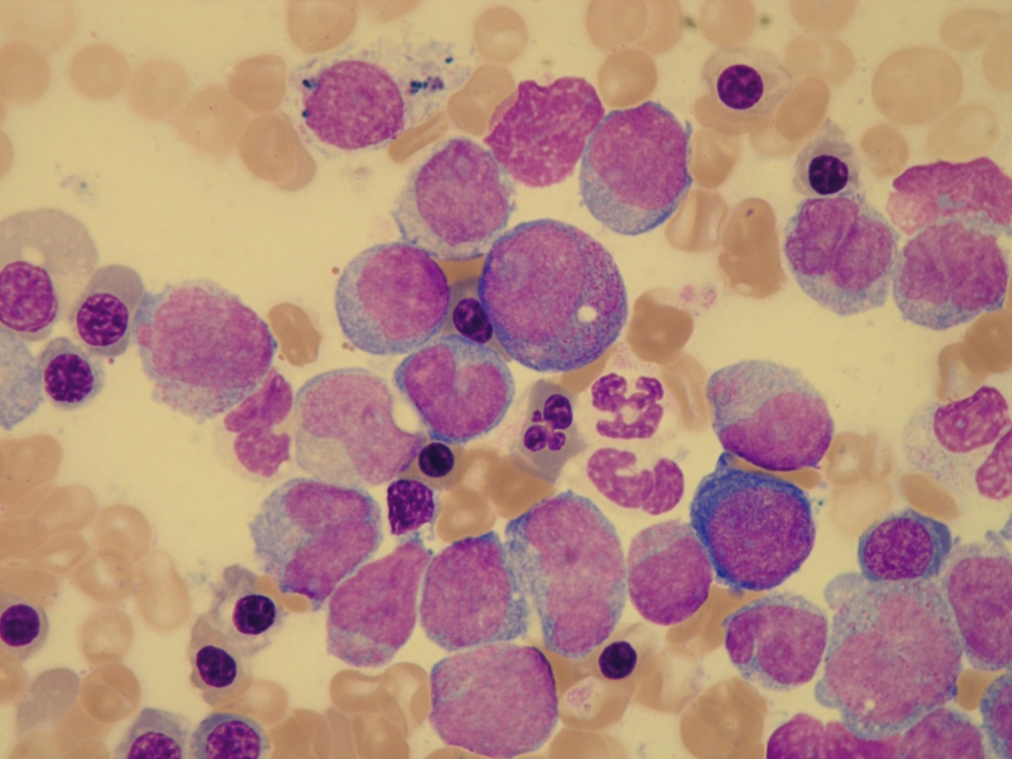
Myelodysplastic Syndromes MDS
Normal
Dysplastic
Blood: Pancytopenia with dysplasia
BM: Hypercellular with dysplasia
Ineffective Hematopoiesis
Proliferation
Apoptosis

Slide 18
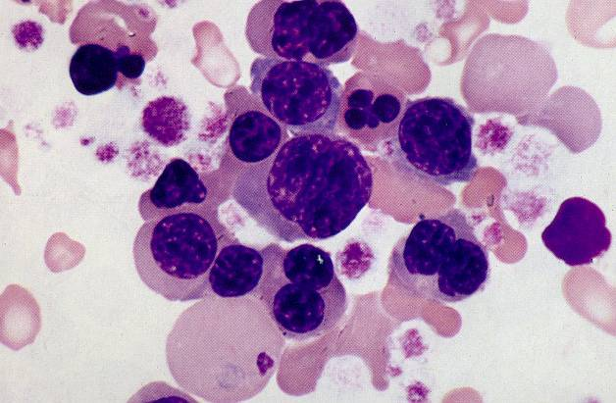
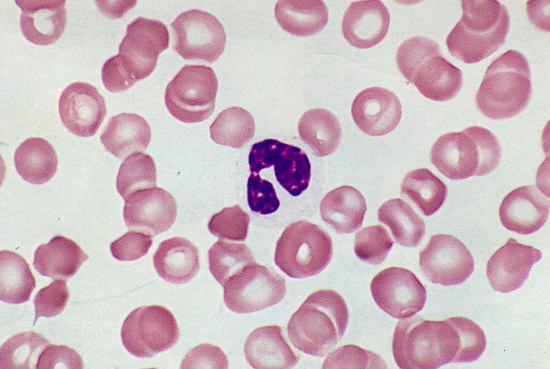
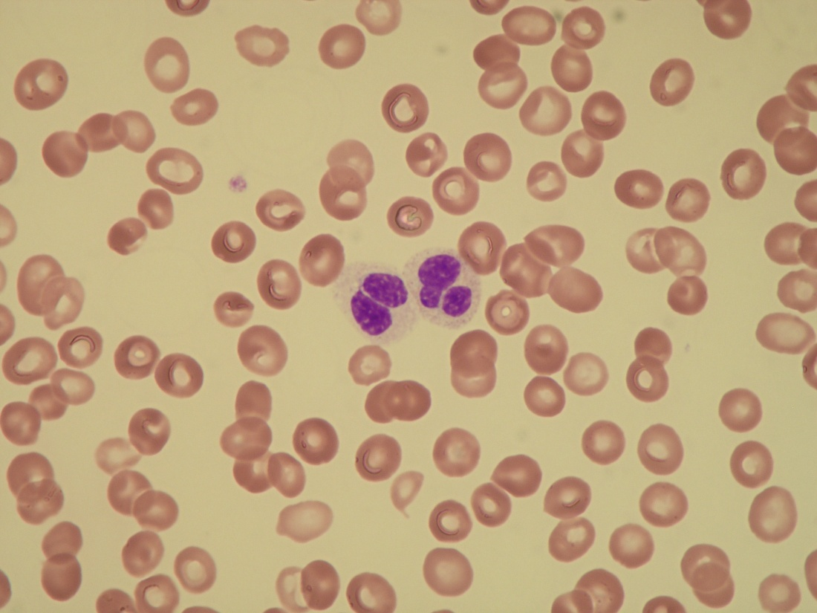
MDS

Slide 19
Myelodysplastic Syndromes MDS
Many subtypes according to:
1-Blast count
2-Degree of dysplasia
3-Genetics
Variable genetic abnormalities mainly -5, -7
Treatment : supportive +/- chemotherapy

Slide 20
Chronic Myelomonocytic Leukemia (CMML)
Clonal Hematopoietic malignancy characterized by proliferation of both monocytes and neutrophils.
MDS/MPN disease:
* Features of MDS (dysplasia& enhanced apoptosis)
*Features of MPN ( marked proliferation)
Philadelphia chromosome must be negative
Blast must be less than 20%.

Slide 21
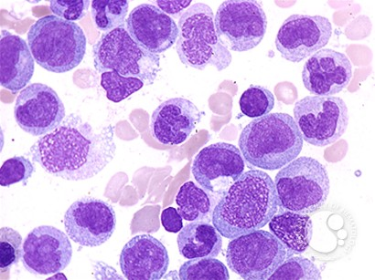
CMML
Aggressive course (survival rate around 2.5 y)
Treatment : Chemotherapy ±SCT

Slide 22
MPN vs. MDS vs. MPN/MDS
MPN
MPN/MDS
MDS
Cytosis
Cytopenia

Slide 23
??

