Slide 1
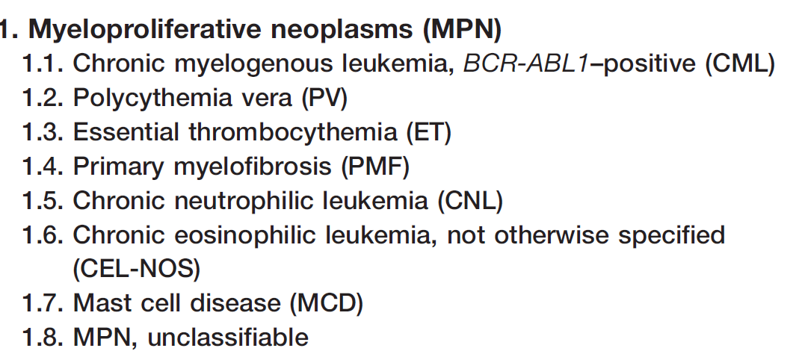
Myeloproliferative Neoplasms

Slide 2
MPN features
Cytosis
Organomegaly (mainly splenomgaly)
High uric acid
Hypercellular bone marrow
Progression to acute leukaemia (mainly AML)

Slide 3
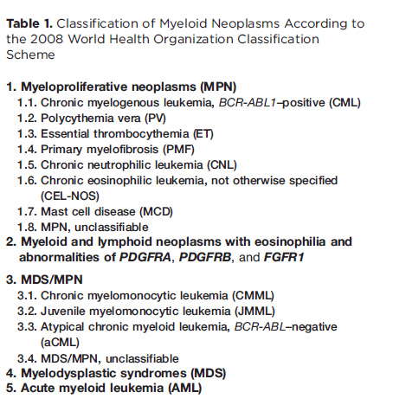
BCR-ABL must be
negative
For reading

Slide 4
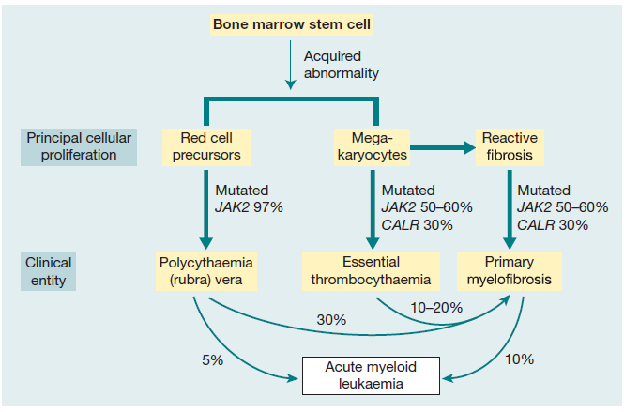
Notes:
Figure 15.1 Relationship between the three myeloproliferative diseases. They may all arise by somatic mutation in the pluripotential stem
and progenitor cells. Many transitional cases occur showing features of two conditions and, in other cases, the disease transforms during
its course from one of these diseases to another or to acute myeloid leukaemia. The three diseases, polycythaemia rubra vera, essential
thrombocythaemia and primary myelofibrosis, are characterized by JAK2 or CALR mutation in a varying proportion of cases.

Slide 5
Polycythemia
In Greek “too many cells in the blood.”.
Absolute increase in total body red cell volume (or mass)
Manifests itself as a raised Hb or packed cell volume (PCV)
Hb is >16.5or 18.5 g/dl in women and men, respectively.

Slide 6
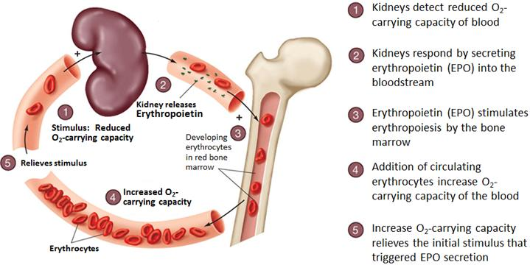
Regulation of Erythropoiesis

Slide 7
Classification of Polycythemia
normal
normal
normal
Relative
Polycythemia
2nd Polycythemia
Polycythemia vera
Decreased plasma volume due to severe dehydration
Increased RBC mass due to high EPO:
1-COPD, Sleep apnea, smoking..
2-High altitude
3-High affinity HB
4-Renal disease
5-Epo secreting tumor (Parathyroid adenoma …)
Increased RBC mass due to malignant proliferation

Slide 8
For reading

Slide 9
Polycythemia Vera
MPN characterized by increased red blood cell production independent of the mechanisms that normally regulate erythropoiesis.
Diagnostic Features:
HB >18.5g/dl in men ,16.5g/dl in women
Hypercellular bone marrow
JAK2 mutation in >95% of cases
Low Serum erythropoietin level

Slide 10
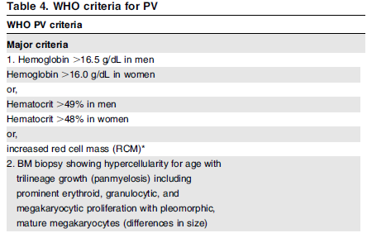
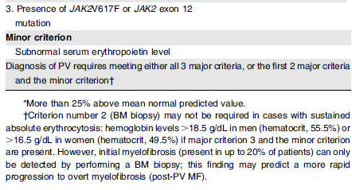
Polycythemia Vera
For reading

Slide 11
Clinical features of PV
1-Increased blood viscosity
Hypertension
Headache, dizziness, visual disturbances & paresthesia
2- Thrombosis
Deep vein thrombosis
Myocardial infarction
Mesenteric, portal or splenic vein thrombosis
3-Splenomegaly in 70%
4-Hepatomegaly in 40%
Dr.Mansour Aljabry

Slide 12
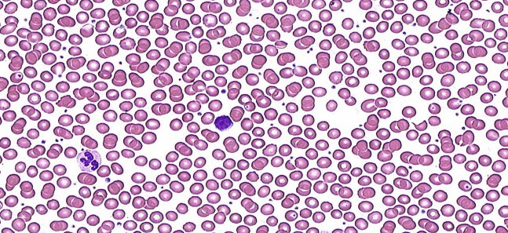
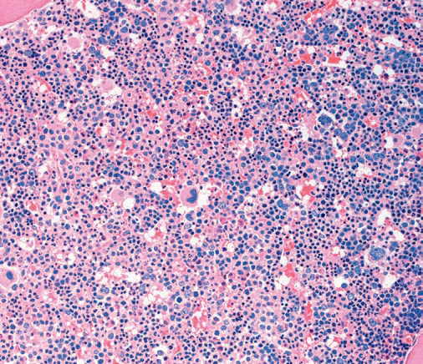
Investigations
CBC:
*RBC: increased *Hb: increased
*WBC & PLT :mildly increased (usually)
Blood smear:
Excess of normocytic normochromic RBC
±Leukocytosis &thrombocytosis
Bone marrow
Hypercellular
Predominant erythroid precursors
± Increased megakaryocytes &Myeloid precursors.
Blasts AL transformation

Slide 13
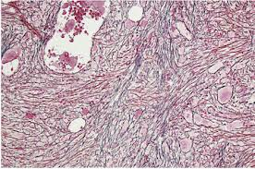
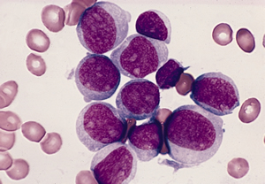
Complication &treatment
Diagnosis of Polycythemia Vera
Treatment:
Venesection + Aspirin
± Myelosuppressive drugs (hydroxyuria)
10-15 years
20%
10%
Myelofibrosis
Acute leukemia

Slide 14
Primary Myelofibrosis

Slide 15
Primary Myelofibrosis
Clonal MPN characterized by a proliferation of megakaryocytes & granulocytes in the bone marrow that associated with deposition of fibrous connective tissue and extramedullary haematopoiesis
Clinical features
Anemia
Leukoerythroblastic blood picture.
Massive splenomegaly
Fibrotic bone marrow
JAK2 mutation (50%)
Risk of AML transformation (20%)

Slide 16
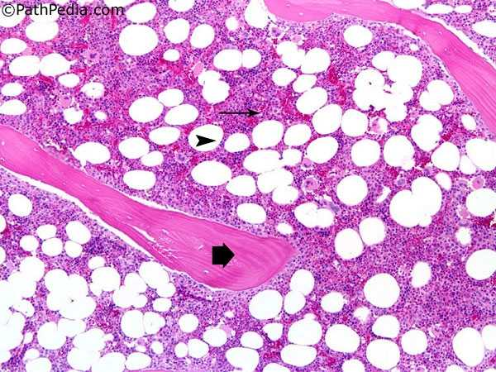
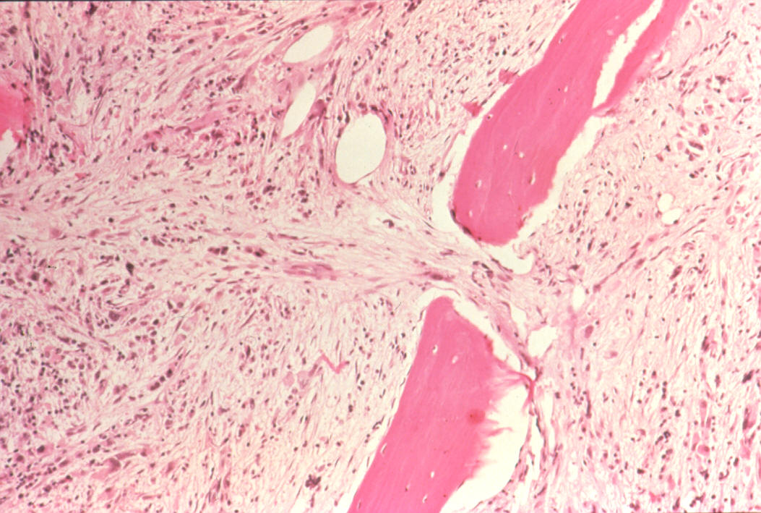
Bone marrow in Myelofibrosis
Normal BM
Fibrotic BM

Slide 17
Stages of PMF
7-10 years survival
Proliferation of megakaryocytes &Granulocytes
Leukocytosis
Thrombocytosis
Prefibrotic stage
3-7 years survival
Fibrotic stage
Anemia
Leukopenia
Thrombocytopenia
Extramedullary hematopoesis
≤1
year survival
AML transformation

Slide 18
Essential Thrombocythemia

Slide 19
Essential Thrombocythemia
ET is MPN that involves primarily the megakaryocytic lineage.
& characterized by sustained thrombocytosis .
Diagnostic Features
Sustained thrombocytosis ≥45O×10⁹.
Hypercellular BM with megakaryocytic proliferation
Exclusion of: CML, MDS,PV &Primary Myelofibrosis
JAK2 mutation (60%),If negative ;no evidence of
reactive thrombocytosis:
Iron def. ,splenoctomy, surgery, infection ,autoimmune disease….

Slide 20
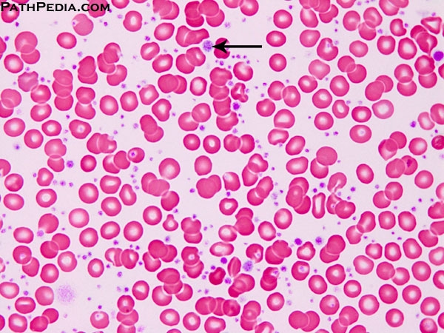

Slide 21
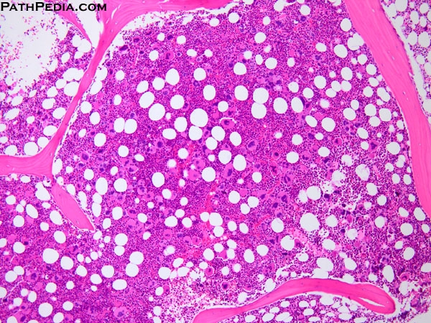

Slide 22
Essential Thrombocythemia
Clinical Presentation
Asymptomatic (50%)
Thrombosis
Bleeding
Mild splenomegaly (50%)
Mild hepatomegaly (20%)
Very indolent
(5% risk of AML transformation )
Treatment
Aspirin ±Hydroxyuria

Slide 23
JAK2 Mutation
JAK2: Non receptor protein tyrosine kinase involved in signal transduction pathway
JAK2 kinase domains structure
JH6
JH5
JH4
JH3
JH2
JH1
Negative feed back
JAK2 mutation :
Point mutation (at codon 617 in JH2) leads to loss of auto inhibitory control over JAK2.
The mutated JAK2 is in a constitutively active state,

Slide 24
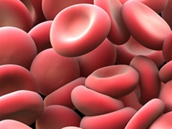
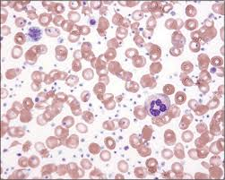
JAK2 Mutation
EPO
JAK2
JH2
JH1
P
-ve
P
RAS
P
95%
STAT
JAK2 (V617) mutation
P
MAPK
+ve
+ve
60%
Transcriptional factors
Increased proliferation
Decreased apoptosis
50%
Dr.Aljabry

Slide 25



