Slide 1
MEGALOBLASTIC ANAEMIA
BY:
DR. FATMA AL-QAHTANI
Consultant Haematopathologist Head of Haematopathology Division Assistant Professor
Department of Pathology College of Medicine King Saud University

Slide 2


LEARNING OBJECTIVES
To understand the mechanisms by which macrocytic
anaemia may arise
To appreciate the signs and symptoms of macrocytic anaemia
To understand how macrocytic anaemia can be
classified
To be able to know the causes of macrocytic anaemia
To understand the normal metabolism of vitamin B12 and folic acid, and to appreciate how megaloblastic anaemia may arise
To suggest some normoblastic causes of macrocytosis

Slide 3
Normal adult red cell values
Male Female
--------------------------------------------------------------------------------------------------------------
Haemoglobin* (g/L) Haematocrit (PCV) (%) Red cell count (x10¹²/L) Mean cell haemoglobin (pg) Mean cell volume (FL) Mean cell haemoglobin concentration g/L) Reticulocyte count (x10⁹/L)
135 – 175
40 – 52
4.5 – 6.5
27 – 34
80 – 95
300 – 350
115 – 155
36 – 48
3.9 – 5.6
25 – 125 (1.0 – 2%)
_____________________________________________________________
* In children normal haemoglobin values are: newborn,
150 –
210g/L; 3 months, 95 – 125g/L; 1 year to puberty, 110 – 135g/L.
* PCV, packed cell volume.

Slide 4
NORMAL WHITE CELLS (WBC)
COUNT IN ADULTS
TOTAL
Neutrophils Lymphocytes Monocytes Eosinophils
Basophil
4.0 - 11.0 X 10⁹/L
2.5 - 7.5 x 10⁹/L
1.5 - 3.5 x 10⁹/L
0.2 - 0.8 x 10⁹/L
0.04 - 0.44 x 10⁹/L
0.01 - 0.1 x 10⁹/L
Platelets 150-450 x 10⁹/L
* Children have higher lymphocytes count

Slide 5
Microcytic, Hypochromic Anaemia
MCV< 80 fL
MCH<27pg
Iron deficiency
Thalassaemia
Anaemia of chronic disease (some cases) Lead poisoning
Sideroblastic anaemia (some cases)

Slide 6
Normocytic, Normochromic Anaemia
MCV 80 – 95 fL
MCH>26pg
Many haemolytic anaemias
Anaemia of chronic disease (some cases) After acute blood loss
Renal disease Mixed deficiencies
Bone marrow failure, e.g. post-chemotherapy, infiltration by carcinoma, etc.

Slide 7

MACROCYTIC ANAEMIA
Macrocytic anaemias can be divided into those showing:
Megaloblastic erythropoiesis
Normoblastic erythropoiesis
Megaloblastic erythropoiesis - describes abnormal red cell development characterized by a lack of synchrony between the maturation of the red cell nucleus and its cytoplasm. It arises as a consequence of disordered DNA synthesis and results in a macrocytic anaemia.
Normoblastic erythropoiesis - describes the normal appearance of red cell maturation - but may still be associated with a macrocytosis in the peripheral blood.

Slide 8
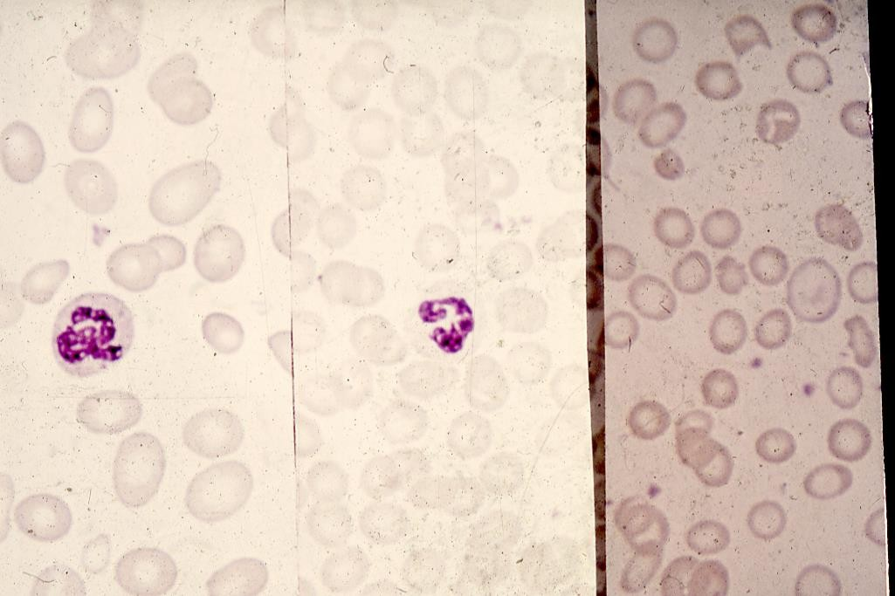

Slide 9
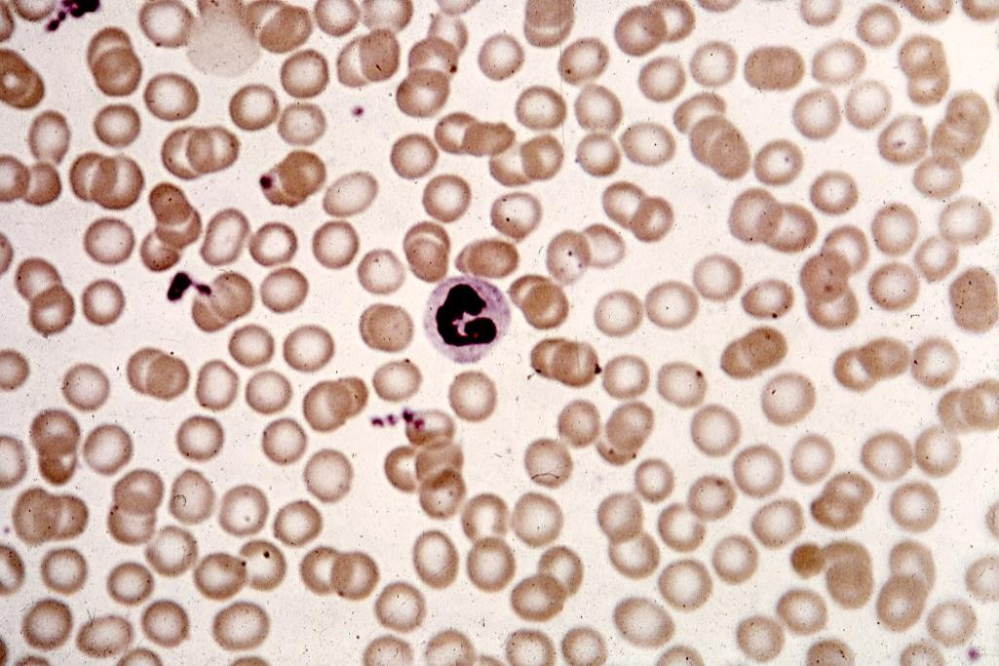

Slide 10
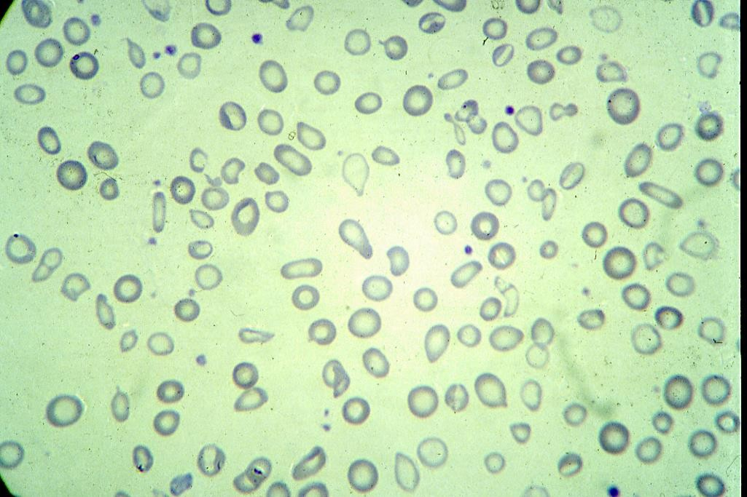

Slide 11
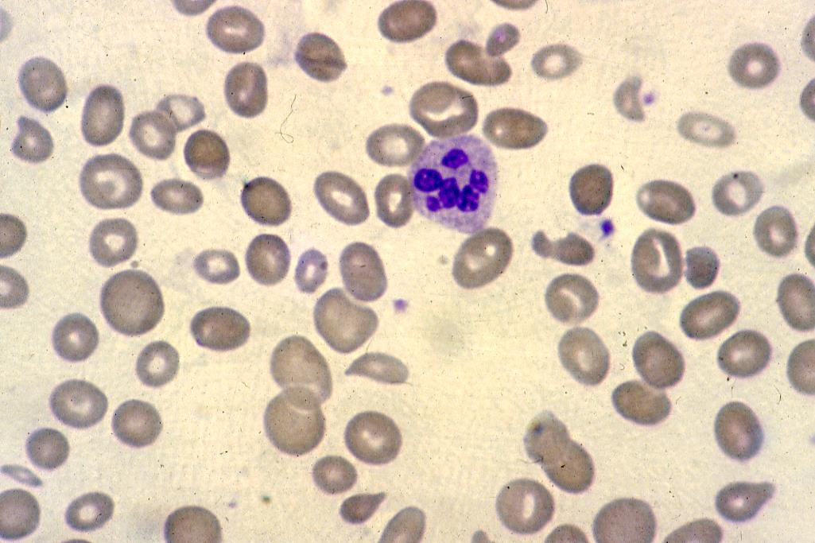

Slide 12
Conditions in which Macrocytosis or hypersegmented neutrophils may occur in the absence of megaloblastic anaemia
Macrocytosis
Alcohol
Liver disease (especially alcoholic) Reticulocytosis (haemolysis or haemorrhage) Aplastic anaemia or red cell aplasia Hypothyroidism
Myelodysplasia including acquired Sideroblastic anaemia
myeloma and macroglobulinaemia Leucoerythroblastic anaemia Myeloproliferative disease Pregnancy
Newborn
? Chronic respiratory failure
Renal failure
Hypersegmented Neutrophils
Congenital (familial) abnormality
? Iron deficiency
----------------------------------------------------------------------------------------------------------
Note:- High MCV recorded when cold agglutinins or paraproteins are present.

Slide 13
Macrocytosis with Normoblasts
Normal neonates (Physiological)
Chronic alcoholism*
Myelodysplastic syndromes*
Chronic liver disease*
Hypothyroidism
Normal pregnancy
Therapy with anticonvulsant drugs*
Haemolytic anaemia
Chronic lung disease (with hypoxia)
Hypoplastic and aplastic anaemia
Myeloma
*Some patients show B₁₂- and folate-independent
megaloblastic erythropoiesis.

Slide 14
Causes of megaloblastic anaemia :
======================================================================================================================================
Cobalamin deficiency or abnormalities of cobalamin metabolism
Folate deficiency or abnormalities of folate metabolism
Therapy with anitfolate drugs (e.g. methotrexate)
Independent of either cobalamin or folate deficiency and refractory to
cobalamin and folate therapy.
  Some cases of acute myeloid leukaemia, myelodysplasia.
  Orotic aciduria (responds to uridine)
  Therapy with drugs interfering with synthemis of DNA (e.g. cytosine arabinoside, hydroxyurea, 6-mercaptopurine, azidothymidine (AZT)
  Thiamine responsive
Suggested but poorly documented causes of megaloblastic anaemia not due to
cobalamin or folate deficiency or metabolic abnormality:
  Vitamin E deficiency
  Lesch-Nyhan syndrome (?responds to adenine)
==============================================================

Slide 15
Other causes of megaloblasts :
Abnormalities of nucleic acid synthesis
Drug therapy
Antipurines (mercaptopurine, azathioprine) Antipyrimidines (fluorouracil, zydovudine (AZT)) Others (hydrozyurea)
Orotic aciduria
Uncertain aetiology
Myelodysplastic syndromes, * erythroleukaemia
Some congenital dyserythropoietic anaemias
*
Some patients show normoblastic erythropoiesis.

Slide 16
Vitamin B₁₂ and folate nutrition and absorption
 | Vitamin B12 | Folate
Diterary sourse | Only food of animal origin, especially liver | Most foods, especially liver, green vegetable and yeast; destroyed by cooking
Average daily intake* | 7 - 30 µg | 200-250 µg
Minimum daily requirement* | 1-3 µg | 100-200 µg†
Body stores* | 3-5 mg, mainly in the liver | 8-20 mg, mainly in the liver
Time to develop deficiency in the absence of intake or absorption* | Anaemia in 2-10 years | Macrocytosis in 5 months.
Requirements for absorption | Intrinsic factor secreted by gastric parietal cells | Conversiion of polyglutamates to monoglutamates by intestinal folate conjugase
Site of absorption | Terminal ileum | Duodenum and jejunum
* In adults. † Higher during pregnancy and lactation.

Slide 17
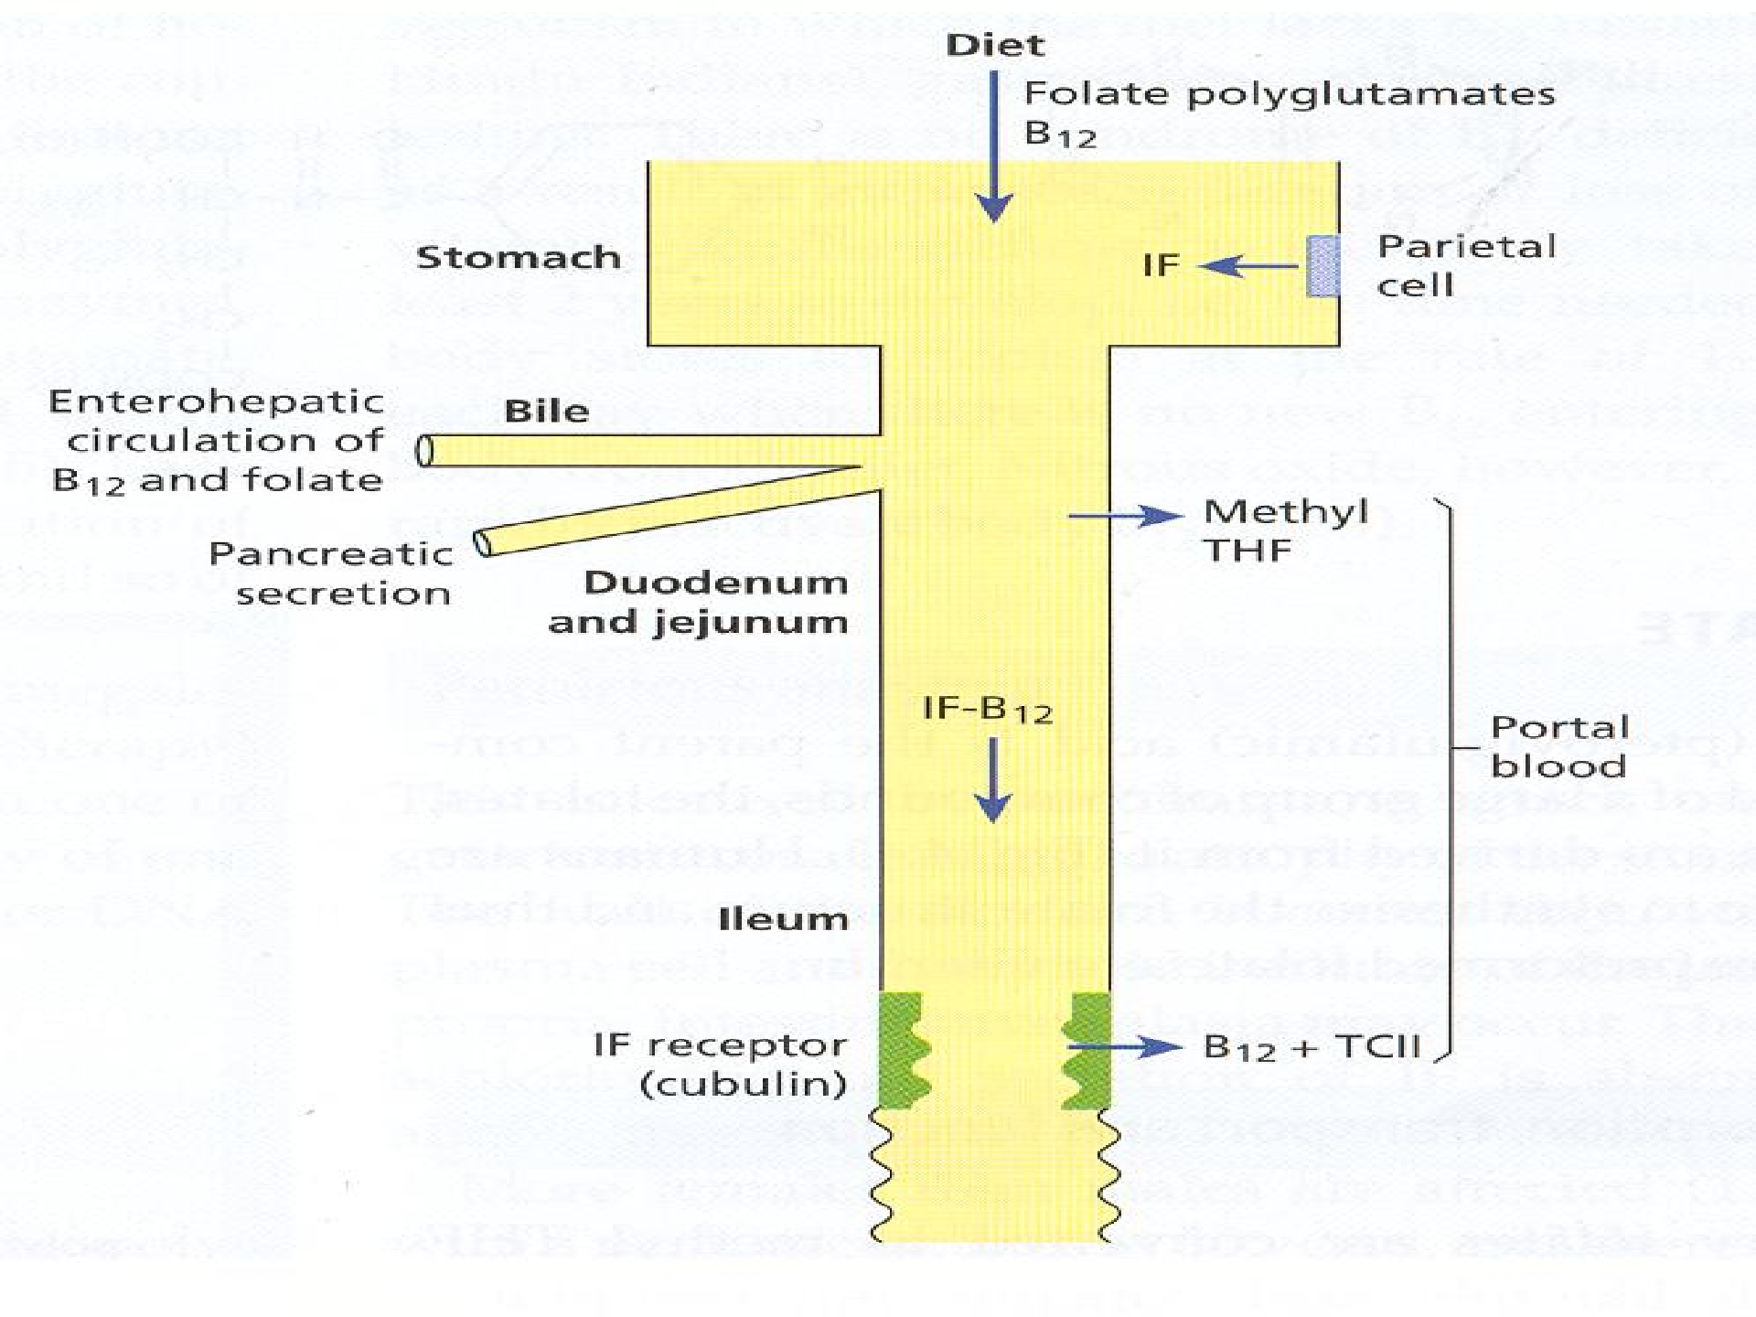
.

Slide 18
Vitamin B₁₂ Deficiency
Inadequate intake
Veganism, lactovegetarianism (some cases)
Inadequate secretion of intrinsic factor
Pernicious anaemia
Total or partial gastrectomy
Congenital intrinsic factor deficiency (rare)
Inadequate release of B₁₂ from food
Partial gastrectomy, vagotomy, gastritis, acid-suppressing drugs, alcohol abuse
Diversion of dietary B₁₂
Abnormal intestinal bacterial flora
multiple jejunal diverticula, small intestinal strictures, stagnant intestinal loops
Diphyllobothrium latum
Malabsorption
Crohn’s disease, ileal resection, chronic tropical sprue, congenital selective B₁₂ malabsorption with proteinuria (Imerslund-Grasbeck syndrome)

Slide 19
PERNICIOUS ANAEMIA
Severe megaloblastic anaemia due to autoimmune
attack on the gastric mucosa leading to atrophy.
More common in elderly female patients than males (1.6:1) at the age of 60 and above
More common in Northern European and tends to be
in families
The mucosa become thin with plasma cells and
lymphoid infiltration of the lamina properia.
Intestinal metaplasia may occur.
It maybe associated with autoimmune diseases
including the autoimmune poly-endocrine syndrome

Slide 20
Achlorhydria and absent secretion of intrinsic factor
(IF).
cont’d…
Progressive neuropathy is a common feature
Absent serum vitamin B12 level or almost absent
level
Raised serum gastrin levels
Helicobacter pylori infection may be the cause which present in younger age as iron deficiency anaemia and in the elderly as pernicious anaemia
Increased incidence of gastric carcinoma in (2-3% of
pernicious anaemia patients).

Slide 21
Causes of folate deficiency
Inadequate dietary intake
Malabsorption
Coeliac disease, jejunal resection, tropical sprue
Increased requirement
Pregnancy, premature infants, chronic haemolytic anaemias, myelofibrosis,
various malignant diseases
Increased loss
Long-term dialysis, congestive heart failure, acute liver disease
Complex mechanism
Anticonvulsant therapy, * ethanol abuse*
* Only some cases with macrocytosis are folate deficient.

Slide 22
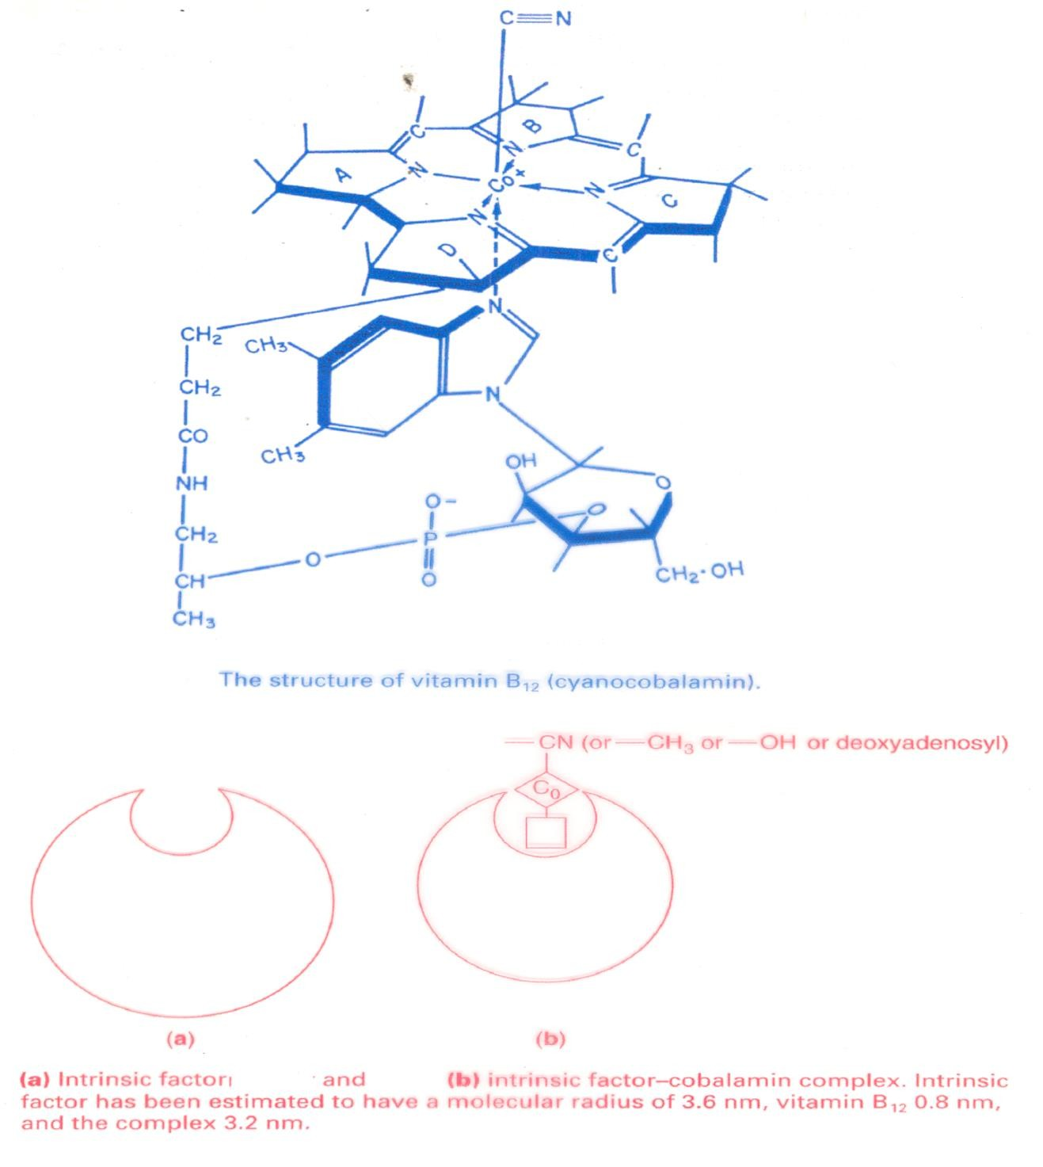

Slide 23
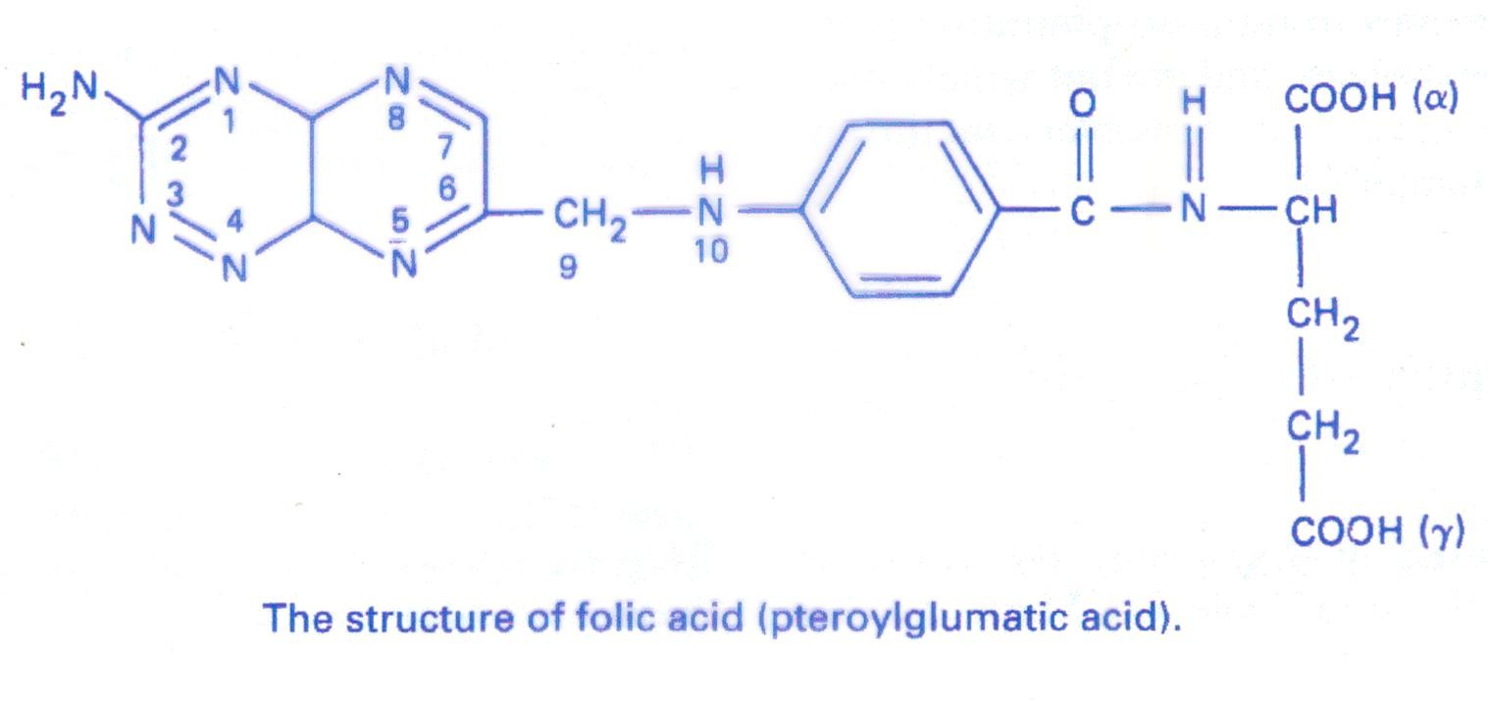

Slide 24
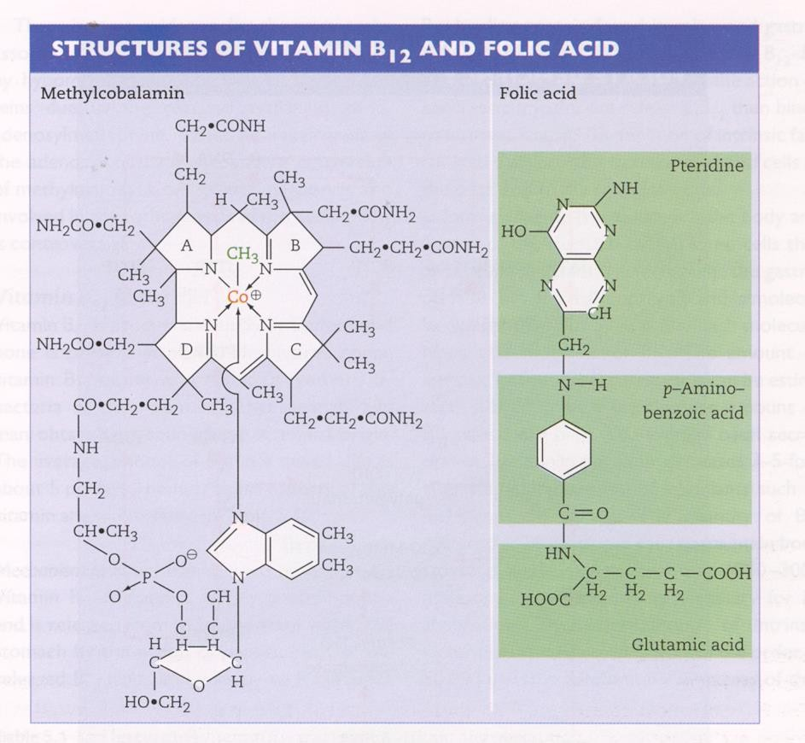

Slide 25
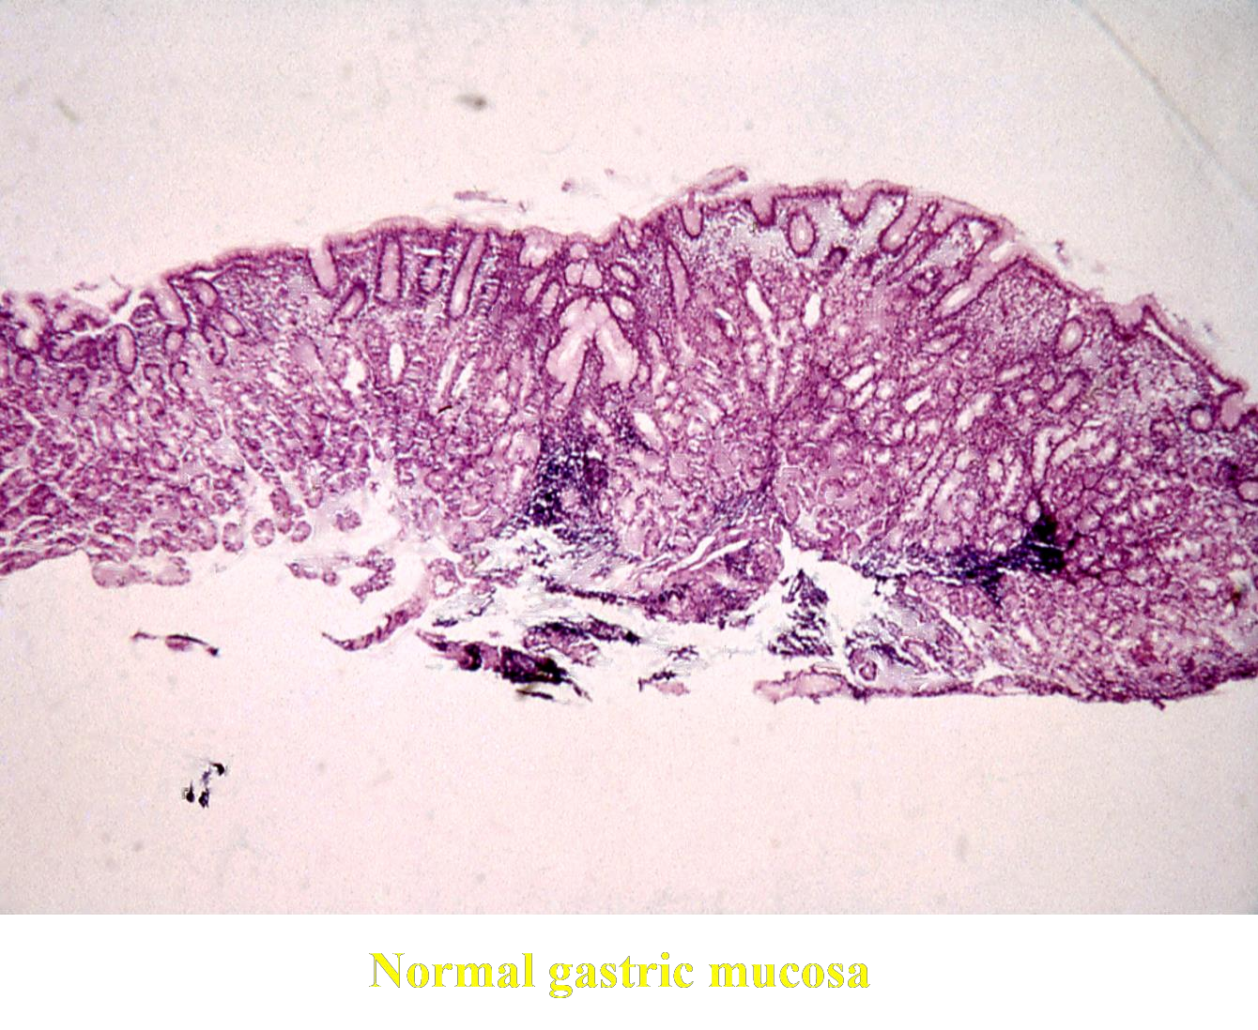
.

Slide 26
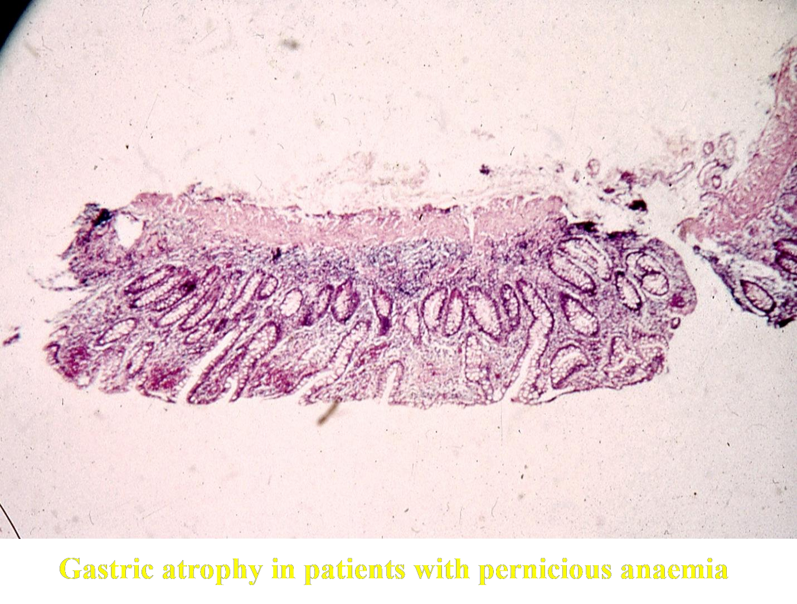

Slide 27
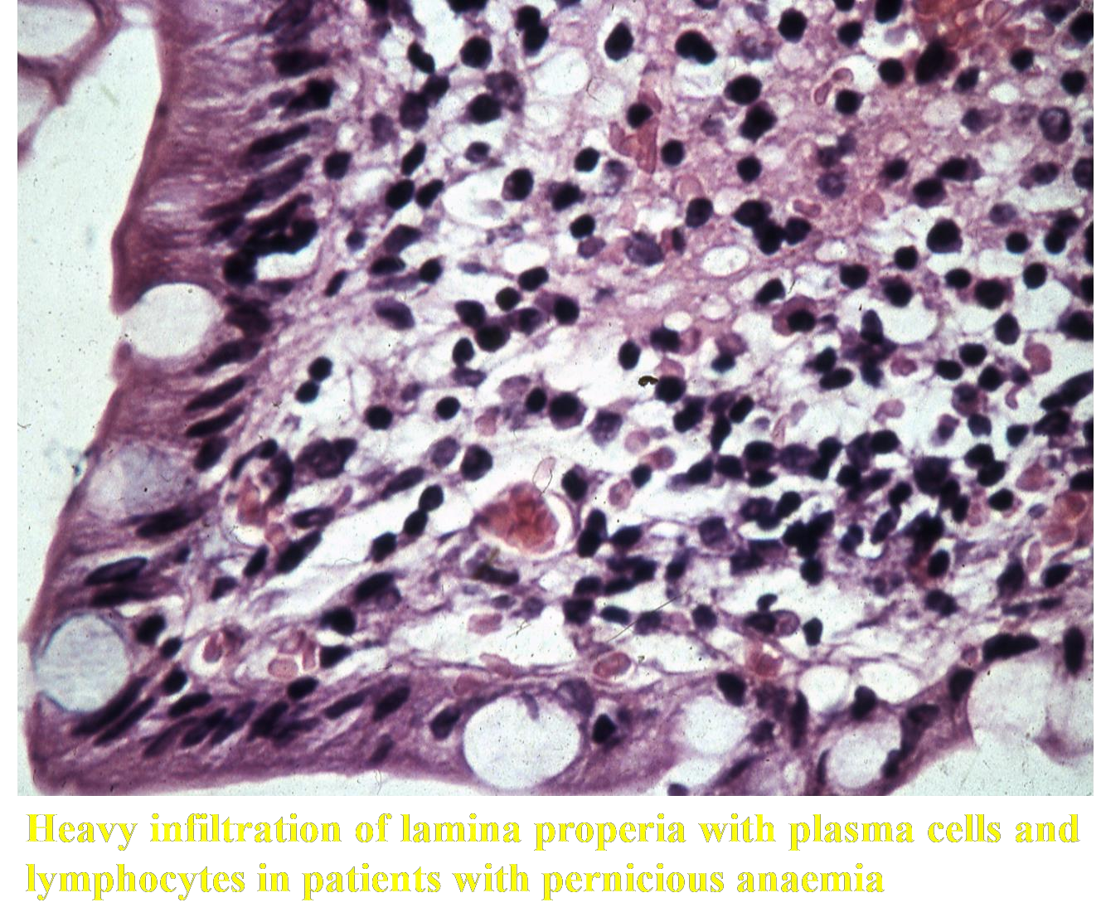
.

Slide 28
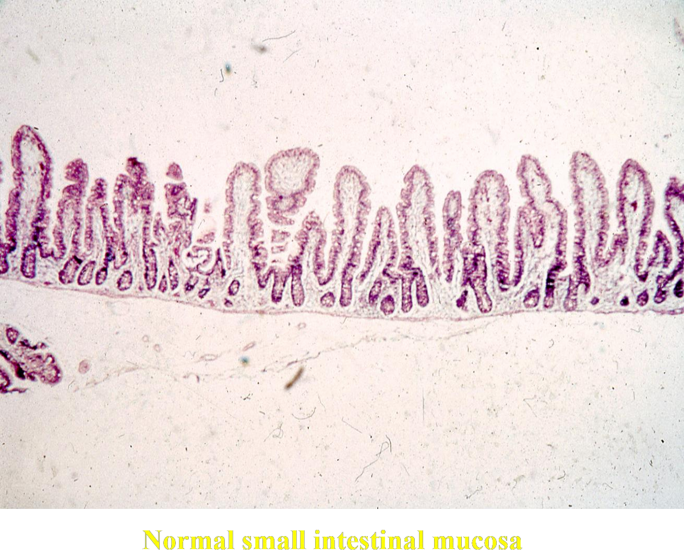

Slide 29
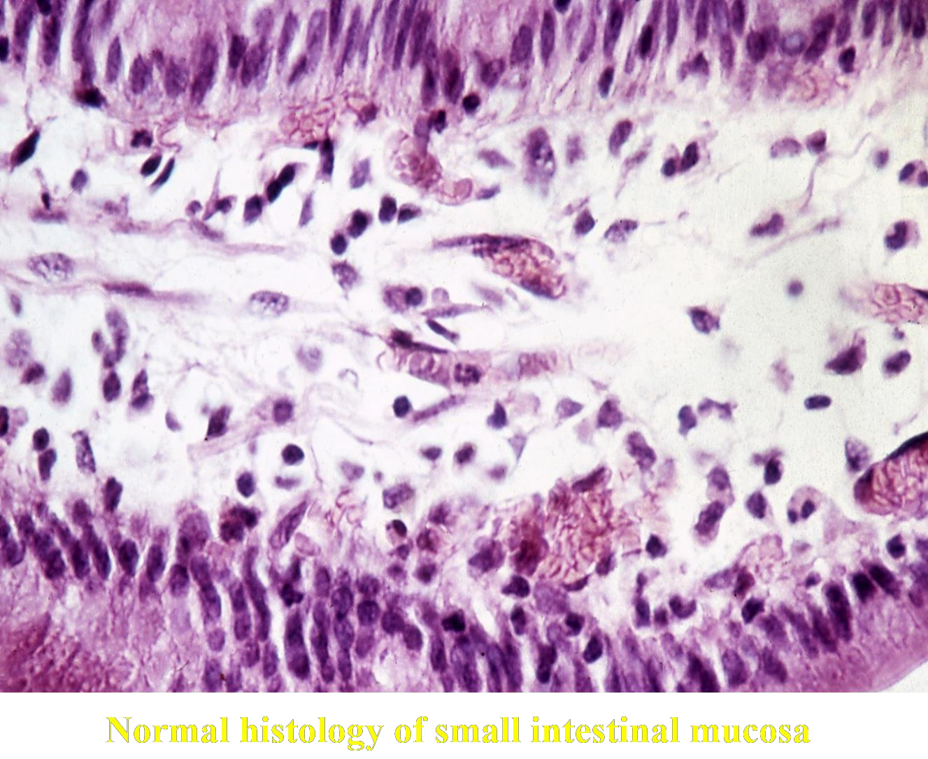

Slide 30
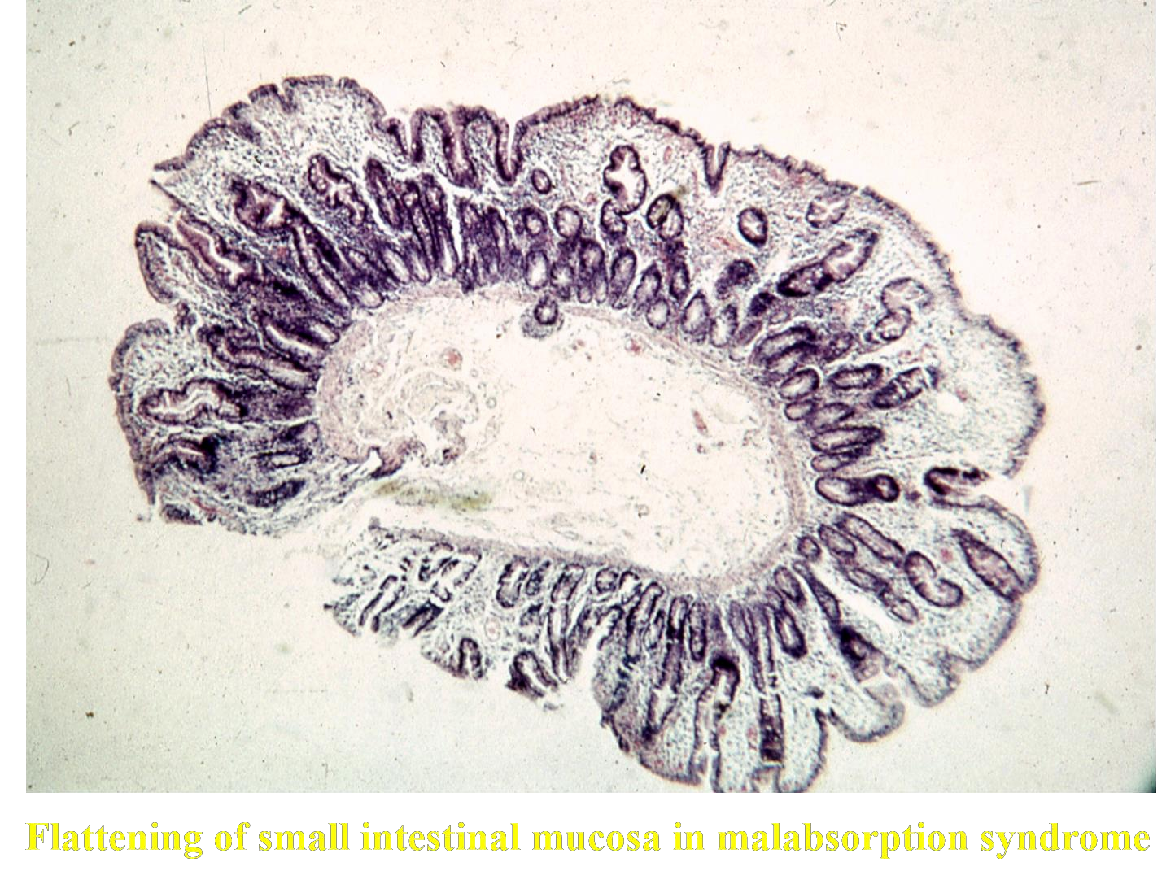

Slide 31
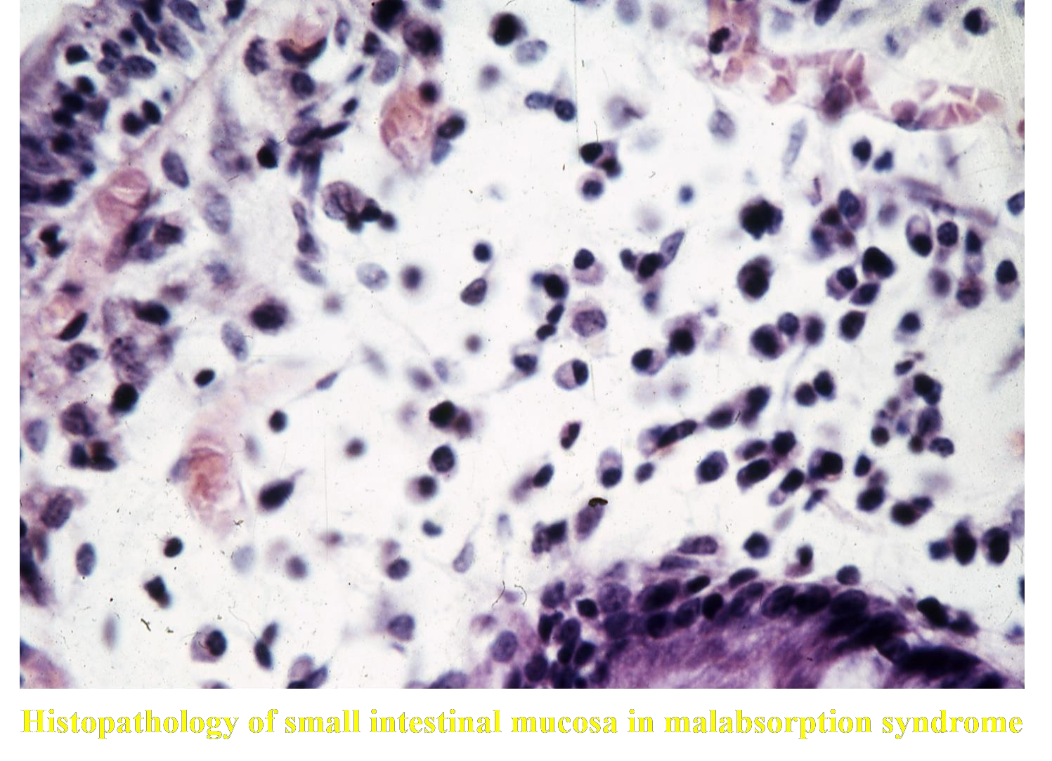

Slide 32
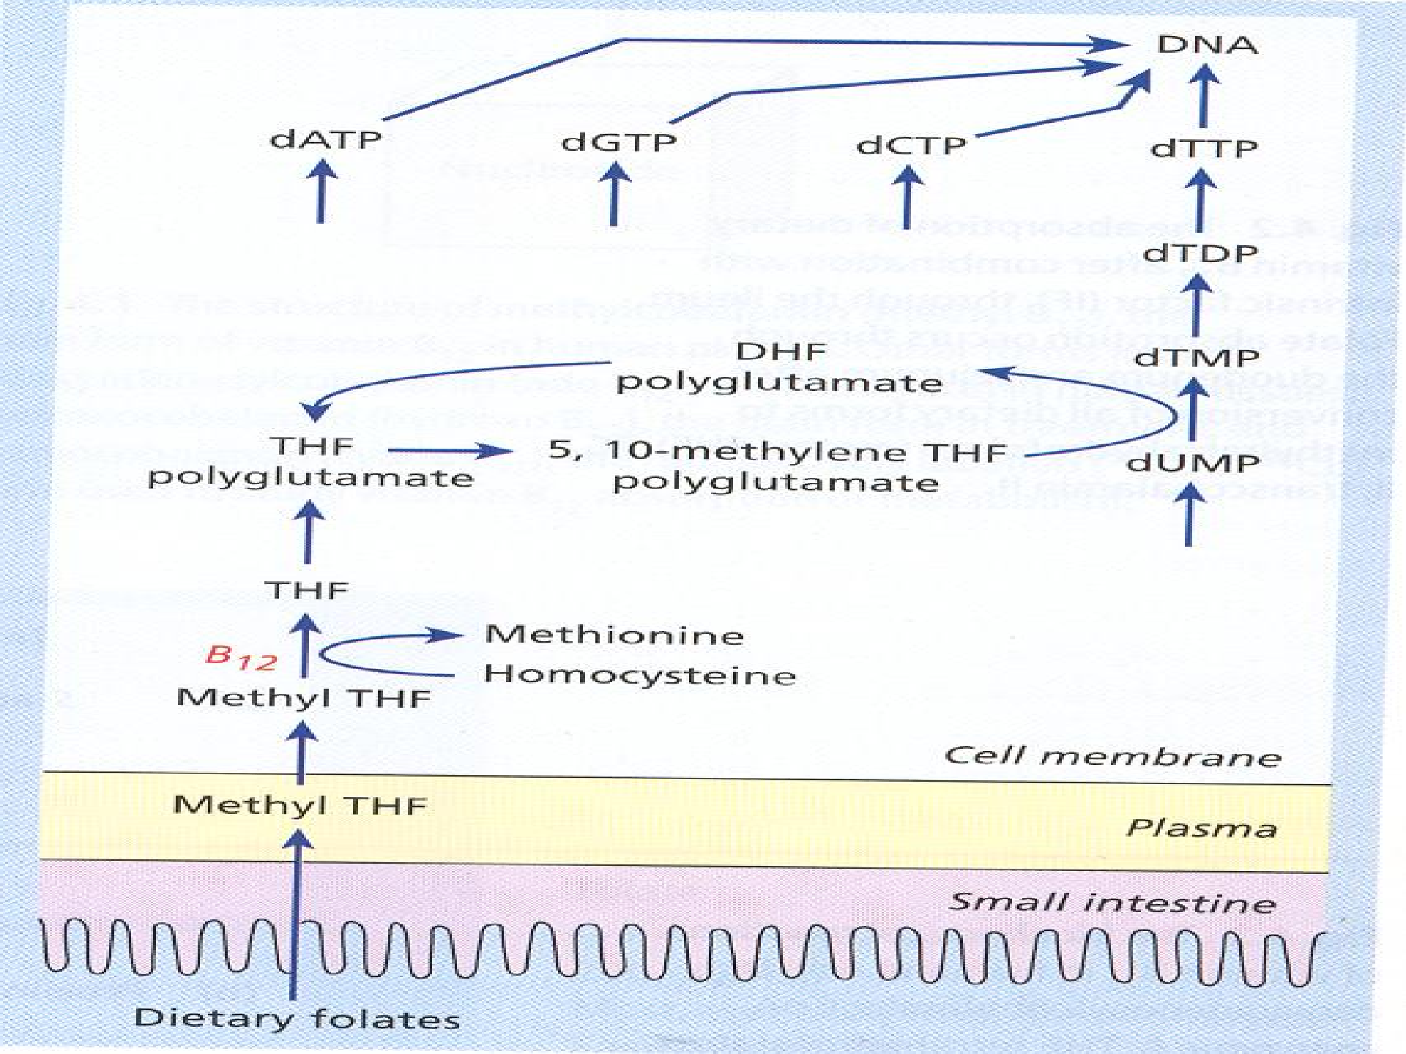
.

Slide 33
dATP dTTP dCTP dGTP
DNA
Inhibits
5-methyl-THF
5-methyl-THF
Cobalamin
dTMP
3H-thymidine
THF --> 5,10-methylene- THF polyglutamate
dUMP
Deoxyuridine
Deoxyuridine suppression test. The circle represents a bone marrow or other haemopoietic cell. THF = tetrahydrofolate; MP = monophosphate; TP = triphosphate; d= deoxyribose; A – adenine; T= thymine ; C = cytosine; G= guanine.

Slide 34
Homocysteine Methyltransferase Methylcobalamin
Homocysteine
Methionine
5-Methylterahydrofolate
Tetrahydrofolate

Slide 35
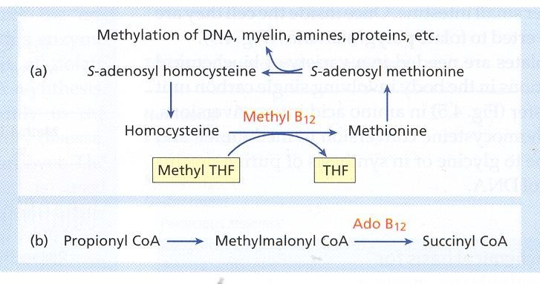
.

Slide 36
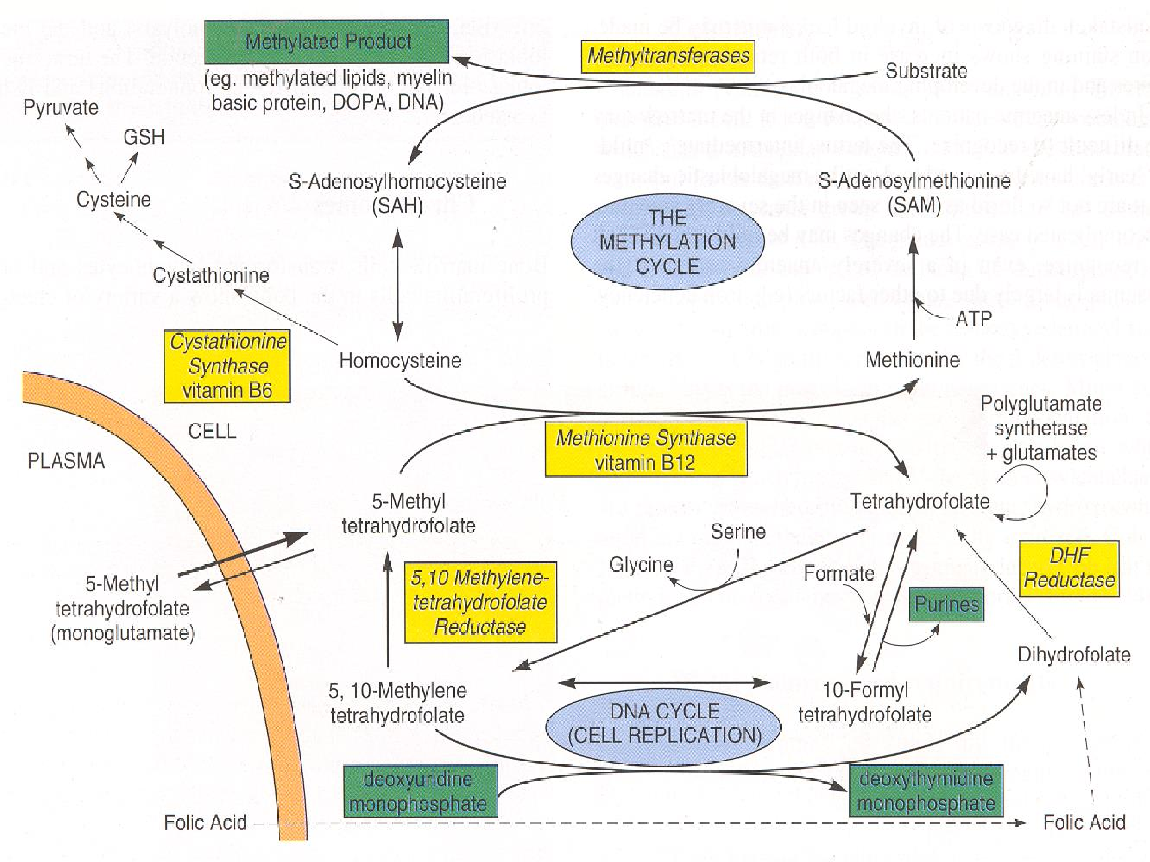
.

Slide 37
Clinical Features of Megaloblastic Anaemia –
Progressive symptoms and signs of anaemia
====================================================================================================================
Weakness, anorexia, weight loss, diarrhoea or constipation, tiredness, shortness of breath, angina of effort, heart failure
Mild jaundice, glossitis, stomatitis, angular cheilosis.
Purpura, melanin pigmentations.
Infections
====================================================================================================================

Slide 38
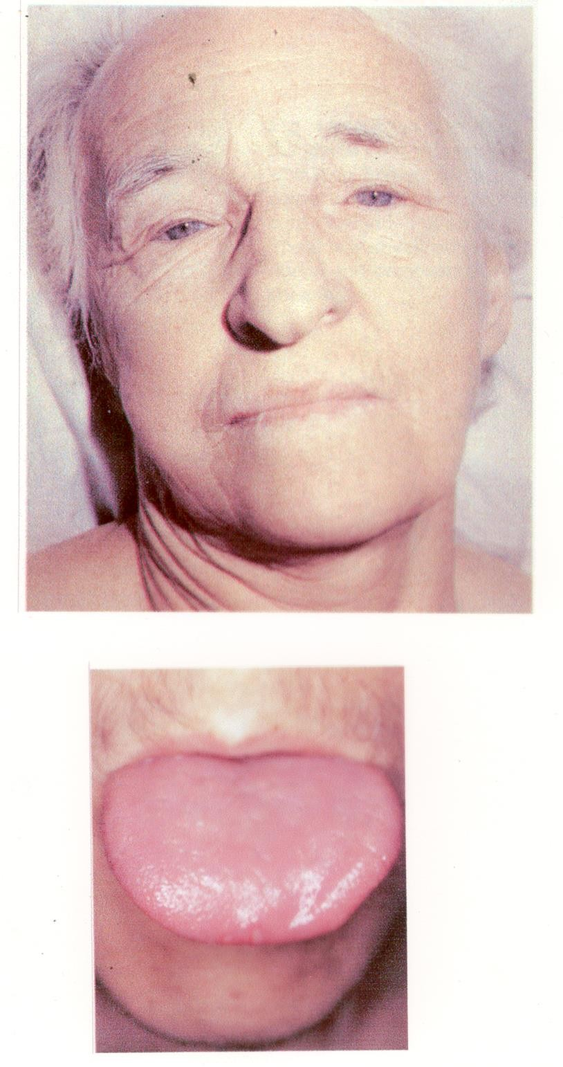

Slide 39
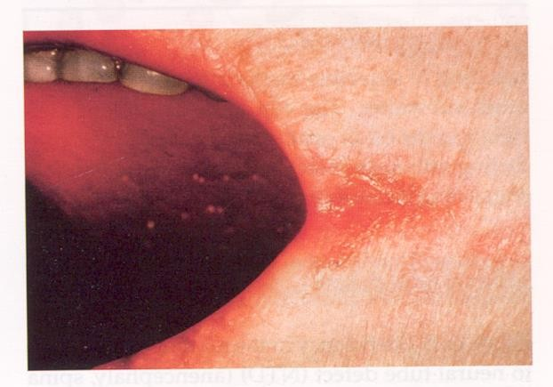

Slide 40
Neuropathy due to Vit B₁₂ and folate deficiency
====================================================================================================================
Progressive neuropathy affecting
The peripheral sensory nerves
Posterior and lateral columns of the spinal cord (subacute combined
degeneration of the cord)
Optic atrophy
Psychiatric symptoms
The neuropathy is likely due to accumulation of S-adenosyl homocysteine and reduced level of S-adenosyl methionine in nervous tissue resulting in defective methylation of myelin and other substrates.
Neuropathy is mostly due to vitamin B₁₂ deficiency.
============================================================

Slide 41
Neural tube defect (NTD)
====================================================================================================================
- (Anencephaly, spina bifida or encephalocoele) in the fetus due to folate or Vit B₁₂ deficiency in the mother. This result in build-up of homocysteine and S- adenosyl homocysteine in the fetus which impair methylation of various proteins and lipids.
- Polymorphism in
the enzyme 5,10 methylene
tetrahydrofolate reductase (5,10-MTHFR). This mutation (677 C→T) in the MTHFR gene results in low serum and red cell folate and high serum homocysteine in the parents and fetus with NTD.
- Cleft palate and hair lip.
======================================================================================

Slide 42
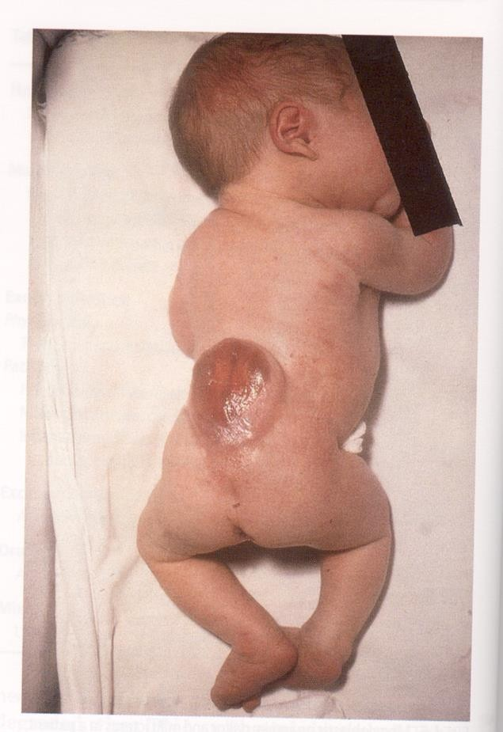

Slide 43
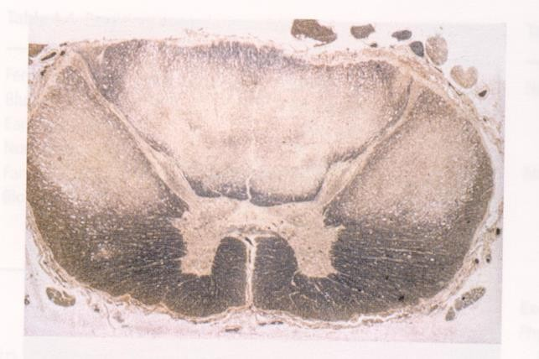

Slide 44
Haematological findings in Megaloblastic Anaemia
======================================================================================================================================
Peripheral Blood:
Macrocytic anaemia, oval macrocytes,
anisocytosis, poikilocytosis high MCV.
Dimorphic anaemia when it is associated with
iron deficiency or with thalassaemia trait.
Hypersegmented neutrophils.
Leucopenia and thrombocytopenia
=========================================================================================================

Slide 45
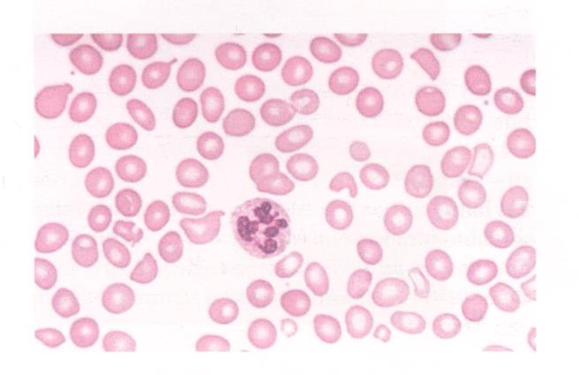

Slide 46
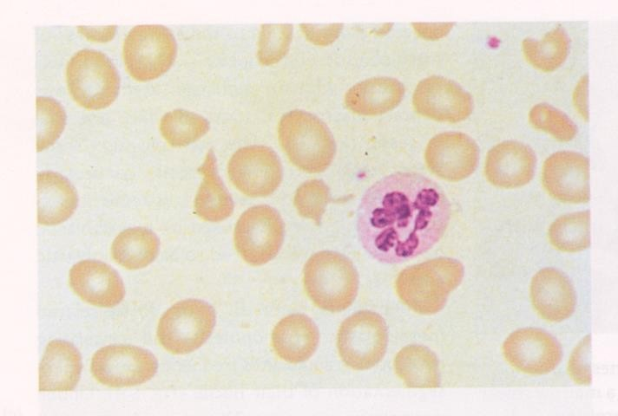

Slide 47
Haematological Findings in Megaloblastic Anaemia
=========================================================================================================
Bone Marrow:
Hypercellular marrow with M:E ratio in normal or reduced.
Accumulation of primitive cells due to selective death of more mature cells.
Megaloblast (large erythroblast which has a nucleus of open, fine, lacy chromatin).
Dissociation between the nuclear and cytoplasmic development in
the erythroblasts.
Mitosis and dying cells are more frequent than normal.
Giant and abnormally shaped, metamyelocytes, polypoid megakaryocytes.
Increased stainable iron in the macrophage and in the
erythroblasts.

Slide 48
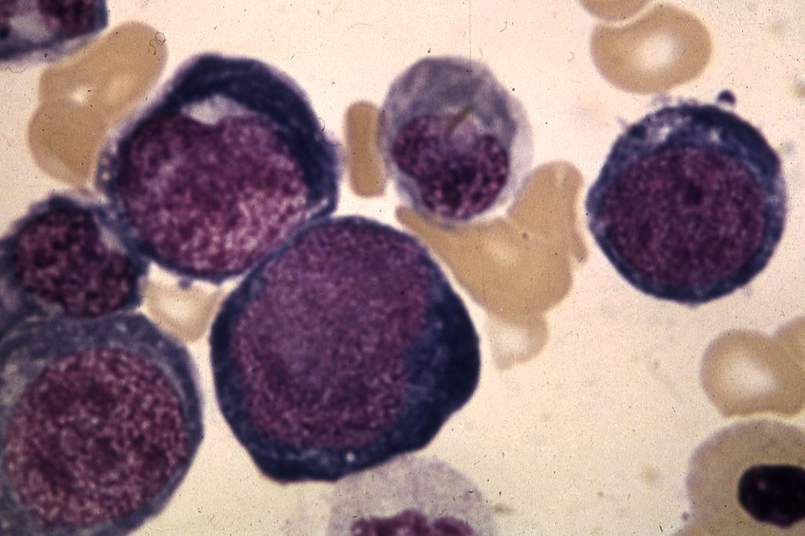
.

Slide 49
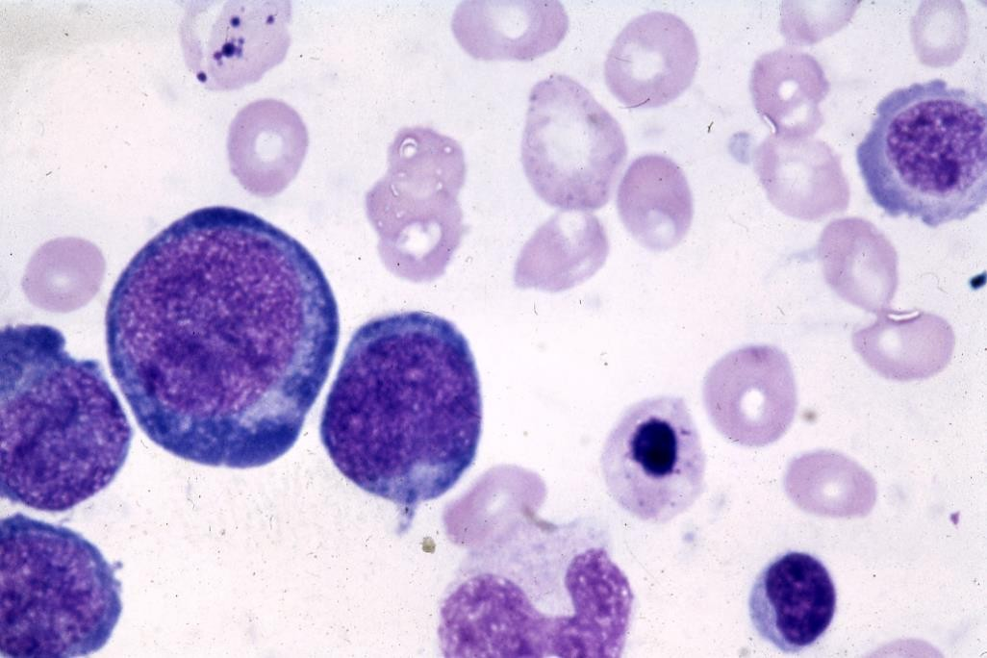
.

Slide 50
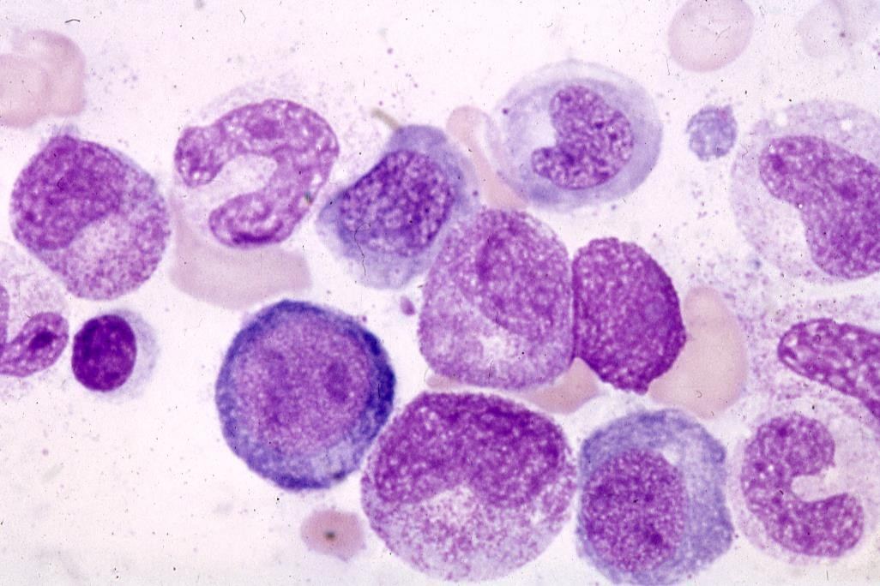
.

Slide 51
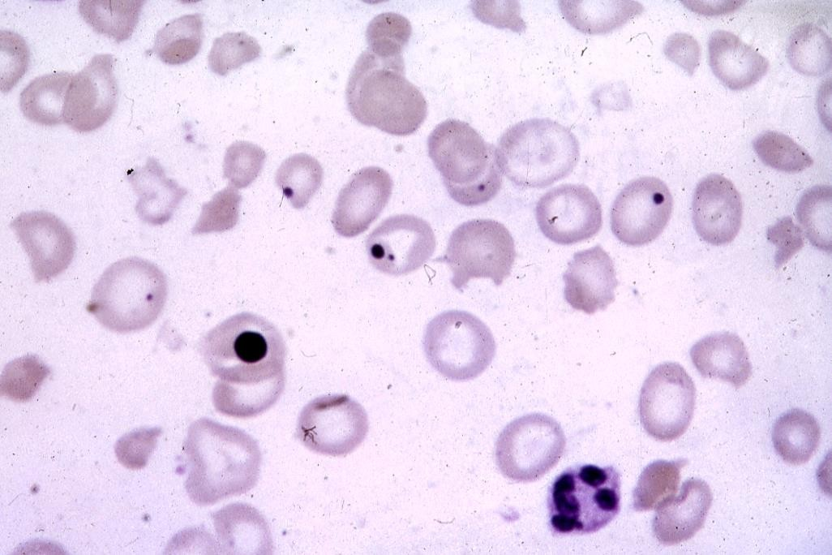
.

Slide 52
Other laboratory abnormalities
======================================================================================================================================
Chromosomal abnormalities
Ineffective haemopoiesis. (Intramedullary cell death by apoptosis)
associated with increased serum indirect bilirubin.
↑ urobillinogen and faecal stercobillinogen.
↑ LDH ↑ serum iron ↑ blood carbon monoxide.
↑ serum lysozyme
↓ reduced haptoglobins
Positive schumm’s test
Positive urine haemosiderin.
=========================================================================================================

Slide 53
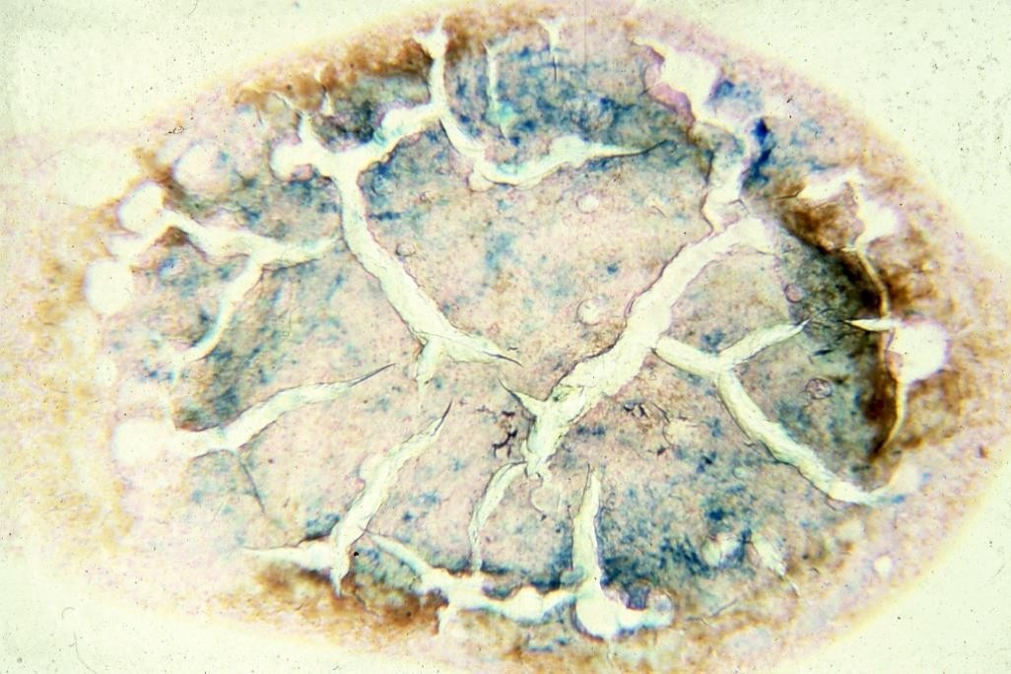
.

Slide 54
Treatment of megaloblatic anaemia
Vitamin B₁₂ deficiency
Folate deficiency
Folic acid
Oral
5mg
Daily for 4 months
Depends on underlying disease; life- long therapy may be needed in chronic inherited haemolytic anaemia, myelofibrosis, renal dialysis
Pregnancy, severe haemolytic anaemias, dialysis, prematurity
Compound Route Dose Initial dose
Maintenance
Hydroxocobalamin Intramuscular 1000 µg
6X1000 µg over 2-3 weeks
1000 µg every 3 months
Prophylactic
Total gastrectomy Ileal resection

Slide 55

Thank you !!!

