Slide 1
Practical Esophagus and Stomach

Slide 2
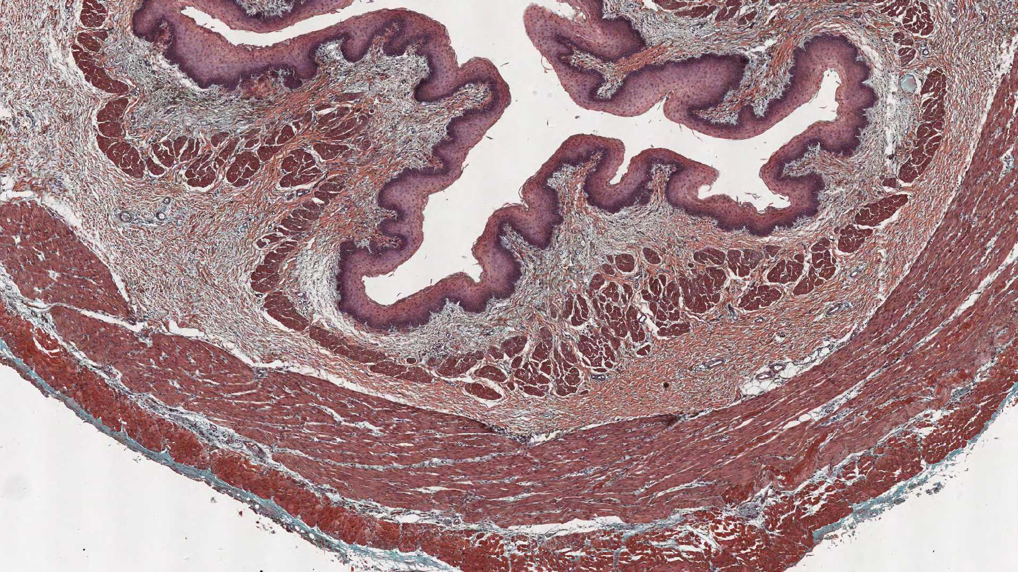
Esophagus

Slide 3
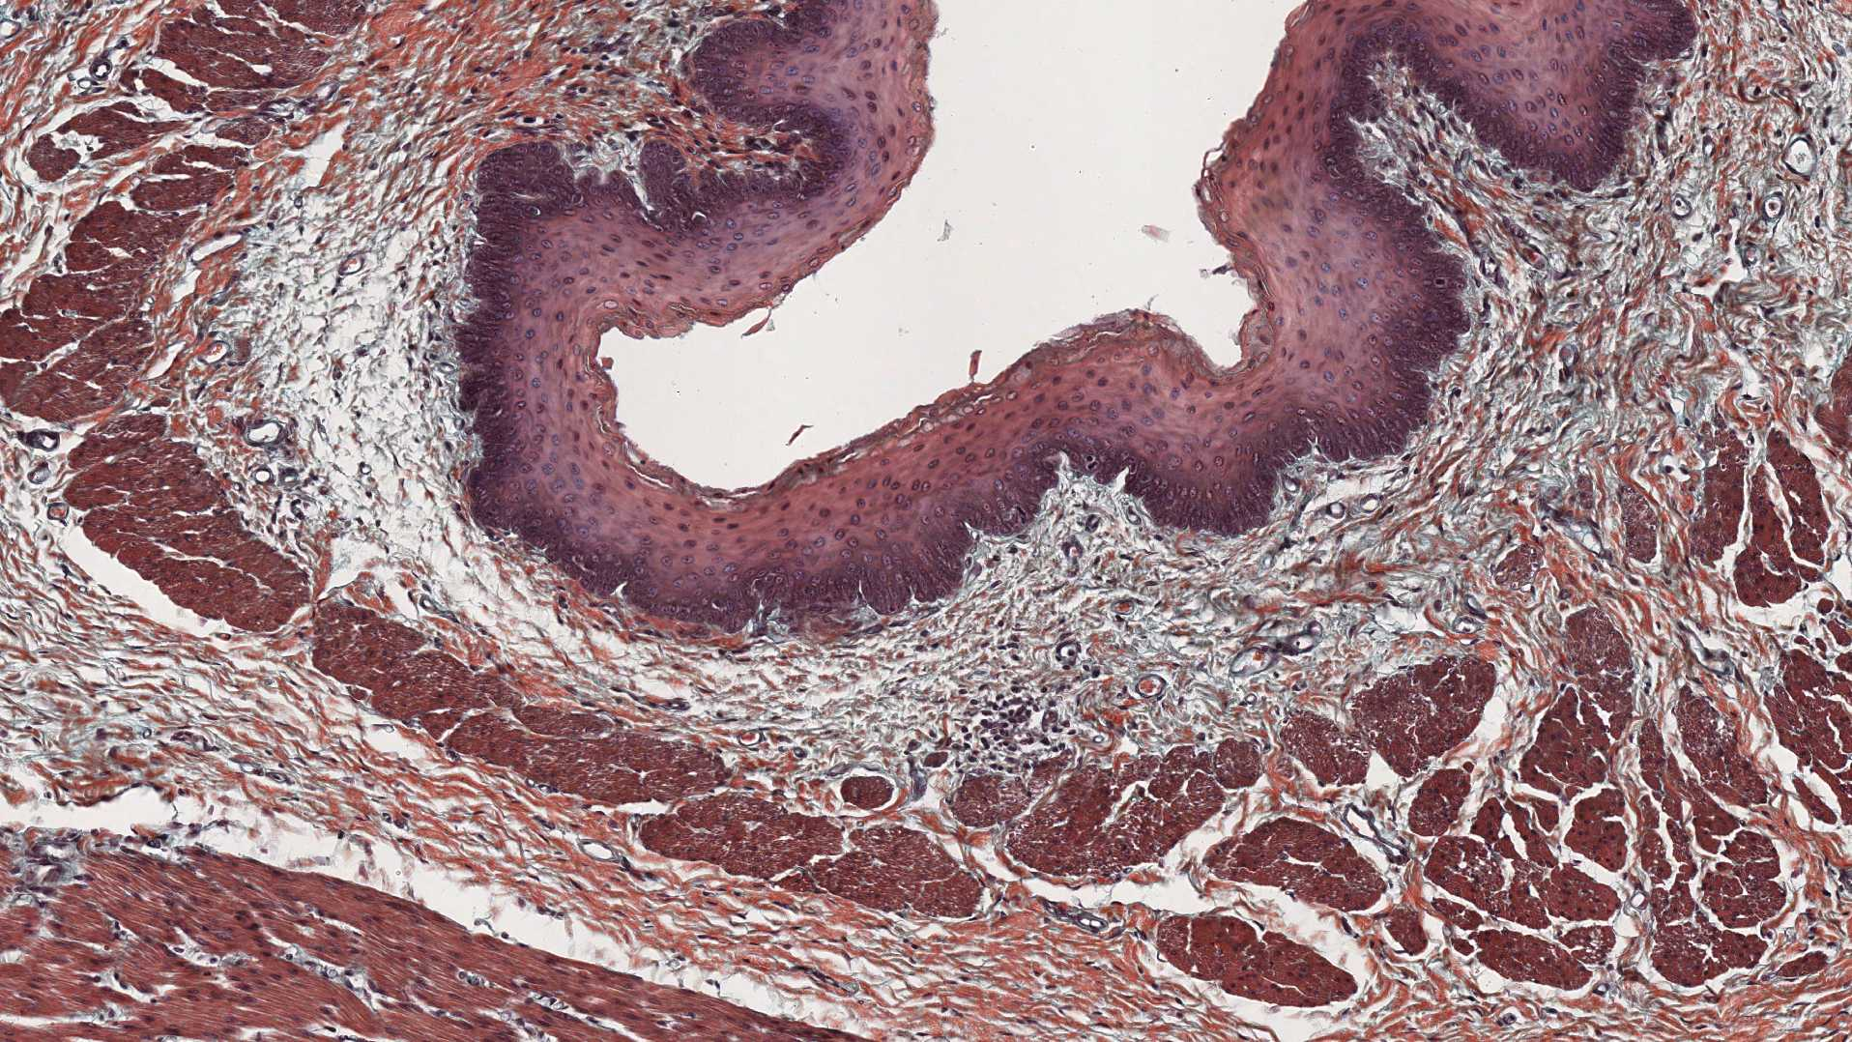
Esophagus

Slide 4
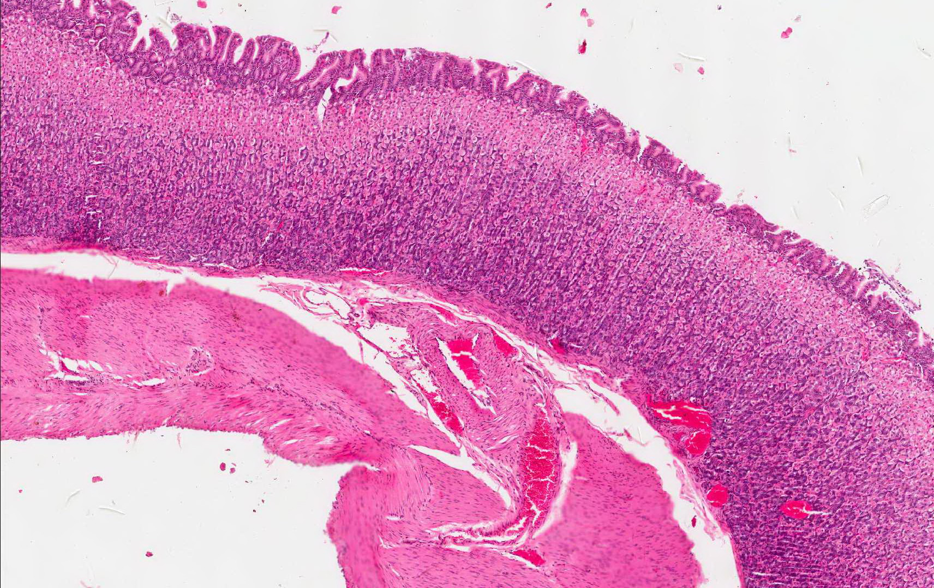
Fundus of the stomach

Slide 5
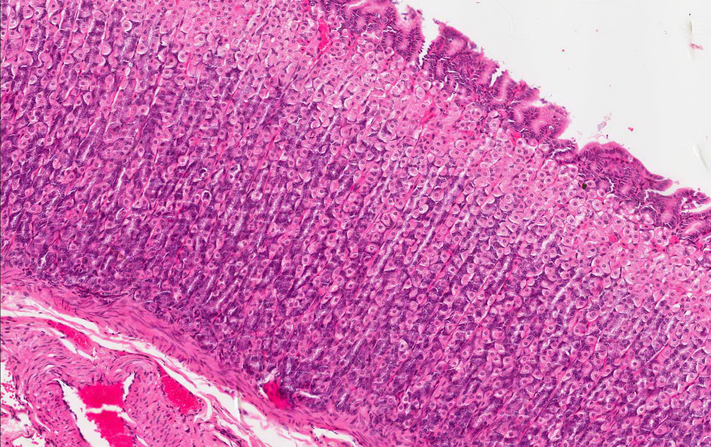
Fundus of the stomach

Slide 6
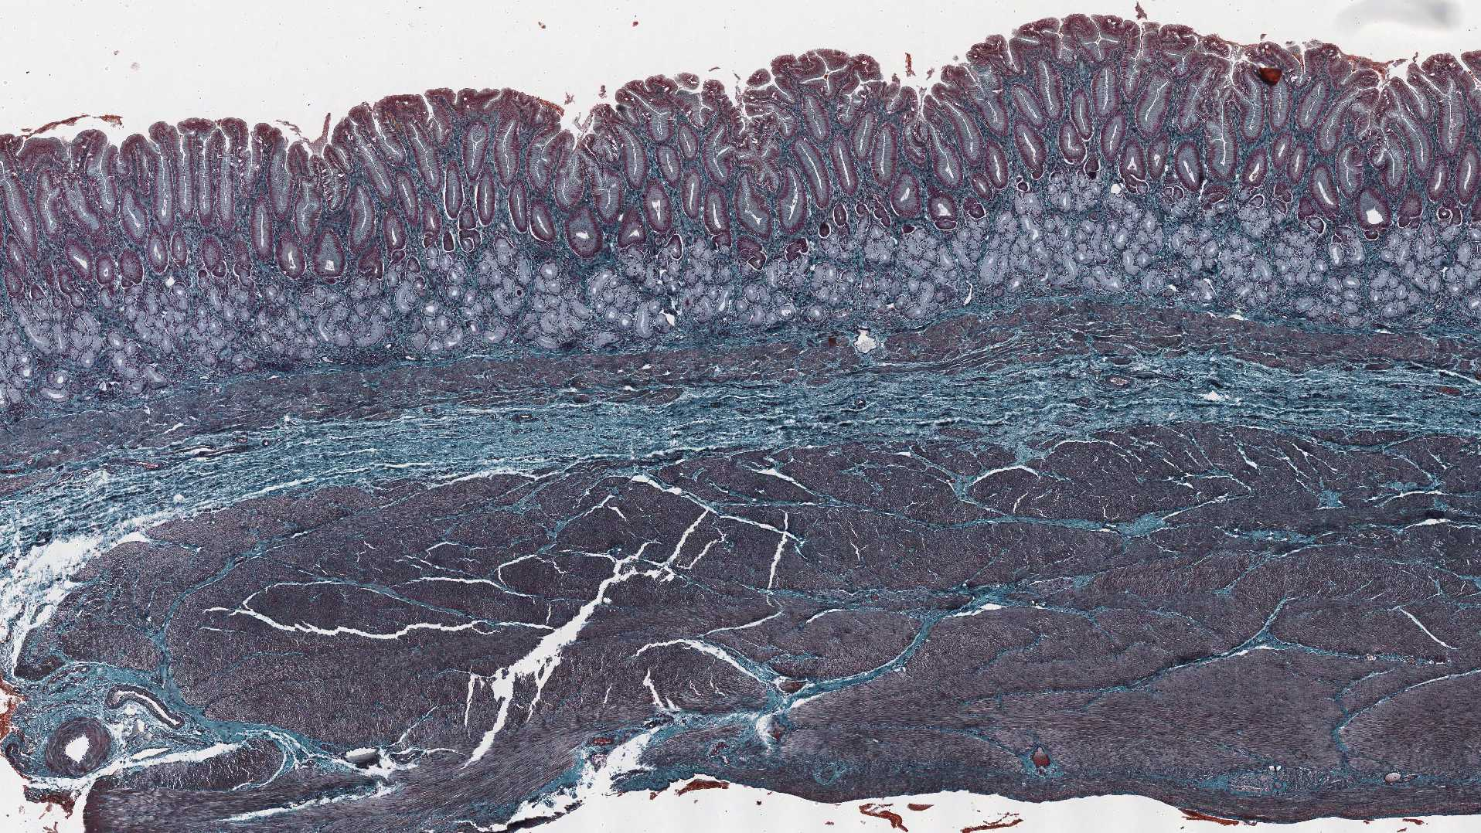
Pylorus of the stomach

Slide 7
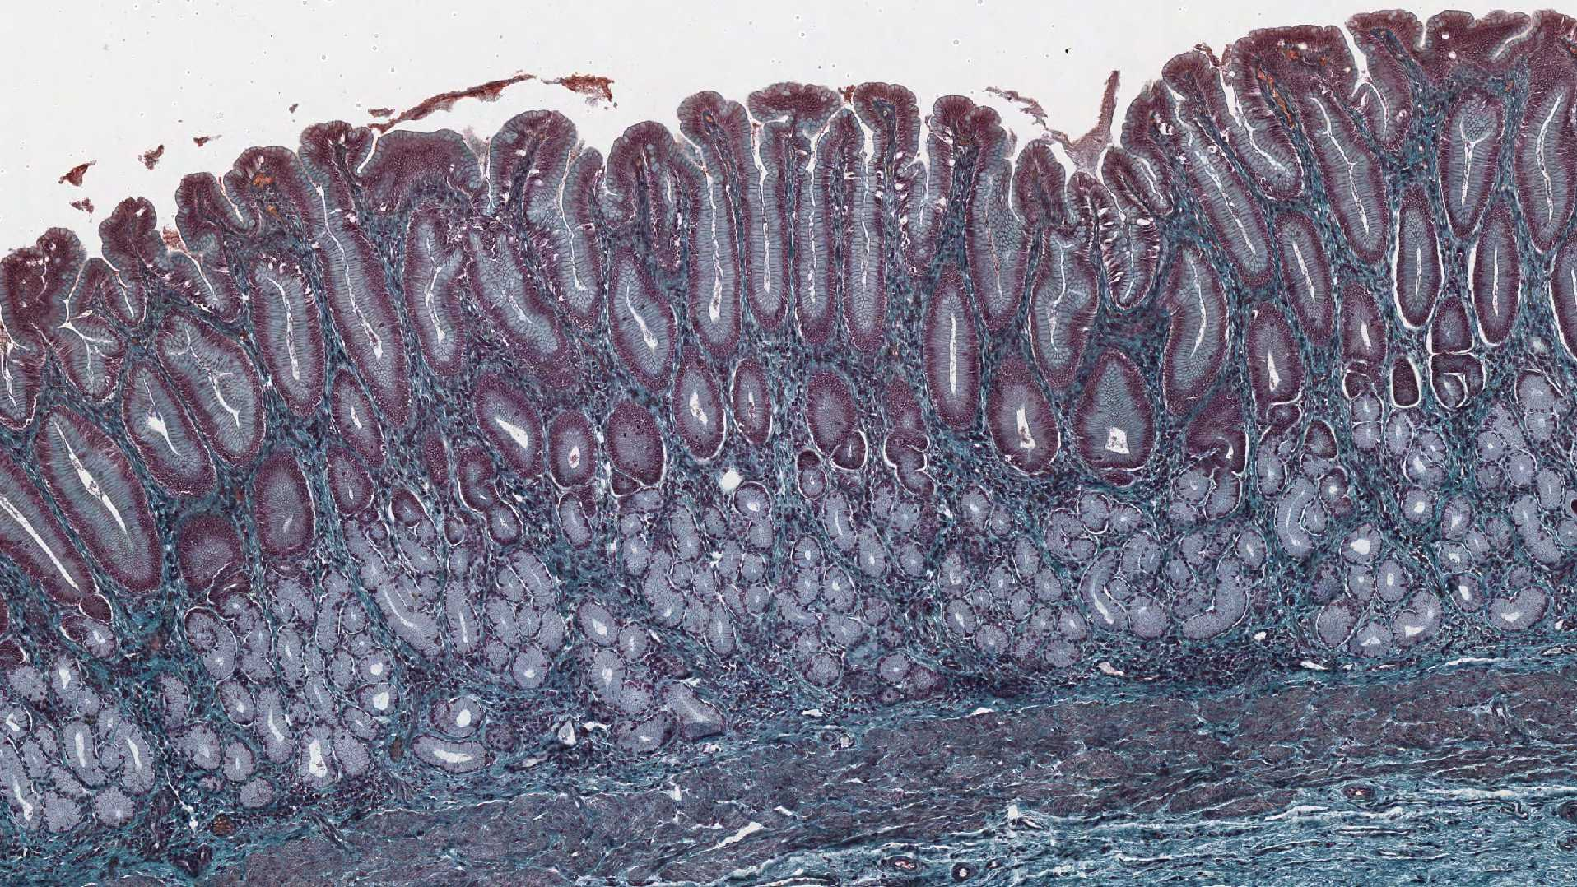
Pylorus of the stomach

