Slide 1
Normal Flora Of The GIT And Introduction To Infectious Diarrhea
Prof .Hanan Habib
Department of Pathology, College of Medicine, KSU

Slide 2
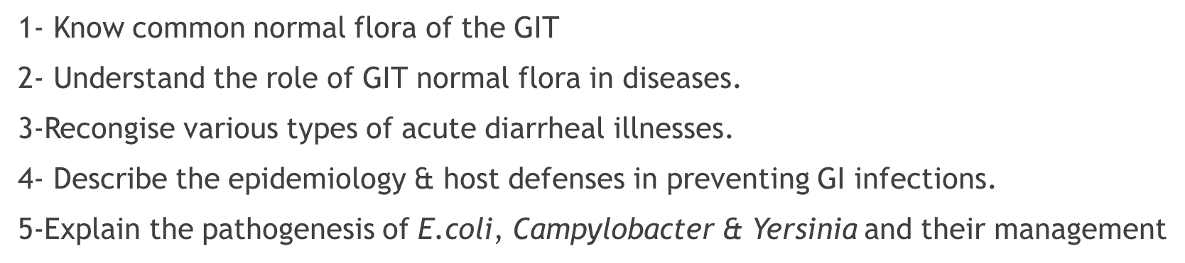
Objectives

Slide 3
Objectives
6-Discuss microbiological methods used for each bacterial agent causing diarrheal infection.
7-Describe the pathogens, risk factors, clinical presentation and prevention of food poisoning ,travelers and antibiotics associated diarrhea.

Slide 4
Introduction to Normal Flora
Normal flora are microorganisms that are frequently found in various body sites in normal, healthy individuals.
Constituents and number vary according to the age and physiologic status.
Able to colonize and multiply under the exiting condition of different body sites.
Inhibit competing intruders.
Have symbiotic relationship that benefit the host.
Can cause disease in immunocompromized patients.

Slide 5
Normal Flora of the GIT
Oral cavity: contain high number of flora which vary from site to site of the mouth.
Saliva contain mixed flora :108 organism /ml
Stomach : empty stomach has no normal flora in health due to HCL and peptic enzymes
Small intestine : very scanty except near colon
Colon of adults: 1010 org/gm stool, >90% are Bacteriodes ( anaerobic), 10% other bacteria.
Direct effect of diet composition.

Slide 6
Normal Flora of the GIT
Mouth: Viridans streptococci, Neisseria spp., Moraxella, Peptostreptococcus.
Nasopharynx :
Niesseria spp., Viridans sterpt. Moraxella, Peptostreptococcus.
Stomach : streptococci, Peptosterptococcus, others from mouth.
Small intestine: scanty, variable
Colon of adults :Bacteriodes,Fusobacterium,Bifidobacteria,Lactobacillus, enterobacteria, Clostridium
Colon of Breastfeeding infants: Bifidobacterium, Lactobacillus
Mouth: Candida albicans
Nasopharynx: S.pneumoniae, N.meningitidis, H.infuenzae,S.pyogenes, S.aureus
Stomach: none
Small intestine : none
Colon of adults: B.fragilis, E.coli, Pseudomonas, Candida, Clostridium
Colon of Breast feeding infants: none
Normal flora ( low virulence)
Potential pathogen (carrier)

Slide 7
Role of GIT Normal Flora in Disease
Many are opportunistic pathogens. Example: perforation of the colon from ruptured diverticulum, feces enters into peritoneal cavity and cause peritonitis
Viridans streptocci of oral cavity enters the blood and colonize damaged heart valves.
Mouth flora play a role in dental caries.
Compromised defense systems increase the opportunity for invasion.
Death after lethal dose of radiation due to massive invasion of normal flora.

Slide 8
Role of Normal Flora in Diarrheal Diseases
E.coli : the most common Enterobacteriacae; a facultative flora of colon followed by Klebsiella, Proteus and Enterobacter.
Salmonella, Shigella and Yersinia are NOT normal flora of the intestinal tract.
Some strains of E.coli ,Salmonella ,Shigella and Yersinia enterocolitica are able to produce diseases in the intestinal tract.

Slide 9
Intestinal Pathogens
Invasive and Cytotoxic strains produce inflammatory diarrhea ( Dysentry ) with WBCs and /or blood in the stool.
Enterotoxin –producing strains cause watery diarrhea with loss of fluid.
Some produce systemic illness due to spread to multiple organs such as enteric ( typhoid) fever.

Slide 10
Acute Diarrheal Illnesses and Food Poisoning

Slide 11
Introduction
Acute diarrheal illness is one of the most common problems evaluated by clinicians.
A major cause of morbidity and mortality world wide.
Most of healthy people have mild illness but other might develop serious squeals so it is important to identify those individuals who require early treatment.

Slide 12
Definition of Diarrhea
Stool weight in excess of 200 gm/day
Three or more loose or watery stools/day
Alteration in normal bowel movement characterized by decreased consistency and increased frequency
Less than 14 days in duration.

Slide 13
Etiology
Viral: 70-80% of infectious diarrhea in developed countries
Bacterial: 10-20% of infectious diarrhea but responsible for most cases of severe diarrhea
Protozoan: less than 10%.

Slide 14
Epidemiology
1.2 - 1.9 episodes per person annually in the general population
2.4 episodes per child <3 years old annually
5 episodes per year for children <3 years old and in daycare
Seasonal peak in the winter.

Slide 15
Classifications
Infectious Diarrhea: Viral, Bacterial (eg. Campylobcator, Shigella, Salmnella, Yersinea, Vibrio cholera & E.coli).
Food Poisoning: Staphylococcus aureus, Clostridium perfringens, Bacillus spp.
Traveler Diarrhea : Enterotoxogenic E.coli.
Antibiotic Associated Diarrhea: Clostridium difficile.

Slide 16
Risk Factors
Food from restaurant
Family member with gastrointestinal symptoms
Recent travel to developing countries
Patient underlying illness and medication, low stomach acidity, cyst, spores
Abnormal peristalsis
Low Immunoglobulin IgA.
Antibiotics decrease the normal flora to less 10¹²
Median infective dose (ID₅₀)

Slide 17
Clinical Presentation and Pathogenic Mechanism I
Enterotoxin mediated
Lack of pus in the stool (no gut invasion)
Lack of fever
Rapid onset performed toxin<12 hour
Small intestine affected.
Vomiting non-bloody diarrhea, abdominal cramp.
Vibreo cholerae, Staphylococcus aureus, Clostridium perfringens and Bacillus cereus
Other viral and some parasitic infections.

Slide 18
Clinical Presentation and Pathogenic Mechanism II
Invasive
Pus and blood in the stool
Fever due to inflammation
Shigella, Solmonella spp., Campylobacter, some E.coli and Entameba histolytica
Affect colonic mucosa
Extension to lymph nodes
Incubation period 1-3 days
Dysentery syndrome- gross blood and mucous
EHEC bloody diarrhea
Entameoba histolytica 1-3 wk

Slide 19
Campylobacter
Family :Campylobacteraceae
Common species : C.jejuni, C. coli, C fetus.
Epidemiology
Source: dog , cat, birds, poultry ,water, milk, meat, person to person transmission can occur.

Slide 20
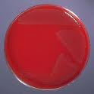
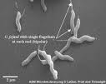
Campylobacter

Slide 21
Clinically
Incubation period: 2-6 days
Lower abdominal pain , watery or dysenteric diarrhea with pus and blood. fever in some patients . Nausea and vomiting are rare
Self limiting after 2-6 Day
Chronic carrier
Guillain- Barrie’ syndrome and Reactive arthritis cases frequently preceded by C.jejuni infection.

Slide 22
Laboratory diagnosis and treatment
Laboratory diagnosis:
  Transport media
  Culture on CAMPYBAP media contain antibiotics.
  Incubate in microaerophilic atmosphere (5%O₂ 10%CO₂ 85%N ) at 42°C except C.fetus 37°C
  Identification :Gram stain/culture biochemical/Serology.
Treatment:
  Only severe cases
  Erythromycin or Ciprofloxacin .

Slide 23
E.coli
About 10 -15% of strains of E. coli associated with diarrhea.
Based on virulence factors, clinical manifestation, epidemiology and different O and H serotype. There are five major categories of diarrheagenic E.coli .
Types of Diarrheagenic E. coli :
  Enterotoxigenic E. coli (E T E C)
  Enteropathogenic E. coli (E P E C)
  Enteroinvasive E. coli (E I E C)
  Enterohaemorrhagic E. coli (E H E C )
  Enteroaggregative E.coli (EAEC)

Slide 24
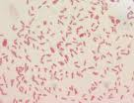
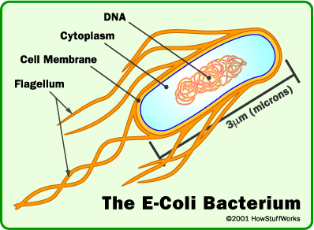
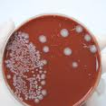
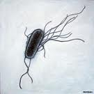
E.coli

Slide 25
1. Enterotoxigenic E.coli (ETEC)
Major cause of Traveler's diarrhea in infant and adult in developing countries from contaminated food and water.
It has high infective dose 10⁶-10¹⁰
Has heat-labile toxin (LT) and heat-stable toxin (ST) each has two fragment (A and B) . No invasion or inflammation.
LT leads to accumulation of CGMP, which lead to hyper-secretion of fluid with no cellular injury
Symptoms watery diarrhea, abdominal cramps and some time vomiting .
Self limiting .No routine diagnostic method required.

Slide 26
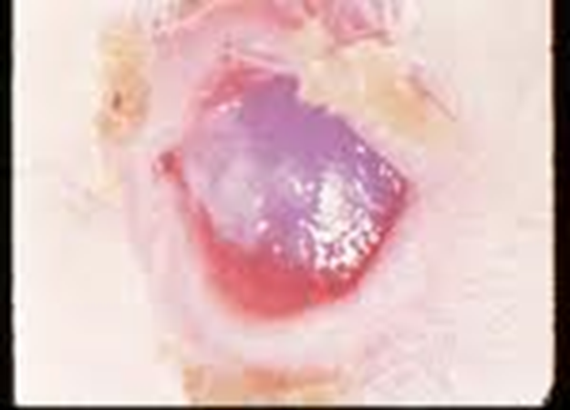
2. Enteroinvasive E.coli ( EIEC)
Produce dysentery (Penetration, invasion and destruction).Common in children.
Similar to Shigella spp. (non motile, LNF)
Transmission :Fecal oral route .
Fever, severe abdominal cramp, malaise and watery diarrhea
Infective dose 10⁶
Diagnosis Sereny test and DNA probes.

Slide 27
3-Enteropathogenic E.coli ( EPEC)
Cause infantile diarrhea ( bottle fed infants)
Disrupt microvilli and intestinal absorptive function.
Outbreak in hospital nurseries and day care centers
Low grade fever, malaise, vomiting and watery diarrhea
mucous in stool but no blood.

Slide 28
4-Enterohemorrhagic E.coli ( EHEC)
0157:H7 Hemorrhagic diarrhea, colitis and hemolytic uremic syndrome (HUS)=low Platelet count, hemolytic anemia and kidney failure
Bloody diarrhea, low grade fever and stool has no leucocytes
Fatal disease in young and elderly persons in nursing homes
Undercooked hamburgers, unpasteurized dairy products, Apple cider, cookie dough
Cytotoxin =vertoxin І and vertoxin ІІ Similar to Stx₁ (shiga-toxin I&II)
E.coli other than 0157:H7 can cause HUS.
Diagnosis by culture on SMAC(sorbitol MacConkey agar cefixime), Vertoxin detection by immunological test or PCR.

Slide 29
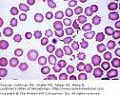

HUS

Slide 30
5. Enteroaggregative E.coli ( EAEC)
Pediatric diarrheal disease
Adhering to the surface of the intestinal mucosa. Produce aggregative stacked brick .
Produce mucoid ,watery diarrhea, vomiting, dehydration and abdominal pain
may resolve after two weeks or more .

Slide 31
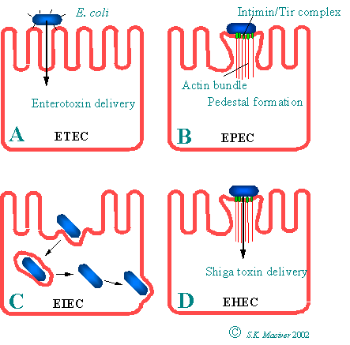

Slide 32
Yersinia enterocolitica
Mesenteric lymphadenitis in children and septicemia in immunocompromised hosts
Common in Europe, USA, Canada .Cat, dog, swine (chitterlings)
Survive cold temperatures and associated with transfusion of packed red blood cells.
Presented with enteritis, arthritis and erythema nodosum
Generalize infection in adult and children 1-5 year, usually mild but in old children adult mimic appendicitis
Growth at 25°-30°C media Cefsulodin-Igrasan-Novobiocin

Slide 33
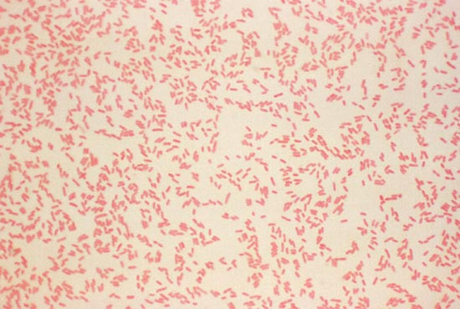

Yersinia enterocolitica

Slide 34
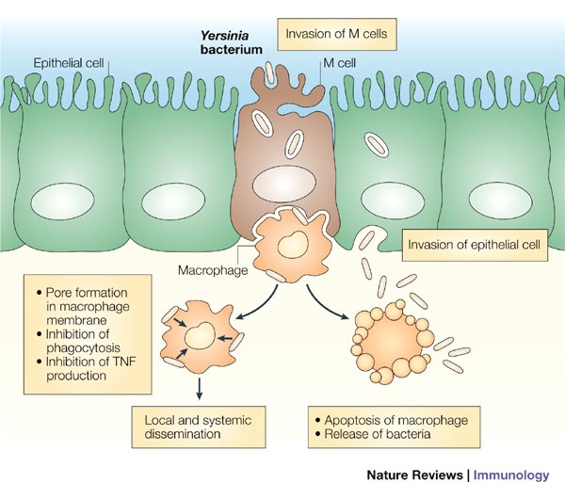

Slide 35
Clostridium difficile
Antibiotic associated diarrhea ( ampicillin, cephalosporins & clindamycin).
Transmits from person to person via fecal-oral route
Cultured from in animate hospital surfaces.
Disruption of the endogenous bacterial flora of the colon
Produce toxin A ( enterotoxic & cytotoxic effects ) and B ( cytotoxic ) that can bind to surface epithelial cell receptors leading to inflammation mucosal injury and diarrhea.

Slide 36
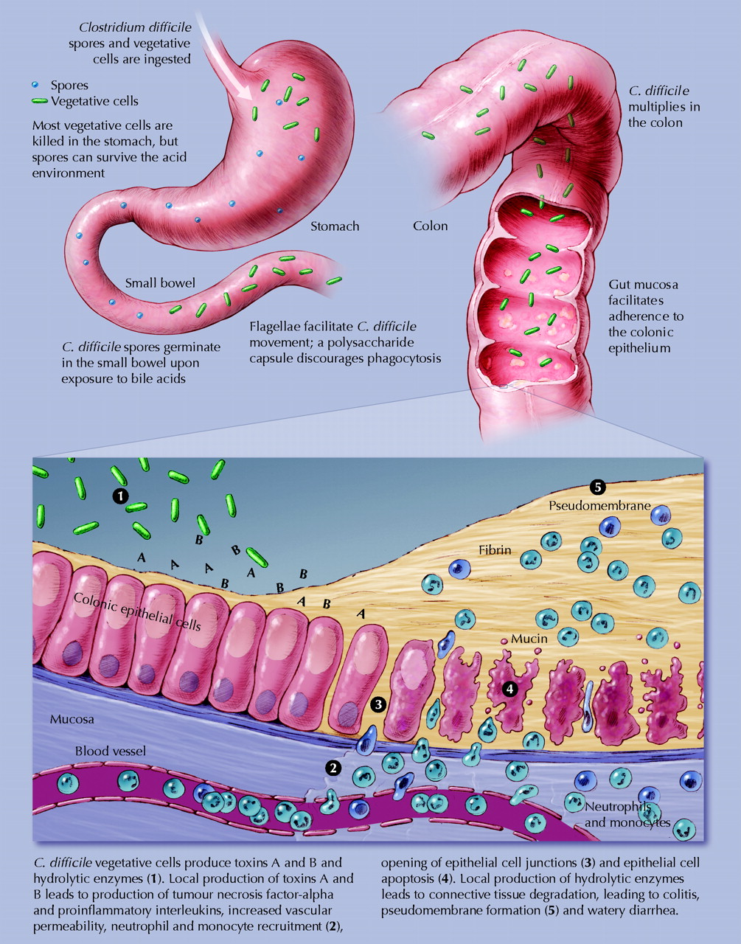

Slide 37




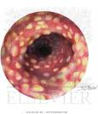
C.difficile & pseudomembraneous colitis

Slide 38
Clostridium difficile
Patient presents with fever, leukocytosis, abdominal pain and diarrhea
Pseudomembrane can result (neutrophils, fibrin, and cellular debris in the colonic mucosa) and toxic megacolon
Diagnosis: direct toxin detection from stool by enzyme immunoassay(EIA)
Treatment Metronidazole ± Vancomycin and supportive treatment

Slide 39
Selected Clinical and Epidemiologic Characteristics of Typical Illness Caused By Common Foodborne Pathogens*
Pathogen | Typical Incubation Period | Duration | Typical Clinical Presentation | Assorted Foods
Bacterial
Salmonella species | 1-3 Days | 4-7 Days | Gastroenteritis | Undercooked eggs or poultry, produce
Campylobacter jejuni | 2-5 Days | 2-10 Days | Gastroenteritis | Undercooked poultry, unpasteurized dairy products
E. coli, Enterotoxigenic | 1-3 Days | 3-7 Days | Gastroenteritis | Many foods
Shigella species | 1-2 Days | 4-7 Days | Gastroenteritis | Produce, egg salad

Slide 40
Listeria monocytogenes | 2-6 weeks | Variable | Gastroenteritis, meningitis abortion | Deli meat, hotdogs, unpasteurized dairy products
Bacillus cereus | 1-6 hour | <24 hour | Vomiting, Gastroenteritis | Fried rice, meats
Clostridium botulinum | 12-72 hour | Days-months | Blurred vision, paralysis | Home-canned foods, fermented fish
Staphylococcus aureus | 1-6 hour | 1-2 Days | Gastroenteritis, particularly nausea | Meats, potato & pork, unpasteurized dairy products.
Yersinia enterocolitica | 1-2 Days | 1-3 weeks | Gastroenteritis, appendicitis-like syndrome | Undercooked pork, unpasteurized dairy products.

Slide 41
Lab diagnosis of diarrheal diseases
Stool specimens:
Microscopy: for the presence of polymorphs or blood may help . Test for the presence of ova & parasites.
Culture :on selective media for Salmonella, Shigella & Campylobacter. Other organisms eg. Vibreo choleae, EHEC or Yersinia if suspected.
Toxin assay: C.difficile toxins or Verotoxin if suspected.

