Slide 1
Salmonella & shigella
GIT BLOCK
Prof. Ali Somily & Prof .Hanan Habib
Department of Pathology& Laboratory Medicine
KSUMC

Slide 2
Objectives
1-Develop an algorithm using biochemical to
identify and classify Salmonella and Shigella
2- Describe the antigenic structures and virulence factors of Salmonella and Shigella
3- Compare the pathogenesis of various species of Salmonella and Shigella
4-Describe the clinical features and risk factors for the infection with the two organisms
5- Describe the general concepts for the management of gastroenteritis caused by both organisms.

Slide 3
SALMONELLA

Slide 4
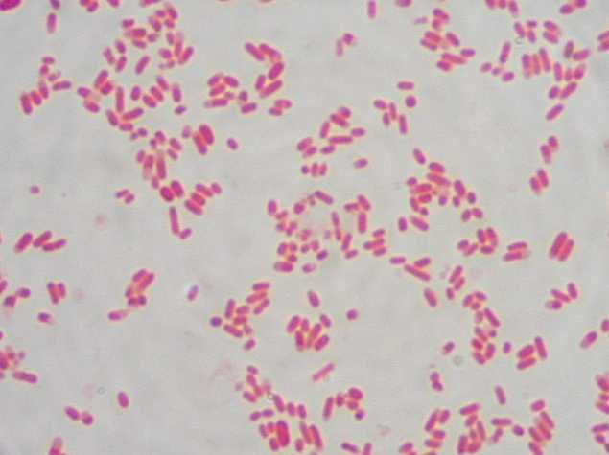
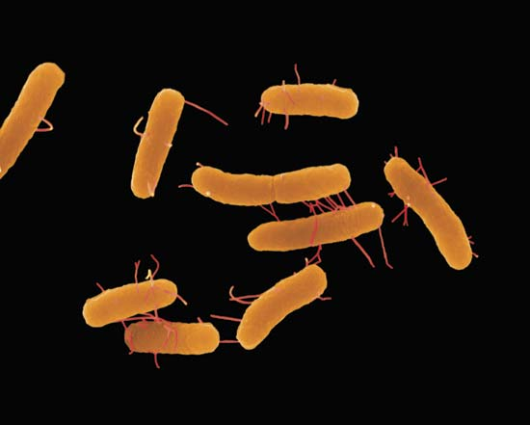
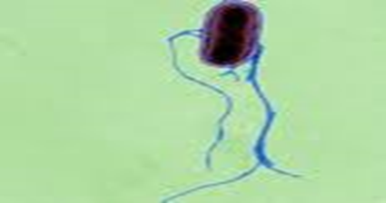
Salmonella

Slide 5
INTRODUCTION
Gram negative facultative anaerobic bacilli
Non lactose fermenting colonies
Motile

Slide 6
CLASSIFICATION -Has two species s.enterica (six subspecies I, II, III, IV, V, VI) s.borgori (rare) -Cold blooded animal, birds, rodents, turtles, snake and fish
Has two species S.enterica (six subspecies I, II, III, IV, V, VI) S.borgori (rare)
Cold blooded animal, birds, rodents, turtles, snake and fish

Slide 7
VIRULENCE FACTORS
Fimbriae ( Pili) : for adherence
Enterotoxin

Slide 8
Antigenic structures
O. Somatic antigen
H. Flagellar antigen
K. Capsular antigen

Slide 9
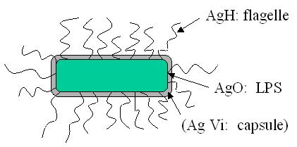
V_{i} surface polysaccharide antigen in Salmonella serotype typhi prevents phagocytosis & allow intracellular survival.
O Antigen (Heat – stable) is lipopolysaccharide in the outer membrane
H antigen (Heat labile)

Slide 10
CLINICAL FEATURES
Acute gastroenteritis
Typhoid fever
Nontyphoidal bacteremia
Carrier state following Salmonella infection

Slide 11
Source
Water, food and milk contaminated with human or animal excreta.
Salmonella typhi and S. paratyphi : the source is human.

Slide 12
GASTROENTERITIS
Food poisoning through contaminated food
S. enterica subsp. enterica
Source :poultry, milk, egg & egg products and handling pets
Infective dose: 10⁶ bacteria
IP: 8 – 36 hrs.
fever, chills, watery diarrhea and abdominal pain. Self limiting.
In sickle cell ,hemolytic disorder and ulcerative colitis, elderly or very young patients; the infection may be very severe.
Patients at high risk for dissemination ; antimicrobial therapy is indicated.

Slide 13
ENTERIC FEVER
Prolonged fever
Bacteremia
Involvement of the reticulo endothelial system (liver, spleen, intestines and mesentery)
Dissemination to multiple organs
Ingestion of contaminated food by infected or carrier individual
Caused by Salmonella serotype typhi or S. paratyphi A, B and C (less severe)
Common in tropical ,subtropical countries, travelers due to inappropriate sewage disposal and poor sanitation.
IP : 9 – 14 days.

Slide 14
First week: fever, malaise, anorexia, myalgia and a continuous dull frontal headache then,
Patient develops constipation
Mesenteric lymph node → blood stream liver, spleen and bone marrow
Engulfment of Salmonella by mononuclear phagocytes .
Bacteria released into the blood stream again and can lead to high fever .Positive blood culture at this stage.

Slide 15
2nd and 3rd week
Sustained fever & prolonged bacteremia.
Invade gallbladder and Payer's patches
Rose spots 2nd week of fever
Billiary tract → GIT
Organism isolated from stool in large number.

Slide 16
Management & Treatment
Ceftriaxone
Ciprofloxacin
Trimelhoprim – Sulfamethoxazole
Ampicillin
Azithromycin or Ceftriaxone for patients from India and SEAsia due to Ciprofloxacin resistance of strains. Ciprofloxacin can be used for patients from other areas.
Uncomplicated cases of Salmonella gastroenteritis require fluid and electrolyte replacement only.

Slide 17
COMPLICATIONS
Necrotizing cholecystitis
Bowel hemorrhage and perforation
Pneumonia and thrombophlebitis
Meningitis, osteomyelitis, endocarditis and abscesses.

Slide 18
SHIGELLA

Slide 19
Non lactose fermenting bacteria
Cause bacillary dysentery ( blood, mucus and pus in the stool)

Slide 20
ANTIGENIC STRUCTURE
Has four species and four major O antigen groups
All have O antigens ,some serotype has K antigen
Shigella are non motile so lack H antigen

Slide 21
CLINICAL INFECTION
S.sonnei : most predominant in USA. Produce fever & watery diarrhea.
S.flexneri :2nd common in developing countries
Young adult & ( man who have sex with man)
S. dysenteriae and S. boydii are most common isolates in developing countries
S. dysenteriae type 1 associated with morbidity and mortality.
Human is the only reservoir

Slide 22
Person to person through fecal –oral route .
Flies, fingers ( have role in spread).
Food and water.
Young children in daycare, people in crowded area and anal oral sex in developed countries.
Low infective dose < 200 bacilli
Penetrate epithelial cells ,leads to local inflammation, shedding of intestinal lining and ulcer formation.

Slide 23
SYMPTOMS
High fever, chill, abdominal cramp and pain accompanied by tenesmus , bloody stool with mucus & leukocytes.
IP : 24 - 48 hrs
Can lead to rectal prolapsed in children
Complications: ileus, obstruction dilatation and toxic mega colon
Bacteremia in 4 % of severely ill patient
Seizures, HUS ( hemolytic uremic syndrome)

Slide 24
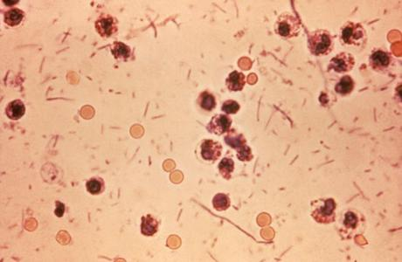
DYSENTRY STOOL

Slide 25
Lab diagnosis of Salmonella & Shigella in stool
-Both are Gram negative bacilli
-Culture in selective media
-Biochemical tests
-Motility test
-Serology for serotypes.

Slide 26
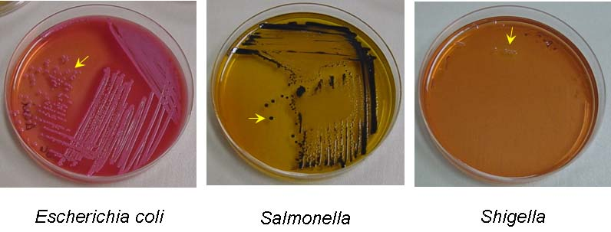
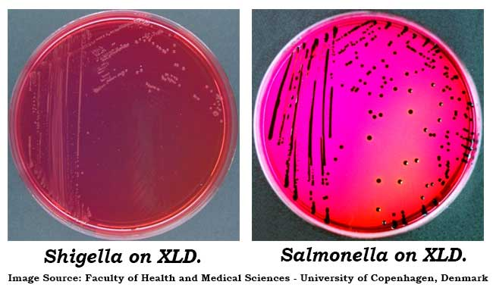

Slide 27
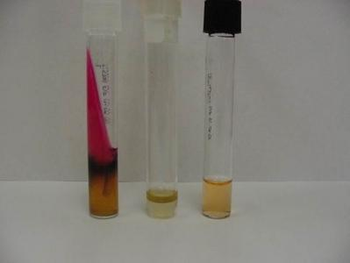
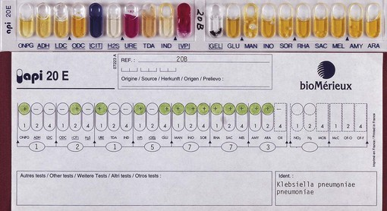
BIOCHEMICAL TESTS

Slide 28
MOTILITY TEST

Slide 30
Treatment of Shigella Dysentery
-Antibiotic indicated if symptoms were severe and to reduce duration of illness.
-Antimicrobial agents depending on susceptibility testing including :
Ampicillin
Ceftriaxone
TMP-SMX
Ciprofloxacin

