Slide 1
King Saud University College of Medicine
Department of Medical Education and the Department of Pathology
MICROBIOLOGY
PRACTICAL
YEAR TWO, GASTROINTESTINAL & HAEMATOLOGY BLOCK
STUDENT’S TASK-2017

Slide 2
Copyright Statement
This material is protected by copyright laws. For any other purposes other than teaching and research in the King Saud University, no part may be reproduced or copied in any form or by any means without prior permission of the King Saud University
© King Saud University, Kingdom of Saudi Arabia .
This practical class is designed and Prepared by:
Prof. Samy A. Azer (Medical Education) Dr. Ali Somily (Microbiology)
Prof. Abdul Mageed Kambal(Microbiology) Dr. Malak El-Hazmi (Microbiology)
Dr. Fawzia Al-Otaibi (Microbiology)

Slide 3
PART 1
objectives:
Understand the use of viral serological studies for the diagnosis of hepatitis A , B & C infections.
To know measures to prevent hepatitis A & B infections.
To know the viral serological tests used to screen blood donors.
Risk of transmission of HBV

Slide 4
King Saud University College of Medicine
Department of Medical Education and the Department of Pathology
Case 1
Mohammed Khan is a 20 year-old male who has recently arrived from India to work as a food handler in a restaurant in Riyadh. Three weeks after his arrival he was seen in A&E
Dept. of KKUH because of repeated vomiting, abdominal pain and fever. On examination, his temperature was 38°C, his pulse rate 110/min and BP 120/80mmHg, he was jaundiced and had tenderness in the right upper quadrant of his abdomen.
QUESTIONS
What are the possible causes for his presentation?
Viral hepatitis
Acute Cholecystitis
Malaria
Leptospirosis
Typhoid
2. What investigations would you like to order investigations would help you.
for him? Explain
how these

Slide 5
CBC & ESR
Blood Film for Malaria
Liver function tests
Viral Hepatitis screening
Blood Culture
Test | How this investigation will help you?
1. CBC & ESR | Shows non-specific signs of infections or inflammation
2. Blood Film for Malaria | To exclude malaria
3. Liver function test | To asses liver function
4. Viral Hepatitis screening | To exclude viral hepatitis
5. Blood Culture | To exclude typhoid fever
Investigation
CBC | LFTs
Hb = 14.2 g/L WBCs = 6100 mm³ Platelet= 271 g/L ESR= 4 mm/h Blood film for Malaria = -ve. Blood culture is negative. | AST 1557 U/L ALT 1879 IU/L ALP 441 IU/L Albn 42.3 g/L Bilirubin 86 µmol/L
3. Based on these findings what is the most likely diagnosis?

Slide 6
Viral Hepatitis A
B C E
4. What further investigations would you like to order? Hepatitis serology
5. The serologic results were as follows:
TEST | RESULT
Anti-HAV-IgM | Positive
HBsAg | Negative
Anti-HCV | Negative
Anti-HEV IgM | Negative
Based on the serologic results, what is the diagnosis?
…………Hepatitis A …………………………………………………….
Briefly outline the management of this patient.
Supportive
Not working
Contact tracing
Follow up (Clinical and laboratory)

Slide 7
Case 2
Mohammed Abdullah is a 34 year old married Saudi male who has donated two units of blood at KKUH for a relative undergoing an operation. Two days later, the Blood Bank called him because of abnormal blood test results.
On arrival to the blood bank, the doctor informed him that his blood is not suitable for transfusion because of the presence of infection and advised him to see his physician
QUESTIONS
What type of infectious agents can be transmitted through blood transfusion? (List 4 ).
HBV
HCV
HIV
HTLV

Slide 8
2. The next day Mohammed came to see his general practitioner with a letter from the Blood Bank. The letter revealed the result shown below.
what is your interpretation?
Test | Result
HBsAg | Negative
Anti-HBc | Negative
Anti-HCV | Positive
HIV-Ag/Ab | Negative
Anti-HTLV | Negative
2-What do you do next?
Repeat tests and Serology
LFTs

Slide 9
3. The results are available. See the table below. How would you interpret these results?
Lab. Test | Patient Result | Normal Range
ALT | 49 | 20-65 IU
AST | 29 | 12-37 IU
Bilirubin | 4 | 3-17 mol/L
HIV-Ag/Ab | Negative | -
Anti-HCV | Positive | -
HBsAg | Negative | -
Anti-HBc | Negative | -
Anti-HBs | Negative | -
How do you diagnose HCV infection?
Screening for (Anti-HCV) by ELISA
Confirmatory test by immunoblot assay

Slide 10
What other laboratory test needed?
The General practitioner arranged for him to see hepatologist who examined him and reviewed his results. He further requested PCR with genotype for the management Hepatitis C.
What is the significance of these tests and how they can help in the management?
Test | Significance | How it can help?
1. PCR | Qualitative: - or + (HCV-RNA) Quantitative: viral load | Confirm the Dx Monitor response to Rx
2. Genotype | Identify the genotype of HCV | Guide the choice antiviral & duration of therapy
10 | P a g e

Slide 11
Case 3
A 15-weeks pregnant Saudi woman was seen for the first time at the antenatal clinic at KKUH. As part of the antenatal screening, the doctor arranged for blood screening for viral serology.
The results were as follows:
Test | Result
HBsAg | positive
HBeAg | negative
Anti-HBe | positive
Anti-HBc IgM | negative
Total Anti-HBc | positive
HIV Ag/Ab | negative
Anti-HCV | negative
How would you interpret these results? She has a hepatitis B with low infectivity. She is not infected by HCV or HIV
On the lights of these Laboratory results how would you manage the newborn? Post-exposure prophylaxis:
A- Hepatitis B immune globulin (HBIG) within 12 hours of birth. B- First dose of HBV vaccine.
Is there a risk of transmission of HBV to the newborn?
10-20% of women seropositive for HBsAg transmit the virus to their neonates in the
absence of immunoprophylaxis. In women who are seropositive for both HBsAg and HBeAg vertical transmission is approximately 90%. In patients with acute hepatitis B vertical transmission occurs in up to 10% of neonates when infection occurs in the first trimester and in 80 -90% of neonates when acute infection occurs in the third trimester

Slide 12
4. What further management would you offer to the mother? Pregnant Hepatitis B carriers should be advised to
Not donate blood, body organs, other tissue.
Not share any personal items that may have blood on them (e.g., toothbrushes ). Obtain vaccination against hepatitis viruses A as indicated.
Be seen at least annually by their regular medical doctor.
Discuss the risk for transmission with their partner and need for testing
Today the mother is admitted in labour and you were among the staff involved in the delivery. During a repair of the episiotomy, you accidentally prick your finger with a needle stained by the patient blood.
What should you do?
report occupational exposures immediately
The hepatitis B vaccination status and the vaccine-response status (if known) should be reviewed

Slide 13
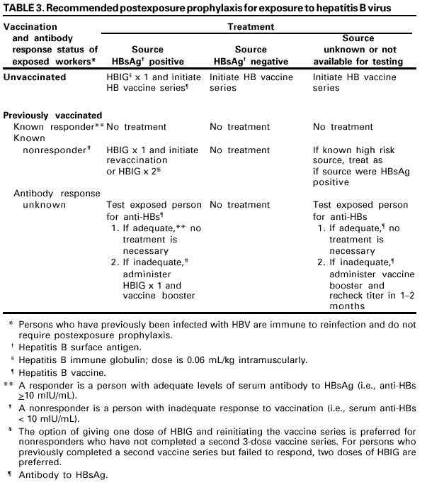

Slide 14
2. What is the risk of infection to you?
The risk of developing clinical hepatitis if the blood was both hepatitis B surface
antigen (HBsAg) and HBeAg-positive was 22%--31%; the risk of developing serologic evidence of HBV infection was 37%--62%.
By comparison, the risk of developing clinical hepatitis from a needle contaminated with HBsAg-positive, HBeAg-negative blood was 1%--6%,
and the risk of developing serologic evidence of HBV infection, 23%--37% .

Slide 15
Interpretation of the Hepatitis B Panel Tests Results Interpretation
Tests | Results | Interpretation
HBsAg anti-HBc anti-HBs | negative negative negative | susceptible
HBsAg anti-HBc anti-HBs | negative positive positive | immune due to natural infection
HBsAg anti-HBc anti-HBs | negative negative positive | immune due to hepatitis B vaccination
HBsAg anti-HBc IgM anti-HBc anti-HBs | positive positive positive negative | acutely infected
HBsAg anti-HBc IgM anti-HBc anti-HBs | positive positive negative negative | chronically infected
HBsAg anti-HBc anti-HBs | negative positive negative | four interpretations possible *
1. May be recovering from acute HBV infection. May be distantly immune and test not sensitive enough to to detect very low level of anti-HBs in serum. May be susceptible with a false positive anti-HBc. May be undetectable level of HBsAg present in the serum and the person is actually a carrier.

