Slide 1
PANCREAS
Pathology Dept, KSU
GIT Block

Slide 2
Normal anatomy & histology
Pathology Dept, KSU
GIT Block

Slide 3
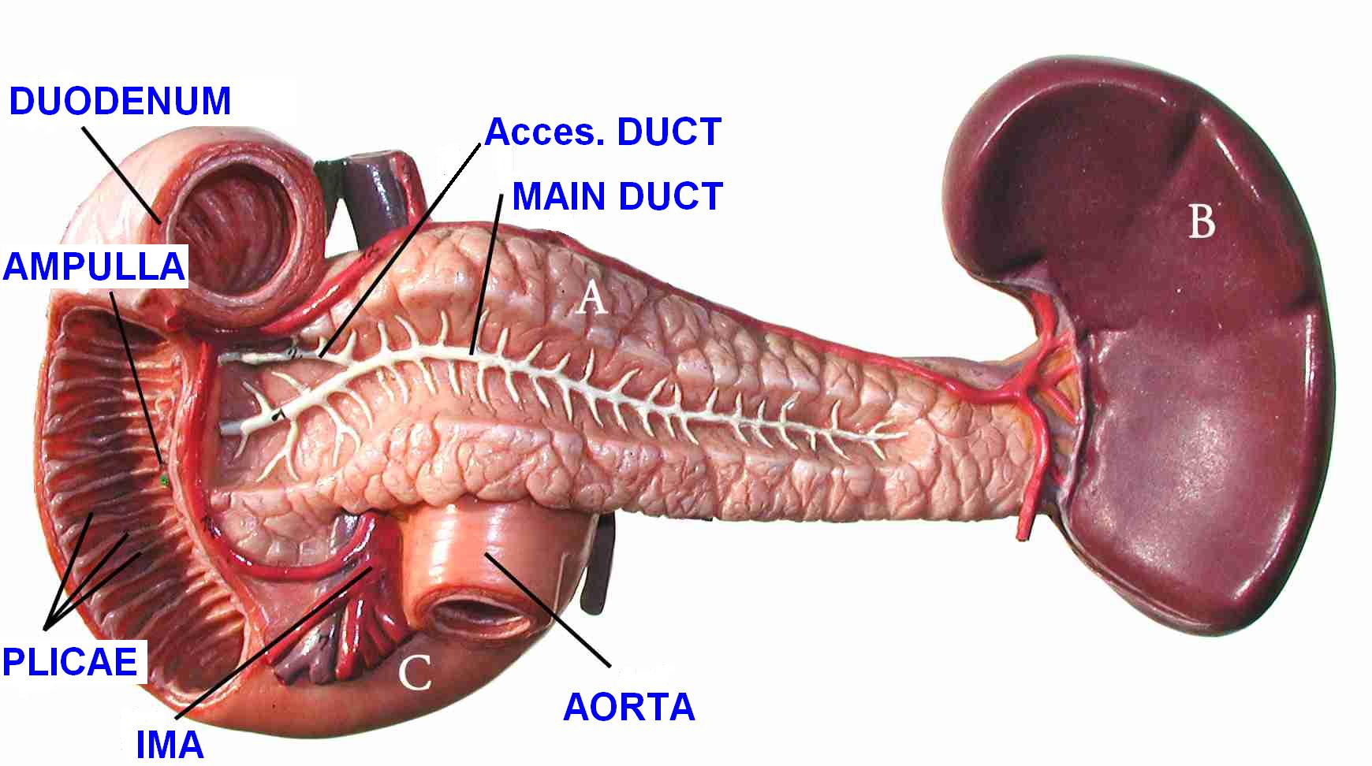
PANCREAS – Normal Anatomy
Pathology Dept, KSU
GIT Block

Slide 4
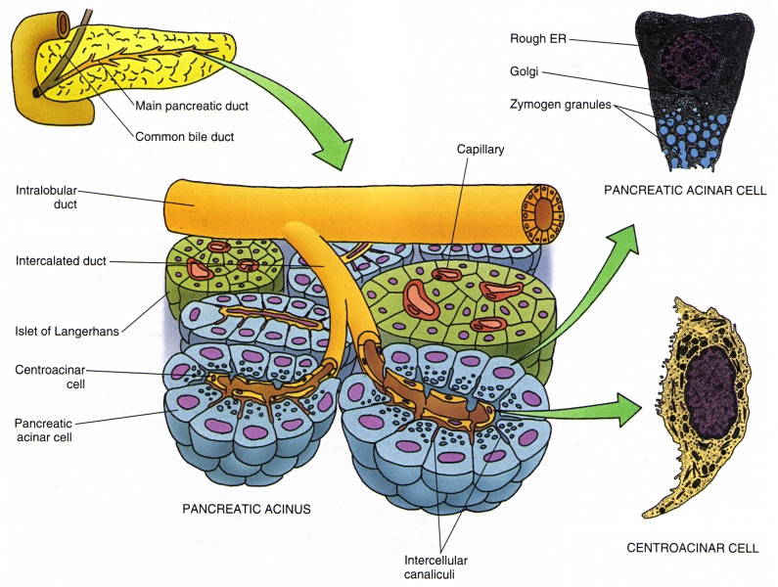
PANCREAS – Normal Histology (Diagram)
Pathology Dept, KSU
GIT Block
Notes:
Histology concepts.

Slide 5
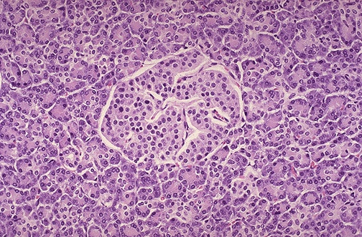
PANCREAS – Normal Histology -LPF
Here is a normal pancreatic islet of Langerhans surrounded by normal exocrine pancreatic acinar tissue. The islets contain alpha cells secreting glucagon, beta cells secreting insulin, and delta cells secreting somatostatin.
Pathology Dept, KSU
GIT Block

Slide 6
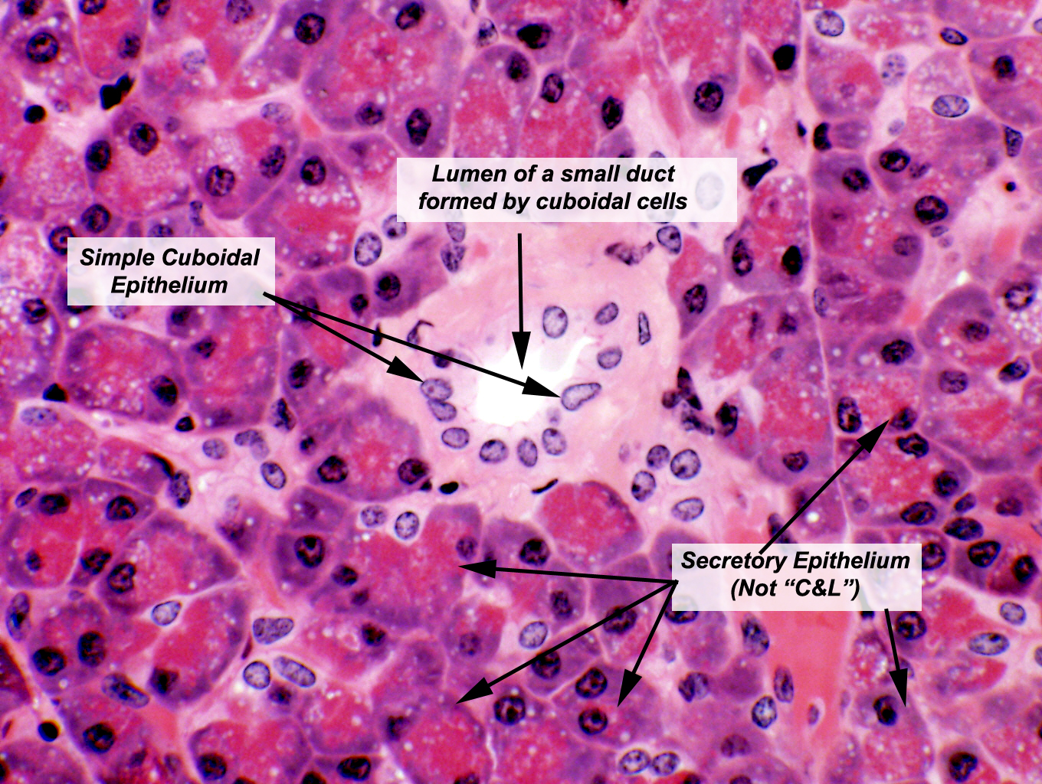
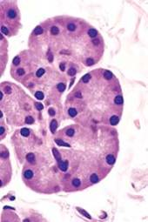
PANCREAS – Normal Histology -HPF
This section of pancreas shows a small duct in the center of the field. The wall of the duct is made of simple cuboidal epithelium. Exocrine gland ducts of this type are made of cuboidal cells arranged like bricks in a wall. As the duct enlarges there may be a transition from cuboidal to a columnar shape
Pathology Dept, KSU
GIT Block

Slide 7
GROSS & HISTOPATHOLOGY
Pathology Dept, KSU
GIT Block

Slide 8
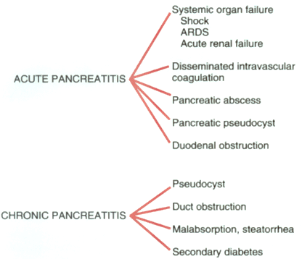
PANCREATITIS - Types
ACUTE (Very serious)
CHRONIC (Calcifications, Pseudocyst)
Pathology Dept, KSU
GIT Block

Slide 9
PANCREATITIS – Common causes
Pathology Dept, KSU
GIT Block

Slide 10
Acute pancreatitis
Pathology Dept, KSU
GIT Block

Slide 11
ACUTE PANCREATITIS - Causes
Alcoholism
Bile reflux
Medications (thiazides)
Hypertriglyceridemia, hypercalcemia
Acute ischemia
Trauma, blunt, iatrogenic
Genes: PRSS1, SPINK1
Idiopathic, 10-20%
Pathology Dept, KSU
GIT Block

Slide 12
ACUTE PANCREATITIS – Clinical Features
SEVERE ABDOMINAL PAIN
Extreme Emergency Situation
High Mortality
The MOST important lab test is……….????? → α – AMYLASE estimation
Pathology Dept, KSU
GIT Block

Slide 13
ACUTE PANCREATITIS – Consequences
EDEMA
FAT NECROSIS
ACUTE INFLAMMATORY INFILTRATE
PANCREAS AUTODIGESTION
BLOOD VESSEL DESTRUCTION
“SAPONIFICATION”
Pathology Dept, KSU
GIT Block

Slide 14
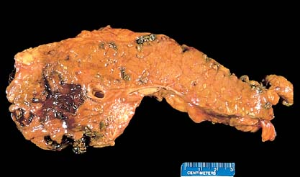
ACUTE PANCREATITIS – Gross
Acute Pancreatitis : Fat necrosis appears as chalky white calcium soaps.
Pathology Dept, KSU
GIT Block

Slide 15
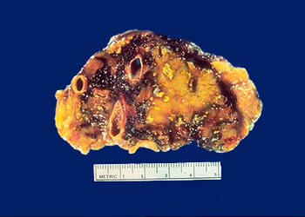
ACUTE PANCREATITIS – Gross
In severe acute pancreatitis, black areas of hemorrhage are present within the pancreas as well as chalky, yellow-white areas of fat necrosis. Pancreatic parenchyma is soft and gray-white due to necrosis
Pathology Dept, KSU
GIT Block

Slide 16
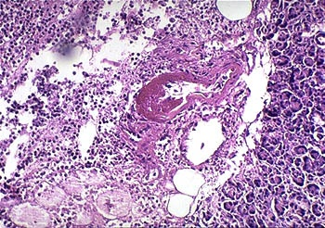
ACUTE PANCREATITIS – LPF
Severe acute pancreatitis shows an area of acute inflammation with necrosis. Within the necrotic area is a blood vessel showing fibrinoid necrosis of the vessel wall leads to severe, hemorrhagic, acute pancreatitis. Common causes of acute pancreatitis are alcoholism , gall stones impaction , traumatic , hereditary and idiopathic .
Pathology Dept, KSU
GIT Block

Slide 17
Chronic pancreatitis
Pathology Dept, KSU
GIT Block

Slide 18
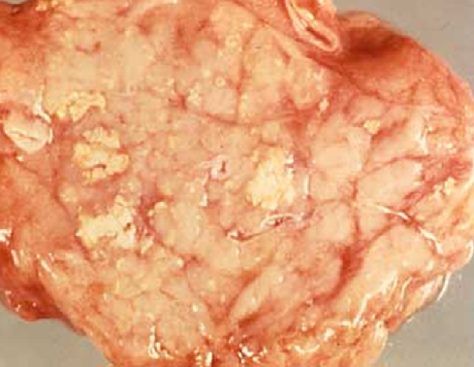
CHRONIC PANCREATITIS – GROSS
Find the “soap”, find the calcium. Calcium deposition is secondary to fat necrosis and dystrophic calcification . Possible causes of chronic pacreatitis are gall stones , alcoholism, tropical , hereditary and idiopathic .
Pathology Dept, KSU
GIT Block

Slide 19
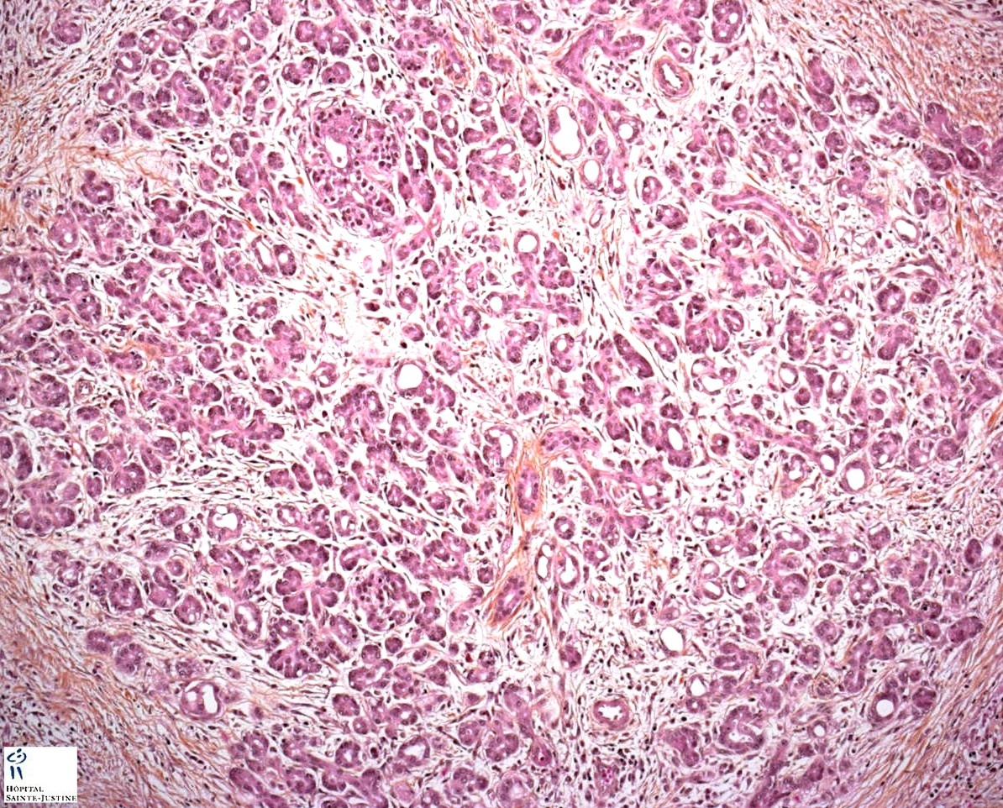
CHRONIC PANCREATITIS – LPF
Unfortunately dense fibrosis is a feature BOTH of chronic pancreatitis as well as adenocarcinoma.
Pathology Dept, KSU
GIT Block

Slide 20
CHRONIC PANCREATITIS – LPF
Chronic Pancreatitis: parenchymal fibrosis, chronic inflammatory infiltrate and reduced number and size of acini with variable dilatation of pancreatic ducts and relative sparing of islets of langerhans ( arrow )
Pathology Dept, KSU
GIT Block

Slide 21
Pancreatic adenocarcinoma
Pathology Dept, KSU
GIT Block

Slide 22
PANCREATIC ADENOCARCINOMA – Gross
Horizontal section of pancreas showing a well circumscribed tumor nodule at the head of pancreas. Note the presence of a dilated main pancreatic duct. Part of the duodenum is seen on the left and the spleen on the right side.
Pathology Dept, KSU
GIT Block

Slide 23
PANCREATIC ADENOCARCINOMA – Cut surface
Gross appearance of large duct type ductal adenocarcinoma. A microcystic pattern with cysts measuring from millimeters up to 1 cm.
Pathology Dept, KSU
GIT Block

Slide 24
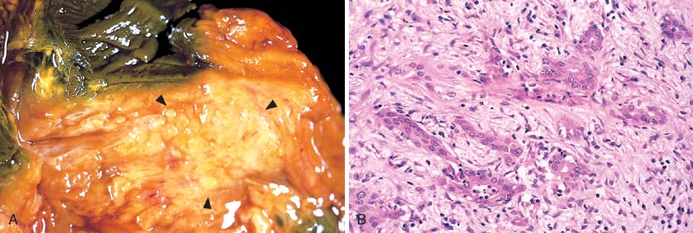
PANCREATIC ADENOCARCINOMA – Gross & LPF
Gross picture shows ill defined pale and firm pancreatic mass ( left ). Microscopic picture shows malignant glands or acini surrounded by desmoplastic fibrous stroma ( right) .
Pathology Dept, KSU
GIT Block

Slide 25
PANCREATIC ADENOCARCINOMA – LPF
Deeply infiltrative growth pattern with irregular shape and distribution , desmoplasia , marked nuclear pleomorphism with nucleoli, loss of polarity and mitotic figures
Pathology Dept, KSU
GIT Block

Slide 26
THE END

