Slide 1
Coagulation Mechanisms
Dr. Nervana Bayoumy
Associate Professor
Department of Physiology

Slide 2
Objectives
At the end of this lecture you should be able to:
Recognize the different clotting factors
Understand the role of calcium ions during clotting cascades.
Describe the cascades of intrinsic and extrinsic pathways for clotting.
Recognize process of fibrinolysis and function of plasmin
Recognize some conditions causing excessive bleeding
Understand some important anticoagulants and their mechanism of action

Slide 3
Mechanism of Blood Coagulation
• A crucial physiological balance exists between factors promoting coagulation (procoagulants) and factors inhibiting coagulation (anticoagulants).
• Coagulation of blood depends on the balance between these two factors.
• Disturbances in this balance could lead to thrombosis or bleeding

Slide 5
Hemostasis:
prevention or stoppage of blood loss.
Hemostatic Mechanisms:
Vessel wall (Vasoconstriction)
Platelets (Production and activation, Platelets Plug formation)
Blood coagulation
Clot formation (intrinsic & extrinsic pathways)
4. Fibrinolysis

Slide 6
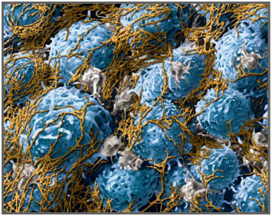
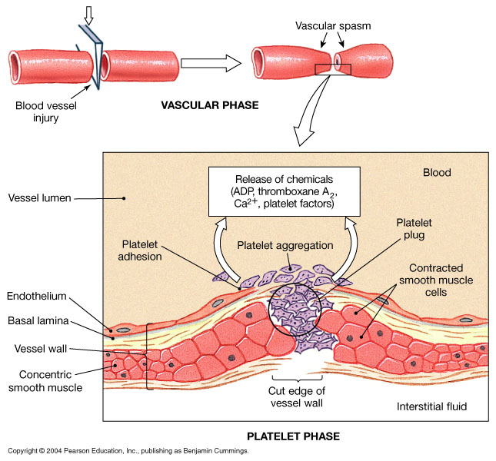
Coagulation: Formation of fibrin meshwork (Threads) to form a
CLOT

Slide 7
Clotting Factors
Names | Factors
Fibrinogen Prothrombin Thromboplastin (tissue factor) Calcium Labile factor Stable factor Antihemophilic factor Antihemophilic factor B Stuart-Prower factor Plasma thromboplastin antecedent (PTA) Hageman factor Fibrin stablizing factors | I II III IV V VII VIII IX X XI XII XIII

Slide 8
Prothrombin (factor II):
- is a plasma protein, α2-globulin
- present in normal plasma in a concentration of 15 mg/dl
- it is unstable protein that can be split easily into thrombin
- it is continually formed by the liver
Vitamin K is important for normal production of prothrombin by the liver.
Lack of vit K or liver disease can decrease the of prothrombin formation to a very low level >>>> bleeding
Thrombin:
- is a protein enzyme with weak proteolytic capabilities
- it acts on fibrinogen to form one molecule of fibrin monomer
- fibrin monomers polymerize with one another to form fibrin fibers
- it activates factor XIII

Slide 9
Fibrin-stabilizing factor (XIII):
- is a plasma protein
- it is also released from platelets that is entrapped in the clot
- it must be activated before it affects the fibrin fibers
- activated XIII factor operates as an enzyme causing additional strength of fibrin meshwork
Fibrinogen (factor I):
- is a high-molecular-weight plasma protein
- it is continually formed by the liver
- little or no fibrinogen leak from blood vessels
Blood Clot:
- is composed of a meshwork of fibrin fibers running in all directions and entrapping blood cells, platelets, plasma.

Slide 10
Intrinsic system
Extrinsic system
Kallik.
Pre-K
tissue factor
HMWK
XII
XIIa
VIIa
VII
HMWK
Ca⁺⁺
XI
XIa
IX
IXa
Ca⁺⁺
X X
Xa
Ca⁺⁺, PL, VIII
Final
common
pathway
XIII
Prothrombin II
thrombin IIa
Ca⁺⁺, PL, V
XIIIa
Ca⁺⁺
Fibrinogen I
Fibrin monomer
Fibrin
Notes:
10

Slide 11
Initiation
Cell based model
TF
VIIa
Fibroblast
IXa
Propagation
Xa
Prothrombin
Thrombin
Thrombin
Prothrombin
Xa
IXa
XIa
VIIIa
XIa
Platelet
Activated platelets
Amplification

Slide 12
Thrombin
Thrombin changes fibrinogen to fibrin
Thrombin is essential in platelet morphological changes to form primary plug
Thrombin stimulates platelets to release ADP & thromboxane A2; both stimulate further platelets aggregation
Activates factor V

Slide 13
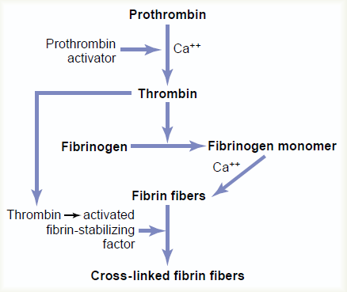
ACTION OF THROMBIN ON FIBRONOGEN TO FORM FIBRIN

Slide 14
Blood coagulation (clot formation)
A series of biochemical reactions leading to the formation of a blood clot within few seconds after injury
Prothrombin (inactive thrombin) is activated by a long intrinsic or short extrinsic pathways
This reaction leads to the activation of thrombin enzyme from inactive form prothrombin
Thrombin will change fibrinogen (plasma protein) into fibrin (insoluble protein)

Slide 15
Intrinsic pathway
The trigger is the activation of factor XII by contact with foreign surface, injured blood vessel, and glass.
Activated factor XII will activate factor XI
Activated factor Xl will activate IX
Activated factor IX + factor VIII + platelet phospholipid factor (PF3)+ Ca activate factor X
Following this step the pathway is common for both intrinsic and extrinsic

Slide 16
Extrinsic pathway
Triggered by material released from damaged tissues (tissue thromboplastin)
Tissue thromboplastin + VII + Ca → activate X
Common pathway
Activated factor X + factor V +PF3 + Ca activate prothrombin activator; a proteolytic enzyme which activates prothrombin.
Activated prothrombin activates thrombin
Thrombin acts on fibrinogen and change it into insoluble thread like fibrin.
Factor XIII + Calcium → strong fibrin (strong clot)

Slide 17
Activation of Blood Coagulation
Intrinsic Pathway: all clotting factors present in the blood
Extrinsic Pathway: triggered by tissue factor (thromboplastin)
Common Pathway

Slide 18
Fibrinolysis
Formed blood clot can either become fibrous or dissolved.
Fibrinolysis (dissolving) = Break down of fibrin by naturally occurring enzyme plasmin therefore prevent intravascular blocking.
There is a balance between clotting and fibrinolysis
Excess clotting → blocking of Blood Vessels
Excess fibrinolysis → tendency for bleeding

Slide 19
Released from injured tissues and vascular endothelium
Fibrinolysis
Tissue Plasminogen Activator (t-PA)
Plasminogen
Plasmin
(Protein in the blood)
Anti-activators
Fibrinolysis
Anti-plasmin
Fibrinogen
Fibrin
Thrombin
FDP*
FDP*: Fibrin Degradation Products

Slide 20
Plasmin
Is present in the blood in an inactive form plasminogen
Is activated by tissue plasminogen activators (t-PA) in blood.
Digests intra & extra vascular deposit of Fibrin → fibrin degradation products (FDP)
Unwanted effect of plasmin is the digestion of clotting factors

Slide 21
Plasmin
Plasmin is controlled by:
Tissue Plasminogen Activator Inhibitor (TPAI)
Antiplasmin from the liver
Uses:
Tissue Plasminogen Activator (TPA) used to activate plasminogen to dissolve coronary clots

Slide 22
Prevention of blood clotting in the normal vascular system and Anticoagulants
Endothelial surface factors
Smoothness of the ECS.
Glycocalyx layer
Thrombomodulin protein
Fibrin fibers, adsorbs ~ 90% of thrombin to removes it from circulating blood
Antithrombin III, combines the remaining thrombin and removes it from blood
Heparin, combines with Antithrombin III and quickly removes thrombin from blood
- Liver, lungs, mast cells, basophils

Slide 23
Conditions that cause excessive bleeding
Vitamin K Deficiency
Prothrombin, Factor VII, Factor IX, Factor X require vitamin K for their synthesis
Hepatitis, Cirrhosis, acute yellow atrophy AND GI disease
Hemophilia
↑ bleeding tendency.
X-linked disease.
Affects males.
85% due to Factor VIII deficiency (hemophilia A), and 15% due to Factor IX deficiency (hemophilia B).
Thrombocytopenia
Very low number of platelets in blood (< 50,000/μl)
Thrombocytopenia purpura, hemorrhages throughout all the body tissues
Idiopathic Thrombocytopenia, unknown cause.

