Slide 1
Liver & Spleen

Slide 2
Objectives
At the end of the lecture, the student should be able to describe the:
Location, subdivisions and relations and peritoneal reflection of liver.
Blood supply, nerve supply and lymphatic drainage of liver
Location, subdivisions and relations and peritoneal reflection of spleen.
Blood supply, nerve supply and lymphatic drainage of spleen.

Slide 3
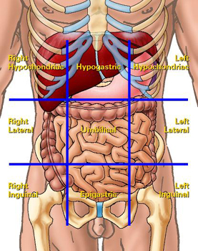
Liver
The largest gland in the body.
Weighs approximately 1500 g (approximately 2.5% of adult body weight).
Lies mainly in the right hypochondrium and epigastrium and extends into the left hypochondrium.
Protected by the thoracic cage and diaphragm, lies deep to ribs 7-11 on the right side and crosses the midline toward the left nipple.

Slide 4
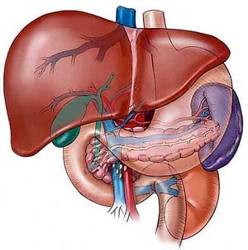
Relations of Liver
Anterior: Diaphragm, Right and left costal margins, right and left pleura and lower margins of both lungs, xiphoid process, and anterior abdominal wall in the subcostal angle
Posterior: Diaphragm, right kidney, hepatic flexure of the colon, duodenum, gallbladder, inferior vena cava, esophagus and fundus of the stomach

Slide 5
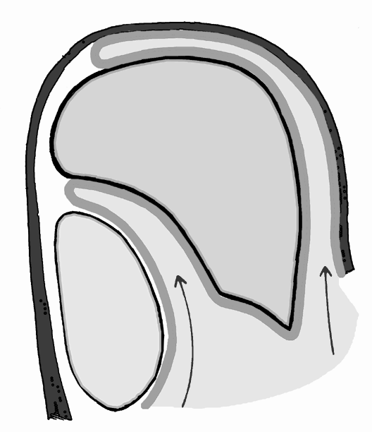
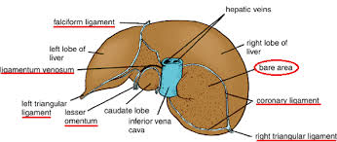
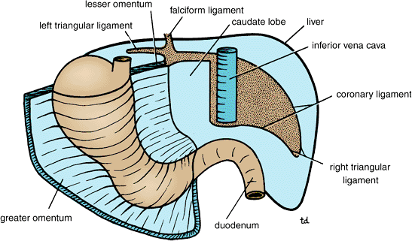
Peritoneal Reflection
The liver is completely surrounded by a fibrous capsule and covered by peritoneum (except the bare areas).
The bare area of the liver is an area of the liver on the diaphragmatic surface (on the posterior surface of right lobe) where there is no intervening peritoneum between the liver and the diaphragm.
Boundaries of Bare area:
Anterior: superior layer of coronary ligament.
Posterior: inferior layer of coronary ligament.
Laterally: right and left triangular ligaments.
Superior layer of coronary ligament
Diaphragm
Peritoneum
Inferior layer of coronary ligament
Anterior abdominal wall
Posterior abdominal wall
Other bare areas include: Porta hepatis, fossa for gall bladder & grooves for IVC

Slide 6
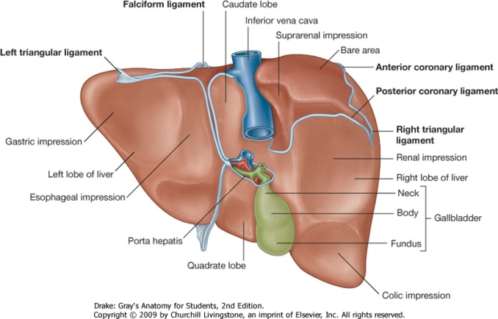
Surfaces of Liver
The liver has two surfaces:
A convex diaphragmatic surface (anterosuperior).
A relatively flat or even concave visceral surface (posteroinferior)

Slide 7
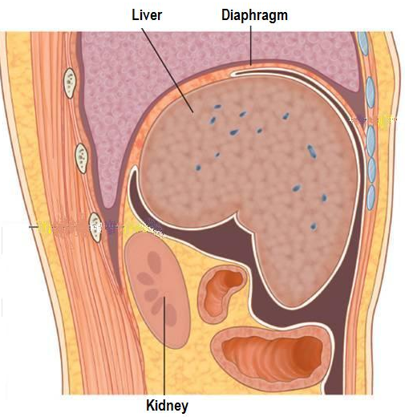
Diaphragmatic Surface
The convex upper surface is smooth and molded to the undersurface of the domes of the diaphragm which separates it from the pleurae, lungs, pericardium, and heart .
Covered with visceral peritoneum, except posteriorly in the bare area of the liver, where it lies in direct contact with the diaphragm.

Slide 8
Visceral Surface
It is the posteroinferior surface, related to abdominal viscera.
It is covered with peritoneum, except at the fossa for the gallbladder and the porta hepatis
It bears multiple fissures and impressions for contact with other organs.

Slide 9
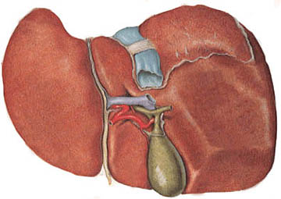
Fissures
Two sagittally oriented fissures, linked centrally by the transverse porta hepatis, form the letter H on the visceral surface.
The left fissure is the continuous groove formed:
Anteriorly by the fissure for the round ligament
Posteriorly by the fissure for the ligamentum venosum.
The right fissure is the continuous groove formed:
Anteriorly by the fossa for the gallbladder
Posteriorly by the groove for the inferior vena cava.
Ligamentum venosum
Inferior vena cava
Round ligament
Porta hepatis
Gall bladder

Slide 10
Relations of Visceral Surface of the Liver
The visceral surface is related to the:
stomach and duodenum
Esophagus
lesser omentum
gallbladder
right colic flexure
right kidney and right suprarenal gland
1
2
6
3
4
5

Slide 11
Porta Hepatis (Hilum of the Liver)
A transverse fissure found on the posteroinferior surface and lies between the caudate and quadrate lobes.
The upper part of the free edge of the lesser omentum is attached to its margins.
Structures passing through the porta hepatis include:
Right and left hepatic ducts.
Right and left branches of the hepatic artery
Right and left branches of the portal vein
Sympathetic and parasympathetic nerve fibers
A few hepatic lymph nodes drain the liver and gallbladder and send their efferent vessels to the celiac lymph nodes.

Slide 12
Ligaments of the Liver
Falciform ligament
It is a two-layered fold of the peritoneum.
It connects the liver with the diaphragm and anterior abdominal wall & umblicus..
Its sickle-shaped free margin contains the ligamentum teres (round Ligament) of liver, the remains of the umbilical vein, which carried oxygenated from the placenta to the fetus.
Ligamentum venosum
It is the fibrous remnant of the fetal ductus venosus, which shunted blood from the umbilical vein to the IVC.
Ligamentum venosum
IVC
Porta Hepatis
Round ligament of liver
GB

Slide 13
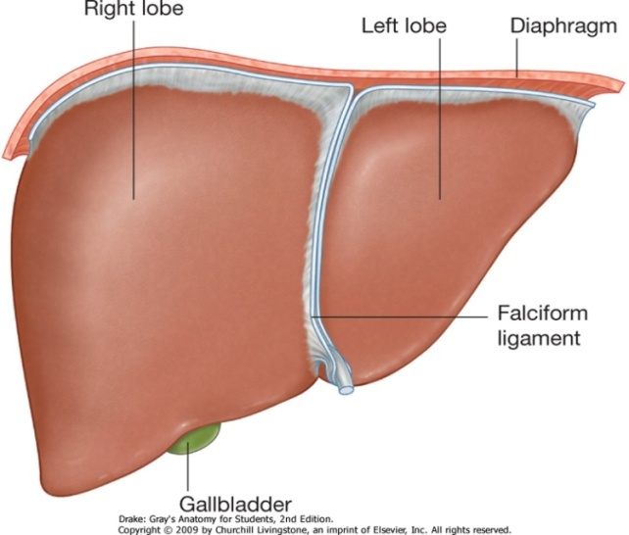
Lobes of The Liver
The liver is divided into a large right lobe and a small left lobe by the attachment of the falciform ligament.
The right lobe is further divided into a quadrate lobe and a caudate lobe by the presence of the gallbladder, the fissure for the ligamentum teres, the inferior vena cava, and the fissure for the ligamentum venosum.
The caudate lobe is connected to the right lobe by the caudate process.
The quadrate and caudate lobes are a functional part of the left lobe of the liver.
Caudate process
Cauate lobe
Left lobe
Right lobe
Quadrate lobe

Slide 14
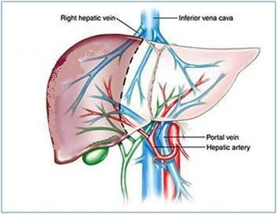
Blood Circulation through the Liver
The blood vessels conveying blood to the liver are the hepatic artery (30%) a branch of celiac trunk, and portal vein (70%).
The hepatic artery brings oxygenated blood to the liver
The portal vein brings venous blood rich in the products of digestion, which have been absorbed from the gastrointestinal tract to the liver.
The venous blood is drained by right & left hepatic veins which drain into the inferior vena cava

Slide 15
At or close to the porta hepatis, the hepatic artery and portal vein terminate by dividing into right and left primary branches which supply the right and left parts of liver, respectively.
Within the liver, the primary branches divide to give secondary and tertiary to supply the hepatic segments independently
The hepatic veins, are intersegmental in their distribution and function, draining parts of adjacent segments.
The attachment of these veins to the IVC helps hold the liver in position. (The peritoneal ligaments and the tone of the abdominal muscles play a minor role in the support of liver).

Slide 16
Lymph Drainage
The liver produces a large amount of lymph—about one third to one half of all body lymph.
The lymph vessels leave the liver and enter several lymph nodes in the porta hepatis.
The efferent vessels pass to the celiac nodes.
A few vessels pass from the bare area of the liver through the diaphragm to the posterior mediastinal lymph nodes.
Nerve Supply
Sympathetic and parasympathetic nerves from the celiac plexus.
The anterior vagal trunk gives rise to a large hepatic branch, which passes directly to the liver.

Slide 17
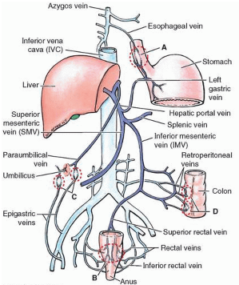
Portal-Systemic (Portacaval) Anastomoses
It is a specific type of anastomosis that occurs between the veins of portal circulation and those of systemic circulation
In portal hypertion, these anastomosis open and form venous dilatation called varices.
Sites:
Esophagus
Anal canal
Paraumbilical region
Retroperitoneal
Intrahepatic (Patent ductus venosus)

Slide 18
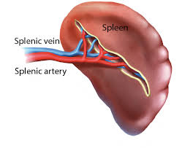
Spleen
Largest single mass of lymphoid tissue
Located in the left hypochondrium, deep to 9, 10 & 11 ribs
Long axis lies along the shaft of the 10th rib and separated from them by the diaphragm and the costodiaphragmatic recess(space in pleural cavity).
Ovoid in shape with notched anterior border
Lower pole extends forward as far as the midaxillary line.
Normal size spleen can not be palpated on clinical examination.

Slide 19
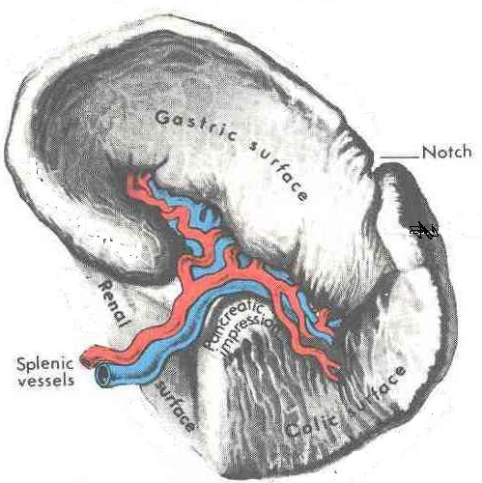
Surfaces:
Diaphragmatic surface: is convexly curved to fit the concavity of the diaphragm and curved bodies of the adjacent ribs
Visceral surface: related to viscera
Borders:
The anterior and superior borders are sharp. Anterior border is notched.
The posterior (medial) and inferior borders are rounded.

Slide 20
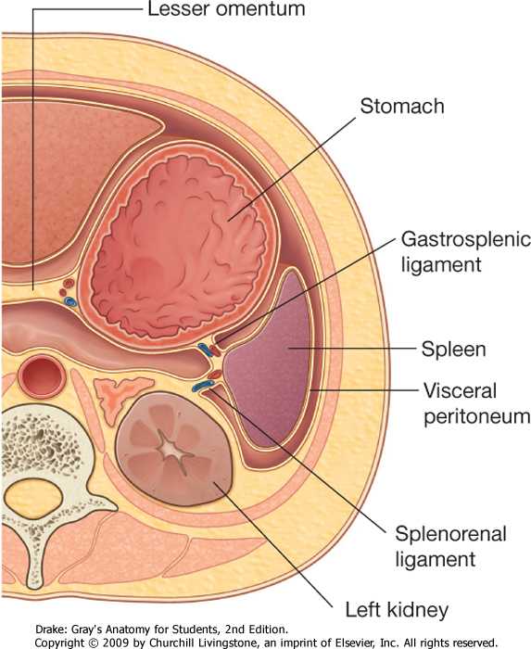
Peritoneal Reflections/Ligaments
Spleen is completely surrounded by peritoneum EXCEPT at the hilum where its margins give attachement to :
Gastrosplenic ligament to the greater curvature of stomach (carrying the short gastric and left gastroepiploic vessels)
Lienorenal ligament to the left kidney (carrying the splenic vessels and the tail of pancreas)

Slide 21
Relations
Anteriorly: Stomach, tail of pancreas, left colic flexure & left kidney
Posteriorly: Diaphragm, that separates it from the left pleura (left costo-diaphragmatic recess), left lung & 9, 10 & 11 ribs
Inferiorly: Left colic flexure.
Medially: Left kidney.

Slide 22
Arterial Supply
Splenic artery
Largest branch of the celiac artery
Runs a tortuous course along the upper border of the pancreas
Passes within the lienorenal ligament
Divides into 4-5 branches, which enter the spleen at the hilus
The lack of anastomosis of these arterial vessels within the spleen results in the formation of vascular segments of the spleen with relatively avascular planes between them, enabling subtotal splenectomy.

Slide 23
Venous Drainage
Splenic vein
Leaves the hilus
Runs behind the tail & body of the pancreas
Reaches behind the neck of pancreas, where it joins the superior mesenteric vein to form the portal vein
Tributaries:
Short gastric vein
left gastroepiploic vein
Pancreatic veins
Inferior mesenteric vein

Slide 24
Lymph Drainage
Lymphatics emerge from the hilus and drain into several nodes lying at the hilum
Efferents from the hilar nodes pass along the course of splenic artery, and drain into the celiac lymph nodes
Nerve Supply
Derived from the celiac plexus.
Are distributed mainly along branches of the splenic artery, and are vasomotor in function.

Slide 25
Thank You

