Slide 1
Normal flora & introduction to infectious diarrhea
Ali M Somily MD
Prof Hanan Habib

Slide 2
Objectives
By the end of this lecture the student should be able to:
Define and recognize the various types of acute diarrheal illness
Describe the epidemiology the host defenses in preventing the gastrointestinal infection
Explain pathogenesis by which Escherichia coli campylobacter and yersinia and their management
Discuss the microbiological methods used for diagnosis of each of the bacterial agents including microscopy, selective media for maximal recovery
Describe the pathogens, risk factors, clinical presentation and prevention of food poisoning travelers and antibiotic associated diarrhea.
Name the etiological agents causing food poisoning and their clinical presentation

Slide 3
Background
Acute diarrheal illness is one of the most common problems evaluated by clinicians.
A major cause of morbidity and mortality world wide.
Most of healthy people have mild illness but other might develop serious squeals so it is important to identify those individuals who require early treatment.

Slide 4
Normal flora - Gastrointestinal tract
Ecology
Birth: sterile
Breast-fed Bifidobacteria species
Switch to cow’s milk Enteric, bacteroides, enterococci, lactobacilli and clostridia
Switch to solid food
Microflora similar to parents
Notes:
Ecology
Birth: sterile
Breast-fed
Bifidobacteria species (>90% of intestinal flora)
Switch to cow’s milk
Bifidobacteria joined by enteric, bacteroides, enterococci, lactobacilli and clostridia
Human milk contains, on average, 1.1% protein, 4.2% fat, 7.0% lactose (a sugar), and supplies 72 kcal of energy per 100 grams.▪ Cow's milk contains, on average, 3.4% protein, 3.6% fat, and 4.6% lactose, and supplies 66 kcal of energy per 100 grams. http://en.wikipedia.org/wiki/Milk
Switch to solid food
Microflora similar to parents
▪ Human milk contains, on average, 1.1% protein, 4.2% fat, 7.0% lactose (a sugar), and supplies 72 kcal of energy per 100 grams.▪ Cow's milk contains, on average, 3.4% protein, 3.6% fat, and 4.6% lactose, and supplies 66 kcal of energy per 100 grams. http://en.wikipedia.org/wiki/Milk

Slide 5
Normal flora - Gastrointestinal tract
GI ecology varies
Esophagus saliva ,food
Stomach harsh 10
Small intestine (10³ -10⁸)
Large intestine
10⁹-10¹¹/ml
>350 species
E. coli = 0.1% of total population
Primarily anaerobic
Facultative aerobes deplete oxygen
Adult excretes 3x10¹³ bacteria/day
25%-35% of fecal mass = bacteria
Notes:
GI ecology
Varies along the tract (longitudinal levels)
Varies along horizontal level: lumen vs. epithelium
Esophagus
Microbes associated with saliva and food
Stomach
Low pH limits population numbers (10 bacteria/ml)
Helicobacter pylori, acid-tolerant lactobacilli
Reduction of acidity (increase alkalinity)
Increases population of resident flora
Populated by flora of intestine (reflux)
Small intestine
Proximal small intestine (duodenum and jejunum)
Sparse (<10³ bacteria/ml fluid) due to acid from stomach, bile and pancreatic secretions
Lactobacilli, Enterococcus faecalis
Distal small intestine (ileum)
Increases (10⁸ bacteria/ml) due to pH change
Lactobacilli, Enterococcus faecalis, coliforms, Bacteroides, bifidobacteria
More like colon microbiota
Bile: Alkaline solution containing cholesterol, phospholipids, bile pigments, bile salts, bicarbonate ions. Acts as emulsifier of fats. Produced by hepatocytes. Drains through many bile ducts throughout liver
Pancreatic secretions: digestive enzymes (trypsin, chymotrypsin, pancreatic lipase, pancreatic amylase) and alkaline-salt fluid secreted into small intestine

Slide 6
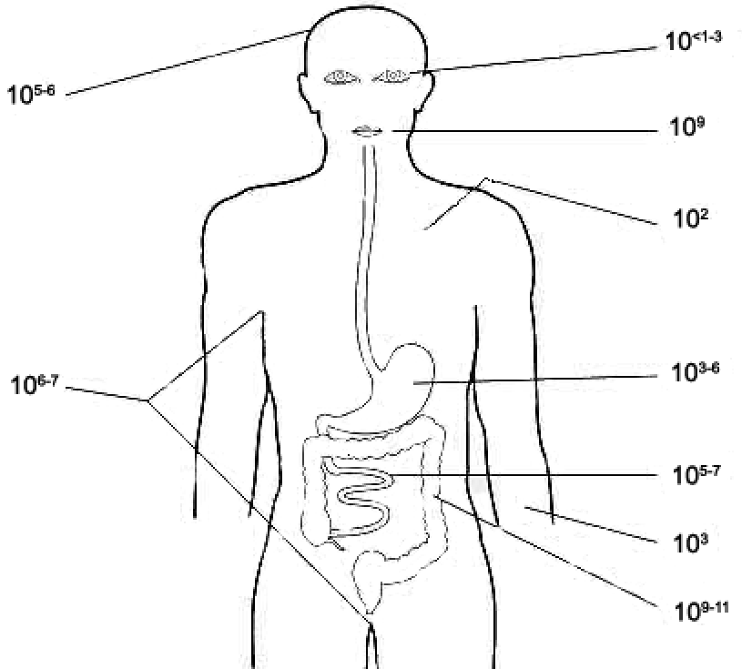
Normal flora - Gastrointestinal tract
Location (adult) | Bacteria/gram contents
duodenum | 10³-10⁶
jejunum and ileum | 10⁵-10⁸
cecum and transverse colon | 10⁸-10¹⁰
sigmoid colon and rectum | 10¹¹
Notes:
In the normal adult colon, 96–99% of the resident bacterial flora consists of anaerobes: bacteroides species, especially B fragilis; fusobacterium species; anaerobic lactobacilli, e.g., bifidobacteria; clostridia (C perfringens); and anaerobic gram-positive cocci (Peptostreptococcus species).

Slide 7
Definition
Stool weight in excess of 200 gm/day
3 or more loose or watery stools/day
Acute < 14 days
Alteration in normal bowel movement characterized by decreased consistency and increased frequency
Less than 14 days in duration

Slide 8
Etiology
Viral: 70-80% of infectious diarrhea in developed countries
Bacterial: 10-20% of infectious diarrhea but responsible for most cases of severe diarrhea
Protozoan: less than 10%

Slide 9
Epidemiology
1.4 million deaths in study in 2010
1.2-1.9 episodes per person annually in the general population
2.4 episodes per child >3 years old annually
5 episodes per year for children <3 years old and in daycare
Seasonal peak in the winter

Slide 10
Risk Factors
Food from restaurants.
Family member with Gastrointestinal symptoms.
Recent travel to developing countries.
Patient underlying illness and mediation(↓Stomach acidity cyst, spores)
Abnormal peristalsis.
Low Immunoglobulin IgA.
Antibiotics decrease the normal flora to less 10¹²
Median infective dose (ID₅₀)

Slide 11
Classifications
1. Infectious diarrhea- viral Bacterial organism. Campylobcator, Shigella, Solmnella, Yersinea, Cholera and E.coli
2. Food poisoning:Staphylococcus, Clostridium perferinges, Bacillus.
3. Traveler diarrhea - Enterotoxogenic E-coli IP >1 day last 3
4. Antibiotic associated diarrhea-Clostridium defficile

Slide 12
Clinical Presentation and Pathogenic Mechanism I
Enterotoxin mediated
Lack of pus in the stool (no invasion)
Lack of fever
Rapid onset preformed toxin<12 hr
Small intestine
Vomiting ,non-bloody diarrhea, abdominal cramp
Vibreo cholero, Staphylococcus aureus, Clostridium perfringens and Bacillus cereus
Other viral and some parasitic infection

Slide 13
Clinical Presentation and Pathogenic Mechanism II
Invasive:-
Pus and blood in the stool
Fever due to inflammation
Shigella, and Endameba histolytica
Affect colonic mucosal surface of the bowel
Sometime Solmonella spp, Campylobacter, some E-coli EHEC , Yersinia and Clostridium difficile
.
Extension to lymph nodes
Incubation period 1-3 days
E.histolytica 1-3 wk
Dysentery syndrome- gross blood and mucous

Slide 14
TOXIN TYPE | TOXIN-PRODUCING BACTERIA | TOXIN NAME, IF RELEVANT
Neurotoxin Central autonomic Nervous system Food poisoning | Staphylococcus aureus | Enterotoxin B
 | Bacillus cereus | Emetic toxin
 | Clostridium botulinum | Botulinum toxin
Enterotoxin | Vibrio cholerae | Cholera toxin
 | Enterotoxigenic Escherichia coli | Heat-labile toxin, heat-stable toxin
 | Clostridium perfringens | Enterotoxin
Cytotoxin | Shigella dysenteriae type I | Shiga toxin
 | Enterohemorrhagic E. coli | Shiga toxins 1 and 2 Globotriaosylceramide (Gb3) 23 S r RNA in 60 Subunit
 | Vibrio parahaemolyticus | Thermostable direct hemolysin
 | Campylobacter jejuni | Cytolethal distending toxin
 | Clostridium difficile | Toxin A, toxin B
 | Clostridium perfringens | Alpha toxin
 | E. histolytica | protozoal phospholipase A and pore-forming peptides

Slide 15
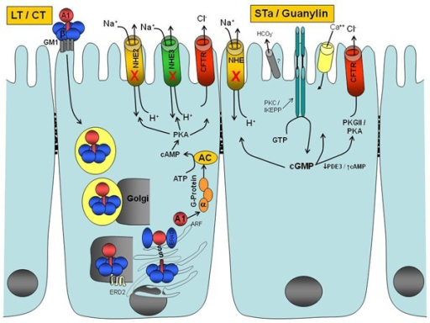
A1-B5 protein enterotoxin that is exported out of the bacterial cell by a type II protein secretion system
Monosialoganglioside
GM1 receptor
A1 subunit
ADP ribosylating factor
G protein
Adenylate Cyclase AC
ATP to cAMP
Prevent CL absorption
Notes:
Enterotoxins
A number of pathogenic bacteria produce enterotoxins that act directly on gastrointestinal mucosal cells to stimulate net fluid secretion. The prototypical example of this class is cholera toxin, which is an A₁-B₅ protein enterotoxin that is exported out of the bacterial cell by a type II protein secretion system.⁹⁶ The B pentamer binds to the enterocyte surface receptor GM1 monosialoganglioside. The A subunit is then nicked by a protease and reduced, and a portion of the A subunit enters the eukaryotic cell cytoplasm, where it catalyzes adenosine diphosphate ribosylation of an arginine residue on the Gsα subunit of adenylate cyclase, leading to increased intracellular cyclic adenosine monophosphate and net fluid secretion through the apical chloride channels of the epithelial cell.⁹⁷ The genes for the A and B subunits of cholera toxin are encoded together on a bacteriophage that inserts itself into the chromosome of pathogenic strains of V. cholerae.⁹⁸
ETEC produces a heat-labile enterotoxin that is very similar to cholera toxin, both in protein sequence as well as in mechanism of action.⁷⁵ Strains of ETEC may also produce a heat-stable enterotoxin that is secreted extracellularly and binds and activates intestinal guanylate cyclase in the cell membrane of intestinal epithelial cells. Heat-stable enterotoxin acts as a homologue of the peptide guanylin, an endogenous peptide made by small intestinal villus cells that regulates normal intestinal secretion by stimulating intracellular cyclic guanosine monophosphate production.⁹⁹

Slide 16
Shigella and Salmonella
Salmonella enterica is the common cause of food poisoning in Saudi Arabia.
Salmonella typhi transmitted through human faeces.
Shiegella causes local Gastrointestinal invasion and bacterimia less common in normal host.

Slide 17
Campylobacter
Family Campylobacteraceae
Genus arcobacter
Epidemiology
Source: poultry, birds, dog , cat, →water, milk, meat, person to person can occurs

Slide 18
Clinically
IP 2-6 days
Abdominal cramp, bloody diarrhea , nausea and vomiting are rare
Self limiting 2-6 Day
Chronic carrier
GB and Reactive arthritis

Slide 19
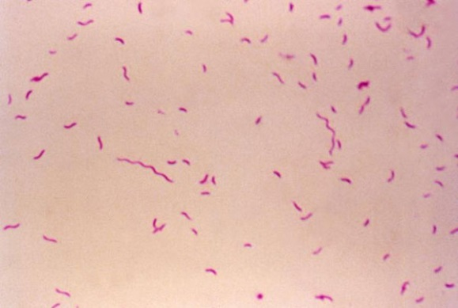
Laboratory diagnosis and treatment
Laboratory
Transport media Cary Blair
CAMPY BAP contain antibiotics
Incubate in 5%O₂ 10%CO₂ 85%N @ 42°C except C.fetus 37°C
Gram stain/culture biochemical/Serology
Treatment:
Ciprofloxacin, Erythromycin or Tetracycline

Slide 20
E.Coli
Only about 10 -15% of strains of E. coli associated with diarrhea.
Based on virulence factors, clinical manifestation, epidemiology and different O and H serotype.
There are five major categories of diarrheagenic E.coli:
Types of E. coli diarrhea
Enterotoxigenic E. coli (E T E C)
Enteropathogenic E. coli (E P E C)
Enteroinvasive E. coli (E I E C)
Enterohaemorrhagic E. coli (E H E C )
Enteroadherent E.coli (EAEC)

Slide 21
1. Enterotoxigenic E.coli
Major cause of traveler's diarrhea in infant and adult in developing countries from contaminated food and water
It has ↑infective dose 10⁶-10¹⁰
Has heat-labile toxin (LT) and heat-stable toxin (ST) each has two fragment (A and B) LT leads to accumulation of CGMP, which lead to hyper secretion
Symptoms watery diarrhea, abdominal cramps and some time vomiting
No routine diagnostic method.

Slide 22
2. Enteroinvasive E-coli
Produce dysentery (Penetration, invasion and distraction)
Similar to Shigella spp (Non motile, LNF)
Fecal oral route
Fever, severe abd. cramp, malaise and watery diarrhea
Infective dose10⁶
Diagnosis Sereny test and DNA probes.

Slide 23
3-Enteropathogenic E-coli
Infantile diarrhea
Outbreak in hospital nurseries and day- care centers
Low grade fever, malaise, vomiting and diarrhea
Stool mucous but no blood.

Slide 24
4-Entero hemorrhagic E-coli
O157H7 and Non O157H7 Hemorrhagic diarrhea, colitis and hemolytic uremic syndrome (HUS)=↓Platelet count, hemolytic anemia and kidney failure
Undercooked hamburgers, unpasteurized dairy products, apple cider, cookie dough
Bloody diarrhea, low grade fever and stool has no leucocytes
Fetal disease in young and elderly persons in nursing homes
Cytotoxin =vertoxin І and vertoxin ІІ Similar to Stx₁ (shigotoxin I&II)
E.coli other than 0157H7 can cause HUS
Diagnosis by culture on SMAC, MUG test , Vertoxin detection by immunological test or PCR
Notes:
براعم الفاصوليا الخام

Slide 25
5. Enteroadherent E-coli
Pediatric Diarrheal Disease
Adhering to the surface of the intestinal mucosa
Aggregative stacked brick
Watery diarrhea, vomiting, dehydration and abdominal pain
Two or more weeks

Slide 26
Yersinia enterocolitica
Mesenteric lymphadenitis in children and septicemia in immunocompramised hosts
Common in Europe, USA, Canada and cat, dog, swine (chitterlings)
Survive cold temperatures and associated with transfusion of packed red blood cells.
Presented with enteritis, arthritis and erythema nodosum
Generalize infection in 1'C adult children 1-5 yrs usually mild but in old children adult mimic appendicitis
Growth at 25°c-30°c media Cefsulodin-Igrasan-Novabiacin (CIN)

Slide 27
Clostridium difficile
Antibiotic associated diarrhea
Transmit from person to person via Fecal-Oral route
Have been cultured from in animate hospital surfaces
Disruption of the indigenous bacterial flora of the colon
Produce toxin A and B that can bind to surface epithelial cell receptors leading to inflammation mucosal injury and diarrhea

Slide 28
Clostridium difficile
Patient Presents with fever, leukocytosis, abdominal pain and diarrhea
Pseudomembrane can result (neutrophils, fibrin, and cellular debris in the colonic mucosa) and toxic megacolon
Diagnosis, toxin detection by EIA
Treatment Metronidazole ± Vancomycin and supportive treatment

Slide 29
Diagnostic Approach
Duration
Chronic vs acute
Symptoms
Fever, bloody, weight loss and dehydration
Risk factor
Travel , immunocompromised , diet, medications, outbreak
Fever and blood do culture
Watery no fever symptomatic treatment
Hospital acquire think about C.difficle
Chronic diarrhea think about
Protozoa (giardia, crypto, cyclo, microsporidia, MAC
Other malabsorption, lactase defic. Or bacterial overgrowth

