Slide 1
Haemoflagellates Leishmania & Trypanosomes

Slide 2
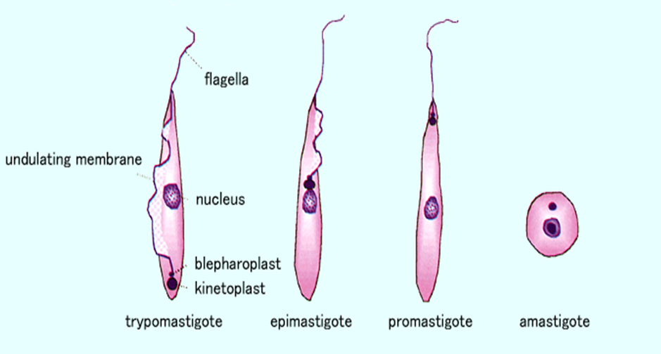
Different stages of Haemoflagellates

Slide 3
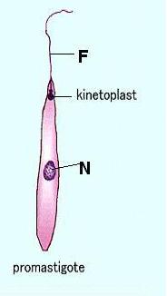
Promastigotes of Leishmania
Amastigote of Leishmania

Slide 4
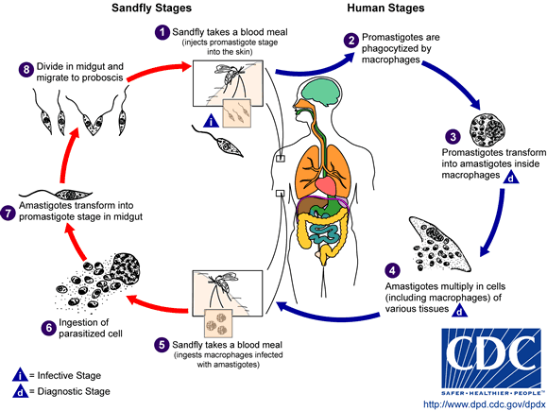
The life cycle of Leishmania

Slide 5
Leishmania Parasites and Diseases
Disease | SPECIES
Cutaneous leishmaniasis | Leishmania tropica* Leishmania major* Leishmania aethiopica Leishmania mexicana
Mucocutaneous leishmaniasis | Leishmania braziliensis
Visceral leishmaniasis | Leishmania donovani* Leishmania infantum* Leishmania chagasi
* Endemic in Saudi Arabia

Slide 6
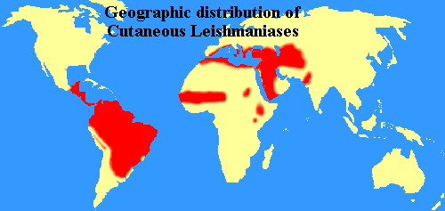

Slide 7
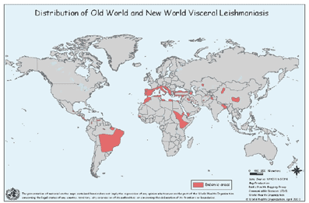
World distribution of Visceral Leishmaniasis

Slide 8
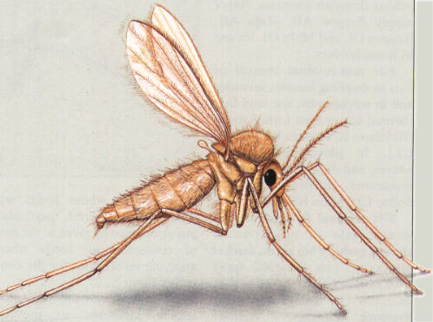
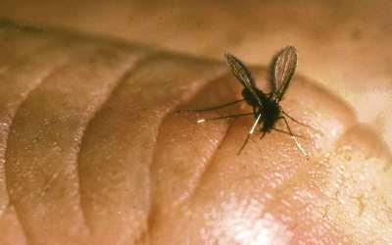
Sand fly

Slide 9
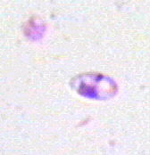
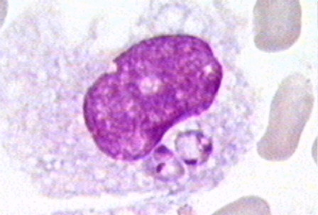
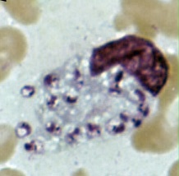
Amastigotes of Leishmania

Slide 10
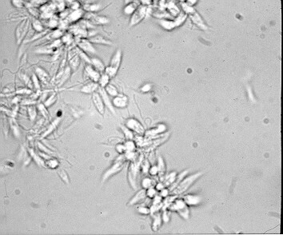
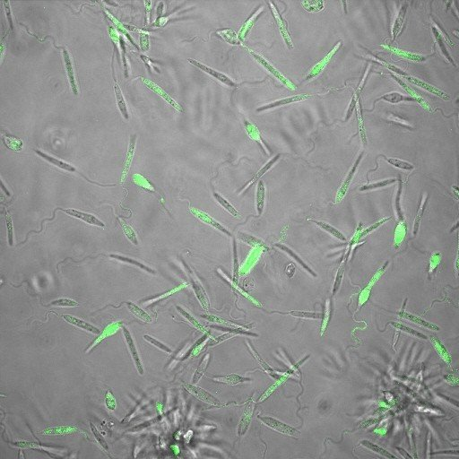
Promastigotes of Leishmania

Slide 11
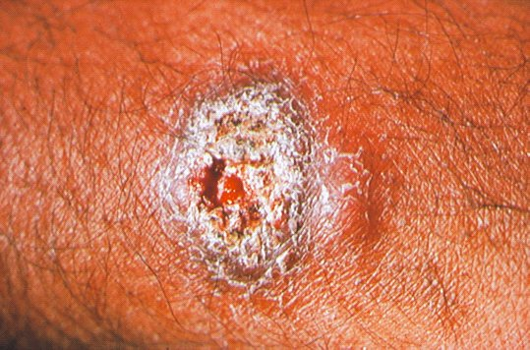
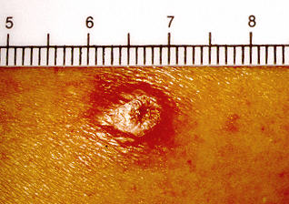
lesion of cutaneous leishmaniasis

Slide 12
Clinical types of cutaneous leishmaniasis
Leishmania major: Zoonotic cutaneous leishmaniasis: wet lesions with severe reaction
Leishmania tropica: Anthroponotic cutaneous leishmaniasis: Dry lesions with minimal ulceration
Oriental sore (most common) classical self-limited ulcer

Slide 13
CUTANEOUS LISHMANIASIS THE COMMON TYPE
This starts as a painless papule on exposed parts of the body, generally the face.
The lesion ulcerates after a few months producing an ulcer with an indurate margin. In some cases the ulcer remains dry and heals readily (dry-type-lesion) .
In some other cases the ulcer may spread with an inflammatory zone around, these known as (wet-type-lesion) which heal slowly.

Slide 14
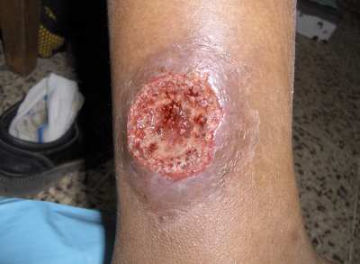
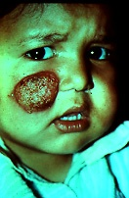
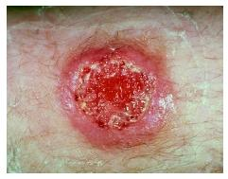

Slide 15
UNCOMMON TYPES OF CUTANEUS LEISHMANIASIS
Diffuse cutaneous leishmaniasis (DCL):
Caused by L. aethiopica, diffuse nodular non-ulcerating lesions, seen in a part of Africa, people with low immunity to Leishmania antigens. Diffuse cutaneous (DCL), and consists of nodules and a thickening of the skin, generally without any ulceration, it needs numerous parasite.
Leishmaniasis recidiva (lupoid leishmaniasis):
Severe immunological reaction to leishmania antigen leading to persistent dry skin lesions, few parasites.

Slide 16
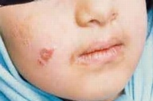
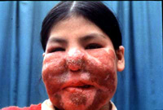
Diffuse cutaneous leishmaniasis (DCL)
Leishmaniasis recidiva

Slide 17
Mucocutaneous leishmaniasis
The lesion starts as a pustular swelling in the mouth or on the nostrils. The lesion may become ulcerative after many months and then extend into the naso- pharyngeal mucous membrane.
Secondary infection is very common with destruction of the nasal cartilage and the facial bone.

Slide 18
cutaneous & muco-cutaneous leishmaniasis
Diagnosis:
The parasite can be isolated from the margin of the ulcer.
A diagnostic skin test, known as Leishmanin test (Montenegro Test), is useful.
Smear: Giemsa stain – microscopy for LD bodies (Leishman-Donovan bodies, amastigotes).
Skin biopsy: microscopy for LD bodies or culture in NNN medium for promastigotes.

Slide 19
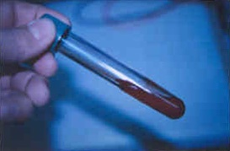
NNN medium

Slide 20
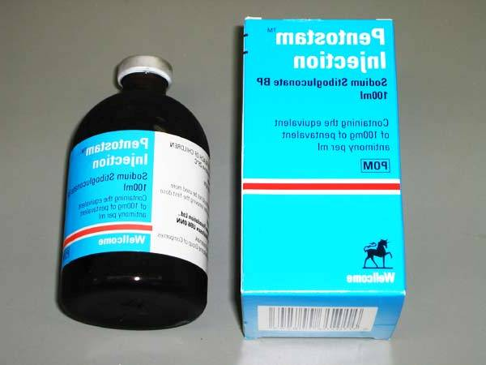
Treatment
No treatment – self-healing lesions
Medical:
Pentavalent antimony (Pentostam), Amphotericin B
Antifungal drugs
+/- Antibiotics for secondary bacterial infection.
Surgical:
Cryosurgery
Excision
Curettage
REFERENCE :WHO (2010) Control of leishmaniasis. Report of a meeting 571 of the WHO expert committee on the control of leishmaniasis. http://whqlibdoc.who.int/trs/WHO_TRS_949_eng.pdf

Slide 21
Visceral leishmaniasis
There are geographical variations.
The disease is called kala-azar
Leishmania infantum mainly affect children
Leishmania donovani mainly affects adults
The incubation period is usually 4-10 months.
The early symptoms are generally low grade fever with malaise and sweating .
In later stages, the fever becomes intermittent and their can be liver enlargement or spleen enlargement or hepatosplenomegally because of the hyperplasia of the lymphoid –macrophage system.

Slide 22
Presentation
Fever
Splenomegaly, hepatomegaly, hepatosplenomegaly
Weight loss
Anaemia
Epistaxis
Cough
Diarrhoea

Slide 23
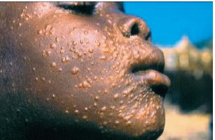
Untreated disease can be fatal
After recovery it might produce a condition called post kala-azar dermal leishmaniasis (PKDL)

Slide 24
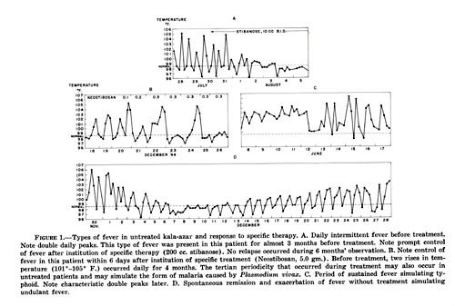
Fever 2 times a day due to kala-azar

Slide 25
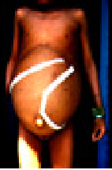
Hepatosplenomegaly in visceral leishmaniasis

Slide 26
Visceral leishmaniasis
Diagnosis
Parasitological diagnosis:
Bone marrow aspirate 1. microscopy (LD bodies)
Splenic aspirate 2. culture in NNN medium
(promastigotes)
Lymph node
Tissue biopsy

Slide 27
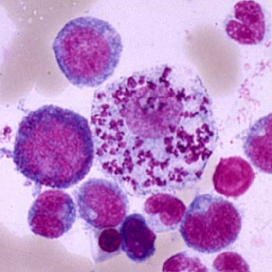
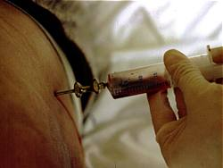
Bone marrow aspiration
Bone marrow amastigotes

Slide 28
(2) Immunological Diagnosis:
Specific serologic tests: Direct Agglutination Test (DAT), ELISA, IFAT
Skin test (leishmanin test) for survey of populations and follow-up after treatment.

Slide 29
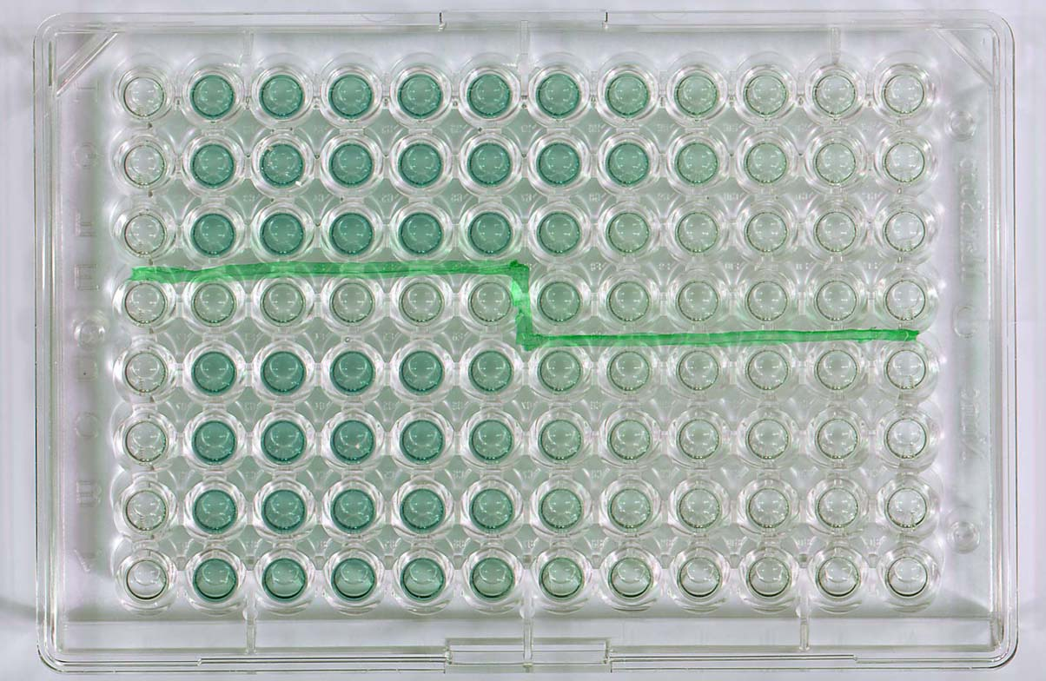
DAT test
ELISA test

Slide 30
Treatment of visceral leishmaniasis
Recommended treatment varies in different endemic areas:
Pentavalent antimony- sodium stibogluconate (Pentostam)
Amphotericin B
Treatment of complications:
Anaemia
Bleeding
Infections etc.
REFERENCE :WHO (2010) Control of leishmaniasis. Report of a meeting 571 of the WHO expert committee on the control of leishmaniasis. http://whqlibdoc.who.int/trs/WHO_TRS_949_eng.pdf

Slide 31
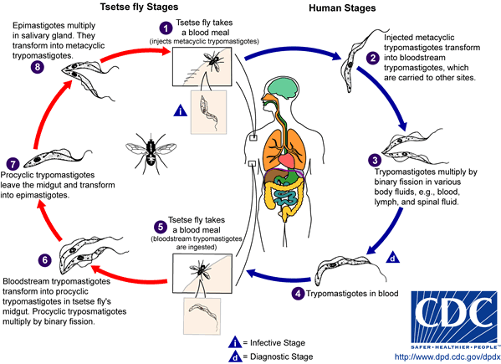
African Trypanosomiasis
Life cycle of Trypanosoma
brucei gambiense & T. b. rhodesiense

Slide 32
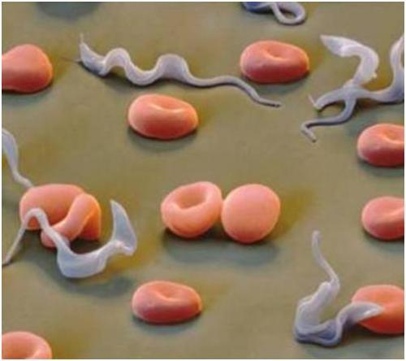
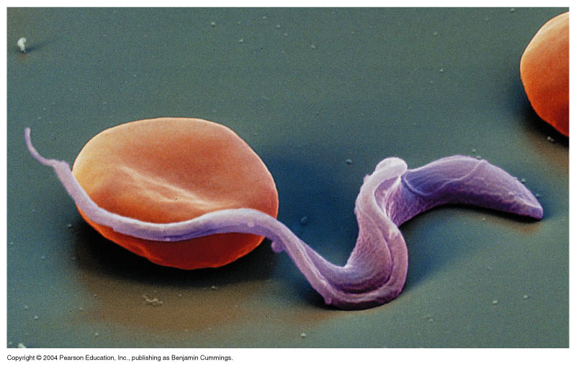
Trypanosomiases

Slide 33
1-African sleeping sickness
Trypanosoma brucei rhodesiense: East Africa, wild and domestic animal reservoirs
Trypanosoma brucei gambiense: West and Central Africa, mainly human infection
2-Chagas’ disease in central and south America
Trypanosma cruzi cause Chagas’ disease.

Slide 34
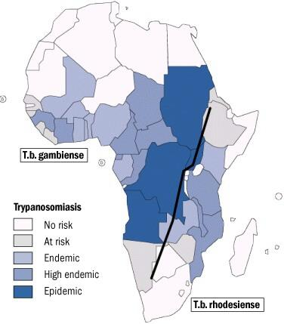

Slide 35
Animal reservoir hosts for African sleeping sickness

Slide 36
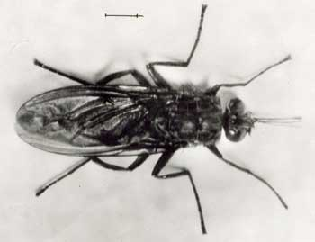
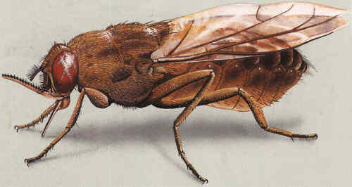
Tsetse fly

Slide 37
Pathology and clinical picture
A primary reaction occurs at the site of inoculation of Trypanosoma, skin stage: chancre which resolve in 2-3 weeks.
Systemic Haemato-lymphatic stage: intermittent fever, headache and generalized lymphadenopathy mainly in the cervical and sub occipital region (Winterbottom’ sign), anaemia, generalized organ involvement.
Central nervous system stage (CNS): Meningoencephalitis.
(Development of the disease more rapid in Trypanosoma brucei rhodesiense)

Slide 38
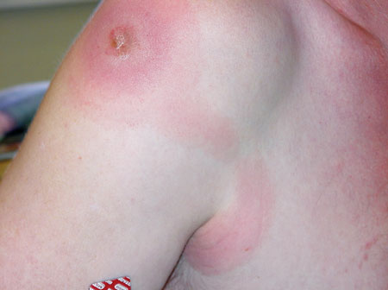
Chancre skin stage

Slide 39
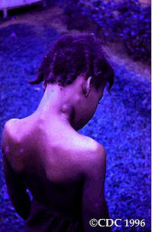
Winterbottom’s stage

Slide 40
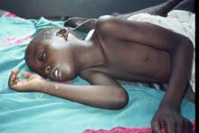
3rd stage CNS: CNS involvement in typical case there is daytime sleeping, psychological changes, tremors, convulsions and finally coma.

Slide 41
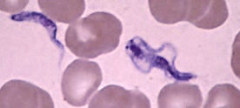
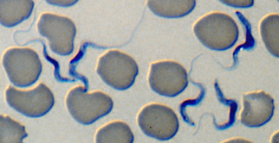
trypanosoma

Slide 42
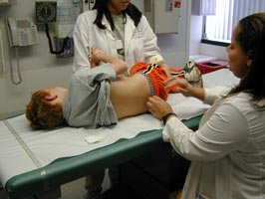
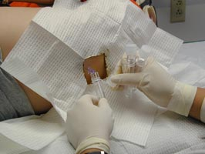
CSF lumbar puncture

Slide 43
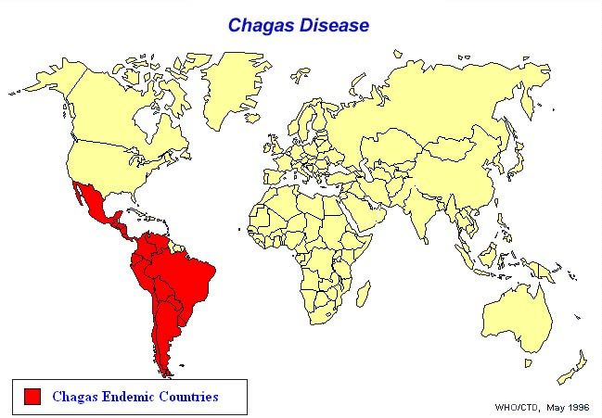

Slide 44
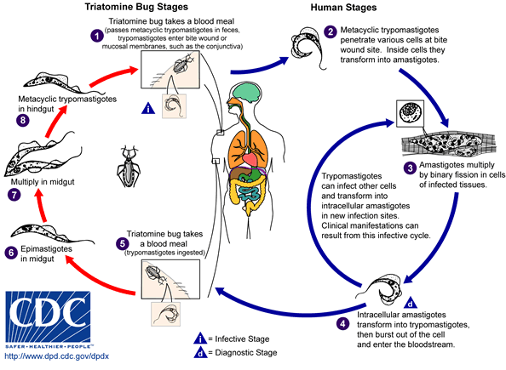
AMERICAN TRYPANOSOMIASIS
LIFE CYCLE OF Trypanosoma cruzi

Slide 45
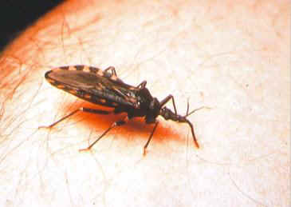
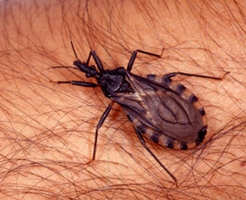
Reduviid (Triatomine) bug

Slide 46
American trypanosomes (Chaga’s disease)
The parasites produce focal lymphangitis and oedema at the site of parasites entry (chagoma) after that parasites (trypomastigote) enter the blood stream and find there way, mainly on the face near the eyelids, it produces a swelling of the eye and temporal region with conjunctivitis (ROMANA’S sign), and also find their way mainly the cardiac muscle cells. The most constant feature of the cardiac disease is cardiomyopathy, in severe cases can lead to partial or complete heart block which may lead to cardiac failure.
NOTE: Parasite when free in blood stream in form (TRYPTOMASTIGOTE), but in the tissue it become in form of (Amastigote).

Slide 47
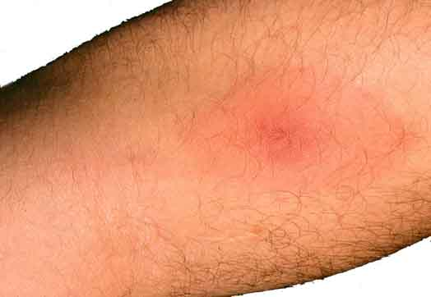
T.cruzi causes cutaneous stage (chagoma)

Slide 48
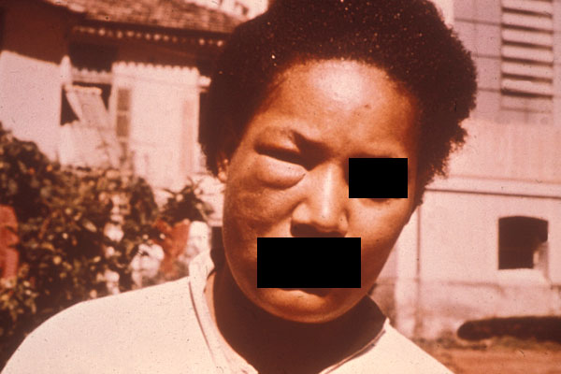
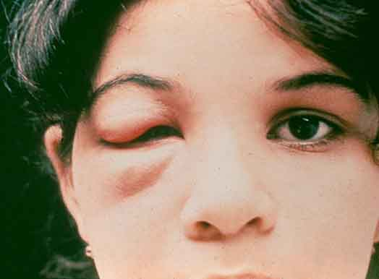
Ocular lesion (Romana’s sign)

Slide 49
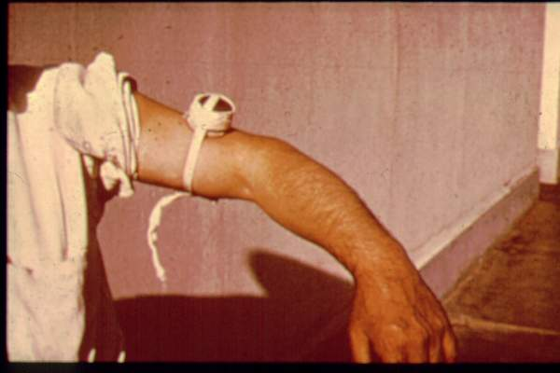
Diagnosis
Blood film
Serology: IFAT
Xenodiagnosis: feeding bugs on a suspected cases.

Slide 50
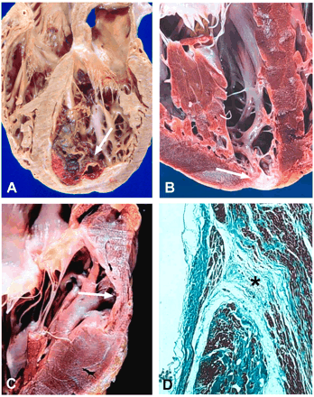
Heart damage due to American trypanosomiasis

Slide 51
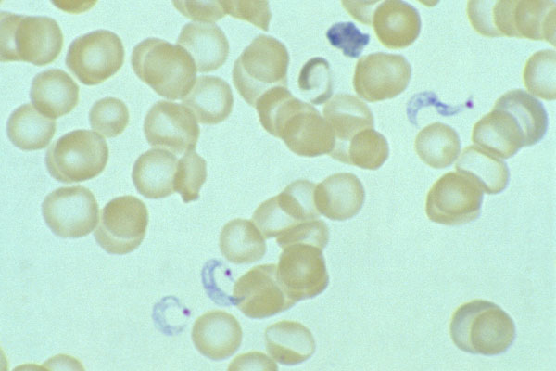
C-shape

Slide 52
TREATMENT OF TRYPANOSOMIASIS
African trypanosomiasis
For early infection
pentamidine
suramin
For late infection
eflornithine (Diflouromethylornithine- DFMO)
American trypanosomiasis (Chaga’s disease)
benznidazole
nifurtimox

