Slide 1
Chapter 63; pages-797-806 Lecture 1 Gastrointestinal Physiology
General Principles of Gastrointestinal Function-Motility, Nervous Control, and Blood Circulation
Mohammed Alzoghaibi, Ph.D
zzoghaibi@gmail.com
Cell Phone #: 0506338400

Slide 2
Required Textbook
Textbook of Medical Physiology
Thirteenth Edition
Guyton & Hall
Published by Elsevier Saunders
2016

Slide 3
Learning Objectives
Physiologic Anatomy of the Gastrointestinal Wall
The General Characteristics of Smooth Muscle and its Function
Smooth muscle cell classifications and types of contraction
Muscle layers in GI wall
Electrical Activity of Gastrointestinal Smooth Muscle
Slow Waves and spike potentials
Calcium Ions and Muscle Contraction
Neural Control of Gastrointestinal Function-Enteric Nervous System

Slide 4
Learning Objectives (Cont.)
Differences Between the Myenteric and Submucosal Plexuses
Types of Neurotransmitters Secreted by Enteric Neurons
Autonomic Control of the Gastrointestinal Tract
Hormonal Control of Gastrointestinal Motility
Functional Types of Movements in the Gastrointestinal Tract
Gastrointestinal Blood Flow-"Splanchnic Circulation"
Effect of Gut Activity and Metabolic Factors on Gastrointestinal Blood Flow

Slide 5
General Principles of Gastrointestinal Function-Motility, Nervous Control, and Blood Circulation
The alimentary tract provides the body with a continual supply of water, electrolytes, and nutrients. To achieve this requires
movement of food through the alimentary tract
secretion of digestive juices and digestion of the food
absorption of water, various electrolytes, and digestive products
circulation of blood through the gastrointestinal organs to carry away the absorbed substances
control of all these functions by local, nervous, and hormonal systems

Slide 6
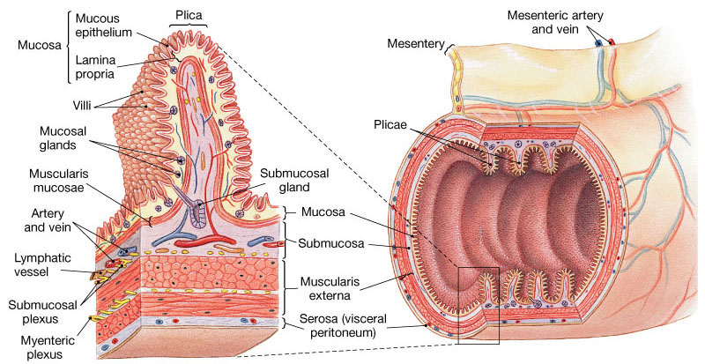
General Principles of Gastrointestinal Motility Physiological Anatomy of the Gastrointestinal Wall
The following layers structure the GI wall from outer surface inward: (1) the serosa, (2) a longitudinal muscle layer, (3) a circular muscle layer, (4) the submucosa, and (5) the mucosa. In addition, sparse bundles of smooth muscle fibers, the mucosal muscle, lie in the deeper layers of the mucosa.

Slide 7
The General Characteristics of Smooth Muscle
TWO SMOOTH MUSCLE CLASSIFICATIONS:
Unitary type:
Contracts spontaneously in the absence of neural or hormonal influence but in response to stretch (such as in stomach and intestine)
Cells are electrically coupled via gap junctions
2. Multiunit type:
Does not contract in response to stretch or without neural input (such as in esophagus & gall bladder)

Slide 8
The General Characteristics of Smooth Muscle (Cont.)
TYPES OF CONTRACTION:
Phasic contractions (rhythmical)
periodic contractions followed by relaxation; such as in gastric antrum, small intestine and esophagus
Tonic contractions
maintained contraction without relaxation; such as in Orad region of the stomach, lower esoghageal, ileocecal and internal anal sphincter
Caused by: 1- repetitive spike potentials, 2- hormones, 3- continuous entry of Ca ions (not associated with changes in membrane potentials).
Not associated with slow waves (often lasting several minutes or hours).

Slide 9
The General Characteristics of Smooth Muscle and its Function
Two main muscle layers:
Longitudinal Smooth Muscles:
Contraction of this type shortens the segment of the intestine and expands the lumen. They are innervated by enteric nervous system (ENS), and mainly by excitatory motor neurons. The Ca influx from out side is important in the activity of this type of muscle.
2. Circular Smooth Muscles:
They are thicker and more powerful than longitudinal. Contraction of this type reduces the diameter of the lumen and increases its length. They are innervated by ENS, both excitatory and inhibitory motor neurons. More gap junctions are available than in longitudinal muscle. Intracellular release of Ca is more important.

Slide 10
The Specific Characteristics of Smooth Muscle in the Gut
Gastrointestinal Smooth Muscle Functions as a Syncytium:
The individual smooth muscle fibers are 200 to 500 µm in length and 2 to 10 µm in diameter, and they are arranged in bundles of as many as 1000 parallel fibers.
Within each bundle, the muscle fibers are electrically connected with one another through large numbers of gap junctions.
Each bundle of smooth muscle fibers is partly separated from the next by loose connective tissue but they fuse with one another at many points, so each muscle layer represents a branching latticework of smooth muscle bundles. Therefore, each muscle layer functions as a syncytium; that is, when an action potential is elicited anywhere within the muscle mass, it generally travels in all directions in the muscle.

Slide 11
The Specific Characteristics of Smooth Muscle in the Gut
Single-Unit Type
Muscle
Gap
Junction
Caveolae
Myosin
Actin
Dense
Body
Intermediate
Filaments

Slide 12
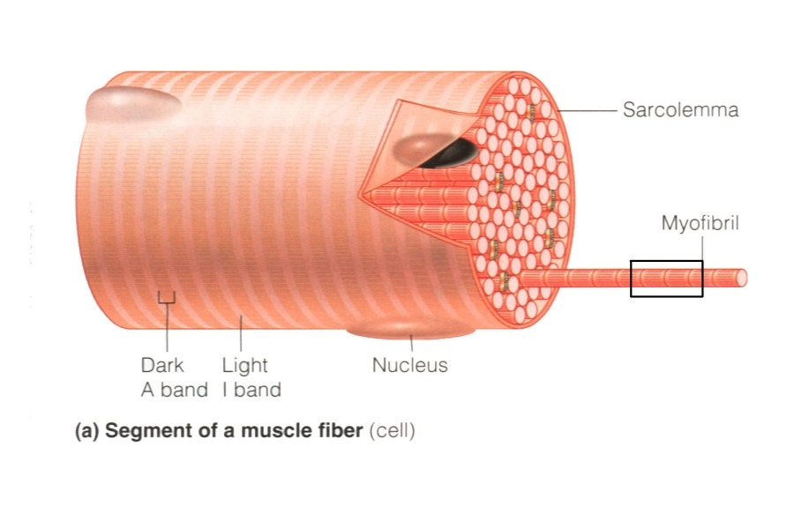
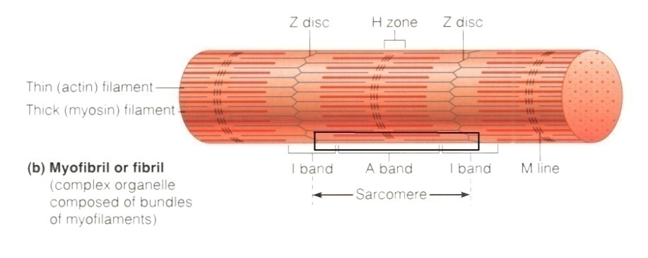
The Specific Characteristics of The Muscle Cells

Slide 13
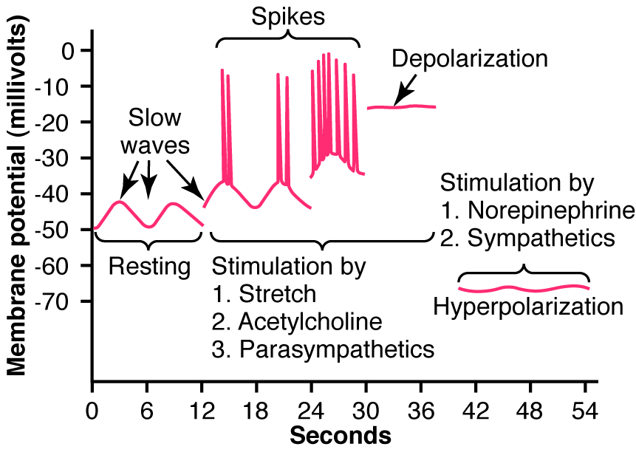
The Specific Characteristics of Smooth Muscle in the Gut (Cont.)
Electrical Activity of Gastrointestinal Smooth Muscle:
The smooth muscle of the gastrointestinal tract is excited by almost continual slow, intrinsic electrical activity along the membranes of the muscle fibers. This activity has two basic types of electrical waves: (a) slow waves and (b) spikes.

Slide 14
Membrane potentials in intestinal smooth muscle

Slide 15
Smooth Muscle in the Gut (Cont.)
a. Slow Waves
Most gastrointestinal contractions occur rhythmically, and this rhythm is determined mainly by the frequency of so-called "slow waves" of smooth muscle membrane potential. These waves are not action potentials. Instead, they are oscillating depolarization and repolarization in the resting membrane potential with unknown cause.
Their intensity usually varies between 5 and 15 mV, and their frequency ranges in different parts of the human gastrointestinal tract from 3 to 12 per minute: about 3 in the body of the stomach, as much as 12 in the duodenum, and about 8 or 9 in the terminal ileum.
Origin of slow waves: They may originate in the interstitial cells of Cajal (ICC, the GI pacemaker), which are abundant in the myenteric plexues. These ICCs form a network with each other and are interposed between the smooth muscle layers, with synaptic-like contacts to smooth muscle cells.

Slide 16
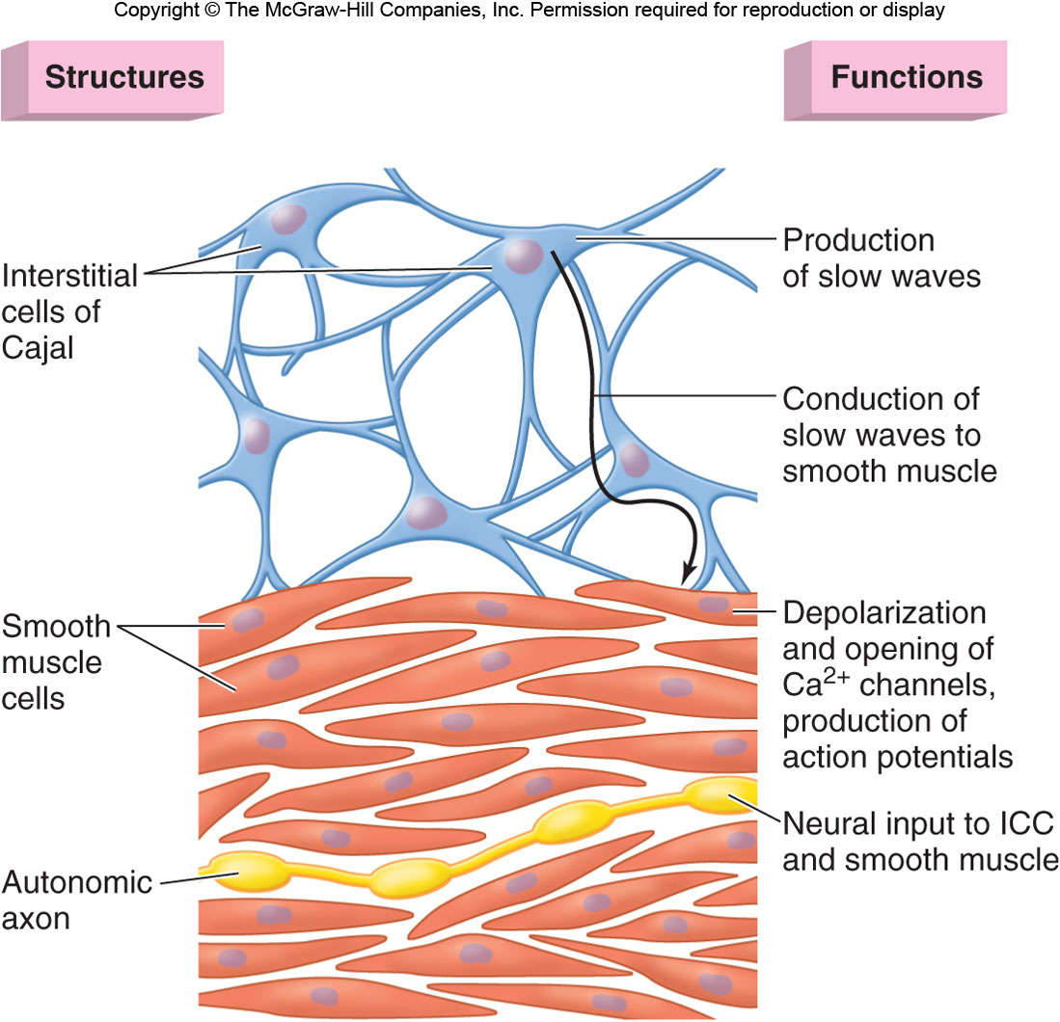
Membrane potentials in intestinal smooth muscle (cont.)

Slide 17
The Specific Characteristics of Smooth Muscle in the Gut (Cont.)
b. The spike potentials are true action potentials. They occur automatically when the resting membrane potential of the gut smooth muscle becomes more positive (<-40 mV) (the normal resting membrane potential is between -50 and -60 mV). The higher the slow wave potential rises, the greater the frequency of the spike potentials, usually ranging between 1 and 10 spikes per second. The spike potentials last 10 to 40 times as long in gastrointestinal muscle as the action potentials in large nerve fibers, each gastrointestinal spike lasting as long as 10 to 20 msec.
In gastrointestinal smooth muscle fibers, the channels responsible for the action potentials are somewhat different; they allow especially large numbers of calcium ions to enter along with smaller numbers of sodium ions and therefore are called calcium-sodium channels. These channels are much slower to open and close than the rapid Na channels of large nerve fibers.

Slide 18
Smooth Muscle in the Gut (Cont.)
Changes in Voltage of the Resting Membrane Potential.
The resting membrane potential averages about -56 millivolts, but multiple factors can change this level. When the potential becomes less negative, which is called depolarization of the membrane, the muscle fibers become more excitable. When the potential becomes more negative, which is called hyperpolarization, the fibers become less excitable.
Factors that depolarize the membrane-that make it more excitable-are:
stretching of the muscle, (2) stimulation by acetylcholine released from the endings of parasympathetic nerves, and (3) stimulation by several specific gastrointestinal hormones.
Factors that make the membrane potential more negative-that is, hyperpolarize the membrane and make the muscle fibers less excitable-are: (1) the effect of norepinephrine or epinephrine on the fiber membrane and (2) stimulation of the sympathetic nerves that secrete mainly norepinephrine at their endings.

Slide 19
The Specific Characteristics of Smooth Muscle in the Gut (Cont.)
Calcium Ions and Muscle Contraction. Smooth muscle contraction occurs in response to entry of calcium ions into the muscle fiber. The slow waves do not cause calcium ions to enter the smooth muscle fiber (only sodium ions). Therefore, the slow waves by themselves usually cause no muscle contraction. Instead, it is during the spike potentials, generated at the peaks of the slow waves, that significant quantities of calcium ions do enter the fibers and cause most of the contraction.
Tonic Contraction of Some Gastrointestinal Smooth Muscle.
Some smooth muscle of the GI exhibits tonic contraction as well as or instead of rhythmical contractions. Tonic contraction is continuous, not associated with the basic electrical rhythm of the slow waves but often lasting several minutes or even hours.
Tonic contraction is sometimes caused by:
1. Continuous repetitive spike potentials. 2. Hormones. 3. Continuous entry of calcium ions into the interior of the cell brought about in ways not associated with changes in membrane potential (Not via voltage-gated Ca channels).

Slide 20
Neural Control of Gastrointestinal Function-Enteric Nervous System

Slide 21
Neural Control of Gastrointestinal Function-Enteric Nervous System
Enteric Nervous System is the nervous system of GI tract. It lies entirely in the wall of the gut, beginning in the esophagus and extending all the way to the anus. It has as many neurons as spinal cord (about 100 million).
The enteric nervous system is composed mainly of two plexuses:
(1) an outer plexus lying between the longitudinal and circular muscle layers, called the myenteric plexus; controls mainly the gastrointestinal movements.
(2) an inner plexus, called the submucosal plexus or Meissner's plexus, that lies in the submucosa; controls mainly gastrointestinal secretion and local blood flow.

Slide 22
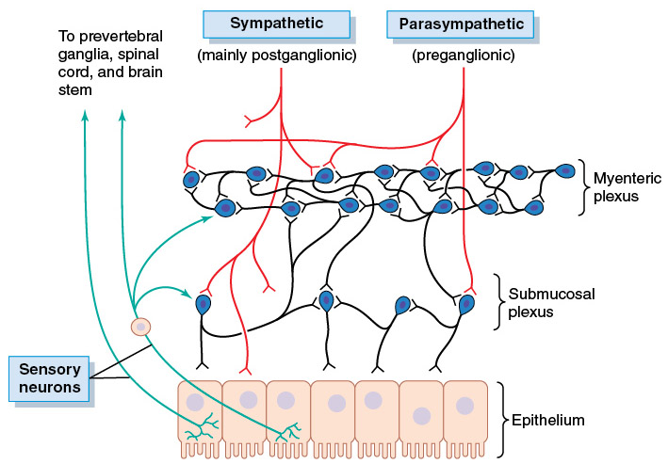
Neural Control of Gastrointestinal Function-Enteric Nervous System

Slide 23
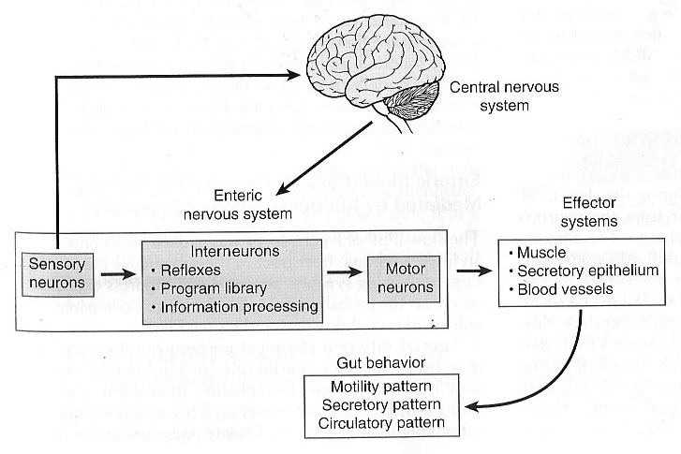
Neural Control of Gastrointestinal Function-Enteric Nervous System

Slide 24
Neural Control of Gastrointestinal Function-Enteric Nervous System
The enteric nervous system can function on its own, independently of the parasympathetic and sympathetic systems, however, these extrinsic nerves can greatly enhance or inhibit gastrointestinal functions. The sensory nerve endings send afferent fibers to both plexuses of the enteric system and then to: (1) the prevertebral ganglia of the sympathetic nervous system, (2) the spinal cord, and (3) the vagus nerves all the way to the brain stem. These sensory nerves can elicit local reflexes within the gut wall.
Spinal cord (in cross-section)
Stimulus
2
Sensory neuron
3
Integration center
1
Receptor
4
Motor neuron
Skin
5
Effector
Interneuron

Slide 25
Differences Between the Myenteric and Submucosal Plexuses
The myenteric plexus
Consists mostly of a linear chain of many interconnecting neurons.
When it is stimulated, its principal effects are:
(1) increased tonic contraction
(2) increased intensity of the rhythmical contractions
(3) increased rate of the rhythm of contraction
(4) increased velocity of conduction of excitatory waves along the gut wall
The myenteric plexus has excitatory and inhibitory motor neurons (fiber endings secrete an inhibitory transmitter, e.g., vasoactive intestinal polypeptide)
The submucosal plexus
Controls local intestinal secretion, local absorption, and local contraction of the submucosal muscle that causes various degrees of infolding of the gastrointestinal mucosa.

Slide 26
Types of Neurotransmitters Secreted by Enteric Neurons
The specific functions of many of GI neurotransmitters are not well known, but some research workers have discovered the effects of some of these substances as following:
Excitatory Motor Neurons Evoke Muscle Contraction & Intestinal Secretion:
Neurotransmitters of motor neurons:
Substance P; 2. Ach
Neurotransmitters of secretomotor neurons (releasing of water, electrolytes and mucus from crypts of Lieberkuhn):
Ach 2. VIP 3. Histamine (neurogenic secretory diarrhea)
Inhibitory Motor Neurons Suppress Muscle Contraction:
ATP 2. NO 3. VIP

Slide 27
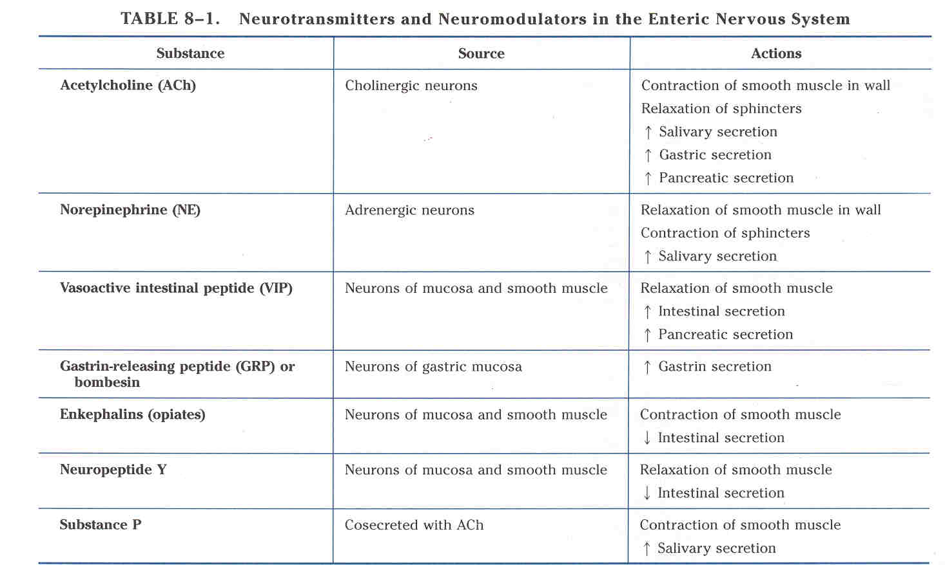
Types of Neurotransmitters Secreted by Enteric Neurons (cont.)

Slide 28
Autonomic Control of the Gastrointestinal Tract
Autonomic nervous system (ANS) is divided into
- Parasympathetic
- Sympathetic
- Enteric Nervous System (ENS)

Slide 29
Parasympathetic Innervation
The parasympathetic supply to the gut is divided into cranial and sacral divisions.
The cranial parasympathetic nerve fibers are almost entirely in the vagus nerves.
The esophagus, stomach, pancreas and the intestines down through the first half of the large intestine are innervated by vagus nerves.
The distal half of the large intestine and the anus are innervated by the sacral parasympathetics which pass through the pelvic nerves (to execute the defecation reflexes).
The postganglionic neurons of the gastrointestinal parasympathetic system are located mainly in the myenteric and submucosal plexuses. Stimulation of these parasympathetic nerves causes general increase in activity of the entire enteric nervous system.

Slide 30
Parasympathetic Innervation

Slide 31
Neural Control of Gastrointestinal Function-Enteric Nervous System

Slide 32
Sympathetic Innervation
The sympathetic fibers to the gastrointestinal tract originate in the spinal cord between segments T-5 and L-2.
The sympathetics innervate essentially all of the GI tract, rather than being more extensive nearest the oral cavity and anus as is true of the parasympathetics.
The sympathetic nerve endings secrete mainly norepinephrine.
Stimulation of the sympathetic nervous system inhibits activity of the GI. Strong stimulation of the sympathetic system can inhibit motor movements of the gut so greatly that this literally can block movement of food through the gastrointestinal tract.

Slide 33
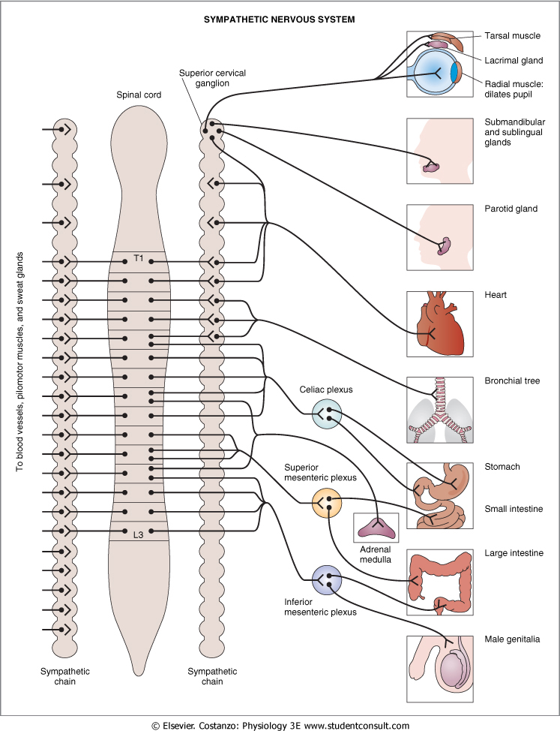
Sympathetic Innervation

Slide 34
Afferent Sensory Nerve Fibers from the Gut
Many afferent sensory nerve fibers innervate the gut. Some of them have their cell bodies in the enteric nervous system and some in the dorsal root ganglia of the spinal cord
These sensory nerves can be stimulated by (1) irritation of the gut mucosa, (2) excessive distention of the gut, or (3) presence of specific chemical substances in the gut.
Signals transmitted through the fibers can then cause excitation or inhibition of intestinal movements or intestinal secretion.
Other sensory signals from the gut go all the way to multiple areas of the spinal cord and even the brain stem. For example, 80% of the nerve fibers in the vagus nerves are afferent rather than efferent. These afferent fibers transmit sensory signals from the gastrointestinal tract into the brain medulla, which in turn initiates vagal reflex signals (vagovagal reflexes).

Slide 35
Gastrointestinal Reflexes
The anatomical arrangement of the enteric nervous system and its connections with the sympathetic and parasympathetic systems support three types of gastrointestinal reflexes that are essential to gastrointestinal control. They are the following:
Reflexes that are integrated entirely within the gut wall enteric nervous system.

Slide 36
Gastrointestinal Reflexes (Cont.)
2. Reflexes from the gut to the prevertebral sympathetic ganglia and then back to the gastrointestinal tract.
These reflexes transmit signals long distances to other areas of the gastrointestinal tract, such as signals from the stomach to the colon (the gastrocolic reflex), signals from the colon and small intestine to inhibit stomach motility and stomach secretion (the enterogastric reflexes), and reflexes from the colon to inhibit emptying of ileal contents into the colon (the colonoileal reflex).

Slide 37
Gastrointestinal Reflexes (Cont.)
3. Reflexes from the gut to the spinal cord or brain stem and then back to the gastrointestinal tract.
These include: (1) reflexes from the stomach and duodenum to the brain stem and back to the stomach—by way of the vagus nerves—to control gastric motor and secretory activity; (2) pain reflexes that cause general inhibition of the entire gastrointestinal tract; and (3) defecation reflexes that travel from the colon and rectum to the spinal cord and back again to produce the powerful colonic, rectal, and abdominal contractions required for defecation (the defecation reflexes).

Slide 38
Hormonal Control of Gastrointestinal Motility

Slide 39
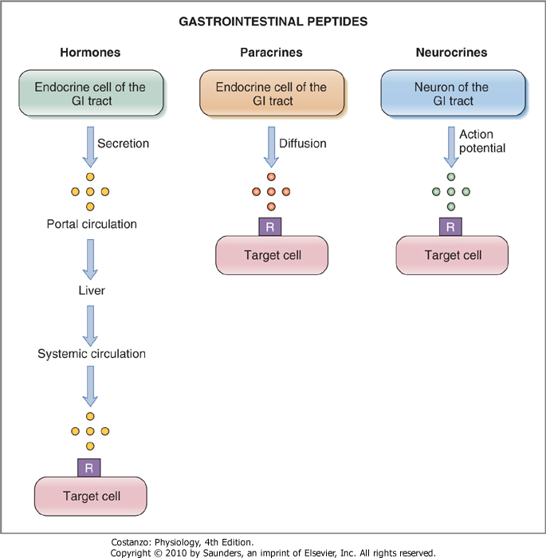
Gastrointestinal Peptides

Slide 40
Hormone | Site of Secretion | Stimuli for Secretion | Actions
Gastrin | G cells of the stomach | Small peptides and amino acids Distention of the stomach Vagal stimulation (GRP) | ↑ Gastric H⁺ secretion Stimulates growth of gastric mucosa
Cholecystokinin (CCK) | I cells of the duodenum and jejunum | Small peptides and amino acids Fatty acids | ↑ Pancreatic enzyme secretion ↑ Pancreatic HCO₃⁻ secretion Stimulates contraction of the gallbladder and relaxation of the sphincter of Oddi Stimulates growth of the exocrine pancreas and gallbladder Inhibits gastric emptying
Secretin | S cells of the duodenum | H⁺ in the duodenum Fatty acids in the duodenum | ↑ Pancreatic HCO₃⁻ secretion ↑ Biliary HCO₃⁻ secretion ↓ Gastric H⁺ secretion Inhibits trophic effect of gastrin on gastric mucosa
Glucose-Dependent Insulinotropic Peptide (GIP) | K cells of the Duodenum and jejunum | Fatty acids Amino acids Oral glucose | ↑ Insulin secretion from pancreatic β cells ↓ Gastric H⁺ secretion
Motilin | M cells of the duodenum and jejunum | Fat Acid Nerve | Stimulates: Gastric motility Intestinal motility

Slide 41
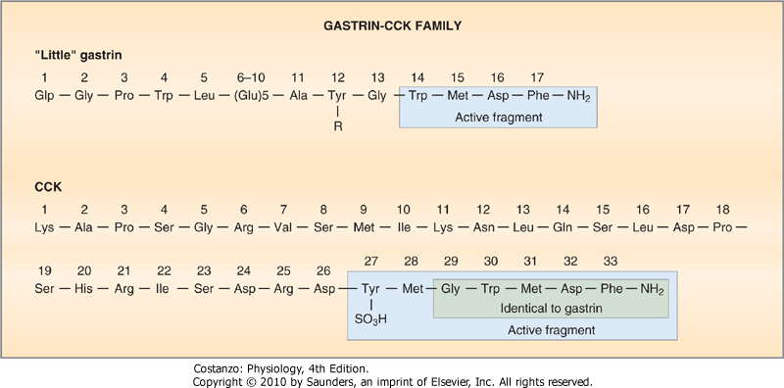
Gastrin- cholecystokinin (CCK) Family

Slide 42
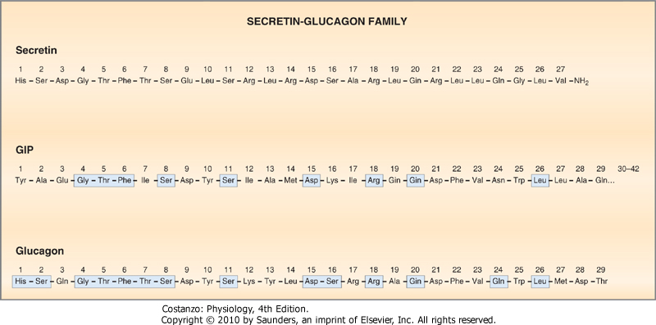
Secretin-Glucagon Family

Slide 43
Functional Types of Movements in the Gastrointestinal Tract
Two types of movements occur in the GI tract:
Propulsive Movements – Peristalsis:
Organizes propulsion of material over variable distances within the GI lumen
Usual stimulus is distention. Other stimuli that can initiate peristalsis include chemical or physical irritation of the epithelial lining in the gut.
Myenteric plexus is important
Atropine (cholinergic blocker) depresses propulsion
Receiving segment---contraction (longitudinal M.)
---relaxation (circular M.)
Propulsive segment ---contraction (circular M.)
----relaxation (longitudinal M.)

Slide 44
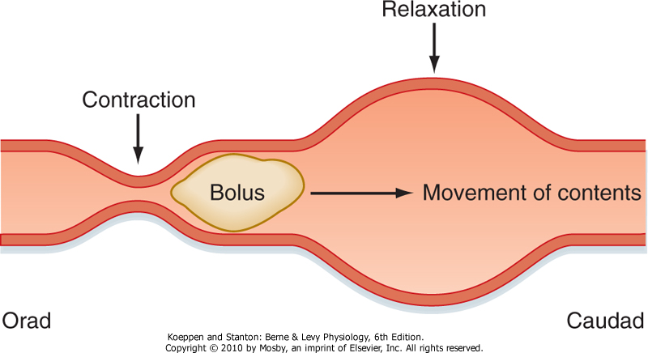
Functional Types of Movements in the Gastrointestinal Tract (Cont.)

Slide 45
Functional Types of Movements in the Gastrointestinal Tract (Cont.)
Peristaltic Reflex and the "Law of the Gut." When a segment of the intestinal tract is excited by distention and thereby initiates peristalsis, the contractile ring causing the peristalsis normally begins on the Orad side of the distended segment and moves toward the distended segment, pushing the intestinal contents in the anal direction (Caudad direction) for 5 to 10 cm before dying out.

Slide 46
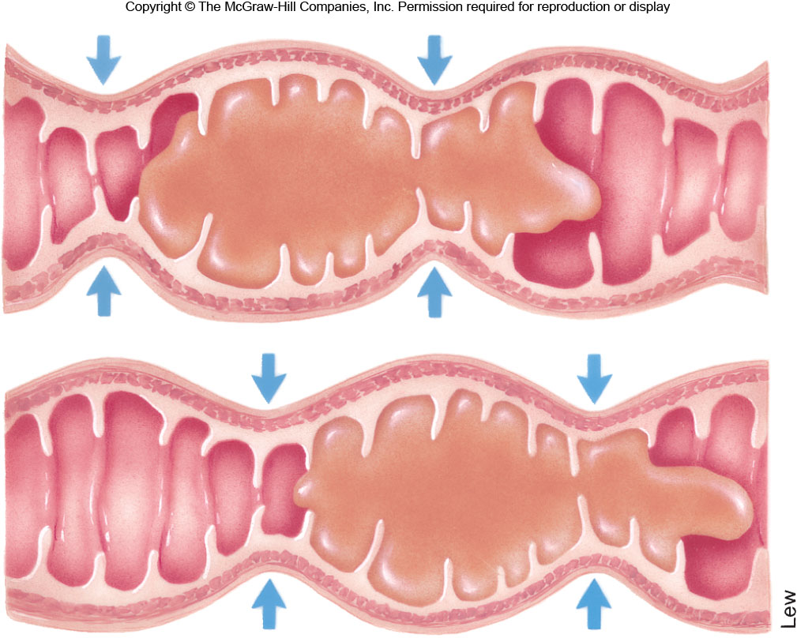
Functional Types of Movements in the Gastrointestinal Tract (Cont.)
2) Mixing movements (segmentation)
Blend different juices with the chyme
Bring products of digestion in contact with absorptive surfaces

Slide 47
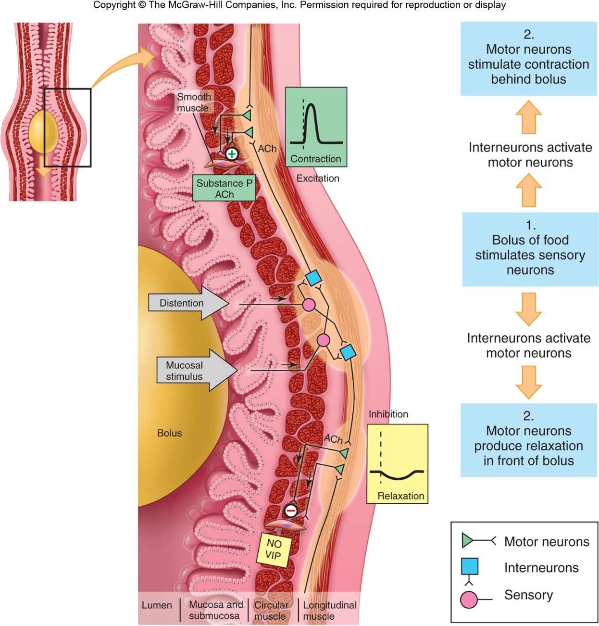
Enteric Nervous System

Slide 48
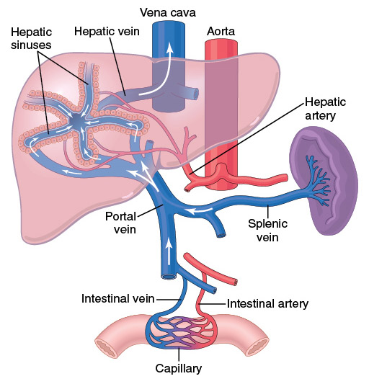
Gastrointestinal Blood Flow-"Splanchnic Circulation"
Splanchnic circulation includes the blood flow through the gut itself plus blood flows through the spleen, pancreas, and liver. The design of this system is such that all the blood that courses through the gut, spleen, and pancreas then flows immediately into the liver by way of the portal vein. In the liver, the blood passes through millions of minute liver sinusoids and finally leaves the liver by way of hepatic veins that empty into the vena cava of the general circulation.

Slide 49
Effect of Gut Activity and Metabolic Factors on Gastrointestinal Blood Flow
Possible Causes of the Increased Blood Flow During Gastrointestinal Activity
Most of the peptide hormones, including cholecystokinin (CCK), vasoactive intestinal peptide (VIP), gastrin, and secretin.
Some of the GI glands release into the gut wall two kinins, kallidin and bradykinin (vasodilators)
Decreased oxygen concentration in the gut wall can increase intestinal blood flow at least 50 to 100 percent.

Slide 50
Nervous Control of Gastrointestinal Blood Flow
Stimulation of the parasympathetic nerves going to the stomach and lower colon increases local blood flow at the same time that it increases glandular secretion.
Sympathetic stimulation, by contrast, has a direct effect on essentially all the gastrointestinal tract to cause intense vasoconstriction of the arterioles with greatly decreased blood flow. But the local metabolic vasodilator mechanisms override the sympathetic vasoconstriction effects, returning the normal blood flow to GI muscle and glands.

Slide 51
The End

