Slide 1
RADIOLOGY OF THE ABDOMEN
Abdulaziz almanie MD
Radiology Department

Slide 2
OBJECTIVES
To know radiology modalities used in abdomen imaging mainly GI tract.
To know advantages and disadvantages of each modality.
To know indications and contraindications of each modality.
Overview on normal abdomen appearance and common pathologies including:
Pneumoperitomium
Bowell obstruction
Inflammatory bowel disease
Large bowel masses/malignancies

Slide 3
What radiological modalities are GOOD in imaging the abdomen mainly the GI tract?

Slide 4
What radiological modalities are GOOD in imaging the abdomen mainly the STOMACH and BOWEL LOOPS?
X-ray
Fluoroscopy
CT scan
MRI
?? US

Slide 5
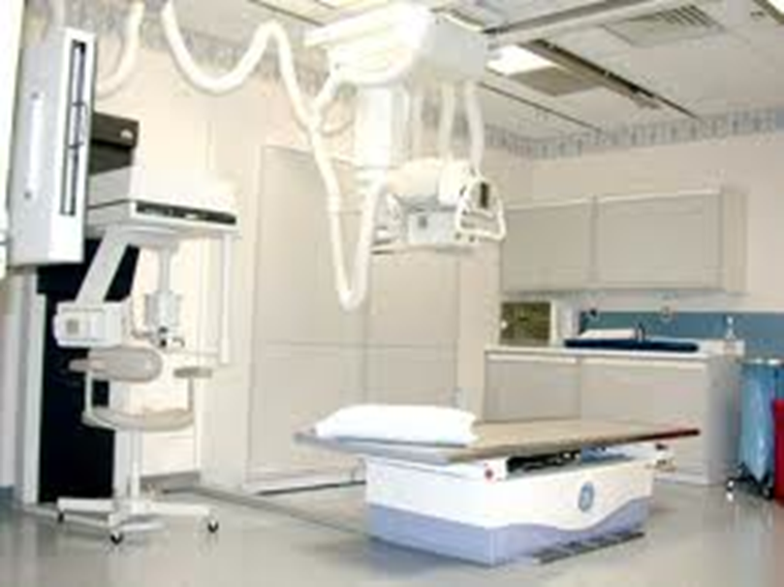
X-Ray

Slide 6
Abdominal x-ray
X-ray is a form of radiation, that are focused into a beam
X-ray can pass through most objects including the human body.
When X-rays strike a piece of photographic film, they make a picture.

Slide 7
ABDOMINAL X-RAY
White ----- bone and calcification
Grey ------ soft tissue
Black ----- air

Slide 8
ADVANTAGES:
Widely available
Cheap
Excellent in diagnosing free air in the abdomen
Good in diagnosing bowel obstruction & stones/calcifications
DISADVANTAGES:
Radiation
Poor soft tissue details

Slide 9
INDICATIONS
Abdominal pain
Bowel obstruction
Stones
Masses
Trauma
Others, foreign body, supportive lines.. Etc
CONTRAINDICATIONS:
pregnancy

Slide 10
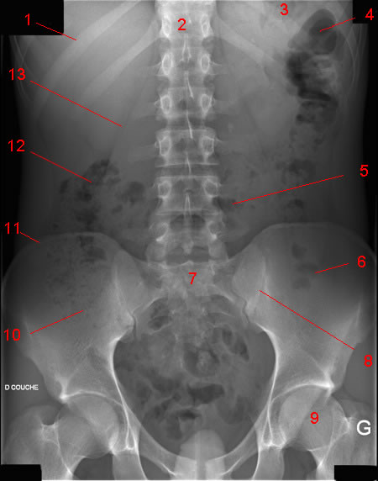
Normal AXR

Slide 11
Normal AXR
Liver
Gas in stomach
T12
Splenic flexure
11th rib
Psoas margin
Left kidney
Hepatic flexure
Transverse colon
Iliac crest
Gas in sigmoid
Sacrum
Gas in caecum
SI joint
Bladder
Femoral head

Slide 12
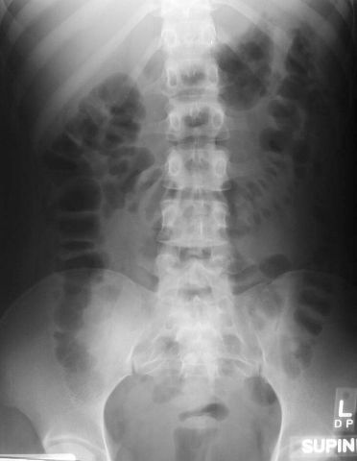
First step of reading an Abdominal X-ray is assessing gas pattern
What is normal?
Stomach
Almost always air in stomach
Small bowel
Usually small amount of air in
2 or 3 loops
Large bowel
Almost always air in rectum
and sigmoid
Varying amount of gas in rest of large bowel

Slide 13
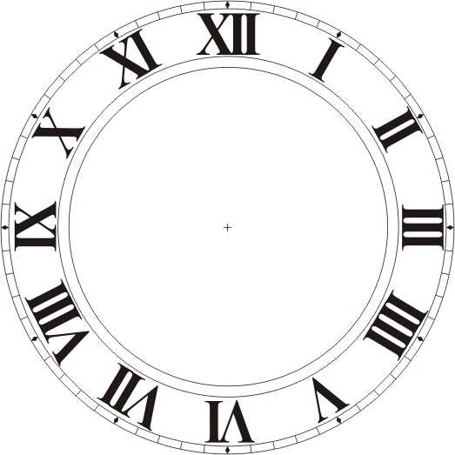
3, 6, 9 RULE
Maximum Normal Diameter of bowel
Small bowel 3cm
Large bowel 6cm
Caecum 9cm

Slide 14
Mechanical small bowl obstruction
Mechanical SBO causes:
1-Adhesion from previous abdominal surgery (most common cause)
2-hernias containing bowl
3-neoplasm

Slide 15
Is this X ray normal or abnormal ? and Why?

Slide 16
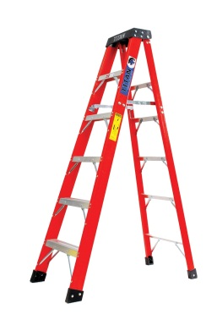
It is ABNORMAL
S Small bowl obstruction
Dilated bowel loops
Air fluid levels
Loops arrange themselves from left upper to right lower quadrant in distal SBO

Slide 17
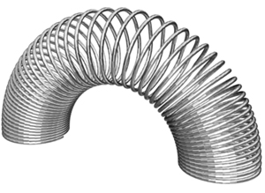
Coil spring

Slide 18
Double Bubble Sign
Duodenal Atresia

Slide 19
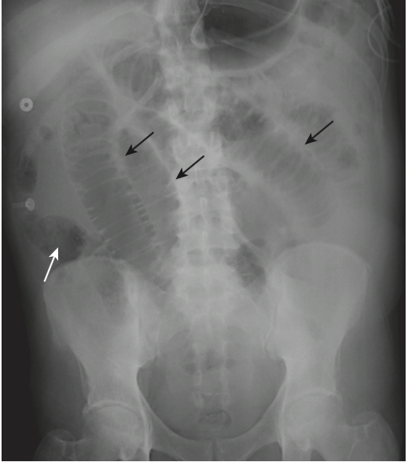
How to differentiate between small and large bowl on X-ray
The small bowel is centrally placed in the abdomen.
Valvular markings typically extend across the lumen of the small bowel from one wall to the other. The valvulae are spaced much closer together.
The small bowel can achieve a maximum diameter, when abnormally dilated, of about 5 cm. The large bowel can dilate to many times that size.

Slide 20
Causes of Mechanical LBO
Causes of Large bowl obstruction:
1-Tumor (carcinoma)
2-Hernia
3-Volvulus
4-Diverticulitis
5-Intussusception

Slide 21
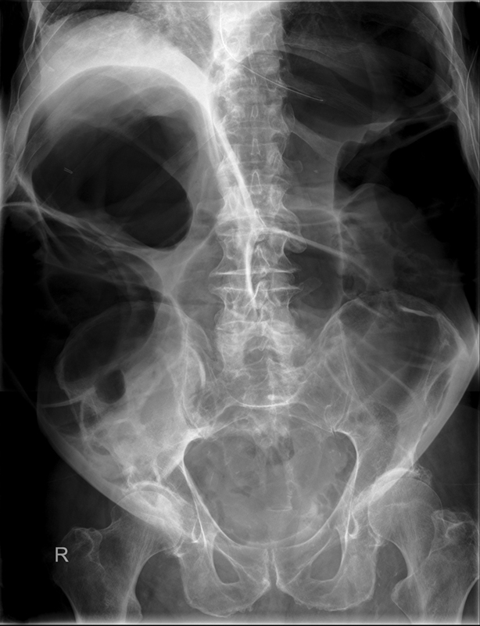
Mechanical LBO
Colon dilates from point of obstruction backwards
Little/no air fluid levels (colon reabsorbs water)
Little or no air in rectum/sigmoid

Slide 22
Coffee Bean Sign Sigmoid volvulus
Massively dilated sigmoid loop

Slide 23
Thumbprinting
The distance between loops of bowel is increased due to thickening of the bowel wall.
The haustral folds are very thick, leading to a sign known as 'thumbprinting.'

Slide 24
Extraluminal air
Second step is reading an abdominal X-ray is assesing for extra luminal Air
Pneumoperitoneum

Slide 25
Upright film best
The patient should be positioned sitting upright for 10-20 minutes prior to acquiring the erect chest X-ray image.
This allows any free intra-abdominal gas to rise up, forming a crescent beneath the diaphragm. It is said that as little as 1ml of gas can be detected in this way.

Slide 26
Signs of free air
Crescent sign
Riglers sign
Football sign
Falciform ligament sign

Slide 27
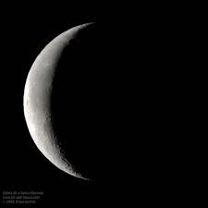
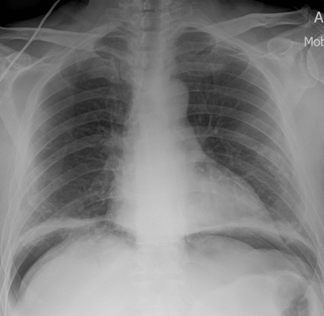
Crescent Sign
Free air under the diaphragm
Best demonstrated on upright chest x rays or left lat decub
Easier to see under right diaphragm ? Why?

Slide 28
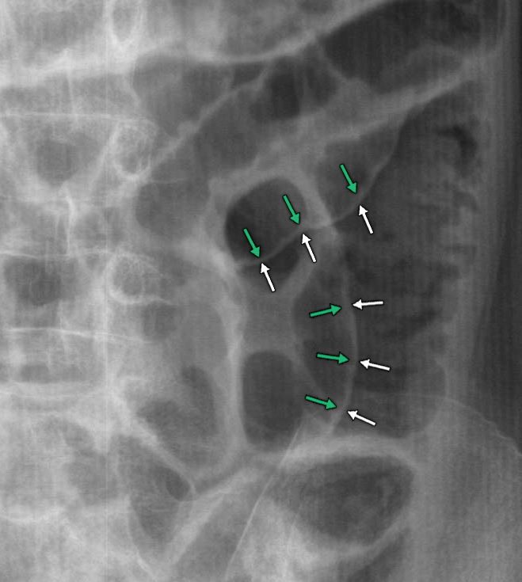
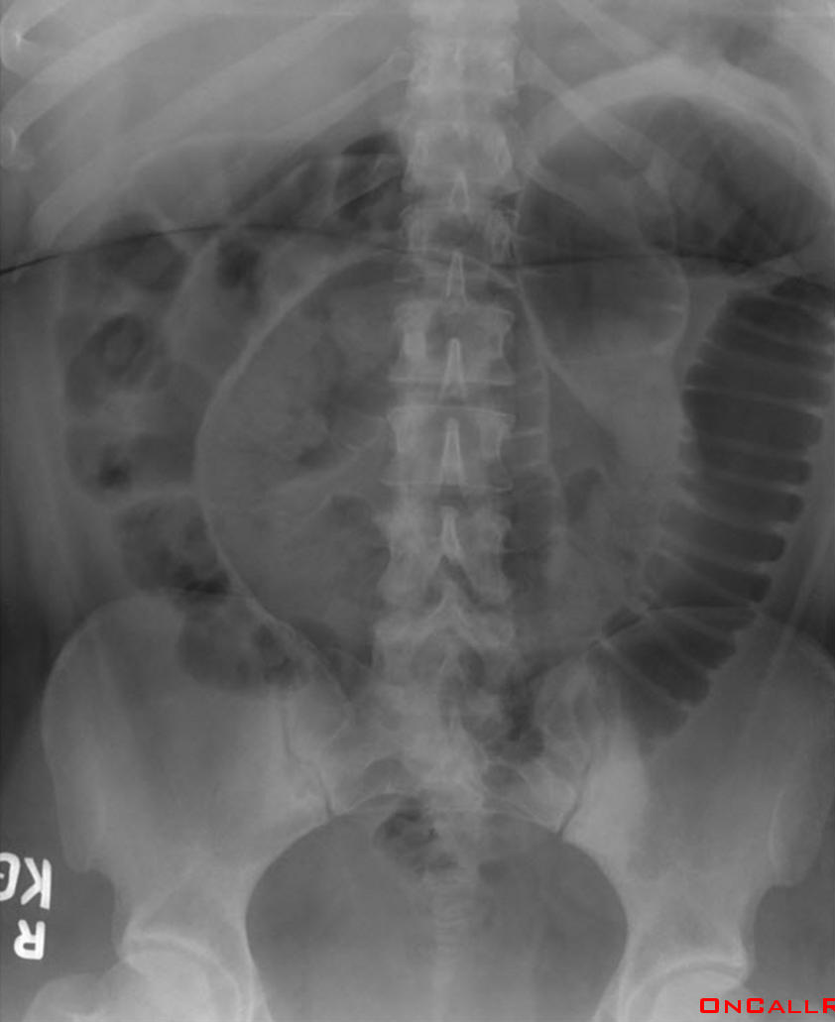
Rigler’s Sign
Bowel wall visualised on both sides due to intra and extraluminal air
Usually large amounts of free air
May be confused with overlapping loops of bowel, confirm with upright view

Slide 29
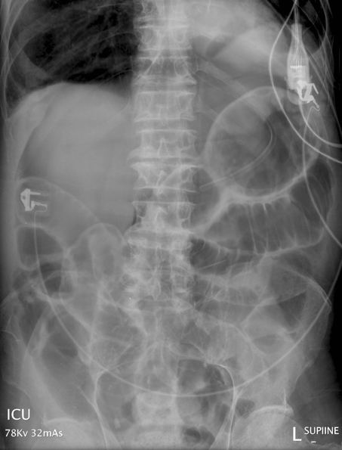
Football Sign
Seen with massive pneumoperitoneum
Most often in children with necrotising enterocolitis
In supine position air collects anterior to abdominal viscera
Paediatric
Adult

Slide 30
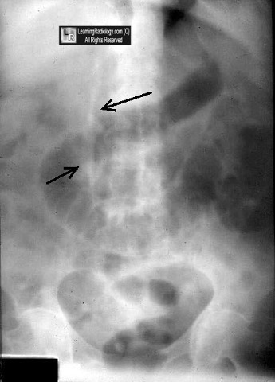
Falciform ligament sign
Normally invisible.
Supine film, free air rises over anterior surface of liver

Slide 31
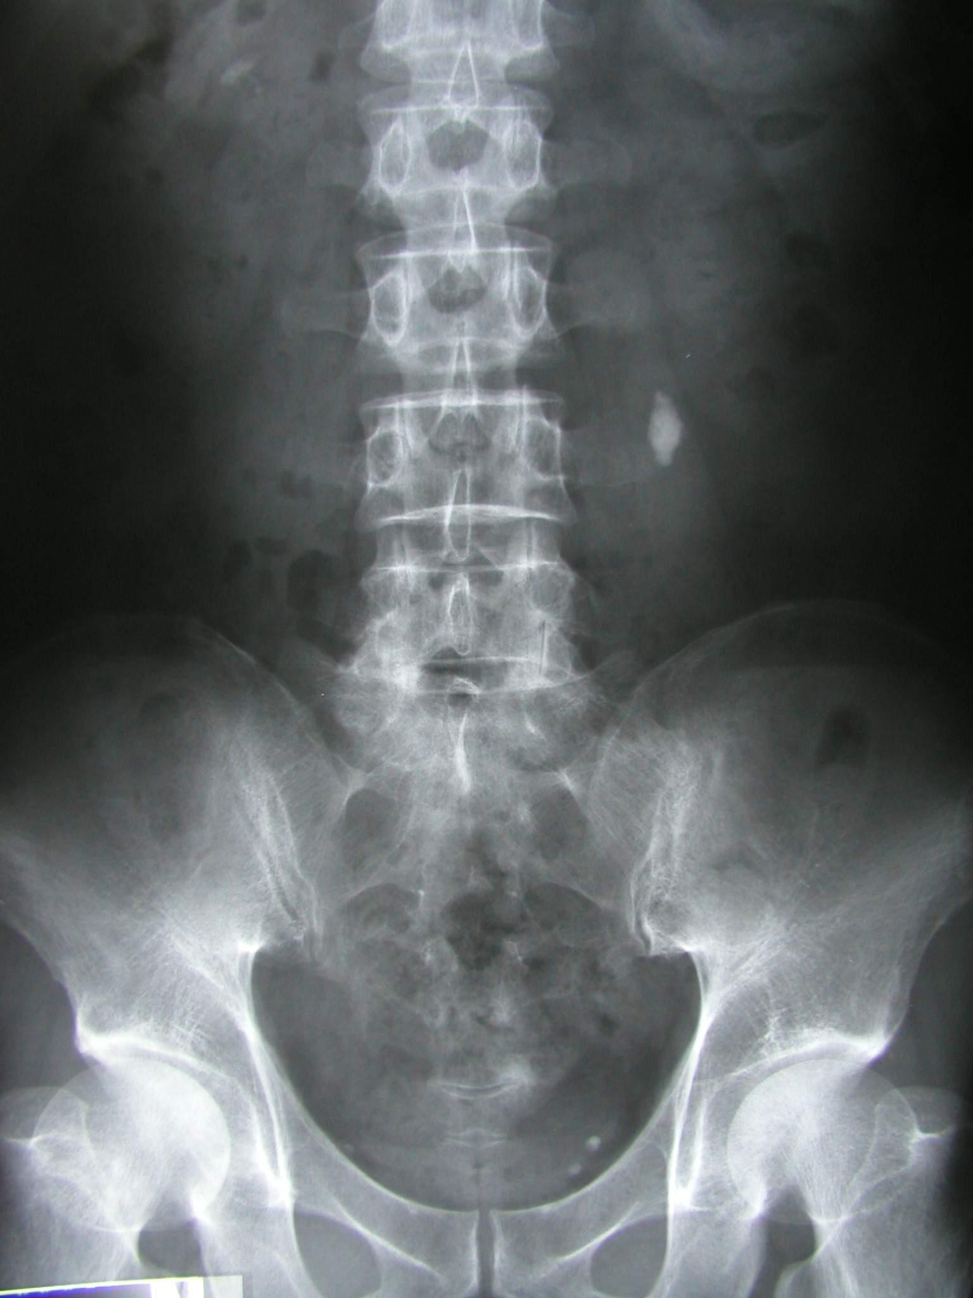
Checking for calcifications 3rd step in reading an x-ray Renal calculi
Pelvicalyceal calcifications

Slide 32
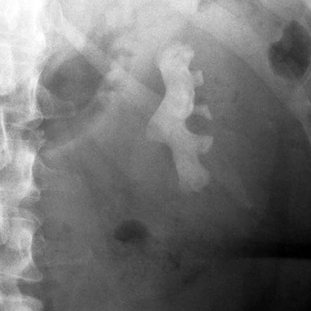
Staghorn Calcification
Renal stones are often small, but if large can fill the renal pelvis or a calyx, taking on its shape which is likened to a staghorn.
Tubular

Slide 33
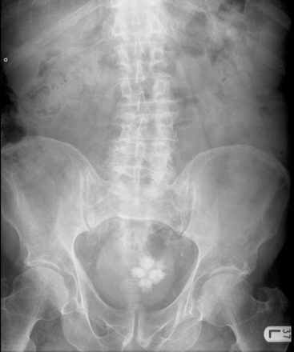
Bladder calculi
Lamellar

Slide 34
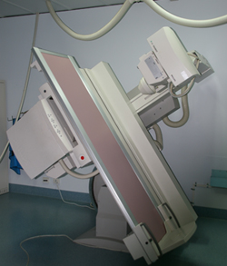
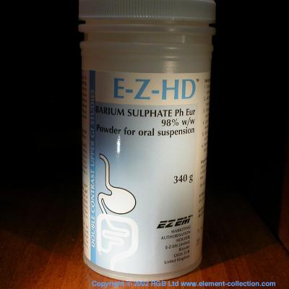
Fluoroscopy
+
ORAL
CONTRAST
X-RAY

Slide 35
Barium swallow --------------> Esophagus
Barium meal ------------------> Stomach
Barium follow through -----> Small bowel
Barium enema ----------------> Large bowel

Slide 36
ADVANTAGES:
Available
Relatively cheap
Excellent in evaluation the bowel lumen and mucosa
DISADVANTAGES:
Radiation highest of all modalities
Poor in evaluating extra luminal pathologies

Slide 37
INDICATIONS
Assessing the mucosal outline
Abdominal pain
Gastro esophageal reflux
Masses
Inflammatory bowel diseases
Post surgical, leak
CONTRAINDICATIONS:
Pregnancy
Bowel obstruction
Bowel perforation (with barium type of contrast)

Slide 38
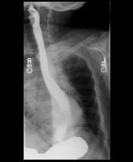
BARIUM SWALLOW

Slide 39
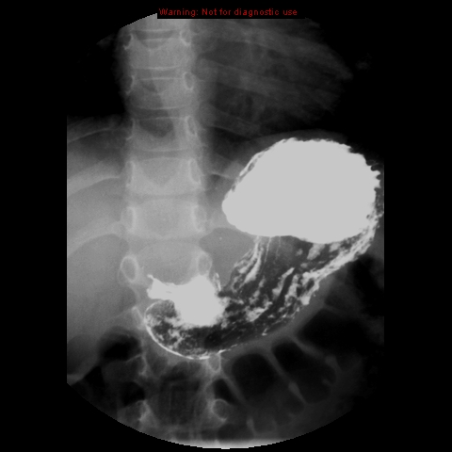
BARIUM MEAL

Slide 40
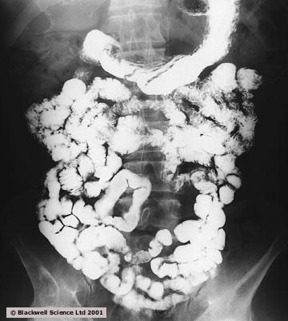
BARIUM FOLLOW THROUGH

Slide 41
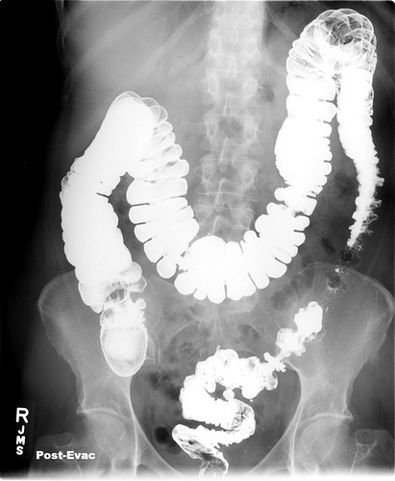
BARIUM ENEMA

Slide 42
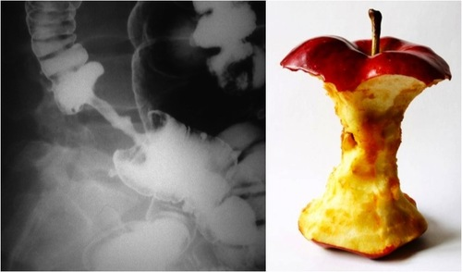
What is abnormal in this barium enema?

Slide 43
Colon mass/malignancy (Apple core appearance)

Slide 44
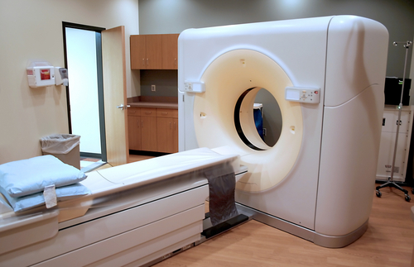
CT scan

Slide 45
ADVANTAGES:
Available
Short scan time
Much more soft tissue and bone details
Excellent in diagnosing extra-luminal lesions
Excellent in diagnosing the cause of bowel obstruction
DISADVANTAGES:
Radiation
Some times need intra venous contrast (renal disease)
Relatively expensive

Slide 46
INDICATIONS
Abdominal pain
To look for bowel obstruction cause
To diagnose intra-abdominal masses
Trauma
CONTRAINDICATIONS:
Pregnancy
No IV contrast in renal failure
Unstable patients (severe trauma/ICU)

Slide 48
5
2
1
6
4
3

Slide 49
5
2
2
1
1
6
4
3
1- Rectum 2-Sigmoid colon 3-Descending colon 4-Ascending colon 5-Transverse colon 6-Cecum

Slide 50
3
2
4
1
5
6

Slide 51
3
2
4
1
5
6
Descending colon
Splenic flexure
Hepatic flexure
Ascending colon
cecum
Sigmoid colon

Slide 52
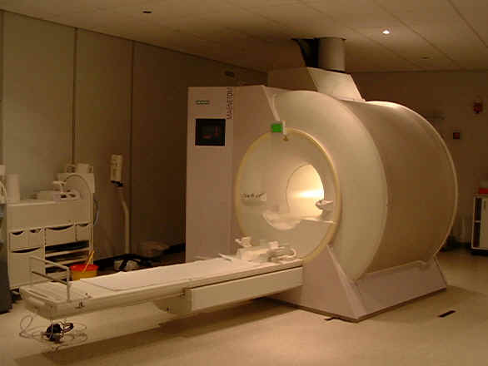
MRI

Slide 53
ADVANTAGES:
Relatively safe in pregnancy (no radiation)
Give much more soft tissue details
Excellent in diagnosing abdominal solid organ lesion: liver, spleen, kidneys
DISADVANTAGES:
Expensive
Long scanning time
Sensitive to motion

Slide 54
INDICATIONS
Abdominal solid organ masses
Inflammatory bowel disease
CONTRAINDICATIONS:
uncooperative patients
Early pregnancy (relative contraindication)
No IV contrast renal failure (relative contraindication)
Pacemaker or metallic prosthesis

Slide 56
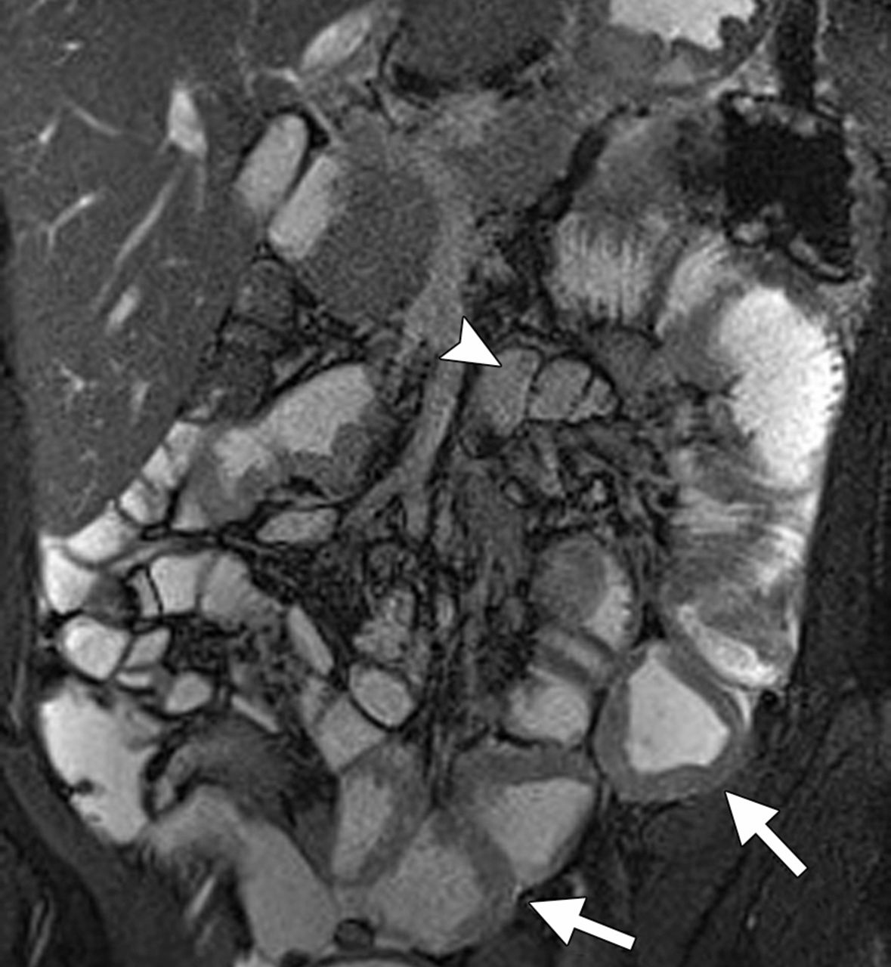
Inflammatory bowel disease
Bowel wall thickening

Slide 57
Thank you

