Slide 1
RADIOLOGY OF ESOPHAGUS AND STOMACH

Slide 2
ESOPHAGUS ANATOMY

Slide 3
What are the modalities can be used in imaging the esophagus?
CT scan
MRI
Fluoroscopy
US
X-ray
Nuclear medicine

Slide 4
What are the modalities can be used in imaging the esophagus?
CT scan
MRI
Fluoroscopy
US
X-ray
Nuclear medicine

Slide 5
CT scan

Slide 6
5
2
4
1
3
1

Slide 7
5
2
4
1
3
1
Esophagus
Trachea
Aorta
Lung
Pulmonary artery

Slide 8
Fluoroscopy

Slide 9
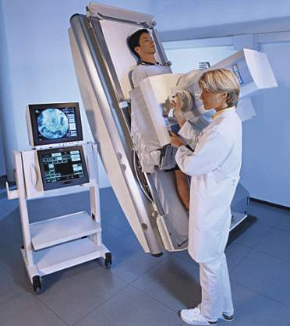
Fluoroscope
Real-time x ray. x-ray video
Multiple sequential images
Spot films

Slide 10
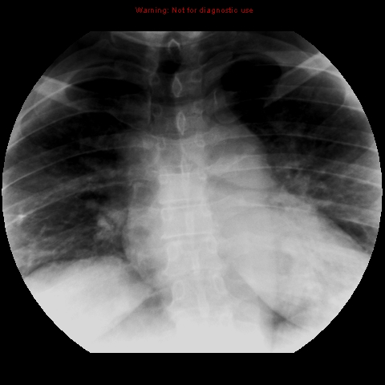

Slide 11
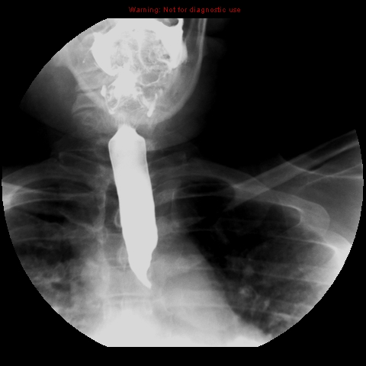

Slide 12
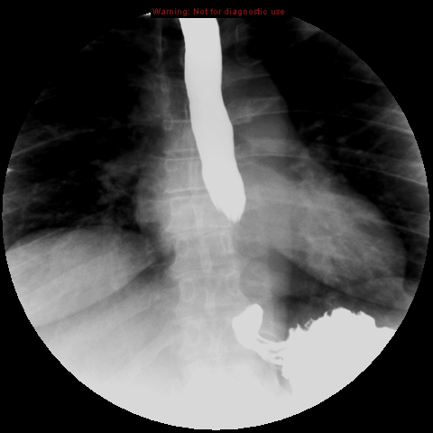

Slide 13
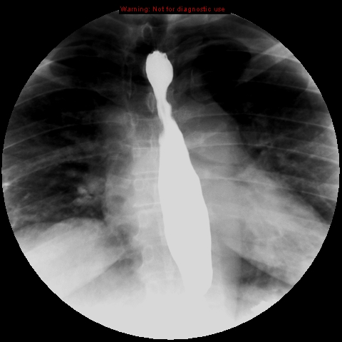

Slide 14
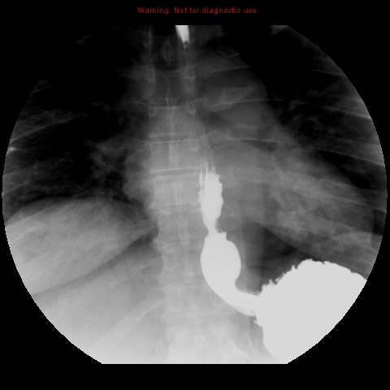
2
1
4
3

Slide 15
1-esophageal vestibule (ampulla).
2- B ring.
3- gastroesophageal junction.
4- stomach (gastric fundus).
2
1
4
3

Slide 16
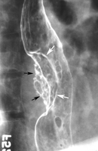
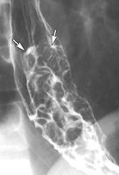
Abnormal esophagus (masses)

Slide 17
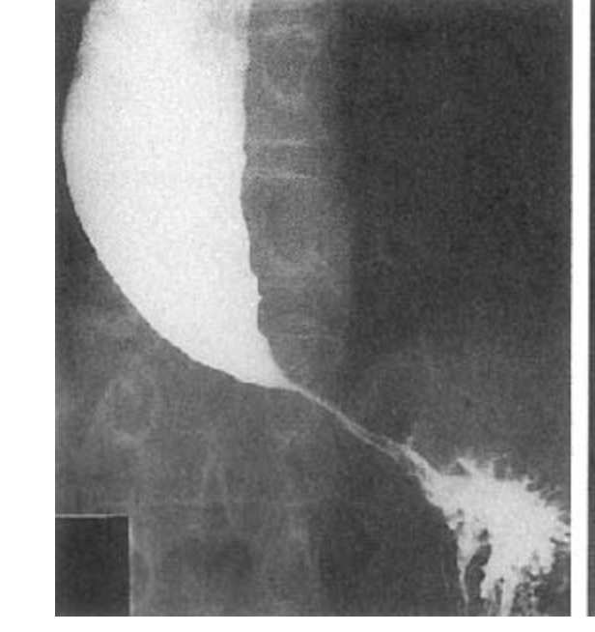
Bird's beak appearance

Slide 18
STOMACH ANATOMY

Slide 19
X RAY

Slide 20
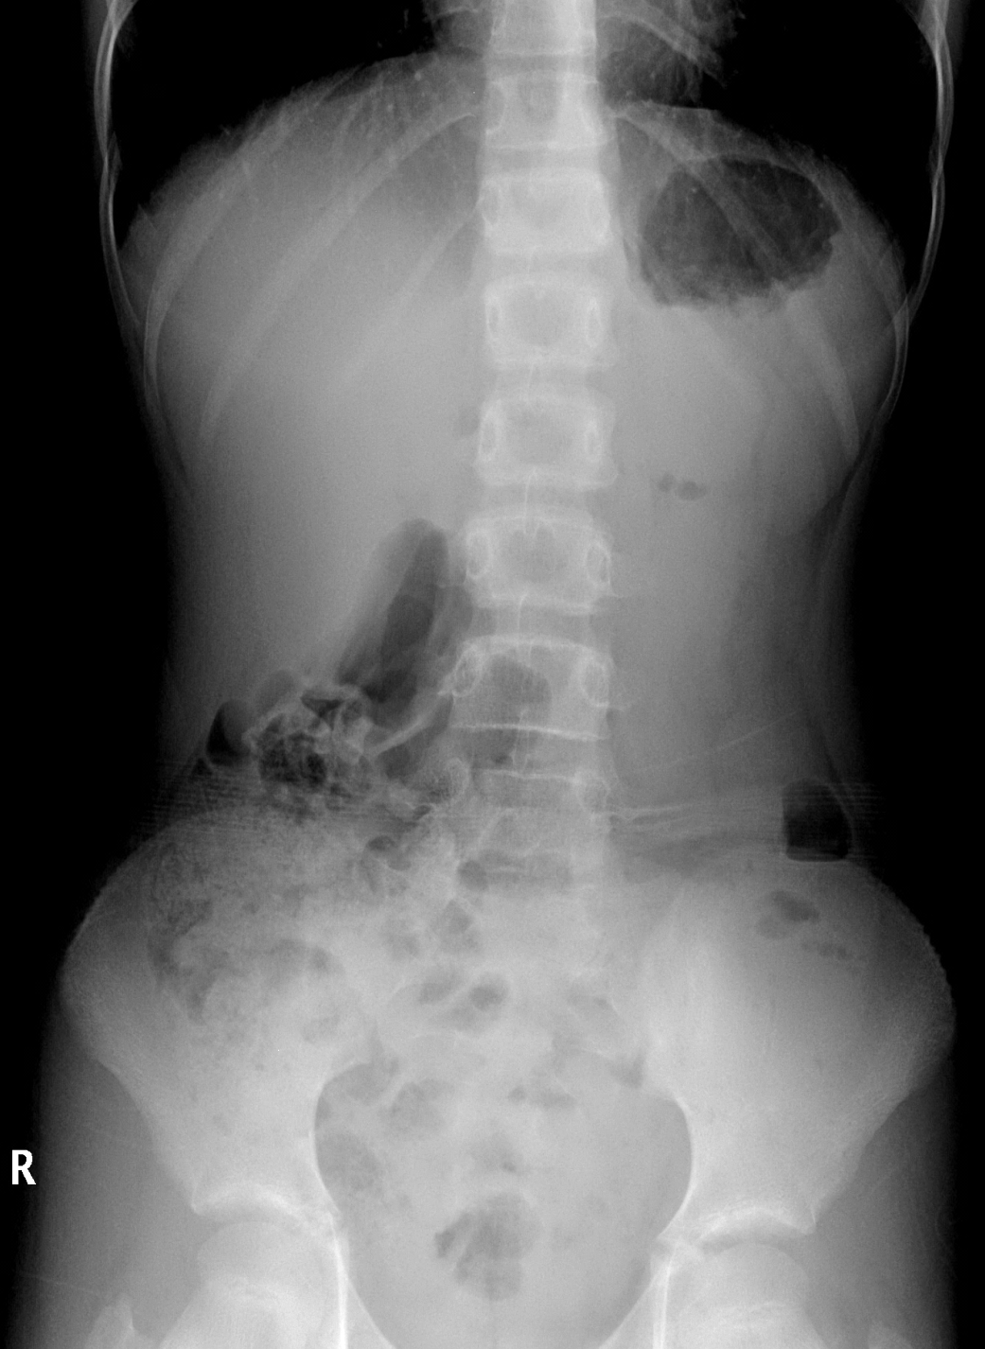
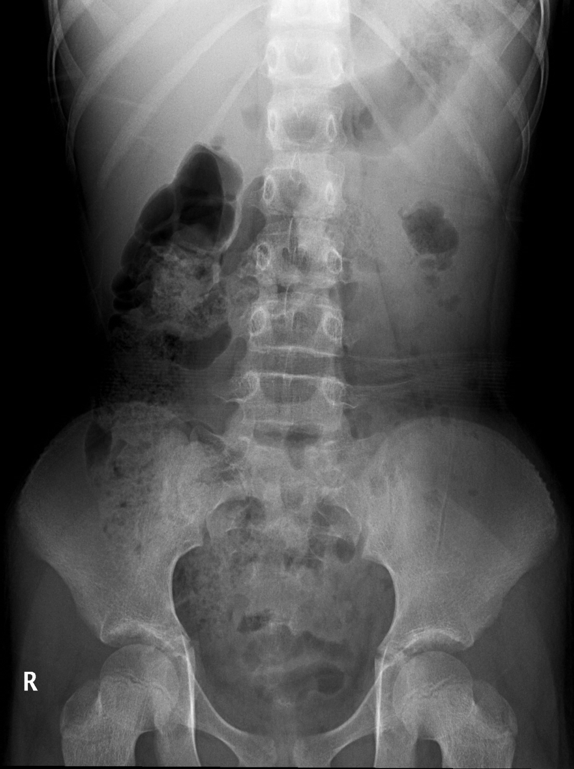

Slide 21
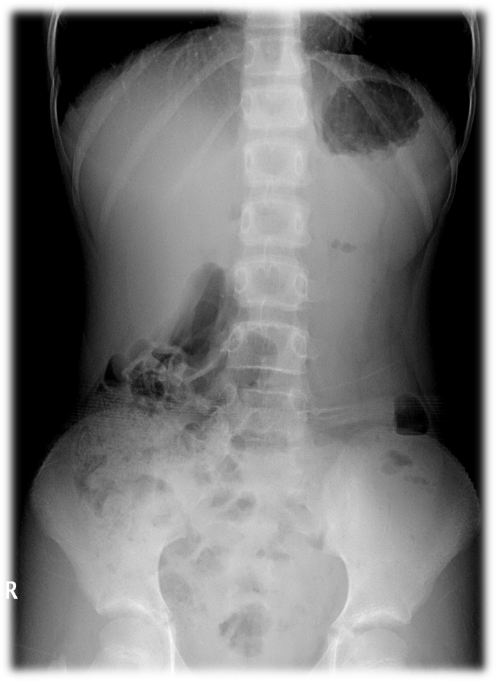

Slide 22
Fluoroscopy

Slide 23
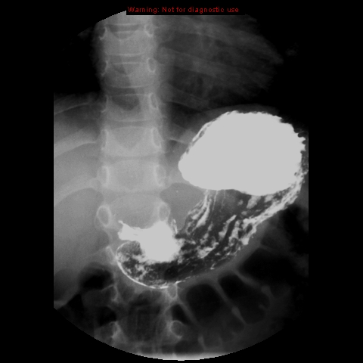
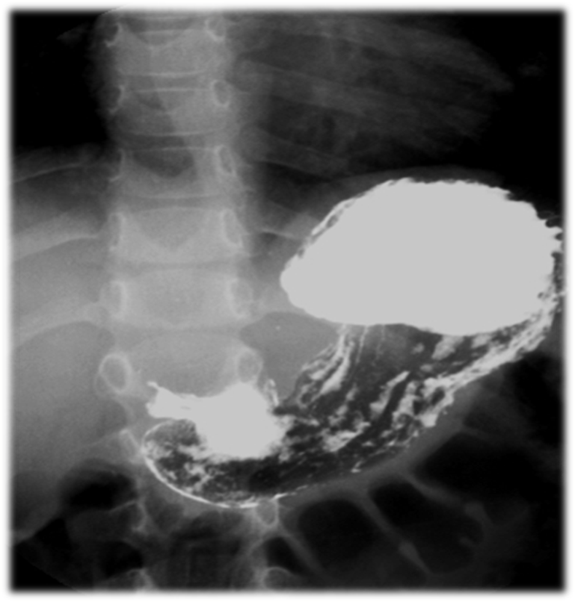
1
3
5
2
4
6

Slide 24
1
Stomach fundus
Greater curvature
Lesser curvature
Antrum
Pylorus
Mucosal folds
3
5
2
4
6

Slide 25
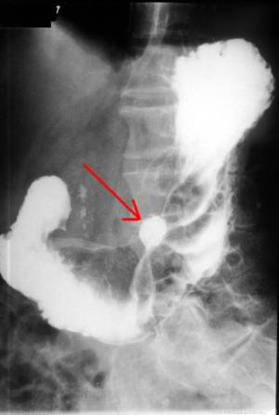
Gastric ulcer

Slide 26
CT Scan vs MRI

Slide 27
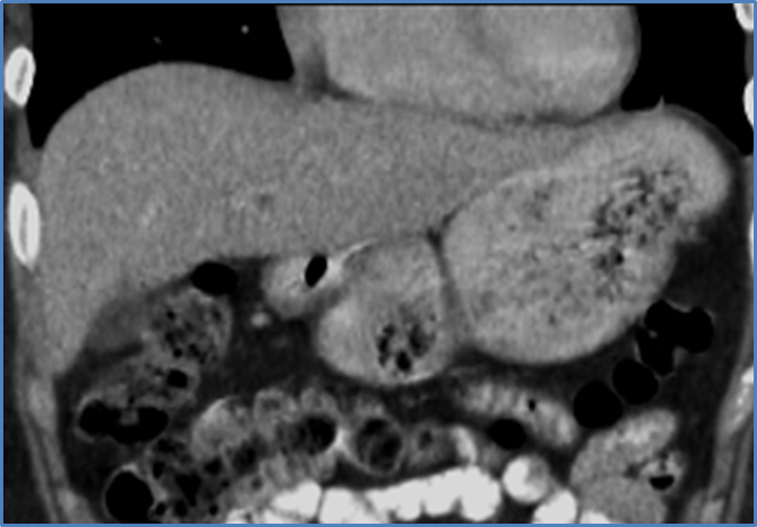
CT SCAN
MRI

Slide 28
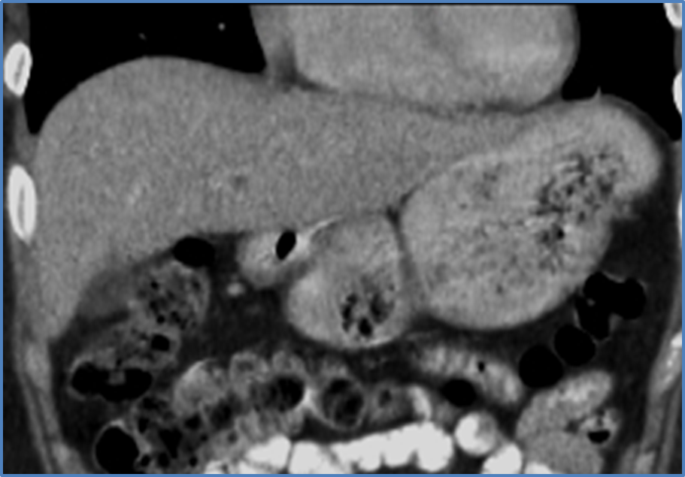
2
3
5
4
1

Slide 29
2
3
5
4
1
1-Greater curvature
2-Lesser curvature
3-Stomach fundus
4-Antrum
5-Pylorus

Slide 30
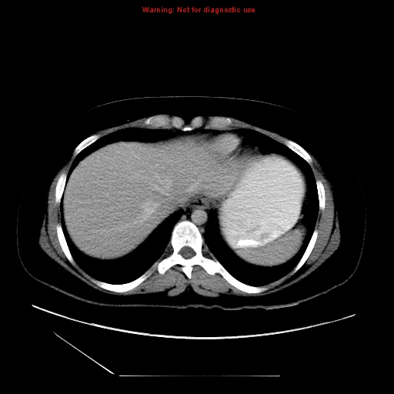
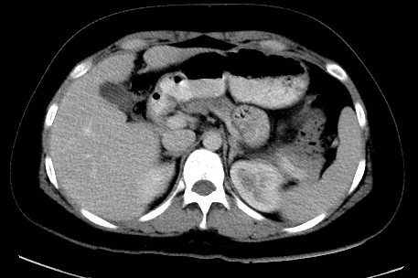
2
1
3
4
6
5

Slide 31
Stomach
Liver
Antrum
Pylorus
Spleen
Kidney
2
1
3
4
6
5

Slide 32
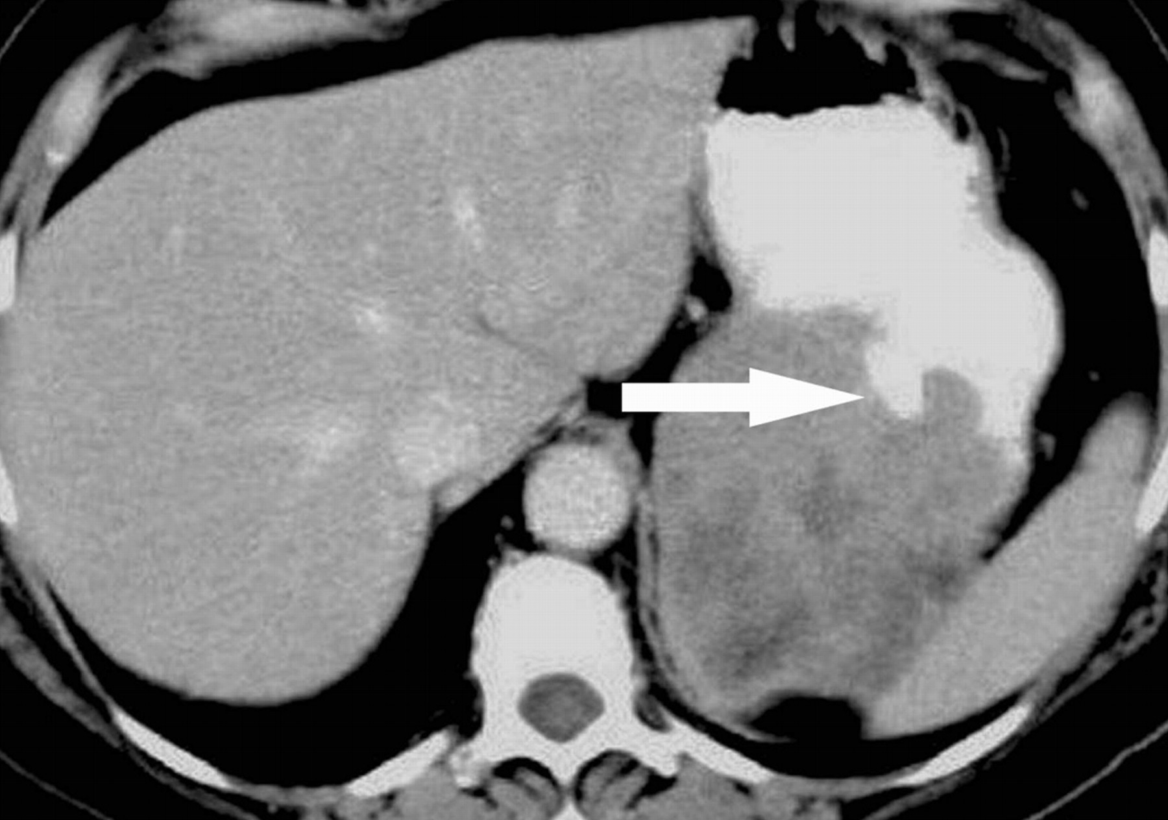
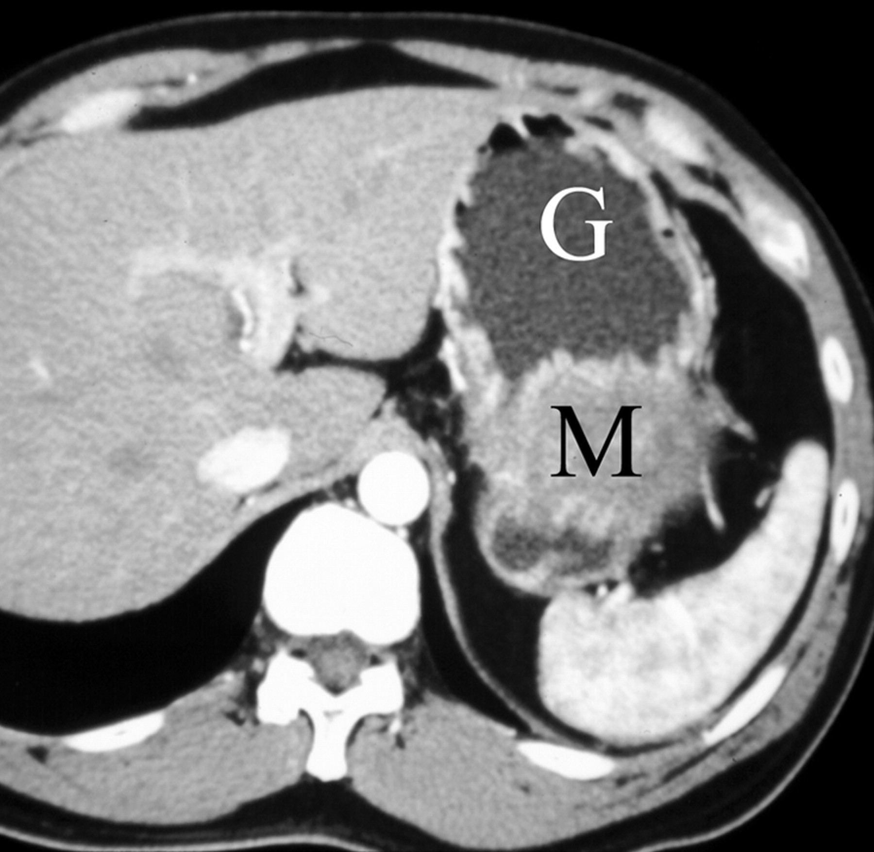
Stomach mass

Slide 33
THE END

