Slide 1
United States Medical Licensing Examination USMLE
Hashem Almahmoud
hashemalm@gmail.com
Notes:
Study well in first and second years.
After third year start taking electives to deicide. It’s okay if you can’t decide early.

Slide 2
USMLE
Step 1.
Step 2 Clinical Knowledge.
Step 2 Clinical skills…. ECFMG certified!!
Step 3… to practice unsupervised.

Slide 3
Who and Why
Apply for the US!
A maybe! Have all the options when it’s time to decide.
Fellowship.
Knowledge?!
Resume…Canada?

Slide 4
USMLE step 1
MCQs Exam
Designed to test students on how to apply basic science Knowledge and concepts to clinical scenarios
Taken by medical students and graduates seeking to practice medicine in the States.

Slide 5
Importance of step 1!
Number one factor in selection.
Excellent electives (do it before internship).
Solid background in basic medical sciences.

Slide 6
National Resident Matching Program
http://www.nrmp.org/wp-content/uploads/2014/09/PD-Survey-Report-2014.pdf
Notes:
There is more… for each specialty

Slide 7
Subjects
Behavioral Science (Statistics, Medical ethics, Psychology/Psychiatry)
Gross Anatomy & Embryology
Histology & Cell Biology
Biochemistry
Genetics
Nutrition
Microbiology & Immunology
Physiology
Pathology
Pharmacology

Slide 8
Step 1
308 Questions
Seven blocks, 44Q each
60 minutes per Block
15 minutes tutorial, 45 minutes break
Total exam time is 8 hrs !!!
After May 2016: 40 questions per block. Total 280 questions!!!

Slide 9
Distribution of questions among the different subjects…
The 3 Ps… physiology, pharma, pathology make up a huge part of the exam, but it’s hard to give a number!
Biochem and genetics.
Micro! Immune!
Neuro anatomoy and pathology.
It’s all interconnected, complementary to each other.

Slide 12
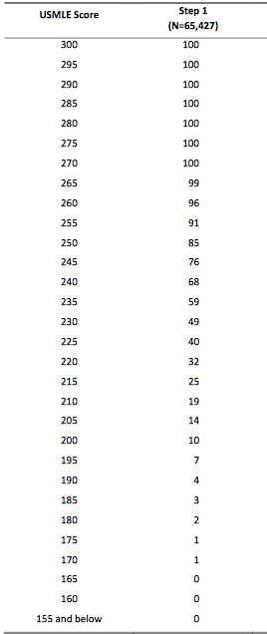

Slide 13
How to apply?
Visit this website to sign up: www.ecfmg.org
Or simply follow this link:
https://secure2.ecfmg.org/emain.asp?app=iwa
Tip: year of graduation!

Slide 14
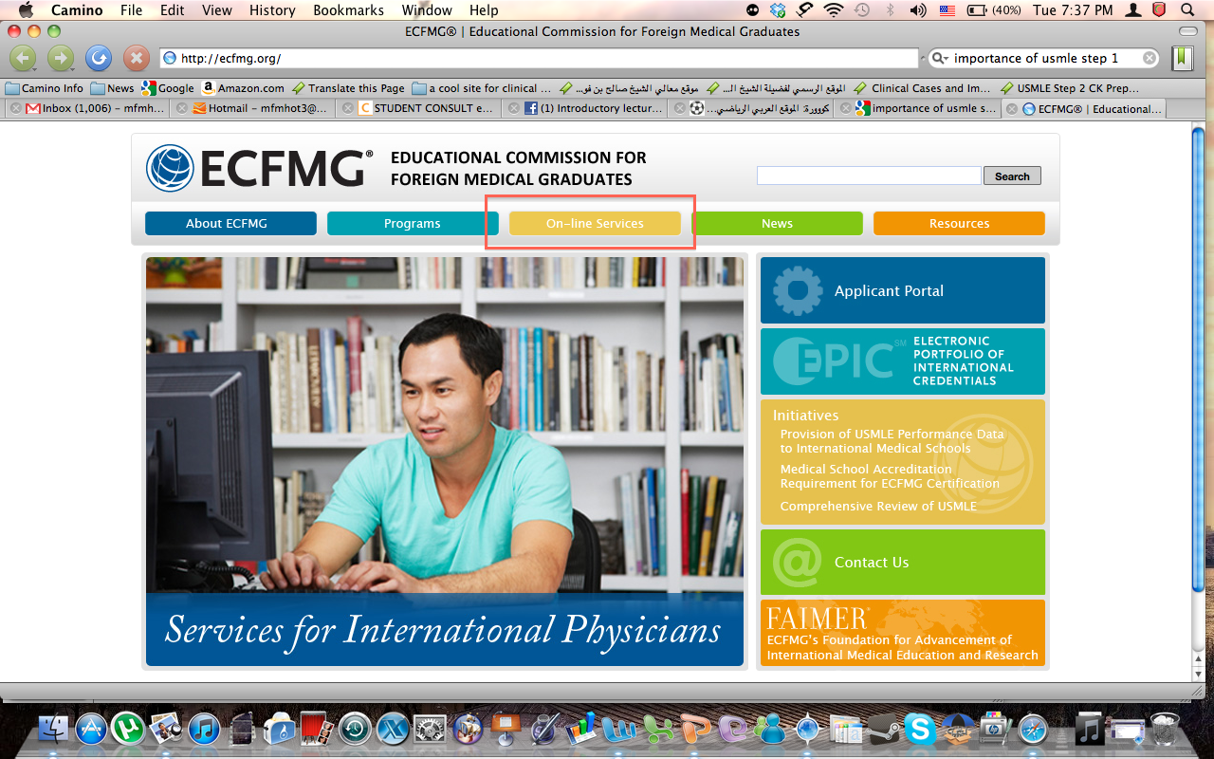

Slide 15
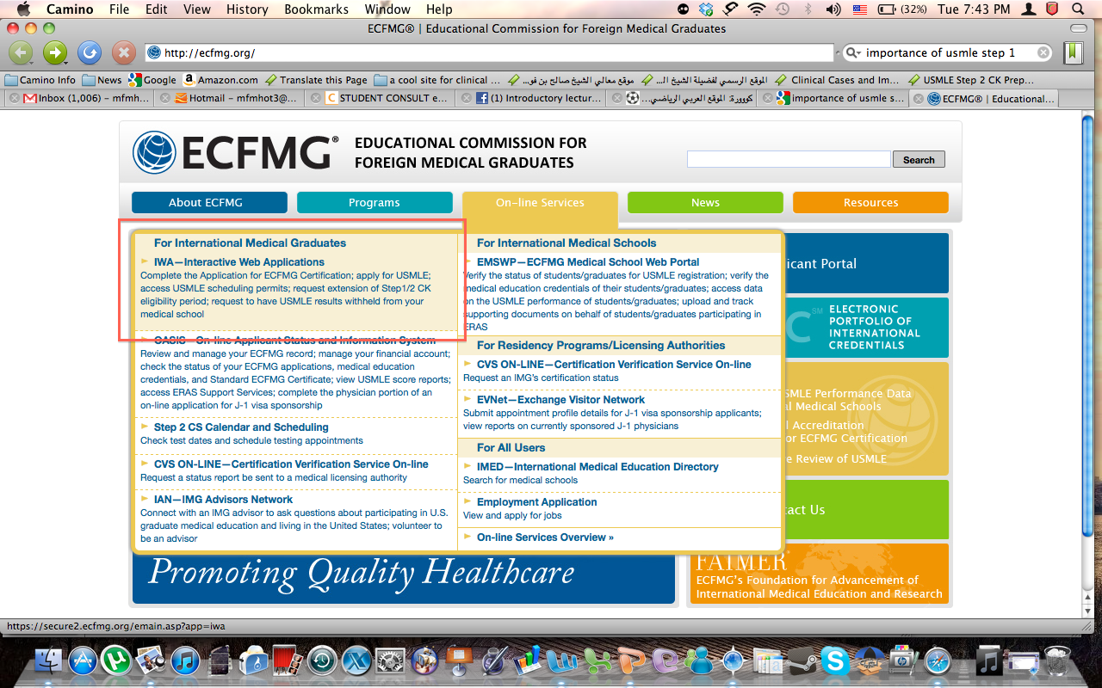

Slide 16
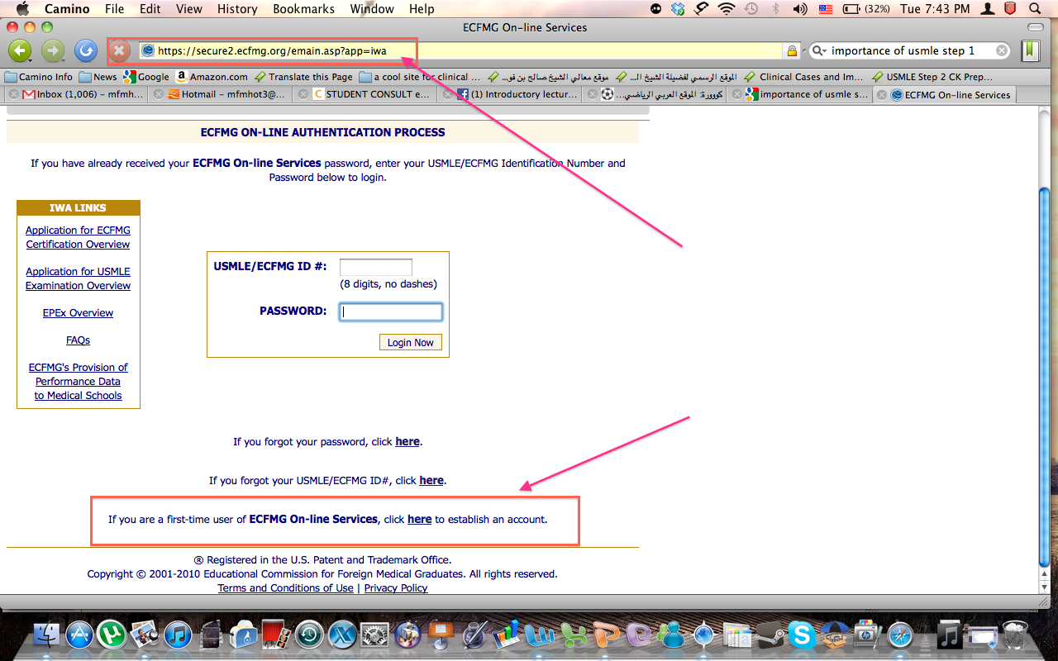

Slide 17
Check this link for detailed steps http://www.usmle-forums.com/ecfmg-forum/362-ecfmg-registration-steps.html
Manage your application comfortably couple of months ahead of your planned exam date, the process may take one month if everything goes smoothly
Cost: around 1000$

Slide 18
You will receive an email notifying your scheduling permit is available, visit Prometric testing center website, to schedule a test date.
Nearest exam date: Depends on the location ( Riyadh, Dubai, Qatar,…etc.)
One Time eligibility period ( 3 months) extension – a fee is charged-
If you do not take the examination within your eligibility period, you must reapply with a new application and fee

Slide 19
General Rules
You can take the exam at any time of the year
At any order
Must be done within 7 years (completion of all steps for purposes of licensure)
You’re allowed for 6 attempts only, - if you fail-
Once passed, Valid for life, cannot be repeated

Slide 20
Resources
5 categories
Videos/ Lectures
Books* (Kaplan notes)
Q banks
Review books ( First Aid)< A MUST !
Self assessment test.
Check the top-rated resources in First Aid
Complement each other
Notes:
*Microbiology Alternatives:
*Pathology Alternative

Slide 22
USMLE prep courses
My own opinion.
Kaplan.
Becker.

Slide 23
Videos
Kaplan.
Doctors in Training- DIT.
First Aid videos.
Many others…

Slide 24
Q banks
Uworld.
Kaplan qbank.
Usmle rx.
More…

Slide 27
Pathology.
Goljan: (book + Audio) ,( last edition is 700+ pages )
Pathoma = Book + Video ( 200 pages, 35 hrs)
Many others…

Slide 28
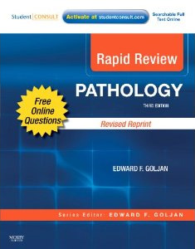
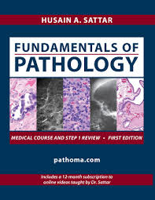

Slide 29
Physiology
Kaplan.
Becker.
BRS.
More…

Slide 30
Pharmacology
Kaplan.
Becker.
Lippincott's…
More…

Slide 31
Micro
Kaplan.
Becker.
Clinical Micro Made Ridiculously Simple.
SketchyMicro.com
Flash cards.
More…

Slide 32
Immunology.
Kaplan.
Becker.
Videos on the internet!
More…

Slide 33
Anatomy, Histology, and embryology
Kaplan.
Becker.
HY anatomy.

Slide 34
Neuro anatomy
Kaplan.
Becker.
High yield neuroanatomy.
It’s almost all neuro pathology!
Basics from second year CNS block!

Slide 35
Behavioral Sciences
Statistics and research. (Kaplan, videos, UWORLD biostatistic 70+ MCQs…)
Ethics (Kaplan, videos, Khan, Fissure)
Psychology/psychiatry (Kaplan, videos…)

Slide 36
Biochemistry
Biochem, metablism, nutrition.
Genetics.
Molecular biology.
Kaplan. Videos.
Becker.
Lippincott’s? clinically relevant.
More…

Slide 37
Assessment exams
NBME.
Uworld self assessment.
Kaplan?
FRED, official.

Slide 38
Omar A. Alyamani, Md --- د.عمر اليماني
Residency in the US 5 (Arabic) الزمالة الطبية بأمريكا ٥ - لطلاب الطب والأطباء‬

Slide 39
How I studied
Cover topic from all sources (e.g. cardiac science ):
Kaplan books + videos. (not all videos though)
FA.
Uworld.
Pathoma.
MMRS.
Immunology videos (youtube!)
There is never a single best way!
take advice from others. But Don’t take too much advice!

Slide 40
Tips
Don’t distract yourself by studying from everywhere.
Study well in med school!!!
Know how to answer the question (the technique). Use the internet for more examples!

Slide 41
Important websites
Student Doctor Network.
Usmle forum.
Usmle official website (check for update!)

Slide 42
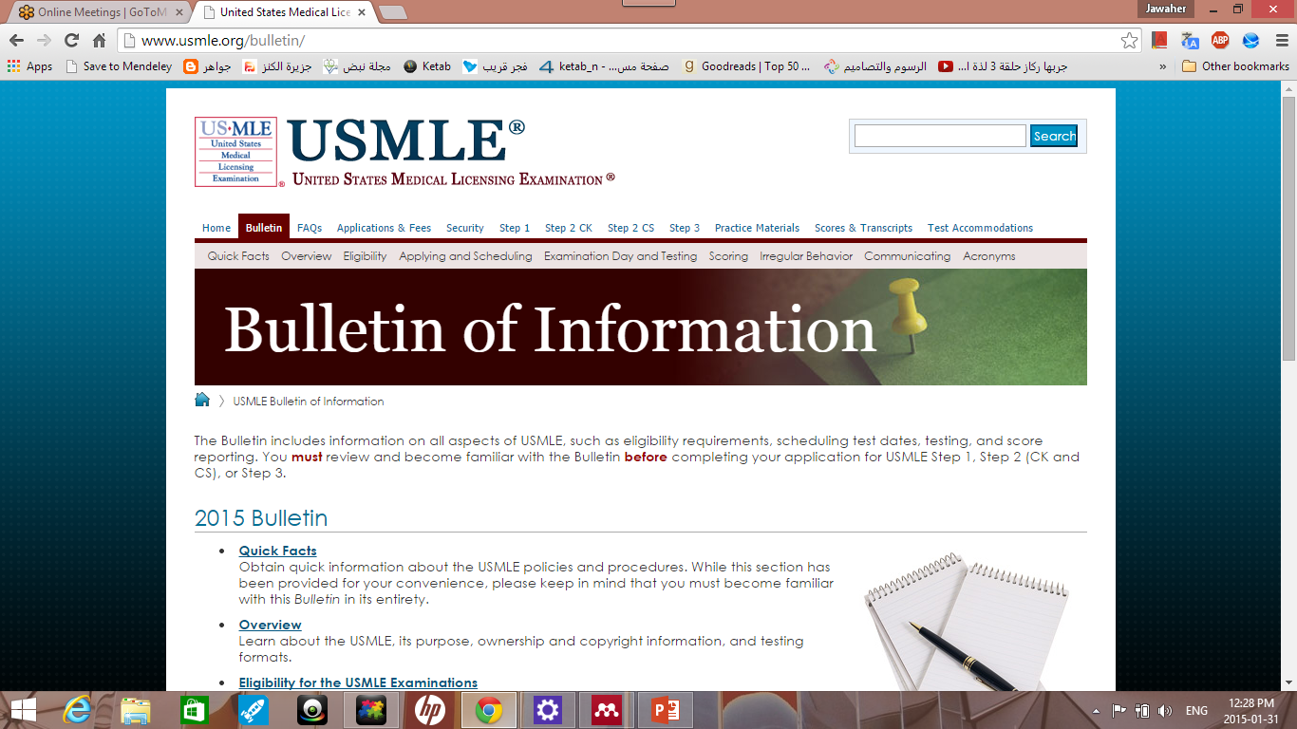

Slide 43
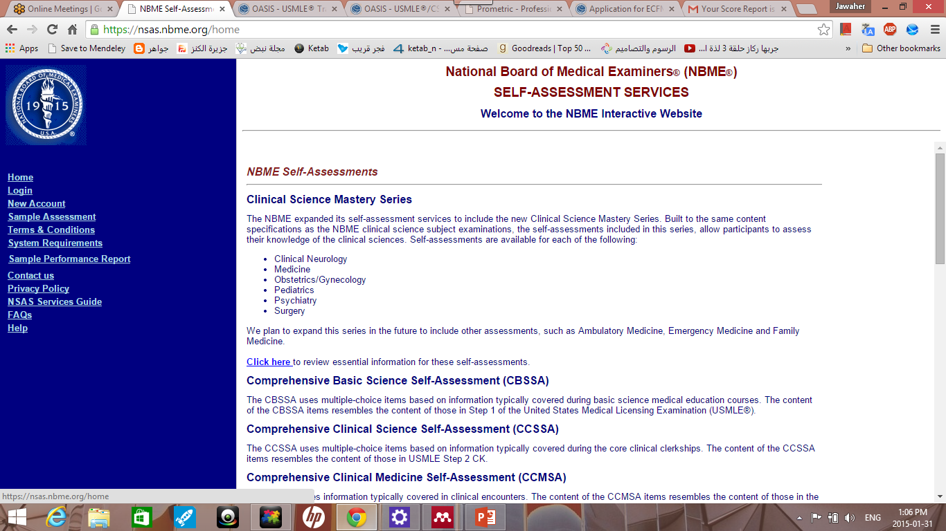

Slide 44
Emtar
https://www.facebook.com/groups/usmlesteponeeamtar/

Slide 45
Saudi MD in US

Slide 46
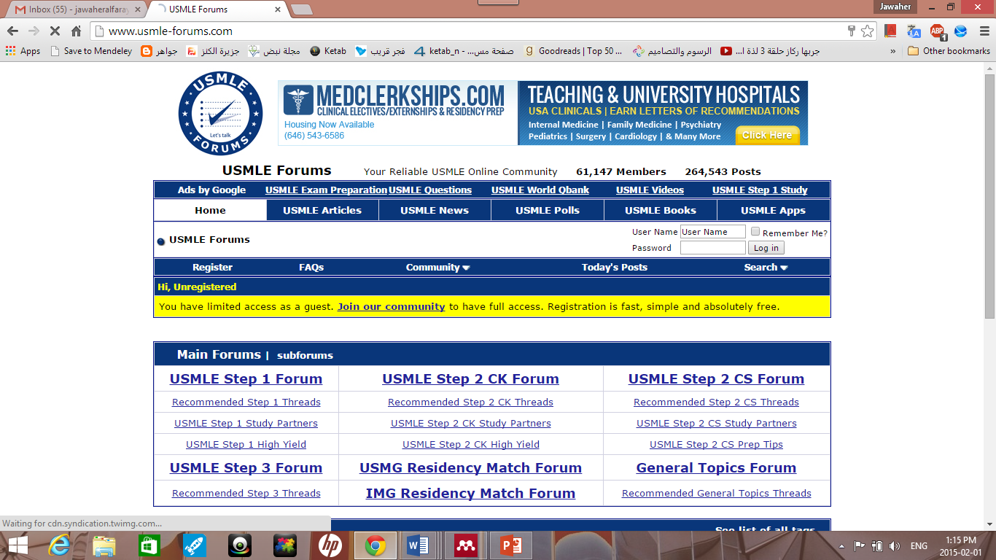

Slide 47
When to take my exam…
There is no best time!
Between 2nd and 3rd year.
Between 3rd and 4th year
Between 4th and 5th year. (personally preferable choice)
Early internship
Don’t take too long. Grades in school.

Slide 48
How Long should I study for the darn thing?!
Depends???
Score.
Personal abilities.

Slide 49
Step 2 – Clinical Knowledge Content
Internal Medicine
Obstetrics and Gynecology
Pediatrics
Surgery
Preventive Medicine (including biostat and ethics…)
Psychiatry

Slide 50
Step 2 – CK Type of questions
describe clinical situations and require that you provide one or more of the following:
A diagnosis
A prognosis
Best test to order
Most appropriate management.
Apply basic science knowledge to clinical problems
The next step in medical care, including preventive measures

Slide 51
Step 2 – CK
Heavily based on step 1 knowledge!
It’s better to do step 1 before step 2.

Slide 52
Step 2 – Clinical Knowledge
350 questions.
44 questions per block.
8 blocks.
9 hours long!
Notes:
Step 2 CK is a one-day examination. It is divided into eight 60-minute blocks and administered in one 9-hour testing session. The number of questions per block on a given examination form will vary, but will not exceed 44. The total number of items on the overall examination form will not exceed 350.

Slide 53
Step 2 – Clinical Knowledge Resources
Uworld!!
FA step2 vs Master the board (for step2 and 3).
Kaplan books! (study source in 4th and 5th year).
Pocket books (step 2 secrets?)
Step up to medicine?
Check out the back of FA step2 (top rated review resources).

Slide 54
Step 2 – Clinical Skills

Slide 55
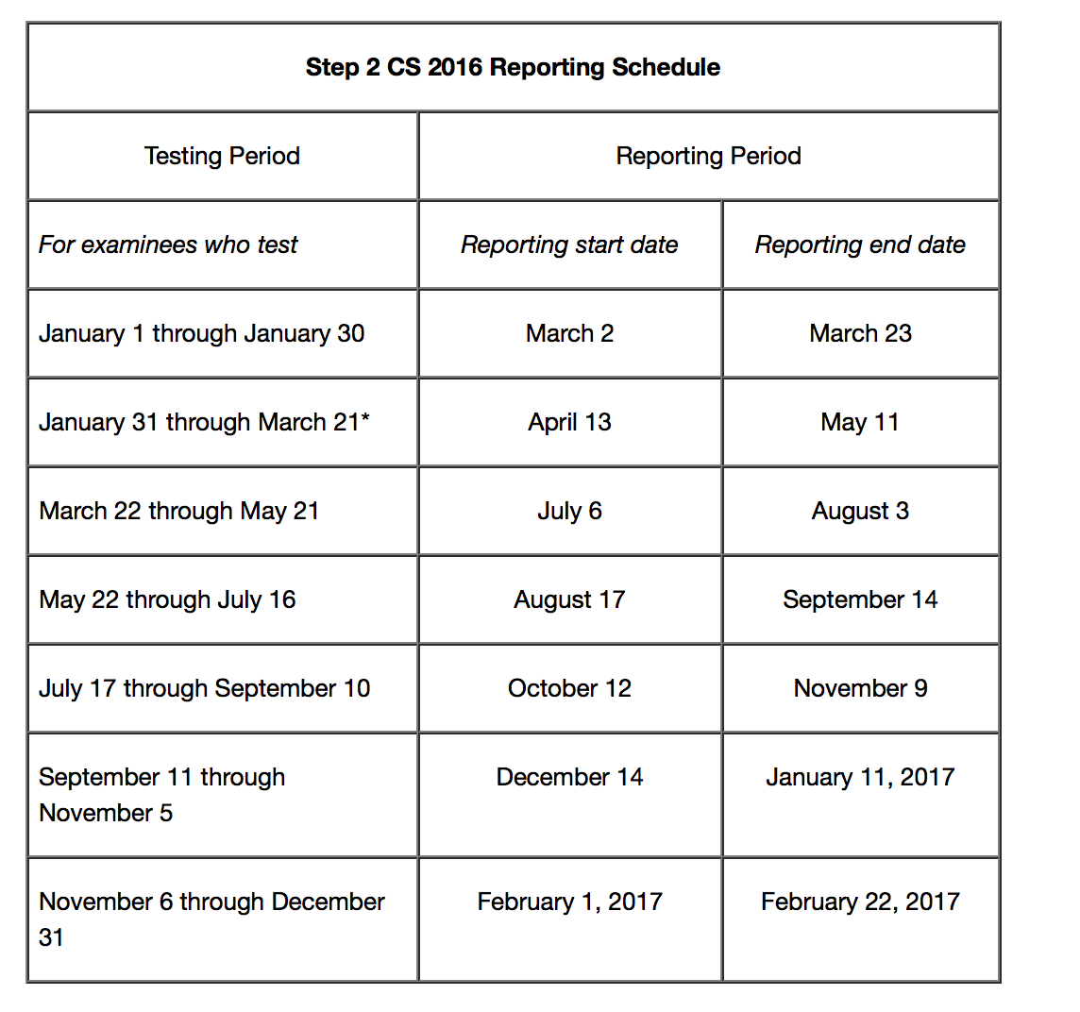
Step 2 – Clinical Skills

Slide 56
Step 3
You have to be ecfmg certified.
You can practice in the US.
It looks good in your application!

Slide 57
Minimum score to pass:
Step 1: 192
Step 2 CK: 209
Step 3: 196

Slide 58
Thank you

