Slide 1
Diabetes Mellitus

Slide 2
Objectives
Understand the structure of the pancreas and have a basic understanding of its function.
The student should have an understanding of the pathogenesis and major histopathological changes seen in diabetes mellitus type 1 and type 2.
The student should recognize the major complications of diabetes mellitus.

Slide 3
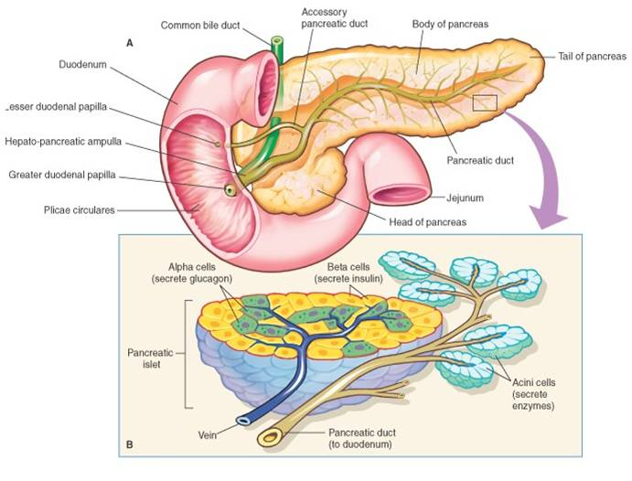

Slide 4
THE ENDOCRINE PANCREAS
islets of Langerhans, contain four major and two minor cell types.
The four main types are β, α, δ, and PP (pancreatic polypeptide) cells.
The β cell produces insulin
The α cell secretes glucagon .
δ cells contain somatostatin
PP cells contain a unique pancreatic polypeptide.
The two rare cell types are D1 cells and enterochromaffin cells.
Notes:
- PP cells exerts several gastrointestinal effects, such as stimulation of secretion of gastric and intestinal enzymes and inhibition of intestinal motility.
D1 cells elaborate vasoactive intestinal polypeptide (VIP), a hormone that induces glycogenolysis and hyperglycemia; it also stimulates gastrointestinal fluid secretion and causes secretory diarrhea.
Enterochromaffin cells synthesize serotonin and are the source of pancreatic tumors that cause the carcinoid syndrome .

Slide 5
Diabetes Mellitus (DM)
Sir William Osler defined diabetes mellitus as “a syndrome due to a disturbance in carbohydrate metabolism from various causes, in which sugar appears in the urine, associated with thirst, polyuria, wasting and imperfect oxidation of fats.”

Slide 6
Diabetes Mellitus (DM)
Major health problem that affects increasing numbers of persons in the developed world.
Group of metabolic disorders sharing the common underlying feature of hyperglycemia
Hyperglycemia in diabetes results from defects in insulin secretion, insulin action, or, most commonly, both.
The chronic hyperglycemia may be associated with secondary damage in multiple organ systems, especially the kidneys, eyes, nerves, and blood vessels.
prediabetes, is defined as elevated blood sugar that does not reach the criterion accepted for an outright diagnosis of diabetes, persons with prediabetes have an elevated risk for development of frank diabetes.

Slide 7
Diagnosis of DM
Any one of three criteria:
1- A random glucose concentration greater than 200 mg/dL, with classical signs and symptoms .
2- A fasting glucose concentration greater than 126 mg/dL on more than one occasion.
3- An abnormal oral glucose tolerance test (OGTT), in which the glucose concentration is greater than 200 mg/dL 2 hours after a standard carbohydrate load.
Notes:
Those with fasting glucose concentrations greater than 100 mg/dL but less than 126 mg/dL, or OGTT values greater than 140 mg/dL but less than 200 mg/dL, are considered to have impaired glucose tolerance, also known as "pre-diabetes.“
Pre-diabetic individuals have a significant risk of progressing to overt diabetes over time, with as many as 5% to 10% advancing to diabetes mellitus per year. In addition, pre-diabetics are at risk for cardiovascular disease.

Slide 8
Classification of DM

Slide 9
T1DM
Type 1 diabetes (T1D) is characterized by an absolute deficiency of insulin secretion caused by pancreatic beta cell destruction, usually resulting from an autoimmune attack. Type 1 diabetes accounts for approximately 10% of all cases.

Slide 10
Type 2 DM
Type 2 diabetes (T2D) is caused by a combination of peripheral resistance to insulin action and an inadequate compensatory response of insulin secretion by the pancreatic beta cells (relative insulin deficiency). Approximately 80% to 90% of patients have type 2 diabetes.

Slide 11
MODY
Maturity-onset diabetes of the young (MODY) :
Rare autosomal dominant form of inherited diabetes.
Associated with a variety of gene defects that affect B-cell function, including glucokinase, an important sensor for glucose metabolism within the B-cell, and several mutations in genes that control the development and function of the B-cells.
Mutations in these genes, however, do not account for the typical prevalent forms ofT2DM.

Slide 12
Type 1 Diabetes Mellitus pathogenesis
Autoimmune destruction of the B cells in the islets of Langerhans.
The disease is characterized by:
few if any functional B cells in the islets of Langerhans and
Extremely limited or nonexistent insulin secretion.
As a result, body fat rather than glucose is preferentially metabolized as a source of energy.
In turn, oxidation of fat overproduces ketone bodies (acetoacetic acid and B-hydroxybutyric acid), which are released into the blood from the liver and lead to metabolic ketoacidosis.

Slide 13
T1DM ,PATHOGENESIS
Represents interplay of genetic susceptibility , autoimmunity and environmental factors.

Slide 14
Type 1 Diabetes Mellitus
Hyperglycemia results from unsuppressed hepatic glucose out-put and reduced glucose disposal in skeletal muscle and adipose tissue and leads to glucosuria and dehydration from loss of body water into the urine.
If uncorrected, the progressive acidosis and dehydration ultimately lead to coma and death

Slide 15
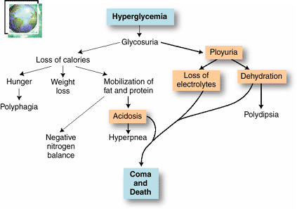

Slide 16
T1DM, EPIDEMIOLOGY
The peak age of onset coincides with puberty.
Some older patients may present with autoimmune B-cell destruction that has developed slowly over many years.

Slide 17
PATHOLOGY
Lymphocytic infiltrate in the islets (insulitis), sometimes accompanied by a few macrophages and neutrophils
As the disease becomes chronic, the B cells of the islets are progressively depleted of Beta cells
Fibrosis of the islets is uncommon.
In contrast to T2DM, deposition of amyloid in the islets of Langerhans is absent in T1DM.
The exocrine pancreas in chronic T1DM often exhibits diffuse interlobular and interacinar fibrosis, accompanied by atrophy of the acinar cells.

Slide 18
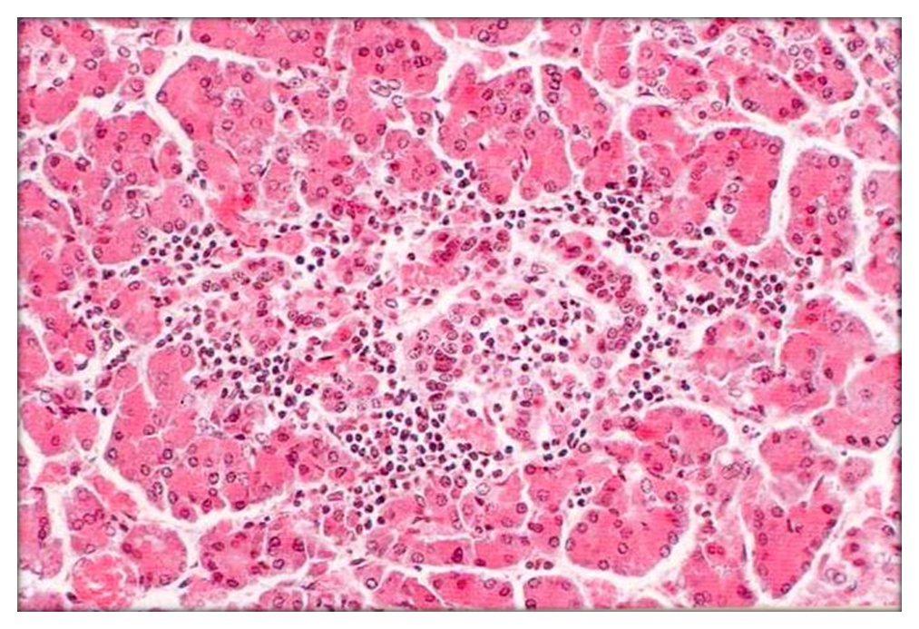
Insulitis

Slide 19
Type 2 DM, Epidemiology
Almost 10%of persons older than 65 years of age are affected, and 80% of patients with T2DM are overweight
Heterogeneous disorder characterized by a combination of reduced tissue sensitivity to insulin and inadequate secretion of insulin from the pancreas.
The disease usually develops in adults, with an increased prevalence in obese persons and in the elderly.

Slide 20
Type 2 DM, Epidemiology
Recently, T2DM has been appearing in increasing numbers in younger adults and adolescents, owing to worsening obesity and lack of exercise in this age group.
Hyperglycemia in T2DM is a failure of the B-cells to meet an increased demand for insulin in the body.

Slide 21
T2 DM, Pathogenesis
Multi-factorial
Sixty percent of patients have either a parent or a sibling with the disease.
The inheritance pattern is complex and thought to be due to multiple interacting susceptibility genes.
Constitutional factors such as obesity (which itself has strong genetic determinants),hypertension, and the amount of exercise influence the phenotypic expression of the disorder

Slide 22
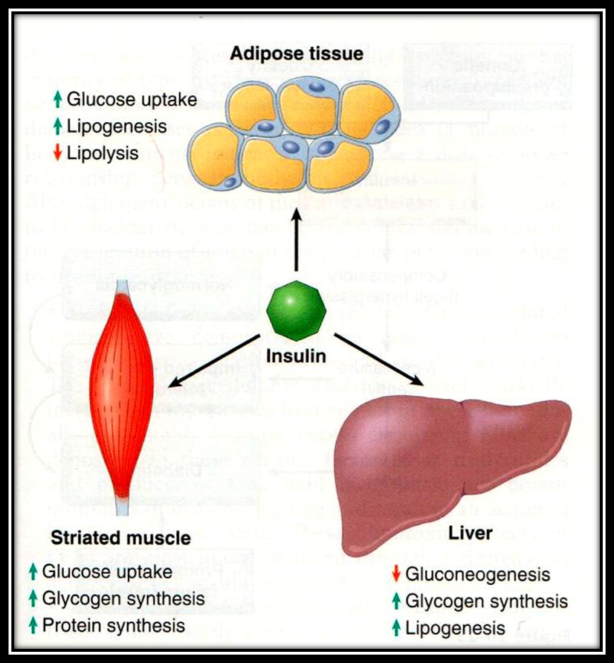

Slide 23
Insulin resistance is defined as the failure of target tissues to respond normally to insulin. It leads to decreased uptake of glucose in muscle, reduced glycolysis and fatty acid oxidation in the liver, and an inability to suppress hepatic gluconeogenesis.

Slide 24
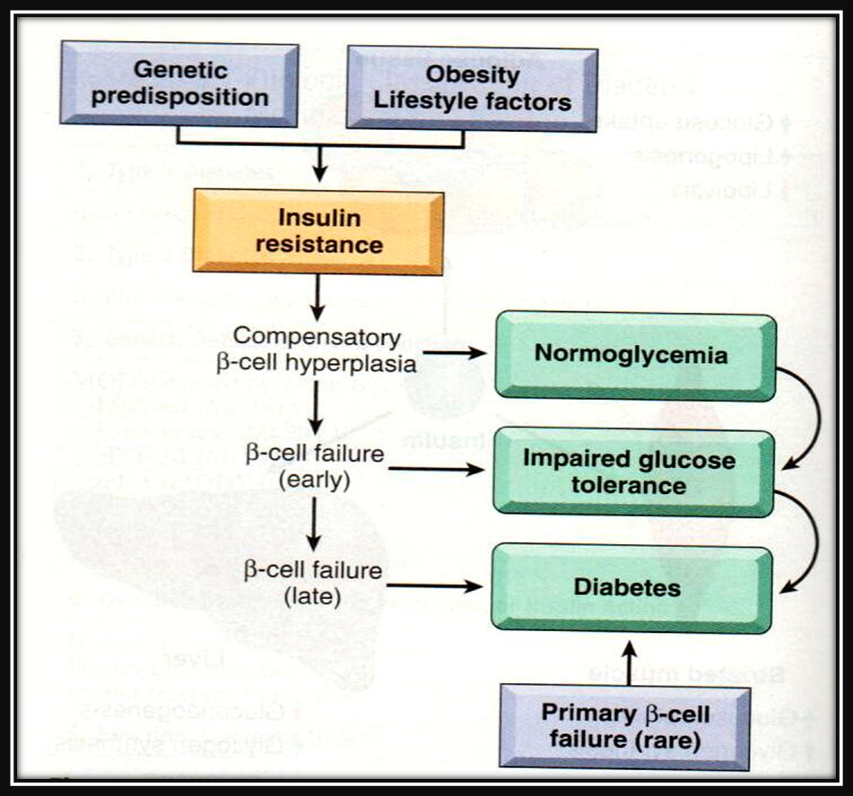
T2 DM, PATHOGENESIS

Slide 25
Obesity and diabetes

Slide 26
T2 DM , Pathology
No consistent reduction in the number of B-cells
No morphologic lesions of B- cells
In some islets, fibrous tissue accumulates, sometimes to such a degree that they are obliterated.
Islet amyloid is often present particularly in patients over 60 years of age.

Slide 28
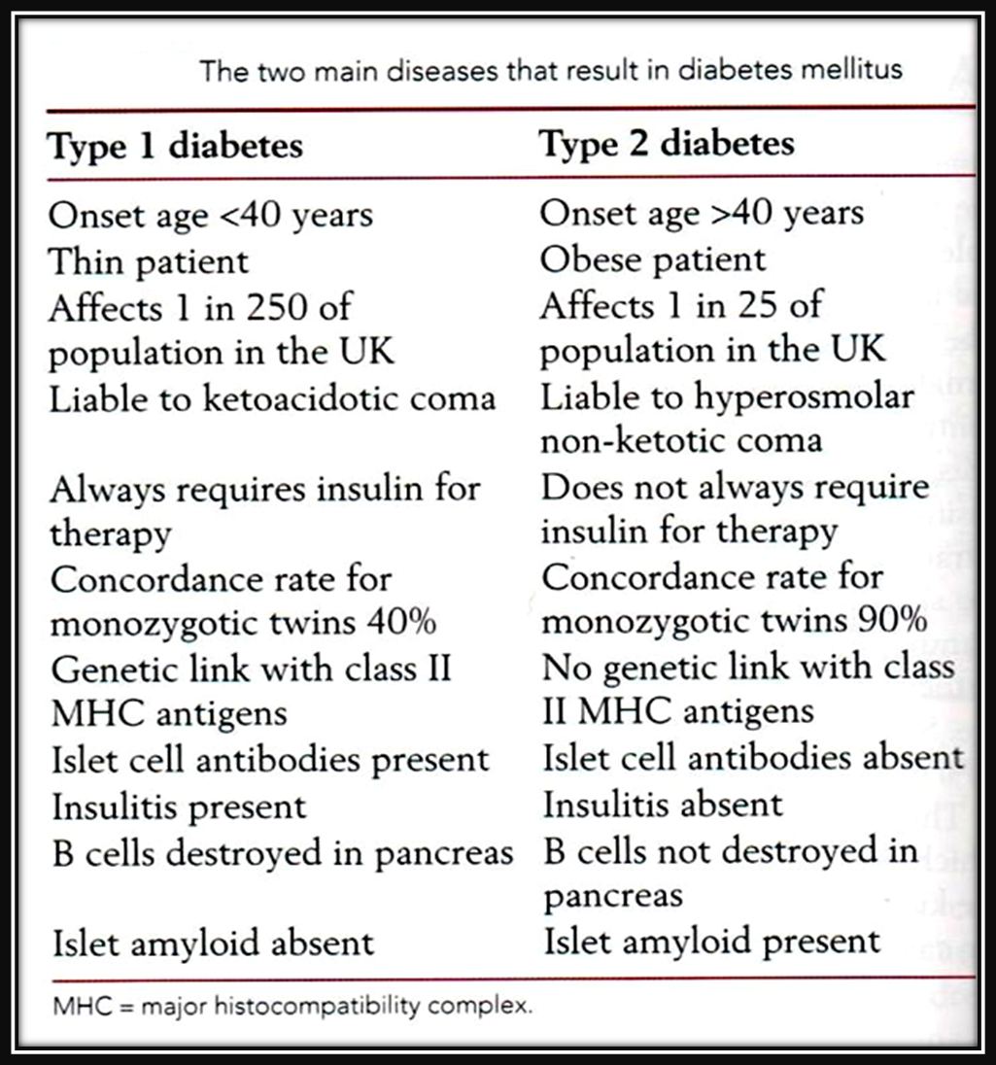

Slide 29
Complications of Diabetes
The most significant complications of diabetes are vascular abnormalities, renal damage, and lesions affecting the peripheral nerves and eyes
Although the 2 major types of diabetes have different pathogenesis and clinical presentations, the long term systemic complications are the same.

Slide 30
Complications of Diabetes
Diabetic Microvascular Disease:
Responsible for Many of the Complications of Diabetes, Including Renal Failure and Blindness (diabetic microangiopathy)
Arteriolosclerosis and capillary basement membrane thickening are characteristic vascular changes in diabetes.
The frequent occurrence of hypertension contributes to the development of the arteriolar lesions.
Aggregation of platelets in smaller blood vessels and impaired fibrinolytic mechanisms have also been suggested as playing a role in the pathogenesis of diabetic microvascular disease.

Slide 31
Complications of Diabetes
Diabetic Microvascular Disease:
The effects of microvascular disease on tissue perfusion and wound healing are profound
Reduce blood flow to the heart, which is already compromised by coronary atherosclerosis.
Healing of chronic ulcers that develop from trauma and infection of the feet in diabetic patients is commonly defective (gangrene)

Slide 32
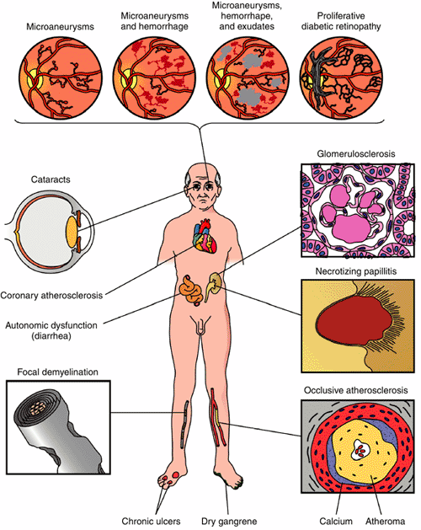

Slide 33
Diabetic Nephropathy
30% to 40% of T1DM ultimately develop renal failure. A somewhat smaller proportion (up to 20%) of patients with T2DM are similarly affected
Diabetic nephropathy accounts for one third of all new cases of renal failure.
The prevalence of diabetic nephropathy increases with the severity and duration of the hyperglycemia.
The glomeruli in the diabetic kidney exhibit a unique lesion termed Kimmelstiel-Wilson disease or nodular glomerulosclerosis
Vascular changes: atherosclerosis and arteriolsclersosi
Parynchyma :pyelonephritis and necrotizing papilitis.

Slide 34
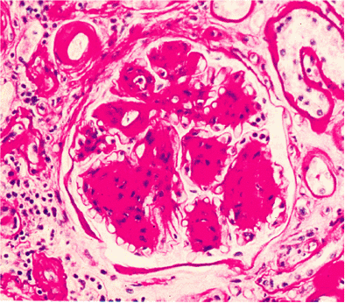

Slide 35
Diabetic Retinopathy
The most devastating ophthalmic complication of diabetes
The most important cause of blindness in the Unites States in persons under the age of 60 years.
The risk is higher in T1DM than in T2DM.

Slide 36
Diabetic retinopathy
Non-proliferative changes:
Thickening of capillary basement membrane(microangioathy) with microaneurysms
Retinal hemorrhages(bots)
Retinal edema and exudate (cotton wool sopts)
Proliferative changes: neovascularization and fibrosis leads to retinal detachment and blindness.

Slide 37
Diabetic Neuropathy
Characterized by pain and abnormal sensations in the extremities.
The most common and distressing complications of diabetes.
Microvasculopathy involving the small blood vessels of nerves contributes to the disorder.
Affects Sensory and Autonomic Innervations, Peripheral sensory impairment, and autonomic nerve dysfunction.

Slide 38
Diabetic Neuropathy
Changes in the nerves are complex, and abnormalities in axons, the myelin sheath, and Schwann cells have all been found.
Peripheral neuropathy can leads to foot ulcers.

Slide 39
Infections
Bacterial and Fungal Infections Occur in Diabetic Hyperglycemia if Poorly Controlled
Renal papillary necrosis may be a devastating complication of bladder infection.
Mucormycosis: A dangerous infectious complication of poorly controlled diabetes is often fatal fungal infection tends to originate in the nasopharynx or paranasal sinuses and spreads rapidly to the orbit and brain.

Slide 40
Gestational diabetes
Diabetes Occurring During Pregnancy
May Put both Mother and Fetus at risk
Develops in only a few percent of seemingly healthy women during pregnancy.
It may continue after parturition in a small proportion of these patients.
These women highly susceptible to overt T2DM later in life.

