Slide 1
بسم الله الرحمن الرحيم

Slide 2
ENDOCRINOLOGY
The Adrenal Gland
Adrenal Medulla

Slide 3
Learning outcomes
After reviewing the PowerPoint presentation, lecture notes and associated material, the student should be able to:
Summarize the actions of adrenal androgens.
Describe the causes and major manifestations of hyperadrenocorticism and Hypoadrenocorticism
Describe circumstances in which catecholamines are released from the adrenal gland.
List the major actions of catecholamines.

Slide 4
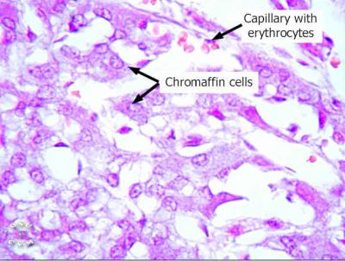
The adrenal medulla is the inner part or core of each adrenal gland.
It is considered as part of sympathetic nervous system.
It secretes catecholamines:
Adrenaline (epinephrine) -- 80% of the secretion.
Noradrenaline (norepinephrine) -- 20 % of the secretion.
small amount of dopamine
>> Secretion of these hormones causes:
Blood to be diverted to the brain, heart, and skeletal muscle
They are released from chromaffin cells
Epinephrine is the more potent stimulator of the heart and metabolic activities
Norepinephrine is more influential on peripheral vasoconstriction and blood pressure

Slide 5
Role of the adrenal medullary hormones
1. Enhance the effects of the sympathetic nervous system.
2. Prepare the body for a stressful event.
The response is known as the “fight or flight” response.

Slide 6
Effects of Catecholamines
1- Glycogenolysis in liver and skeletal muscle (can lead to hyperglycemia) which increases blood glucose level
2- Increase heart rate and blood pressure
3- Cause vasoconstriction of blood vessels
4- Mobilization of free fatty acids
5- Increase metabolic rate
6- Increase O₂ consumption

Slide 7
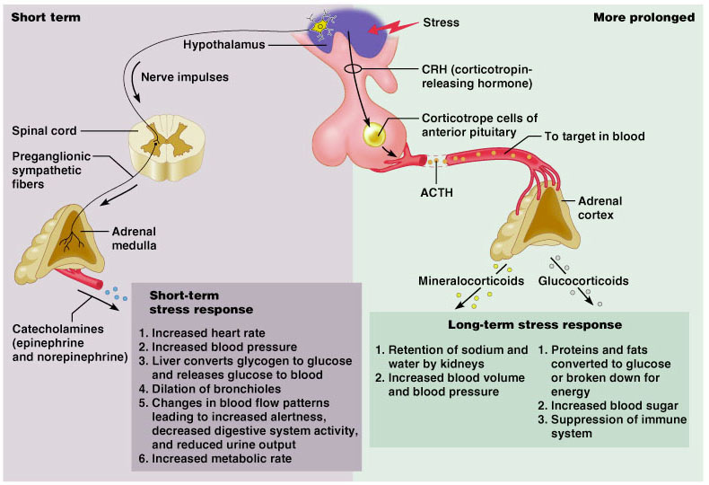
Stress and the Adrenal Gland

Slide 8
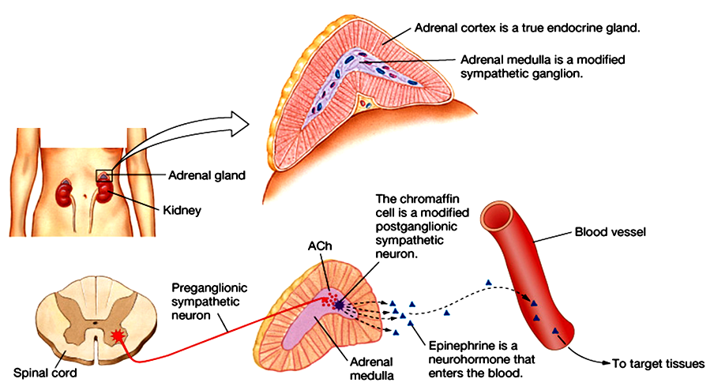
Its secretions are derived from tyrosine :
Tyrosine Dopamine Norepinephrine Epinephrine
Phenylethanolamine N-methyltransferase (PNMT) is an enzyme found in the adrenal medulla that converts norepinephrine (noradrenaline) to epinephrine (adrenaline).

Slide 9
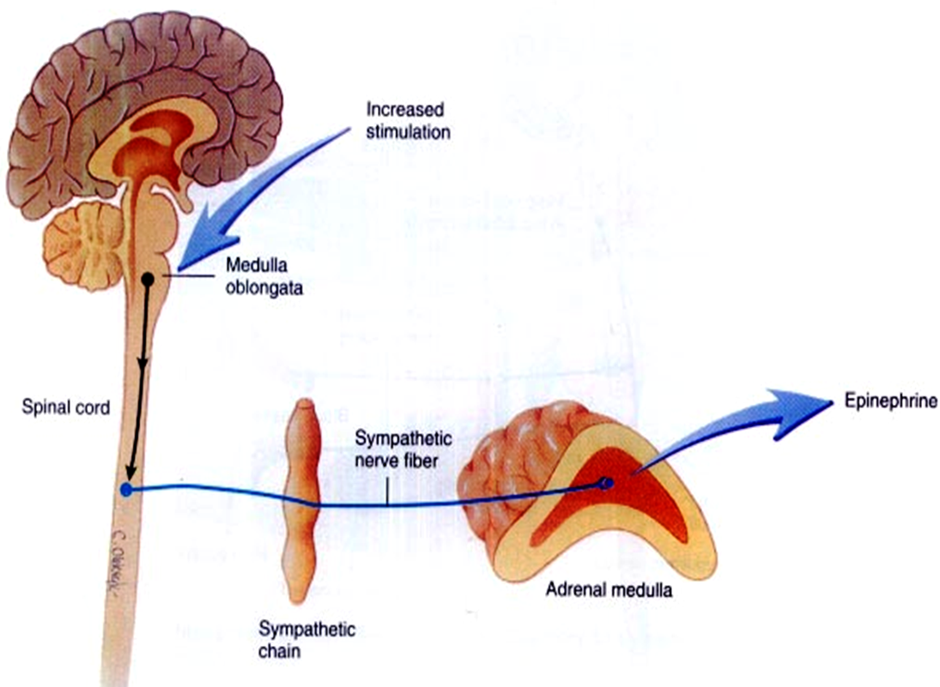
The adrenal medulla is, functionally , integral part تعتبر جزء لا يتجزof the sympathetic system .
80% of its secretion is Epinephrine ( EP) and
20% of its secretion is Norepinephrine (NE ).
EP in the bloodstream , on the other hand , comes solely from the adrenal medulla .
BUT → NE in blood comes from BOTH adrenal medulla and postganglionic sympathetic nerves
This is because postganglionic sympathetic nerves can not synthesize EP from its precursor NE , because they lack the enzyme ( PNMT) needed for conversion of NE into EP .

Slide 10
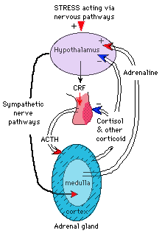
Control of secretion of
adrenal medullary hormones
The adrenal medulla is innervated by the sympathetic nervous system.
Adrenal hormones are released from the medulla in response to signals from the sympathetic nervous system.
The sympathetic nervous system is activated in response to stress also know as the “fight or flight” response. Stress can be physical (exercise), physiological (hypoglycemia, hemmorhage), or emotional,
Cortisol, when secreted from the adrenal cortex in response to stress, causes release of these hormones from the medulla.

Slide 11
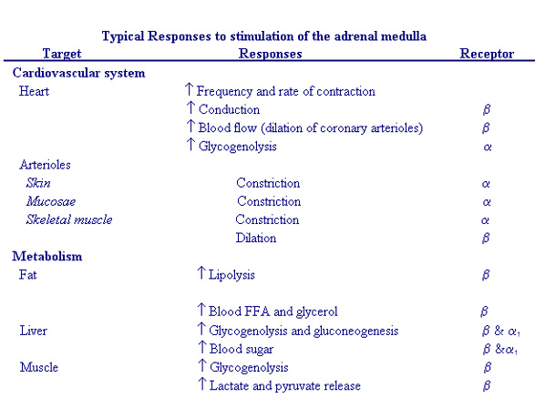
Actions of adrenal medullary hormones

Slide 12
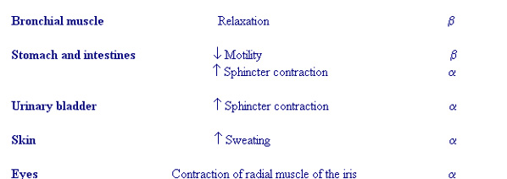
Actions of adrenal medullary hormones
The effects of the adrenal medullary hormones underlie the role of these hormones in preparation of body for fight or flight.
The overall effect is to ensue that all requirements for increased muscle activity are available. What are these?

Slide 13
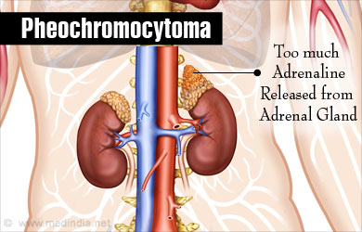
Pheochromocytoma
Pheochromocytoma is a tumor of adrenal medulla .
It can be life threatening if not recognized & not treated.
Most often occurs in middle age.
Symptoms & signs →

Slide 14
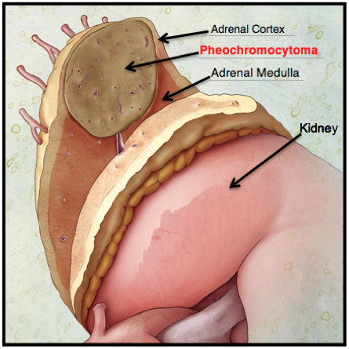
>> Pheochromocytoma is derived from chromaffin cells (arise from neural crest).
>> Most tumors secrete epinephrine, NE, and dopamine and can cause episodic hypertension.
>> Urinary vanillylmandelic acid, VMA (a breakdown product of norepinephrine) and plasma catecholamines are elevated.
>> Associated with neurofibromatosis.
www.medical-institution.com

Slide 15
Signs and Symptoms of Pheochromocytoma
resistant hypertension (95%)
headache
sweating
palpitations
chest pain
anxiety
glucose intolerance
increased metabolic rate
classic triad

Slide 16
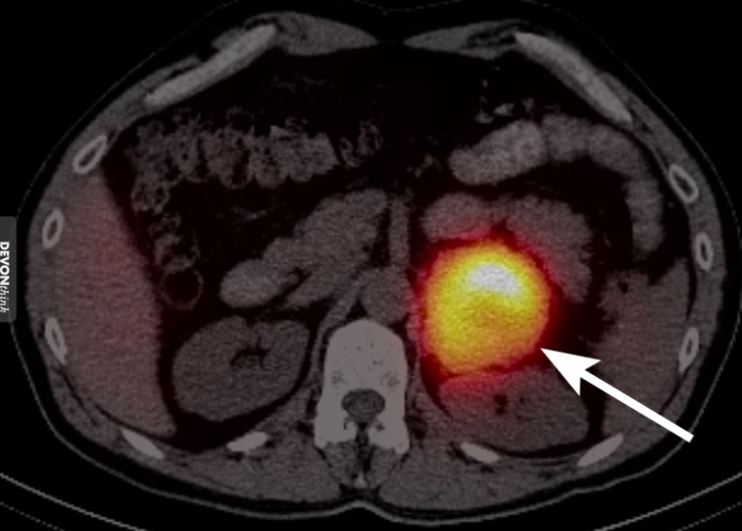
Diagnosis and Treatment
High plasma catecholamine.
Increased metabolites [VMA] in urine
Treatment is surgical resection
Imaging

Slide 17
Thank You

