Slide 1
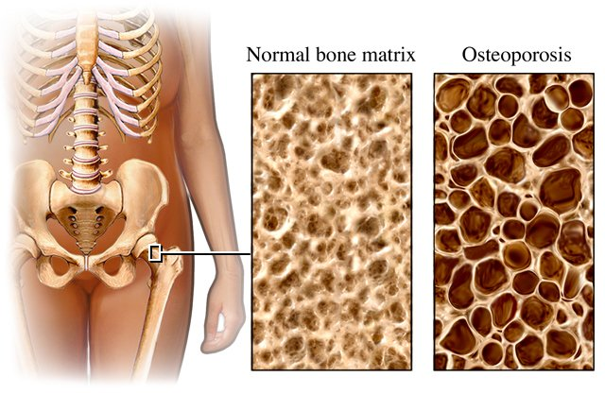
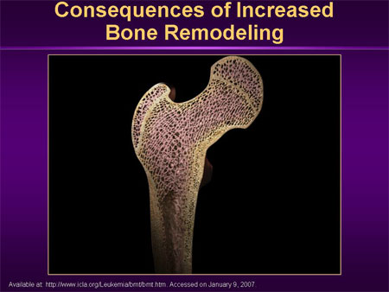
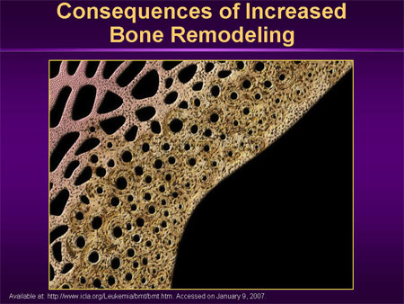
OSTEOPOROSIS

Slide 2
OSTEOPOROSIS
ILOs
By the end of this lecture you will be able to:
Revise the composition, regulation & the remodeling stages
of bone turnover
Recognize the interlinks of osteoblastic & osteoclastic function
Relate changes to the development of osteoporosis
Classify drugs according to their replacement, antiresorptive or
anabolic mechanism of action
Detail the pharmacology of such group of drugs& their clinical
utility in combating osteoporosis
Notes:
Intended Learning Outcomes (ILOs)

Slide 3
OSTEOPOROSIS ;
Key points

Slide 4
OSTEOPOROSIS:
“Osteo” is Latin for “bone”
“Porosis” means “porous or full of holes”
“Osteoporosis” means “bones that are full of holes”
Osteoporosis can develop without symptoms “The Silent Disease”

Slide 5
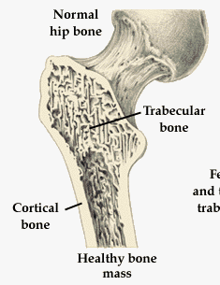
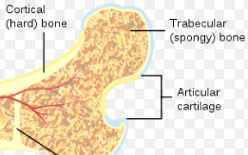
TYPES OF BONE
(1) Cortical – is hard, compact, dense bone (example: mid-section of larger, long-bones of arms and legs)
(2) Trabecular (cancellous)– is spongy, porous and flexible bone (example: end of the wrist, hip and the spine)
Activity - Understanding Our Bones

Slide 6
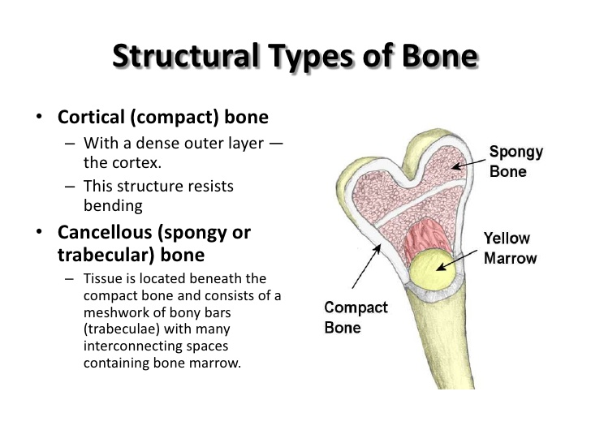

Slide 7
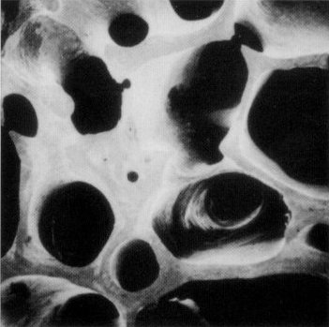
HEALTHY BONE
Bone is living tissue, which is constantly being broken down and rebuilt, a process called remodeling
Bone is renewed like skin, hair and nails

Slide 8
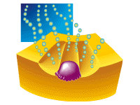
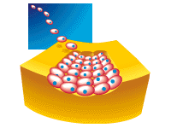
BONE “REMODELING”
Resorption-removes old bone
Formation-replaces old bone with new bone

Slide 9

BONE “REMODELING”
OSTEOCLASTS-PHASE 1
Cells called osteoclasts (think “C” for cutting of bone) seek out old bone or damaged bone tissue and destroy it, leaving small spaces (resorption)

Slide 10
BONE “REMODELING”
OSTEOBLASTS – PHASE 2
Cells called osteoblasts (think “B” for builder) use minerals like calcium, phosphorus, and vitamin D to fill in the spaces with new bone (formation)

Slide 11
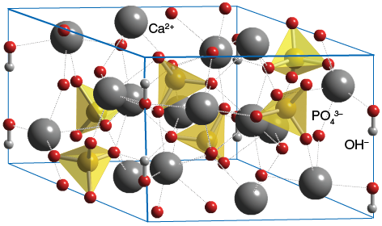
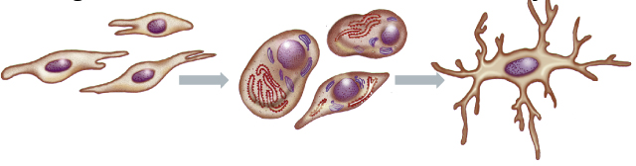
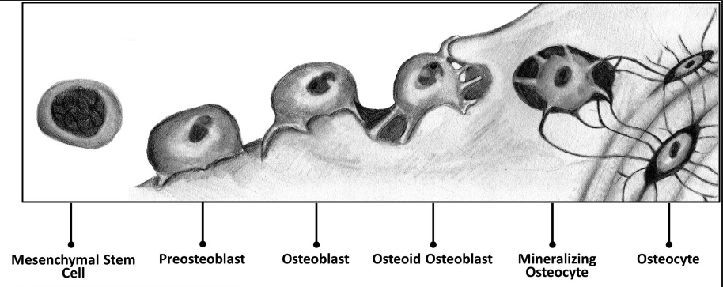
Bone is basically composed of 2 types of tissues
  INORGANIC 65% of mass  Consists of crystaline calcium phosphate salts (hydroxyapatite, HAp)
  Organic  35% of mass  Consists of ;osteoblasts, osteoclasts and osteocytes).
• Bone cells are either; Bone Forming or Bone Resorptive
A. Bone Forming Cells:
    Osteogenic cells  mesenchymal in origin  are found on all bone surfaces
    Osteoblasts  forms osteoid framework & help in its mineralization
Osteoblasts
Osteocytes
Notes:
INORGANIC 65% of mass  Consists of hydroxyapatite, calcium & phosphorus salts
Hydroxyapatite (HAp) is the major mineral constituent of bones and teeth.
Bone is a composite consisting mainly of calcium phosphate (69%), water (9%), and collagen (20%).
Formed during OSTEOGENESIS by MINERALIZATION of the organic matrix (osteoid Frame work) & is mediated by alkaline phosphatase
Organic  35% of mass  Consists of ;
Organic matrix [OSTEOID]  produced by osteoblasts Bone Framework
Osteogenic cells  mesenchymal in origin  are progenitor of blasts & cytes  are found on all bone surfaces
Osteocytes  sense mechanical stress  signals to both blasts & clasts
Osteocytes, derived from osteoblasts, reside within bone and communicate extensively with other bone cell populations to regulate bone metabolism.

Slide 12
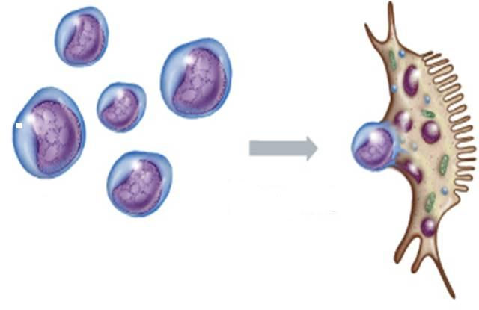
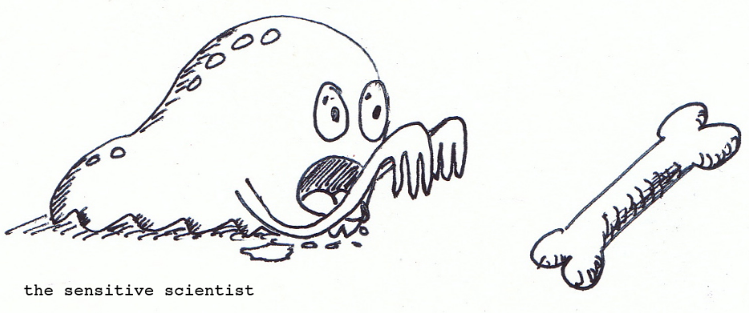
B. Bone Resorptive Cell:
Osteoclastes 
Reside in pits (resorption bays) that form by eaten bone surface. Secretes lysosomal enzymes (collagenase & metalloproteinase) + hydrochloric a.  dissolve bone matrix
Osteoclasts
NORMALLY
bones continuously form & resorb
○ BONE REMODELING
Under control of systemic hormones, body mineral contents
& local autocrine-paracrine secretions (Cytokines, Growth Factors, PGs)
It is meant to maintain calcium homeostasis & to renew bone in repair of microdamage & microcracks
Notes:
Osteoclastes  myloid in origin  made by fusion of multiple progenitors of monocytes.

Slide 13
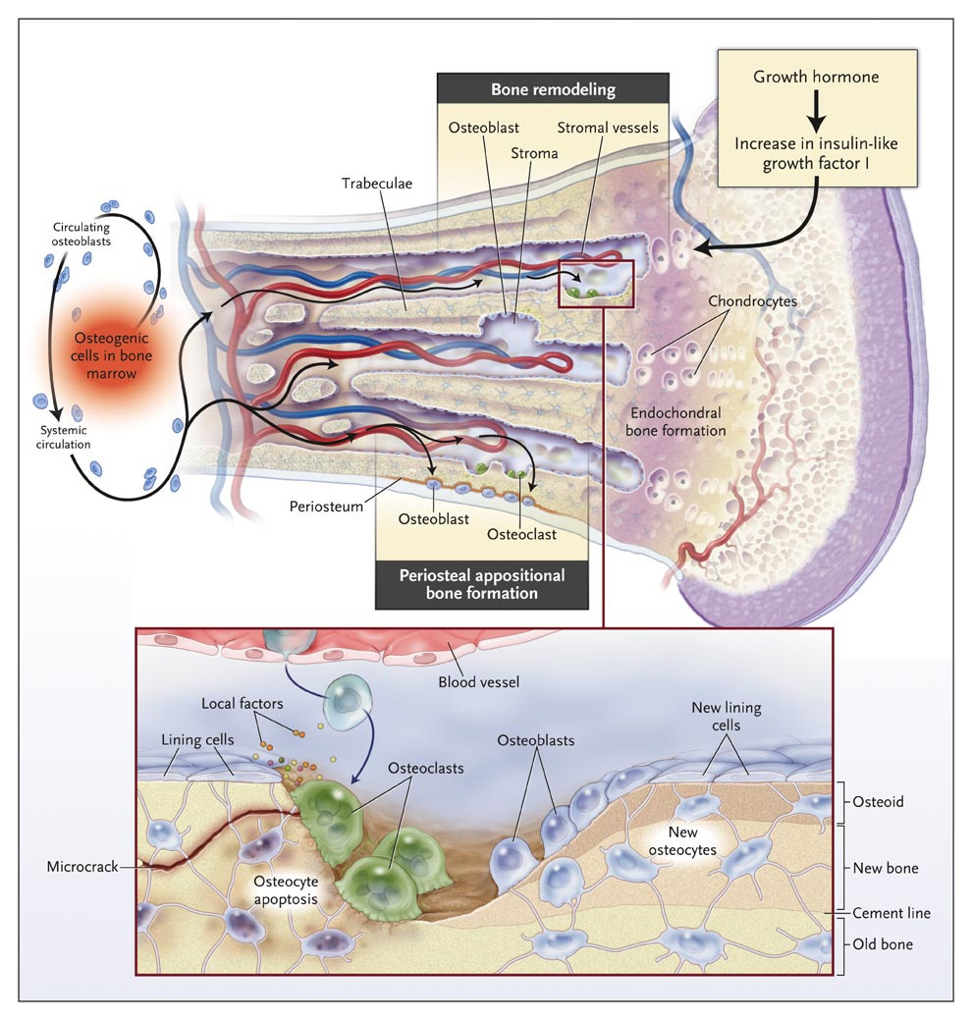
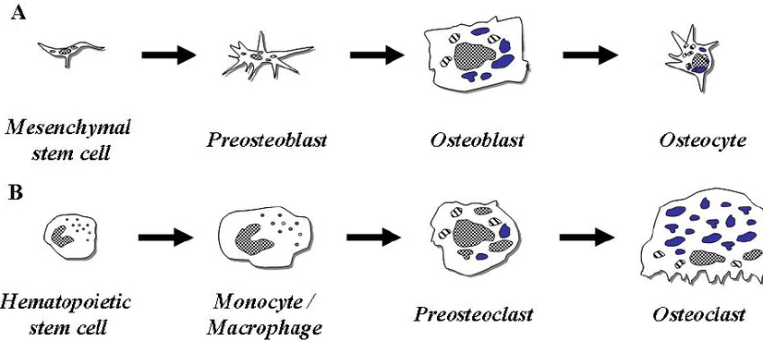

Slide 14
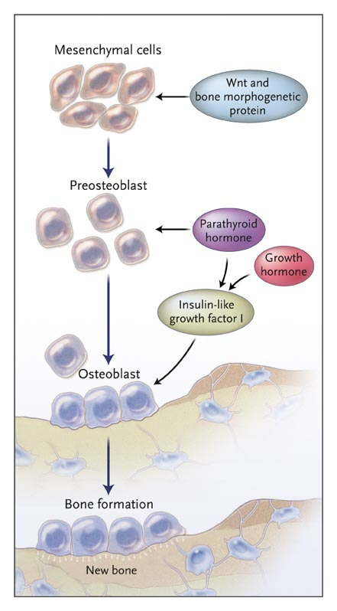
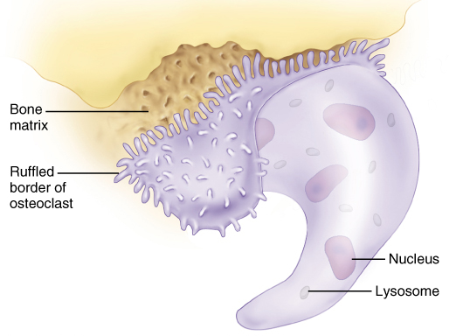
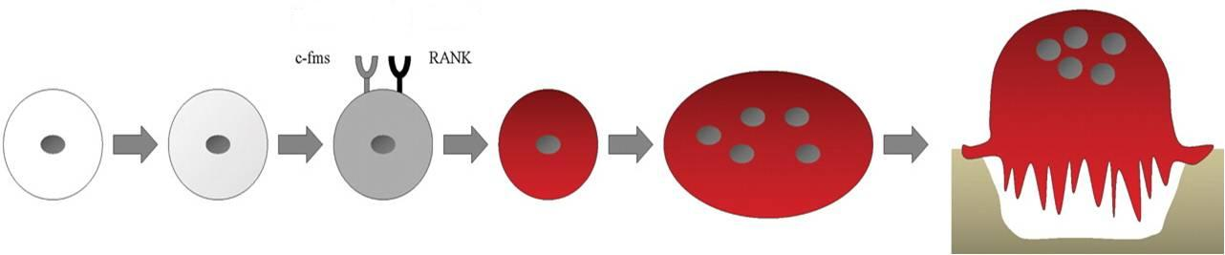
LOCAL FACTORS DRIVING THE REMODELING PROCSS
Osteoprotegerin [OPG]
RANKL
HSC
Myloid Proginator
Monocyte
Pre-Osteoclast
Mature
Osteoclast
Resorbing
Osteoclast
Notes:
HSC: hematopoietic stem cells…
One of the major signaling pathways involved in the regulation of bone homeostasis is the WNT signaling pathway.

Slide 15
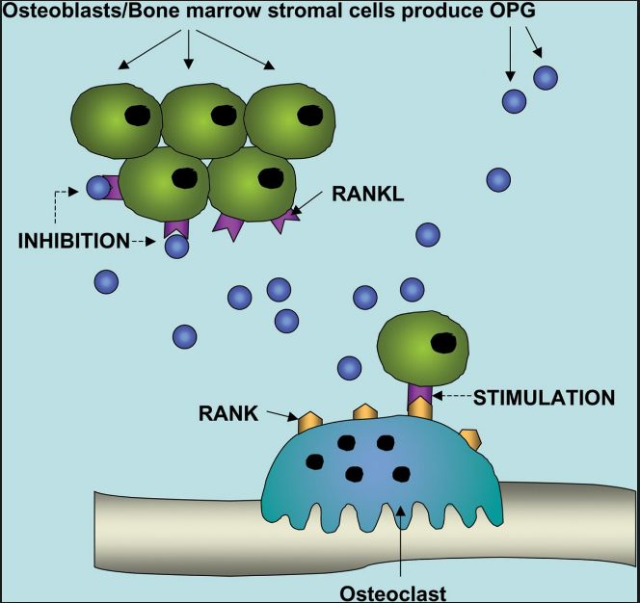
Notes:
Role of OPG in bone remodelling OPG produced by osteoblasts/BMSCs binds RANKL and prevents the association of RANK–RANKL required for osteoclast maturation and activity.
RANKL has three isoforms and its soluble form is secreted from osteoblasts. RANKL binding to its receptor on precursors and mature osteoclasts triggers the NF-κB pathway, resulting in differentiation, activation and survival of osteoclasts as well as bone turnover.
Osteoprotegrin (OPG), an antagonist of RANKL and member of the tumor necrosis factor (TNF) receptor superfamily, is secreted by osteoblasts and prevents the differentiation and activity of osteoclasts.
OPG (osteoprotegerin), a secreted member of the TNF (tumour necrosis factor) receptor superfamily, has a variety of biological functions which include the regulation of bone turnover. OPG is a potent inhibitor of osteoclastic bone resorption and has been investigated as a potential therapeutic for the treatment of both osteoporosis and tumour-induced bone disease. Indeed, in murine models of cancer-induced bone disease, inhibition of osteoclastic activity by OPG was also associated with a reduction in tumour burden.

Slide 16
SYSTEMIC HORMONES Controlling Remodeling
1. PARATHORMONE (parathyroid hormone)
regulates calcium homeostasis via
 bone formation ( intermittent) / bone resorption (continuous)
renal tubular calcium reabsorption
 renal calcitriol production
2. CALCITROL
 intestinal Ca & phosphorus absorption  bone mineralization
3. ESTROGEN & ANDROGEN
 rate of bone loss by acting on many local factors
 osteoclast apoptosis & growth factors from osteoblasts
No. & depth of resorption cavities & release of cytokines
4. CALCITONIN
◉ osteoclasts & bone resorption
5. CLUCOCORTICOIDS
 apoptosis of osteoblasts & osteocytes   resorption
6. THYROID HORMONE
 Bone turn-over i.e. resorption & formation
7. Growth hormone
 skeletal growth
Notes:
A decrease in Ca²⁺ induces a release of PTH, whereas an increase in Ca²⁺ level has an inhibitory effect on the PTH secretion through the calcium-sensing receptor.
PTH increases ionic calcium concentration in the serum, acting primarily on bone and kidney cells through the type 1 PTH receptor. Interestingly, PTH stimulates bone formation when administrated intermittently but causes severe bone loss with continuous administration. [Low levels of PTH prevent bone loss.]
PTH (1-34) is a promising anabolic agent to date in the treatment of osteoporosis [4]. This is due to direct stimulation of bone formation. PTH injections improve bone qualities, increase bone mass and prevent osteoporotic fractures.
Parathyroid hormone (PTH) is one of the two major hormones modulating calcium and phosphate homeostasis, the other being calcitriol (1,25-dihydroxyvitamin D).
On a more chronic basis, PTH also stimulates the conversion of calcidiol (25-hydroxyvitamin D) to calcitriol in renal tubular cells, thereby stimulating intestinal calcium absorption.
PTH secretion is, in turn, regulated by serum ionized calcium acting via an exquisitely sensitive calcium-sensing receptor (CaSR) on the surface of parathyroid cells.
PTH also stimulates secretion of calcitriol;
Calcitriol (1,25 dihydroxycholecalciferol = composed of vit. D); The direct influence of calcitriol is increasing the uptake of dietary calcium into the blood, but also the uptake of calcium into the bones (4) (Calcitriol therefore also stimulates osteoblast activity (22) and thus increases osteoblasts apoptosis (5)) and deportation of calcium from the bones. (23)
Calcitriol however also inhibits secretion of PTH.
estrogen does not stimulate osteoblasts, but even inhibits osteoblast activity (and number) and therefore inhibits calcium influx in the bones and also inhibits deportation of calcium from the bones. Thus estrogen protects the bones against excessive bone turnover and osteoblasts against apoptosis.
Estrogen prevents death of osteoblasts, in particular, because osteoblasts are more sensitive to aging phenomena than osteoclasts.
Calcitonin works to control calcium and potassium levels. It does this by inhibiting the activity of the osteoclasts, the cells that break down bone. Calcitonin is a hormone secreted by the thyroid gland that reduces the concentration of blood calcium level when it has risen to an above normal level.
Calcitonin opposes the effects of parathyroid hormone (PTH), which acts to increase the blood calcium level. Calcitonin lowers blood calcium levels by suppressing osteoclast activity in the bones and increasing the amount of calcium excreted in the urine. The hormone also prevents the absorption of calcium from the intestine, as well as increasing the calcium absorbed by the kidney.
Calcitonin is used to treat or prevent conditions that lead to loss of calcium from the bones.

Slide 17
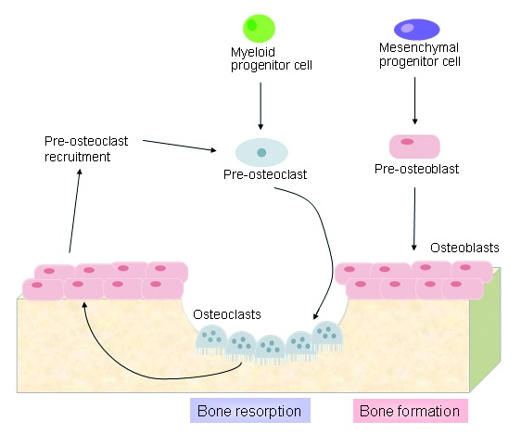
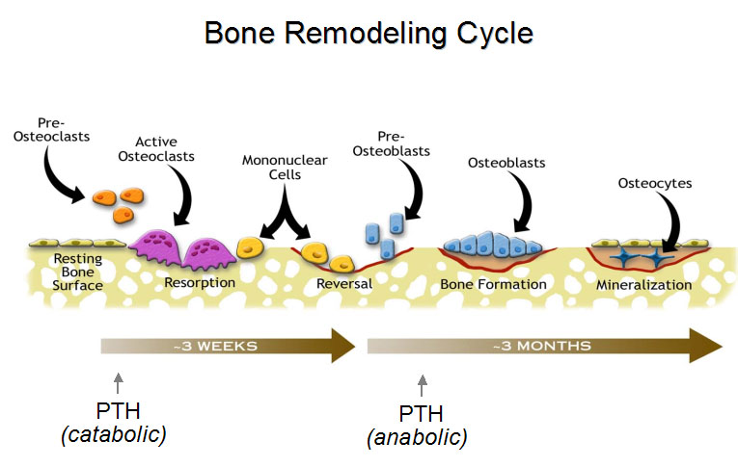
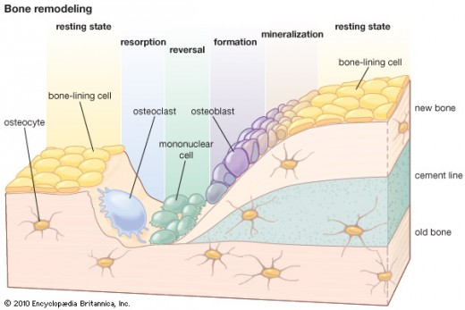
Stages of BONE REMODELING
  Occurs at periosteal & endosteal surfaces
1.
2.
3.
4.
5.
  2-6 weeks
  ~2-6 months
Non-mineralized
extracellular matrix (osteoid)
Mineralized extracellular matrix
Notes:
The point of this pic is to know that the bone remodeling require long time.
From birth through adolescence, new bone is built faster than old bone is removed
In mid-life, depending on lifestyle and other factors, bone removal can achieve a balance with bone formation
After menopause, bone removal may accelerate due to a decrease in estrogen

Slide 18
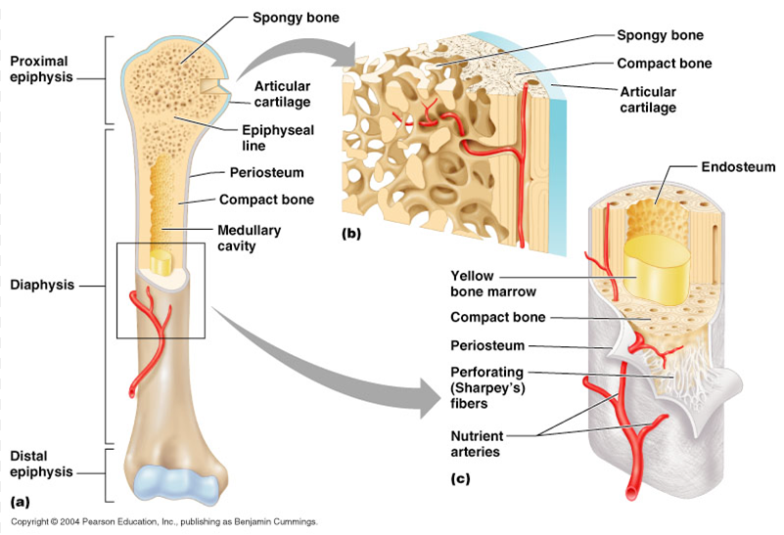

Slide 19
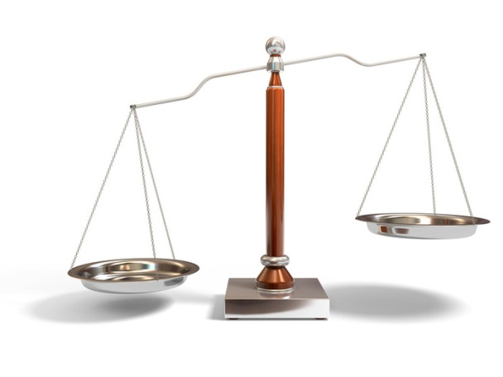
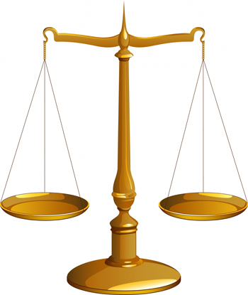
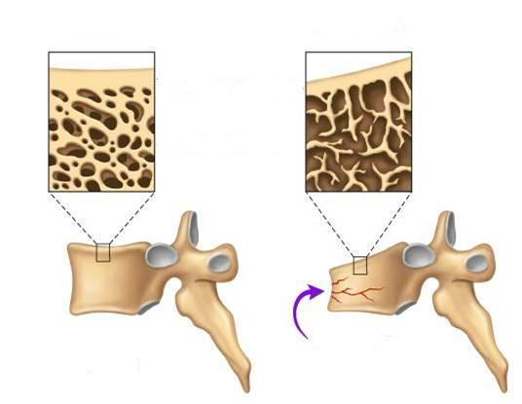
BONE REMODELING
Formation
Resorption
Formation
Resorption
OSTEOPOROSIS
A complex endocrinologic disorder of bone & mineral metabolism
(bone resorption > formation)
Low bone mass
Disruption of bone architecture
Reduced bone strength
Risk of fractures

Slide 20
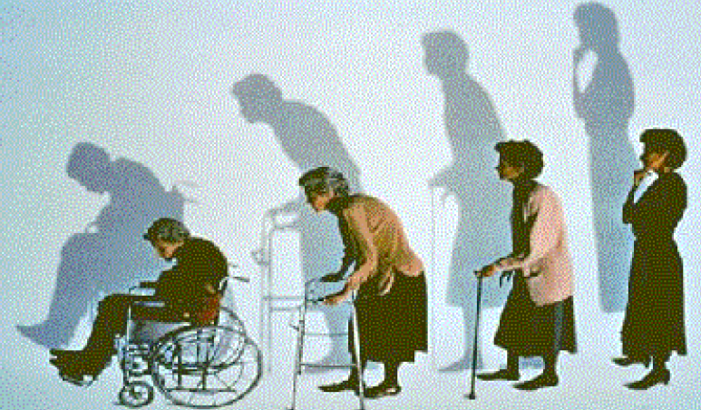

OSTEOPOROSIS
PREVENTION
TREATMENT
Potentially Modifiable | Nonmodifiable
Current cigarette smoking | Personal history of fracture
Diet low in calcium/vitamin D | 1st-degree relative has fracture
Glucocorticoids, anticonvulsants | Race (Caucasian or Asian)
Excessive alcohol intake | Elderly age
Sedentary lifestyle | Poor health
Body weight | Dementia
Lack of estrogen | Hormonal disorders
Environmental risks | Neoplastic disorders
Poor eyesight | Metabolic abnormalities
Notes:
You build bone until about age 30
Steps to building healthy bones include:
Calcium & vitamin D
Limit Caffeine & Alcohol
Exercise
Don’t Smoke
Osteoporotic fractures, with an estimated annual incidence of 2 million among US citizens aged 50 years or older (Burge et al 2007),
Bone densitometry by dual-energy X-ray absorptiometry (DXA), which measures bone mineral density (BMD), is the canonical method for diagnosing osteoporosis (Briot and Roux 2005). The relationship between low BMD and fracture is stronger than the relationship between cholesterol and heart attacks (US Department of Health and Human Services 2004).
The World Health Organization (WHO) defines osteoporosis as a BMD T-score of ≥2.5 standard deviations below the gender-specific young adult mean, as measured by DXA (World Health Organization 1994).

Slide 21
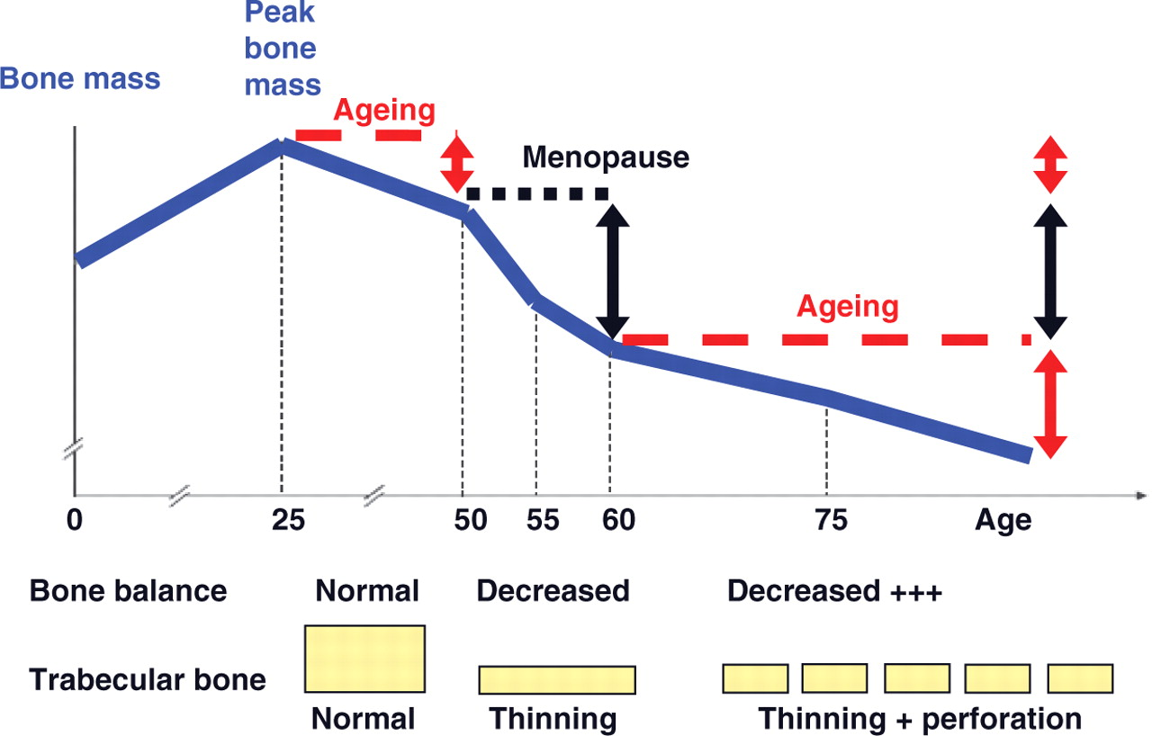
Notes:
BONE LOSS & AGING
The first 5-15 years after menopause a woman can lose approximately 25 - 30 % of trabecular bone & approximately 10 – 15 % of cortical bone
Osteoporosis – a progressive loss of bone strength and quality that multiplies fracture risk – is a common and underrecognized hazard to postmenopausal women. Its prevalence among US women ranges from 26% at age 65 years and older to over 50% at age 85 years and older (US Department of Health and Human Services 2004), reflecting an altered balance of bone turnover that begins immediately upon menopause and increases steadily with age (Garnero et al 1996b). Fortunately, osteoporosis is eminently preventable and treatable. Lifelong attention to nutrition and exercise, bone density monitoring after menopause, and appropriate treatment of diagnosed osteoporosis can reduce the burden of disability, cost, and mortality.
Bone loss often occurs
without symptoms or
warning signs

Slide 22
TREATMENT OF OSTEOPOROSIS
  Replace what is missing….Ca, Vit D, Na fluoride
  Reset back the balance of remodeling
Used to enhance the strength by the formation of fluorapatite.
Is considered only when trabecular bone is  in presence of normal cortical bones
ANTIRESORPTIVE AGENTS
BONE ANABOLIC AGENTS

BISPHOSPHONATES
ESTROGEN ANALOGES
ANDROGEN ANALOGES
SERMS
CALCITONIN
RANKL INHIBITORS
TERIPARATIDE
(Parathyroid hormone)




STRONTIUM

Others; Thiazide diuretics, statins (Decrease the incidence of Osteoporosis)
Notes:
Selective estrogen receptor modulators (SERMs) are a class of drugs that act on the estrogen receptor (ER)
so SERMs produce estrogenic or antiestrogenic effects depending on the specific tissue.
Raloxifene is a SERM that is more antiestrogenic than tamoxifen; both are estrogenic in bone, but raloxifene is antiestrogenic in the uterus while tamoxifen is estrogenic in this location
Teriparatide (Forteo) is a synthetic version of the human parathyroid hormone, which helps to regulate calcium metabolism.
It is the only osteoporosis medicine approved by the FDA that rebuilds bone.
Teriparatide is a synthetic form of the natural human parathyroid hormone and is used by injection to treat osteoporosis. Teriparatide forms new bone, increases bone mineral density and bone strength, and as a result reduces the chance of getting a fracture (broken bone).
Teriparatide has been used by injection into a vein as a test to help diagnose problems of the parathyroid gland. This test determines whether you have hypoparathyroidism or a type of pseudohypoparathyroidism.
This product, for use as a test to help diagnose problems of the parathyroid gland, was withdrawn from the U.S. market in January 1997.

Slide 23
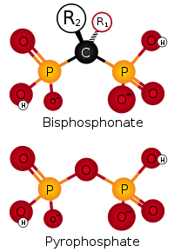
BISPHOSPHONATES
Are compounds that have two phosphonate (PO₃) groups
Non-Nitrogenous
Nitrogenous
Etidronate
Clodronate
Tildronate
Alendronate
Ibandronate
Risedronate
Zoledronate
p.o.
i.v.
p.o.
i.v.
Mechanism
Are structurally similar to pyrophosphate, thereby inhibiting activation of enzymes that utilize it.
They preferentially "stick" to calcium  concentrate in bones, bound to hydroxyapatite, decreasing its solubility and making it more resistant to osteoclastic activity.
They prevent bone resorption by inhibiting osteoclast function.
Their relative potencies for osteoclast inhibition is the most with 3rd generation “Zoledronate”
Notes:
How do they inhibit osteoclasts???  It is taken up during osteoclast resorptive activity  blocks steps in cholesterol synthetic pathway within osteoclast  end up by osteoclast apoptosis
They are called bisphosphonates because they have two phosphonate (PO(OH)
2) groups.
The arrangement of 2 phosphate groups bound to a geminal carbon (rather than an oxygen as in pyrophosphate) creates a non-hydrolyzable pyrophosphate analog (Rogers et al 2000), and the R₁ and R₂ groups occupying the carbon’s other bonds mediate high-affinity calcium chelation.
Fosamax (alendronate), Actonel (risedronate)
First-line osteoporosis pharmacotherapy employs nitrogen-containing bisphosphonates. The inconvenience of daily oral treatment has motivated development of weekly, monthly, and intermittent oral regimens, as well as quarterly and yearly intravenous (iv) regimens.
Ibandronate is the first bisphosphonate to have shown direct anti-fracture efficacy with a non-daily regimen; it was approved for once-monthly oral dosing in 2005 and for quarterly iv dosing in 2006. Intermittent oral risedronate and yearly iv zoledronic acid were approved in 2007.

Slide 24
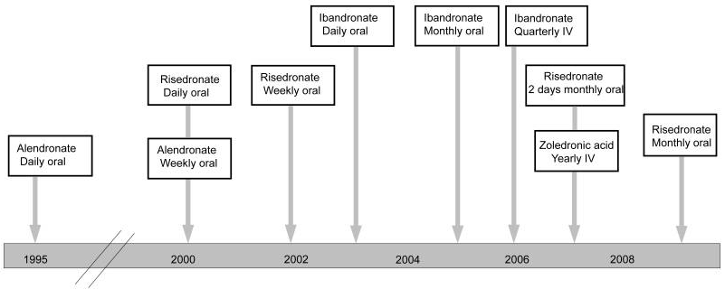
Timeline of Food and Drug Administration approvals of different bisphosphonate regimens.

Slide 25
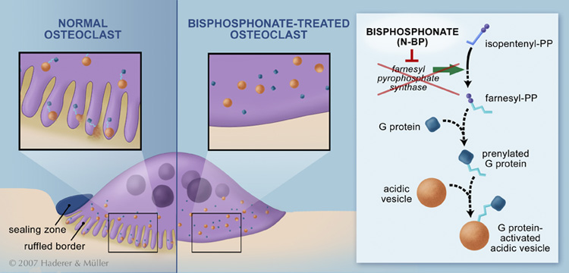
BLOCK STEPS IN CHOLESTROL SYNTHETIC PATHWAY IN OSTEOCLAST
that act as signaling molecules responsible for the osteoclastic hydrolytic & phagocytic activity.
Stop function  apoptosis (increased death of osteoclast)
How do they inhibit osteoclasts???  It is also taken up by osteoclast  blocks steps in cholestrol synthetic pathway within osteoclast  end up by osteoclast apoptosis .
Notes:
Nitrogenous bisphosphonates act on bone metabolism by binding and blocking the enzyme farnesyl diphosphate synthase (FPPS) in the HMG-CoA reductase pathway (also known as the mevalonate pathway)
Disruption of the HMG CoA-reductase pathway at the level of FPPS prevents the formation of two metabolites (farnesol and geranylgeraniol) that are essential for connecting some small proteins to the cell membrane. This phenomenon is known as prenylation,
While inhibition of protein prenylation may affect many proteins found in an osteoclast, disruption to the lipid modification of Ras, Rho, Rac proteins has been speculated to underlie the effects of bisphosphonates. These proteins can affect both osteoclastogenesis, cell survival, and cytoskeletal dynamics.
Statins are another class of drugs that inhibit the HMG-CoA reductase pathway. Unlike bisphosphonates, statins do not bind to bone surfaces with high affinity, and thus are not specific for bone

Slide 26
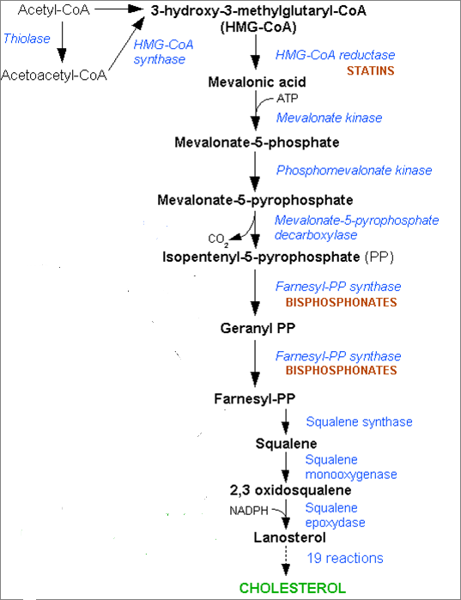
BLOCK STEPS IN CHOLESTROL SYNTHETIC PATHWAY IN OSTEOCLAST
that act as signaling molecules responsible for the osteoclastic hydrolytic & phagocytic activity.
Stop function  apoptosis
Prenylated small GP

Slide 27
BISPHOSPHONATES
Kinetics
Poorly abs (< 10%), food impair absorption more  must be given on
an empty stomach. / infused IV.
t_{1/2} 1 hr.
Half of absorbed drug accumulates in bones, remainder  excreted
unchanged in urine.
In bone it is retained for months, depending on bone turnover.
Indications
Osteoporosis, 2ndry to menopause, glucocorticoids, ….
Paget’s Disease
Malignancy- associated hypercalcaemia
Dosing
Once weekly, or on two consecutive days each month
Taken 1st thing am with glass of water, on empty stomach then nothing taken after for ½ hr.
Should be taken in upright position (to avoid esophagitis).
Separate 4 hrs before giving Ca, Mg, Al containing drugs
Notes:
Note : calcium and vit D supplementation given during bisphosphante theray don’t ingest it along with bisphosphonate…?
Newer preparations can be given as 2 hrs IV infusion (or better over a lesser time), monthly in 1st year then every 3 months after.
Paget's disease) is caused by the excessive breakdown and formation of bone, followed by disorganized bone remodeling. This causes affected bone to weaken, resulting in pain, misshapen bones, fractures and arthritis in the joints near the affected bones.
Often Paget's disease is localized to only a few bones in the body. The pelvis, femur, and lower lumbar vertebrae are the most commonly affected bones. Paget's disease typically is localized, affecting just one or a few bones, as opposed to osteoporosis, for example, which usually affects all the bones in the body.
Paget's disease should have an alkaline phosphatase blood test every two or three years. If the alkaline phosphatase level is above normal, other tests such as a bone-specific alkaline phosphatase test, bone scan, or X-ray can be performed.

Slide 28
BISPHOSPHONATES
ADRs
GIT irritation; nausea, vomiting, gastritis , ulceration  to avoid
give large amount of water to avoid risk of the tablet getting stuck in the esophagus
Gastro-esophageal reflux + ulcerations  to avoid give on empty
stomach while sitting in upright for 30 min
Flue like manifestations upon IV infusion
Osteo-necrosis of the jaw [ mandible > jaw ] more upon long use
with IV infusion preparation usually after dental surgical
procedures.
If a dental implant or extraction is already planned, delay bisphosphonate therapy for a few months until healing of the jaw is complete
Atrial fibrillation > women with alendronate & zolidronate
Contraindications
Decreased renal function and Peptic ulcer / esophageal reflux

Slide 29
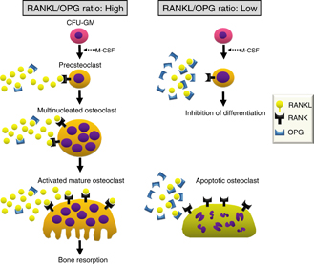
RANKL INHIBITORS
DENOSUMAB
It is a fully human MOA (a human monoclonal antibody) that mimics the activity of osteoprotegrin (OPG).
Mechanism
It binds to RANKL, expressed by osteoblasts 
Block RANKL from interacting with RANK expressed on preosteoclasts   osteoclastogenesis ( no mature osteoclasts).
It binds also to mature osteoclast  its apoptosis
So net effect   bone resorption .
Administration
Subcutaneous every 6 month
Contraindications
In patients with hypocalcemia. Correct Ca & Vit D levels before starting denosumab
Notes:
Normally, the osteoblasts secrete RANKL & OPG in equal amount, then the RANKL bind to OPG. In some case like osteoporosis , the RANKL produce more than OPG, so the extra amount don’t have enough OPG to bind to them , as a result they bind to receptors in the Monocytes , that leading to form more Osteoclast. So when we want to treat osteoporosis, we can make drug that inhibit the RANKL, and that what will see in some mechanism of action of osteoporosis drugs
Denosumab (trade names Prolia and Xgeva) is a human monoclonal antibody^{[1]} for the treatment of osteoporosis,^{[1]} treatment-induced bone loss, metastases to bone,^{[1]} and giant cell tumor of bone.^{[2]}
Denosumab is contraindicated in people with low blood calcium levels.
The most common side effects are joint and muscle pain in the arms or legs.^{[3]}
Denosumab is a RANKL inhibitor,^{[1]} which works by preventing the development of osteoclasts
Denosumab is used for those with osteoporosis at high risk for fractures, bone loss due to certain medications, and in those with bone metastases.
Denosumab is the first RANKL inhibitor to be approved by the FDA.
On 2 June 2010, denosumab was approved for post-menopausal osteoporosis by the US FDA.
MOA:
pre-osteoclasts, express surface receptors called RANK (receptor activator of nuclear factor-kappa B).
RANK is activated by RANKL (the RANK-Ligand),
RANKL which exists as cell surface molecules on osteoblasts.
Precursors to osteoclasts, called pre-osteoclasts, express surface receptors called RANK (receptor activator of nuclear factor-kappa B). RANK is a member of the tumor necrosis factor receptor (TNFR) superfamily. RANK is activated by RANKL (the RANK-Ligand), which exists as cell surface molecules on osteoblasts. Activation of RANK by RANKL promotes the maturation of pre-osteoclasts into osteoclasts. Denosumab inhibits this maturation of osteoclasts by binding to and inhibiting RANKL. This mimics the natural action of osteoprotegerin, an endogenous RANKL inhibitor, that presents with decreasing concentrations (and perhaps decreased avidity) in patients who are suffering from osteoporosis

Slide 30
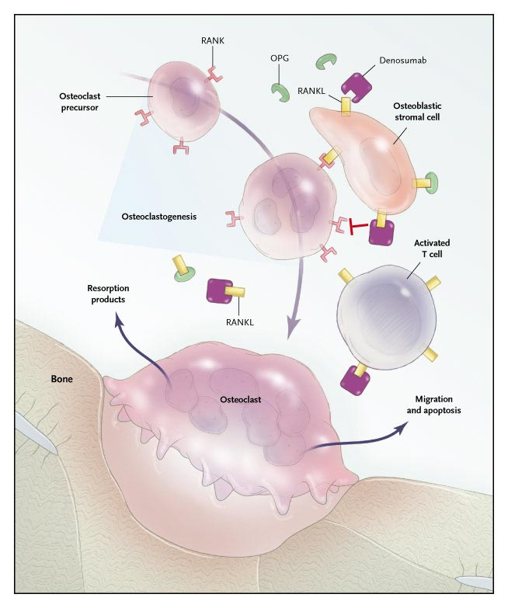
Mechanism
DENOSUMAB
RANKL binds to its receptor RANK on the surface of precursor and mature osteoclasts, and stimulates these cells to mature and resorb bone. OPG, which competes with RANK for binding to RANKL, is the physiological inhibitor of RANKL. Denosumab binds with high affinity to RANKL, mimicking the effect of OPG.
ADRs
Infections;
urinary & respiratory
Eczema & skin rash
Constipation
Cataract
Joint pains

Slide 31
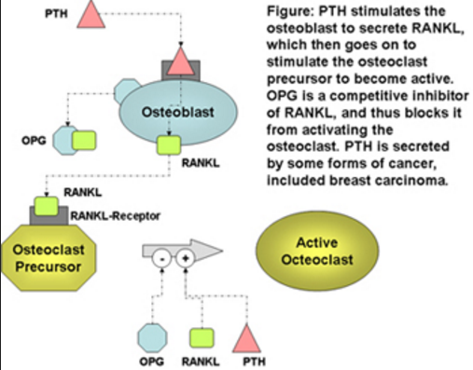
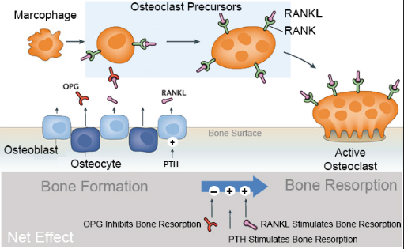
Bone Signaling & RANKL
Notes:
http://www.orthobullets.com/basic-science/9010/bone-signaling-and-rankl
(OBQ13.84) Which of the following is true regarding osteoprotegerin (OPG)? Review Topic
QID:4719
1 It is secreted by osteoclasts
2 It increases bone resorption
3 Binds to prostoglandin E2 before stimulating osteoclasts
4 Osteoprotegerin knock-out mice develop osteopetrosis
5 Binds to and sequesters RANKL
0
1
16
16
9 3
Bone Signaling & RANKL
Author: Daniel Hatch
IntroductionBone metabolism is a dynamic process that balances bone formation and bone resorption
bone resorption
performed by active osteoclast
stimulated by RANKL in normal process
stimulated by PTH in pathologic process (metastatic disease)
bone formation
performed by inhibiting osteoclasts and stimulating osteoblasts
OPG inhibits osteoclasts
Osteoclast Activation Osteoclast activation stimulates bone resorption
Molecules that stimulate bone resorption
RANKL
RANKL (ligand) is secreted by osteoblasts and binds to the RANK receptor on osteoclast precursor and mature osteoclast cells
PTH (secreted by many cancer cells)
activation of its receptor stimulates adenylyl cyclase
binds to cell-surface receptors on osteoblasts to stimulate production of RANKL and M-CSF
interleukin 1 (IL-1)
stimulates osteoclast differentiation and thus bone resorption
1,25 dihydroxy vitamin D
stimulates RANKL expression
prostaglandin E2
activates adenylyl cyclase and stimulates resorption
IL-6 (myeloma)
MIP-1A (myeloma)
Osteoclast InhibitionOsteoclast Inhibition decreases bone resorption
Molecules that inhibit bone resorption
osteoprotegerin (OPG)
decoy receptor produced by osteoblasts and stromal cells that binds to and sequesters RANKL
inhibits osteoclast differentiation, fusion, and activation
calcitonin
interacts directly with the osteoclast via cell-surface receptors
estrogen (via decrease in RANKL)
stimulates bone production (anabolic) and prevents resorption
inhibits activation of adenylyl cyclase
transforming growth factor beta (via increase in OPG)
interleukin 10 (IL-10)
suppresses osteoclasts
Clinical ImplicationsOsteopetrosis
condition caused by a genetic defect resulting in absence of osteoclastic bone resorption
a mouse RANKL knockout model creates a osteopetrosis-like condition
Osteoyltic bone metastasis
found to be mediated by the RANK and RANKL pathway
RANKL is produced directly by the cancer cells
blocking of RANKL by OPG results in decreased skeletal metastasis in animal models
bisphosphonates decrease skeletal events in cancer metastasis
Please rate topic.
Average 4.6 of 41 Ratings
QUESTIONS (8)QUESTIONS
1 of 8
Previous
Next
(OBQ13.84) Which of the following is true regarding osteoprotegerin (OPG)? Review Topic
QID:4719
1It is secreted by osteoclasts
4%
(141/3252)
2It increases bone resorption
3%
(106/3252)
3Binds to prostoglandin E2 before stimulating osteoclasts
4%
(145/3252)
4Osteoprotegerin knock-out mice develop osteopetrosis
7%
(212/3252)
5Binds to and sequesters RANKL
81%
(2620/3252)
PREFERRED RESPONSE 5 Osteoprotegerin is a decoy receptor for RANKL. Binding to RANKL causes decreased production of osteoclasts by inhibiting the differentiation of osteoclast precursors.
Bone resporption/remodeling is a complex process regulated by a large variety of molecules. Molecules that have shown to inhibit osteoclasts include OPG, calcitonin, estrogen, TGF-B, and IL-10. Corticosteroids have been shown to decrease production of OPG, thereby enhancing osteoclast formation and longevity. Prolia, or denosumab, is a newly approved drug used to treat osteoporosis and has a mechanism of action similar to osteoprotegerin (inhibits binding of RANKL to RANK).
Boyle et al. review osteoclast differentiation and activation. The authors state that targeted disruption of OPG causes increased osteoclastogenesis and/or activation resulting in osteopenia.
Illustration A shows how OPG binds to RANKL inhibiting the stimulation of osteoclasts.
Incorrect Answers:
Answer 1: OPG is secreted by osteoblasts.
Answer 2: OPG decreases bone resorption by inactivating RANKL.
Answer 3: OPG does not bind to prostoglandin E2, nor does it stimulate osteoclasts.
Answer 4: RANKL knock-out mice creates an osteopetrosis-like condition.

Slide 32
STRONTIUM
Sr²⁺, is a divalent cation, resembling Ca²⁺ in atomic & ionic properties.
It is orally active as distrontium
Mechanism
1st drug to possess “ dual action “ i.e has both anabolic & antiresor-ptive effects resulting in a rebalance of bone turnover in favor of bone formation.
On Osteoblast;
Since it is like Ca, it acts as agonist on Ca Sensing Receptor [CaSR] ; which is a GP coupled receptor (GPCR) that enhances differentiation of preoteoblast to osteoblast  bone formation
It stimulate the expression of OPG RANKL binding  -ve of osteo-clustogenesis  bone resorption
On Osteoclast;
Acts as agonist on Ca Sensing Receptor [CaSP] suppress differentiation of preoteoclast to osteoclast  osteoclast apoptosis  bone resorption
Notes:
Strontium is a silvery metal found naturally as a non-radioactive element. About 99% of the strontium in the human body is concentrated in the bones.
Several different forms of strontium are used as medicine. Scientists are testing strontium ranelate to see if it can be taken by mouth to treat thinning bones (osteoporosis). Radioactive strontium-89 is given intravenously (by IV) for prostate cancer and advanced bone cancer. Strontium chloride hexahydrate is added to toothpaste to reduce pain in sensitive teeth.
Strontium ranelate or teriparatide are used for refractory disease. The use of strontium ranelate is restricted because of increased risk of venous thromboembolism, pulmonary embolism and serious cardiovascular disorders, including myocardial infarction.^{[8]} In postmenopausal women, the selective estrogen receptor modulator raloxifene is occasionally administered instead of bisphosphonates.

Slide 33
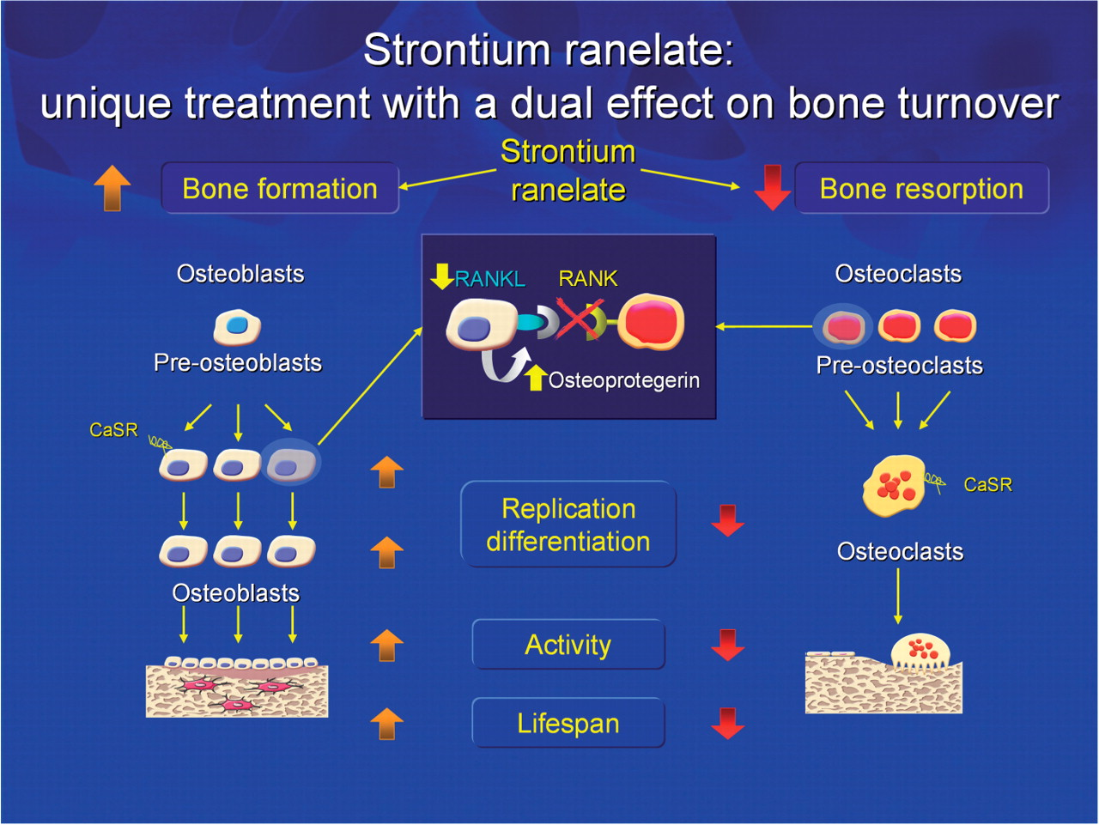

Slide 34
Pharmacokinetics
STRONTIUM
Orally with a modest bioavailability 25%
Binds partially to plasma proteins and strongly to bones
t ½  60 hrs
Excreted mainly by the kidney
Indications
Osteoporosis, 2ndry to menopause, glucocorticoids, ….
Malignancy- associated hypercalcaemia
Contraindications
In severe renal disease.
In hypersensitivity to it
In increased risk of venous thromboembolism
In phenylketonuria
Interactions
Precautions
Food specially containing milk+ its products 
Antacids 
Oral tetracycline & quinolones chelate it
2hrs spacing
ADRs
GIT irritation; nausea, vomiting, headache, eczema
All resolve in 1st 3 months
Notes:
Phenylketonuria (PKU) is an inborn error of metabolism that results in decreased metabolism of the amino acid phenylalanine.^{[2]}Untreated PKU can lead to intellectual disability, seizures, behavioral problems, and mental disorder.

Slide 35



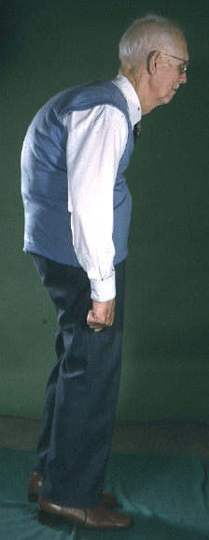
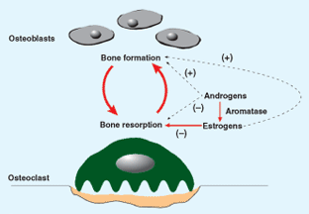
ESTROGENS
If hystrectomy
+ progestins if uterus present
HRT
Menopausal Symptoms
SERMs
Menopause /
Elderly
Estrogen in females & Androgen in males
is essential for normal bone remodeling
ANDROGENS
Elderly men
 osteoclast apoptosis
◉ No. & depth of resorption cavities
 release of growth factors from osteoblasts
◉ release of inflammatory cytokines causing resorption
Adverse effects: HRT (estrogen):
vaginal bleeding,
risk of breast cancer, and venous thromboembolism
Notes:
Hysterectomy "a cutting out of") is the surgical removal of the uterus.
ESTROGENS: use → 1- If hystrectomy
2- With progestins if uterus present (Adding the progestin to prevent the endometrial cancer)
HRT: (Hormone replacement therapy) → Menopausal Symptoms
ANDROGENS →Elderly men
Estrogen in females & Androgen in males is essential for normal bone remodeling .
The reason why osteoporosis risk in women is higher than in men, regardless of menopause and milk consumption, is due to monthly estrogen and PTH fluctuations;
Estrogen levels in women strongly fluctuate monthly.
As estrogen level is at its lowest around menstruation, PTH level is at its highest, increasing deportation of calcium from the bones and uptake of calcium into the bones.
Thus lifetime bone turnover is, on the average, higher in women.

Slide 36



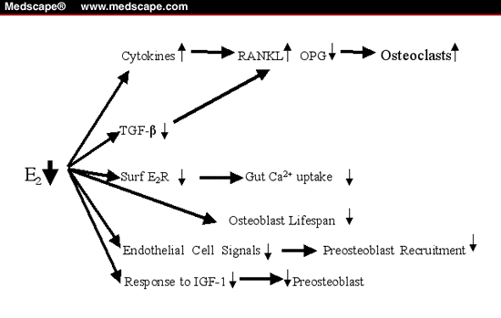

During Hot
Flashes
Post Vasomotor Symptoms
Pre fracture
Post Fracture
ESTROGENS
PTH
Risk
of Fracture
◉ ANDROGENS
Raloxifene
Bisphosphonates
HRT
HRT
Calcitonin
Osteoporosis
AGE
HRT
Raloxifene
Bisphsphonates
PTH
REPLACEMENT THERAPY OR
OTHER THERAPY MODALITIES
?
50 55 60 65 70 75 80 85 90

Slide 37
SERMs
RALOXIFENE
1st selective estrogen Receptor modulator (SERM) for prevention and treatment of osteoporosis
Mechanism
Antiestrogens that exhibits partial agonistic action; acting as an agonist in bone & an antagonist in some female sex organs
 | Brain | Uterus | Vagina | Breast | Bone | CVS
Estradiol | ++ | ++ | ++ | ++ | ++ | ++
Raloxifene | — | — | — | — | + | +
Advantages
   bone density (2%) &  fracture risk (30%)
  No stimulation of breast or endometrial tissue
  No need for progestin in women with uterus
  ◉ LDL
  Good for women with risk of uterine
  and breast cancer.
  Lower risk of thromboembolism comopared to estrogen
Disadvantages
  May  hot flushes
  No effect on HDL
Notes:
Hot flashes (also known as hot flushes) are a form of flushing due to reduced levels of estradiol. Hot flashes are a symptom which may have several other causes, but which is often caused by the changing hormone levels that are characteristic of menopause. They are typically experienced as a feeling of intense heat with sweating and rapid heartbeat, and may typically last from 2 to 30 minutes for each occurrence.

Slide 38
SERMs
RALOXIFENE
1st selective estrogen R modulator for prevention of osteoporosis
Mechanism
Antiestrogens that exhibits partial agonistic action; acting as an agonist in bone & an antagonist in some female sex organs
 | Brain | Uterus | Vagina | Breast | Bone | CVS
Estradiol | ++ | ++ | ++ | ++ | ++ | ++
Raloxifene | — | — | — | — | + | +
Advantages
   bone density (2%) &  fracture risk (30%)
  No stimulation of breast or endometrial tissue
  No need for progestin in women with uterus
  ◉ LDL
Disadvantages
   risk of thromboembolic events
  Doesn’t treat well Post-menopausal Symptoms
  May  hot flushes
  No effect on HDL

Slide 39
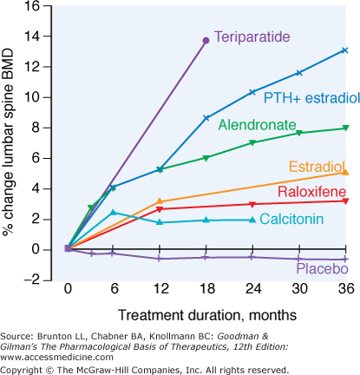
Relative efficacy of different therapeutic interventions on bone mineral density of the lumbar spine

Slide 40
OSTEOPOROSIS
GOOD LUCK

