Slide 1
Endocrinology Physiology of posterior pituitary gland

Slide 2
Structure of pituitary gland
Pituitary gland consists of two lobes
Anterior (Adenohypophysis)
Posterior (Neurohypophysis)

Slide 3
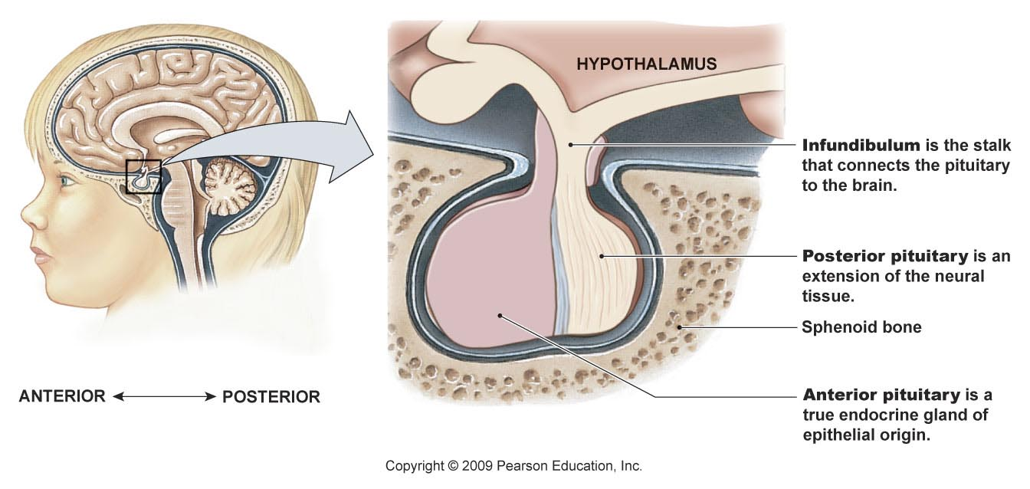
Physiology of posterior Pituitary gland
Posterior pituitary hormones
ADH also known as Vasopressin
Oxytocin
These hormones are synthesized in the neuron cell bodies in the hypothalamus and packed in secretory vesicles with neurophysin (carrier protein)

Slide 4
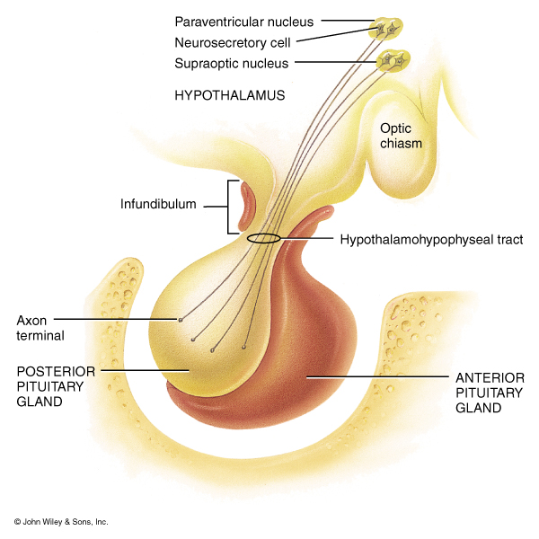
Posterior Pituitary Gland
Posterior pituitary gland
Does not synthesize hormones
Consists of axon terminals of hypothalamic neurons

Slide 5
Hypothalamic-Pituitary Relationships: Posterior Lobe
The posterior lobe is a downgrowth of hypothalamic neural tissue
Has a neural connection with the hypothalamus (hypothalamic-hypophyseal tract)
Nuclei of the hypothalamus synthesize oxytocin and antidiuretic hormone (ADH)
These hormones are transported to the posterior pituitary

Slide 6
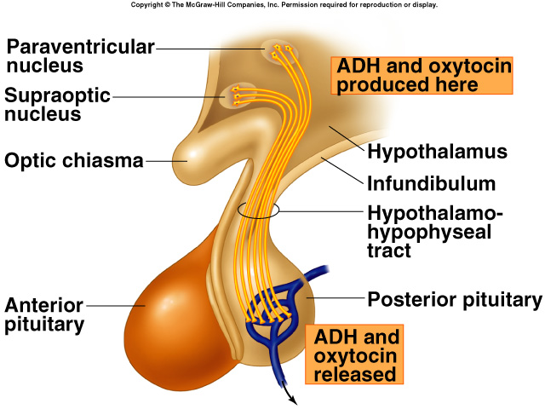
Hypothalamic control of pituitary secretions
Secretions of the posterior pituitary are controlled by
Nervous signals from hypothalamus

Slide 7
Antidiuretic Hormone (ADH)
(vasopressin)

Slide 8
Synthesis of ADH
It is synthesized as pre-prohormone and processed into a nonapeptide
ADH synthesized in the cell bodies of hypothalamic neurons(supraoptic nucleus)
ADH is stored in the posterior pituitary

Slide 9
Receptors of ADH (vasopressin)
ADH Receptors:
V1 receptors mediate vasoconstriction
V2 receptors are located in the principle cells in distal convoluted tubule and collecting ducts in the kidneys

Slide 10
Mechanism of action of ADH: Antidiuresis
ADH binds to V2 receptors on the principle cells of the distal convoluted tubules and collecting ducts.
Via adenylate cyclase/cAMP induces production of specific proteins into the luminal membrane and enhances permeability of cell to water.
Increased membrane permeability to water permits back diffusion of free water, resulting in increased urine osmolality (concentrates urine).

Slide 11
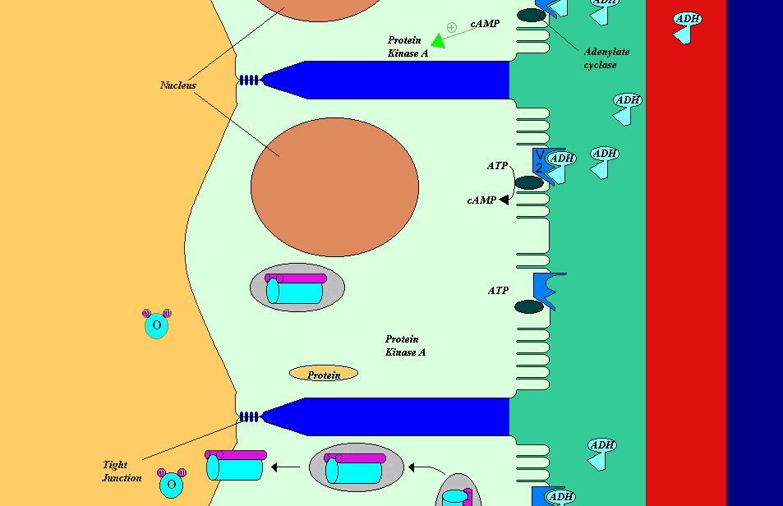
Mechanism of action of ADH

Slide 12
Control of ADH Release
Osmotic pressure:
Osmoreceptors in the hypothalamus
osmotic pressure  ADH secretion
 osmotic pressure   ADH secretion
Blood volume :
Baroreceptor in carotid artery and aortic arch, and Stretch receptors in left atrium
blood pressure   ADH secretion
blood pressure   ADH secretion

Slide 13
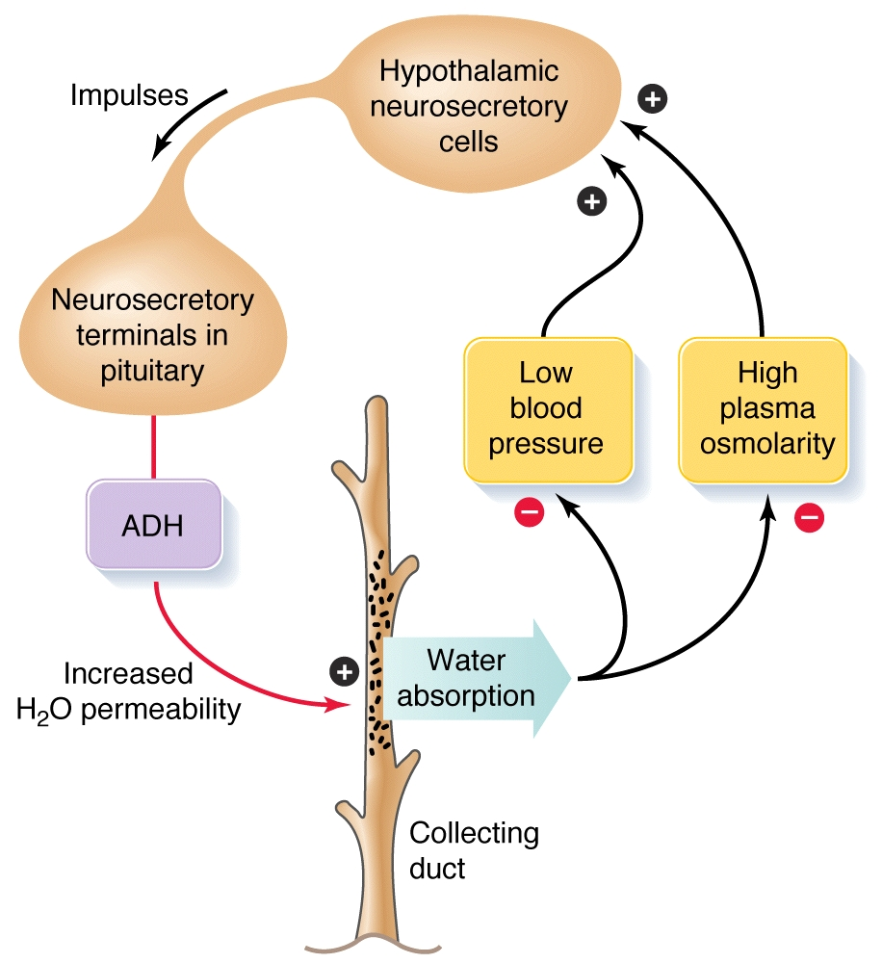
Function of ADH (vasopressin)

Slide 14
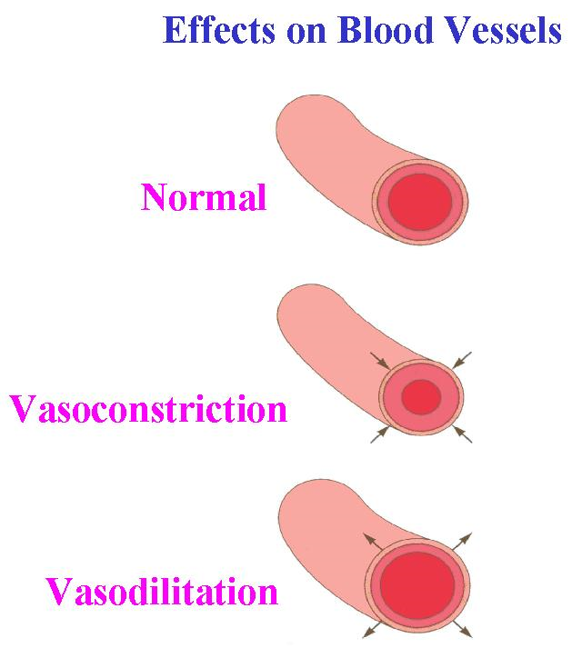
ADH
Increased
Blood
Pressure
V1 receptor

Slide 15
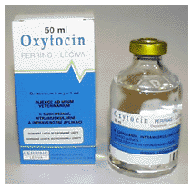
Oxytocin

Slide 16
Synthesis of Oxytocin
Oxytocin is synthesized in the cell bodies of hypothalamic neurons(paraventricular nucleus)
Oxytocin is stored in the posterior pituitary

Slide 17
Functions of oxytocin
Suckling during breast-feeding
Contracts the myoepithelial cells of the alveoli
Childbirth (Parturition)
In late pregnancy, uterine smooth muscle (myometrium) becomes sensitive to oxytocin (positive feedback)

Slide 18
Summary of posterior pituitary hormones actions

Slide 19
The End
Thank You

