Slide 1
Reproduction Block Pathology Practicals
Prof. Ammar Al Rikabi
Dr. Sayed Al Esawy
Dr. Shaesta Zaidi
Dr. Abdullah Basabein
Prepared by:
Head of Pathology Department: Dr. Hisham Al Khalidi

Slide 2
1st Practical Session
MALE
GENITAL SYSTEM
Pathology Dept, KSU
Reproduction block

Slide 3
TESTIS
Normal Anatomy and Histology
Pathology Dept, KSU
Reproduction block

Slide 4
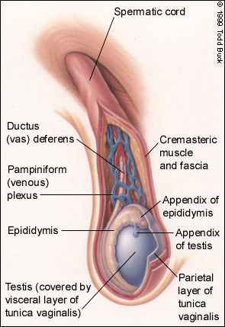
Diagram of Normal Testis
Pathology Dept, KSU
Reproduction block

Slide 5
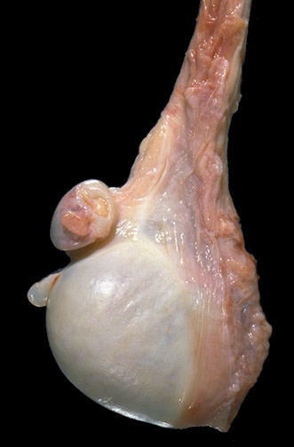
Anatomy of Normal Testis - Gross
Here is a normal testis and adjacent structures. Identify the body of the testis, epididymis, and spermatic cord. Note the presence of two vestigial structures, the appendix testis and the appendix epididymis.
Pathology Dept, KSU
Reproduction block

Slide 6
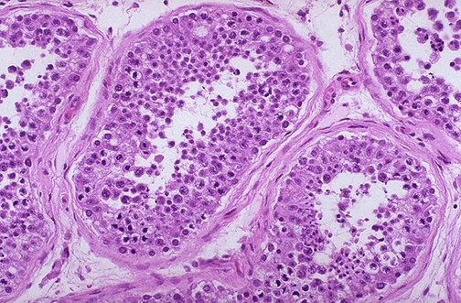
Histology of Normal Testis - LPF
The seminiferous tubules have numerous germ cells. Sertoli cells are inconspicuous. Small dark oblong spermatozoa are seen in the center of the tubules.
Pathology Dept, KSU
Reproduction block

Slide 7
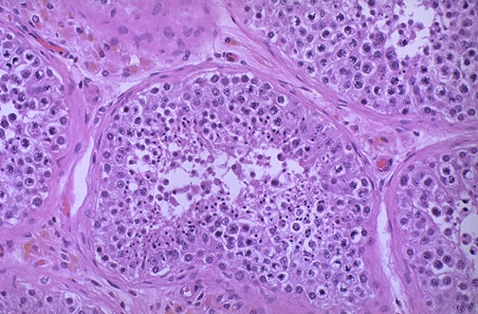
Histology of Normal Testis - LPF
Pink Leyding cells are seen here in the interstitium. Note the pale golden brown pigment as well. There is active spermatogenesis.
Pathology Dept, KSU
Reproduction block

Slide 8
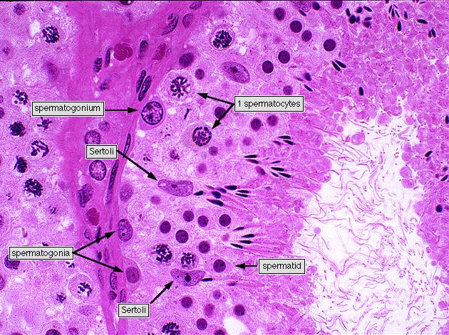
Histology of Normal Testis - HPF
Pathology Dept, KSU
Reproduction block

Slide 9
PROSTATE
Normal Anatomy and Histology
Pathology Dept, KSU
Reproduction block

Slide 10
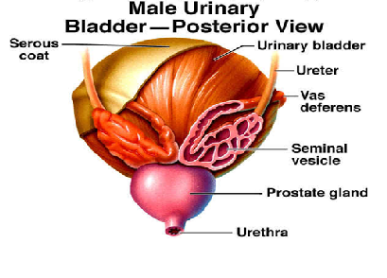
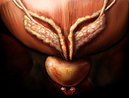
Diagram of Prostate and Seminal Vesicle
Pathology Dept, KSU
Reproduction block

Slide 11
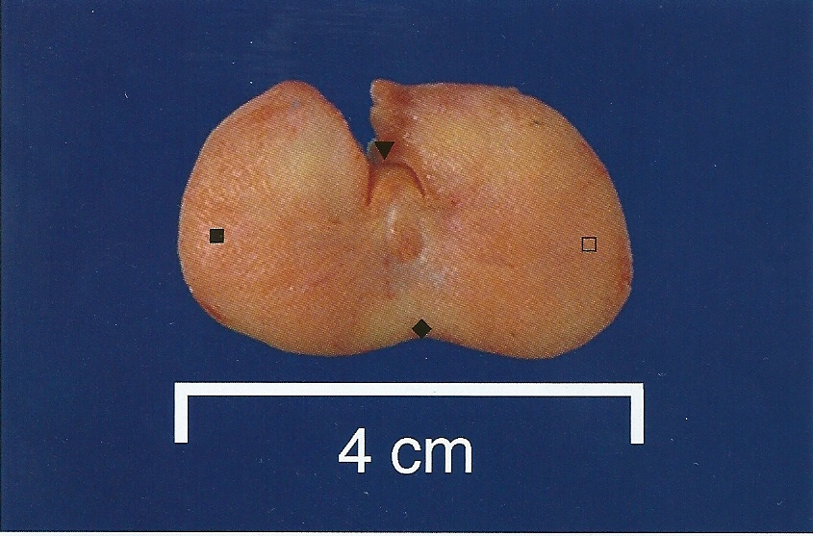
Normal Prostate - Gross
A normal prostate gland is about 3 to 4 cm in diameter.
This is an axial transverse section of a normal prostate. There is a central urethra(▼), at the depth of the cut made to open this prostate anteriorly at autopsy, with the left lateral lobe (), the right lateral lobe () , and the posterior lobe (). Consistency is uniform without nodularity.
Pathology Dept, KSU
Reproduction block

Slide 12
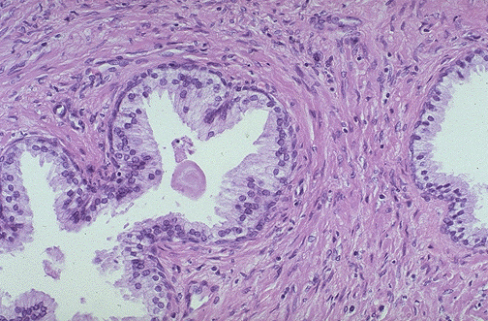
Normal Prostate Histology - LPF
A small pink concretion (typical of the corpora amylacea seen in benign prostatic glands) appears in the gland just to the left of center. Note the well-differentiated glands with tall columnar epithelial lining cells. These cells do not have prominent nucleoli.
Pathology Dept, KSU
Reproduction block

Slide 13
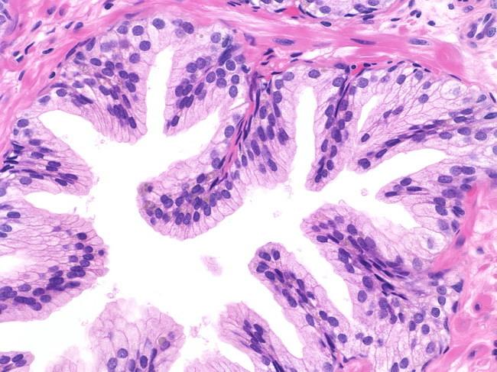
Normal Prostate Histology - HPF
In this benign gland, the luminal contour shows tufts and papillary infoldings. The tall secretory epithelial cells have pale clear cytoplasm and uniform round or oval nuclei. Prominent nucleoli are not seen. Many basal cells can be identified
Pathology Dept, KSU
Reproduction block

Slide 14
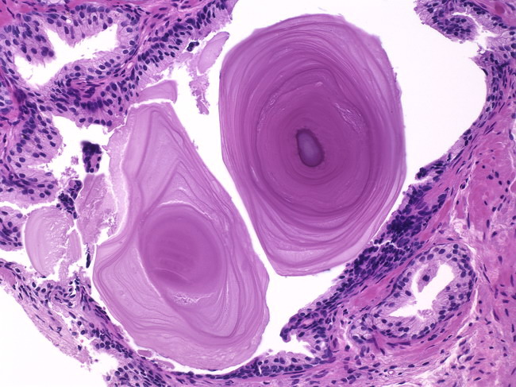
Corpora Amylacea in Prostate - HPF
Corpora amylacea are inspissated secretions that may have a lamellated appearance. Usually they are pink or purple in appearance. Sometimes they may be golden-brown
Pathology Dept, KSU
Reproduction block

Slide 15
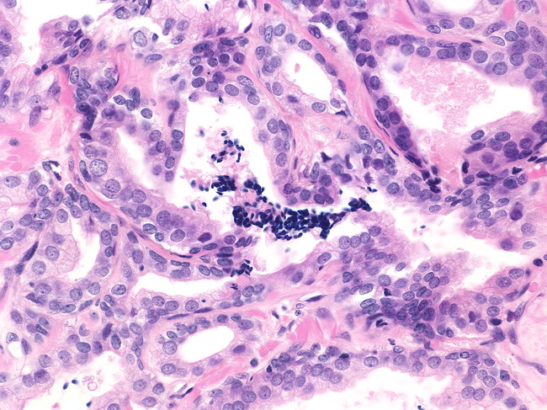
Sperms in Normal Prostate Biopsy – HPF
Spermatozoa are seen in approximately 1% of prostate needle biopsies
Pathology Dept, KSU
Reproduction block

Slide 16
SEMINAL VESICLE
Normal Anatomy and Histology
Pathology Dept, KSU
Reproduction block

Slide 17
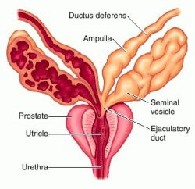
Diagram of Seminal Vesicle
Pathology Dept, KSU
Reproduction block

Slide 18
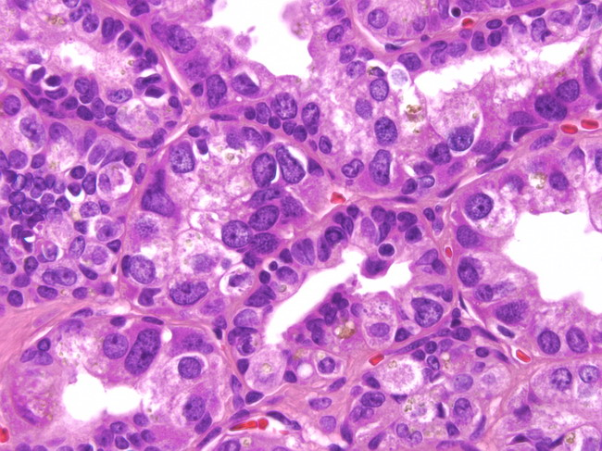
Normal Seminal Vesicle – HPF
Highly atypical cells are a normal finding in the seminal vesicles of about 80% of older men. The nuclei are large, irregular, hyperchromatic & show prominent nucleoli.
The atypia is degenerative and not observed in the
seminal vesicles of young men
Pathology Dept, KSU
Reproduction block

Slide 19
HISTOPATHOLOGY
OF THE TESTIS
Testicular Atrophy
Pathology Dept, KSU
Reproduction block

Slide 20
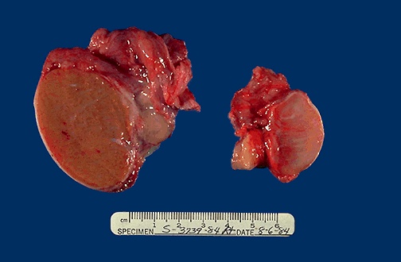
Normal vs Atrophied Testis - Gross
On the left is a normal testis. On the right is a testis that has undergone atrophy. Bilateral atrophy may occur with a variety of conditions including chronic alcoholism, hypopituitarism, atherosclerosis, chemotherapy or radiation, and severe prolonged illness.
Pathology Dept, KSU
Reproduction block

Slide 21
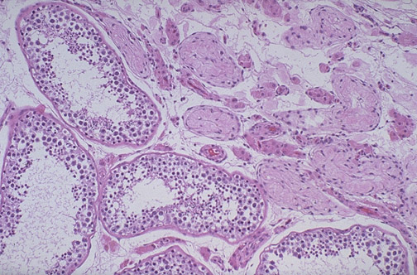
Normal vs Atrophied Testis - Microscopic
Lt
Rt
There is focal atrophy of tubules seen here to the upper right. The most common reason for this is probably childhood infection with the mumps virus, which produces a patchy orchitis
Pathology Dept, KSU
Reproduction block

Slide 22
Seminoma of the Testis
Pathology Dept, KSU
Reproduction block

Slide 23
Seminoma of the Testis - Gross
Normal testis appears to the left of the mass.
Pale and lobulated testicular mass with bulging and potato like cut surface with attached and congested spermatic cord .
Most important risk factor is cryptorchidism (undescended testicle) .
Pathology Dept, KSU
Reproduction block

Slide 24
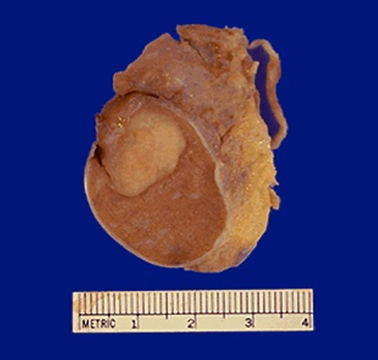
Seminoma of the Testis - Gross
Seminoma: Germ cell neoplasms are the most common types of testicular neoplasm. They are most common in the 15 to 34 age group. They often have several histologic components: seminoma, embryonal carcinoma, teratoma & choriocarcinoma.
Pathology Dept, KSU
Reproduction block

Slide 25
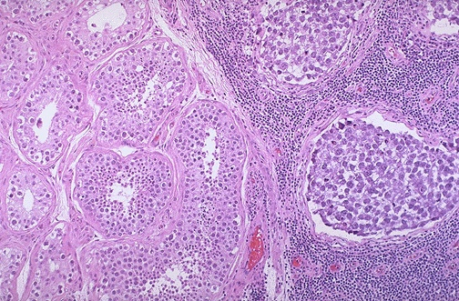
Seminoma vs Normal Testis - LPF
Lt
Rt
Normal testis appears at the left, and seminoma is present at the right. Note the lymphoid stroma between the nests of seminoma.
Pathology Dept, KSU
Reproduction block

Slide 26
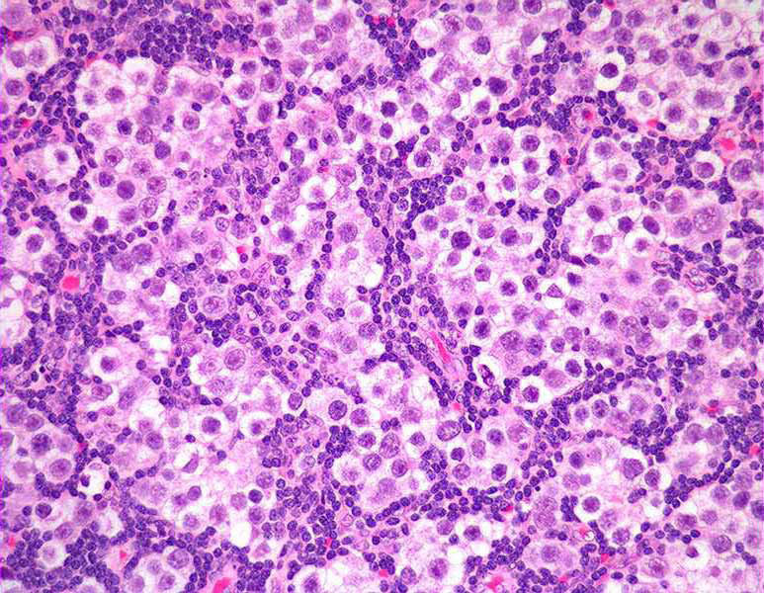
Seminoma of the Testis - HPF
Malignant pale germ cells showing
large vesicular nuclei and prominent nucleoli and
lymphocytes
Pathology Dept, KSU
Reproduction block

Slide 27
Embryonal Carcinoma & Teratoma of the Testis
Pathology Dept, KSU
Reproduction block

Slide 28
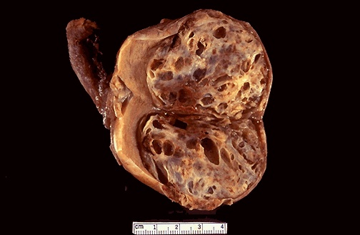
Embryonal Carcinoma & Teratoma - Gross
Here is an embryonal carcinoma mixed with teratoma in which islands of bluish white cartilage from the teratoma component are more prominent. A rim of normal brown testis appears at the left.
Pathology Dept, KSU
Reproduction block

Slide 29
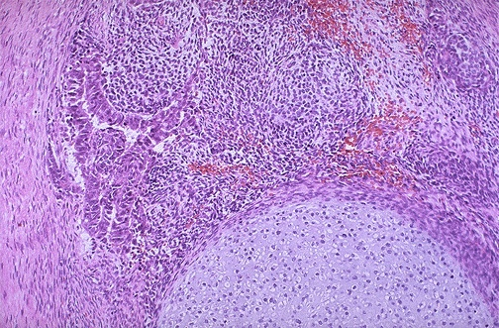
Embryonal Carcinoma & Teratoma - HPF
At the bottom is a focus of cartilage. Above this is a primitive mesenchymal stroma and to the left a focus of primitive cells most characteristic for embryonal carcinoma. This is embryonal carcinoma mixed with teratoma.
Pathology Dept, KSU
Reproduction block

Slide 30
PROSTATE
Pathology Dept, KSU
Reproduction block

Slide 31
Prostatic Hyperplasia
Pathology Dept, KSU
Reproduction block

Slide 32
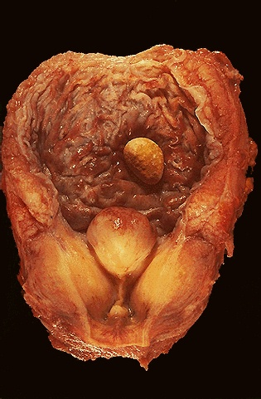
Prostatic Hyperplasia - Gross
Enlarged lateral lobes, and median lobe that obstructs the prostatic urethra that led to obstruction with bladder hypertrophy, as evidenced by the prominent trabeculation of the bladder mucosa. Obstruction with stasis also led to the formation of the yellow-brown calculus (stone).
Pathology Dept, KSU
Reproduction block

Slide 33
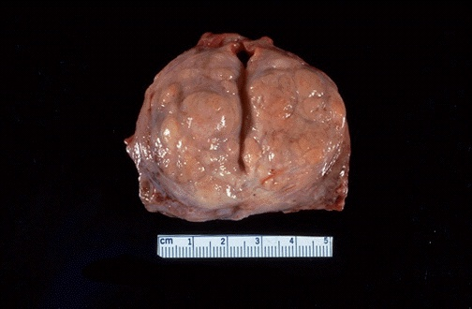
Prostatic Hyperplasia - Gross
Central part and lateral peri-urethral lobes of prostate are commonly affected
a- Nodules formation.
b- Narrowing of prostatic urethra.
Such an enlarged prostate can obstruct urinary outflow from the bladder and lead to an obstructive uropathy
So the patient complains of Frequency, difficulties of micturition, hesitancy, poor urinary stream and nocturia

Slide 34
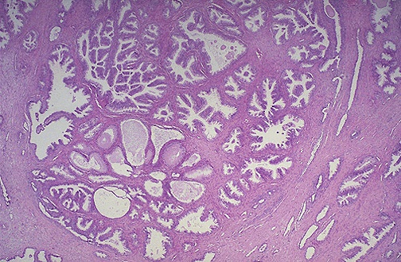
Prostatic Hyperplasia - LPF
Microscopically, benign prostatic hyperplasia can involve both glands and stroma, though the former is usually more prominent. Here, a large hyperplastic nodule of glands is seen
Pathology Dept, KSU
Reproduction block

Slide 35
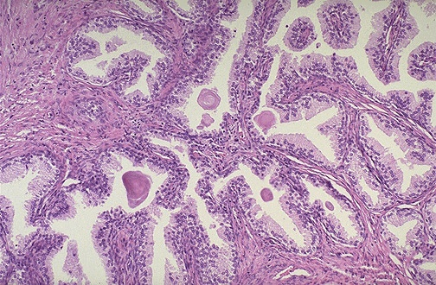
Prostatic Hyperplasia - HPF
The enlarged prostate with:
Glandular hyperplasia.
Stromal or muscular intervening stroma.
Corpora amylacea.
Pathology Dept, KSU
Reproduction block

Slide 36
Adenocarcinoma of Prostate
Pathology Dept, KSU
Reproduction block

Slide 37
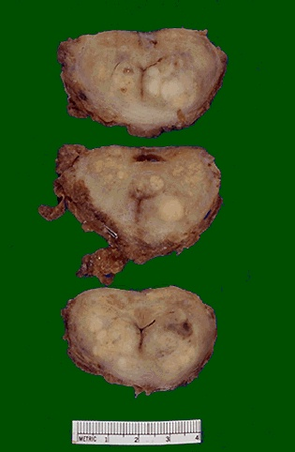
Adenocarcinoma of the Prostate - Gross
These sections through a prostate removed via radical prostatectomy reveal irregular yellowish nodules, mostly in the posterior portion (seen here superiorly). This proved to be prostatic adenocarcinoma
Pathology Dept, KSU
Reproduction block

Slide 38
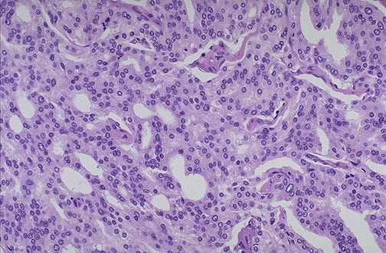
Adenocarcinoma of the Prostate - MPF
At high magnification, the neoplastic glands of prostatic adenocarcinoma are still recognizable as glands, but there is no intervening stroma and the nuclei are hyperchromatic.
Pathology Dept, KSU
Reproduction block

Slide 39
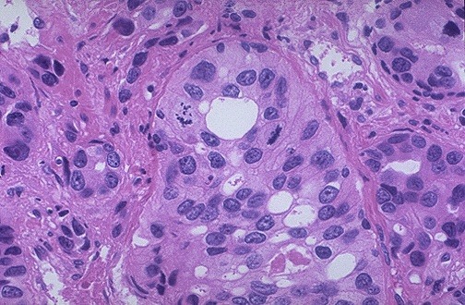
Adenocarcinoma of the Prostate - HPF
At high magnification, this poorly differentiated prostatic adenocarcinoma demonstrates cells with nucleoli and mitotic figures.
Pathology Dept, KSU
Reproduction block

Slide 40
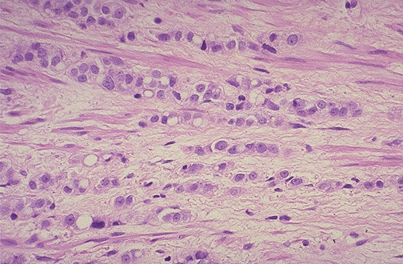
Adenocarcinoma of the Prostate - HPF
This adenocarcinoma of prostate is so poorly differentiated that no glandular structure is recognizable, only cells infiltrating in rows.
Pathology Dept, KSU
Reproduction block

Slide 41
2nd Practical Session
FEMALE
GENITAL SYSTEM
Pathology Dept, KSU
Reproduction block

Slide 42
Normal Anatomy
and Histology
Pathology Dept, KSU
Reproduction block

Slide 43
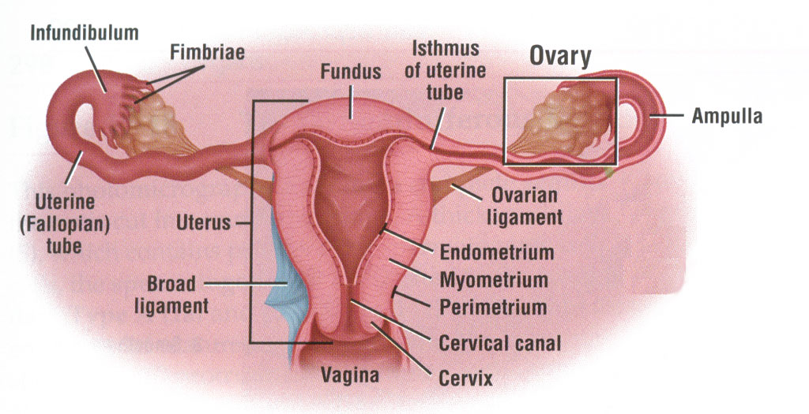
Female Reproductive System - Diagram
Pathology Dept, KSU
Reproduction block

Slide 44
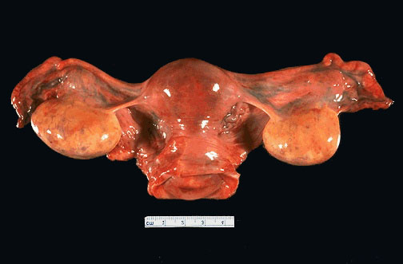
Female Reproductive System - Gross
Uterus with Cervix, Ovaries and Fallopian Tubes
Pathology Dept, KSU
Reproduction block

Slide 45
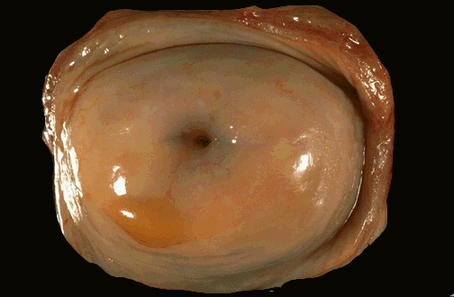
Normal Uterine Cervix - Gross
Normal cervix with a smooth, glistening mucosal surface. There is a small rim of vaginal cuff from this hysterectomy specimen. The cervical os is small and round, typical for a nulliparous woman. The os will have a fish-mouth shape after one or more pregnancies
Pathology Dept, KSU
Reproduction block

Slide 46
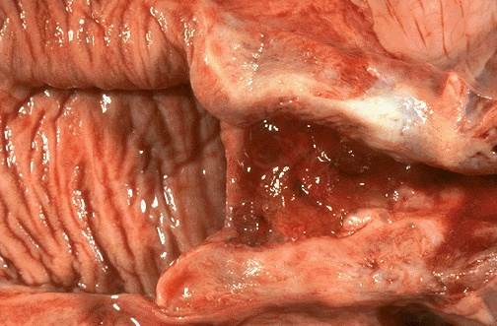
Normal Vagina & Cervix - Gross Cut section
The normal adult vaginal mucosa with a wrinkled appearance that is seen in women of reproductive years appears at the left. The cervix has been opened to reveal an endocervical canal leading to the lower uterine segment at the right that has an erythematous appearance extending to the cervical os consistent with chronic inflammation.
Pathology Dept, KSU
Reproduction block

Slide 47
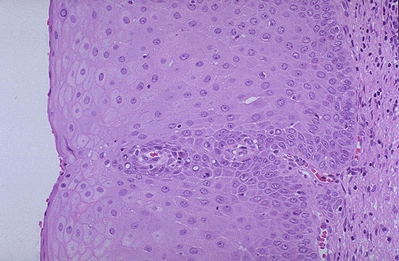
Normal Cervical Mucosa - HPF
This is normal cervical non-keratinizing squamous epithelium. The squamous cells show maturation from the basal layer to the surface
Pathology Dept, KSU
Reproduction block

Slide 48
UTERUS
GROSS and HISTOPATHOLOGY
Pathology Dept, KSU
Reproduction block

Slide 49
ENDOMETRIUM
Pathology Dept, KSU
Reproduction block

Slide 50
Uterine Leiomyomata
Pathology Dept, KSU
Reproduction block

Slide 51
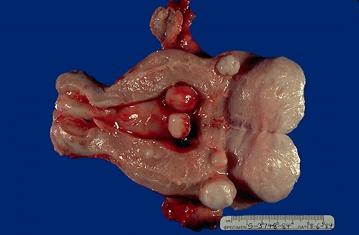
Multiple Uterine Leiomyomata - Gross
Smooth muscle tumors of the uterus are often multiple.
Seen here are submucosal, intramural, and subserosal leiomyomata
of the uterus.
Pathology Dept, KSU
Reproduction block

Slide 52
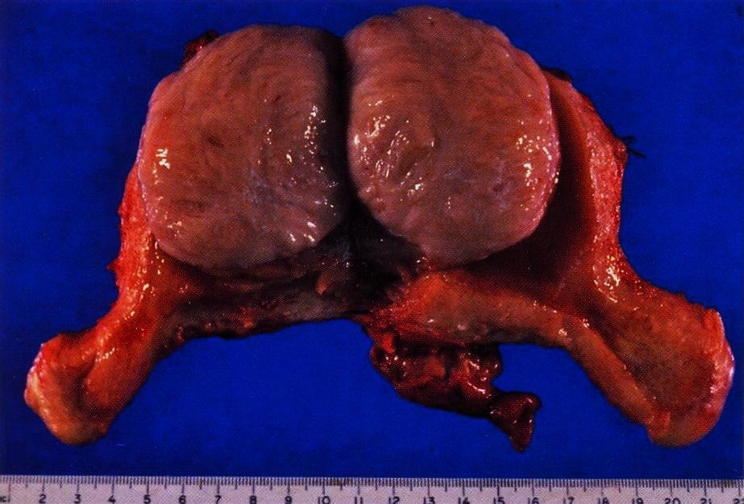
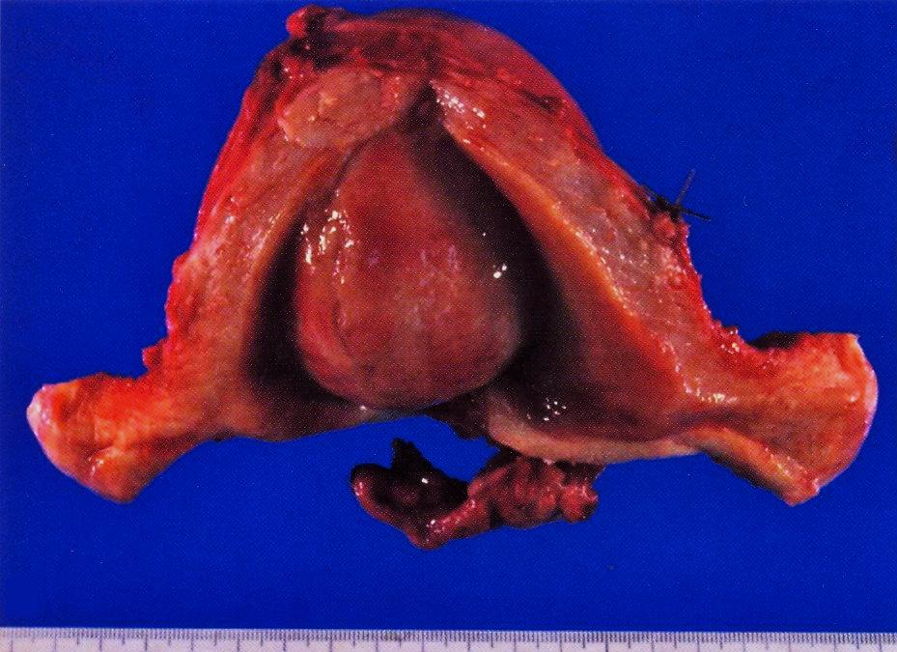
Multiple Uterine Leiomyomata - Gross
A well demarcated tumour mass in the muscle coat of
uterus without a definite capsule.
Pathology Dept, KSU
Reproduction block

Slide 53
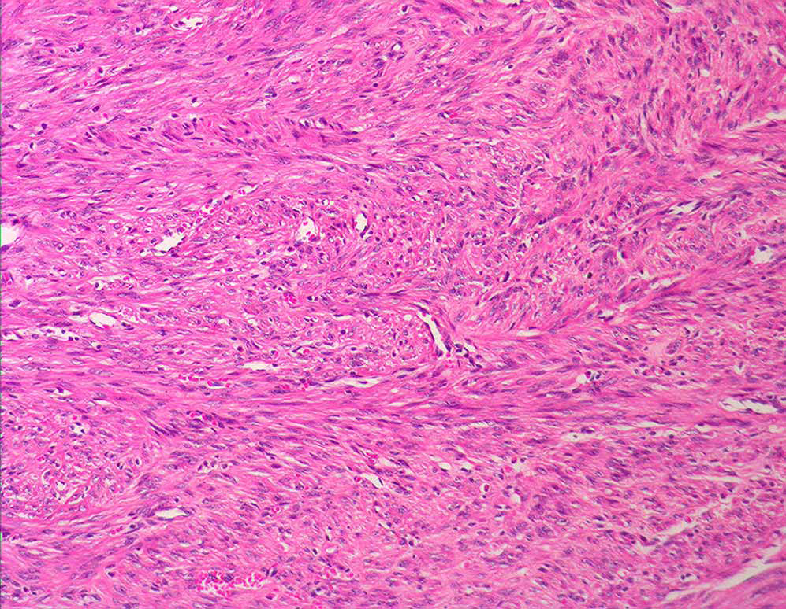
Uterine Leiomyoma – LPF
Tumour consists of interlacing bundles of smooth muscle and fibrous tissue.
The muscle cells are spindle shaped with elongated nuclei and eosinophilic cytoplasm.
Pathology Dept, KSU
Reproduction block

Slide 54
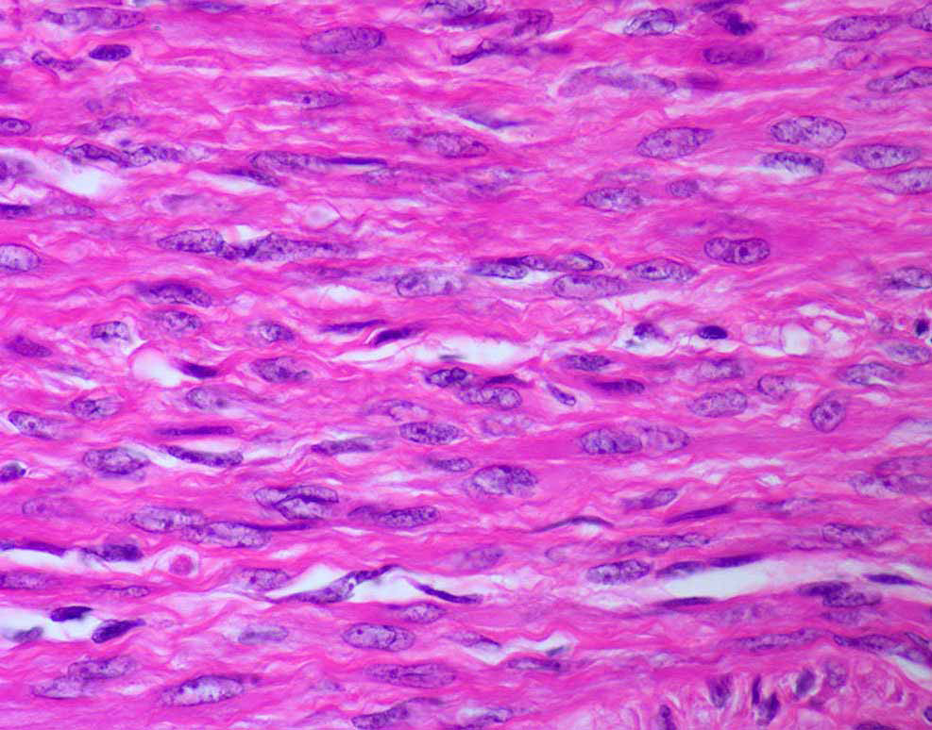
Uterine Leiomyoma – HPF
The muscle cells are spindle shaped with elongated
nuclei and eosinophilic cytoplasm
Pathology Dept, KSU
Reproduction block

Slide 55
Endometrial Hyperplasia & Carcinoma
Pathology Dept, KSU
Reproduction block

Slide 56
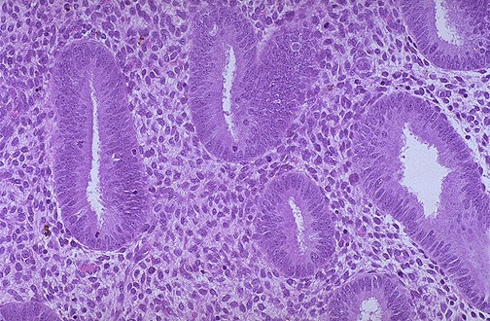
Normal Proliferative Endometrium
Normal proliferative endometrium in the menstrual cycle. The proliferative phase is the variable part of the cycle. In this phase, tubular glands with columnar cells and surrounding dense stroma are proliferating to build up the endometrium following shedding with previous menstruation.
Pathology Dept, KSU
Reproduction block

Slide 57
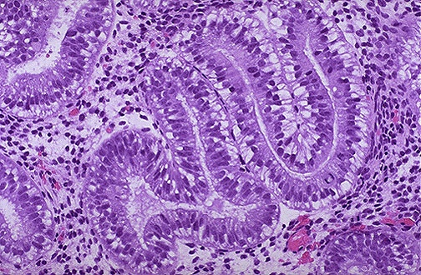
Early Secretory Endometrium
The appearance with prominent subnuclear vacuoles in cells forming the glands is consistent with post-ovulatory day 2 of luteal phase. The histologic changes following ovulation are quite constant over the 14 days to menstruation and can be utilized to date the endometrium.
Pathology Dept, KSU
Reproduction block

Slide 58
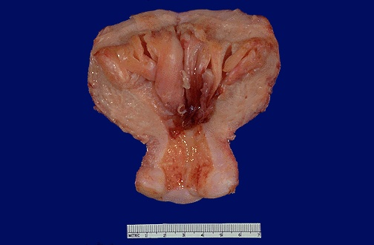
Endometrial Hyperplasia - Gross
The endometrial cavity is opened to reveal lush fronds of hyperplastic endometrium. Endometrial hyperplasia usually results with conditions of prolonged estrogen excess and can lead to metrorrhagia (uterine bleeding at irregular intervals), menorrhagia (excessive bleeding with menstrual periods), or menometrorrhagia.
Pathology Dept, KSU
Reproduction block

Slide 59
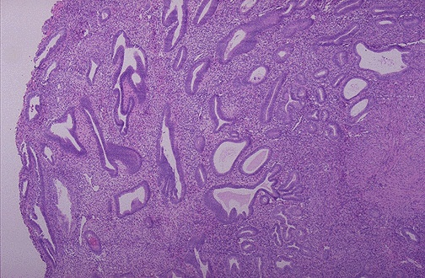
Endometrial Hyperplasia - LPF
This is endometrial cystic hyperplasia in which the amount of endometrium is abnormally increased and not cycling as it should. The glands are enlarged and irregular with columnar cells that have some atypia. Simple endometrial hyperplasias can cause bleeding, but are not thought to be premalignant.
Pathology Dept, KSU
Reproduction block

Slide 60
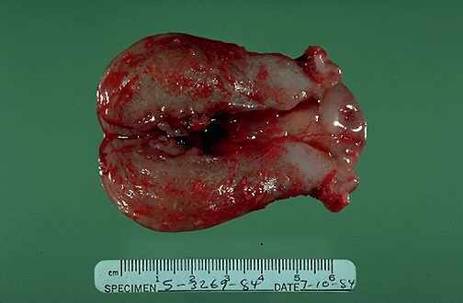
Endometrial Adenocarcinoma - Gross
Predisposing factors
Obesity
Diabetes.
Unopposed estrogenic stimulation.
Hypertension.
Infertility.
Haemorrhagic mass at the uterine fundus.
Gene mutation responsible for endometrial adenocarcinoma :
PTEN.
TP53.
Pathology Dept, KSU
Reproduction block

Slide 61
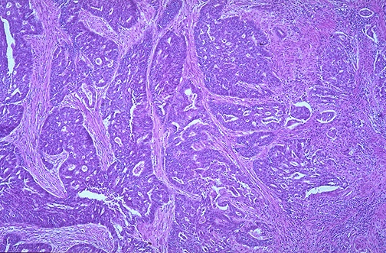
Endometrial Adenocarcinoma - LPF
Endometrial Adenocarcinoma with abnormal malignant glands invading into the smooth muscle bundles of the myometrial wall of the uterus.
This neoplasm has a higher stage than a neoplasm that is just confined to the endometrium
Pathology Dept, KSU
Reproduction block

Slide 62
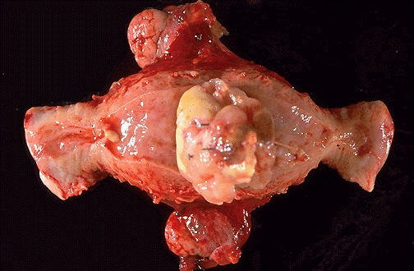
Endometrial Leiomyosarcoma - Gross
This is a leiomyosarcoma protruding from myometrium into the endometrial cavity of this uterus that has been opened laterally so that the halves of the cervix appear at right and left. Fallopian tubes and ovaries project from top and bottom.
Pathology Dept, KSU
Reproduction block

Slide 63
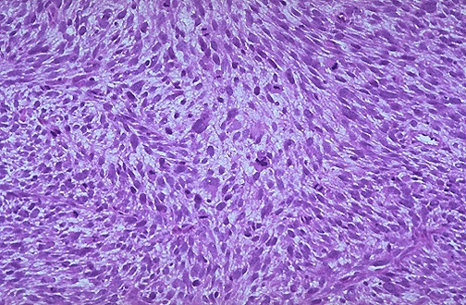
Endometrial Leiomyosarcoma - LPF
Here is the microscopic appearance of
a leiomyosarcoma. It is much more cellular and the cells have much more pleomorphism and hyperchromatism than the benign leiomyoma.
An irregular mitosis is seen in the center
Pathology Dept, KSU
Reproduction block

Slide 64
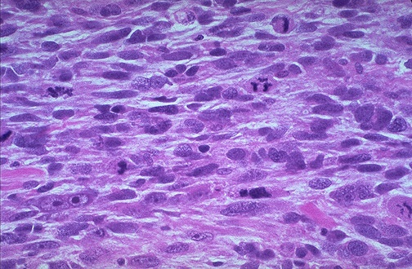
Endometrial Leiomyosarcoma - HPF
As with sarcomas in general, leiomyosarcomas have spindle cells. Several mitoses are seen here, just in this one high power field.
Pathology Dept, KSU
Reproduction block

Slide 65
ENDOMETRIOSIS
Pathology Dept, KSU
Reproduction block

Slide 66
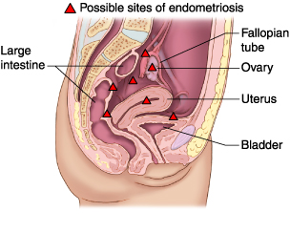
Endometriosis sites - Diagram
Endometriosis, a chronic noncancerous disorder of the female reproductive system, develops when the endometrium grows outside the uterus.
Common sites for endometriosis include ovaries, fallopian tubes, external genitalia (vulva), ligaments supporting the uterus, intestine, bladder, cervix, and vagina.
Pathology Dept, KSU
Reproduction block

Slide 67
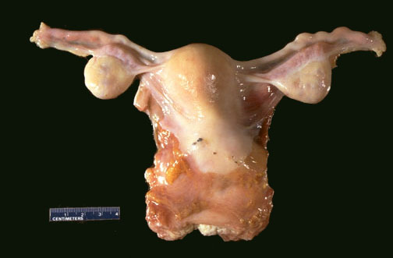
Endometriosis - Gross
Grossly, in areas of endometriosis the blood is darker and gives the small foci of endometriosis the gross appearance of "powder burns". Small foci are seen here just under the serosa of the posterior uterus in the pouch of Douglas.
Pathology Dept, KSU
Reproduction block

Slide 68
Endometriosis - Gross
Upon closer view, these five small areas of endometriosis have a reddish-brown to bluish appearance. Typical locations for endometriosis may include: ovaries, uterine ligaments, rectovaginal septum, pelvic peritoneum, and laparotomy scars
Pathology Dept, KSU
Reproduction block

Slide 69
Endometriosis - HPF Microscopy
Endometrial glands along with stroma are seen at high magnification in the smooth muscle wall of the colon. Endometriosis is symptomatic during reproductive years when patients may present with dysmenorrhea, pelvic pain, and infertility
Pathology Dept, KSU
Reproduction block

Slide 70
UTERINE CERVIX
Pathology Dept, KSU
Reproduction block

Slide 71
Cervical Dysplasia & Cervical Carcinoma
Pathology Dept, KSU
Reproduction block

Slide 72
Normal and Dysplastic Cervical Squamous Epithelium
Dysplasia
Normal
The normal cervical squamous epithelium at the left transforms to dysplastic changes on the right with underlying chronic inflammation
Pathology Dept, KSU
Reproduction block

Slide 73
Endocervical Squamous Dysplasia
Lt
Rt
Cervical squamous dysplasia is seen at medium magnification, extending from the center to the right. The epithelium is normal at the left.
Note how the dysplastic cell nuclei at the right are larger and darker, and the dysplastic cells have a disorderly arrangement
Pathology Dept, KSU
Reproduction block

Slide 74
Cervical Squamous Cell Carcinoma
This is the gross appearance of a cervical squamous cell carcinoma that is still limited to the cervix (stage I).
The tumor is a fungating red to tan to yellow mass.
Pathology Dept, KSU
Reproduction block

Slide 75
Cervical Squamous Cell Carcinoma - HPF
*
At high magnification, nests of neoplastic squamous cells are invaded through a chronically inflamed stroma. This cancer is well- differentiated, as evidenced by keratin pearls (*) within nests of tumor cells. However, most cervical squamous carcinomas are non-keratinizing.
Pathology Dept, KSU
Reproduction block

Slide 76
FALLOPIAN TUBES
Pathology Dept, KSU
Reproduction block

Slide 77
Normal vs Inflamed Fallopian Tube
Pathology Dept, KSU
Reproduction block

Slide 78
Acute Salpingitis - Gross
Complications of salpingitis:
Infertility.
Ectopic pregnancy.
Tubo-ovarian abscesses.
Congested and swollen fallopian tube.
Haemorrhagic and yellowish patches on the serosal surface of the fallopian tube.

Slide 79
Acute Salpingitis - Microscopic
Organisms responsible
Gonococci.
Sreptococci.
Staphylococcus aureus.
Chlamydia and mycoplasma hominis.
Mycobacterium tuberculosis.
a- Oedematous and swollen fallopian tube mucosa.
b- Infiltration by numerous neutrophils.
Pathology Dept, KSU
Reproduction block

