Slide 1
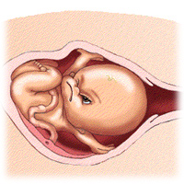
Onset and physiology of labor
Dr. Hana Alzamil

Slide 2
Objectives:
Definition of labor.
Factors that trigger the onset of labor.
Hormonal changes that precedes and accompany labor
Phases of uterine activity
Clinical stages of labor.

Slide 3
Parturition
Definition
  Uterine contractions that lead to expulsion of the fetus to extrauterine environment
  Towards the end of pregnancy the uterus become progressively more excitable and develops strong rhythmic contractions that lead to expulsion of the fetus.

Slide 4
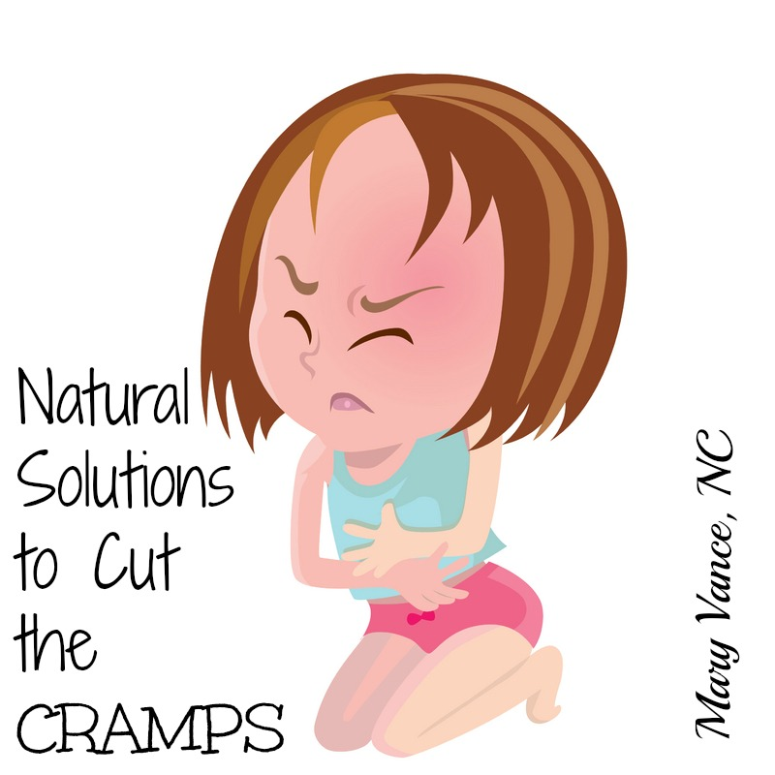
Small group activity
Does non pregnant uterus contract?

Slide 5
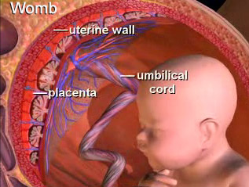
Parturition
Uterus is spontaneously active.
Spontaneous depolarization of pacemaker cells.
Gap junctions spread depolarization
Exact trigger is unknown
  Hormonal changes
  Mechanical changes

Slide 6
Pacemaker cells (Telocytes)

Slide 7
Fig. 17. Human myometrium cells in culture (the 2nd passage): c-kit (green in A, B), c-kit and CD34 (red and green, respectively, in C) and vimentin (green in D, E). Cells which display the morphologic TC feature (long, moniliform processes) express c-kit and contact adjacent cells (A–C). Some cells suggestive of TCs co-express c-kit and CD34 (C). The characteristic cell processes are immunoreactive for vimentin and establish connections with nearby cells (D and E). Original magnification 60x, nuclear counterstaining with Hoechst 33342 (blue). Reproduced, with permission, from Ciontea et al., 2005.

Slide 8
Hormonal changes
Estrogen & Progesterone
  Progesterone inhibit uterine contractility
  Estrogen stimulate uterine contractility
From 7th month till term
  Progesterone secretion remain constant
  Estrogen secretion continuously increase
  Increase estrogen/progesterone ratio

Slide 9
Hormonal changes
Progesteron
  ▼ GAP junctions
  ▼ Oxytocin receptor
  ▼prostaglandins.
  ▲ resting mem. Potential
Estrogen
  ▲ GAP junctions with onset of labour.
  ▲ Oxytocin receptors.
  ▲ Prostaglandins
E
P

Slide 10
Hormonal changes
Oxytocin
  Dramatic ▲of oxytocin receptors (200 folds)
    gradual transition from passive relaxed to active excitatory muscle (↑responsiveness).
  Increase in Oxytocin secretion at labor
  Oxytocin increase uterine contractions by
    Directly on its receptors
    Indirectly by stimulating prostaglandin production

Slide 11
Hormonal changes
Prostaglandins
  Central role in initiation & progression of human labour
  Locally produced (intrauterine)
  Oxytocin and cytokines stimulate its production
  Prostaglandin stimulate uterine contractions by:
    Direct effect:
      Through their own receptors
      Upregulation of myometrial gap junctions
    Indirect effect:
      Upregulation of oxytocin receptors

Slide 12
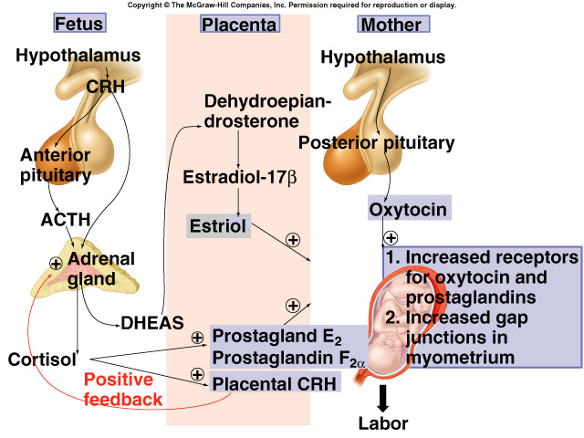
Parturition

Slide 13
Mechanical changes
Stretch of the uterine muscle
  Increases contractility
    Fetal movements
    Multiple pregnancy
Stretch of the cervix
  Increases contractility (reflex)
    Membrane sweeping & rupture
    Fetal head
      Positive feedback mechanism

Slide 14
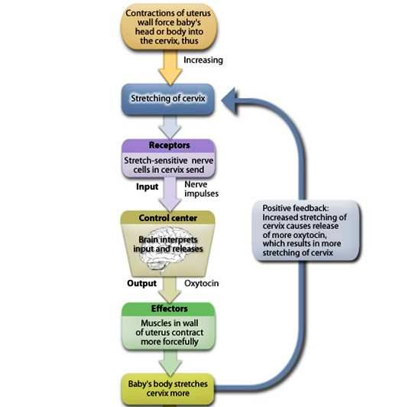
Positive feedback mechanism

Slide 15
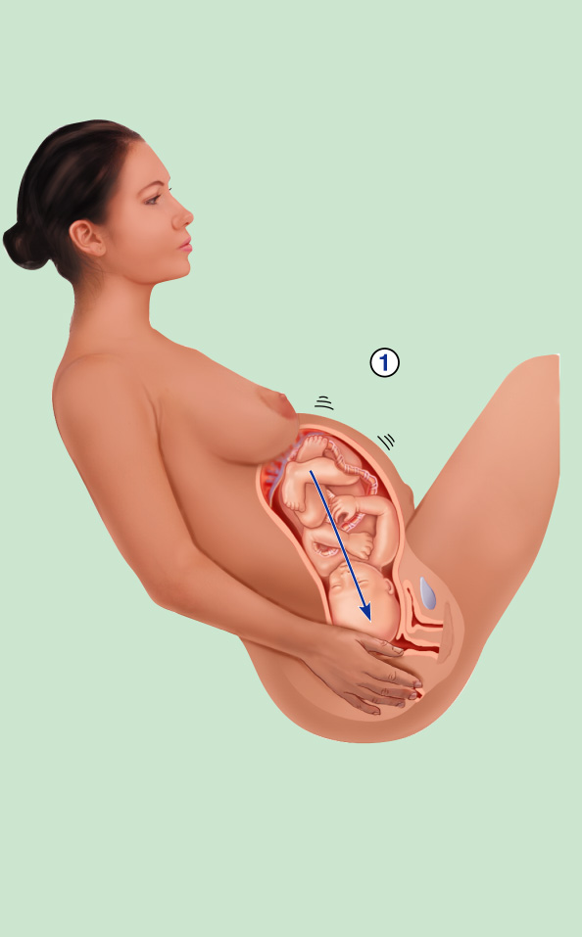
Initiation of Labor
Baby moves
deeper into
mother’s birth
canal
Figure 16.19, step 1

Slide 16

Initiation of Labor
Baby moves
deeper into
mother’s birth
canal
Pressoreceptors
in cervix of
uterus excited
Figure 16.19, step 2

Slide 17

Initiation of Labor
Baby moves
deeper into
mother’s birth
canal
Afferent
impulses to
hypothalamus
Pressoreceptors
in cervix of
uterus excited
Figure 16.19, step 3

Slide 18

Initiation of Labor
Hypothalamus sends efferent
impulses to posterior pituitary,
where oxytocin is stored
Baby moves
deeper into
mother’s birth
canal
Afferent
impulses to
hypothalamus
Pressoreceptors
in cervix of
uterus excited
Figure 16.19, step 4

Slide 19

Initiation of Labor
Hypothalamus sends efferent
impulses to posterior pituitary,
where oxytocin is stored
Posterior pituitary releases
oxytocin to blood; oxytocin
targets mother’s uterine
muscle
Baby moves
deeper into
mother’s birth
canal
Afferent
impulses to
hypothalamus
Pressoreceptors
in cervix of
uterus excited
Figure 16.19, step 5

Slide 20
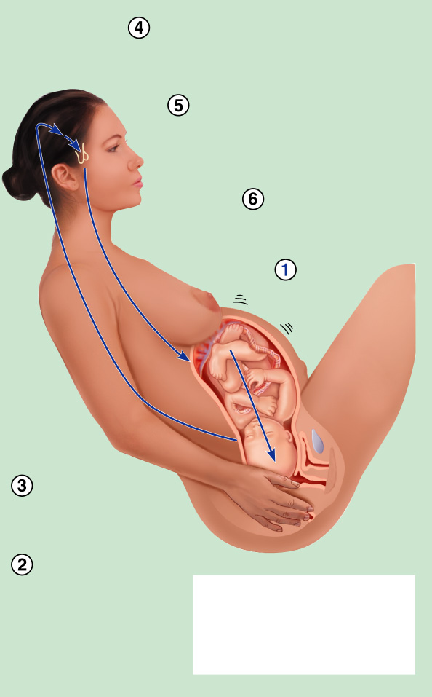
Initiation of Labor
Hypothalamus sends efferent
impulses to posterior pituitary,
where oxytocin is stored
Posterior pituitary releases
oxytocin to blood; oxytocin
targets mother’s uterine
muscle
Uterus responds
by contracting
more vigorously
Baby moves
deeper into
mother’s birth
canal
Afferent
impulses to
hypothalamus
Pressoreceptors
in cervix of
uterus excited
Positive feedback
mechanism continues
to cycle until interrupted
by birth of baby
Figure 16.19, step 6

Slide 21
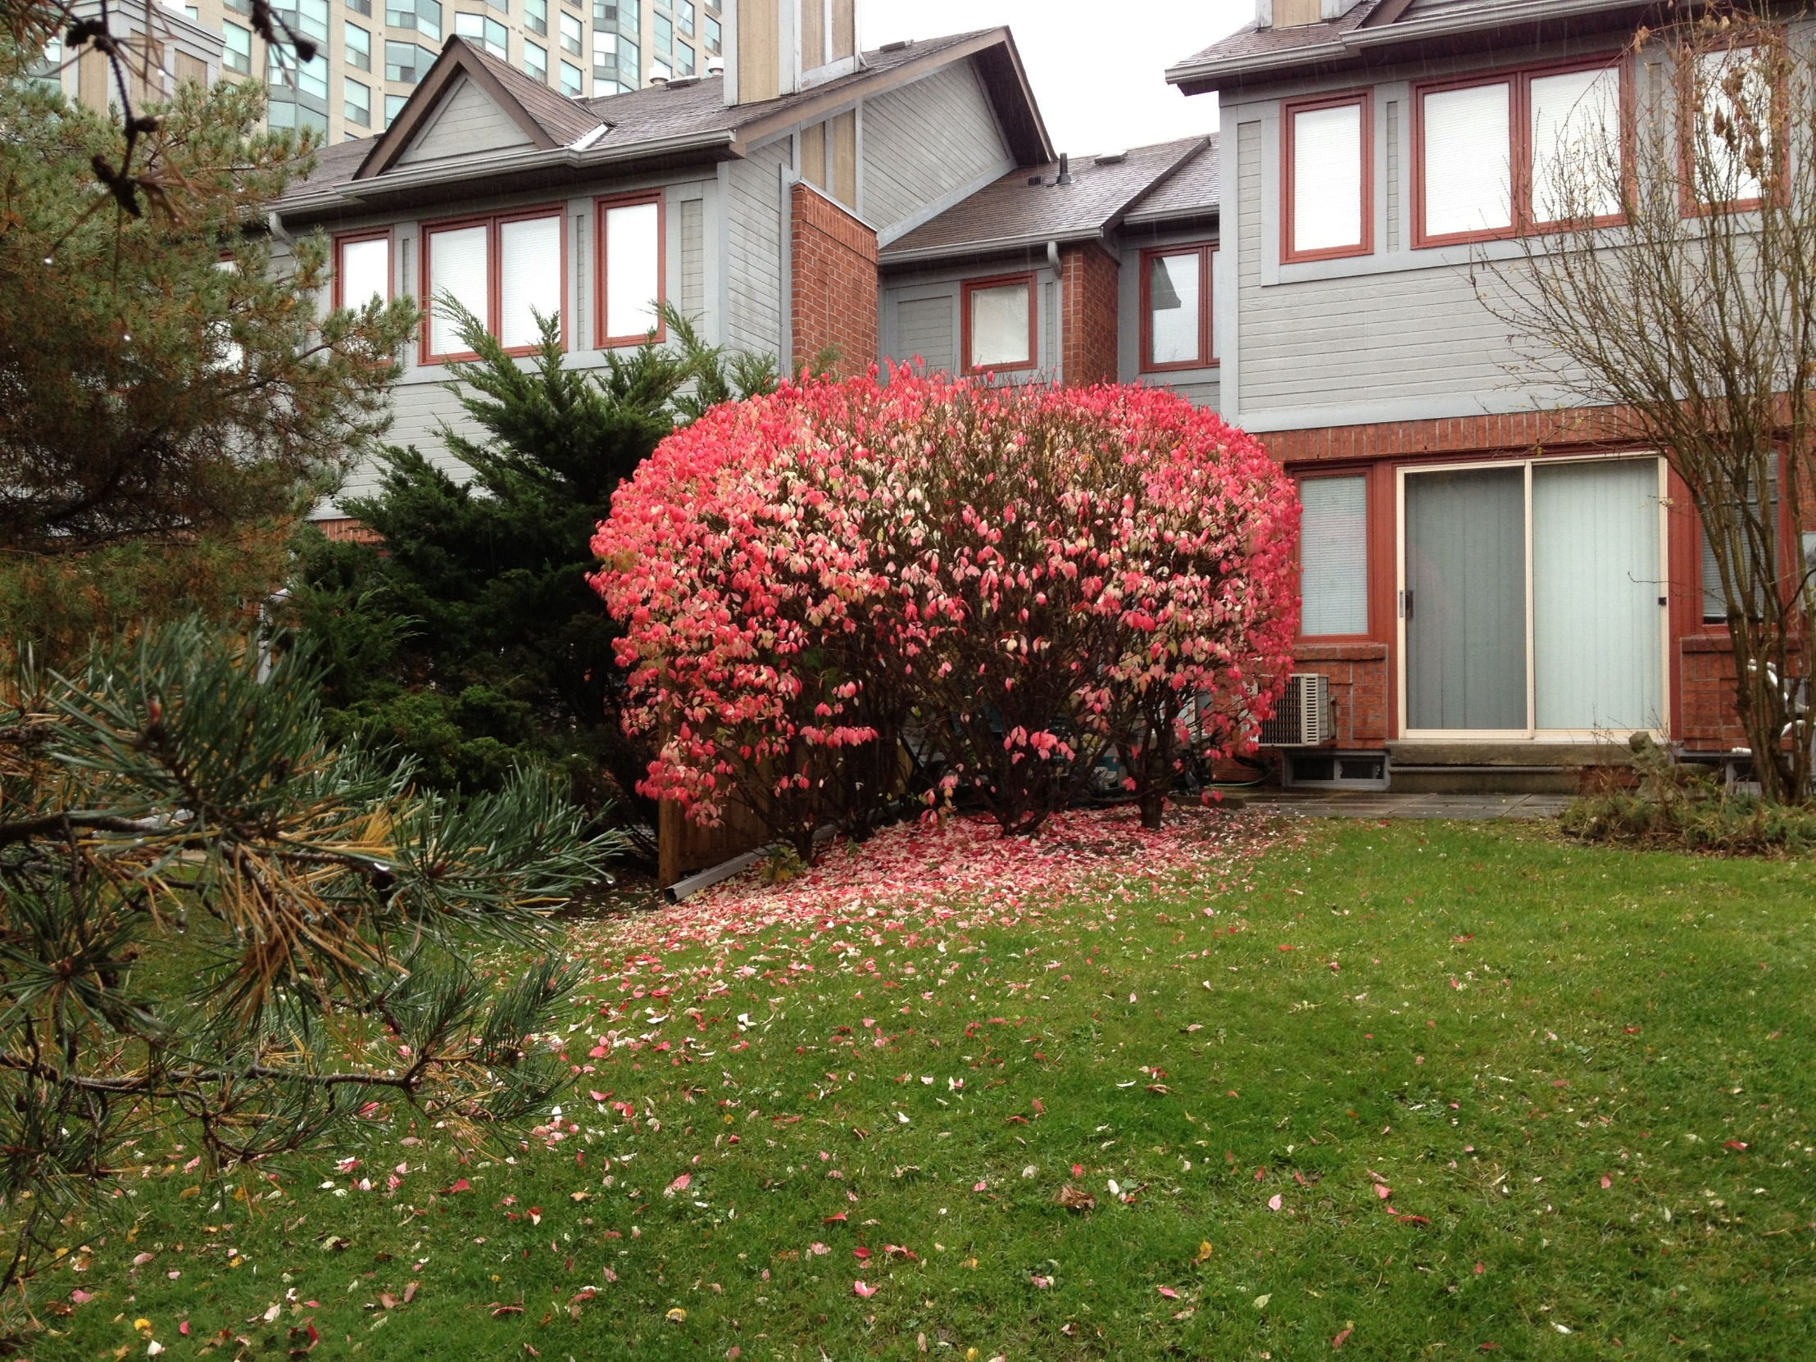

Slide 22
Phases of parturition
Phase 0
  Pregnancy: uterus is relaxed (quiescent)
Phase 1
  Activation
Phase 2
  Stimulation: stage 1& stage 2
Phase 3 = stage 3
  Delivery of the placenta and uterine involution

Slide 23
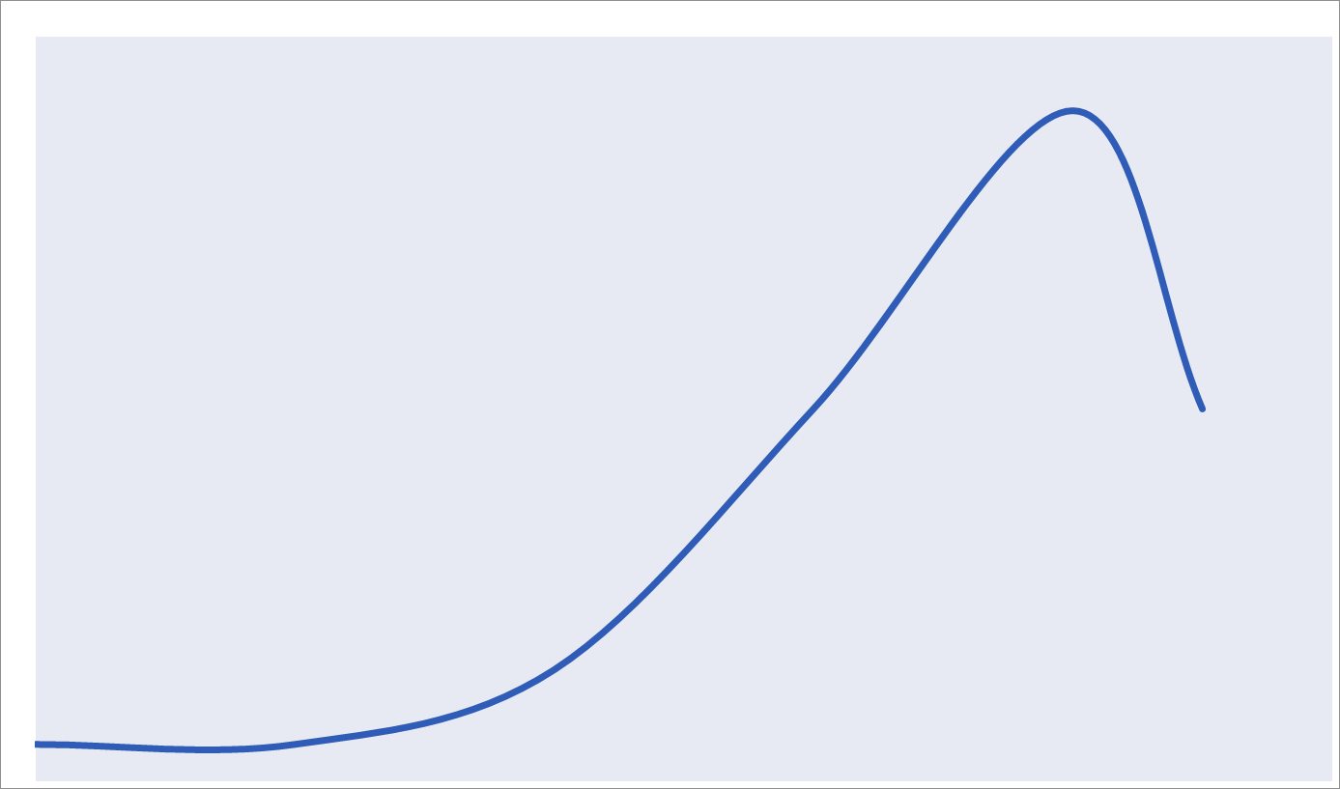
Uterine Activity During Pregnancy
Inhibitors
Progesterone
Prostacycline
Relaxin
Nitric Oxide
Parathyroid hormone-related peptide
  CRH
Quiescence
Phase 0
Uterotrophins
Estrogen
Prostaglandins
CRH
Activation
Phase 1
Uterotonins
Prostaglandins
Oxytocin
Stimulation
Phase 2
Involution
Oxytocin
Involution
Phase 3

Slide 24
Phases of parturition
Phase 0 (pregnancy)
  Increase in cAMP level
  Increase in production of
    Prostacyclin (PGI₂) cause uterine relaxation
    Nitric oxide (NO) cause uterine relaxation
Adapted from Smith, 2007

Slide 25
Phases of parturition
Phase 1 (activation)
  Occurs in third trimester
  Promote a switch from quiescent to active uterus
  Increase excitability & responsiveness to stimulators by
    Increase expression of gap junctions
    Increase G protein-coupled receptors
      Oxytocin receptors
      Increase PGF receptors

Slide 26
Phases of parturition
Phase 2 (stimulation)
  Occurs in last 2-3 gestational weeks
  Increase in synthesis of uterotonins
    Cytokines
    Prostaglandins
    Oxytocin
  Includs 2 stages:
    Stage 1
    Stage 2

Slide 27
Phases of parturition
Phase 3 (uterine involution)
  Pulsatile release of oxytocin
  Delivery of the placenta
  Involution of the uterus
    Occurs in 4-5 weeks after delivery
    Lactation helps in complete involusion

Slide 28
Mechanism of parturition
Contractions start at the fundus and spreds to the lower segment
The intensity of contractions is strong at the fundus but weak at the lower segment
In early stages 1 contraction/ 30 minuets
As labor progress 1 contraction/ 1-3 minutes
Abdominal wall muscles contract
Rhythmical contractions allows blood flow

Slide 29
Onset of labor
During pregnancy
  Periodic episodes of weak and slow rhythmical uterine contractions (Braxton Hicks) 2nd trimester
Towards end of pregnancy
  Uterine contractions become progressively stronger
  Suddenly uterine contractions become very strong leading to:
    Cervical effacement and dilatation

Slide 30


Slide 31
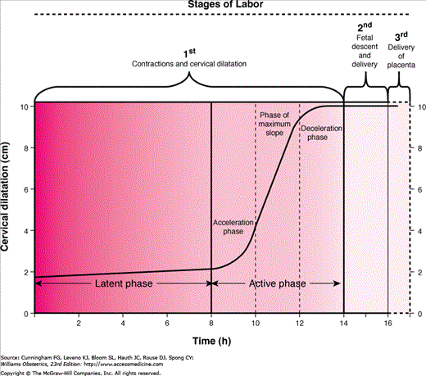
Stages of labor

Slide 32
Stages of Labor
Dilation (stage 1)
  Cervix becomes dilated
  Full dilation is 10 cm
  Uterine contractions begin and increase
  Cervix softens and effaces (thins)
  The amnion ruptures (“breaking the water”)
  Longest stage at 6–12 hours

Slide 33
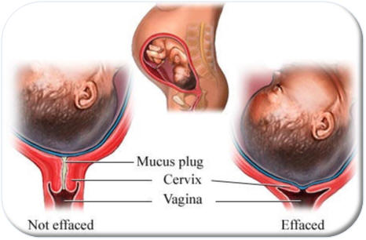
Cervical effacement and dilatation

Slide 34
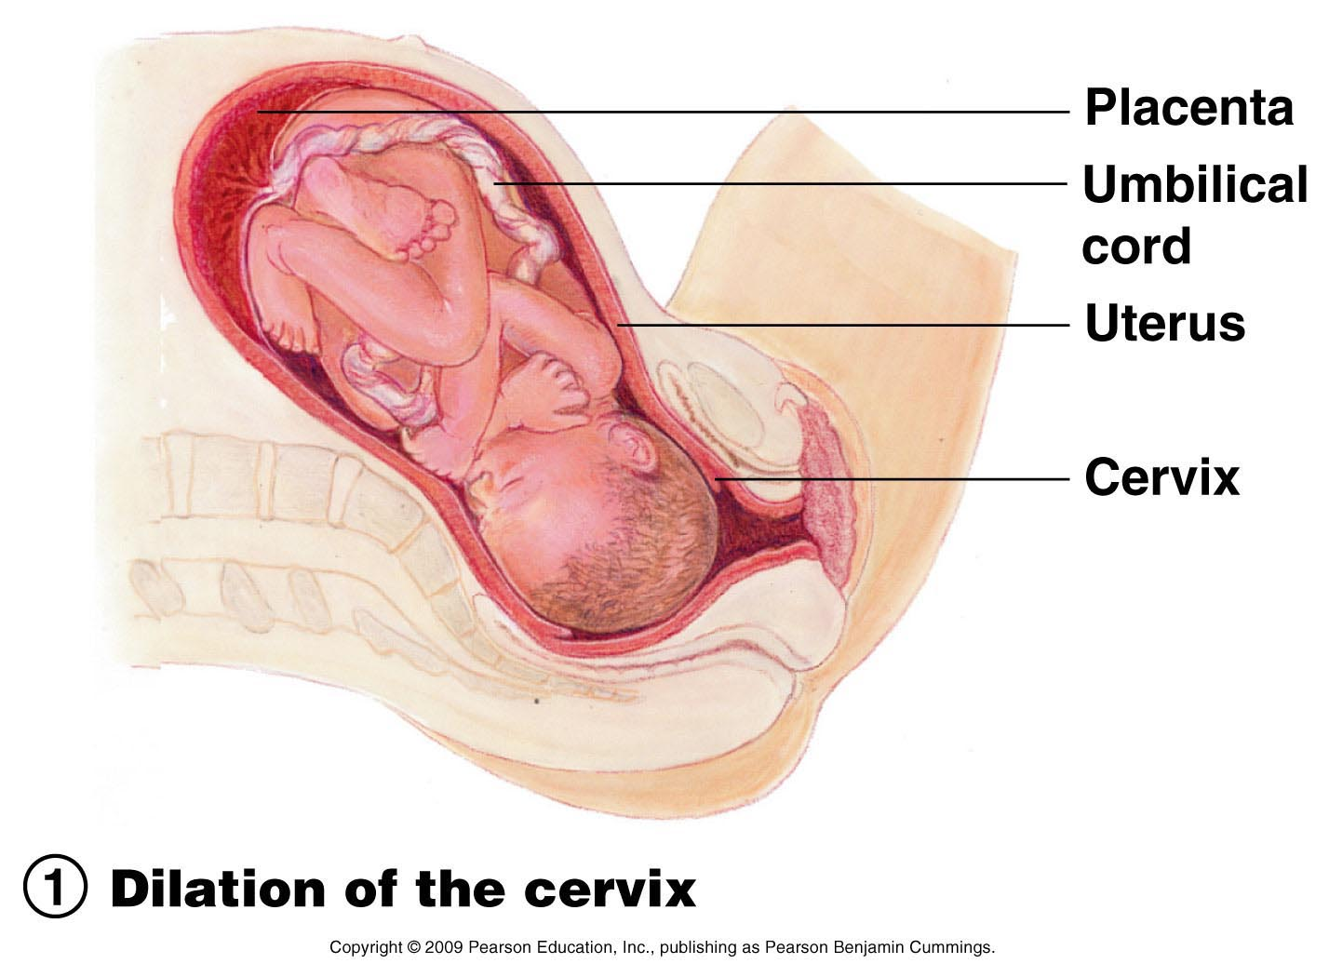
Stages of Labor
Figure 16.20 (1 of 3)

Slide 35
Stages of Labor
Expulsion (stage 2)
  Infant passes through the cervix and vagina
  Can last as long as 2 hours, but typically is 50 minutes in the first birth and 20 minutes in subsequent births
  Normal delivery is head first (vertex position)
  Breech presentation is buttocks-first

Slide 36
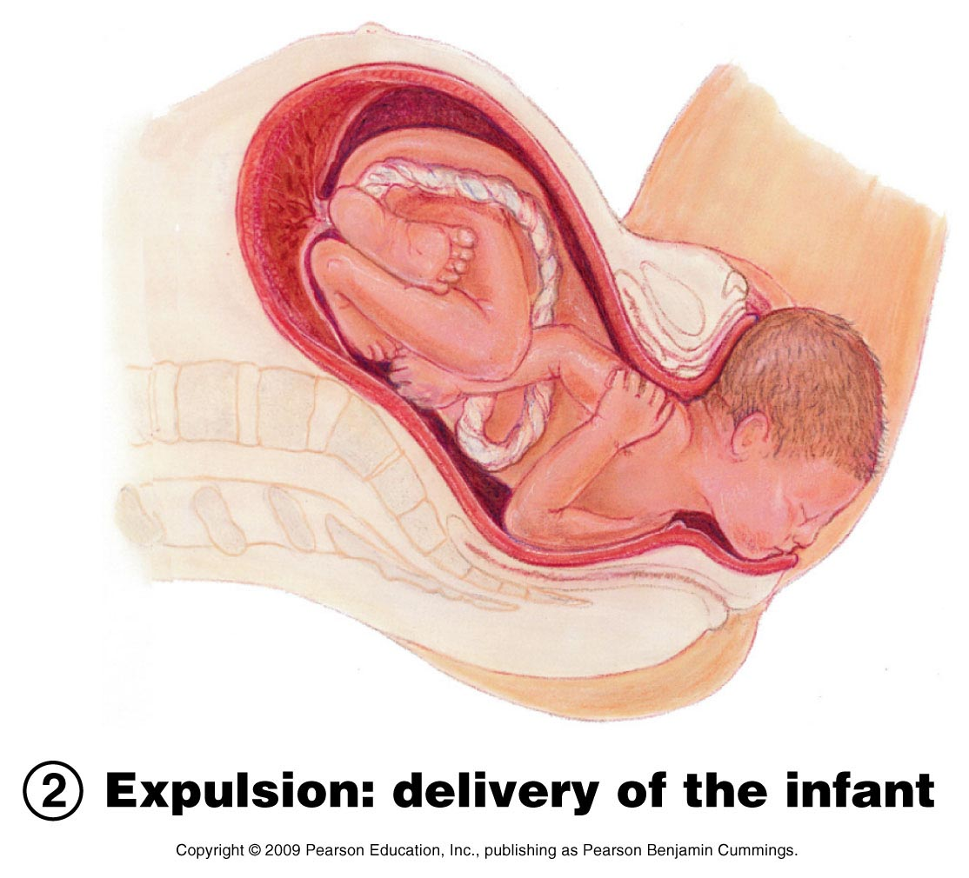
Stages of Labor
Figure 16.20 (2 of 3)

Slide 37
Stages of Labor
Placental stage (stage 3)
  Delivery of the placenta
  Usually accomplished within 15 minutes after birth of infant
  Afterbirth—placenta and attached fetal membranes
  All placental fragments should be removed to avoid postpartum bleeding

Slide 38
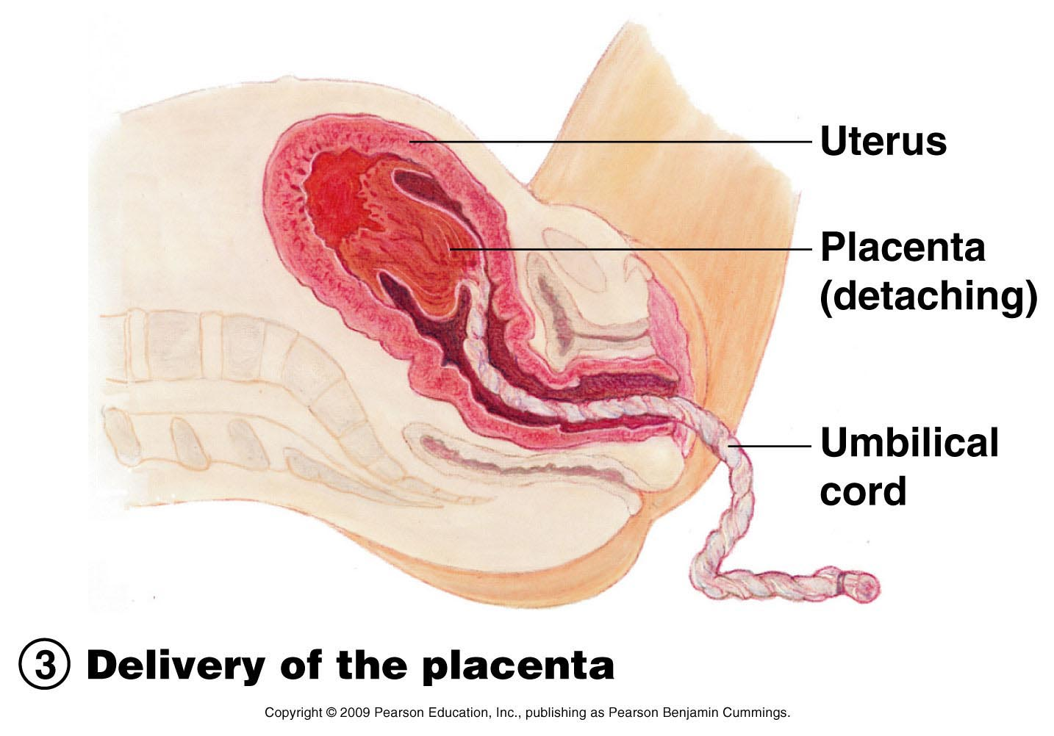
Stages of Labor
Figure 16.20 (3 of 3)

Slide 39
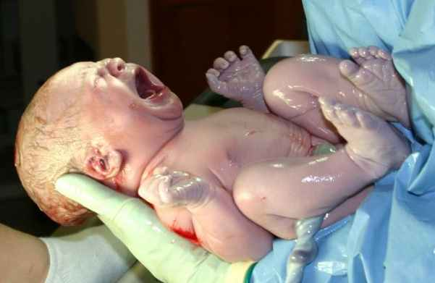
New arrival

Slide 40

{فَأَجَاءهَا الْمَخَاضُ إِلَى جِذْعِ النَّخْلَةِ قَالَتْ يَا لَيْتَنِي مِتُّ قَبْلَ هَذَا وَكُنتُ نَسْياً مَّنسِيّاً {23} فَنَادَاهَا مِن تَحْتِهَا أَلَّا تَحْزَنِي قَدْ جَعَلَ رَبُّكِ تَحْتَكِ سَرِيّاً{24} وَهُزِّي إِلَيْكِ بِجِذْعِ النَّخْلَةِ تُسَاقِطْ عَلَيْكِ رُطَباً جَنِيّاً{25} فَكُلِي وَاشْرَبِي وَقَرِّي عَيْناً } سورة مريم..

