Slide 1
Congenital Adrenal Hyperplasia and Testicular Feminization Syndromes
Reproductive Block

Slide 2
Objectives
Adrenal steroidogenesis
Congenital adrenal hyperplasia syndrome
Types
Biochemical characteristics
Clinical manifestations
Testicular feminization syndrome

Slide 3
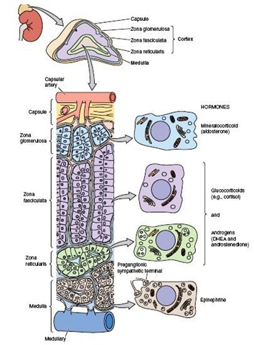
Adrenal Glands
The adrenal glands comprise 3 separate hormone systems:
The zona glomerulosa:
Secretes aldosterone
The zona fasciculata & reticularis:
Secrete cortisol & the adrenal
androgens
The adrenal medulla:
Secretes catecholamines (mainly
epinephrine)

Slide 4
Hermaphroditism or Intersex
A person who has neither standard male or standard female anatomy.
Discrepancy between the type of gonads and the external genitalia
True hermaphrodite (ovary plus testis)
Female pseudohermaphrodite (FPH, only ovary)
Male pseudohermaphrodite (MPH, only testis)

Slide 5
Glucocorticoids & Mineralocorticoids
Glucocorticoids:
Steroids with cortisol-like activity
Potent metabolic regulators & immunosuppressants
Mineralocorticoids:
Steroids with aldosterone-like activity
Promote renal sodium reabsorption

Slide 6
Steroidogenesis and
Congenital adrenal hyperplasia syndrome

Slide 7
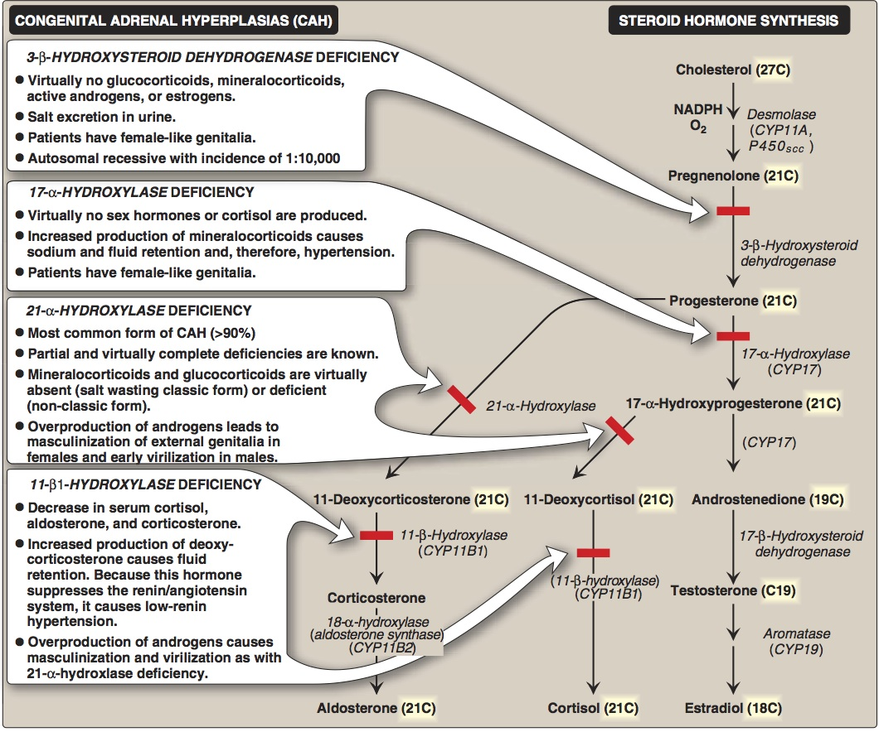

Slide 8
Congenital Adrenal Hyperplasia (CAH) Syndromes
It is the result of an inherited enzyme defect in steroid biosynthesis
The adrenals :
Cannot secrete cortisol → absent negative feedback to the pituitary) → ACTH continues to drive steroid biosynthesis → adrenal hyperplasia and accumulation of cortisol precursors (depending on which enzyme is lacking)
Cannot secrete aldosterone → electrolyte disturbances
Hyponatremia
Hyperkalemia
The condition might be fatal unless diagnosed early

Slide 9
CAH Syndromes
21 α-Hydroxylase deficiency
11 β-Hydroxylase deficiency
17 α-Hydroxylase deficiency
3 β-Hydroxysteroid dehydrogenase deficiency

Slide 10
21 α-Hydroxylase Deficiency
The most common type of CAH (90%)
Clinically:
Complete enzyme defect: ↑ stimulation of adrenal androgen production → virilization in baby girls & precocious puberty in boys.
Partial enzyme defect → late onset form → menstrual irregularity & hirsutism in young females.
Laboratory diagnosis: ↑ plasma [17-hydroxyprogesterone] as early as 4 days after birth

Slide 11
21 α-Hydroxylase Deficiency
X
X
Virilization of ♀
In peripheral tissues
Precocious sexual development in ♂

Slide 12
21 α-Hydroxylase Deficiency………….CONT’D
Autosomal recessive condition
Impaired synthesis of both cortisol & aldosterone
↓ [cortisol]→↑ ACTH secretion → Adrenal gland hyperplasia
Accumulated 17α-hydroxyprogesterone are diverted to the biosynthesis of sex hormones →signs of androgen excess:
Ambiguous genitalia in newborn girls (FPH)
Rapid postnatal growth in both sexes
Severe cases: mineralocorticoid deficiency → salt & H₂O loss → hypovolemia & shock → neonatal adrenal crisis
Late presentation (adult life) is possible in less severe cases

Slide 13
21 α-Hydroxylase Deficiency: Genetics
Mutations in the CYP21 gene
Deletions
Nonsense
Missense
DNA testing:
For prenatal diagnosis and confirmation of diagnosis

Slide 14
21 α-Hydroxylase Deficiency: Diagnosis
Serum sample taken at least 2 days after birth (earlier samples may contain maternally derived 17-hydroxyprogesterone)
Classic (complete) deficiency is characterized by markedly elevated serum levels of 17-hydroxyprogesterone
Late-onset (partial) deficiency may require corticotropin (ACTH) stimulation test:
Measure base-line and stimulated levels of 17-hydroxyprogesterone.
High level of 17-hydroxyprogesterone after stimulation is diagnostic

Slide 15
11 β -Hydroxylase Deficiency
leads to high concentrations of 11-deoxycortisol
Leads to high levels of 11-deoxycorticosterone with mineralocorticoid effect (salt and water retention)
Suppresses renin/angiotensin system low renin hypertension
Masculinization in females (FPH) and early virilization in males

Slide 16
11 β -Hydroxylase Deficiency
X
Virilization of ♀
X
In peripheral tissues
Precocious sexual development in ♂

Slide 17
Testicular Feminization Syndrome (Androgen Insensitivity Syndrome)

Slide 18
Disorders of Male Sexual Differentiation
They are rare group of disorders
The defect may be in:
Androgen receptors (inactive androgen receptors → target tissues cannot respond to stimulation by circulating testosterone; e.g., Testicular feminization syndrome)

Slide 19
Control of testicular function by the gonadotrophins
Hypothalamus
GnRH
₊
₋
₋
Anterior Pituitary
FSH
₊
LH
₊
Testis
Inhibin
Testosterone
_{AR}
Peripheral tissue
Spermatogenesis

Slide 20
Testicular Feminization Syndrome
46, XY karyotype
X-linked recessive disorder
Androgen receptor resistance high testosterone blood level
In peripheral tissue, testosterone will be converted by aromatase into estradiol feminization
Patients have normal testes & produce normal amounts of müllerian-inhibiting factor (MIF), therefore, affected individuals do not have fallopian tubes, a uterus, or a proximal (upper) vagina.

Slide 21
Clinical Picture:
Complete androgen insensitivity syndrome (CAIS): female external genitalia with normal labia, clitoris, and vaginal introitus (MPH)
Partial androgen insensitivity syndrome (PAIS): mildly virilized female external genitalia (clitorimegaly without other external anomalies) to mildly undervirilized male external genitalia (hypospadias and/or diminished penile size)

Slide 22
Laboratory Diagnosis
Karyotype: differentiate an undermasculinized male from a masculinized female.
Fluorescent in situ hybridization (FISH): Presence of a Y chromosome can be confirmed by probes for the SRY region of the Y chromosome. These offer a much quicker turnaround time than conventional karyotypes.
Increased (or normal) testosterone and dihydrotestosterone blood levels
DNA tests and mutation analysis for androgen receptor gene:
Complete or partial gene deletions, point mutations, or small insertions/deletions

Slide 23
Further Investigations
Imaging Studies “Pelvic ultrasound”:
Absence of fallopian tubes and uterus

